Slide 1
Metropolitan NY-NJ Storm Surge Working Group
2024 New Jersey Coastal and
Climate Resilience Conference
14 March 2024

Slide 2
Agenda
1. Storm Surge Working Group (SSWG) Sally Bowman
and Need for Storm Surge Barriers
2. USACE Proposal and Concerns About Suzanne DiGeronimo
Draft Report and Daniel Gutman
3. SSWG Proposal for Flood Protection Robert Yaro
and How it Meets Civic Goals for HATS
​

Slide 3
Metropolitan NY-NJ Storm Surge Working Group
Storm Surge Working Group and
Need for Storm Surge Barriers

Slide 4
The Metro NY-NJ Storm Surge Working Group
A coalition of oceanographers, ecologists, engineers,
urban planners, advocates, architects, and social
scientists dedicated to the premise that:
protection of the NY-NJ metropolitan region against catastrophic flooding from ocean storm surges and rising sea levels can best be secured by a regional approach.

Slide 5
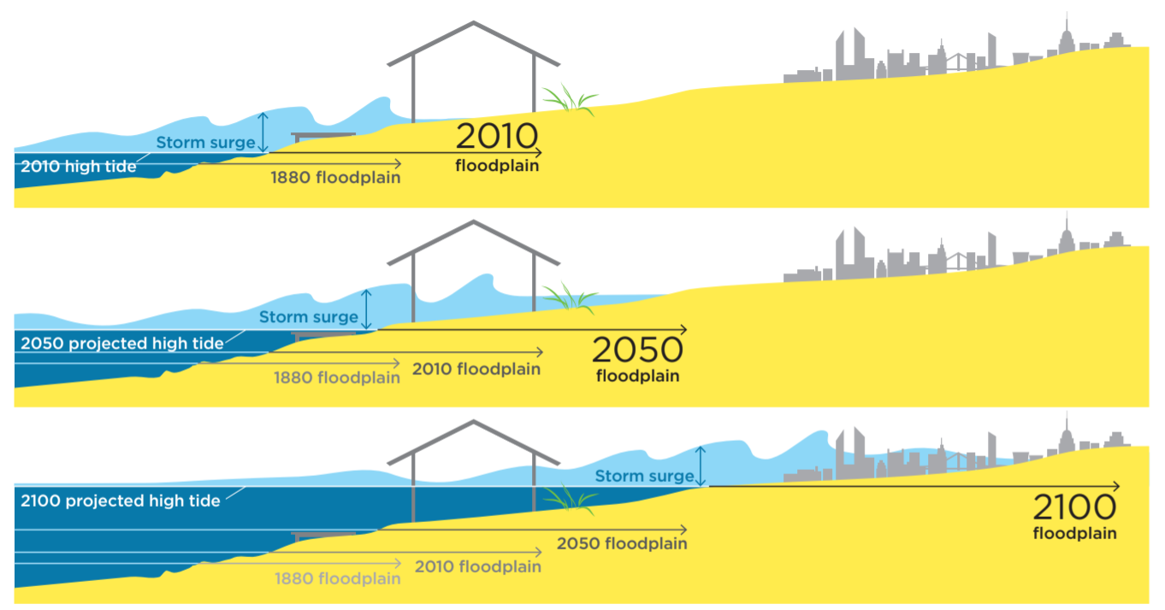
Storm Surge Damage Increases With Sea Level Rise
Union of Concerned Scientists

Slide 6
Sea Level Rise Projections
(1995–2014 Baseline Period)
 | 10th Percentile | 25th Percentile | 75th Percentile | 90th Percentile
2030s | 6 in. | 7 in. | 11 in. | 13 in.
2050s | 12 in. | 14 in. | 19 in. | 23 in.
2080s | 21 in. | 25 in. | 39 in. | 45 in.
2100 | 25 in. | 30 in. | 50 in. | 65 in.
2150 | 38 in. | 47 in. | 89 in. | 177 in.

Slide 7
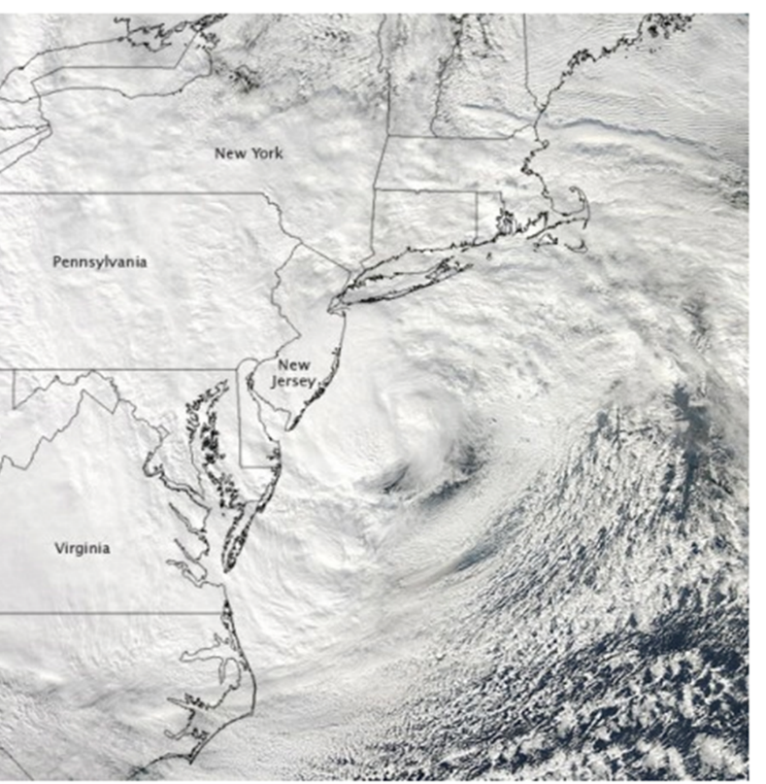
An Approach to Match the Scale of the Threat
October 2012
Hurricane Sandy:
Over $70 Billion in damages
​ 60 deaths in region

Slide 8
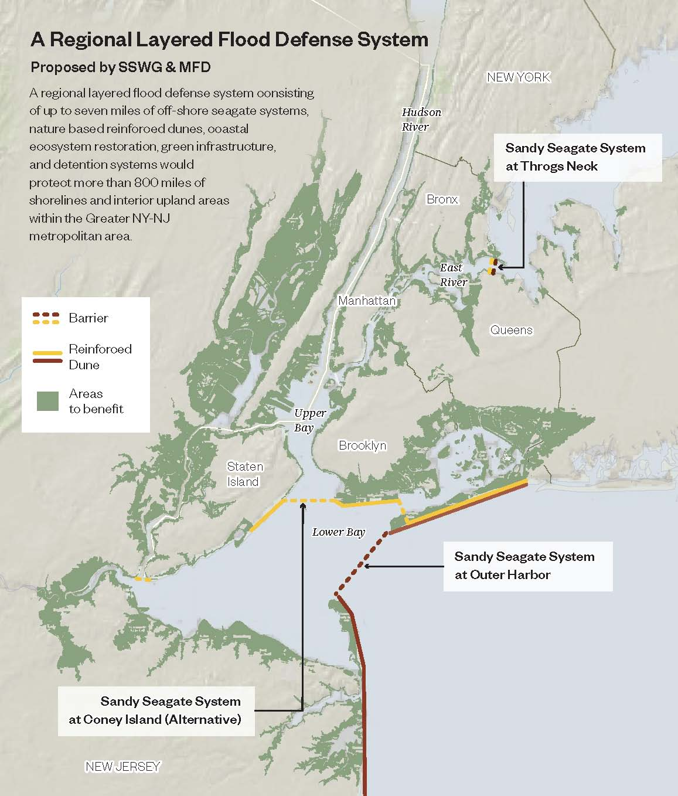
A Regional Barrier System: An Essential Flood Protection Component
A few miles of offshore sea gates would protect up to 900 miles of shoreline

Slide 9
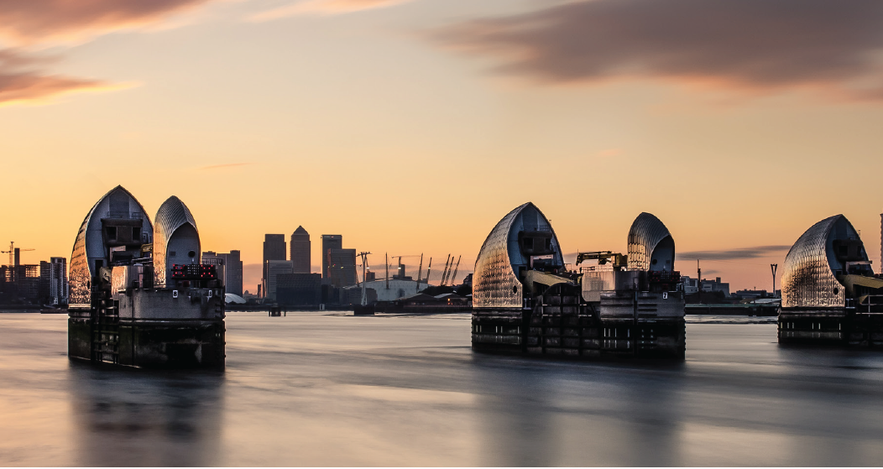
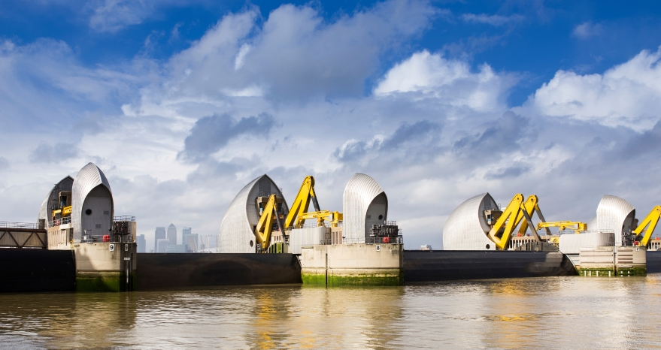
Thames Barrier, London—Rotating Tidal Gates
open
closed

Slide 10
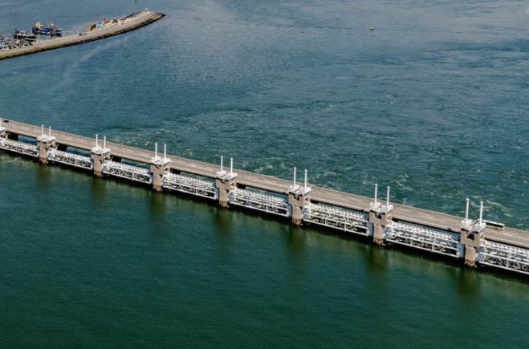
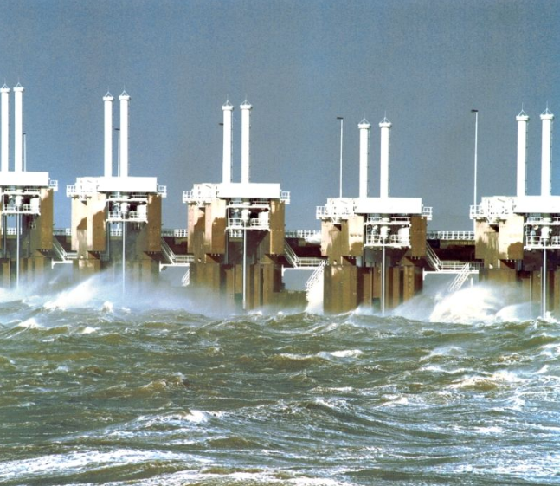
Eastern Scheldt Barrier, NL—Vertical Tidal Gates
open
closed

Slide 11
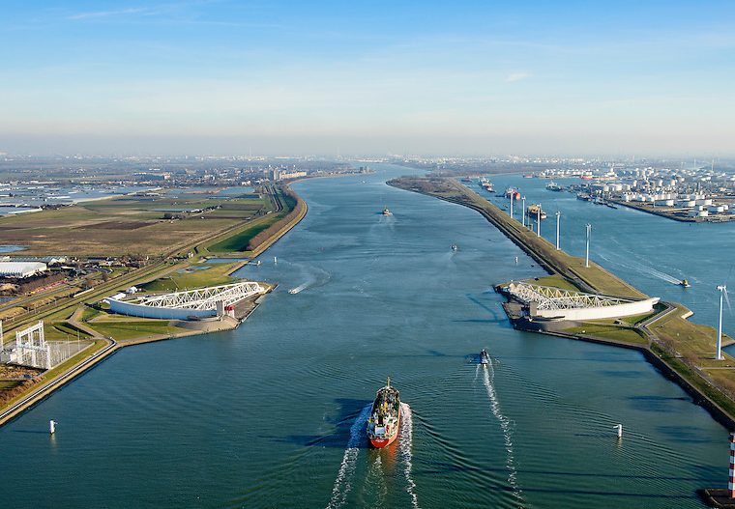
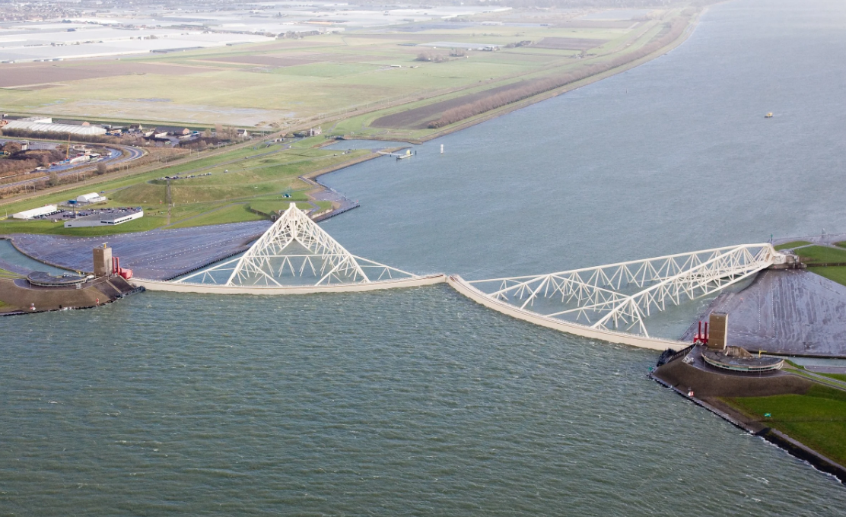
Maeslant Barrier, NL—Horizontal Navigation Gate
open
closed

Slide 12
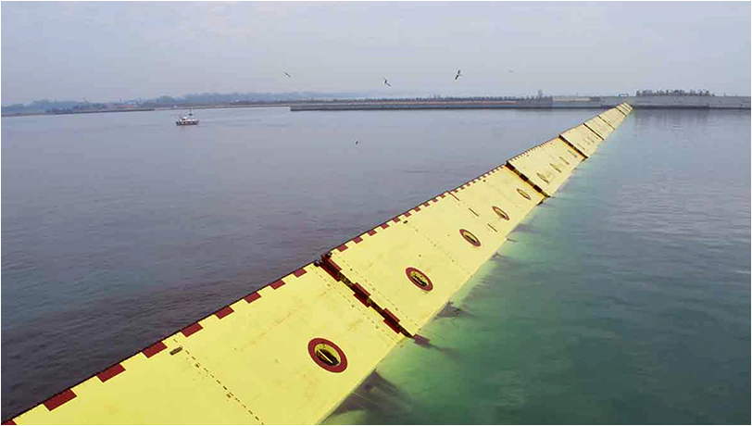
MOSE Barrier, Venice—Floating Navigation Gates
closed

Slide 13
Global Storm Surge Barriers
Netherlands
IJssel Barrier (1965)
Haringvliet (1971)
Eastern Scheldt (1986)
Hartel Barrier (1997)
Maeslant Barrier (1997)
United Kingdom
Hull flood barrier (1980)
Thames Barrier (1982)
Ipswich (2019)
Germany
Eider Barrage (1973)
Ems Barrier (2002)
Italy
MOSE Barrier, Venice (2017)
Russia
St Petersburg (2012)
USA
Fox Point, Rhode Island (1966)
New Bedford, Massachusetts (1966)
Moses Lake, Texas (1967)
Stamford, Connecticut (1969)
Freeport, Texas (1980)
West Closure Complex, New Orleans (2011)
Lake Borgne, New Orleans (2013)
Seabrook Floodgate, New Orleans (2015)

Slide 14
Metropolitan NY-NJ Storm Surge Working Group
USACE Proposal and
Concerns About Draft Report

Slide 15
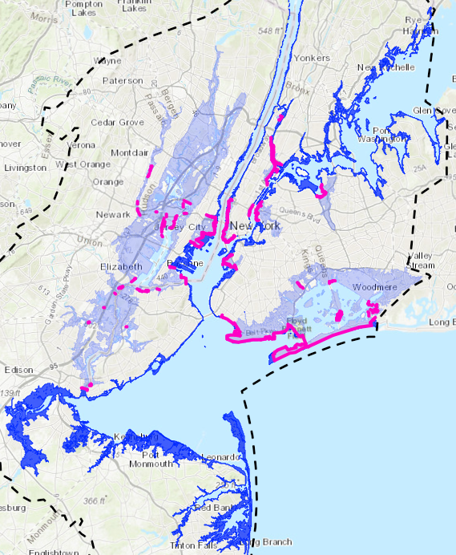
USACE Proposal Alternative 3B
Storm Surge Barriers | 3 | Miles
Tall Shoreline Barriers | 62 | Miles
Short Shoreline Measures | 18 | Miles
Manual Shoreline Gates | 135 | Gates

Slide 16
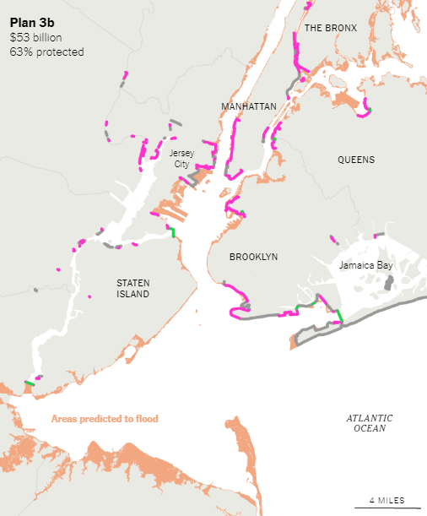
Tall Shoreline Barriers
Floodwalls | 39 | Miles
Levees | 11 | Miles
Reinforced Dunes | 12 | Miles

Slide 17
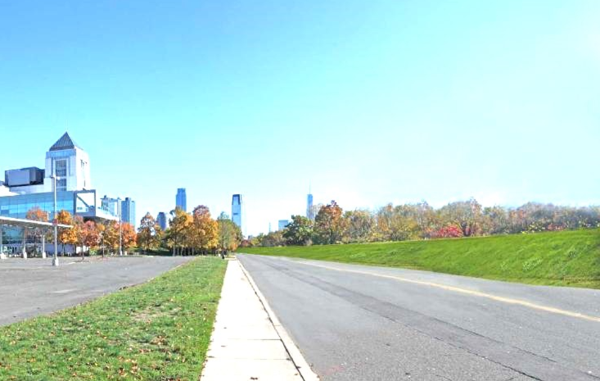
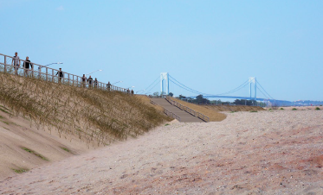
Levees and Dunes
USACE Proposal for Liberty State Park ​
Staten Island Reinforced Dune

Slide 18
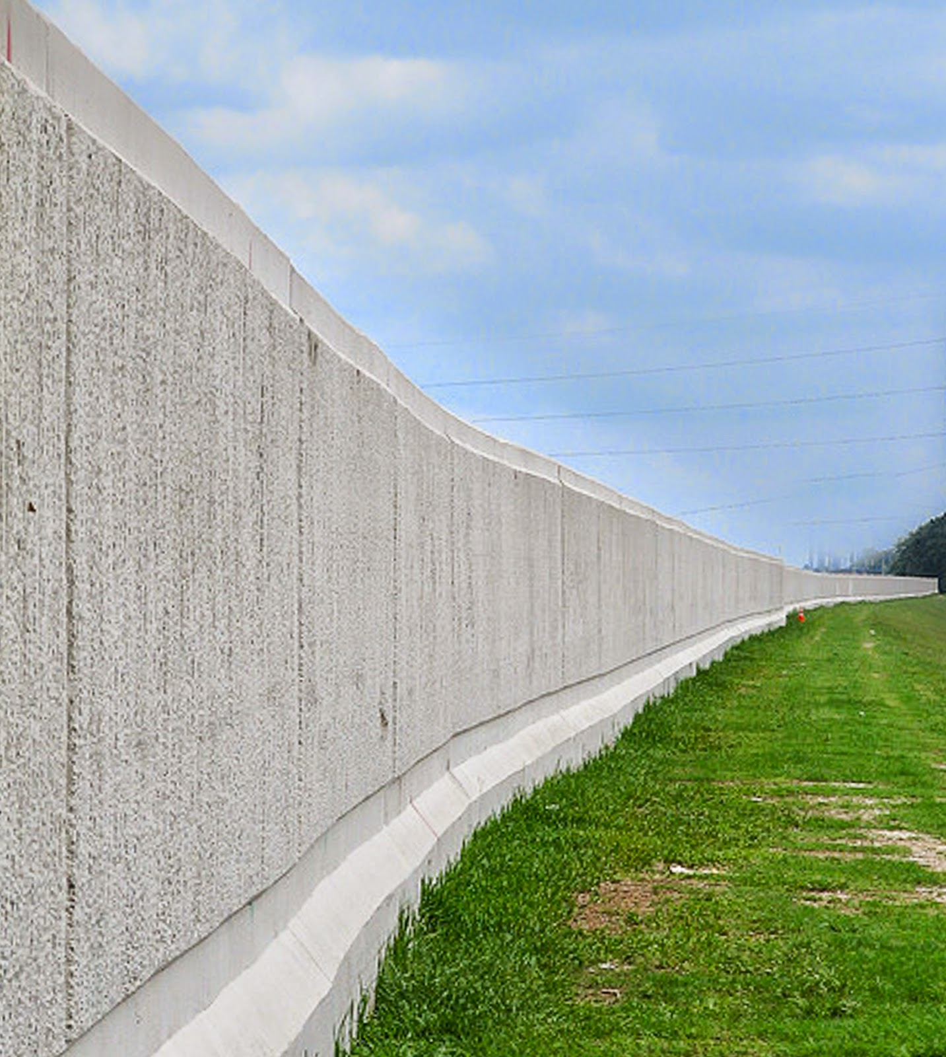
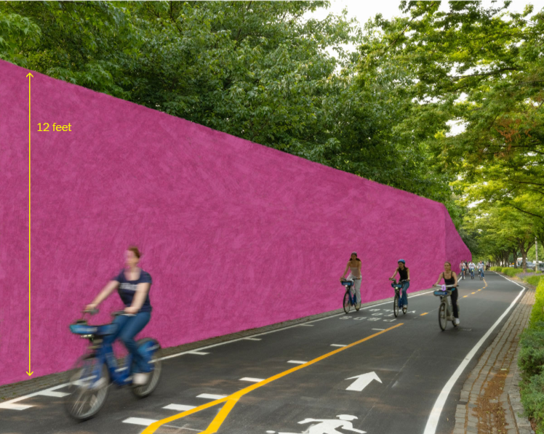
Floodwalls
Floodwall
USACE Proposal for Hudson River Park

Slide 19
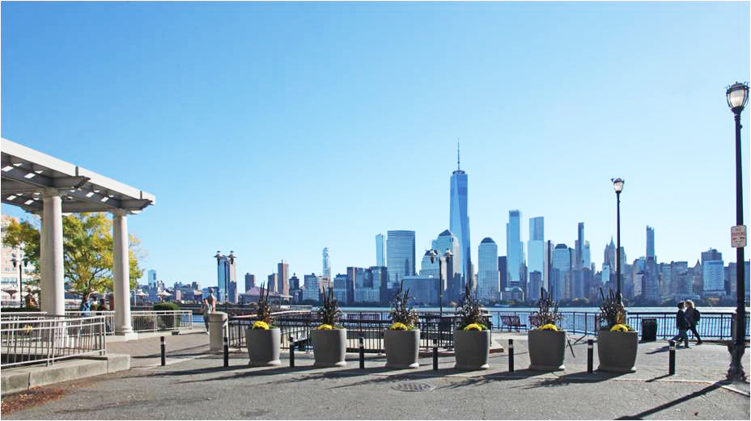
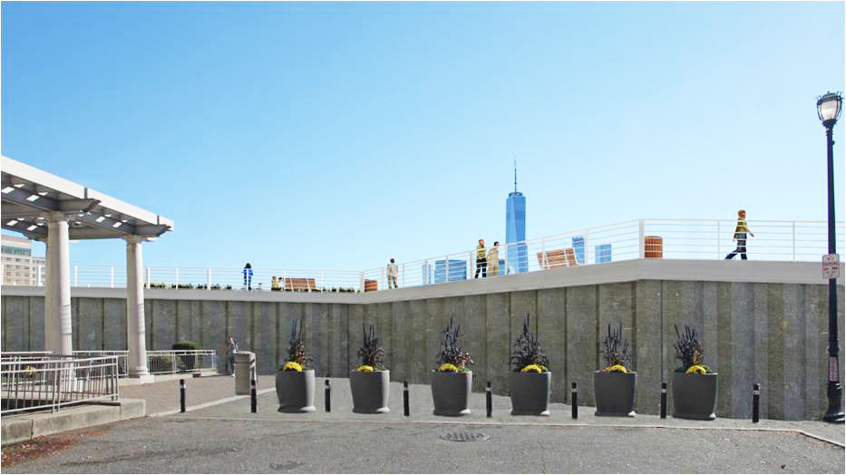
USACE Proposal
Exchange Place, Jersey City

Slide 20
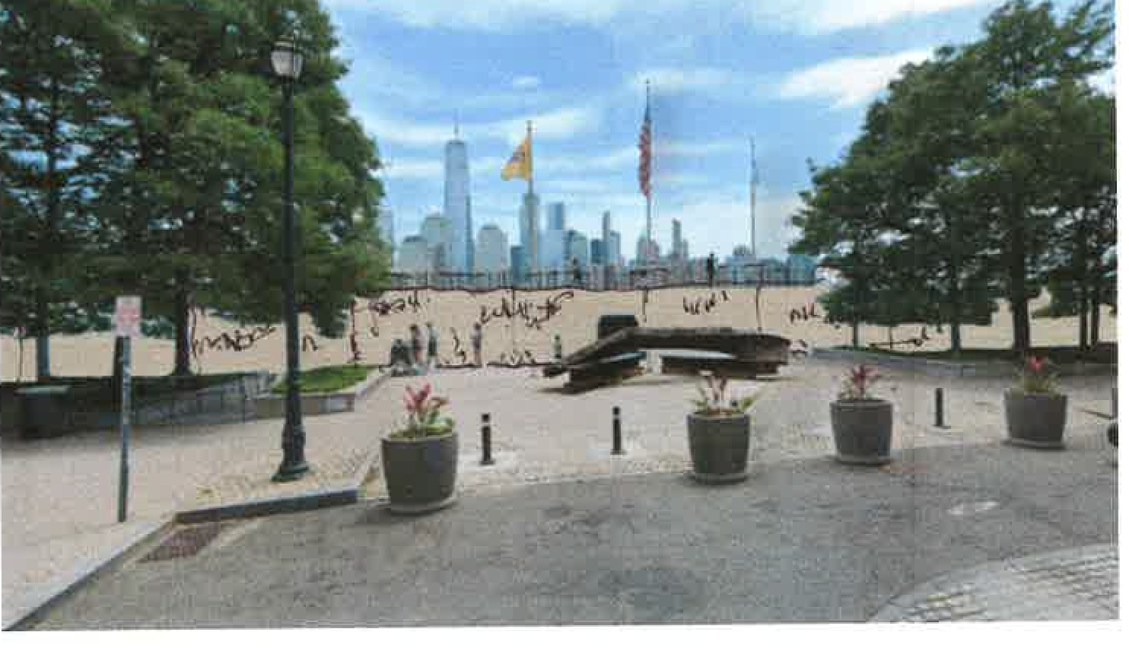
USACE Proposal Grand Street, Jersey City

Slide 21
General Concerns about USACE proposal
Shoreline floodwalls diminish waterfront access and views (e.g. Jersey City), and can divide communities
Many low income, minority, and smaller communities are not protected from storm surge (e.g. Raritan Valley & Bay)
No analysis of reliability. Failure to close manual gate could flood large area
Each proposed floodwall and smaller surge barrier will be a lightning rod for community opposition, controversy, delay

Slide 22
Unwarranted Assumptions Bias HATS
1. Construction time for regional barriers will be 25–32 years
Eastern Scheldt Barrier was constructed in 10 years
2. Regional barriers would close every 10 years, on average
Eastern Scheldt closes every 1.25 years, St. Petersburg closes every 10 months
3. Induced flooding requires extensive (and expensive) mitigation
Computer modeling ignored leakage and overtopping, which lower induced flooding
4. Approved plan moves immediately into design and construction
Funding would likely not be available until another major storm. Later start date favors regional barrier solution

Slide 23
Environmental Issues
When gates are open, environmental impacts are “modest”
David Ralston, Woods Hole Oceanographic Institution, 2022
Slight flow reduction restores natural tidal levels to estuary
Need analysis of environmental impacts during coastal storms
No-build condition means significant environmental impacts from storm-surges (Draft Report, pp. 220, 226–230)
Need comparison of environmental benefits of regional barrier protection vs. shoreline barrier protection during storm surges
Need analysis of impacts on marine organisms
NMF believes SSBs will have significant negative effects on fish

Slide 24
Metropolitan NY-NJ Storm Surge Working Group
SSWG Proposal for Flood Protection and
How it Meets Civic Goals for HATS

Slide 25
SSWG’s Solution: A Layered Defense Strategy
Layer 1 – Storm Surge Protection
Regional Seagates and Nature-Based Dunes
Includes all communities (e.g. South Bronx, Astoria, South Williamsburg, Yonkers), and LGA, Hunts Point Market, Statue of Liberty, Governor’s Island
Secondary benefit: Allows normal storm water drainage into harbor
Layer 2 – Sea Level Rise Measures
Low Berms and Bulkheads, Raised Streets and Buildings, Retreat
Relieves pressure to use storm-surge barriers too often
Layer 3 – Coastal Ecosystems Restoration
Accelerate Hudson Raritan Estuary and Hudson River Habitat restoration projects
Flood benefit: dampens wave action and limits erosion
Layer 4 – Extreme Rainfall Strategies
Networks of detention basins, swales, green roofs, etc.
Upsize storm water drainage systems, where applicable

Slide 27
Metropolitan NY-NJ Storm Surge Working Group
How SSWG’s layered defense
strategy meets goals for HATS
study advocated by civic groups

Slide 28
EDF, RPA, Waterfront Alliance and other civic groups (& SSWG) advanced these goals for HATS
Address all types of flooding
Sea Level Rise, Storm Surge, Tides, Extreme Rainfall
Engage frontline communities
Prioritize people over property values
Incorporate equity into cost-benefit analysis
Maximize nature and minimize harm

Slide 29
Address all Types of Flooding
SSWG’s layered defense strategy:
Storm Surge — USACE Responsibility
Sea Level Rise — Joint USACE/State and Local Responsibility
Extreme Rainfall — State and Local Responsibility

Slide 30
Sea Level Rise — Joint Responsibility
State and local governments are best placed to lead long-term SLR planning
But, along with storm surge, HATS should address initial SLR measures
If no plan, increasing pressure to use gates as SLR increases
Start with Alternative 2 short shoreline measures (36+ miles) and current NYC program (43 miles)

Slide 31
Engage Frontline Communities
SSWG’s layered defense strategy:
Local governments will plan waterfronts to address long-term SLR (or plan retreat) with communities
Cities’ efforts to mitigate extreme rainfall flooding will be discussed with communities

Slide 32
Prioritize people over property values
SSWG’s layered defense strategy:
Protects all harbor communities equally
Fosters equity in cost-benefit analysis because differences in community property values won’t determine degree of protection

Slide 33
Maximize nature and minimize harm
SSWG’s layered defense strategy:
Includes miles of nature-based dunes and
Restores natural systems — USACE responsibility
USACE to complete environmental studies to ensure harms are identified and environmental benefits are assessed

Slide 34
Most Nature-Based Features Cannot Stop Major Storm Surges From “Reducing Coastal Risk on the East and Gulf Coasts,” National Research Council, 2014:
“[T]he level of risk reduction provided by oyster reefs and seagrasses appears much lower than that provided by constructed dunes and hard structures . . . Research has documented reductions in peak water levels from salt marshes and mangroves, but . . . many of these nature-based alternatives can only be used for coastal risk reduction at locations that have sufficient space between developed areas and the coastline. . . .
Many large coastal cities lack the space necessary to take advantage of nature-based risk reduction approaches alone and will instead need additional hard structures to substantially reduce coastal hazards.

Slide 35
Key Points
1. Storm surge adds 10–15 feet on top of sea level rise
2. USACE proposal leaves out many communities and floodwalls diminish waterfront access and views
3. NY-NJ harbor lacks space for most nature-based measures to be effective
4. Regional barriers + nature-based dunes are very effective and protect all harbor communities equally
5. Any storm surge plan must include measures for sea level rise
6. USACE can address storm surge, ecosystem restoration, initial sea level rise, but not long-term SLR planning or extreme rain

Slide 36
Thank You!

Slide 37
Metropolitan NY-NJ Storm Surge Working Group
EXTRA SLIDES

Slide 38
NOAA
Exceedance Probability Levels at the Battery (2018)
Annual Exceedance Probability | Return Period | Feet above NAVD88 | Feet above MHHW
1% | 100 yr | 7.3 | 5.0
10% | 10 yr | 5.8 | 3.5
50% | 2 yr | 4.7 | 2.4
99% | 1 yr | 3.7 | 1.4

Slide 39
NOAA
Exceedance Probability Levels at the Battery (2018)
Annual Exceedance Probability | Return Period | Feet above NAVD88 | Feet above MHHW
1% | 100 yr | 7.3 | 5.0
10% | 10 yr | 5.8 | 3.5
20% | 5 yr | 5.3 | 3.0
50% | 2 yr | 4.7 | 2.4
99% | 1 yr | 3.7 | 1.4

