Slide 1
Updates on the development of the 2024 Science and Technical Advisory Panel report on sea-level rise and coastal storms for New Jersey
James B. Shope, PhD
Assistant Extension Specialist in Climate Services
New Jersey Agricultural Experiment Station Department of Environmental Sciences
Rutgers University
2024 New Jersey Coastal and Climate Resilience Conference March 12, 2024
Notes:
SLR Science
What Is STAP
New SLR projections

Slide 2
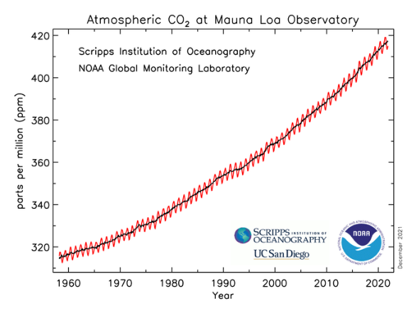
Climate Change Overview
Combustion of fossil fuels (coal, petroleum, natural gas) emits greenhouse gasses into the atmosphere
Carbon dioxide is the largest driver

Slide 3
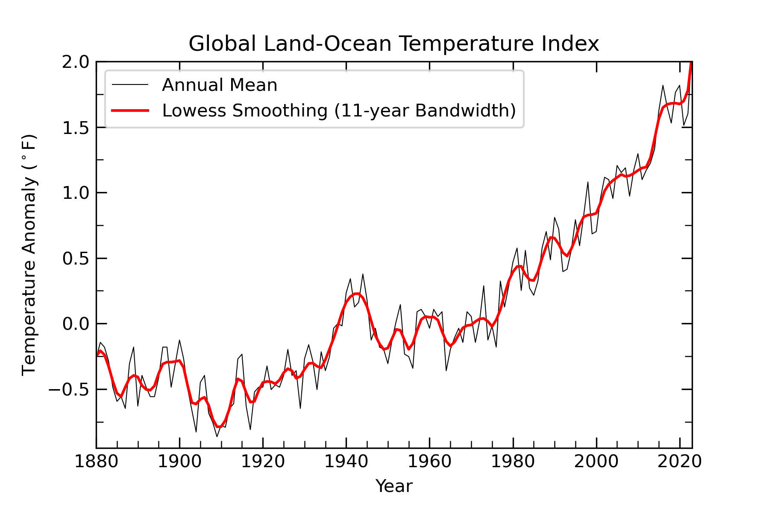
Climate Change Overview
Increasing greenhouse gas concentrations heats the earth
Global temperatures have risen by ~2°F during the past century
Source: NASA/Goddard Institute for Space Studies
Notes:
Since the turn of the century, 19 years have ranked in the top 20 warmest years in records dating back to 1880. The average rate of temperature increase has accelerated from roughly 0.14 °F/decade from 1880 to the present to an average rate of 0.32 °F/decade since 1981.

Slide 4
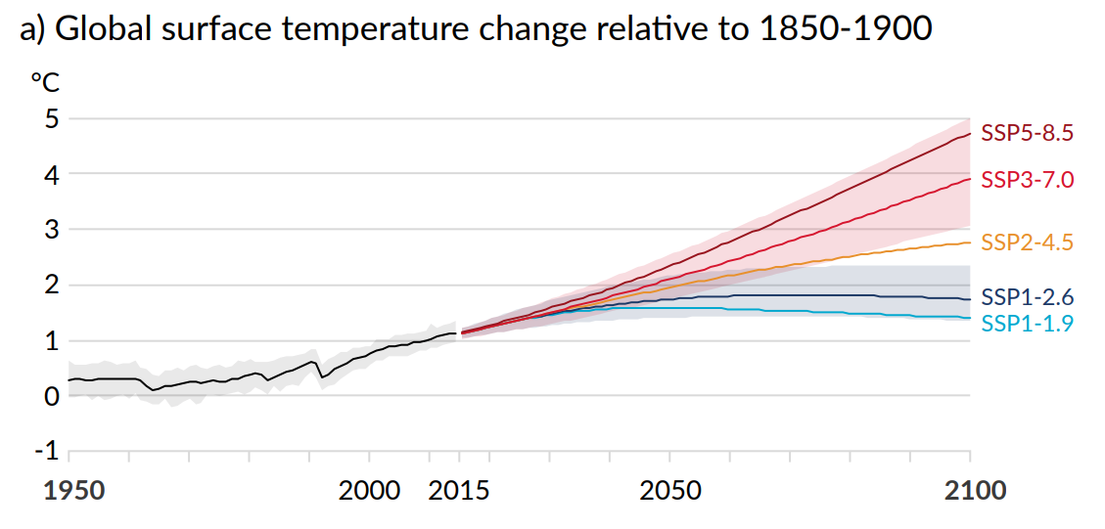
Warming Scenarios
Source: IPCC 2021 Summary for Policymakers
Notes:
How future carbon emissions will change is unknown
Rooted in global technological, economic, and policy changes
Use a range of illustrative scenarios as a guide

Slide 5
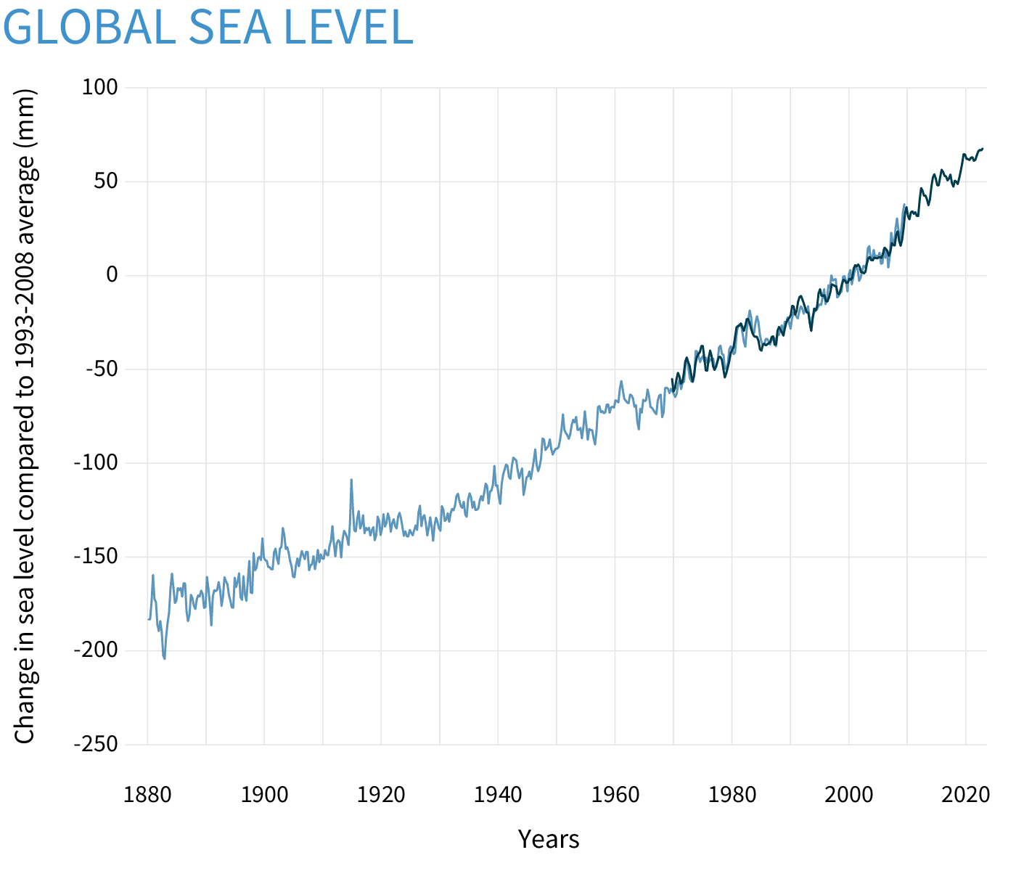
Church and white (2011); University of Hawaii Sea Level Center; Climate.gov
Notes:
1.7 mm/yr over the last century, 1900-2000 (Church and White, 2011)
80 mm = 3.14961 inches

Slide 6
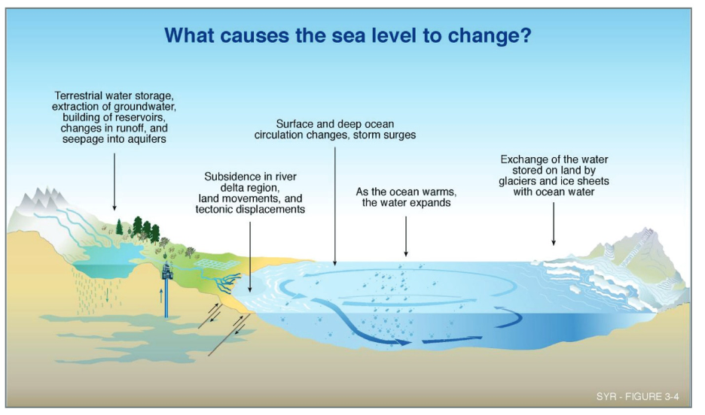
IPCC (2001)

Slide 7
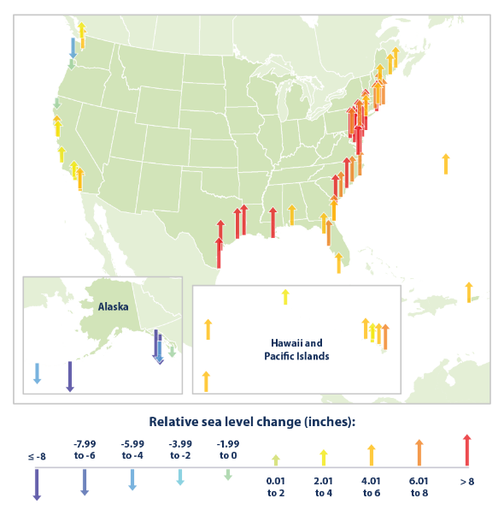
Standard Screen
Content Slide
Source: EPA; NOAA
Notes:
1960 to 2020

Slide 8
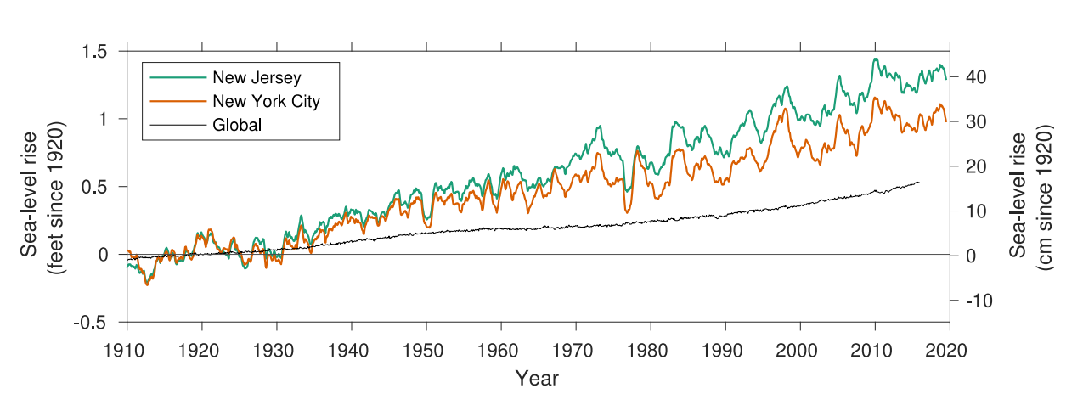
New Jersey Sea-Level Rise
Standard Screen
Content Slide
Source: Kopp et al. (2019)
Notes:
Relative to 1920

Slide 9
2019 STAP

Slide 10
What is STAP?
Science and Technical Advisory Panel
First convened on behalf of the New Jersey Climate Change Alliance
2016: Assessing New Jersey’s Exposure to Sea-Level Rise and Coastal Storms: Report of the New Jersey Climate Adaptation Alliance Science and Technical Advisory Panel
Second report in collaboration with NJDEP
2019: New Jersey’s Rising Seas and Changing Coastal Storms: Report of the 2019 Science and Technical Advisory Panel

Slide 11
What is STAP?
Science and Technical Advisory Panel
The 2019 STAP report evaluated the current science regarding sea level rise projections and changing coastal storms in the context of practices and policies of local and regional stakeholders.
2019 Report - Projections of sea level rise for coastal New Jersey through 2150 that build off the emissions scenarios used by the IPCC’s 5th Assessment Report (AR5) (Church et al., 2013).

Slide 12
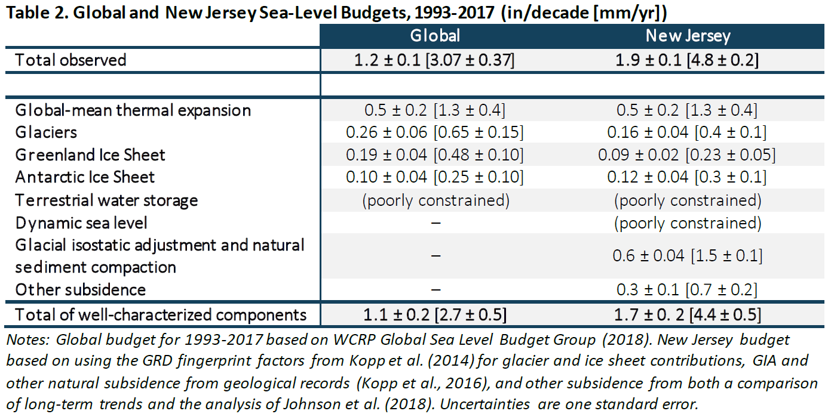
Source: Kopp et al., 2019

Slide 13
+2°C
+3.5°C
+5°C
Source: Kopp et al. (2019)

Slide 14
+2°C
+3.5°C
+5°C
Includes lower confidence ice sheet contributions = more protective
Source: Kopp et al. (2019)

Slide 15
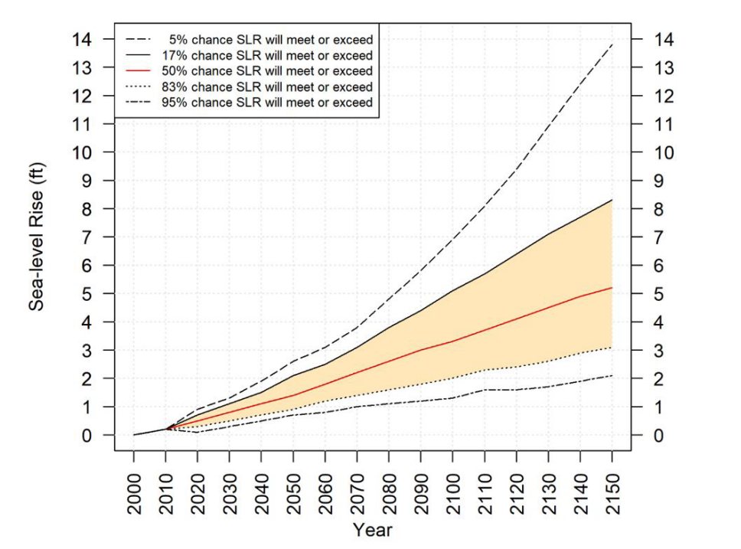
New Jersey Sea-Level Rise Projections
Moderate Warming
Source: Kopp et al. (2019)
Notes:
New Jersey’s Rising Seas and Changing
Coastal Storms: Report of the 2019 Science and Technical Advisory Panel

Slide 16
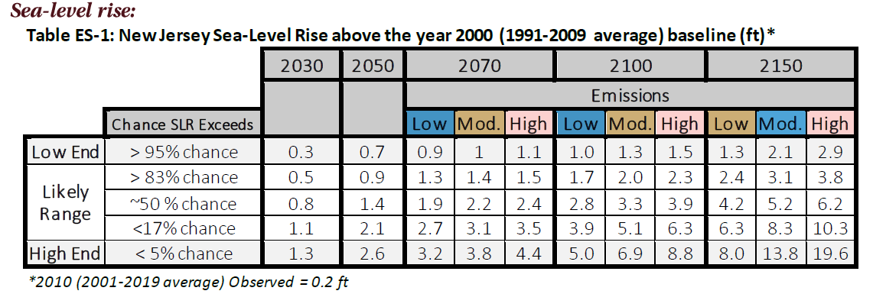
New Jersey Sea-Level Rise Projections
Source: Kopp et al. (2019)
Notes:
New Jersey’s Rising Seas and Changing
Coastal Storms: Report of the 2019 Science and Technical Advisory Panel

Slide 17
2024 STAP

Slide 18
Where are we now?
IPCC Sixth Assessment Report
Climate Model – CMIP5 🡪 CMIP6
Emission/Warming Scenarios – Representative Concentration Pathways (RCPs) to Shared Socioeconomic Pathways (SSPs)
Updated models/estimate methods:
Thermal Expansion
Ocean Dynamics
Glaciers and Ice Sheets
Land water Storage
Gravitational, Rotational, Deformational Effects
Land Subsidence

Slide 19
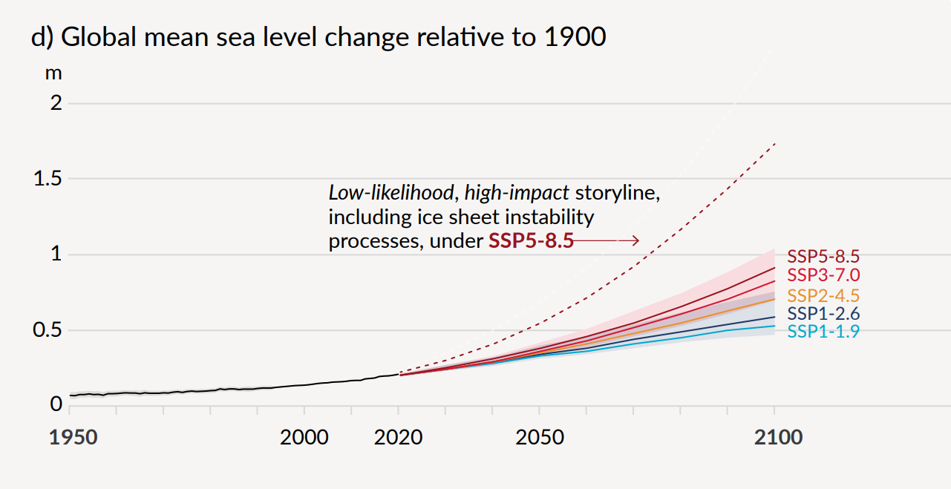
Projected Global Sea Level Trends
Source: IPCC 2021 Summary for Policymakers

Slide 20
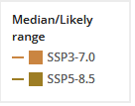
NJ - Atlantic City
Source: IPCC (2021), NASA (2024)
https://sealevel.nasa.gov/data_tools/18

Slide 21
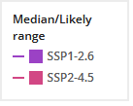
NJ - Atlantic City
Source: IPCC (2021), NASA (2024)
https://sealevel.nasa.gov/data_tools/18

Slide 22
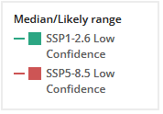
NJ - Atlantic City
Source: IPCC (2021), NASA (2024)
https://sealevel.nasa.gov/data_tools/18

Slide 23
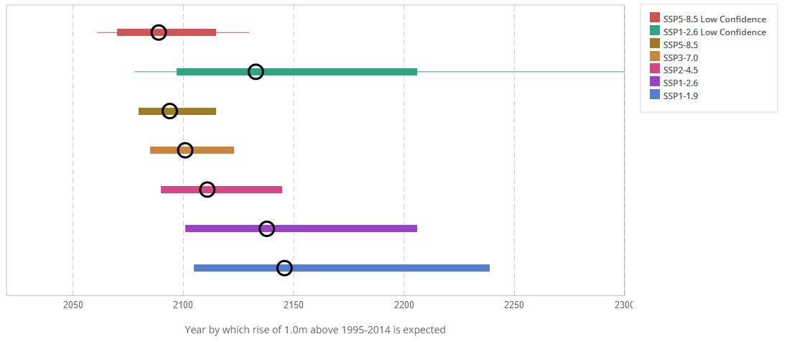
Source: IPCC (2021), NASA (2024)
https://sealevel.nasa.gov/data_tools/18

Slide 24
Next Steps for STAP
Collaboration with NJDEP for an update soon (starting this year).
Recommendations of the 2016 and 2019 STAP to revisit projections shortly after the release of any relevant global (IPCC) or national (the U.S. National Climate Assessment) reports
Summarize most recent global science associated with sea level rise, coastal storms, and coastal flood hazards relevant to New Jersey since the 2019 report.
Practitioner and stakeholder input for presenting the science to inform planning and policy making
What data and format are useful for stakeholders?

Slide 25
James Shope, Assistant Extension Specialist in Climate Services, Rutgers University
James.Shope@rutgers.edu
Thanks to:
Robert Kopp
Janine Barr
Marjorie Kaplan
Jeanne Herb

