Slide 1
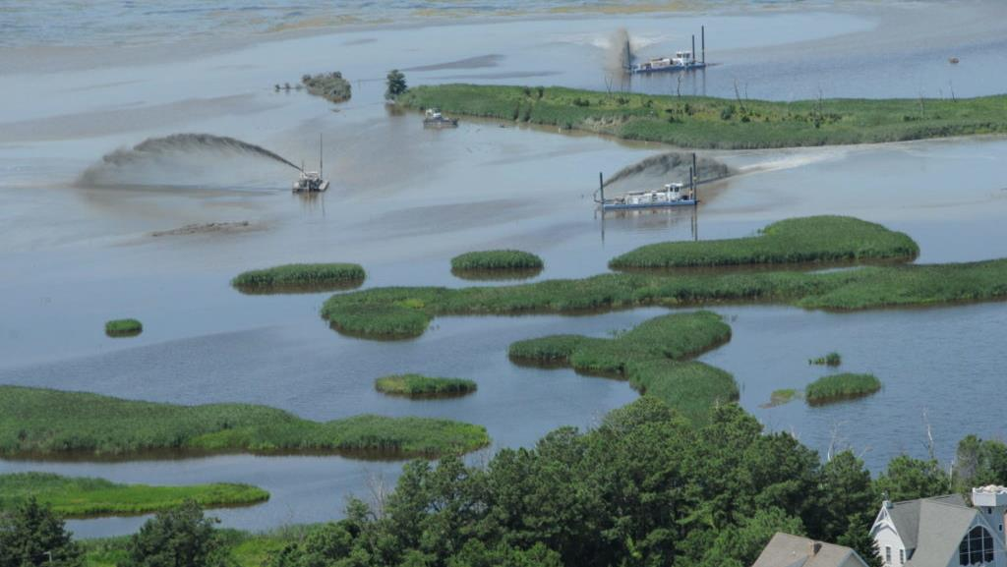
Setting a Research Agenda for Climate Resilience Informed Decision Making
New Jersey Coastal Consortium for Resilient Communities

Slide 2








New Jersey Coastal Consortium for Resilient Communities
Established by the State of New Jersey in 2021
A multi‐disciplinary, multi-university consortium to advance coastal community resilience in New Jersey through actionable research.
Focused on improved understanding of coastal systems to identify practical solutions and responses to climate change.
Utilizing Barnegat Bay as a livening laboratory to research climate change impacts on coastal lagoon estuarine systems in urban and natural environments.

Slide 3
Current Research
Investigation of coupled geomorphologic barrier island - back bay dynamics: Insights from Long Beach Island, New Jersey. J. Lorenzo-Trueba
Estimating Dune Vulnerability under Various SLR Scenarios. J Miller
Applications of a Barnegat Bay Estuary Three-Dimensional Hydrodynamic Model. P. Orton
Analysis of Sediment Transport Pathways & Budgets into the Barnegat Bay System. K. McKenna
Impact of climate change on coastal groundwater. M. Boufadel
Barnegat Bay and Great Bays Resilience Observing Network: Tracking the Changing Environment to Inform the Management of Estuarine Resources. M. De Luca

Slide 4

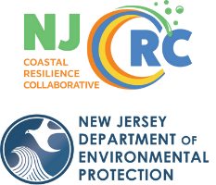
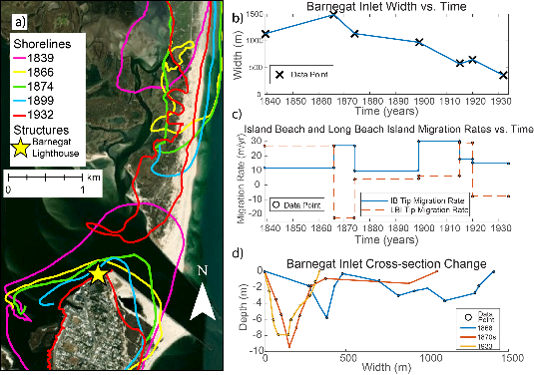
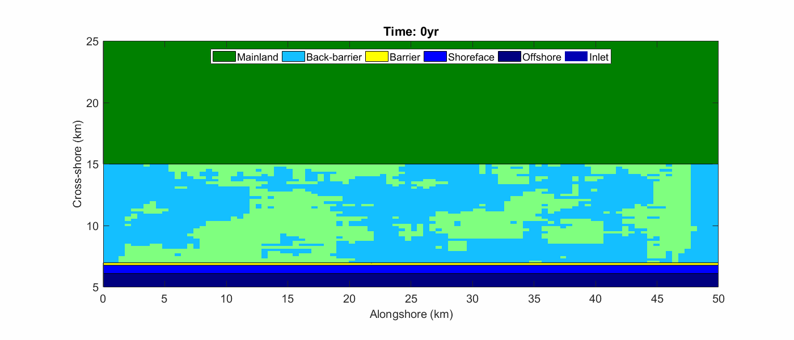
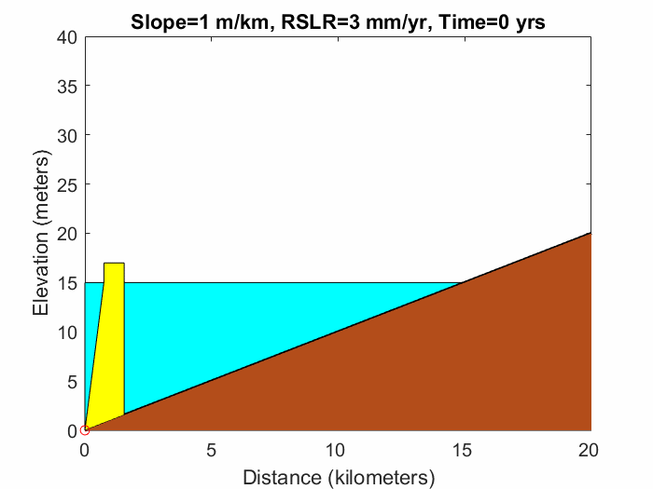
Investigation of coupled geomorphologic barrier island - back bay dynamics: Insights from Long Beach Island, New Jersey.
Jorge Lorenzo-Trueba
3/13/2024
2024 New Jersey Coastal & Climate Resilience Conference
Long Beach Island, NJ
Nienhuis and Lorenzo-Trueba 2019
Ciarletta et al. 2019

Slide 5
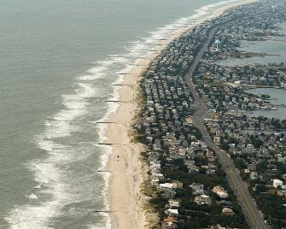
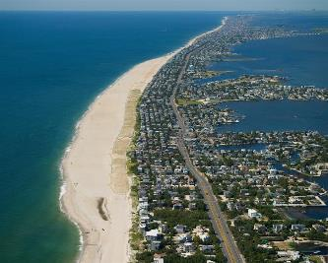


Quantifying the Effect of
Coastal Engineering
on Barrier-backbarrier Evolution
Tenebruso et al. 2022
What has been the role of development and engineering activities on the response of LBI over the last ~2 centuries?
Long Beach Island, NJ
Long Beach Island, NJ
Chris Tenebruso,
MS 2020
Shane Nichols-O’Neill,
MS 2023

Slide 6
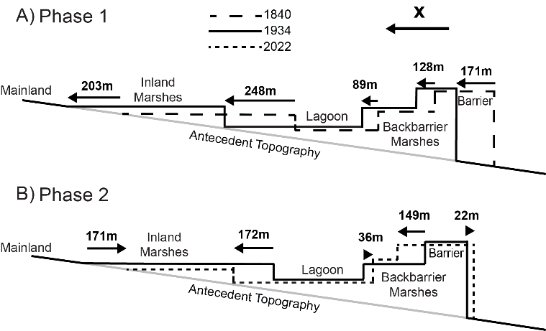
Long Beach Island Evolution from 1840-2022
Tenebruso et al. 2022
Phase 1 → Natural processes dominate; LBI and its backbarrier environment were coupled between 1840 and 1934.
Phase 2 → Human Development dominates; LBI and its backbarrier environment were decoupled between 1934 and 2022 due to human development and coastal engineering.
Future evolution? It depends on environmental forcing, socio-economic factors, coordination between neighboring communities, etc.

Slide 7
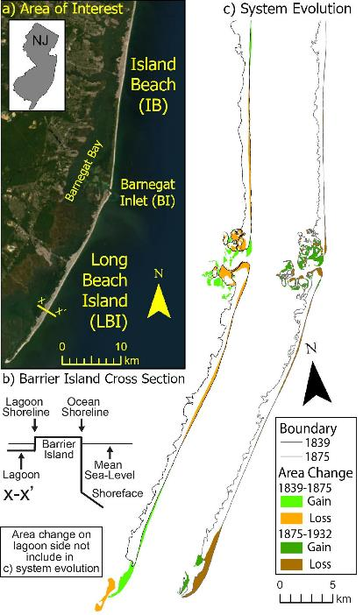
Summary
This versatile and portable approach can be an effective tool to quantify past coastal change and identify the key drivers of change.
This work can inform models for the co-evolution of barrier-backbarrier environments under different scenarios of sea-level rise, storm climate, human development, and coastal protection strategies.
Ciarletta et al. 2019
Shoreline
Active
shoreface
x
Nienhuis and Lorenzo-Trueba 2019

Slide 8
Estimating Dune Vulnerability under Various SLR Scenarios
Jon Miller
Funding from the New Jersey Coastal Resilience Research Consortium

Slide 9
Estimating Dune Vulnerability under Various SLR Scenarios
Objective
  Use data driven methods to estimate the probability of dune impacts under present and future storm climates
  Dune impacts are considered as a proxy for upland impacts
Hypothesis
  The impact of SLR will be more pronounced for extreme events – “design storms” – than for lower intensity events
Storm Intensity Class | Likely Dune Volume Loss (order of magnitude) | Likely Storm Hazard Matrix Impact scale (Leaman et al., 2021)
Extreme | > 40% | Overwash; Inundation; Dune Retreat
Severe | ≤ 40% | Dune Face Erosion
Nuisance | ~10% | Collision, Dune Face Erosion
Insignificant | None | Swash, Minor Beach narrowing

Slide 10
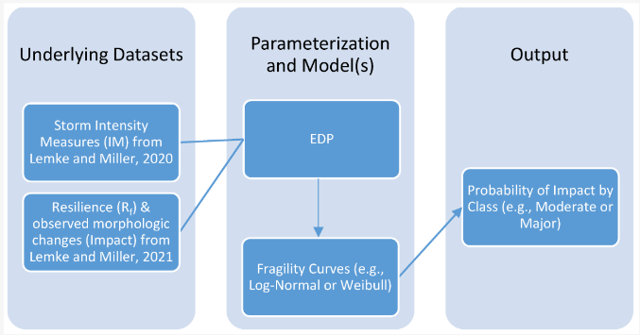
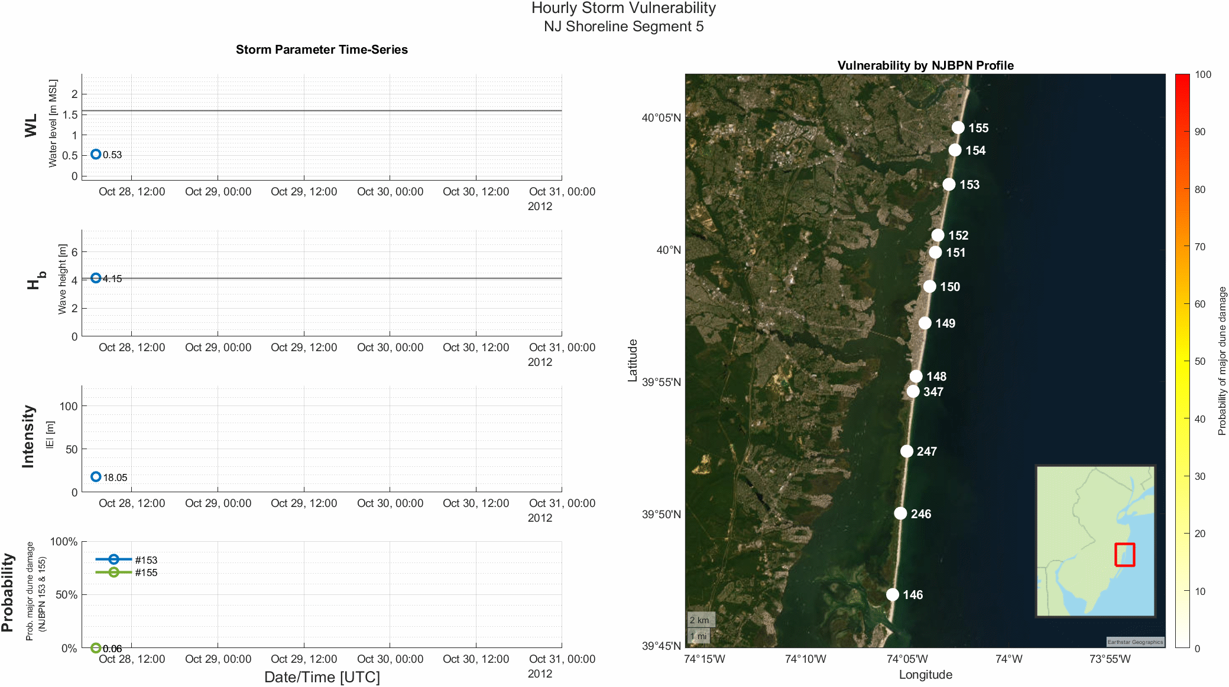
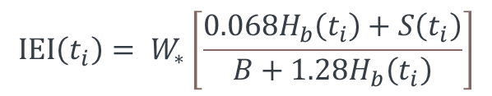
Approach
$$IEI\left(t_{i}\right)= W_{∗}\left[\frac{0.068H_{b}\left(t_{i}\right)+S\left(t_{i}\right)}{B+1.28H_{b}\left(t_{i}\right)}\right]$$

Slide 11
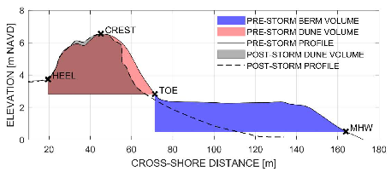
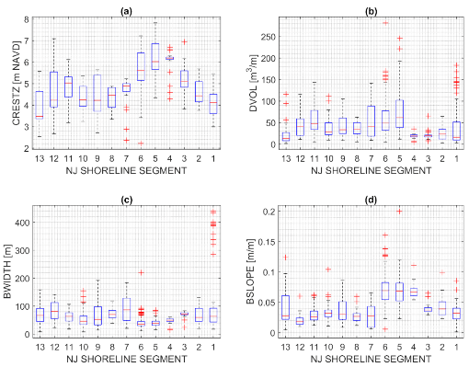
Approach

Slide 12
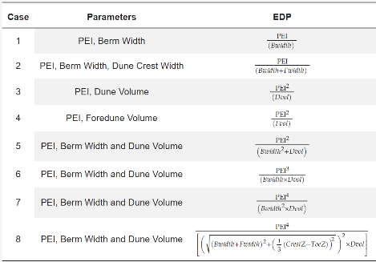

Approach
$$EDP= \frac{Storm Intensity Measure}{Resilience Factor}$$

Slide 13
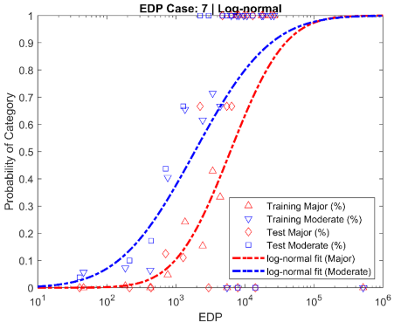
Approach

Slide 14
Approach

Slide 15
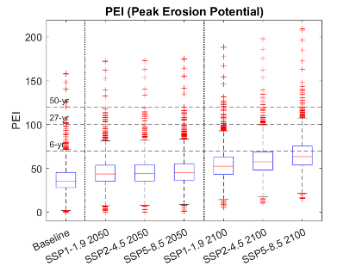
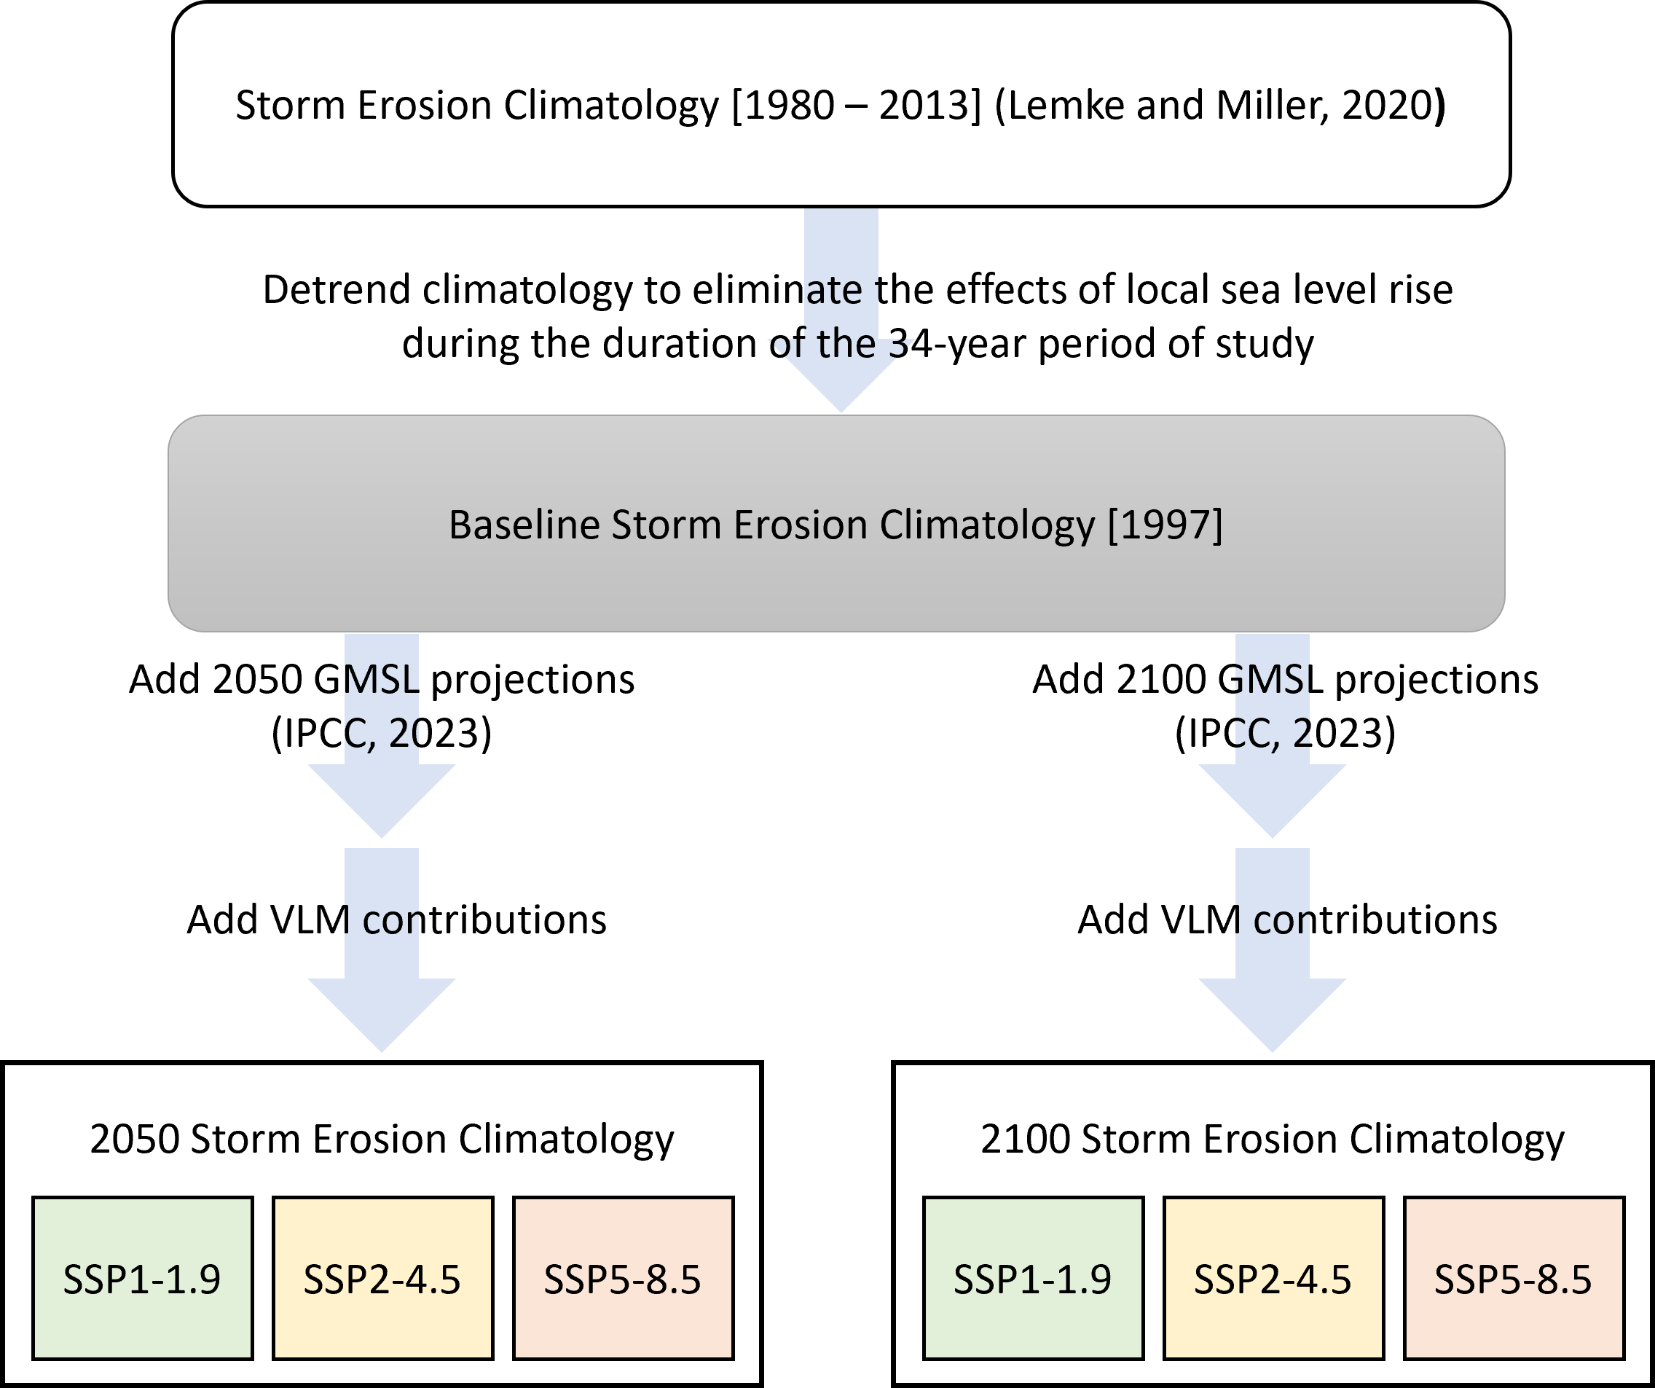
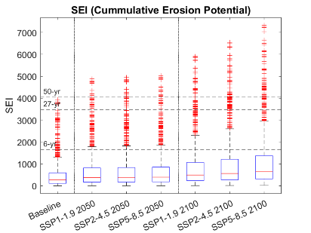
Adjust Storms for SLR

Slide 16
Both the number of storms and storm hours increases across all storms
The increase in both the number of storms and storm hours is greater for nuisance storms as compared to extreme storms
This trend is consistent across all SLR scenarios considered
“Nuisance”
“Severe”

Slide 17
Estimating Dune Vulnerability under Various SLR Scenarios - Conclusions
SLR increases the cumulative intensity more than the peak intensity
Nuisance level storms see greater increases in both number and total storm hours than Moderate or Major level storms
  Under a moderate SLR scenario (SSP2-4.5)
    By 2050 the number of storms and cumulative storm hours associated with Nuisance impacts will increase by 200%
    By 2100, the number of cumulative storm hours associated with Nuisance impacts will increase by 1200%
As the frequency of Nuisance events increases, a critical point will be reached where the beach dune system cannot recover between storms, leaving the dune significantly more exposed to the next storm event
It is recommended that coastal projects, continue to consider extreme events, but also more carefully consider the cumulative effect of low magnitude, moderate to high frequency Nuisance erosion events

Slide 18
Applications of a Barnegat Bay Estuary Three-Dimensional Hydrodynamic Model
Philip Orton and Jon Miller
Funding from the New Jersey Coastal Resilience Research Consortium

Slide 19
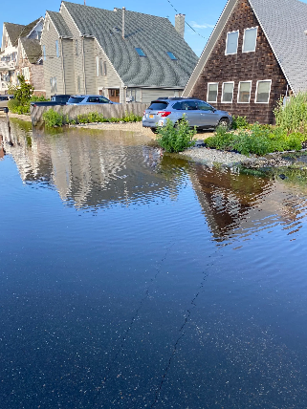
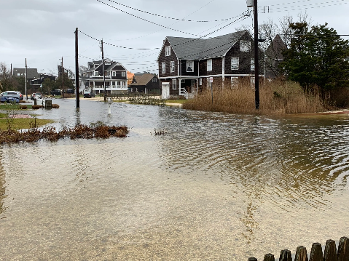
Motivation
Improving a valuable science tool for Barnegat Bay to help address its many challenges
Chronic high-tide and rain flooding

Slide 20
Motivation
Improving a valuable science tool for Barnegat Bay to help address many challenges
Chronic high-tide and rain flooding
Coastal storm flooding
Coastal Storm Risk Management – the NJ Back Bays USACE CSRM study recommended building closable storm surge barriers at two of three inlets – what are the effects?
Water quality

Slide 21
The Model
Background: Zafer Defne and Neil Ganju (USGS) developed a COAWST model of Barnegat Bay but haven’t run it since 2018
COAWST: Coupled Ocean, Atmosphere, Wave and Sediment Transport modeling framework (Warner et al. 2010) with the widely-used open-source ROMS community model for hydrodynamics
Applications (to date): Barnegat Bay circulation, flushing, Hurricane Sandy impacts, tidal wetlands and sediment transport (Defne et al. 2016, 2019; Donatelli et al. 2018)
Model domain ~70km x 20km, resolved with an 800 x 160 x 7 cell 3D mesh
Offshore boundary is 2.5 to 4.0 km seaward of the coastal barrier islands, forced by larger-scale models

Slide 22
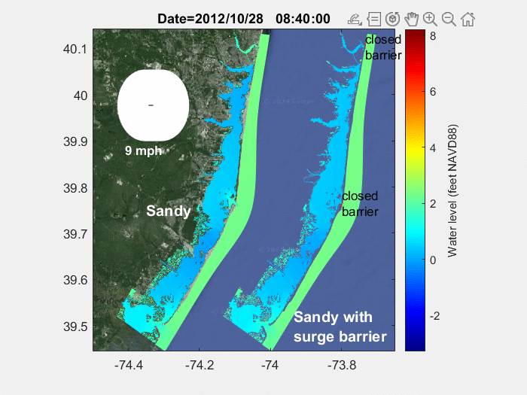
Hurricane Sandy with and without surge barriers
Gated storm surge barriers would close off Manasquan Inlet and Barnegat Inlet
Little Egg Inlet is proposed to remain open, to avoid impacting adjacent natural areas
Preliminary result: The proposed surge barriers would have protected northern Barnegat communities (and wetlands) from flooding
wind

Slide 23
Assessing the uncertainty in wind setup
From: Orton, P.M., Quantifying uncertainties in wind stress and setup in coastal lagoons, poster presented at the Gordon Research Conference on Coastal Ocean Dynamics, June 2023.
Storm surge (wind setup) due to wind stress on shallow coastal lagoons is likely different from the ocean, due to its high sensitivity to shallow water and steep waves
Research using the COAWST model in realistic simulations of Hurricane Sandy and idealized lagoon simulations quantified uncertainties in wind stress and setup
The idealized simulations across a range of wind speeds revealed ~1.0 foot uncertainty for a strong winter storm (50-knot winds) and ~1.3 feet for a Category-1 hurricane, which maps to a large additional flood area
The realistic Sandy simulation showed much smaller differences, likely due to the unsteady and changing direction of winds during Sandy

Slide 24
Future Goals
Improving a valuable science tool for Barnegat Bay to help address many challenges
Better understand influences of USACE tentatively selected plan (surge barriers)
Set up a local high-resolution Barnegat Bay forecast system
Simulate nature-based approaches to reduce storm surge and flooding
Collaborate on any Barnegat Bay topic where the model can be useful!

Slide 25
THANK YOU
Philip Orton and Jon Miller
Stevens Institute of Technology
1 Castle Point Terrace, Hoboken, NJ 07030

Slide 26
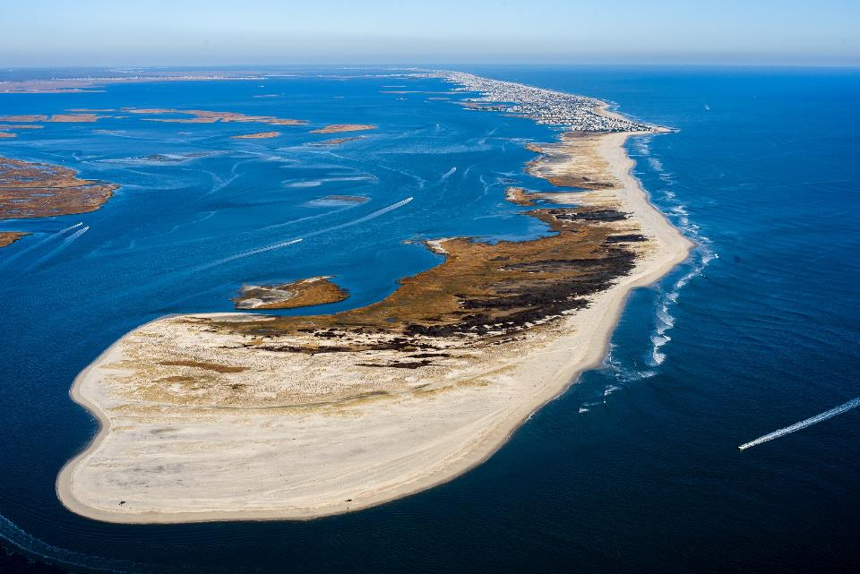

Analysis of Sediment Transport Pathways & Budgets into the
Barnegat Bay System
Kimberly K. McKenna
Interim Executive Director
Coastal Research Center
Stockton University
kimberly.mckenna@stockton.edu
Photo courtesy T. Kingston 11/29/2020
New Jersey Coastal & Climate Conference
Monmouth Univ., March 12-15, 2024

Slide 27
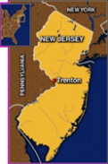
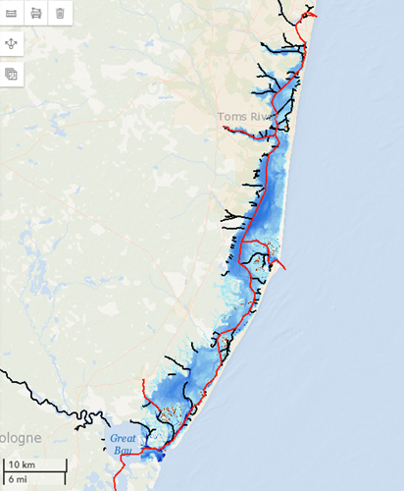
Manasquan Inlet
Outline
What We Know About Sediment Transport & Sediment Budgets in the Barnegat Estuary
Preliminary Results of Local Studies
Knowledge Gaps & Research Needs
Barnegat Inlet
Little Egg Inlet
New Jersey Coastal & Climate Conference
Monmouth Univ., March 12-15, 2024

Slide 28
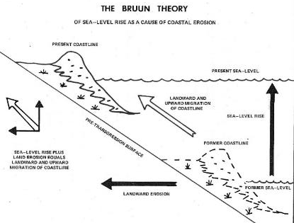
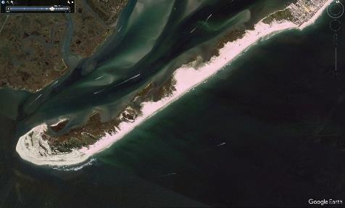
Coastal Sediments
Critical for shoreline “stability” with sea level rise
Sediment Equilibrium: coastal depositional environments (beaches, dunes, tidal marshes) will migrate landward & upward
(Kraft et al 1976)
Sediment Deficit: coastal depositional environments (beaches, dunes, tidal marshes) will migrate landward & risk drowning
New Jersey Coastal & Climate Conference
Monmouth Univ., March 12-15, 2024

Slide 29
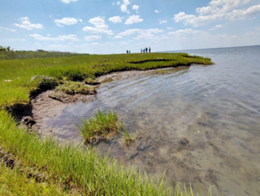
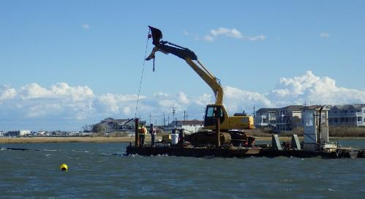
Coastal Sediments
Changing Climate: Increased Storms
Episodic events alter sedimentation patterns - habitat loss, risks to infrastructure & public safety
Sediments deposited in channels & inlets impacts navigation
New Jersey Coastal & Climate Conference
Monmouth Univ., March 12-15, 2024

Slide 30
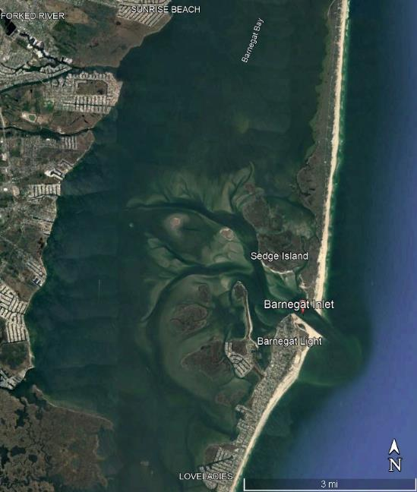
Sediment Sources & Pathways
Watershed Streams
Eroding Marsh
Inlet Flood/Ebb
Channels
Overwash
Beach Profile
Littoral Current
New Jersey Coastal & Climate Conference
Monmouth Univ., March 12-15, 2024

Slide 31
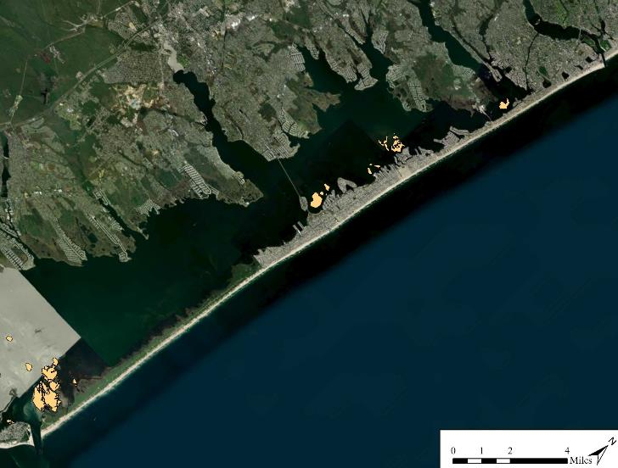
Sediment Contribution & Transport
Point Pleasant
Canal
Manasquan Inlet
Metedeconk
River
Qnet N
30,000-2.0 mil cy/yr
Toms
River
Qnet N
130,000 cy/yr
Qnet N
200,000 cy/yr
Cedar
Creek
Est .Terrestrial Input ~ 0.2 in (5 mm)/yr (Kana et al, 1988)
Qnet N
230,000 cy/yr
Measured Sediment Loads
Toms River, Metedeconk River, Cedar Creek (2012-2015) = 3,713 cy (Wilson, pers. com.)
Qnet N
310,000 cy/yr
(USACE, 2002)
Barnegat Inlet
New Jersey Coastal & Climate Conference
Monmouth Univ., March 12-15, 2024

Slide 32
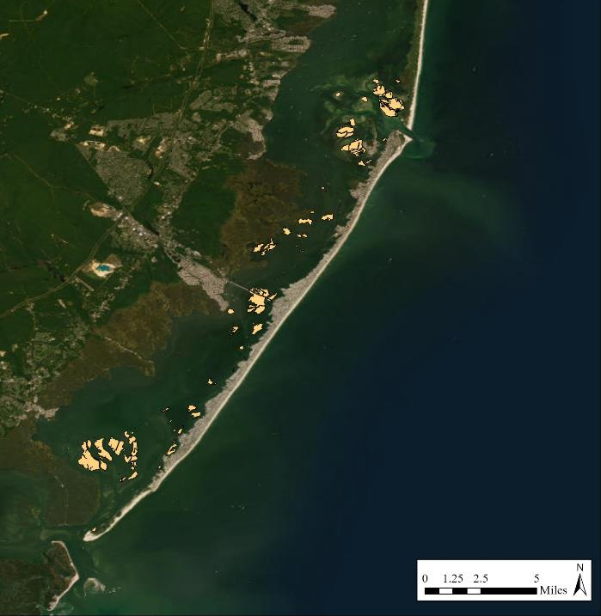
Sediment Transport: LBI & Inlets
28% tidal exchange
(2012-13 Wilson, pers. com.)
Barnegat Inlet
Qnet S
70,000 cy/yr
(USACE, 2002)
Qnet S
115,000 cy/yr
H. Sandy added 218,722 cy Sediment via Overwash, Island Breach, and Through Inlets
(Miselis et al, 2015)
Qnet S
90,000 cy/yr
Qnet S
95,000 cy/yr
Qnet S
80,000 cy/yr
Qnet through LEI
300,000 cy/yr
(Kriebel et al 2018)
Qnet S
95,000 cy/yr
Little Egg Inlet
Qnet S
96,000 cy/yr
(Kriebel et al 2018)
43% tidal exchange
(2012-13 Wilson, pers. com.)
New Jersey Coastal & Climate Conference
Monmouth Univ., March 12-15, 2024

Slide 33
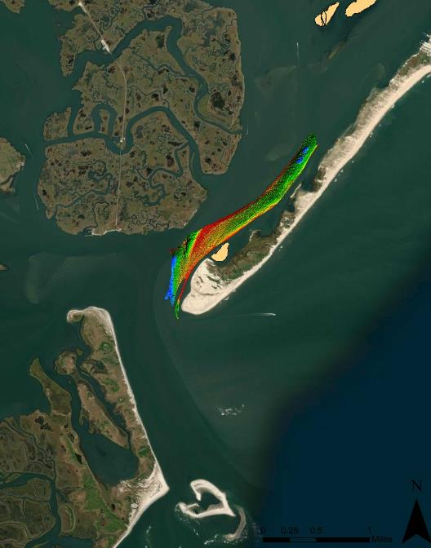
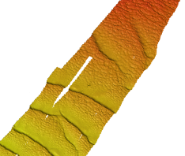
Holgate R2Sonic Multispectral Test
Sand waves moving northward into Little Egg Harbor
Little Egg Inlet
New Jersey Coastal & Climate Conference
Monmouth Univ., March 12-15, 2024

Slide 34
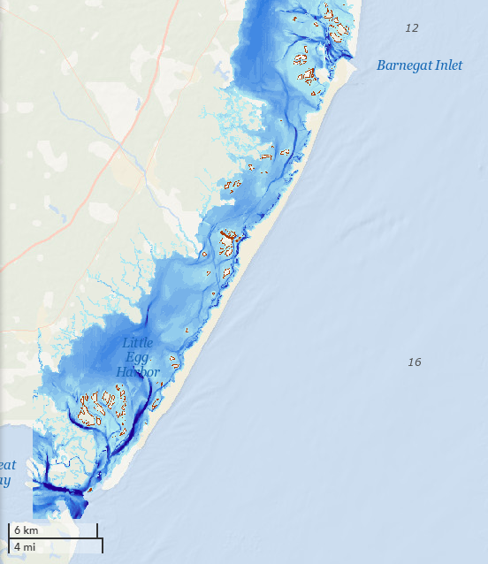

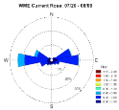

Summer 2023 Currents
Speed & Direction Varied by Location
High Bar Islands
0.0 to 0.6 ft/s
predominantly from S-SE
West Marshelder Island
0.0 to 0.6 ft/s
predominantly from W
Clam Cove
0.0 to 2.1 ft/s
predominantly from SW
New Jersey Coastal & Climate Conference
Monmouth Univ., March 12-15, 2024

Slide 35
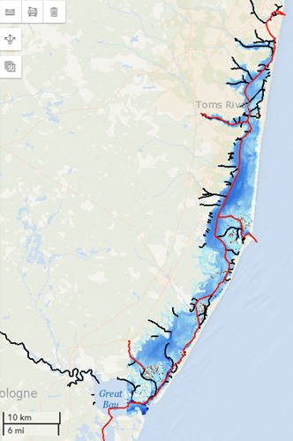
Knowledge Gaps & Research Needs
Not Enough Sediment to Keep Up with Sea Level & Storms
Back Bays: Drowned Bay Islands, Marsh Edge Loss, Low Marsh Platform Elevations, Transition from Low Marsh to Tidal Flat
Develop or use models to quantify and predict sediment movement & deposition
Establish long-term measurements of sediment entering the system through all pathways
Quantify how much sediment we need to keep pace with sea level
New Jersey Coastal & Climate Conference
Monmouth Univ., March 12-15, 2024

Slide 36
Impact of climate change on coastal groundwater
Michel C. Boufadel, PhD, PE, BCEE, Distinguished Professor,
Gunn Nanagara, PhD and Abed Doughan, PhD student
Center for Natural Resources
http://cnr.njit.edu
New Jersey Institute of Technology
boufadel@gmail.com
In collaboration with:
Thomas Herrington (Monmouth)
Elie Bouzeid (Princeton)
Firas Gerges (Princeton)
Leo Geng (U. Hawaii)

Slide 37
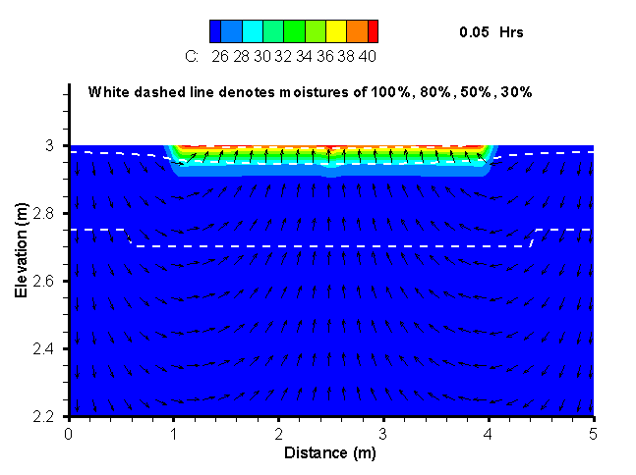
Climate change is likely to increase
1 -the intensity of storms; Floods and shorter time for infiltration
2- the duration between rainfall events: drought
Our group focused on groundwater
Groundwater quality is likely to be more impacted by climate change than surface water!!
Geng, X. and Boufadel, 2015. J Hydrol., 524: 427-438.

Slide 38
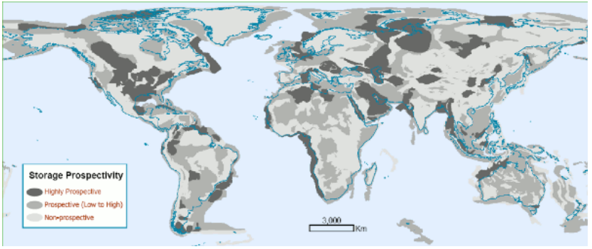
When evaporation increases, porewater salinity increases, and this leads to a decrease in carbon sequestration
Climate change
reduce SOC decomposition rate
reduce plant productivity
Map of global geological carbon storage prospectivity (reported in IPCC 2005)
Soil salinity
Setia, et al. "Soil salinity decreases global soil organic carbon stocks." Stoten, 465, 267-272, 2013.

Slide 39
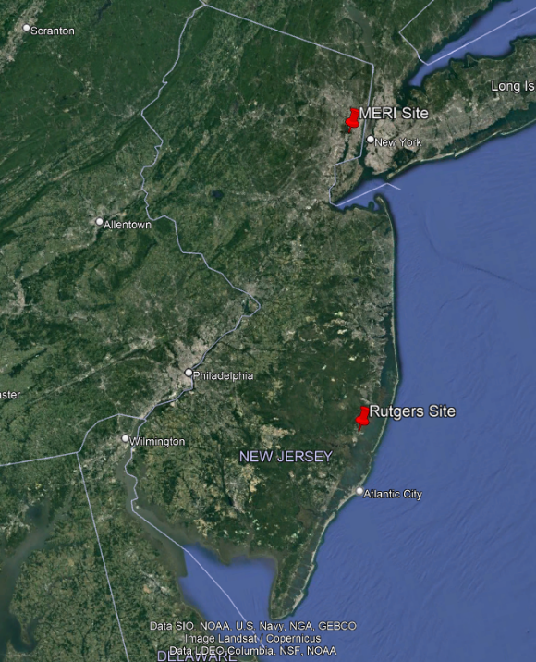
Two experimental stations in New Jersey
NJIT established two observation sites for porewater quality.
Jacques Cousteau Reserve (Rutgers)
Meadowland Env. Research Institute (MERI)
Funding from the NJ Coastal Consortium for Resilient Communities
(Led by Monmouth, McDonald, Herrington)

Slide 40
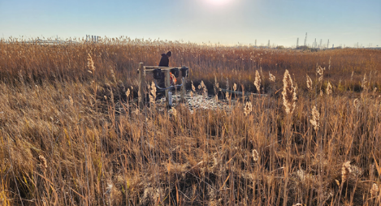
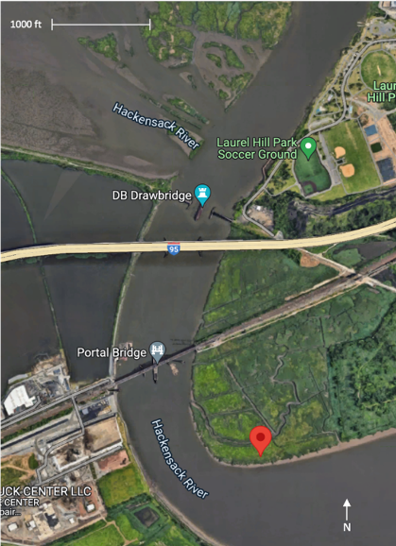
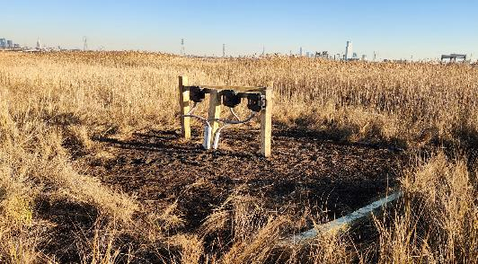
MERI

Slide 41
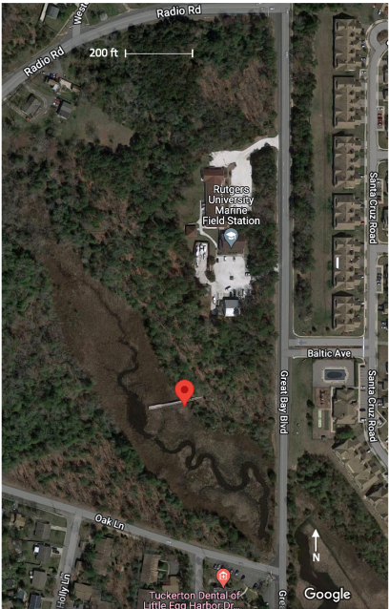
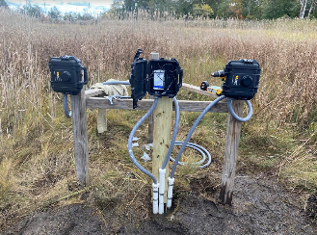
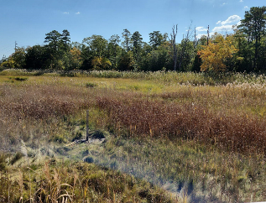
JC Rutgers site

Slide 42
Table 1: Data collected by the NJIT team based on two stations (see Figures 1, 2, and 3)
Data | Rutgers Jacque Cousteau Reserve. (39.593141, -74.346927) Start time/date: 1:15 pm / October 19, 2022 | Meadowland Environmental Research Institute. (40.750700, -74.091034) Start time/date: 2:02 pm / December 2, 2022
Porewater salinity | 15-min measurement interval | 5-min measurement interval
Porewater temperature | 15-min measurement interval | 5-min measurement interval
Porewater pressure (water level) | 15-min measurement interval | 5-min measurement interval
Air temperature | 15-min measurement interval | 5-min measurement interval
Air relative humidity | 15-min measurement interval | 5-min measurement interval
Wind speed | 15-min measurement interval | 5-min measurement interval
Wind direction | 15-min measurement interval | 5-min measurement interval
Barometric pressure | 15-min measurement interval | 5-min measurement interval

Slide 43
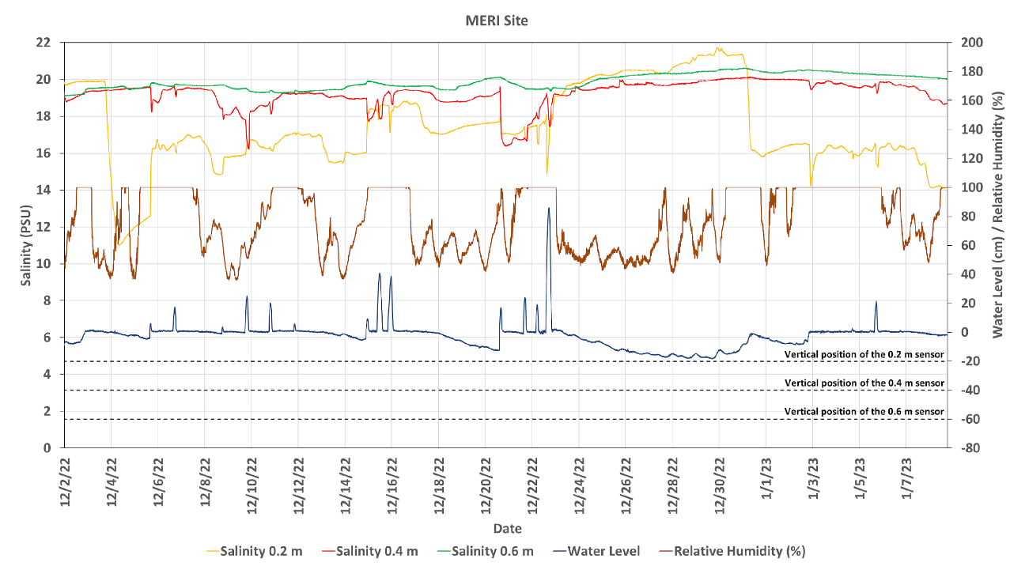
Notes:
Here are the results from the MERI site that we have been collecting.
Although this is a busy slide displaying a couple of parameters at the same time, I will go over them one by one.
The main monitoring parameter of this study is salinity, which has been measured at three different depths from the ground surface
the shallowest sensor was installed at .2 meter below the ground the deeper one is at .4 meter and the deepest one is at .6 meter below the ground.
here we show the salinity form those three depths with three colorful lines.
The yellow line is the salinity at .2 meter the red line is at .4 meter and the green line is at .6 meter.
Most of the time, the salinity Increased width depth.
.2 is the lowest, followed by .4 and the highest salinity was found at .6 meter.
However, we found an interesting result which contradict this trend between December 23rd and December 31^{st.}
During this time salinity at the shallowest sensor drastically increased and exceeded the salinity at the deeper locations.
By looking at the water level data (the blue line at the bottom) we found that, water level decreased substantially, and the relative humidity (which is shown as the brown line) was relatively low, which are indicative for water evaporation.
This results show that evaporation increased salinity of pore water.

Slide 44
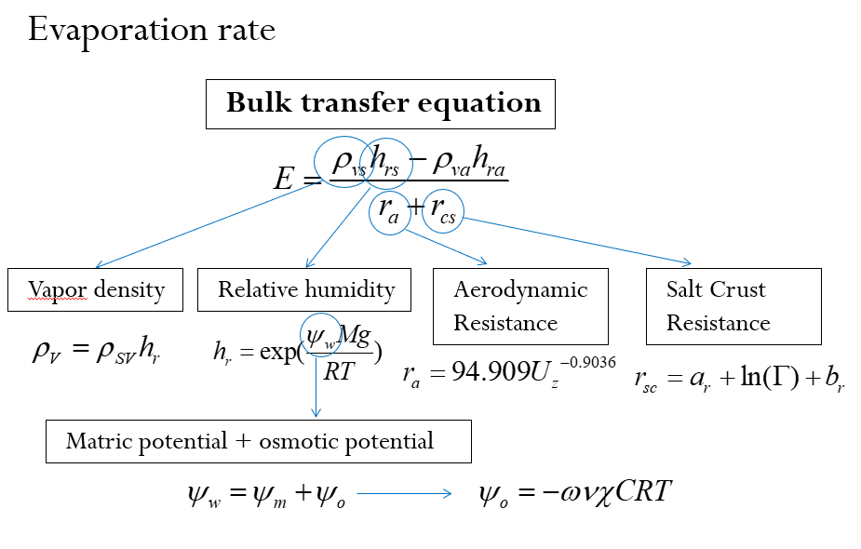
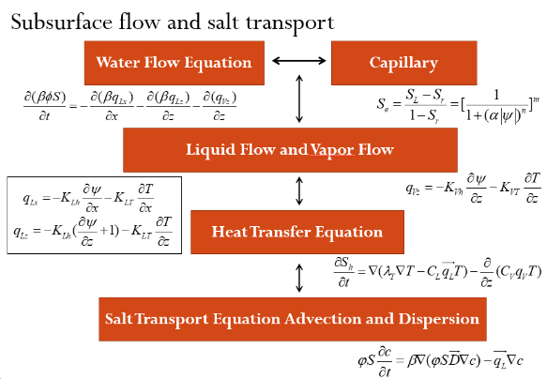
Modeling
Coupling atmospheric and subsurface processes

Slide 45
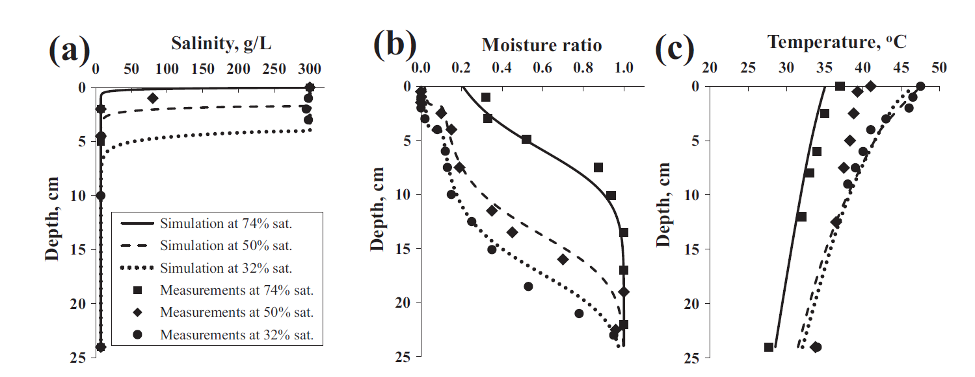
Calibrate the model to NJ data
Comparison to Gran et al. [2011].
Geng, X. and Boufadel, 2017. Water Resour. Res., 53(7). 6218-6238
Gran M, et al., 2011 J Hydrol., 396(3-4): 215-220.

Slide 46


Use global models to predict atmospheric conditions and sea level.
Use the coupled model to predict porewater salinity
(Select various warming scenarios).
Temperature
RCP=8.5

Slide 47


NJCCRC-Rutgers University
Barnegat Bay and Great Bays Resilience Observing Network: Tracking the Changing Environment to Inform the Management of Estuarine Resources
Project Goal
  The integration of climate change research, resiliency planning, and monitoring data to inform the proactive adaptation and management of estuarine resources.
Project Outcome
  An improved understanding of the information needs of estuarine resource managers to support proactive resilience strategies
Notes:
. This will include design characteristics of a representative coastal bay observing network, the Barnegat and Great Bays Resilience Observing Network, gaps in existing monitoring data and the development of site-specific research models.

Slide 48


Project Team
Jacques Cousteau National Estuarine Research Reserve/Rutgers University
  Andrea Habeck
  Amanda Archer
  Amy Plantarich
  Gregg Sakowicz
  Mike De Luca
  jcnerr.org
Rutgers Center for Ocean Observing Leadership
  Josh Kohut
  Travis Miles
  webocean@marine.Rutgers.edu

Slide 49


Year One Tasks
    Conduct a survey to inventory existing observing system infrastructure and identify data gaps in sampling and sensing capabilities.
    Focus Group: Understanding the Data Needed to Inform the Management of Estuarine Resources in Barnegat and Great Bays
    A White Paper Identifying the Gaps Between Available Data and Coastal Management Needs

Slide 50
Year One Project Outcomes
  An assessment of the information needs of resource managers to support sustainable management of estuarine resources in Barnegat and Great Bays.
  A compilation of existing long-term monitoring data and observing system capabilities in the Barnegat and Great Bay estuarine systems, and identification of data and observing system gaps required to support proactive resource management.
  A white paper that outlines a research and observing system strategy to support proactive resource management of the Barnegat and Great Bay estuarine systems.

Slide 51

YEAR TWO TASKS and EXPECTED OUTCOMES
  Tasks
    Mapping Priority Sites in Barnegat and Great Bays
    with YUCO-SCAN AUV and Surveyor2 ASV
    Conduct training opportunities for Rutgers Oceanography Masters in Observational Oceanography students on ASV and YUCO
  Expected Outcomes
    Identification of high priority monitoring and restoration sites withing Barnegat and Great Bays
    Comparison of mapping technologies using the ASV and YUCO
    Equipment training on the ASV and YUCO for oceanography students

Slide 52

Discussion

