Slide 1
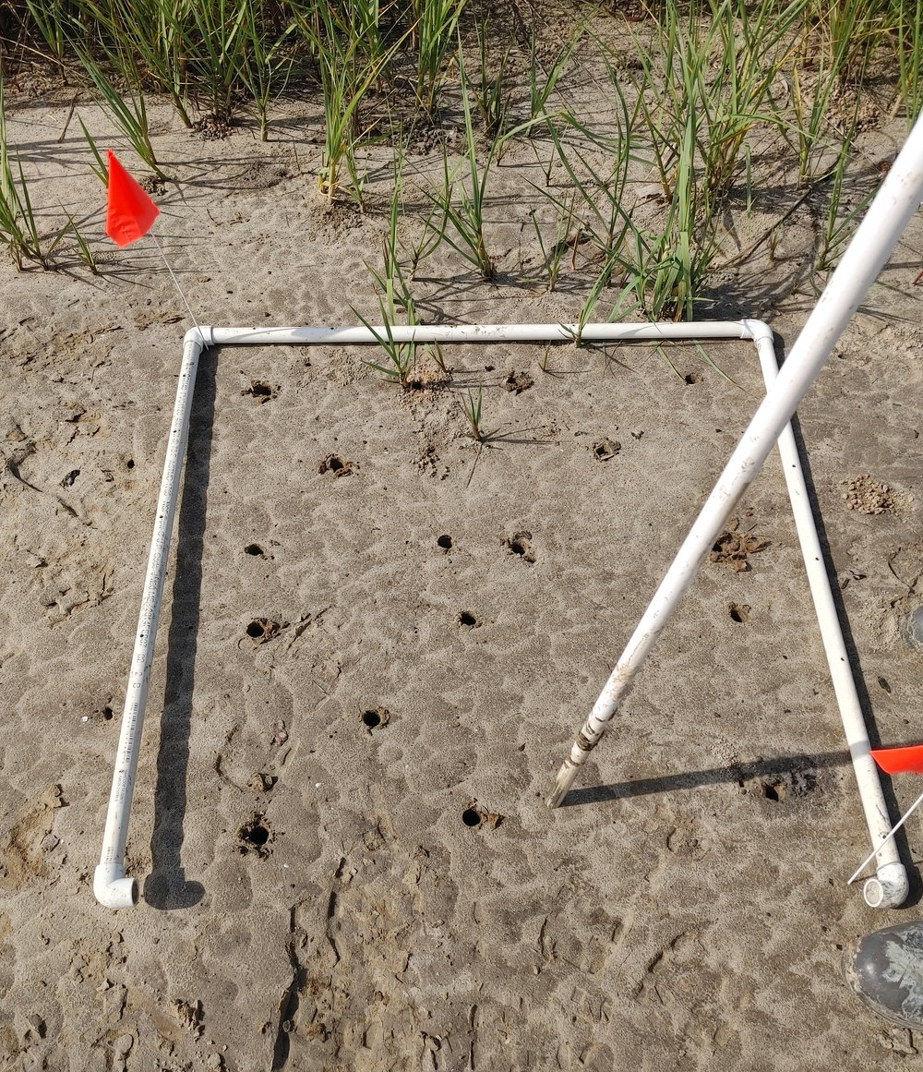
The value of a burrow: Integrating burrowing crab facilitation into tidal marsh restoration.
Shelby Rinehart*, Jacob Dybiec, Morgan Sharbaugh, Taylor Ledford, August Hammill, Corianne Tatariw, Behzad Mortazavi, & Julia Cherry

Slide 2
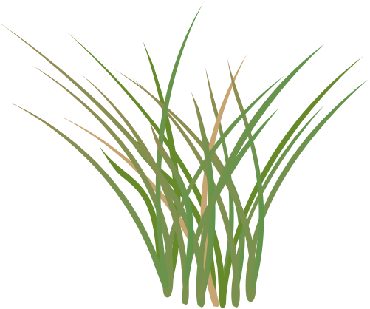
Burrowing crab increase plant productivity in natural marshes.
Recreated figure from Bertness 1984
Bertness 1984 Ecology

Slide 3
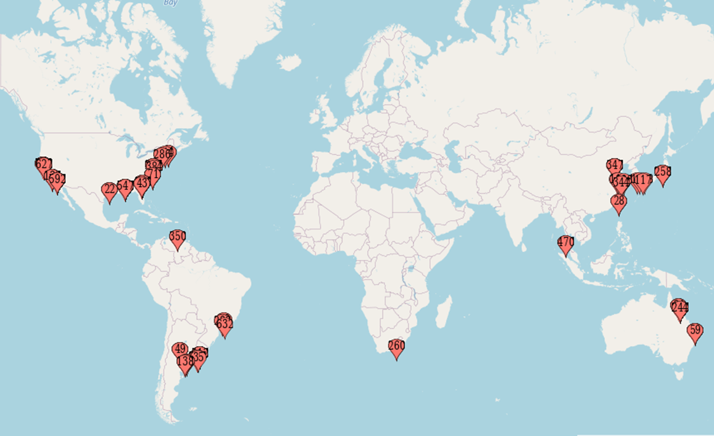
Burrowing crabs affect edaphic conditions in soft-sediment intertidal habitats.
Rinehart et al. Ecosphere In Revision

Slide 4
Burrowing crabs generally reduce sediment compaction.
Rinehart et al. Ecosphere In Revision

Slide 5
Burrowing crabs increase sediment redox potential, likely via bioturbation.
Rinehart et al. Ecosphere In Revision

Slide 6
Overarching Research Objective: When and where do burrowing crabs affect the development of restored/created tidal marshes?

Slide 7
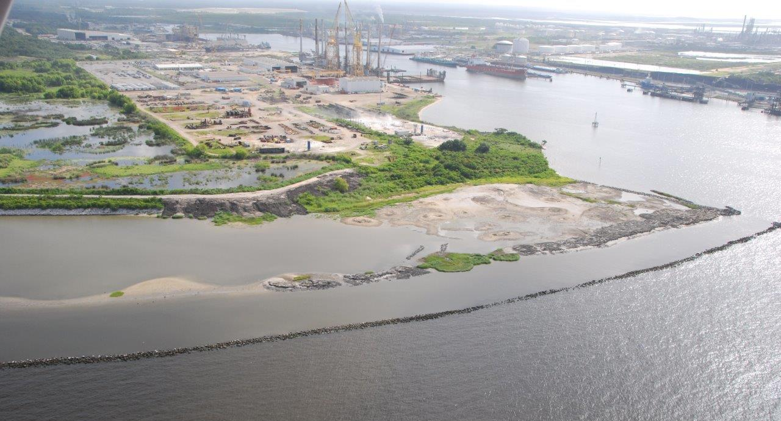
When and where do burrowing crabs affect the development of restored/created tidal marshes?
Sharbaugh et al. In Prep

Slide 8
When and where do burrowing crabs affect the development of restored/created tidal marshes?
Mud flat
Young
Old
0 years old
1-6 years old
6+ years old
Sharbaugh et al. In Prep

Slide 9
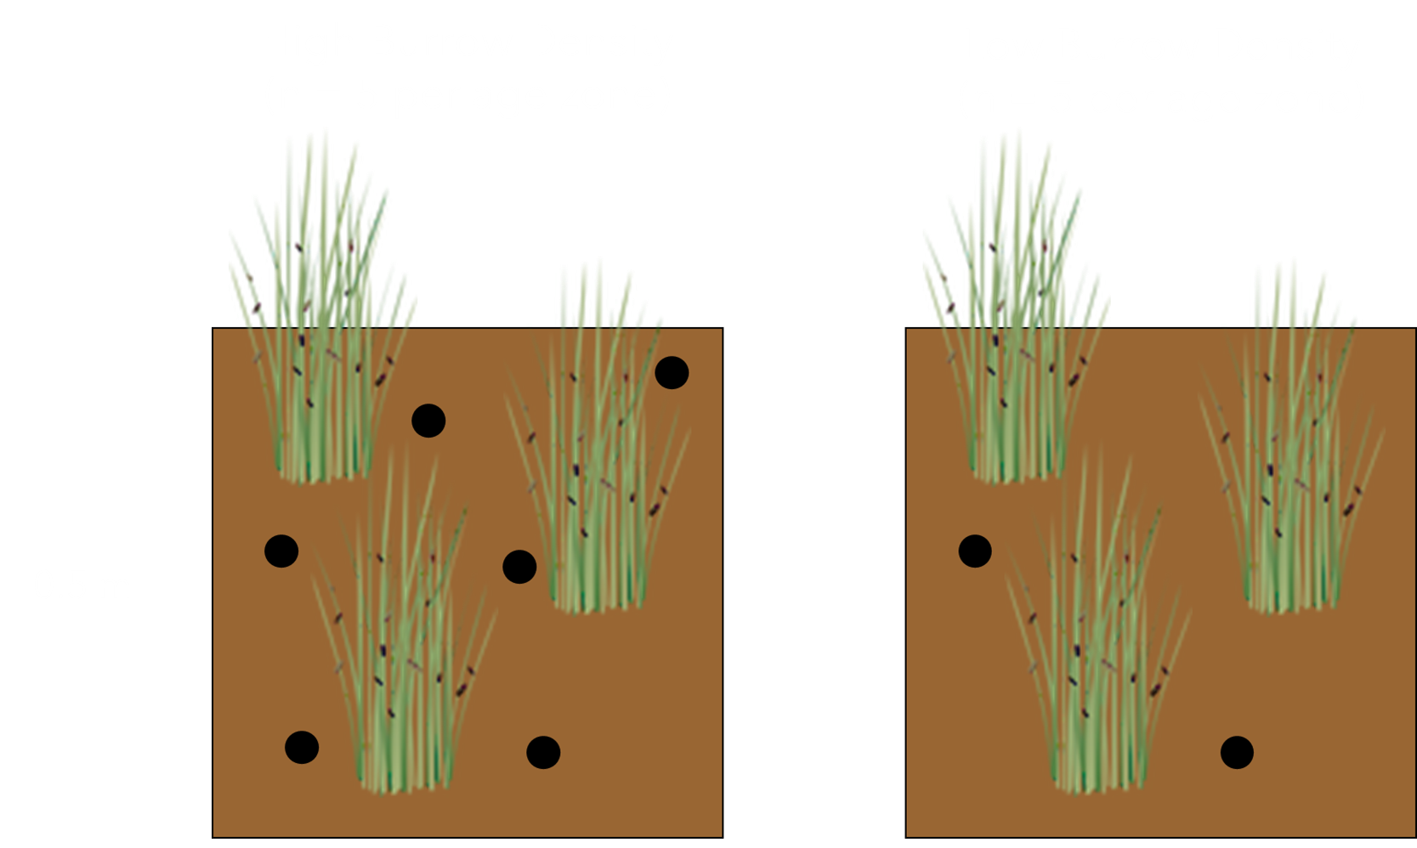
When and where do burrowing crabs affect the development of restored/created tidal marshes?
Mud flat
Ecotone
Young
Old
Sharbaugh et al. In Prep

Slide 10
When and where do burrowing crabs affect the development of restored/created tidal marshes?
Mud flat
Ecotone
Young
Old
Sharbaugh et al. In Prep

Slide 11
Burrowing crabs do not affect Spartina cover in young or old vegetated zones.
Mud flat
Ecotone
Young
Old
Sharbaugh et al. In Prep

Slide 12
Burrowing crabs reduce sediment bulk density in newly-established habitats, but dampen with marsh age.
Mud flat
Ecotone
Young
Old
Sharbaugh et al. In Prep

Slide 13
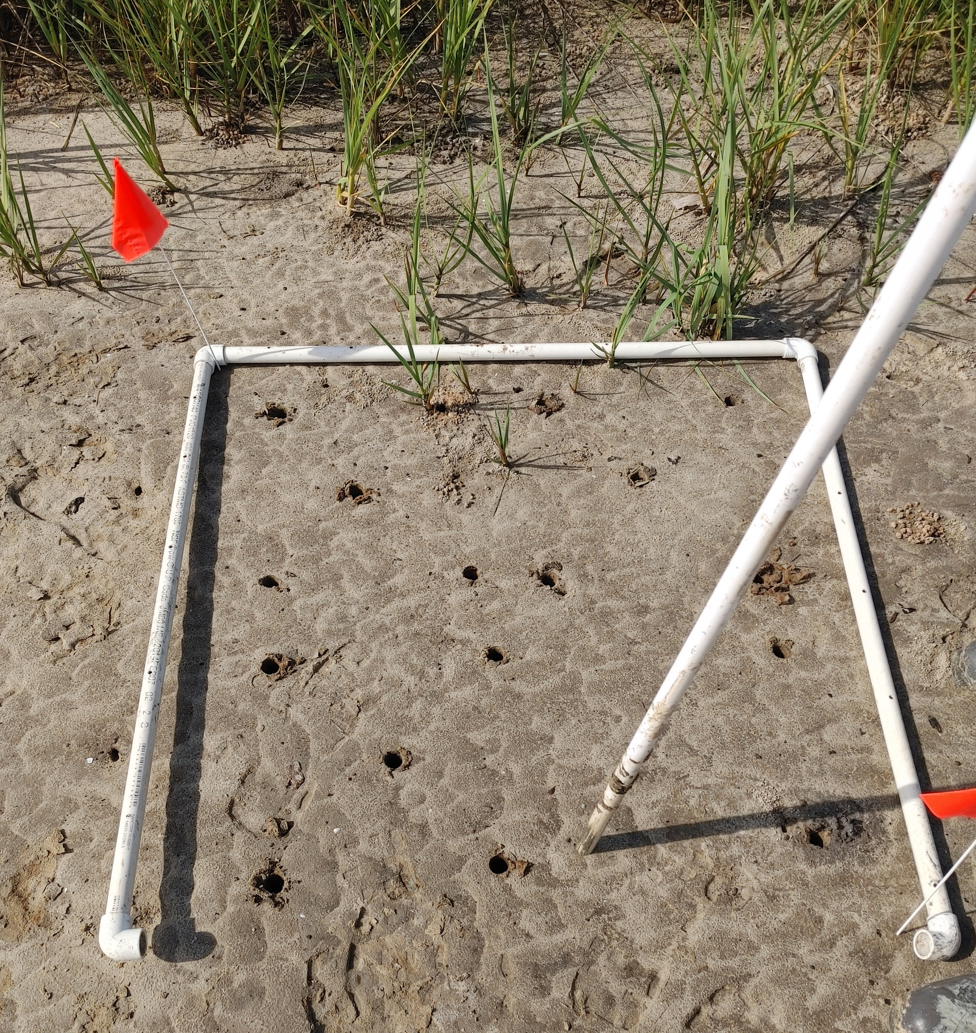
When and where do burrowing crabs affect the development of restored/created tidal marshes?
Mud flat
Ecotone
Young
Old
Sharbaugh et al. In Prep

Slide 14
Crab burrows facilitate plant expansion at the ecotone.
Mud flat
Ecotone
Young
Old
Sharbaugh et al. In Prep

Slide 15
Crab burrows increase plant cover at the ecotone.
Mud flat
Ecotone
Young
Old
Sharbaugh et al. In Prep

Slide 16
Crab burrows increase plant cover at the ecotone.
Spartina
cover
Sharbaugh et al. In Prep

Slide 17
Crab burrows reduce bulk density at the ecotone.
Mud flat
Ecotone
Young
Old
Sharbaugh et al. In Prep

Slide 18
Crab burrow are most important in newly-developing (~0-1 years old) restored tidal marshes.
Absolute value of crab burrow effects
Sharbaugh et al. In Prep

Slide 19
Crab burrow are most important in newly-developing (~0-1 years old) restored tidal marshes.
Absolute value of crab burrow effects
Sharbaugh et al. In Prep

Slide 20
Crab burrow are most important in newly-developing (~0-1 years old) restored tidal marshes.
Absolute value of crab burrow effects
Sharbaugh et al. In Prep

Slide 21
Take aways:
Crab burrows reduce sediment compaction in mud flats made from deposited dredge material.
Crab burrows accelerate Spartina spread into unplanted mud flats in restored marshes.
Fake burrows are an easy way to achieve the benefits of crab burrows for plant growth.

Slide 22
Thank You!
George Ramseur
Jake Pettigrew & Sierra Ortiz
Emily Reiner
Adam Siders
Emily Fromenthal
University of Alabama CARSCA Grant
This work is dedicated to the memory of co-author Jacob M Dybiec

Slide 23
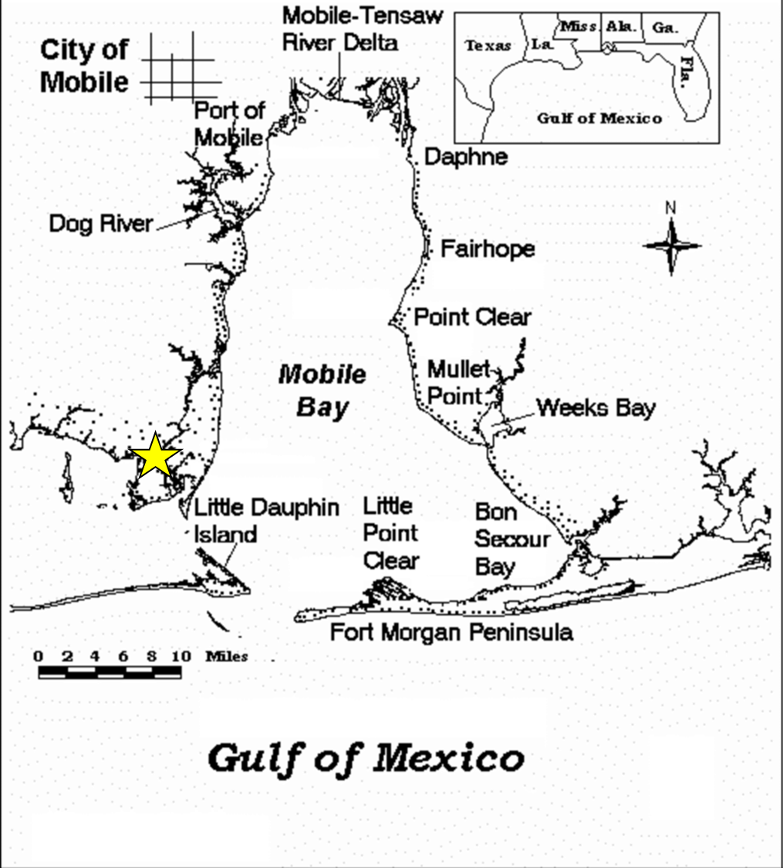
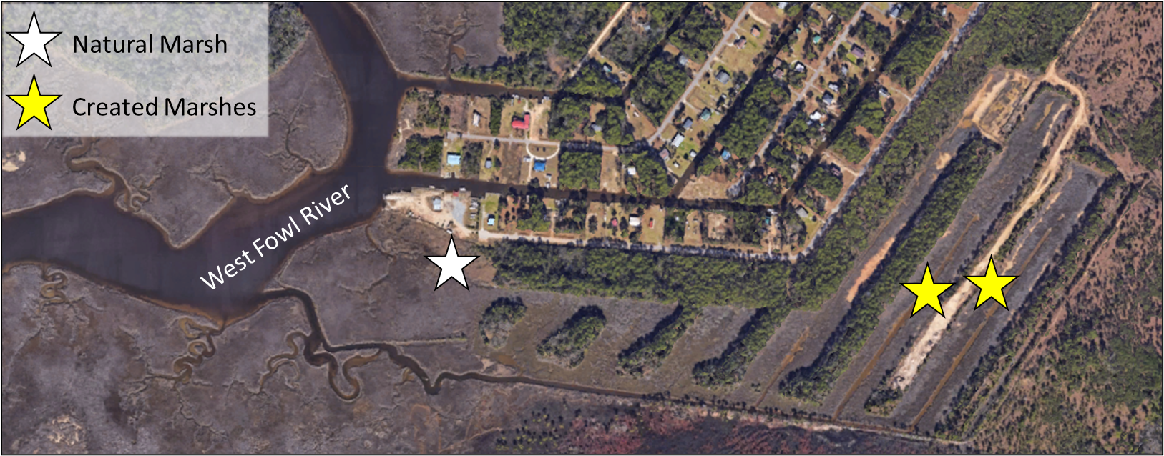
When do burrowing crabs affect sediment processes in restored and created tidal marshes?
Rinehart et al. 2023 Ecosphere

Slide 24
CON and NAT marshes vary in their vertical sediment profiles.
Bulk Density (g/cm³)
SOM (%)
Rinehart et al. 2023 Ecosphere

Slide 25
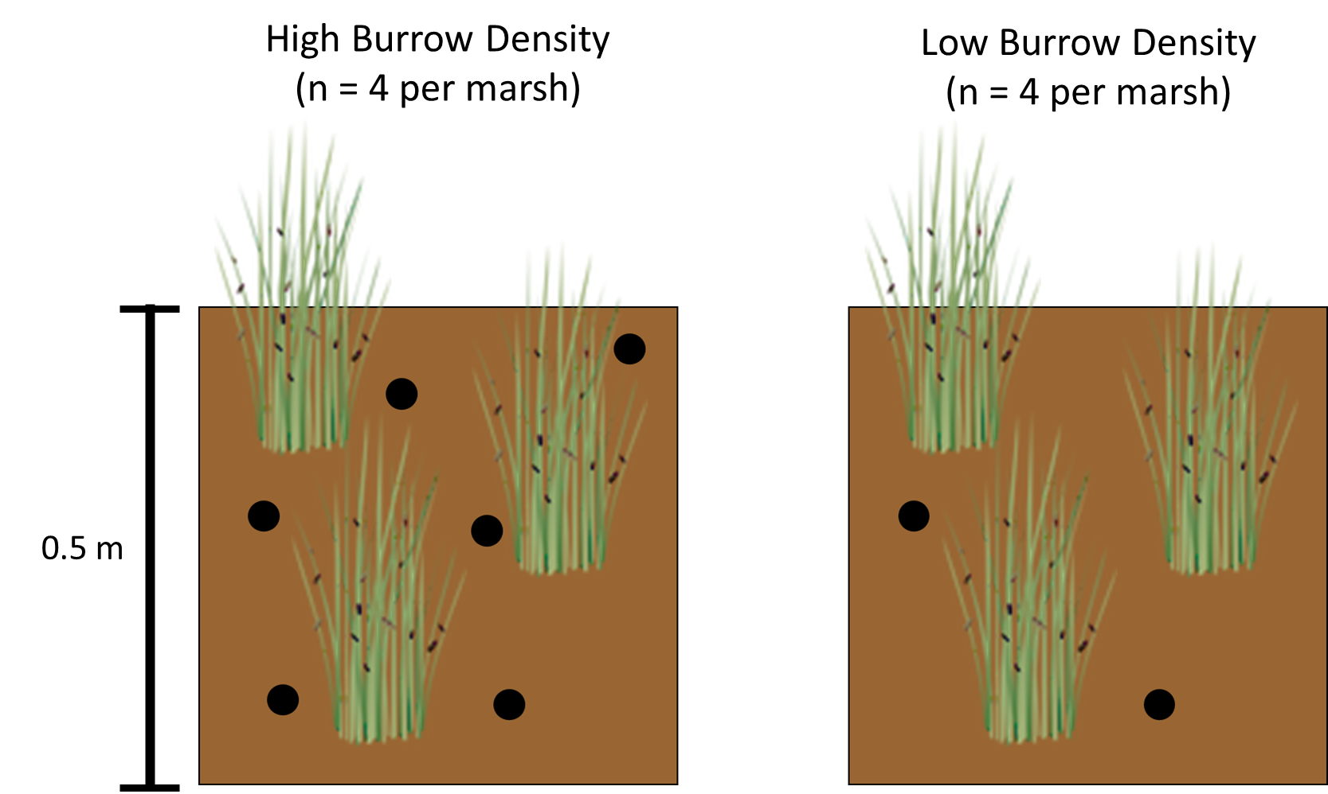
When do burrowing crabs affect sediment processes in restored and created tidal marshes?
Rinehart et al. 2023 Ecosphere

Slide 26
Burrowing crabs homogenize vertical sediment profiles, reducing variability in bulk density.
Rinehart et al. 2023 Ecosphere

Slide 27
Burrowing crabs homogenize sediments, with consequences for sediment pH.
Rinehart et al. 2023 Ecosphere

Slide 28
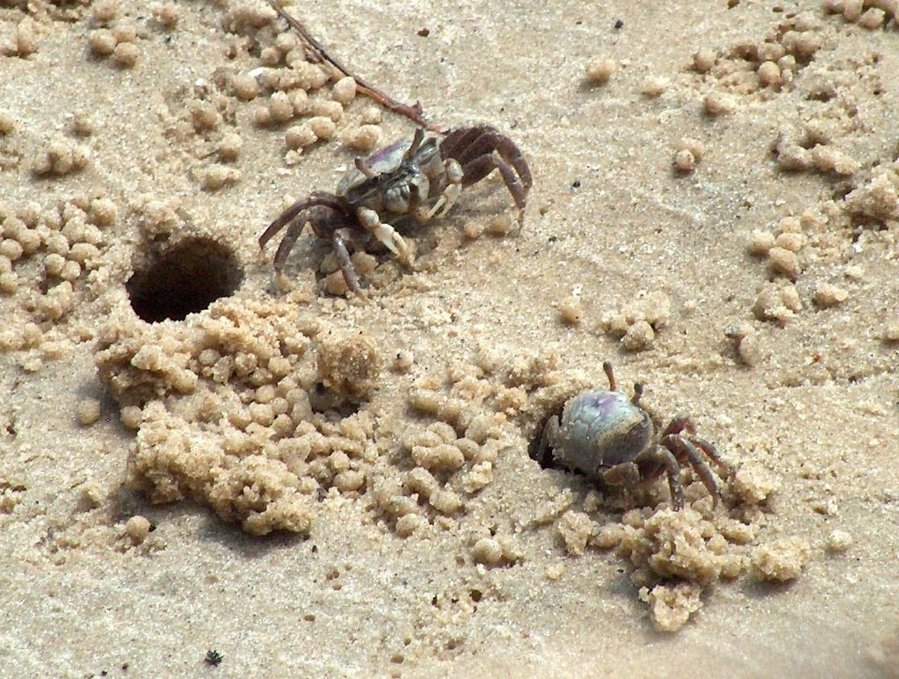
Crabs excavate sediments with higher bulk density and lower pH at CON than NAT.
Excavated sediments
Rinehart et al. 2023 Ecosphere

Slide 29
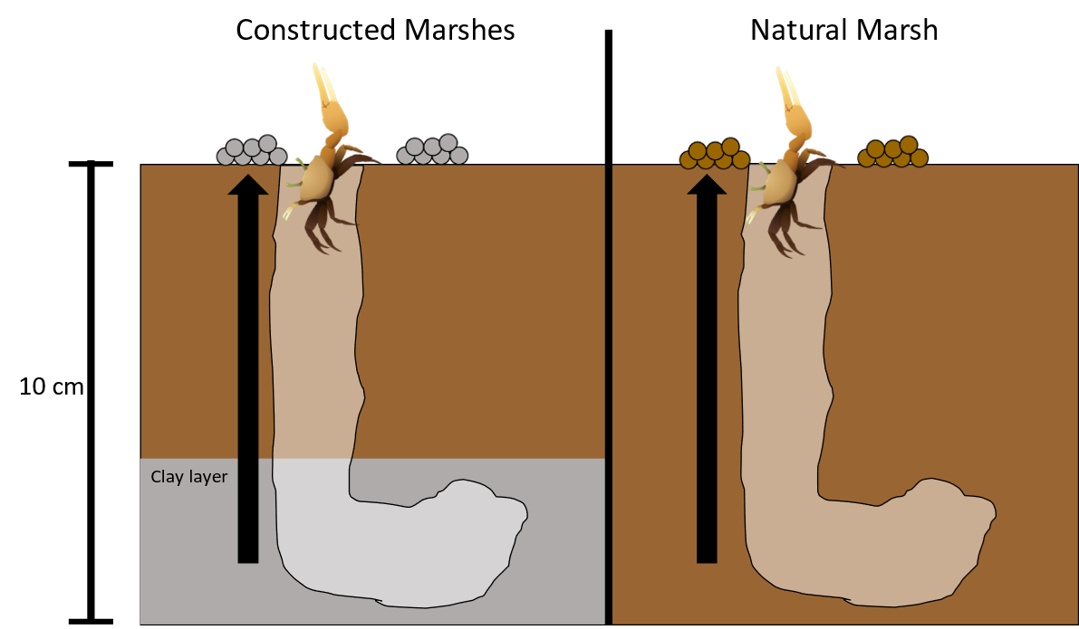
Burrowing crabs homogenize sediments in restored/created marshes.
Rinehart et al. 2023 Ecosphere

