Slide 1
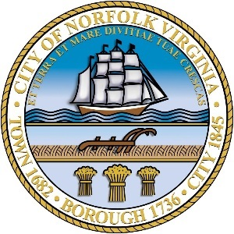
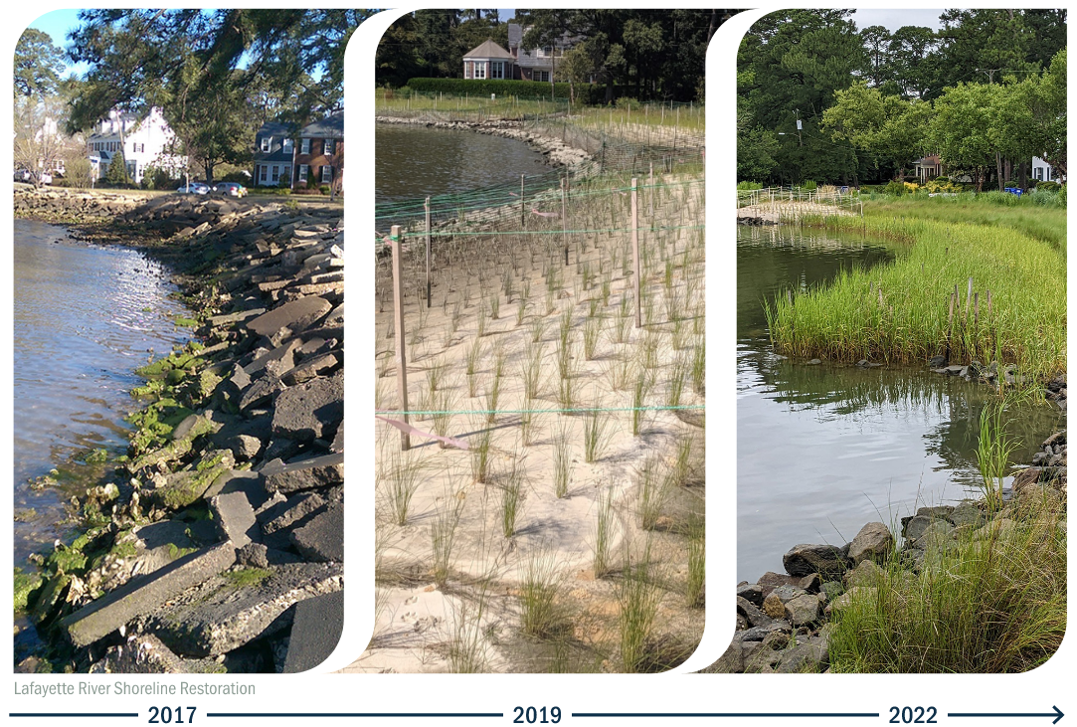
Coastal Resiliency and Shoreline Restoration Design and Post-Construction Review of Living Shoreline Projects
Ben Nash, PLA – Brown and Caldwell
2024 NJ Coastal and Climate Resilience Conference – 3/13/2024

Slide 2
Project Background, History, and Metrics
Second most vulnerable city of its size to climate change in U.S. – second only to New Orleans
Sandy Coastal Resiliency Grant for Lafayette River
Awarded $4.6MM from NFWF
Green Infrastructure Plan
Public Education
Shoreline Restoration
Grant Metrics (Shoreline Restoration)
12,200/11,500 lf of shoreline restoration
3.34 acres of wetland creation
1.44 acres of oyster reef creation
Notes:
Part of Rockefeller 100 Resiliency Cities; this grant became part of the city’s program.
Green Infrastructure Plan – explain part of grant…
Public Education – Veteran workforce development. Also includes high school environmental education.
Grant Metrics
City completed one project that was the match (design) by the city for the grant ~700 lf, remaining 11,500 included in ours
River is a good candidate location to meet metrics
Previous projects included all these objectives; this project is extending the restoration of the overall river.

Slide 3
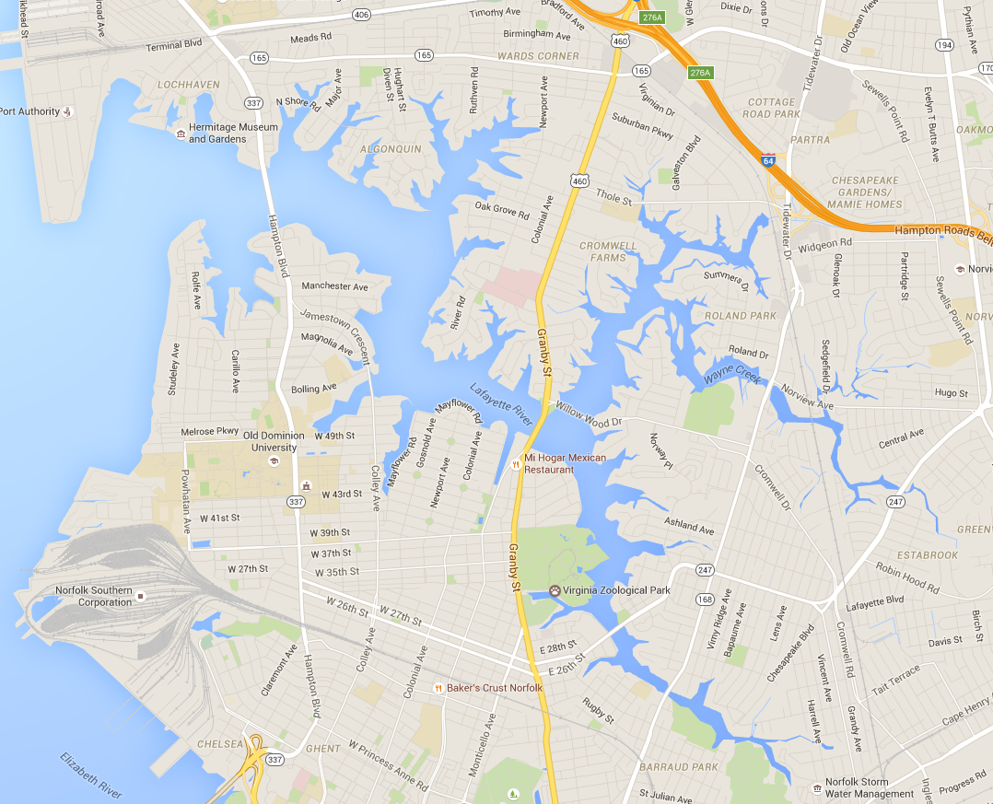
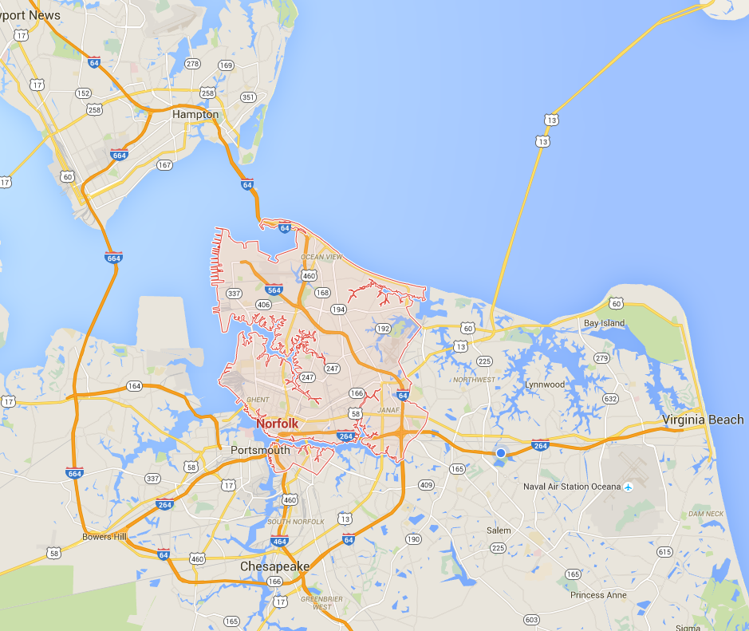
Project Location
Lafayette River
Elizabeth River
Chesapeake Bay
James River
Notes:
CW
Lafayette River – River in a highly urbanized drainage area
Characteristics – 95% built out, 5% designated open space (parks, school grounds, zoo)
River had great need for shoreline restoration

Slide 4
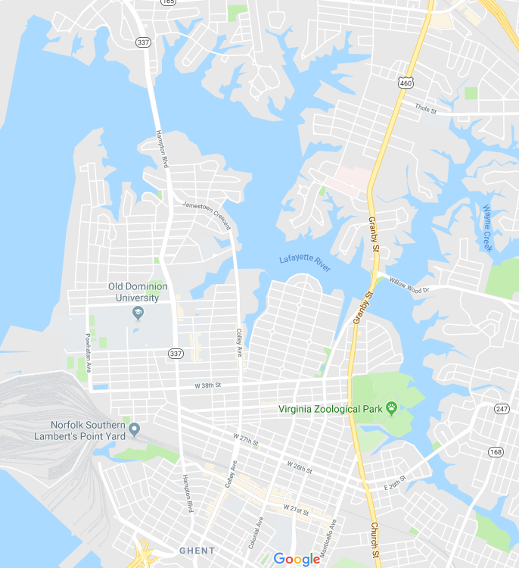
Restoration Locations
North Shore Road
Constructed - 2019
Hermitage Museum
Constructed - 2019
Norfolk International Terminal (NIT)
Constructed - TBD
Knitting Mill
Constructed - 2018
Beach Avenue
Constructed - 2018
Villa Circle
Constructed - 2019
Lindenwood/Barraud Park
Constructed - 2021
Notes:
6 project locations
Beach and Villa construction complete
North Shore and Hermitage under construction
Lindenwood expected to start summer of 2019
NIT in design

Slide 5
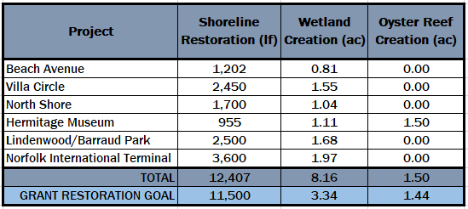
Restoration Metrics

Slide 6
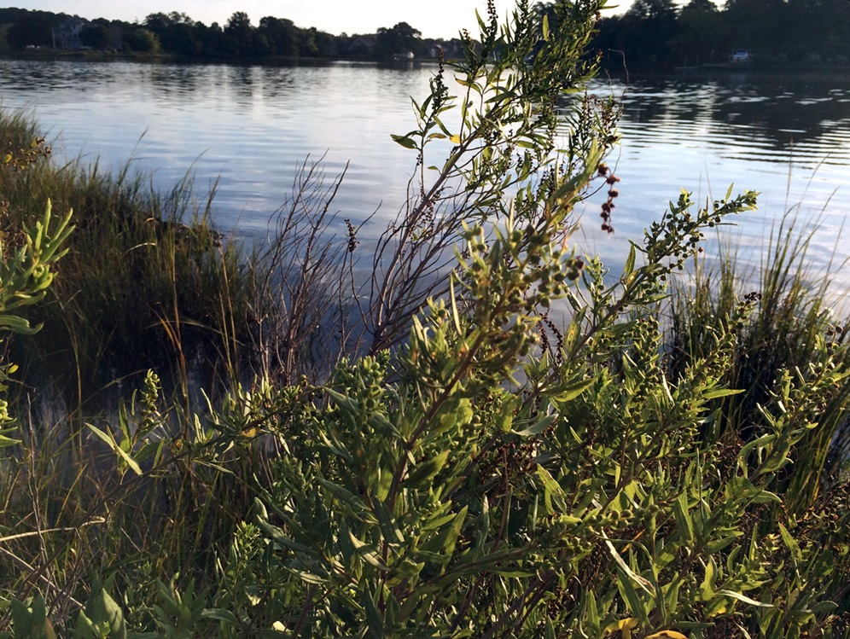
Existing Conditions

Slide 7
Existing Conditions
Notes:
Typical conditions of the river – failed shoreline erosion control practices
Have limited riparian buffer – fence, grass, tree, river within 10’; not a effective buffer
Shoreline is more than just the limited shore – it is wetland, buffer, interaction.
Throwing more rip rap on the shore does not restore the ecosystem of the Bay.

Slide 8
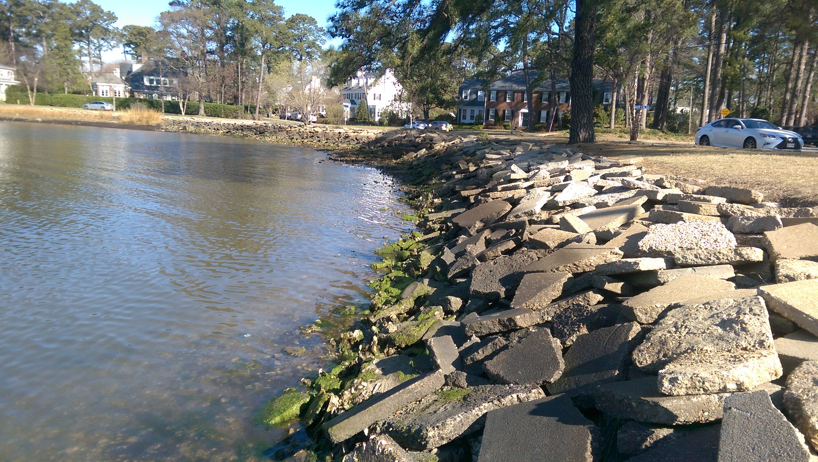
Existing Conditions
Notes:
Concrete debris placed along eroding shoreline, little habitat and points at top of bank of debris beginning to erode behind concrete toward sidewalk.

Slide 9
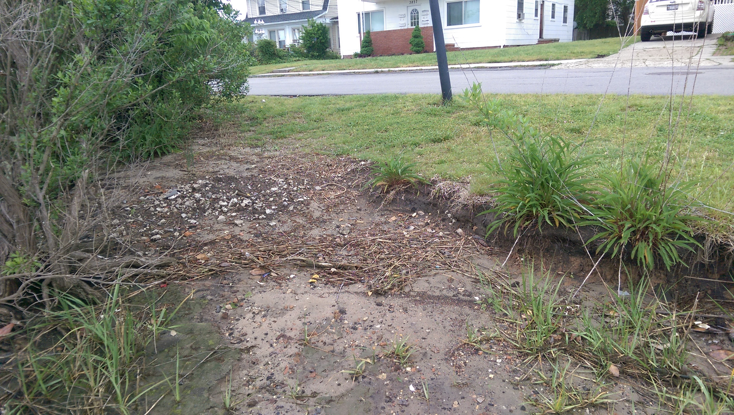
Existing Conditions
Notes:
Active shoreline erosion with little buffer between shoreline and existing infrastructure (SS, Elec, Water, Roads, Homes, etc.)

Slide 10
Design Modifications

Slide 11
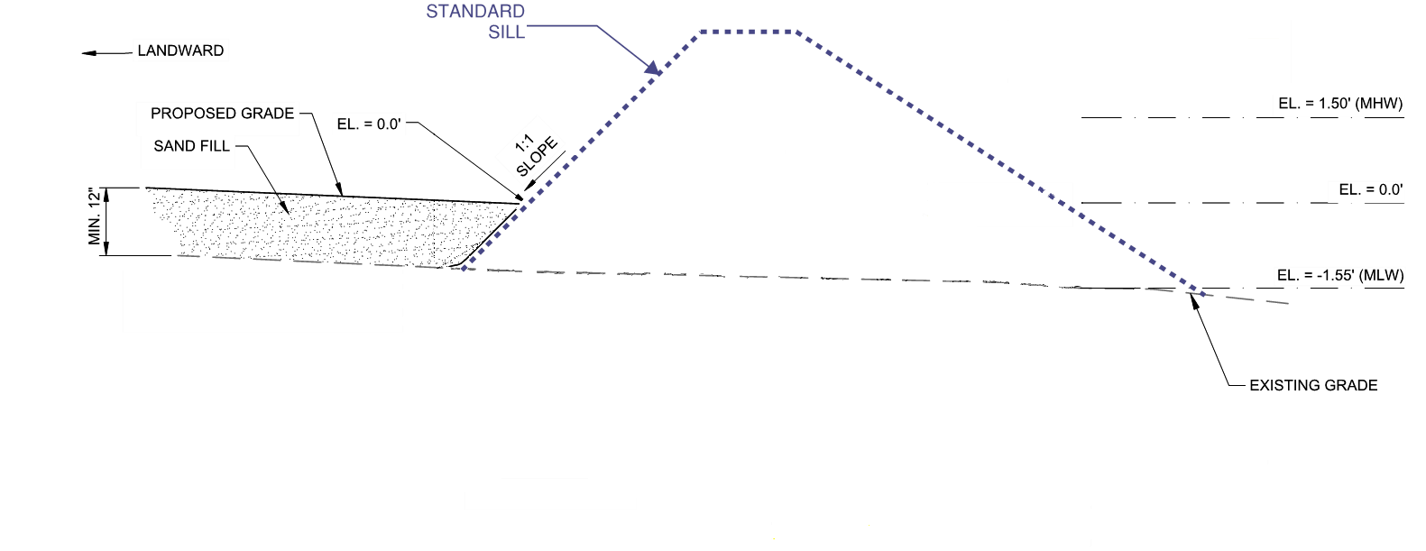
Typical Sill – Low to High Wave Energy
Set at MHW or Higher
Blocks Waves
Requires Low Windows or Breaks in Sill
Typically 1:1 to 2:1 Slopes
Larger Footprint
Marsh
River

Slide 12
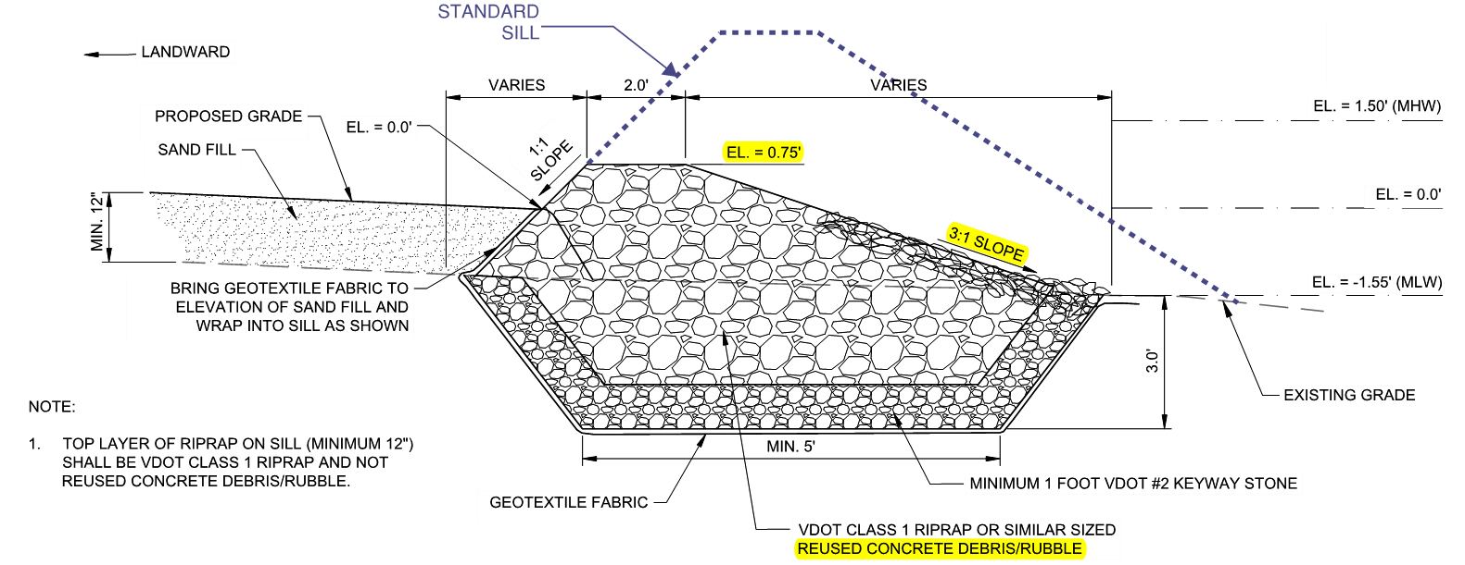
Sill Modification – Low to Medium Wave Energy
Trips Waves
Flatter Channelward Slope (3:1 vs 1.5:1)
Improve Wetland Flushing and Fisheries Connection
Considers Sea-Level Rise
Reuse Concrete Debris
Marsh
River
Notes:
Multiple modifications to standards but most notable was change in sill design. Coordinated w/ VIMS to experiment with a sill that would improve fisheries access to marsh grasses by designing low profile sill with a more gradual channelward slope.
Hybrid Sill – compilation of other sill designs used along Atlantic Coast
Selected height to trip waves rather than block them – initially set at mean tide range (MTR)---Considered sea-level rise at 50 years of 1.5 feet - adjusted up 0.75 feet so sill was still above projected MLW at projected sea-level rise elev.
Re-used conc debris and rubble from shorelines for foundation and sill core
3:1 channelward sill slope – more stable and smoother transition from riverbed bottom for mussels and other fisheries than typ. 1.5:1 slope
Allowed tidal wetland to be naturally flushed without need for windows which could create points of erosion to tidal wetlands during large storms
Improved fisheries connection providing a continuous area for access as opposed to single points – mussels migration onto Spartina provides added stability
More info behind the sill design, you can skip or summarize this if you want to:
Developed a Wind frequency analysis (similar to storm frequency) for the 1, 2, 5, 20 100 year probability for wind speeds. Used data in Automated Coastal Engineering System program (ACES-used by USACE on all coastal projects) to design sill.
Engineering Principles to provide solid foundation for Design and Basis of Design
Generated ‘Wind Return Period’ similar to what we have for rain events – used 30 years of historical wind data from airport
Looked at 1, 2, 5, 20, and 100-year wind event – 99.9%, 50%, 20%, 5%, and 1% probability of occurrence, respectively
Included TS winds as well
ACES for Wave Generation – used derived wind speeds to come up with potential wave heights at each site based on longest fetch from pre-dominant wind direction
Played roll in sill design for resiliency for larger storm events and sea-level rise

Slide 13
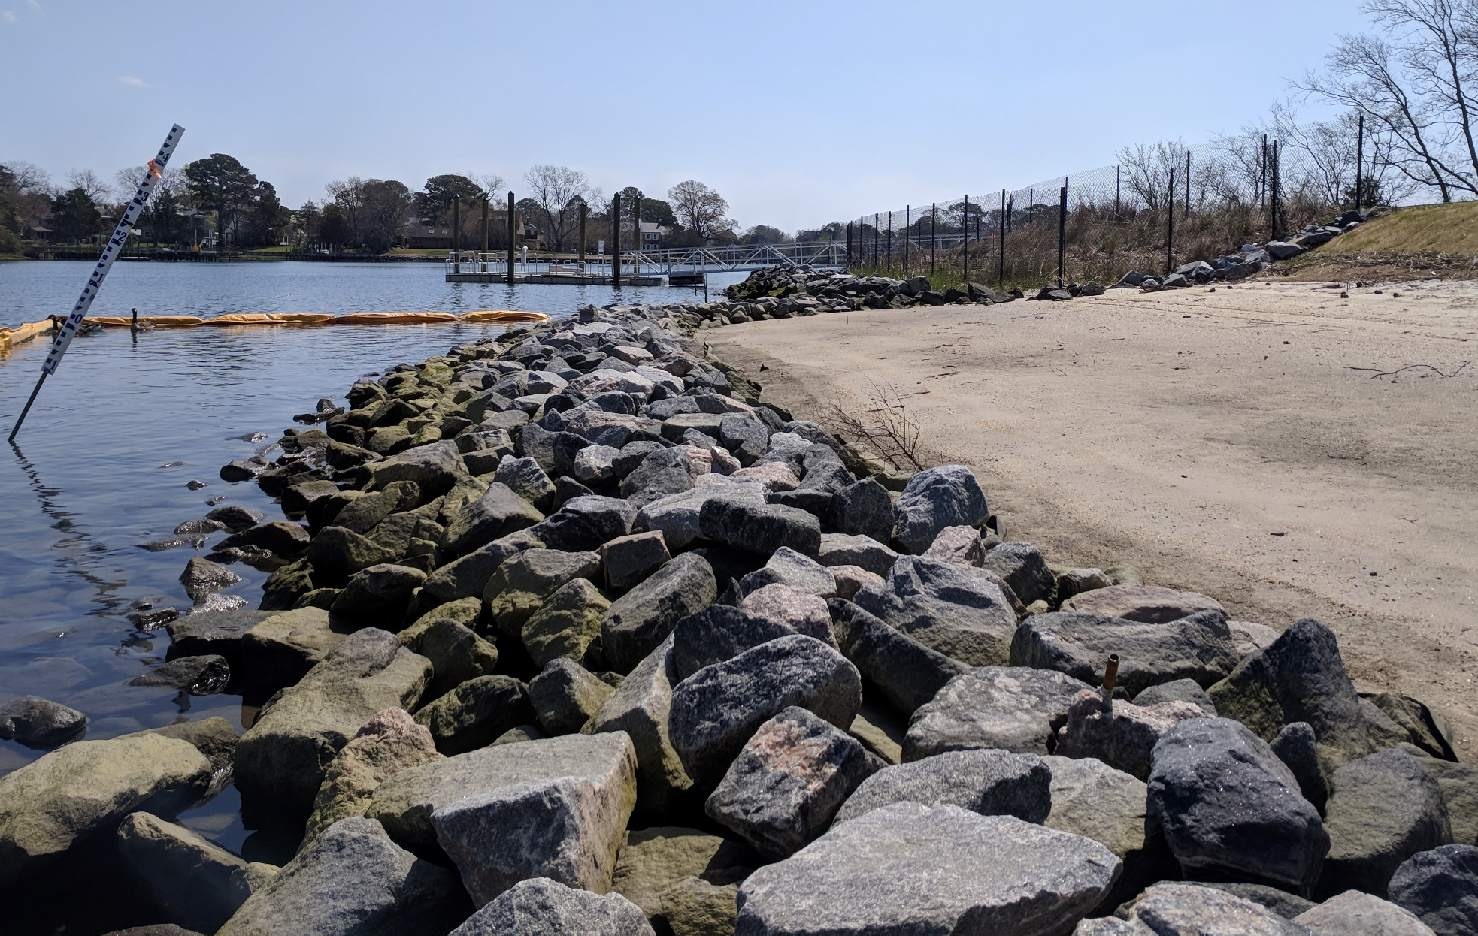
Standard Sill vs New Sill
Standard Sill
1.5H:1V Front Slope
Higher Top Elevation
Modified Low-Profile Sill
3H:1V Front Slope
Lower Top Elevation
Notes:
Photo taken at Beach showing our sill (foreground) next to typical higher sill (background).

Slide 14
Standard Sill vs New Sill
Modified Low-Profile Sill
Standard Sill
Notes:
Photo taken at Beach showing our sill (foreground) next to typical higher sill (background).

Slide 15
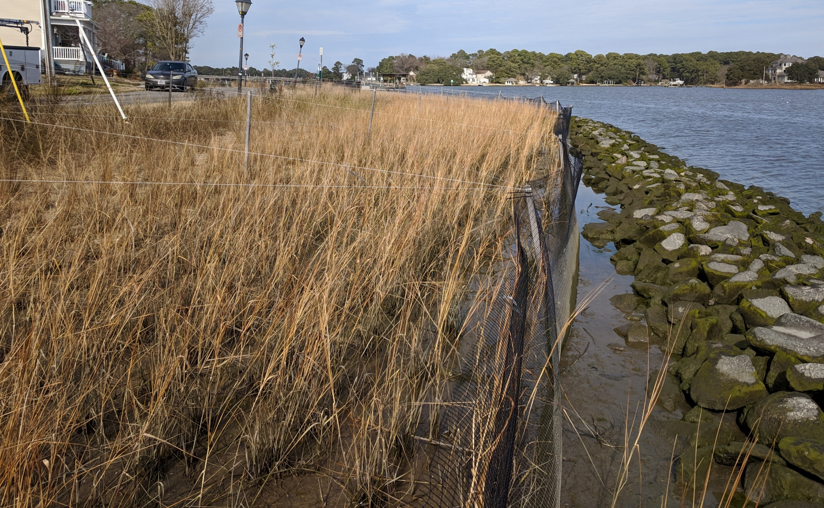
Extend Marsh Wetland
Pre-Project Edge of Shoreline
15’ From Sill
50% of Wave Energy Reduced Within 5 m (15’) of Marsh Edge (Leonard and Croft 2006)
Notes:
Marsh width 30-40 ft – focused on allowing spartina to reduce wave energy working with tripped waves from lower sill design.

Slide 16
Post-Construction

Slide 17
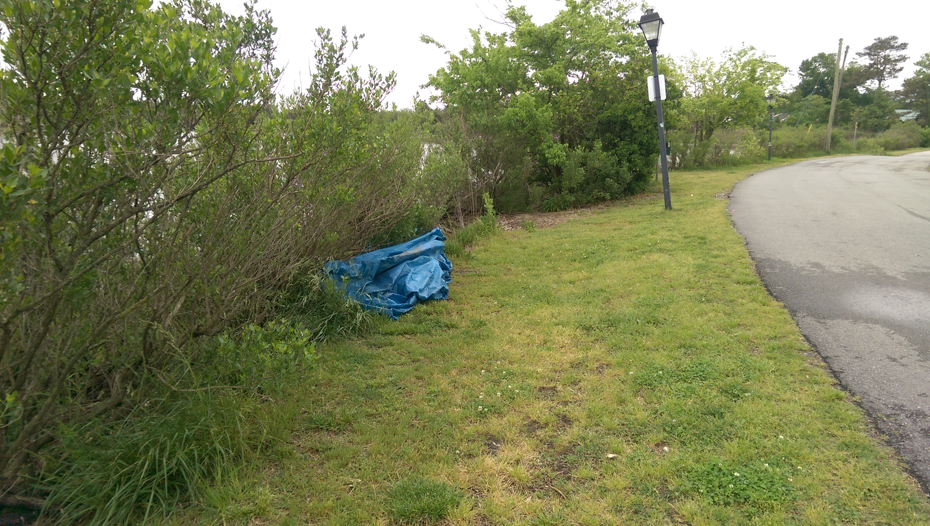
Beach Avenue
Before (2016)
Notes:
Bushes are edge of river bank – turf is ~ 8-10’ wide.

Slide 18
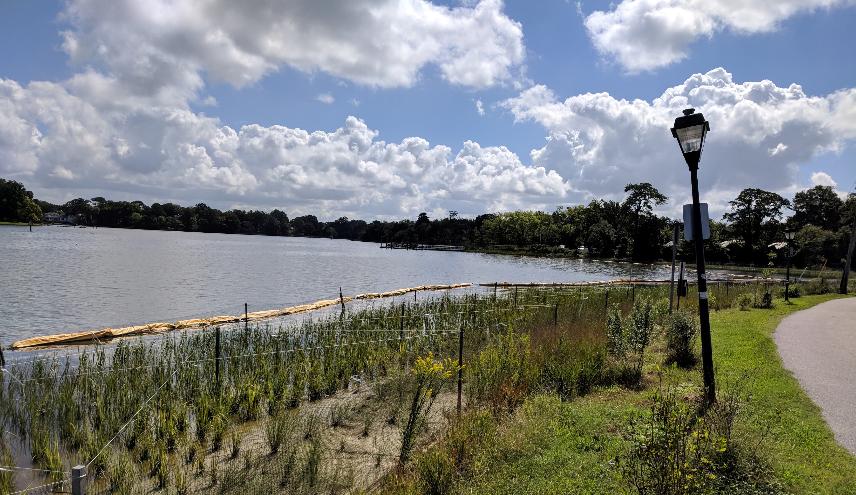
Beach Avenue
After (2018)
Notes:
~30’ of spartina marsh, switchgrass and native shrubs as riparian buffer.

Slide 19
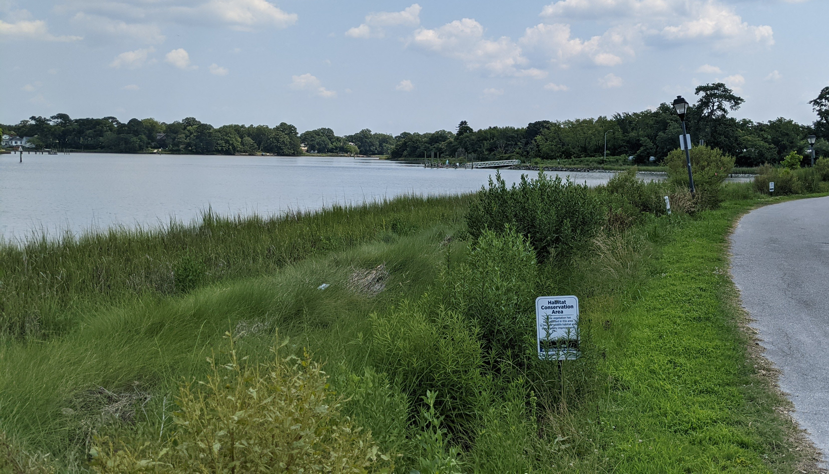
Beach Avenue
After (2021)
Notes:
~30’ of spartina marsh, switchgrass and native shrubs as riparian buffer.

Slide 20
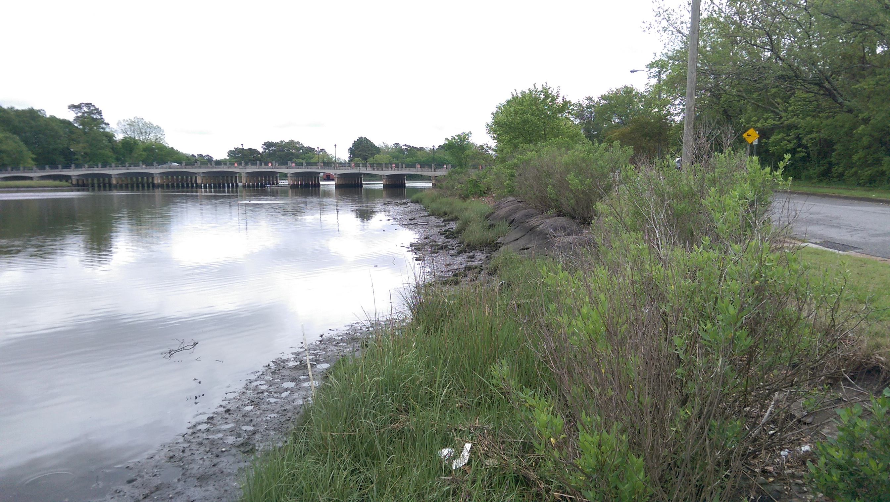
Villa Circle
Before (2016)
Notes:
Majority of banked stabilized by asphalt dumped along shoreline or concrete debris. Minimal spartina along shoreline

Slide 21
Villa Circle
After (2019)
Notes:
Asphalt removed from project, concrete debris re-used in core of sill
Now ~20-30’ of spartina buffer and stabilized riparian banks.

Slide 22
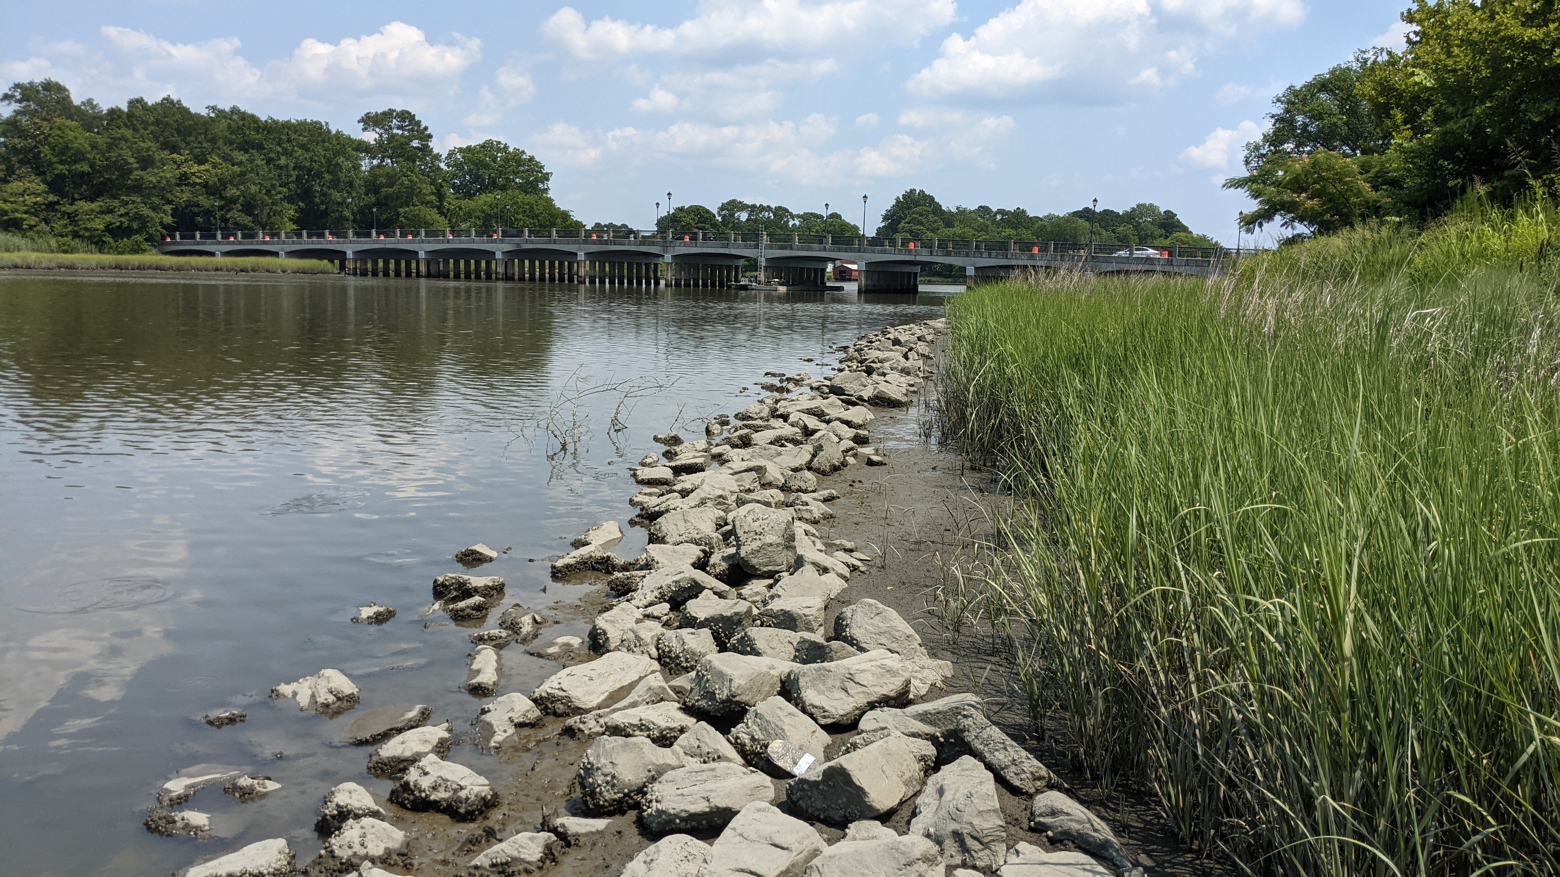
Villa Circle
After (2021)
Notes:
Asphalt removed from project, concrete debris re-used in core of sill
Now ~20-30’ of spartina buffer and stabilized riparian banks.

Slide 23
North Shore
Before (2017)

Slide 24
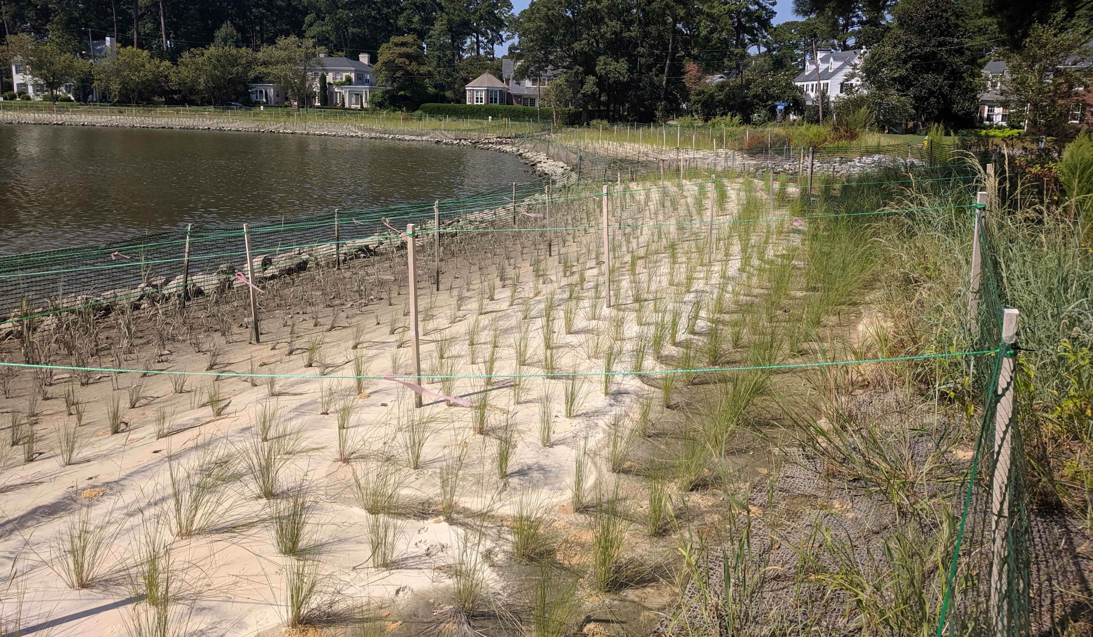
North Shore
After (2019)

Slide 25
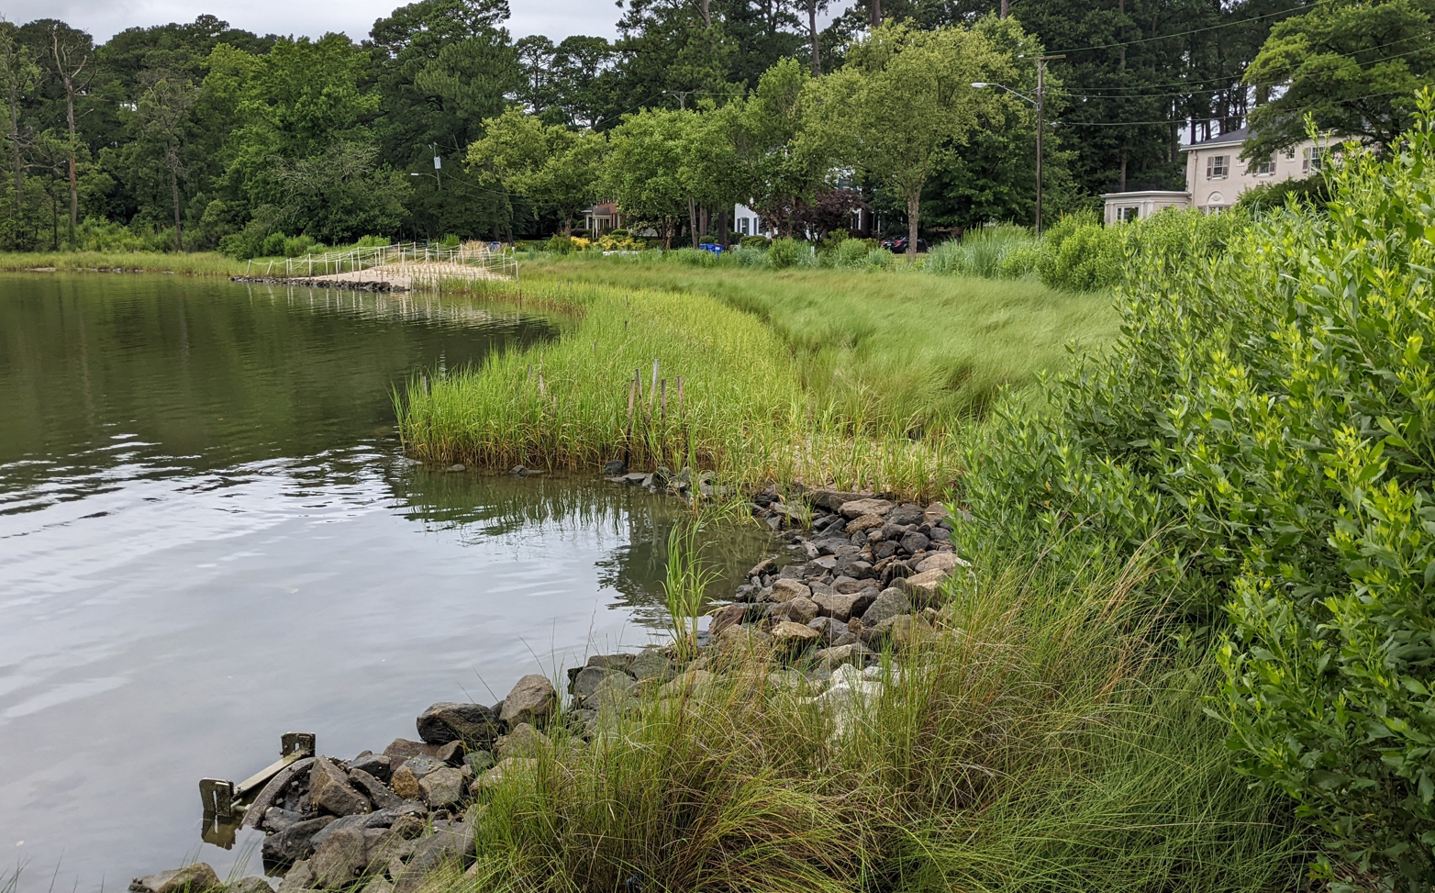
North Shore
After (2022)

Slide 26
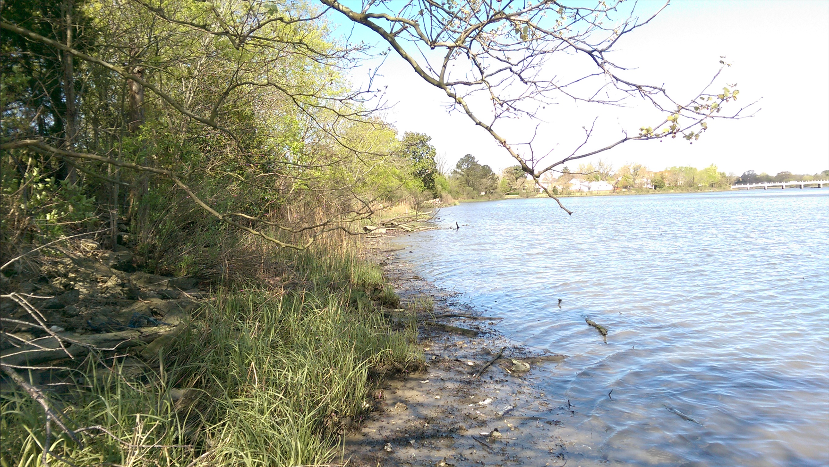
Lindenwood/Barraud Park
Before (2017)

Slide 27
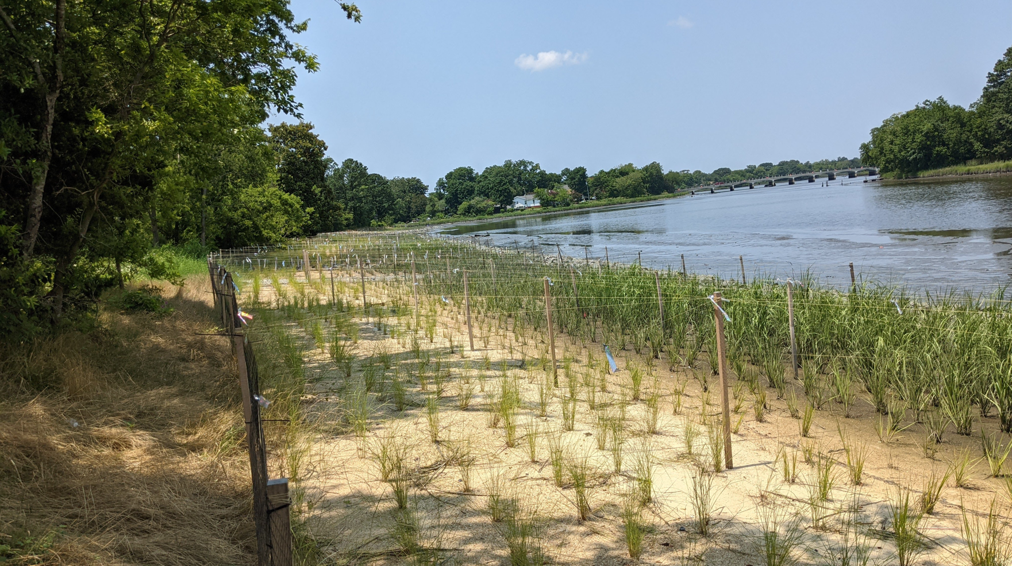
Lindenwood/Barraud Park
After (2021)

Slide 28
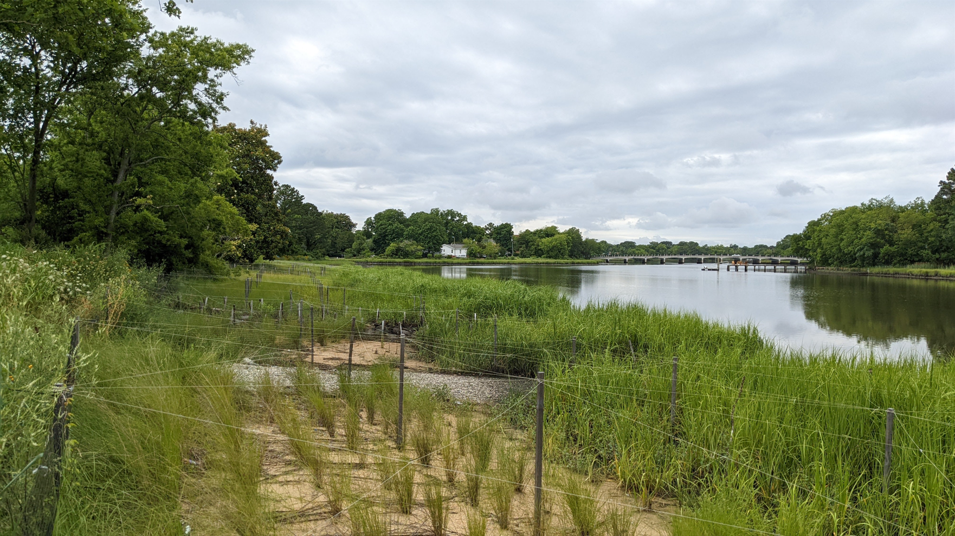
Lindenwood/Barraud Park
After (2022)

Slide 29
Oysters

Slide 30
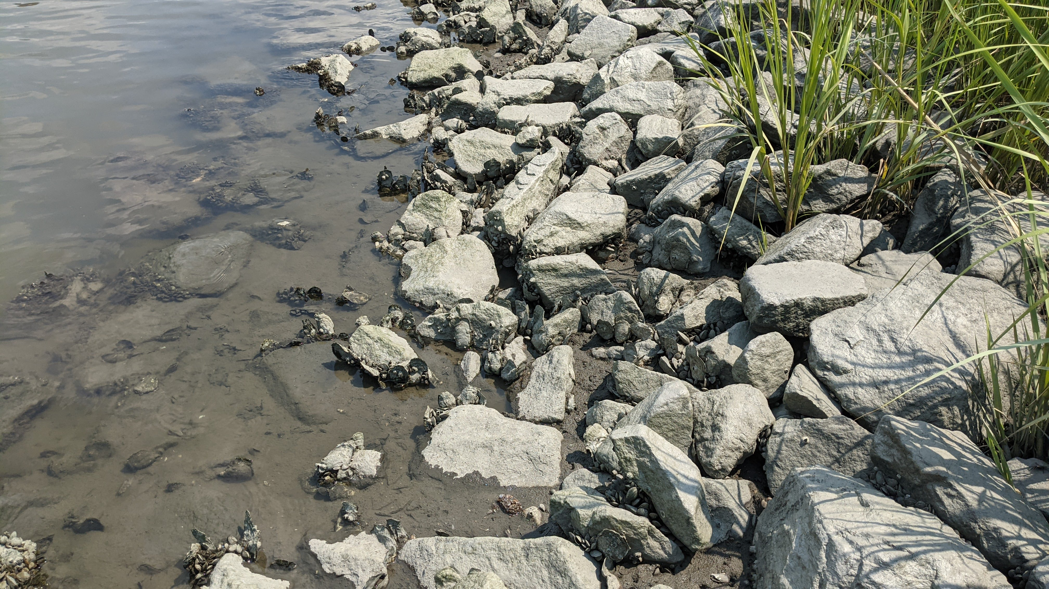
Beach Avenue
Oyster and Mussel Recruitment

Slide 31
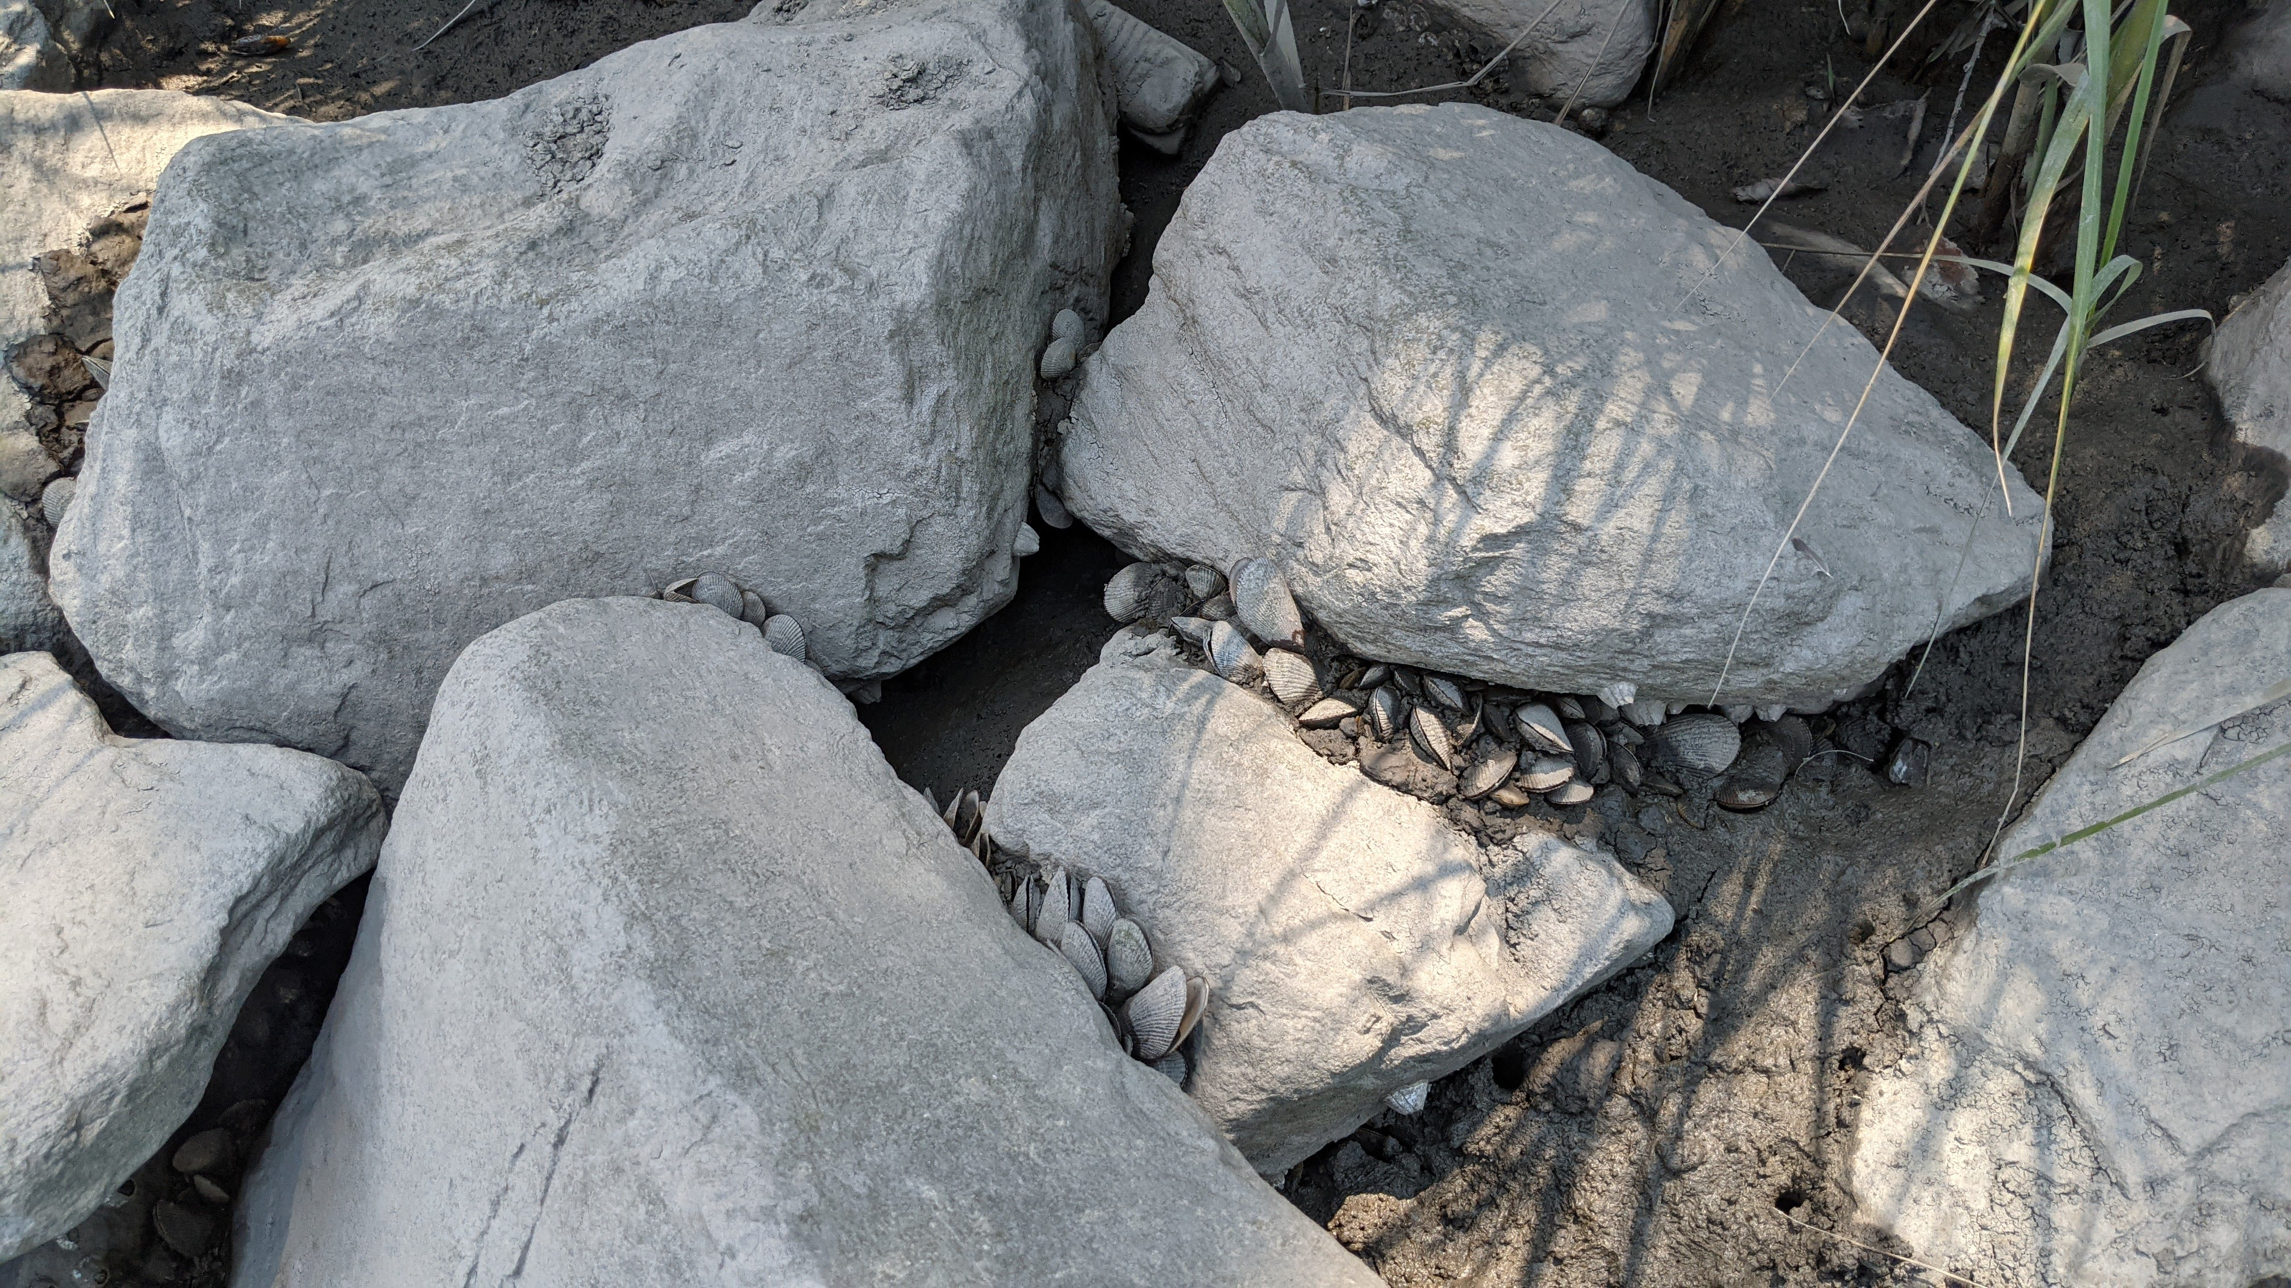
Villa Circle
Oyster and Mussel Recruitment

Slide 32
Lessons Learned
Specify Better Sand Gradation
Target Spring Spartina Planting
Extend Sand Settling Time
Notes:
Sand Gradation: We used the standard from VIMS and others and found it can become a poorly graded sand because it specifies requirements for large and then small gradations but misses the material in the middle. Have found that sand can be too fine while still meeting the VIMS requirement. Changing sand specifications to meet VDOT Grade A sand/stone – very similar to the VIMS specification but requires better gradation eliminating too much find sand.
Spring Planting: Spartina generally ok from Spring to early fall (October) but recommend requiring spring or early summer planting. Will allow plants to grow roots and become established before hurricane season and winter.
Sand Settling: We started with 1-2 weeks for sand to settle before grades were checked before planting. Recommend 2 weeks as a minimum with 3 or 4 being better. Have found settling occurred in some areas after planting making the areas have too long inundation time for spartina to flourish as young plants.

Slide 33
Thank you. Questions?
Ben Nash, PLA, Brown and Caldwell
919.424.1437
bnash@brwncald.com

Slide 34
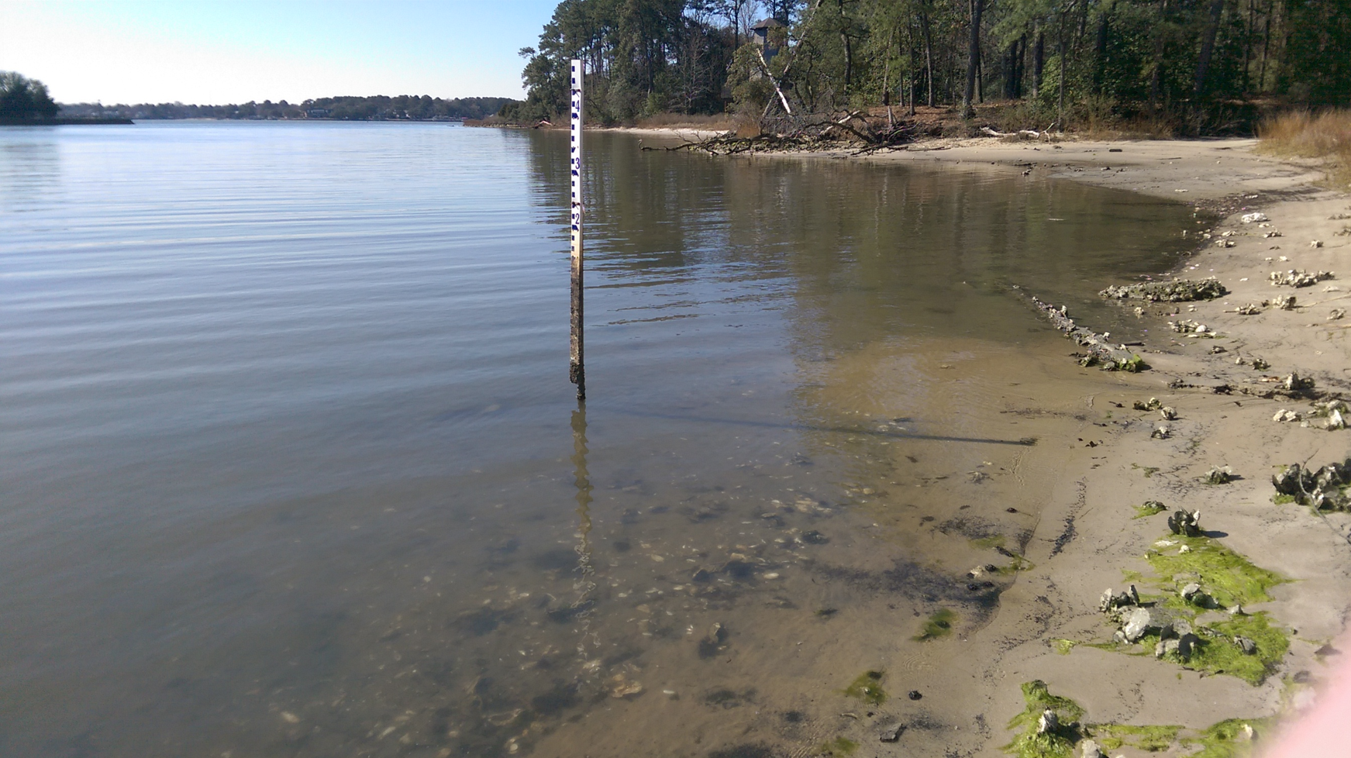
North Shore-Hermitage East Shoreline
Before (2017)

Slide 35
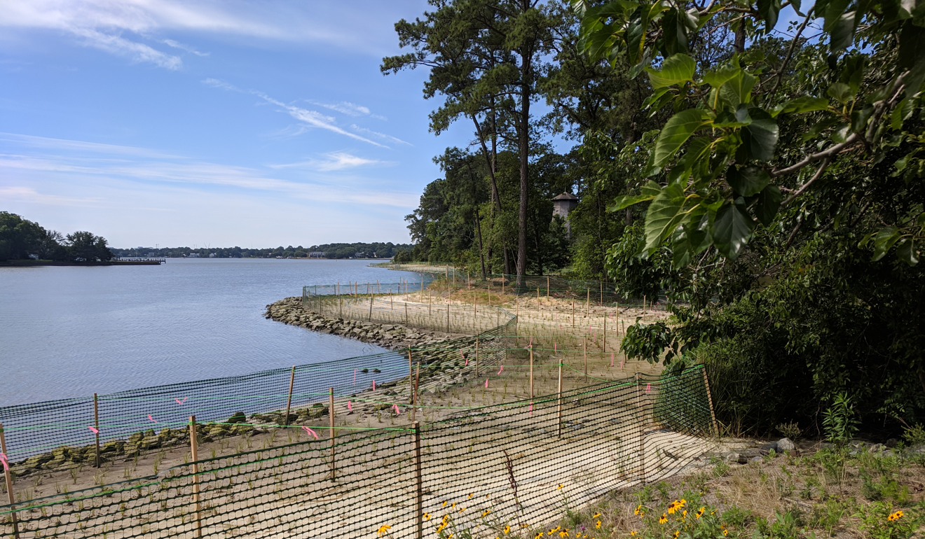
North Shore-Hermitage East Shoreline
After (2019)

Slide 36
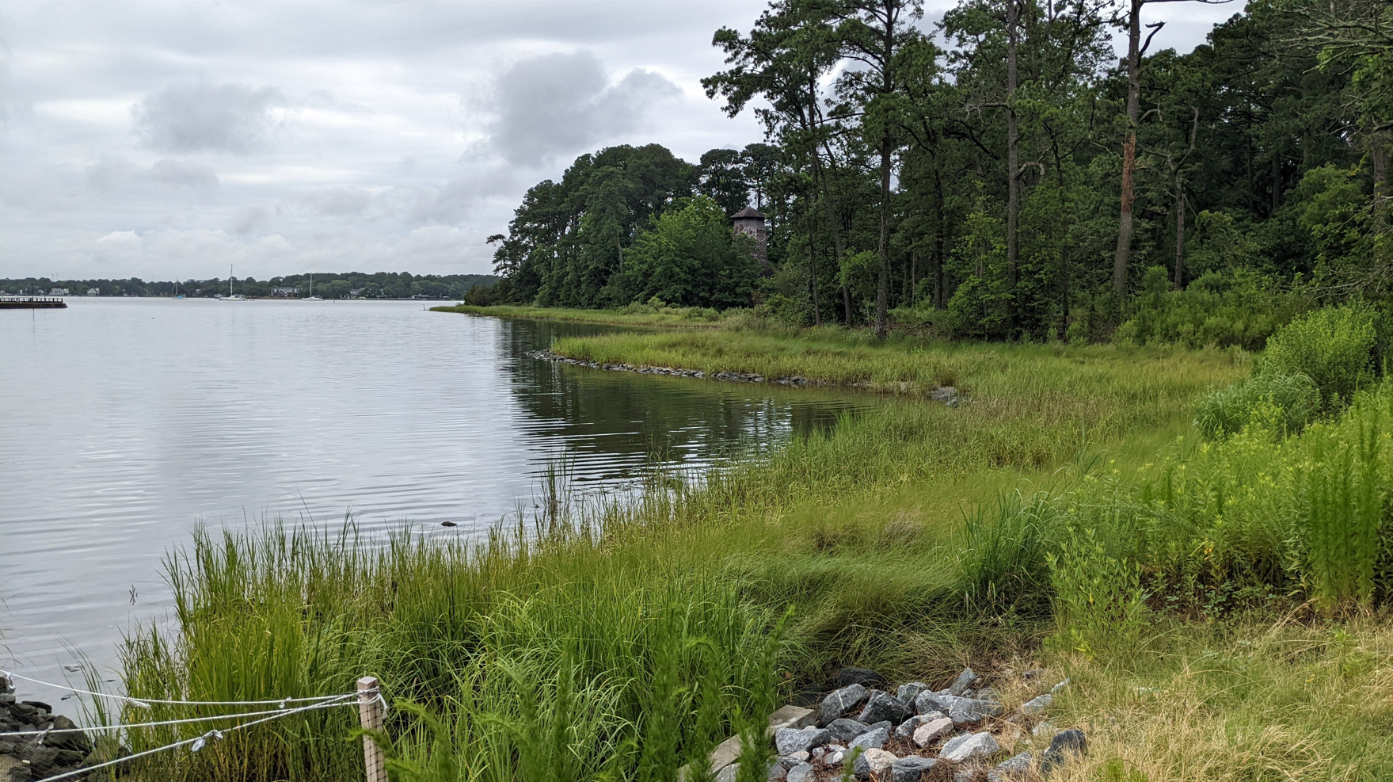
North Shore-Hermitage East Shoreline
After (2022)

