Slide 1
The N.J. Coastal Resilience Collaborative:
Building Partnerships and Networks
to Advance Coastal Community Resilience
MUNICIPAL WORKGROUP
Elissa Commins PE CFM, Workgroup Lead, Brick Township Engineer & Floodplain Manager, ecommins@twp.brick.nj.us
a multi-sector work group of the NJCRC that aims to identify and help overcome municipal obstacles to resilience in NJ's coastal communities.
Fosters partnerships
Quick access to resources, funding, and regulatory changes as they are being developed
Advocates for municipal representation in stakeholder committees
Identifies ways to combat regulatory inhibitions
Develops policy documents
Angela Andersen, Workgroup Lead, Long Beach Township Sustainability Director & Field Station Manager, andersen@longbeachtownship.com

Slide 2
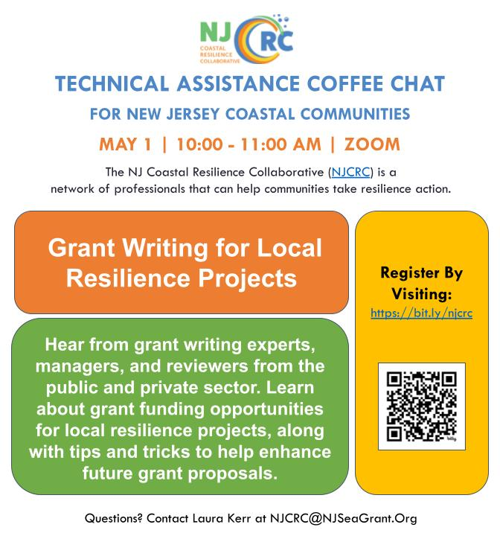
The N.J. Coastal Resilience Collaborative:
Building Partnerships and Networks
to Advance Coastal Community Resilience
TECHINCAL ASSISTANCE COFFEE CHAT WORKGROUP
Amanda Archer, Workgroup Lead, JC NERR Coastal Training Program, amanda.archer@marine.rutgers.edu
Devon Haines, Workgroup Lead, NJDEP CMP, Bureau of Climate Resilience Planning, devon.haines@dep.nj.gov

