Slide 1
Getting to Yes for Climate Action: Collaborative Methods for Speed in Project Approvals and Implementation
New Jersey Coastal & Climate Resilience Conference
March 12, 2024
Presenter
Chris Kane, P.E., J.D.
Notes:
Recent storms have messaged a compelling picture of our climate future in New Jersey. Societal reaction and actions have not mirrored the urgency of this message. The use of collaborative governance, consensus-building and mediation methods is necessary in order to rapidly and successfully Implement Climate Adaptation and Resiliency Projects.
However, time is truly of the essence. Losses from another single Sandy-type event could exceed the costs of the protection needed. Effective collaborative tools are available and must be applied to meet the need for speed in implementing building resiliency and adaptation projects. Improved conflict mitigation, early resolutions along with decision making, and mediation methods can help accelerate the path to reach sustainable solutions and avoid additional losses. My presentation will explore how mediators and facilitators can help those efforts by using some best practices in stakeholder engagement, interest-based negotiations and application of mediation. The goal is to demonstrate how these tools offer a real opportunity to translate resiliency needs in New Jersey, into broad-based support and creative long-term solutions on a much quicker timeline.

Slide 2
AGENDA
The Need For Speed
Climate Action Obstacles
Benefits of a Collaborative Process
Collaboration Tools
Case Studies
Sandy Insurance Claims
Rebuild by Design - Hoboken
Annapolis Maryland - City Dock

Slide 3
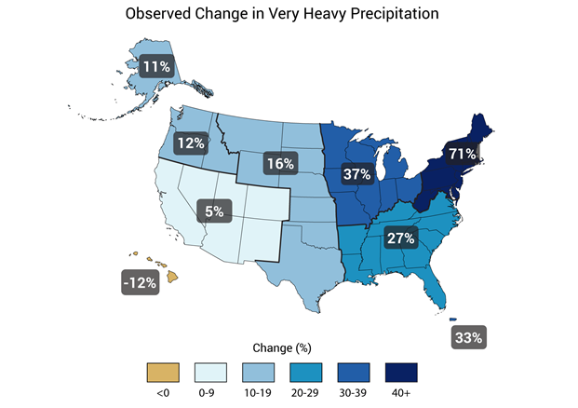
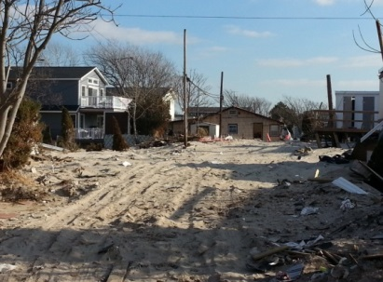
The Need For Speed
Climate impacts are accelerating.
Deteriorating infrastructure
Increasing storm intensity
Increasing sea level rise
Delays directly result in increased loss and damage.
Traditional project delivery can take decades - process is linear
Changes in administrations can stall or stop efforts
Conflicting interests can form adversarial lines that fail to talk and see common interests

Slide 4
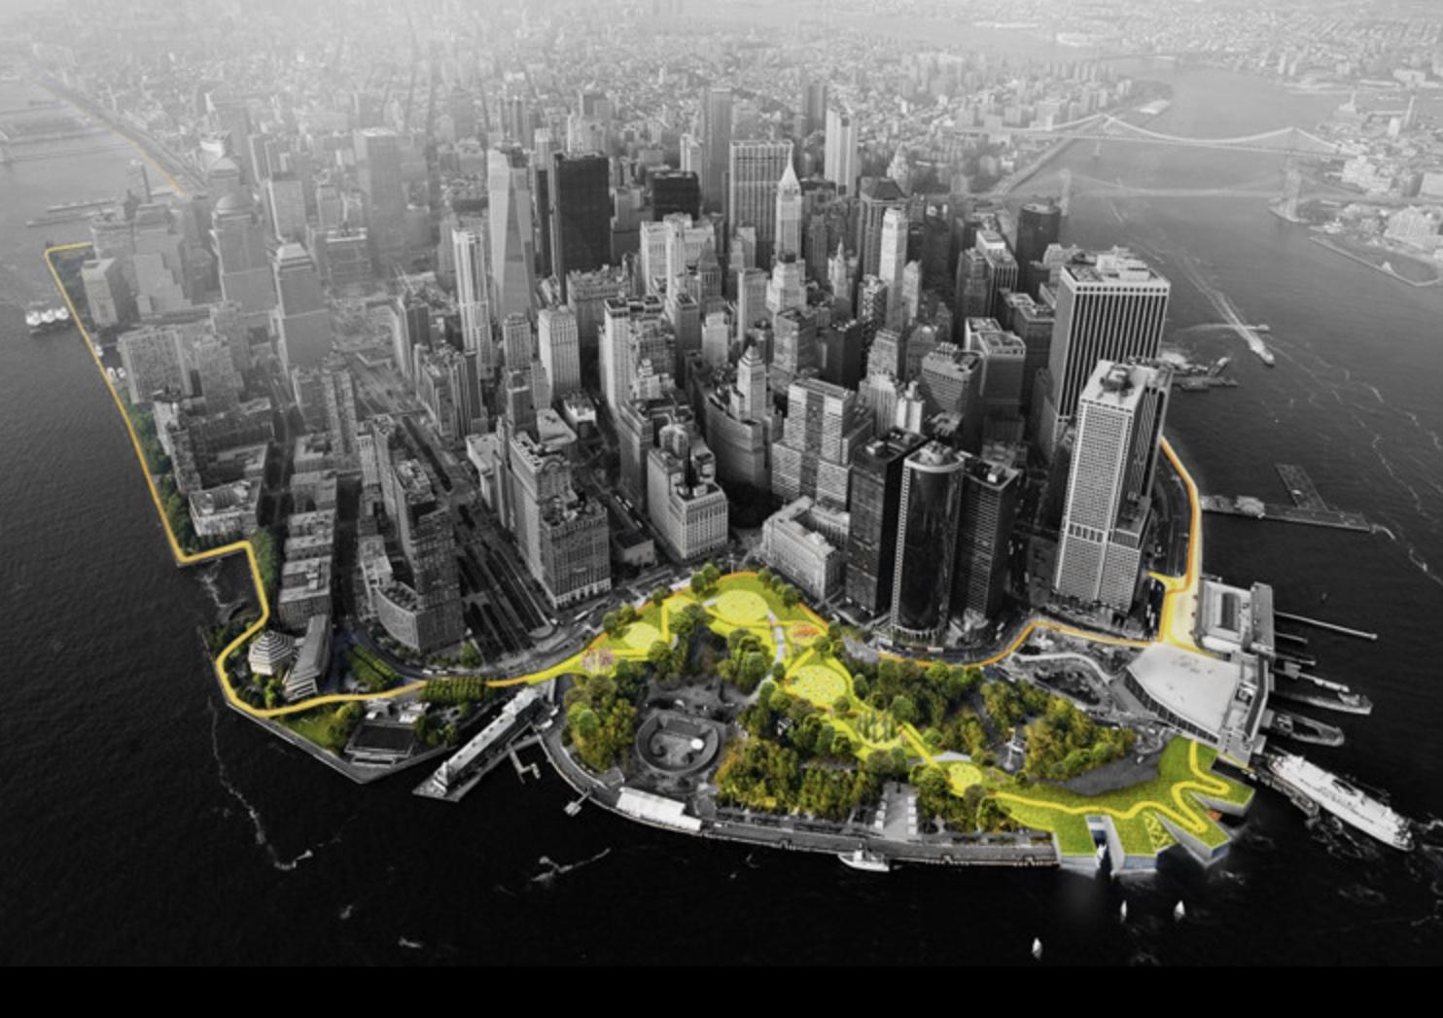
Climate Action Obstacles
Diverse stakeholders, jurisdictions and interests
Lack of a governance structure crossing jurisdictions
Funding shortages and need for long term O&M
Need for approval of assessment districts
Multiple permits and approvals
Disadvantaged groups w/o resources to participate
Resistance to “managed retreat”
Difficult decisions on design – FEMA Flood map
Notes:
A regional case in point, the resiliency and adaptation solutions of lower Manhattan are hampered by the numerous stakeholders, conflicting interests and slow project delivery methods. Ten years after Superstorm Sandy, only part of this area has begun building true flood protection infrastructure and another 15 years may be required to complete all of the protections. In the past, 25 years might be considered “quick” to conceive, approve, permit, finance, design and construct a multi-billion urban mega-project like this.

Slide 5
Potential Stakeholders
Local Businesses
Schools
Retail Malls
Neighborhoods
Parks and Recreation
Agriculture
Churches
Affordable Housing
Disadv. Communities
Federal and State Gov.
EPAs, DOTs, HUD’s
Regional, County Gov.
Municipalities
Suburban Communities
Chamber of Commerce
Economic Dev. Authority
EPA, Climate Change
Healthcare Facilities

Slide 6
Benefits of Collaborative Process
Engaging all stakeholders, even opponents, can prevent surprises and last minute opposition
Building cooperation among the parties and increasing confidence in the process
Improving understanding of facts, designs and differing technical opinions
Identifying all interests and major obstacles and maximizing mutual gains
Building broad consensus to withstand change of administrations - more than a simple majority
Setting up Collaborative Governance can cross jurisdictional boundaries, increase coordination

Slide 7
Collaboration Tools
Streamlining the Environmental Review Process and Building on the Lessons Learned
Use of Consensus Building for infrastructure Project Development and Decision-Making
Collaborative Use of Experts to build consensus on future weather-based design criteria and solutions
Use of Structured Negotiations to develop a viable and realistic Plan of Finance
Engaging Third Party Facilitators to help effectively manage multi-party Stakeholder Engagement
Use of Mediators to help the parties resolve difficult and Complex Issues and Disputes.
Using Public and Private Sector Collaborations with long term, risk/reward sharing Agreements .

Slide 8
Mediation Process
Benefits
Structuring
Need for an “Honest Broker”
Engaging all stakeholders
Building trust among parties and in the process
Improving understanding of facts and design
Identifying all interests and major obstacles
Building consensus - more than a simple majority
Recruit a “Public Champion”.
Engage a Mediator to help structure and manage process
Identify All Stakeholders/ Beneficiary and their interests
Perform Joint Fact-Finding, Cost/ Benefits Analysis
Conduct Sessions to inform, deliberate & get commitments
Advance to a Sustainable Written Agreement

Slide 9
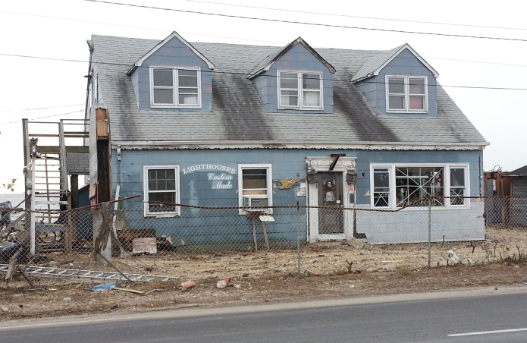
Superstorm Sandy NJ Insurance Claim Mediations
Voluntary for insureds; Mandatory for insurers
Insurers pay the fee for 2 hrs of mediation
AAA’s Program
Filings – 946
Closed - 922
Settlement rate – 67%
Satisfaction rate – 91%

Slide 10
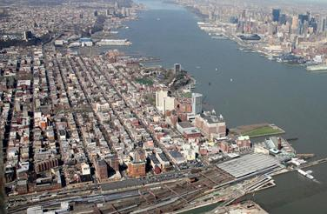
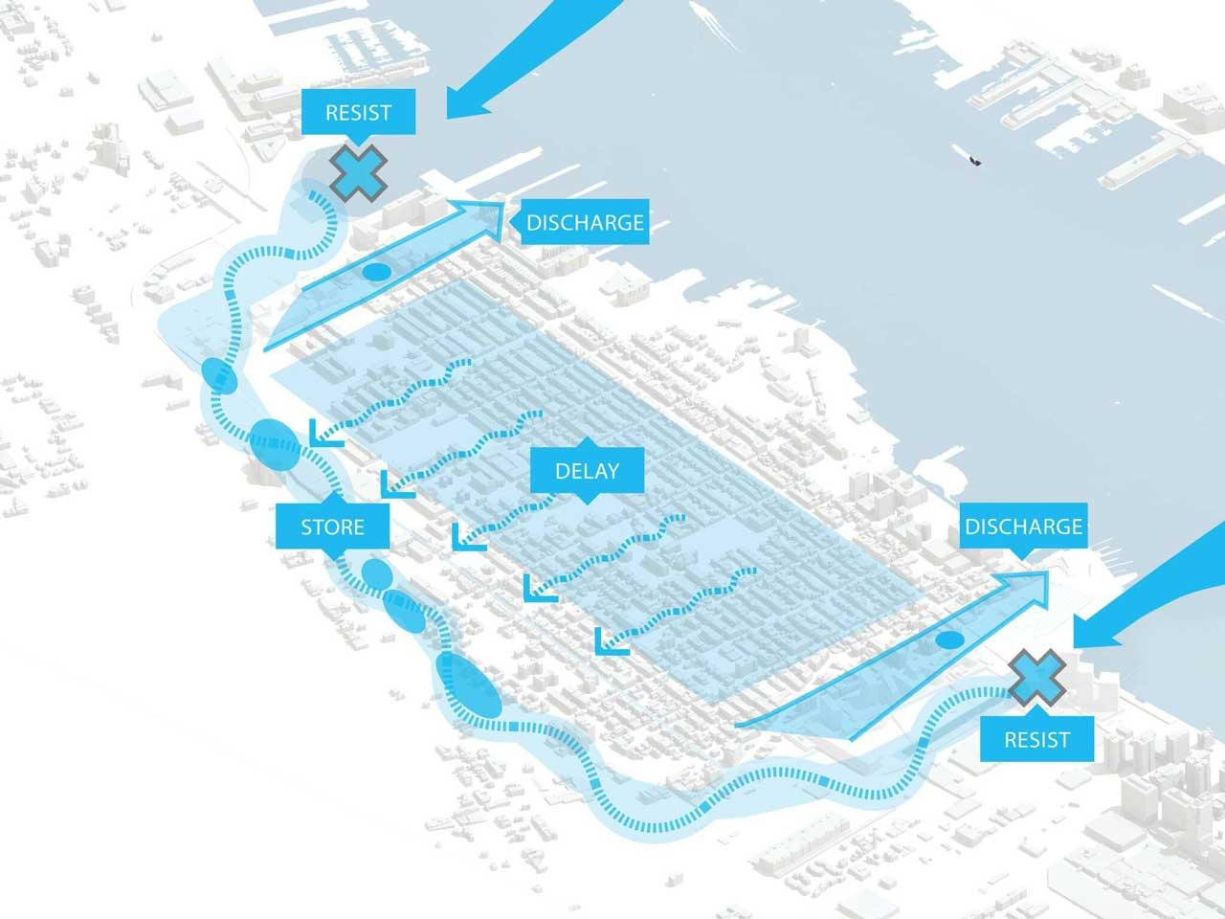
Rebuild by Design Hudson River (Hoboken NJ)
The Hoboken Coastal Resiliency Project was a response to devastation caused by Sandy.
Rebuild by Design is a non-profit organization founded in 2013 in response Sandy and sponsored a proposal by NJ state and local groups.
A consensus-building process considered the participants’ social, economic, engineering and environmental factors.
The resulting comprehensive storm water plan addressed impacts from coastal storm surge flooding and rain flooding experienced during Sandy.
10 years following Sandy, construction begun.

Slide 11
Annapolis, Md. Resiliency

Slide 12
Linking Parking Garage Rehab with City Dock Resiliency

Slide 13
Early Frustrations 2000-2018
Three or four garage committees led to no action.
Multiple City Dock improvement attempts led to minimal action
TOTAL LACK OGF PROGRESS
Merchants: “Don’t take away our parking!”
Taxpayers: “We’re not going to pay for this!”
Historic Annapolis, Inc.: “Save the Burtis House!”
African American Community: ”Make downtown available to our community!”
Boat Show Owners: “Don’t put up barriers!”

Slide 14
Consensus Building Process

Slide 15
Parking Garage Public Private Partnership
Maryland Econ. Dev. Corp., Concessionaire, provides:
Design & construction of Garage,
Operation & maintenance of Garage,
Charging & collection of Parking Fees,
Financing the Garage,
Concession Payment of $24.5M to the City.

Slide 16
Successful Collaborative Effort

Slide 17
Chris Kane, P.E., J.D - 609-802-6506 chris.kane@p3collaborative.com www.p3collaborative.com
Thank You!

