Slide 1
Municipal Support for Resilience Planning: A Model Climate Vulnerability Assessment
NJ Coastal and Climate Resilience Conference
March 12, 2024
Tanya Rohrbach
Notes:
Talking about a guidance resource that provides a Model CCRHVA (VA) and planning process for municipal resilience planning.

Slide 2
Regulatory Requirement
Law P.L. 2021, c6 specifically requires municipalities to:
1. Analyze current and future threats to, and vulnerabilities of, the municipality associated with climate change-related natural hazards;
2. Include a build-out analysis of future residential, commercial, industrial, and other development in the municipality, and an assessment of the threats and vulnerabilities identified above related to that development;
3. Identify critical facilities, utilities, roadways, and other infrastructure that is necessary for evacuation purposes and sustaining quality of life during a natural disaster, to be maintained at all times in an operational state;
4. Analyze the potential impact of natural hazards on relevant components and elements of the master plan;
5. Provide strategies and design standards that may be implemented to reduce or avoid risks associated with natural hazards;
6. Include a specific policy statement on the consistency, coordination, and integration of the climate change-related hazard vulnerability assessment with certain other plans adopted by the municipality; and
7. Rely on the most recent natural hazard projections and best available science provided by the NJDEP.
Notes:
(Background) In 2021, a law was passed to amend the MLUL. The new law requires that municipalities include a CCRHVA in the land use element of their master plans.
In basic terms, the law requires towns to analyze current and future threats and vulnerabilities associated with climate change in a municipality.
And it also has provisions that include providing in the VA --- a build-out analysis, identification of critical facilities, analysis of the alignment of the rest of the master plan with the VA, a policy statement about consistency of the VA with other local plans, and strategies and design standards to reduce risks associated with hazards identified in the assessment.
The law also requires that the VA rely the most recent hazard projections data and best available science provided by the NJDEP.
And it’s good that this requirement is in the master plan, bc that’s the municipality’s mechanism to guide appropriate development and to formulate the capital improvement plan. Both of which are key strategies for dealing with climate change impacts.

Slide 3
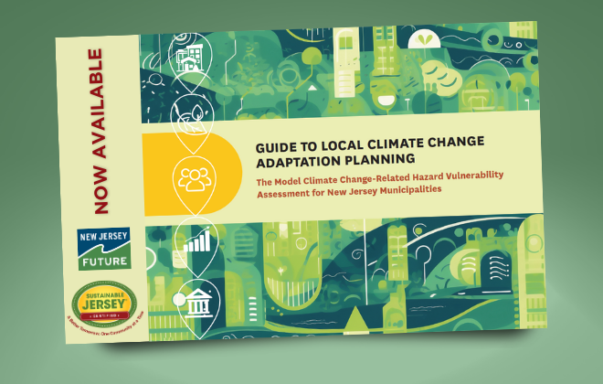
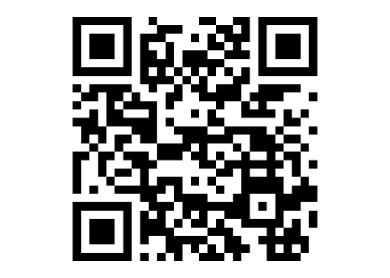
Practitioner’s Guide
Ask your planner to help you figure out the best approach for your community.
Detailed worksheets and methodologies through links within the guide.
Process Guide
Flexible approach, but comprehensive in information.
Practical Guide
Specifies steps that meet the MLUL.
Provides a pathway for going beyond the MLUL.
https://www.njfuture.org/ccrhva/
Notes:
That’s a lot for towns to work through, so we worked through a collaborative process to develop the Guide to Local Climate Change Adaptation Planning – to help towns and planners not only comply with the new law, but to also really advance local resilience beyond the minimum requirement.
You’ll find the guide online at the NJF website. (QR code and web page url)
You can download it there, and the only cost for you is to complete a very brief survey of just a few questions and to provide your email so we can do follow up to make improvements to the guide.
(there were a lot of stakeholders, so it has a lot of content.)
A few considerations.
Has a specific audience:
For practitioner –The main crux of the guide is in the outlined process and the detailed methodologies for analyzing vulnerabilities to climate hazards. So, this resource is designed for practitioners in various roles to use while going through the process.
Process – The guide is organized to provide resources where you’d encounter the need for them in the process. It is a comprehensive planning process to conduct a VA. But the guide doesn’t expect that every town will go through the process in the same way or at the same level. So, there’s flexibility built into it.
Practical – It will help towns meet the MLUL requirements, but going beyond the MLUL is what ultimately needs to be done, so this guide aims to make that easier for towns to do both.

Slide 4
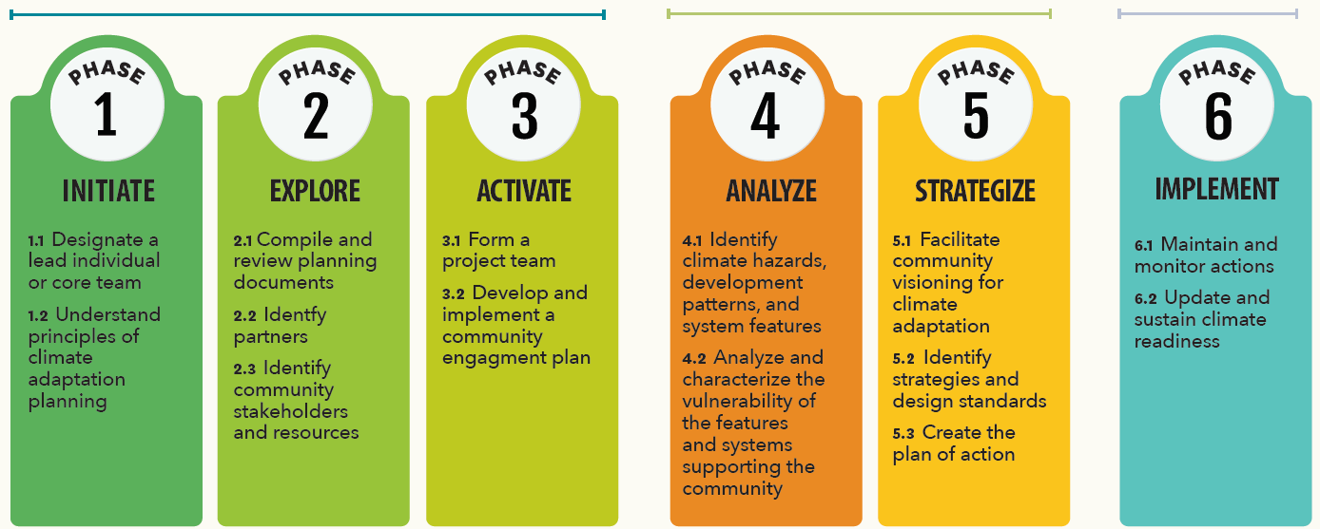
Inside the Guide
Maintaining and Tracking
Gearing up and Scoping
Analyzing and Prioritizing
Notes:
The guide is organized based on a planning process that falls into 3 parts:
It starts with gearing up and scoping,
to analyzing vulnerabilities and prioritizing strategies to address them,
to the last part of implementation, which isn’t really a discrete part because it’s about maintaining ongoing efforts to reduce vulnerabilities and be climate ready.

Slide 5
Inside the Guide
Notes:
Throughout this guide, there’s a focus on socially vulnerable populations and addressing disparities in the community. So, you’ll see an icon dedicated to community engagement activities to help you make the VA in your community an equitable process.
Everything involving analysis of vulnerabilities in the guide is organized around a systems approach, which is a framework for tackling the complexity of climate change impacts and the fact that all the different parts of society that we rely on can be affected by climate hazards.
The guide walks through analysis of features in the built, natural, social, economic, and governance systems supporting the community.
Anne will go through an example of this in a few minutes.

Slide 6
Part I: Scoping
What depth should the CCRHVA go into?
Minimal, moderate, comprehensive
What’s the end product?
Separate component attached to the Land Use Plan Element
Integrated into the Land Use Plan Element
Who should be involved?
Who will lead the process - staff?
Who will produce the deliverable – planner?
Roles of participants - Level and type of volunteer and community engagement?
Notes:
Part I walks you through Gearing up and Scoping. This is where you start putting the pieces in place to really dive in with efficiency and collaboration.
Here you’ll compile data and information about your community so that you can go into the analysis of vulnerabilities with that background knowledge and appropriate levels of stakeholder engagement.
As you’re starting, consider these questions:
What Depth will you go into? – a good VA includes all the components in the guide, not just the technical analysis, and not only looking at selective hazards or assets.
The VAs we’ve seen so far are what we’d consider as a “minimal” assessment by showing the FEMA flood map and maybe including some other information about historical hazards from the HMP.
But most towns probably need to go deeper to look at other hazards, projected hazards, and other features besides just built infrastructure.
End product – We’ve also seen VAs that simply attach some information about hazards to the master plan, without any integration or connection to the master plan. Ultimately, the VA should be the basis of the LUPE, and maybe this occurs over time, but think about how to get there.
Who will do this work? - The first steps of the guide have to do with setting up a lead and making sure you have the technical expertise to do the level and depth of VA that’s needed. At the start of a VA, it’s good to think about the expectations of who would do the work of: leading the project, analyzing vulnerabilities, and engaging the community.

Slide 7
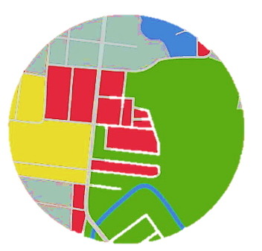
Part II: Analyzing
Step 4.1
Identification of climate hazards
Development analysis – compare climate hazards to zoning
Identify critical facilities and other important features
Notes:
Part II provides a methodology to analyze different features in the community to assess their vulnerabilities to climate hazards.
There are a number of data sources and tools to use to do this, including the Rutgers tools we’re hear about in a little bit. The Guide includes instructions on how to use these tools to produce outputs for a local VA.
Before you can start analyzing vulnerabilities of community features, there are a few steps in the process that can’t be overlooked:
Identification of hazards – This might sound like it’s the whole VA, but hazards identification is not a VA. You’ll find information about hazards in your local HMP, through other resources provided in the guide, and by talking to people in the community.
Development analysis – for many (most?) towns, changes to zoning is likely to be a primary strategy for reducing vulnerabilities. The development analysis outlined in the guide is an initial step to evaluate your zoning in relation to hazards. “Hazards” includes more than just flooding. Heat, wildfire, and landslides are examples of other climate hazards that need to be evaluated in this entire process, including here in this evaluation of zoning bc they are spatial. This is also where you’d do the build-out component required by the MLUL.
Identification of critical facilities and other important features. - This is not only pertaining to assets, bc things that are not assets, like hazardous waste sites, could be very important from a vulnerabilities perspective. It’s a requirement of the MLUL to identify critical facilities, and the community should use a broad definition in defining what facilitates are critical for the community.
Other built features might be important and not rise to the level of critical. Any features considered critical or important should be analyzed in the vulnerability assessment in relation to climate hazards. They can be analyzed as a group, and you don’t need to inspect every single feature thoroughly in order to assess vulnerabilities to your built infrastructure.

Slide 8
Part II: Analyzing Vulnerability = Exposure x Sensitivity x Adaptive Capacity
Step 4.2
Analyze exposure and sensitivity of features
Not binary – Use a qualitative vulnerability key.
Types of Data to use – GIS/mapping, interviews, documents review, lived experiences.
Worksheet 4.2.a Analysis Workflow – provides a methodology, including links to data and tools, what to do for the analysis, what outputs you should put in the CCRHVA, and what those outputs can tell you about vulnerability.
Analyze adaptive capacity
Worksheet 4.1.c Municipal Governance – to analyze adaptive capacity of the municipality.
Phase 5
Steps to identify strategies and prioritize them to do something with the information learned in the CCRHVA.
Notes:
The remainder of Phase 4 walks through analyzing exposure and sensitivity of features to climate hazards and evaluating the municipality’s adaptive capacity to address the vulnerabilities.
The analysis methodology moves away from a binary understanding of vulnerability (in the flood hazard area vs. outside it). Instead, it doesn’t come at this from the perspective of the hazard, but rather by looking at the feature and how vulnerable the feature is to the hazards. There’s a detailed worksheet linked in the guide to walk you through that methodology.
Vulnerability for a feature is high when exposure is high, sensitivity to experiencing harm is high, or adaptive capacity is low.
The guide provides a vulnerability key to assess these three components of vulnerability.
Not everything in here will be applicable to every town. (diverse towns in NJ, so a lot is in the guide) That’s why you need your professionals, along with stakeholder input, to navigate this process so that it’s data-accurate.
What really makes this an assessment of vulnerability and not just a hazards analysis is the evaluation of adaptive capacity.
This is critical because it assesses the municipality’s ability to cope with climate change in the long-term.
Is the municipality prepared to make the necessary changes to the way things are done in order to adapt to the risks posed by climate hazards?
After analyzing vulnerabilities, the next phase (Phase 5) is to identify strategies based on the analysis, including strategies to improve adaptive capacity. Identification of strategies and design standards is a requirement of the MLUL.

Slide 9
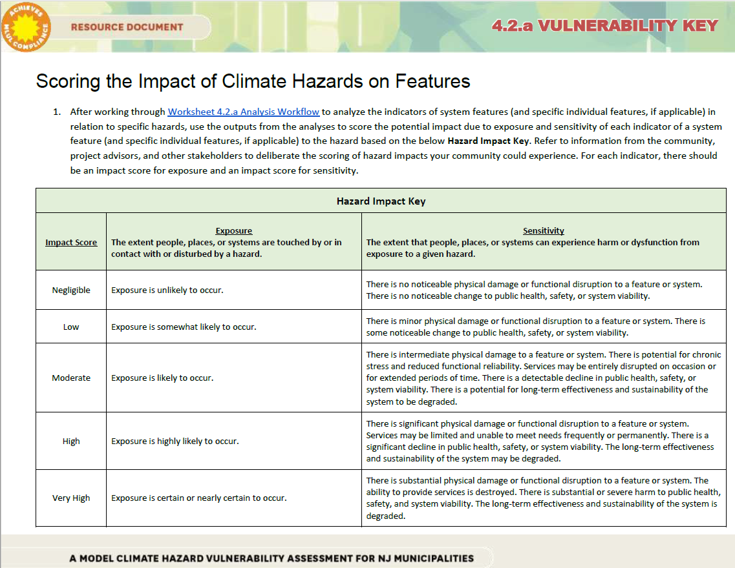
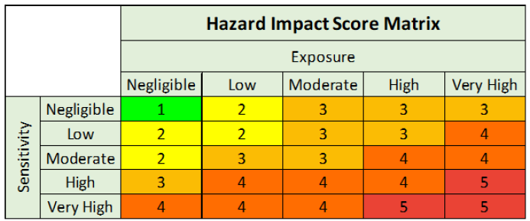
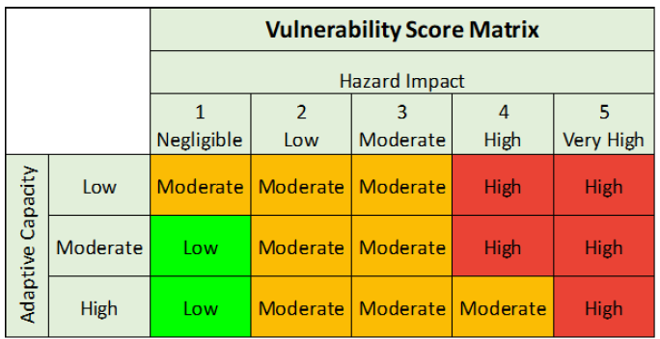
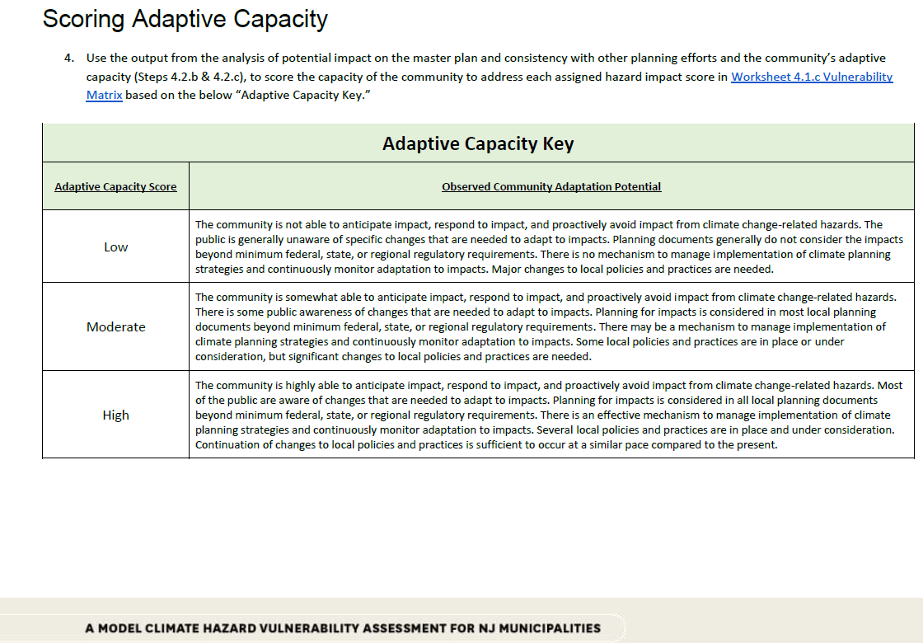
Notes:
Don’t forget to give an assessment of vulnerability. There are some VAs that describe flood hazards, but then don’t say anything about the level of vulnerability.
The vulnerability key provided in the guide is a tool to help towns articulate vulnerabilities.
Using the key, scores get assigned to features based on: the outputs of the analysis, stakeholder input, and deliberations.
The vulnerability key helps you put scores on hazard impact, which is exposure and sensitivity, and on overall vulnerability (which includes adaptive capacity).

Slide 10
Notes:
We’ve got a spreadsheet for you to plug in and sort values.

Slide 11
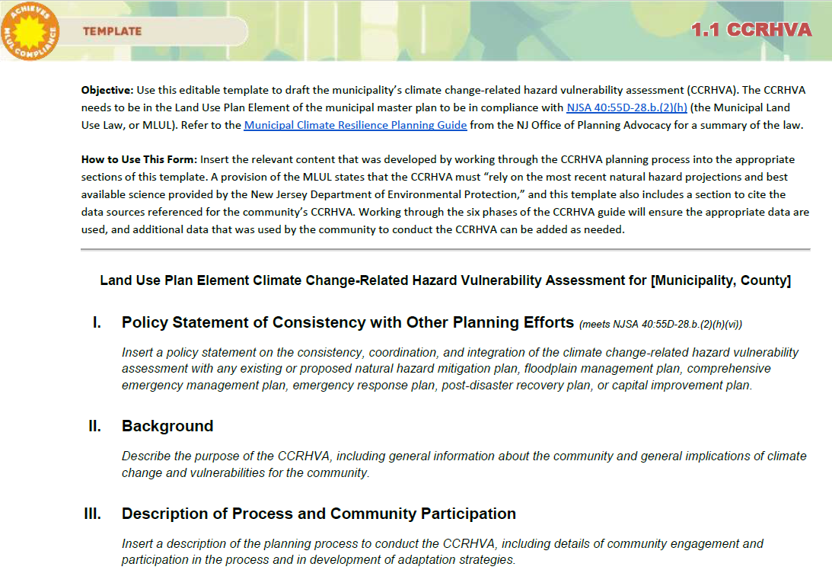
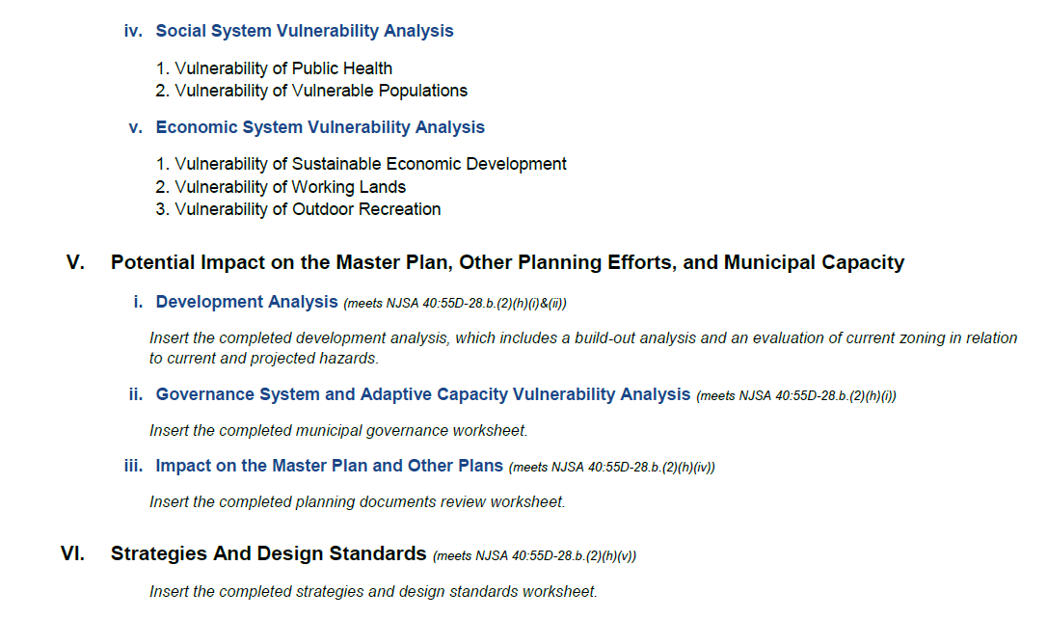
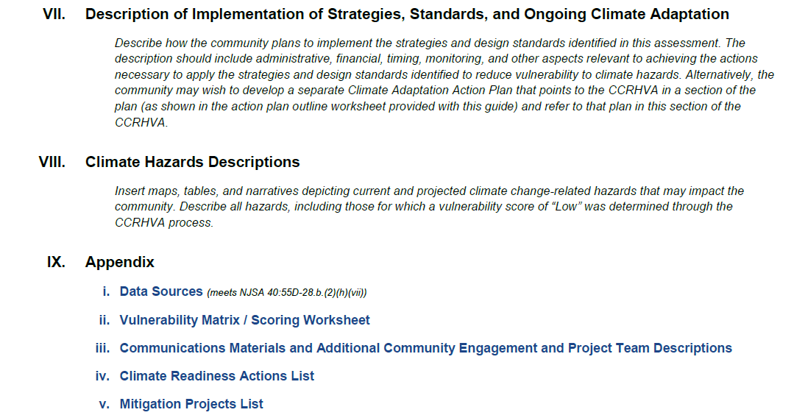
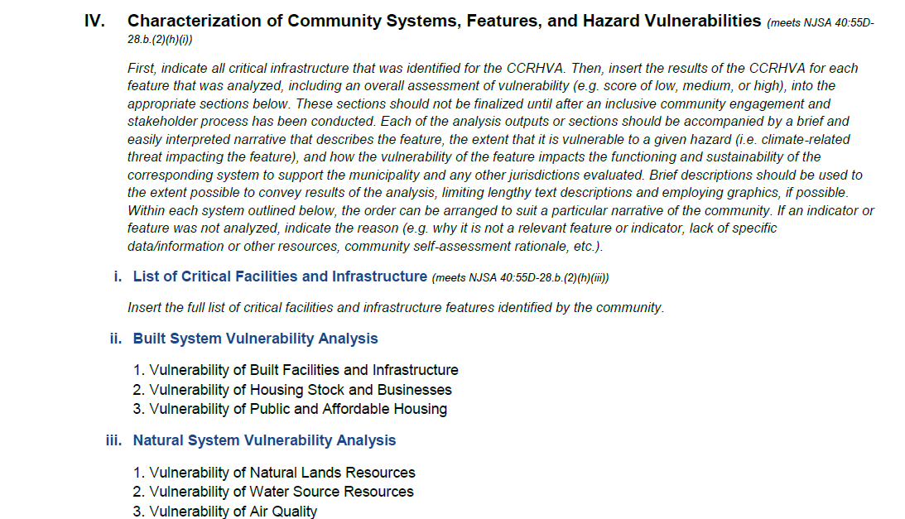
Notes:
Then the information about vulnerabilities, hazards, and the process to conduct the VA gets compiled into the CCRHVA document.
Here’s the CCRHVA Template provided with the guide.
It includes all the provisions of the MLUL so you can see how the regulation intersects with a comprehensive VA.
Notice that the description of climate hazards is at the end. That’s because the VA shouldn’t be a repeat of the HMP or try to be a mini HMP. It should focus on vulnerabilities in the community.
Since this would go on to be an element of the master plan, it’s expected that the municipal planner would play a big role in creating the actual VA document, even if other people contributed throughout the process.
In this guide, we provide this template for the VA to be a standalone document. We are working on a template for the LUPE so that, if towns chose to take that route, the VA can be incorporated into the LUPE as an integral part of it.
This is ultimately the purpose of doing the VA – to use this information in all municipal planning so that we can proactively adapt our communities to climate change.

Slide 12
Part III: Implementation
Phase 6
Implement strategies and design standards
Integrate the CCRHVA throughout the master plan, with the CIP, and other plans
Use the outputs of the CCRHVA in the description of current conditions and then set goals for future conditions while addressing hazard vulnerabilities identified in the CCRHVA.
Sample policy statement on consistency, coordination, and integration of the CCRHVA with other plans (in Phase 4).
Notes:
The last Phase of the guide is to get you started to act on the information learned in the VA. It’s important to do this follow-through to make sure the VA gets integrated into all local plans, policies, regulations, and decisions.
The main thing is that the VA becomes the foundation for the master plan and capital improvement program. It helps to describe the current conditions in the municipality and set goals for a future that’s climate ready.
The guide also has a sample policy statement on the consistency, coordination, and integration of the VA with other plans. Such a policy statement is required by the MLUL.
In the guide, all the things you need to do to meet the MLUL are included in Phase 4, so that’s where the sample policy statement is. But I put it on this slide because that’s where it fit best for the presentation.

Slide 13
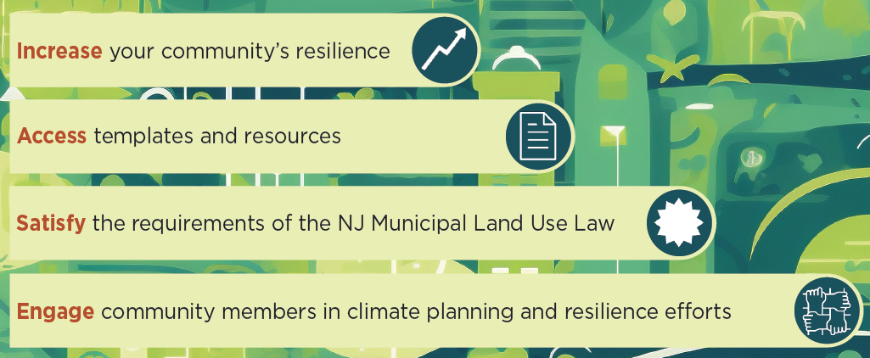
Protect and Strengthen Your Community
Notes:
Wrap up by saying that we all need to get serious about protecting and strengthening our communities in response to climate change because so many facets of our lives are impacted.
The Guide to Local Climate Change Adaptation Planning is a Model resource for doing this in a holistic way – addressing all the key features and systems that support a community.

Slide 14
Provide Feedback
Download the guide
https://www.njfuture.org/ccrhva/
Email me
trohrbach@njfuture.org
Notes:
Please download the guide and provide your perspective through our extremely brief download survey, and then you can provide feedback on the guide if you’re contacted when we do our follow-up.
Or you can email me at trohrbach@njfuture.org.

Slide 15
Municipal Support for Resilience Planning:
A Model Climate Vulnerability Assessment
March 12, 2024
Anne Heasly, Program Manager for Policy and Planning
Notes:
Thank you Tanya, and
Thanks also to the NJ Coastal Resilience Collaborative for the opportunity to talk to you today.
I’m Anne Heasly, Program Manager for Policy and Planning at Sustainable Jersey,
I’m going to spend a little time going a bit deeper in the guide with an example, and before I do that,
Will spend a couple minutes talking about resources your community can use to assist you in being climate ready available from Sustainable Jersey.
.

Slide 16
Statistics
Notes:
I’m hoping that many of you are familiar with Sustainable Jersey –
For those of you who may not be
Sustainable Jersey, it is a nonprofit organization administered by the Sustainability Institute at The College of New Jersey that provides tools, training and financial incentives to support communities as they pursue sustainability.
The program culminates in a certification award to municipalities and schools that have documented meeting a set of rigorous standards found in our different actions.
Since the program’s start in 2009, 83% of New Jersey municipalities are participating in the program, encompassing 91% of New Jersey’s population.
In the presentation today, I’ll discuss the Sustainable Jersey municipal program, but I do want to mention that the Sustainable Jersey for Schools program has a lot of great resources for public schools to meet the requirements for climate change education.

Slide 17
Interim Guidance
Notes:
One of the main tools we use to help municipalities advance sustainability is our actions – numerous and wide ranging – provide a recipe for local action – how to go about making change.
In 2022 with support from NJDEP we prepared some interim guidance to help municipalities use our actions – to advance in the responses to climate change - NOW. While it would be great if all municipalities took the time to assess their vulnerability to climate changes and use the Guide - we know that some of you might have just completed a master plan update and the MLUL doesn’t dictate when your community must complete the vulnerability assessment.
Right now you can get an understanding of your communities vulnerability to heat island impacts by undertaking our Heat Island Assessment and Mitigation Action; or you can undertake our Green Infrastructure Actions - to retrofit your community and reduce paved areas or use our Enhanced SWMCO action to better manage stormwater from future development.

Slide 18
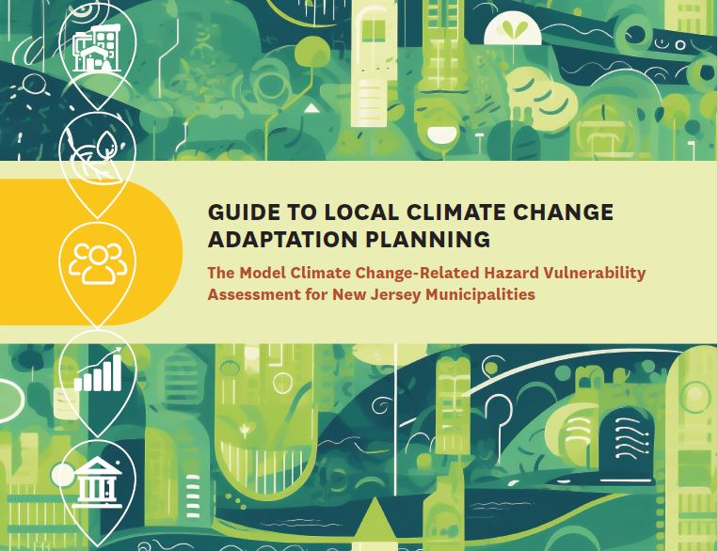
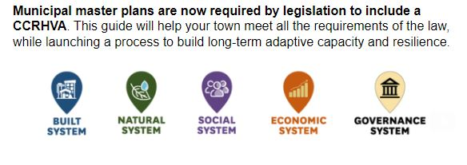
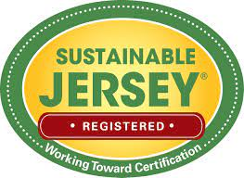
Guide to Local Climate Change Adaptation Planning
Notes:
Now that the guide is available – great first place to start - This year, with funding from the Robert Wood Johnson Foundation, we are taking the guide and the model vulnerability assessment process to develop a new gold star in the Sustainable Jersey program to promote municipalities in understanding and responding to their vulnerability to climate change – hope to share that with you by the end of this year.

Slide 19
Part II: Analyzing Vulnerability = Exposure x Sensitivity x Adaptive Capacity
Step 4.2
Analyze exposure and sensitivity of features
Not binary – Use a qualitative vulnerability key.
Types of Data to use – GIS/mapping, interviews, documents review, lived experiences.
Worksheet 4.2.a Analysis Workflow – provides a methodology, including links to data and tools, what to do for the analysis, what outputs you should put in the CCRHVA, and what those outputs can tell you about vulnerability.
Analyze adaptive capacity
Worksheet 4.1.c Municipal Governance – to analyze adaptive capacity of the municipality.
Phase 5
Steps to identify strategies and prioritize them to do something with the information learned in the CCRHVA.
Notes:
Let’s look at the guide
Phase 4 – specifically; and in particular 4.2 analyze and characterize your vulnerability.
Assume for the purpose of this exercise you have already done 4.1 identified the climate hazards and have characterized their impact on features.

Slide 20
Notes:
Assessing the impact of climate change on our community?
It is our assumption that climate change will require us to adapt – change the way things are done. And these long-term changes will touch local planning; as well as other functions that municipal governments currently manage. how municipalities function.
Evaluated other frameworks and determined to meet the requirements of the MLUL – and role municipal role in everyday life of New Jerseyans – can’t assess everything, but a limited number of features that are important to the systems that maintain the community. And together these features and the systems they support provide a holistic look at a community.

Slide 21
Systems Approach
Systems and the corresponding key features and indicators that sustain a community.
Indicators are based on what is needed to sustain each systems functionality.
Holistic perspective to look at multiple ways to reduce a community’s vulnerability.
Notes:
So how do we look at these systems.
The guidance for assessing vulnerability is based on systems.
Built, Natural, Social, Economic and Governance Systems – made up of features
E.g. Natural System – is made up of three features – land, water, and air – and identified indicators to evaluate each system.
This afternoon – want to look at one feature – the Housing Stock & Businesses; in the Built System – look at one of the indicators for that feature – residential and commercial structures.

Slide 22
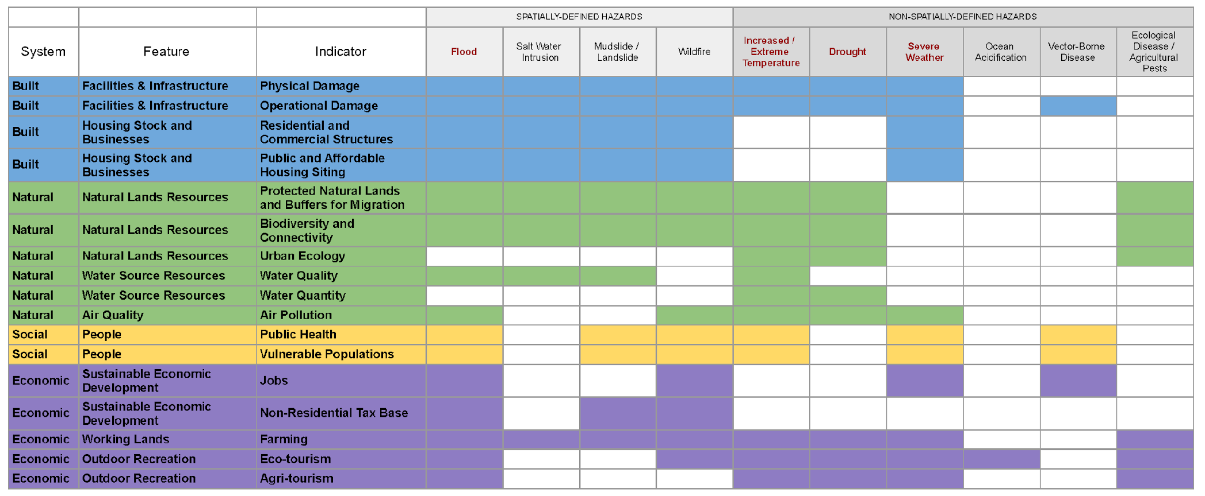
Systems Analysis Matrix
Notes:
This slide shows the systems, features, and indicators for evaluating the features, that are outlined in the guide.
The climate hazards are shown along the top, with the hazards listed in the MLUL rule shown in red.
Exposure to some hazards occurs in certain areas and can be mapped in a GIS, while exposure to other hazards occurs across the entire municipality, although maybe more intensely in certain areas. So, we refer to spatially-defined hazards and non-spatially defined hazards based on that distinction.
Will focus on feature as an example – looking at the Build System; Housing Stock and Businesses – Residential and Commercial Structures and Public and Affordable Housing Siting

Slide 23
Tools for Actionable Outcomes
4.1.c Systems Approach
4.1.c Vulnerability Matrix
4.2.a Analysis Workflow
Notes:
In the Guide you will find links to more detailed documents – that will help in the assessment steps.
4.1.c Explanation of the systems approach and how each applicable hazard impacts a system feature;
4.1c a matrix – looks across the systems and describes what an data should be used to evaluate each feature by each applicable indicator.
4.2a And the Analysis Workflow– highlights the indicator; data and tools available to use; and how to use them to analysis the feature; what the information can tell you; as well as how to capture the results and of this analysis.

Slide 24
Built System
Example: Exposure of homes and businesses to flooding, mudslides/landslides, and wildfire.
Data and Tools:
Building Footprints GIS data
Parcel GIS Data
Impervious Surface GIS Data
NOAA Impervious Surface Analysis Tool
Community Engagement
Analysis:
Identify residential and commercial structures and parcels within areas of current and projected spatially-defined hazards.
Identify residential and commercial structures within areas of high impervious surface (flood exposure).
Notes:
Then analysis work flow – for each feature, describes the available data sources and tools, as well as analysis instruction to produce outputs for the town’s CCRHVA.

Slide 25
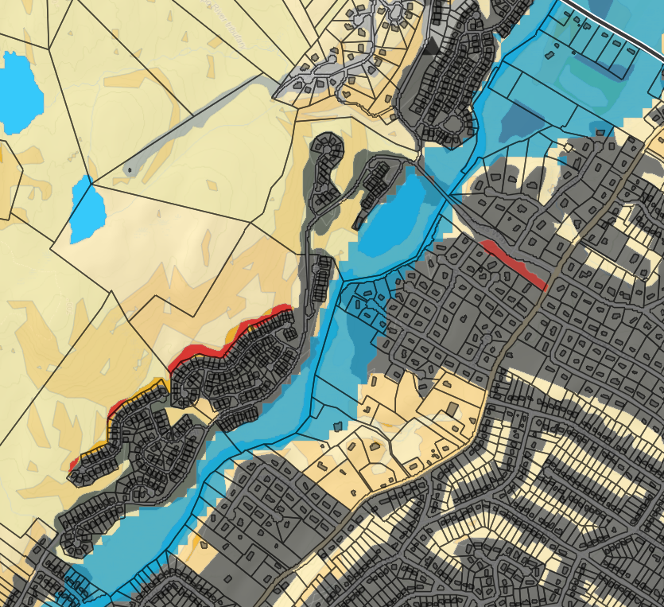
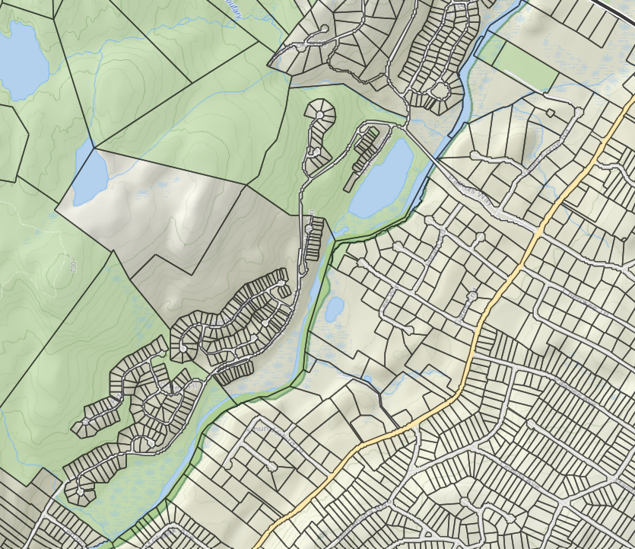
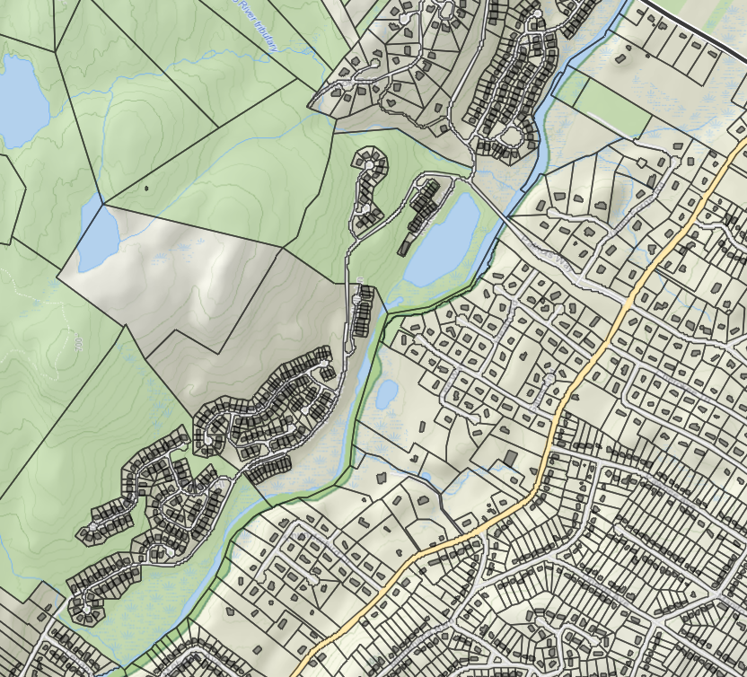
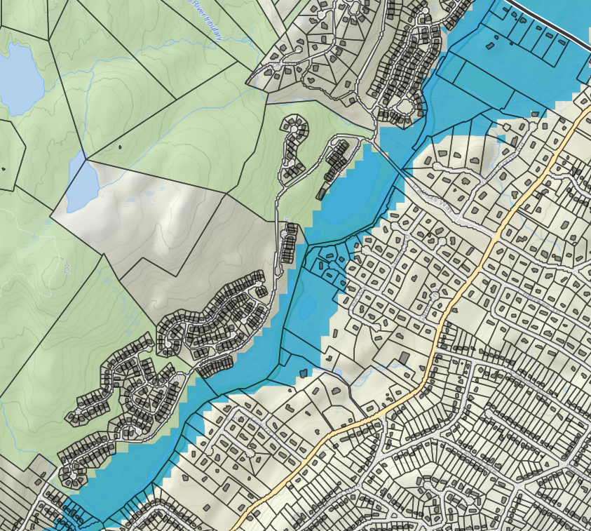
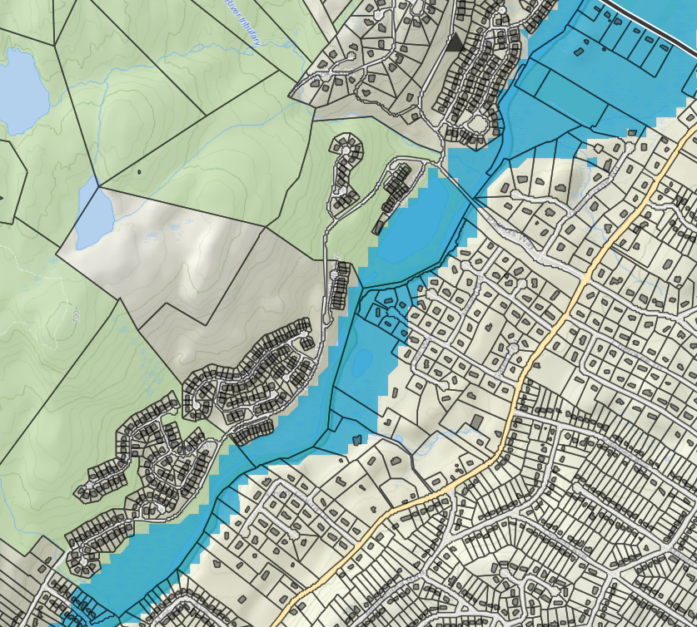
Notes:
Now I’ll walk through a series of screenshots to show how a GIS can help provide information to evaluate exposure of homes and businesses to spatially-defined hazards.
This example uses the new Highlands Region Interactive Environmental Resource Inventory Tool, or the ERI tool, just to provide a visual, and there are also other online mapping tools that later on this session – Rutgers will describe;
This map shows parcels for a portion of a municipality, and you could use MOD-IV tax data to know which parcels contain commercial and residential structures. I’ll add the “Building Footprints” data layer so you can see the locations of structures within the parcels.
Then I’ll add the spatially defined hazards, which are Flooding areas, Landslides, and Wildfire.
By overlaying the hazard areas with structures and parcels, you can get outputs to guide adaptation and also assess overall vulnerability of the municipality.
Outputs:
Map(s) of residential and commercial building footprints, showing exposure to these hazards.
Table(s) of parcels that have exposure.
GIS information needs to be supplemented with other local knowledge.

Slide 26
Vulnerability Assessment
Notes:
Tanya mentioned that the guide links to a spreadsheet to assess vulnerability;
We will use this form.

Slide 27
Notes:
And the vulnerability key provided in the guide - as Tanya mentioned - a tool to help towns articulate vulnerabilities.
Using the key, scores get assigned to features based on: the outputs of the GIS mapping, stakeholder input, and deliberations.
The vulnerability key helps you put scores on hazard impact, which is exposure and sensitivity, and on overall vulnerability (which includes adaptive capacity).

Slide 28
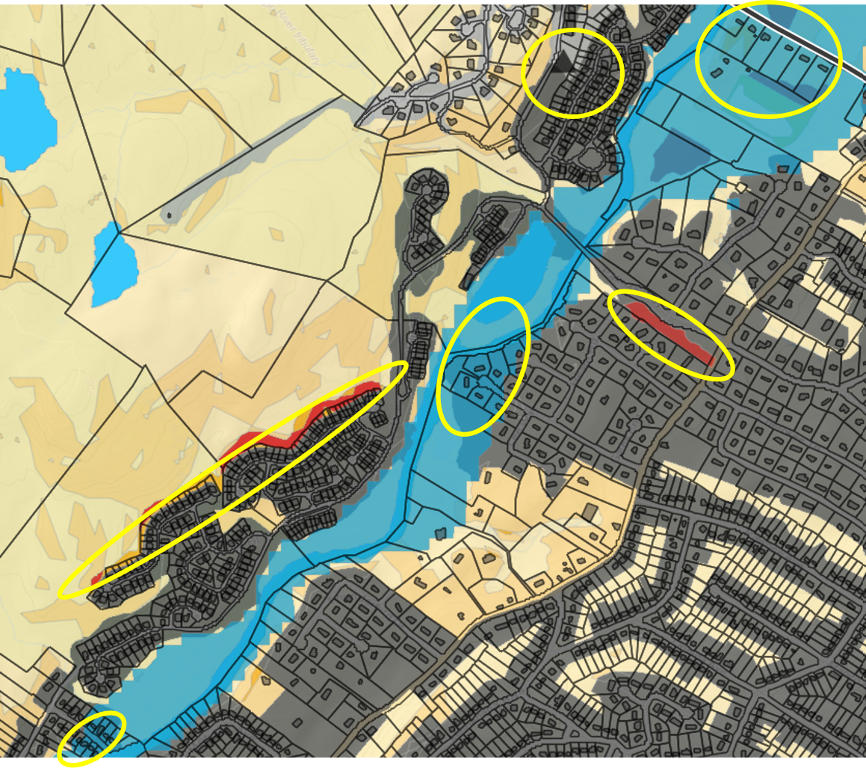
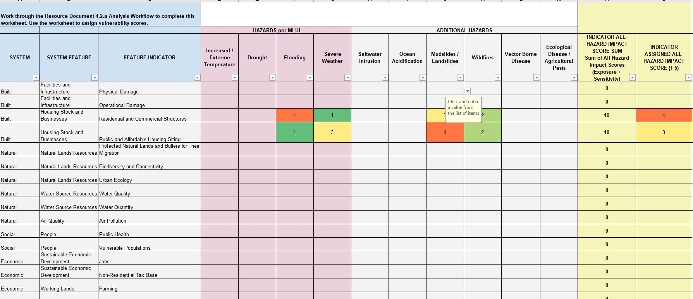
Built System: Feature: Housing Stock & Residences Indicators: Residential & Commercial Structures; Public and Affordable Housing
Notes:
What does it look like we actually use this information to assess vulnerability of this community?
Spatial and non-spatial features and even within a spatial feature – like flooding there is different types of flooding; flooding that occurs when storm sewers are undersize or not maintained – urban flooding.
So we need to ensure that the we work through this information with people that have local knowledge.
For purpose of this exercise – two indicators at once; area of affordable housing – higher density along the ridgeline; affordable housing; commercial shops along main street;
If there is flooding (exposure is high); and sensitivity – will the functioning because of physical damage would be disruptive?
– see areas of residences/commercial; and because our municipal stormwater program coordinator is part of the group assigning the value; we know that flooding in the business area is exacerbated by an undersized storm sewer system – blue line is extended;
And when we look at flooding for the affordable housing; exposure and sensitivity is low
Evaluate each hazard that is applicable to each indicator

Slide 29
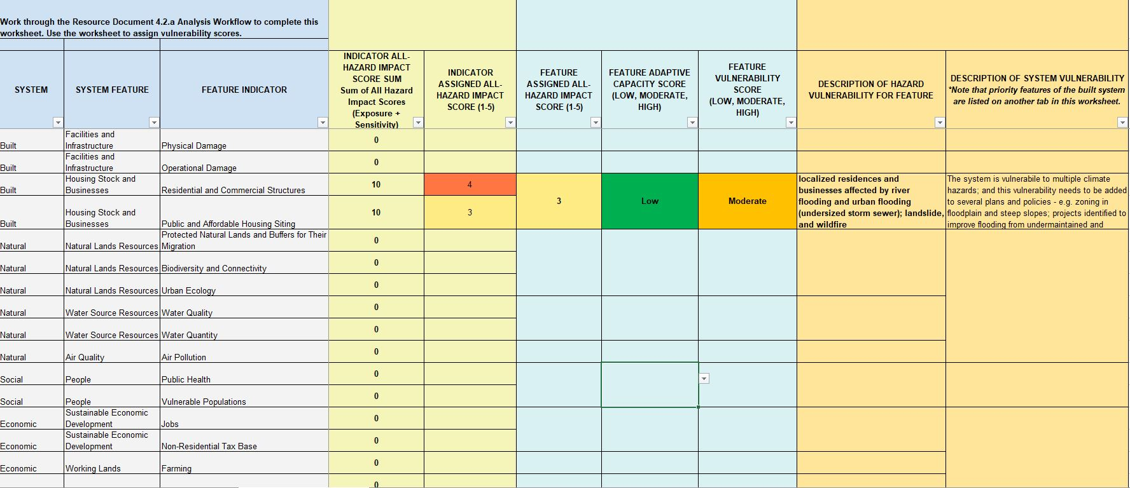
Built System: Feature: Housing Stock & Residences Indicator: Residential & Commercial Structures
Notes:
Look across your assessment to summarize the feature – impact to applicable hazards;
And then to rank the adaptive capacity.
This is critical because it assesses the municipality’s ability to cope with climate change in the long-term.
Is the municipality prepared to make the necessary changes to the way things are done in order to adapt to the risks posed by climate hazards? Goes back to the notion, that climate change planning – outcome – change in many aspects of the community.
There is space to summarize and take notes (and this information will be expand upon in the development of the assessment for your land use plan)
This will serve as your baseline analysis; and can be used to evaluate progress on reducing your vulnerability; notes are important here.

Slide 30
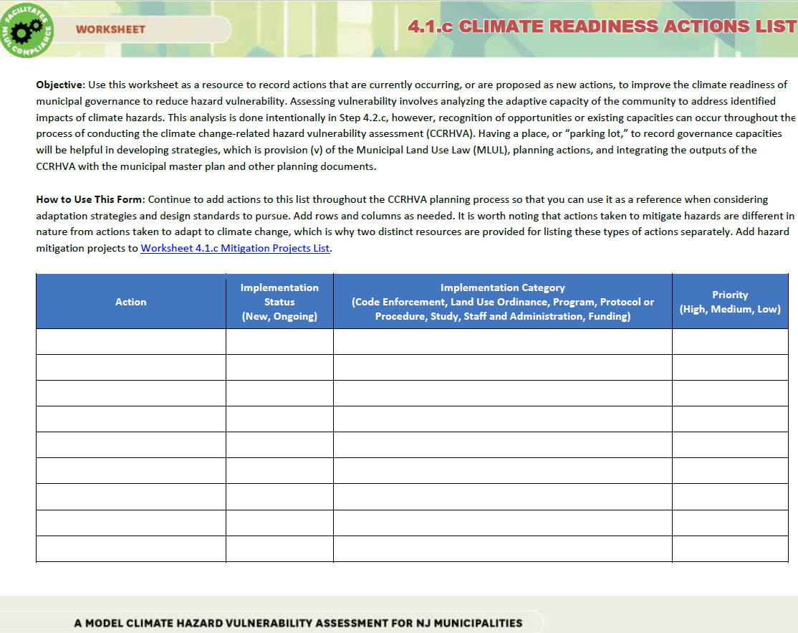
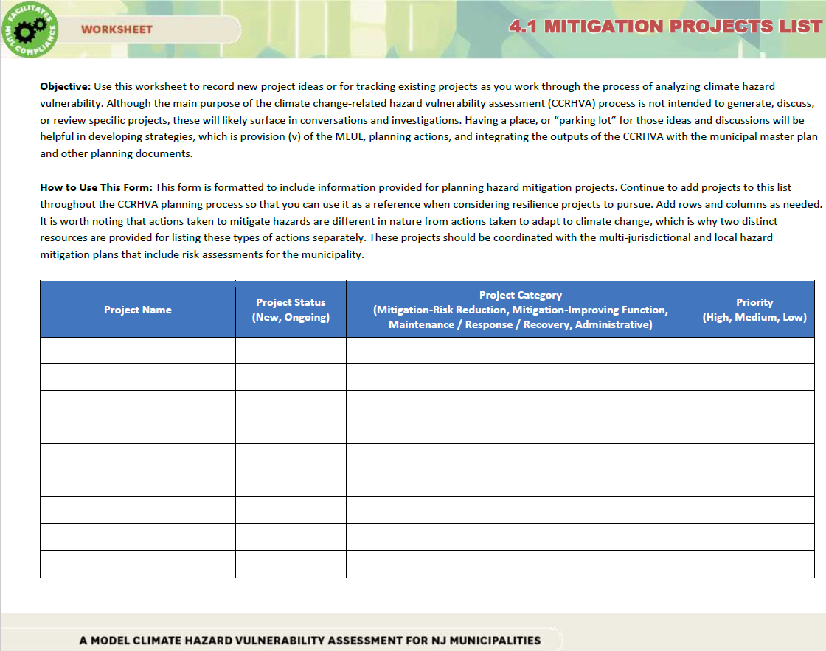
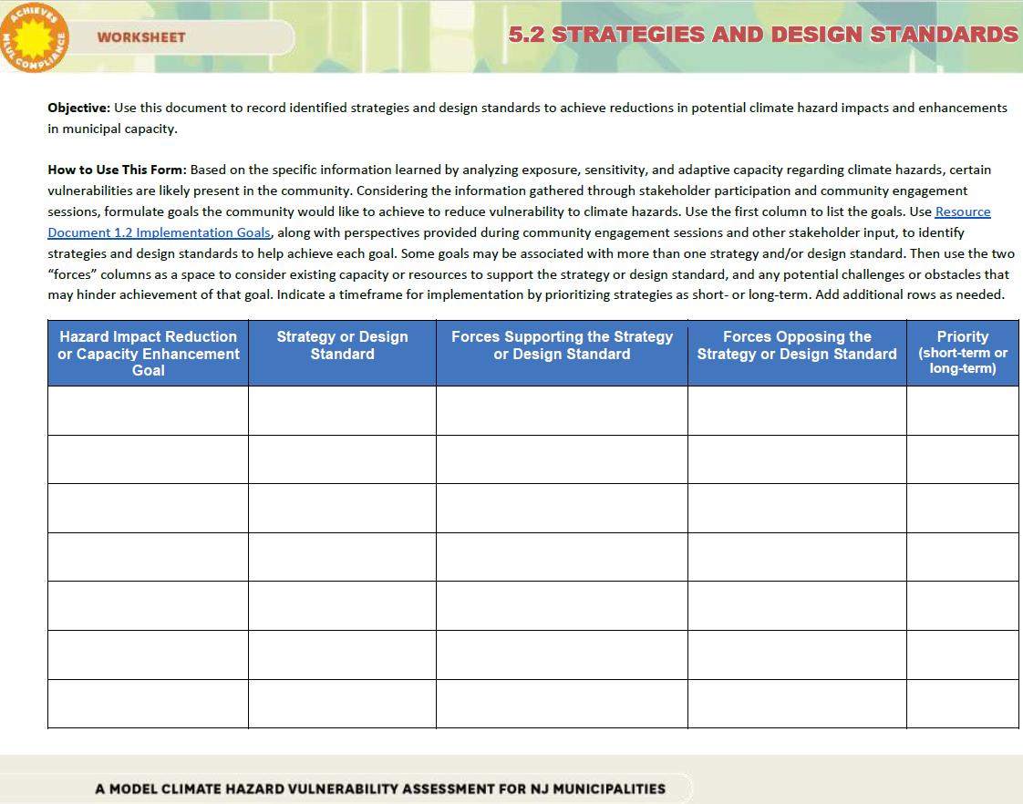
Tools for Actionable Outcomes
Climate Readiness Actions List
Mitigation Projects List
Strategies and Design Standards List
Notes:
And as Tanya noted earlier – the process of assessing vulnerability will likely to yield some ideas for mitigation projects, adaptive capacity actions, and strategies and design standards changes.
For example: The stormwater program coordinator will identify areas that need to be maintained regularly; and could be recorded on one of this forms; and while we have provided three places to list things; could easily be one; need to document the process and results.

Slide 31
Additional Outcomes
Notes:
Additional outcomes – see from the example
This information can help to inform the community and target communication about disaster preparedness, which can reduce vulnerability. And properties that are exposed to climate hazards should be considered in that context of vulnerability during land use planning and regarding changes to zoning.
Or When this community works through the assessment of the Built System: Facilities and Infrastructure; - indicator - physical and operational damage; note wildfire along this roadway – important east/west connector; and it is County Road; with the vulnerability assessment in hand; relative understanding of importance of this hazard to the community; may be important in next iteration of the Hazard Mitigation Plan this be identified. Or use of state wildfire reduction programs – for creating defensible space around homes.
Or when you are assessing the Natural System- looking at Water Quality and Quantity – the municipal stormwater program coordinator, hopefully will realize that some of the spatial information required of the new MS4 permit can be helpful to the assessment; as well as some of the project ideas that may come of this assessment might provide multiple benefits for stormwater management and climate adaptation.

Slide 32
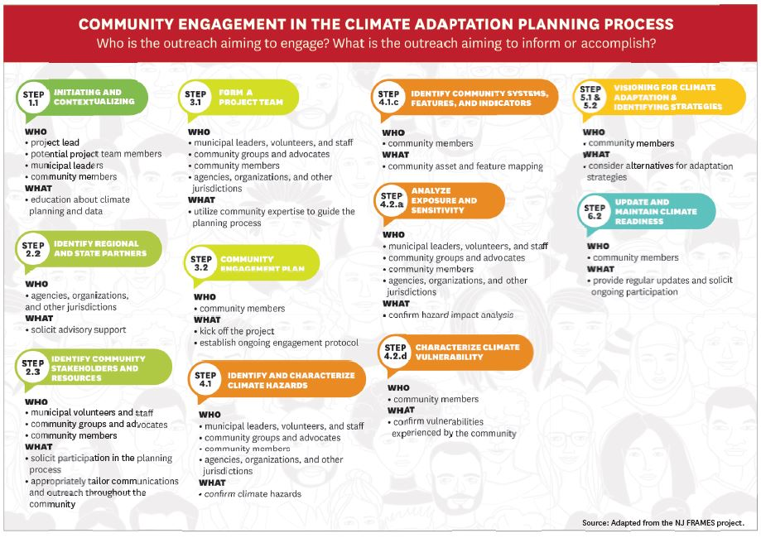
Notes:
Key to have the right people involved; Community engagement throughout the process is highlighted in this illustration in the guide; people in the room or providing information for each of the steps of the process; and critical in this assessment of vulnerability.

Slide 33
Next Steps
Notes:
We hope you come away from this portion of the session with a better understanding of the Guide; how to assess your community; and the steps that you need to take to plan for climate change.

Slide 34
Questions
Tanya Rohrbach, Community Planning Manager, New Jersey Future, trohrbach@njfuture.org
Anne Heasly, Program Manager for Policy and Planning, Sustainable Jersey, heaslya@tcnj.edu
Notes:
QUESTIONS AND ANSWERS:
We will pause here for your questions for a few minutes and then move on to the additional speakers – Pritpal and Lucas to discuss an example, and tools and resources, that Rutgers has developed to help municipalities in this work.
If no questions:
1. Raise your hand if you have heard of the Guide we’ve been discussing?
2. Do you know if your community (where you work or live) is planning on updating their master plan to address climate change?
3. What barriers do you foresee in your community – planning for climate change?

