Slide 1
Living Shorelines
Past, Present, and Future
Jon K. Miller & Laura Kerr

Slide 2
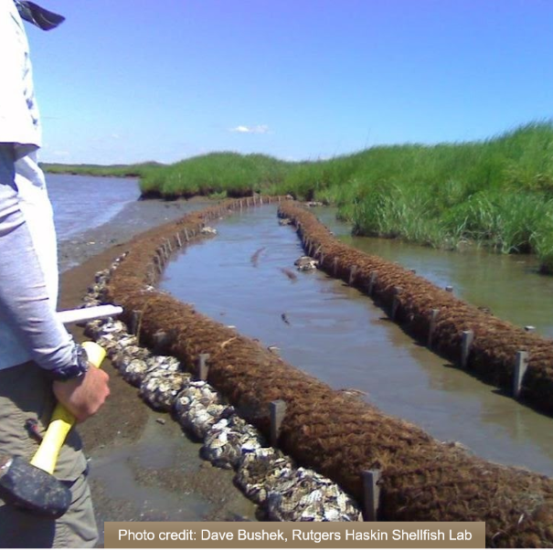
Past
A brief history of Living Shorelines in New Jersey

Slide 3
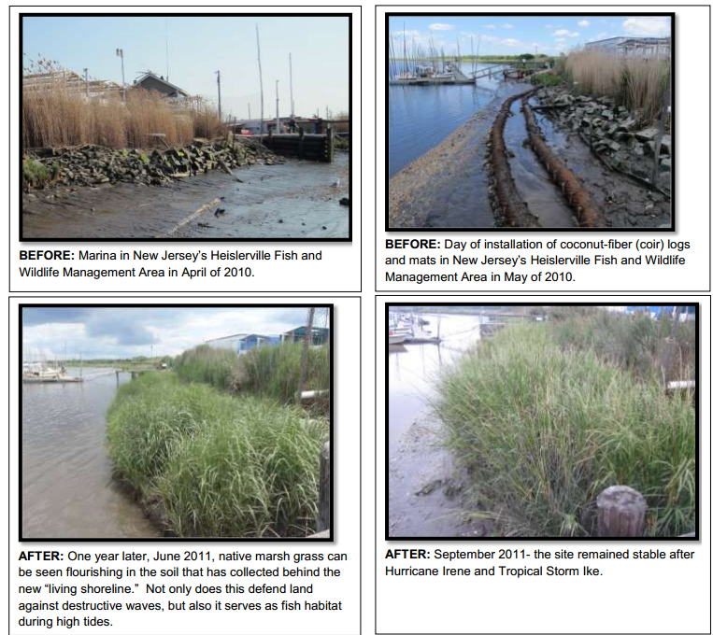
Origins
Mid 1970’s Edgar Garbisch Jr. pioneers “Marsh Fringe Creation”
1980’s and 1990’s marsh sills became common throughout Chesapeake Bay
  David Burke - “Living Shorelines”?
2008 PDE & Rutgers – “Delaware Estuary Living Shorelines Initiative”
  Permitting is painful
  Piloted coir log/shell bag technique
  Demonstrated the technique cold be effective on low-moderate energy shorelines & could survive large storms

Slide 4
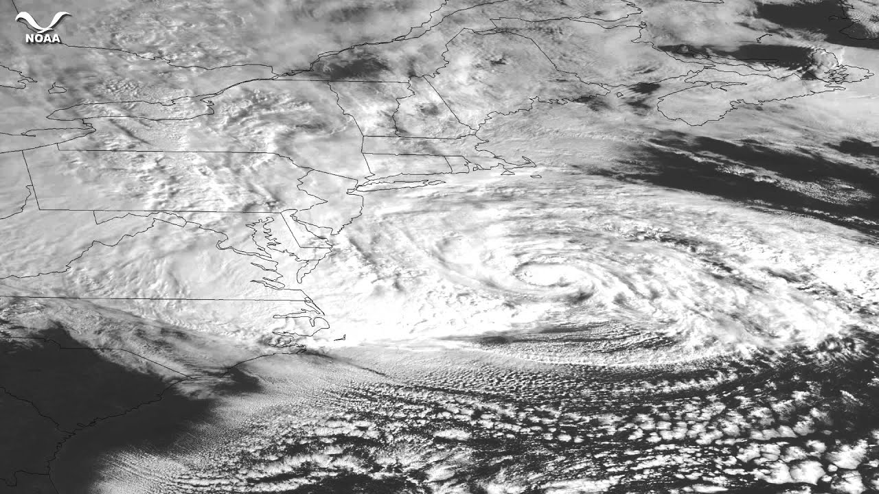
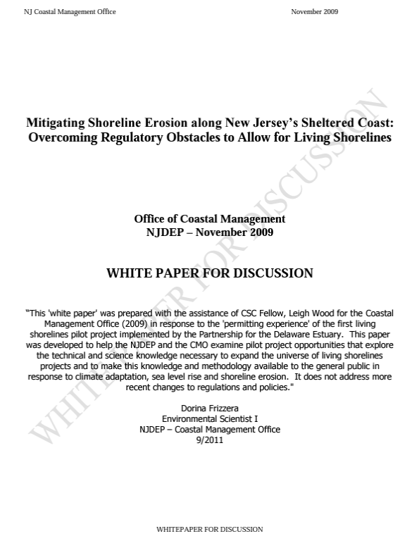
NJDEP
Living Shorelines Initiatives
2009 - Living shorelines whitepaper
2010 - Regulatory rule writing workshop

Slide 5
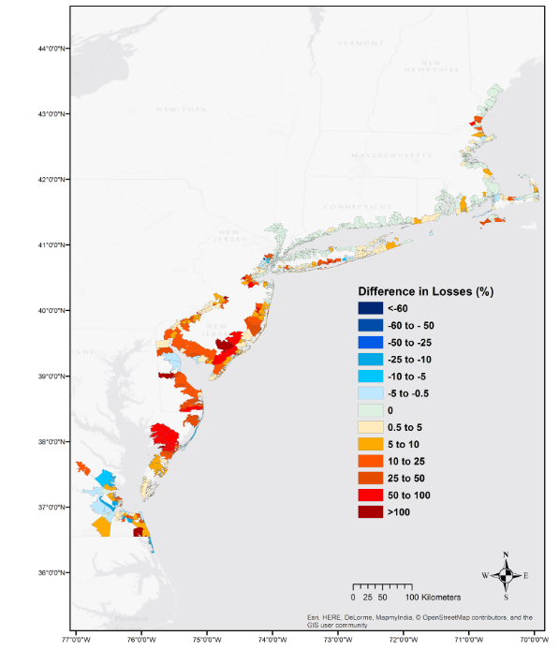
Superstorm Sandy
Graphic credit: “The Value of Coastal Wetlands for Flood Damage Reduction in the Northeastern USA”, Narayan et al. (2017)
An adrenaline shot for Living Shorelines
NRC advocates consideration of the full spectrum of options available
USACE calls for integrated approach to risk management that draws from the full array of available measures
“The Value of Coastal Wetlands for Flood Damage Reduction in the Northeastern USA”, Narayan et al. (2017)
  Wetlands avoided $625 million in direct flood damage during Sandy
  16% average reduction in annual flood losses by Salt Marshes

Slide 6
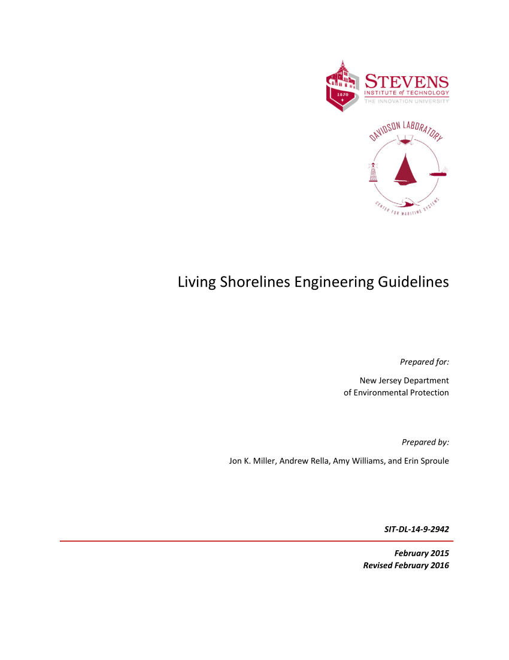
NJDEP
Living Shorelines Initiatives
2009 - Living shorelines whitepaper
2010 - Regulatory rule writing workshop
2013 – Living Shoreline GP
  Projects must have the endorsement of a “sponsor”
  Allows for research projects with universities
  Allows limited fill to the “1977 tidelands line”
2015 – Living Shoreline Engineering Guidelines
2015 to Present – Lots of projects

Slide 7
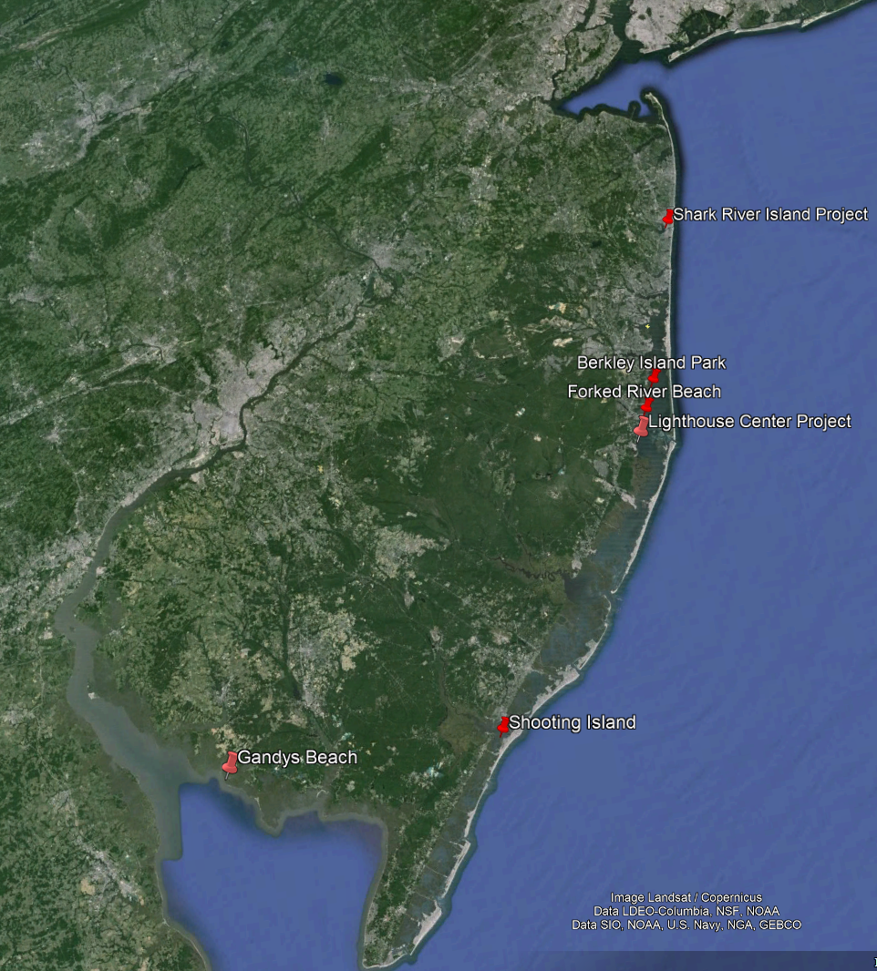
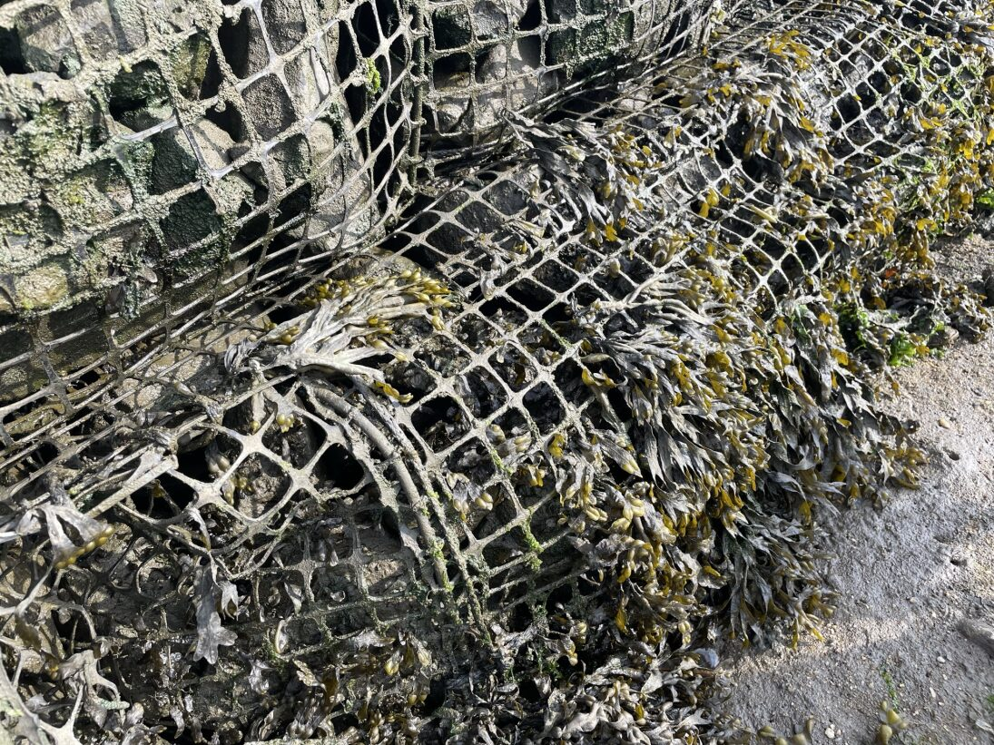
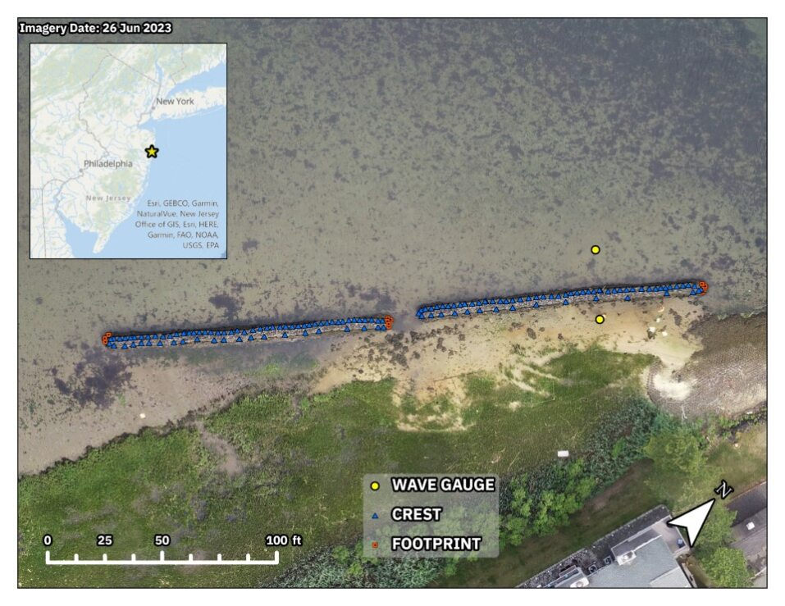
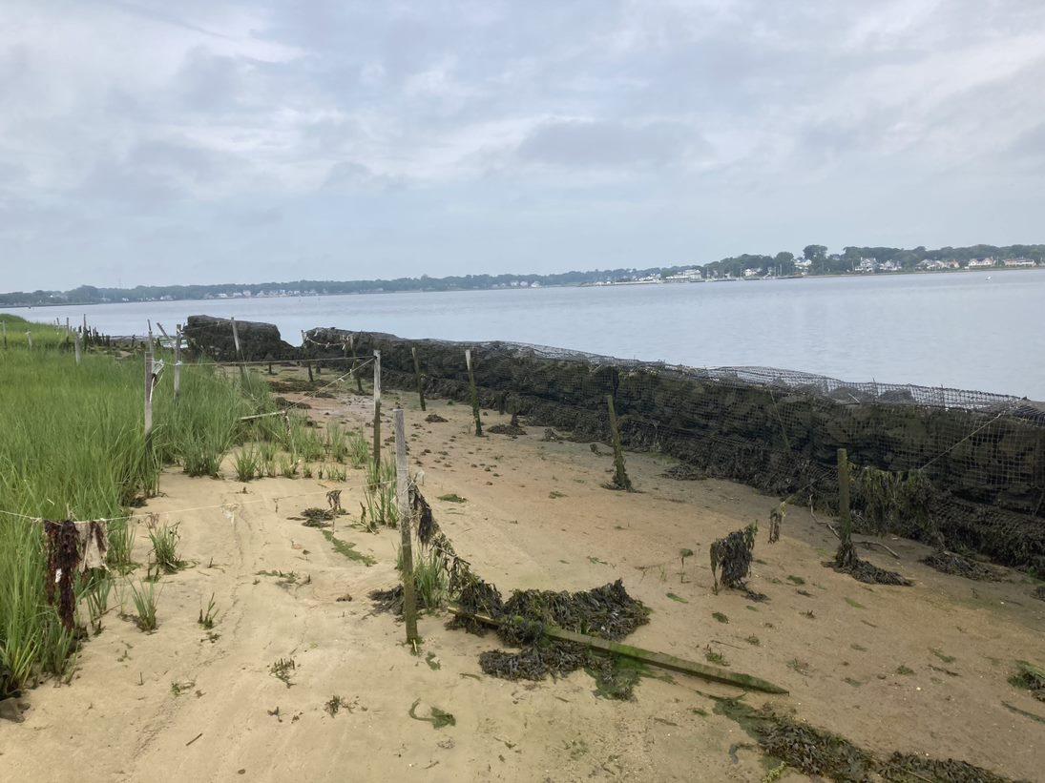

Slide 8
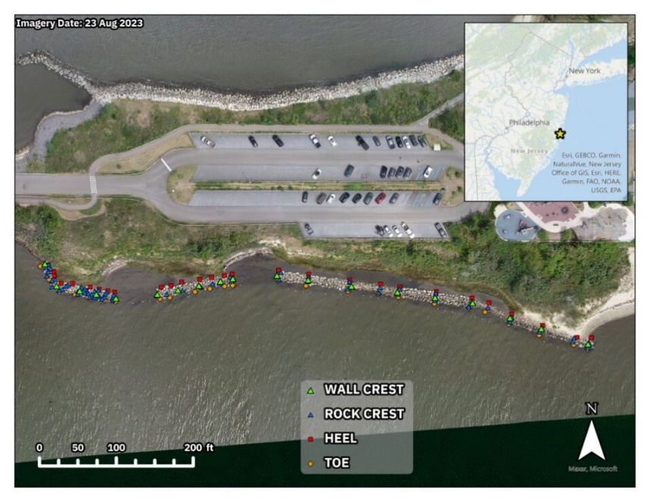
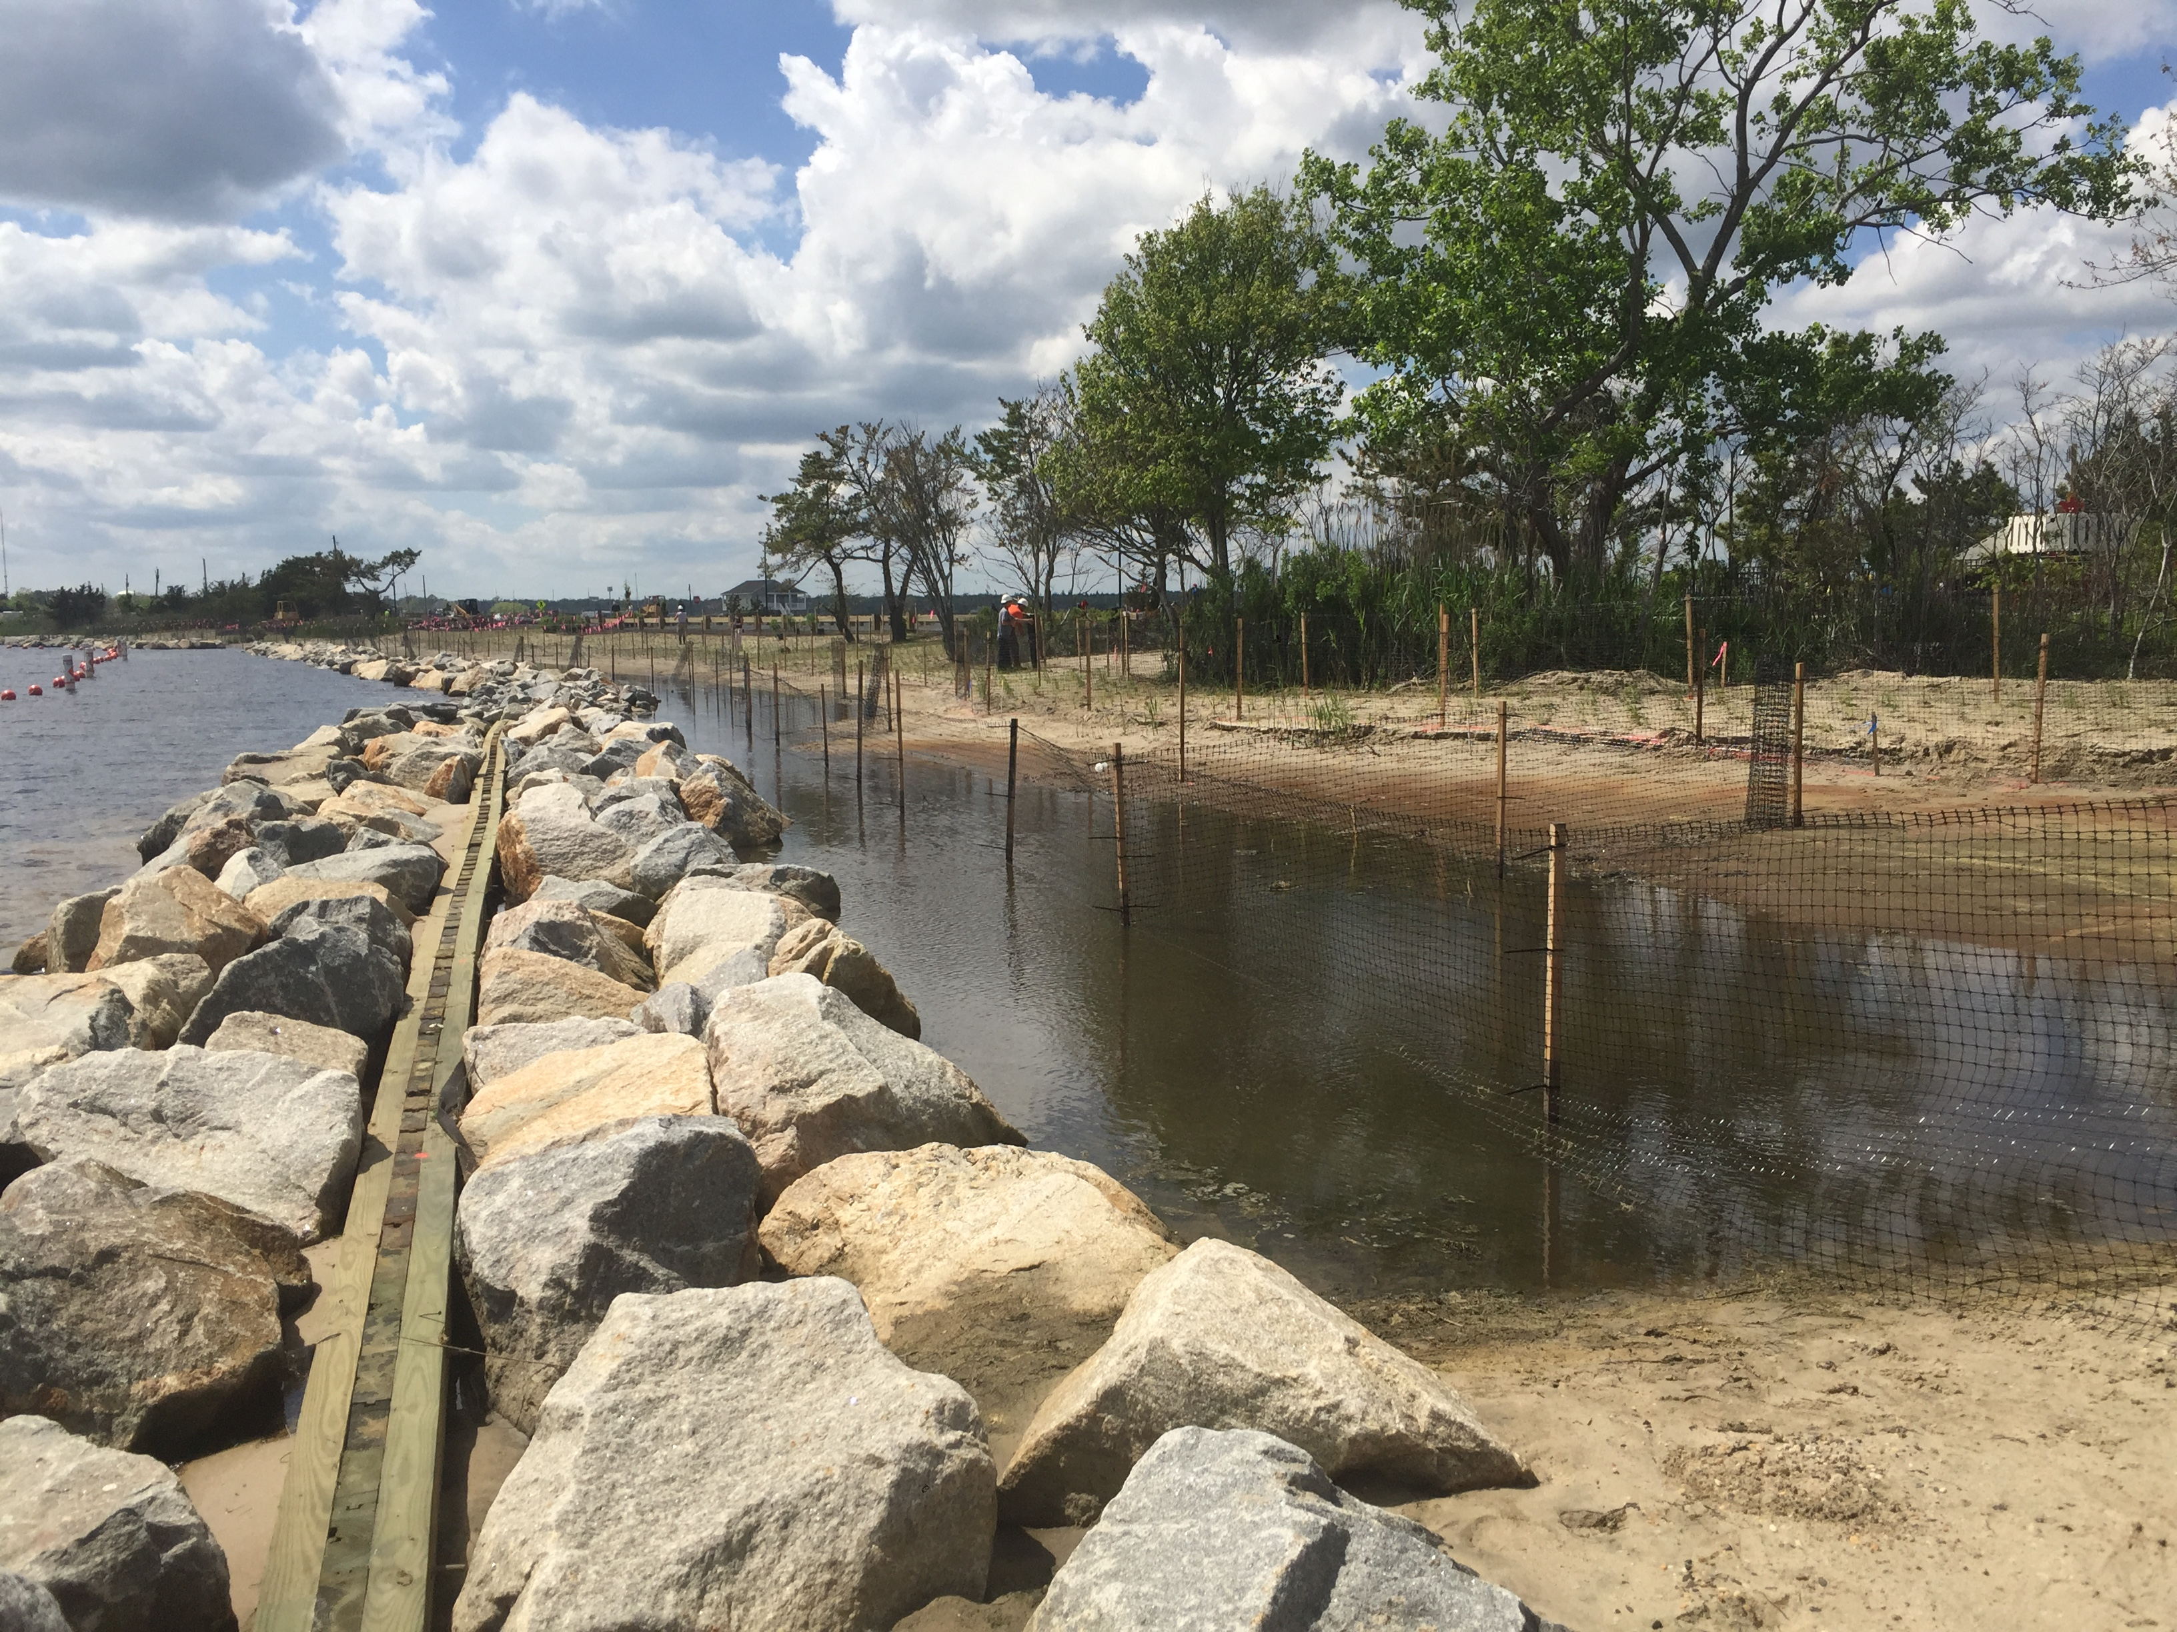
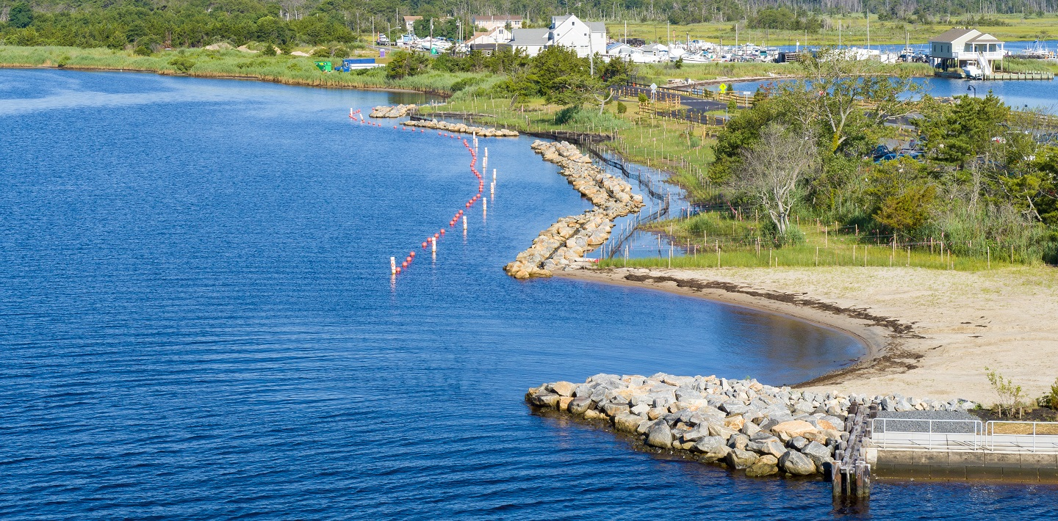

Slide 9
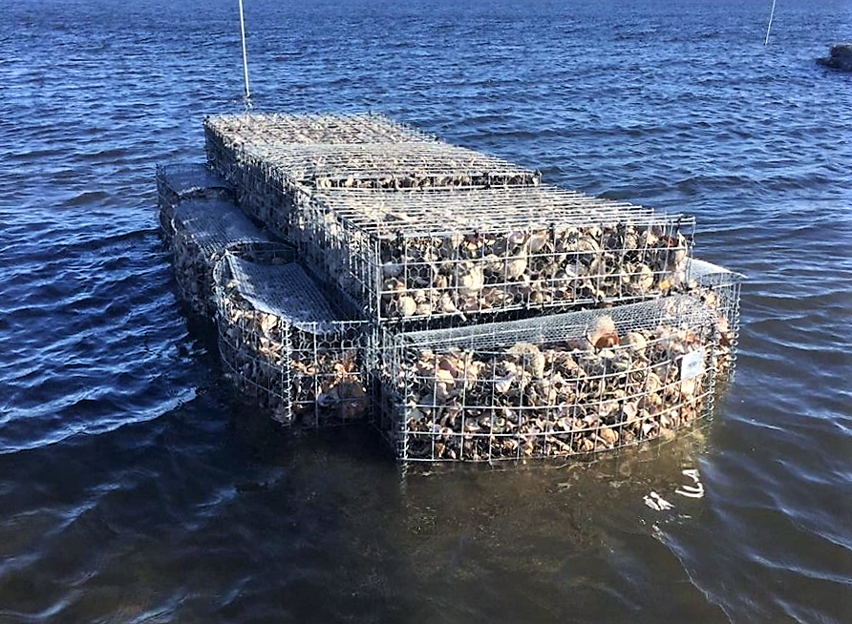
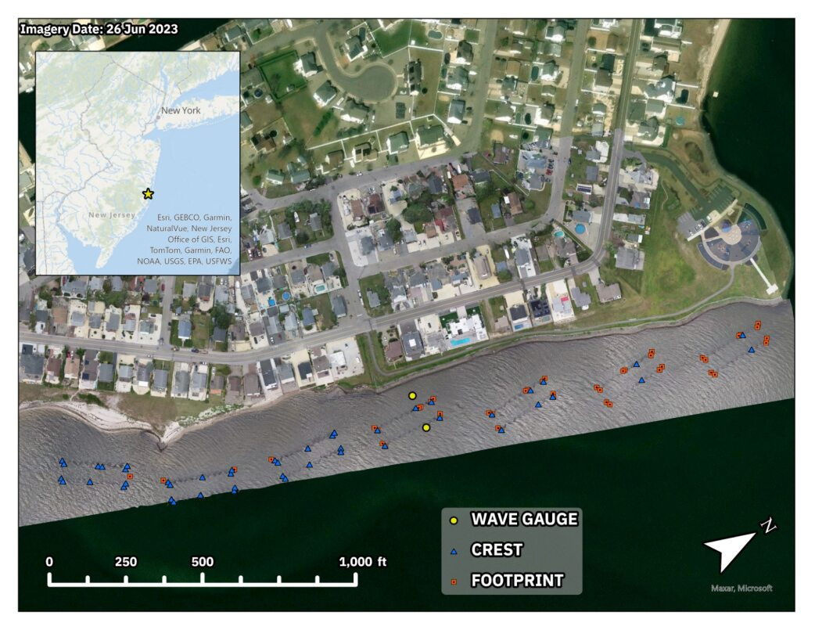
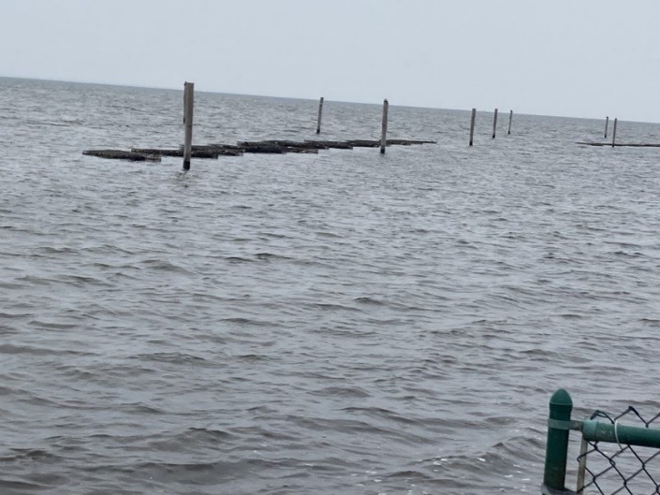

Slide 10
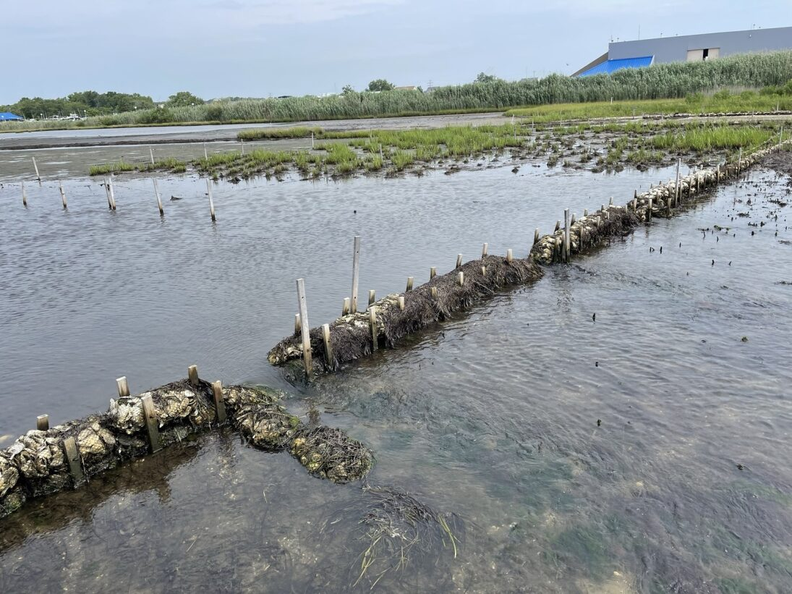
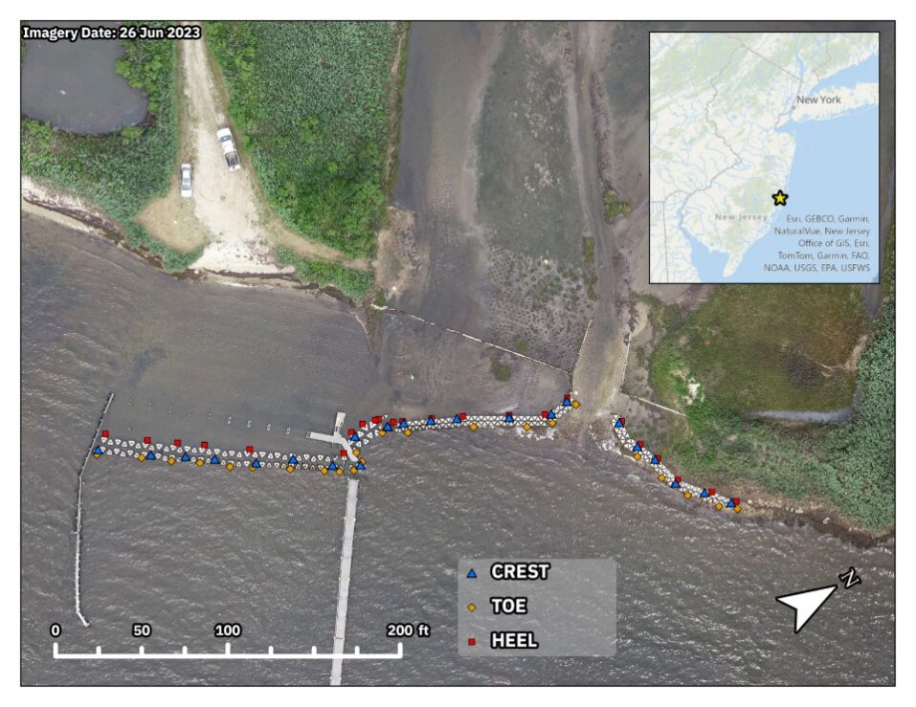
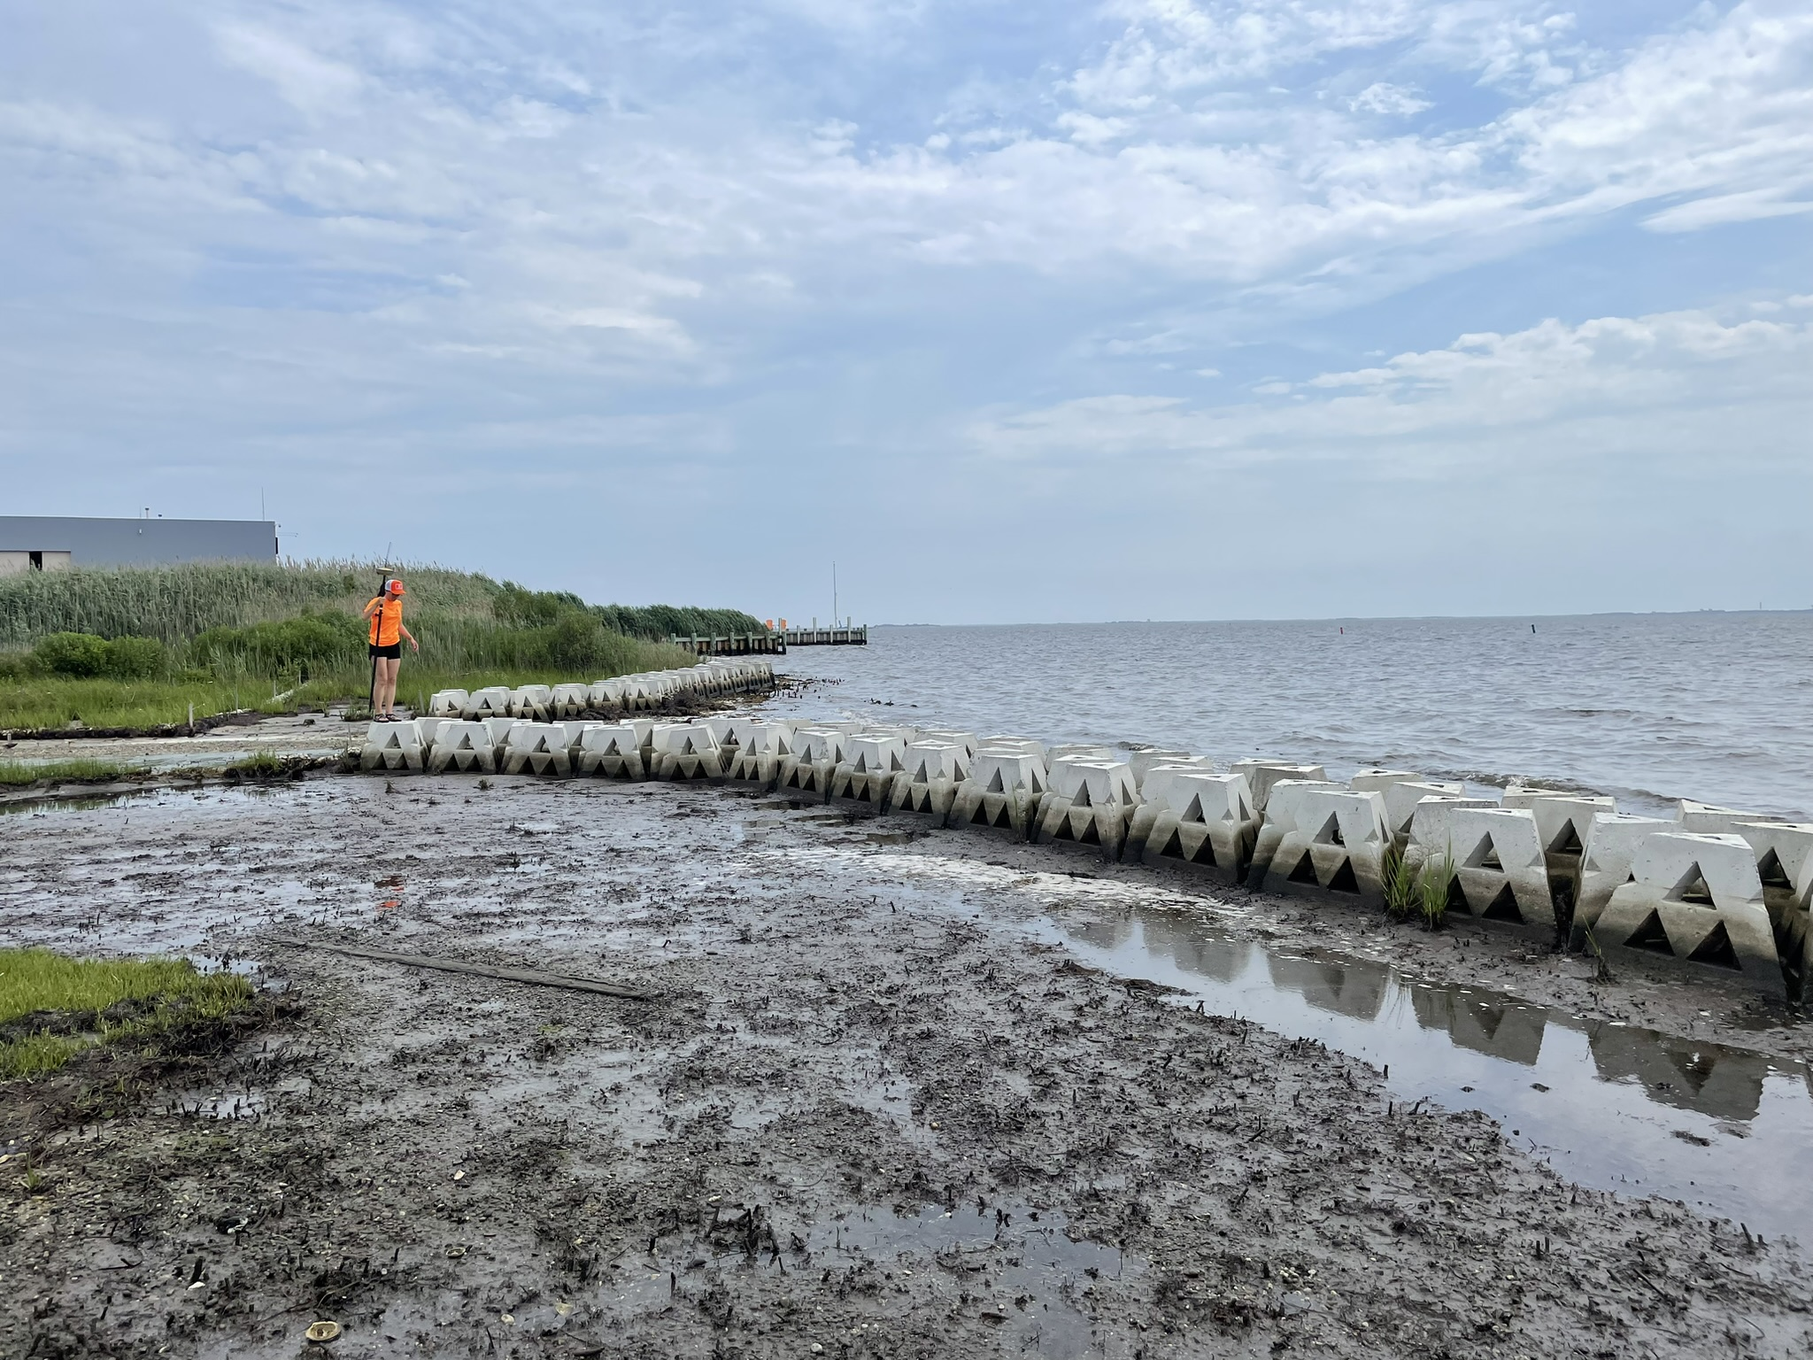

Slide 11
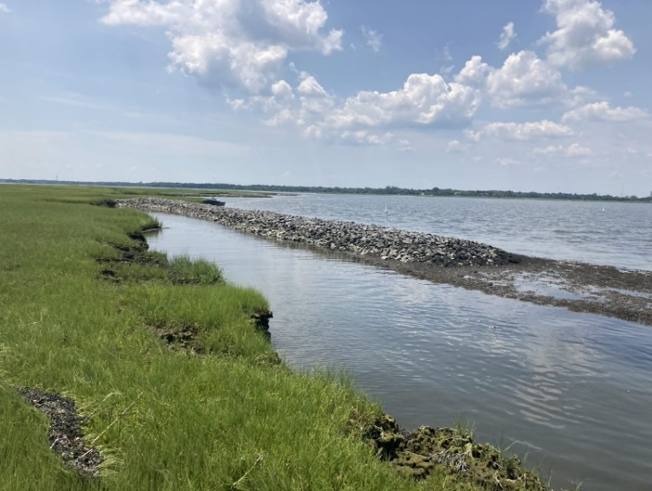
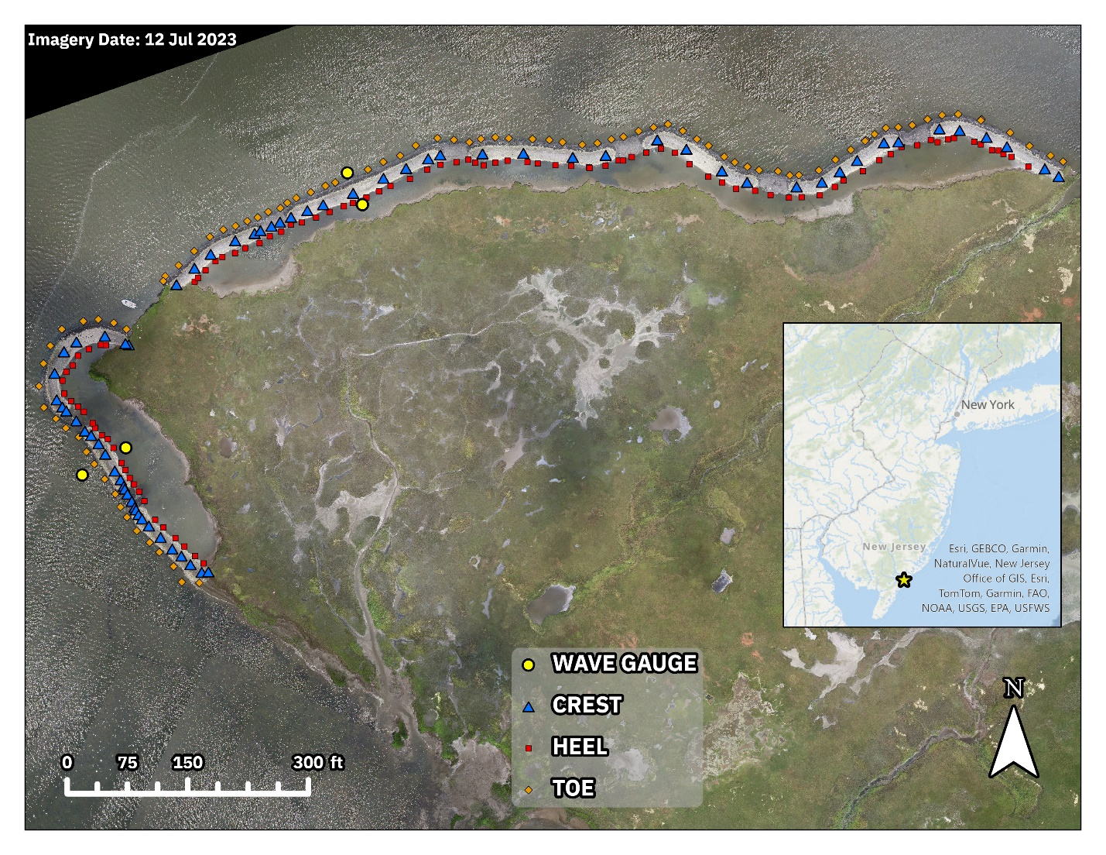
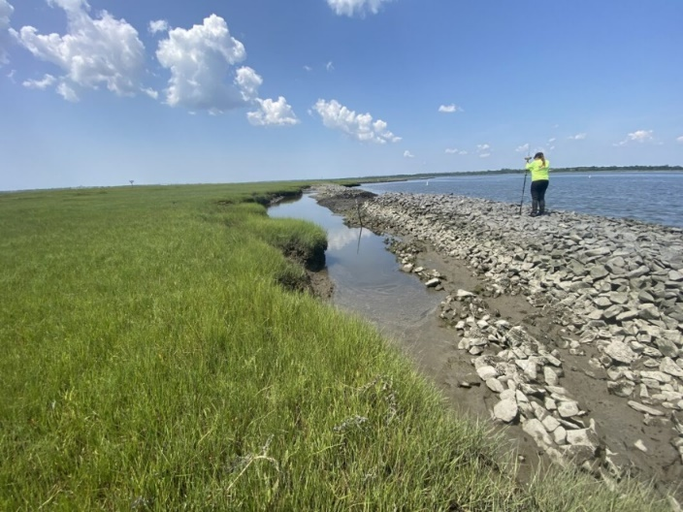

Slide 12
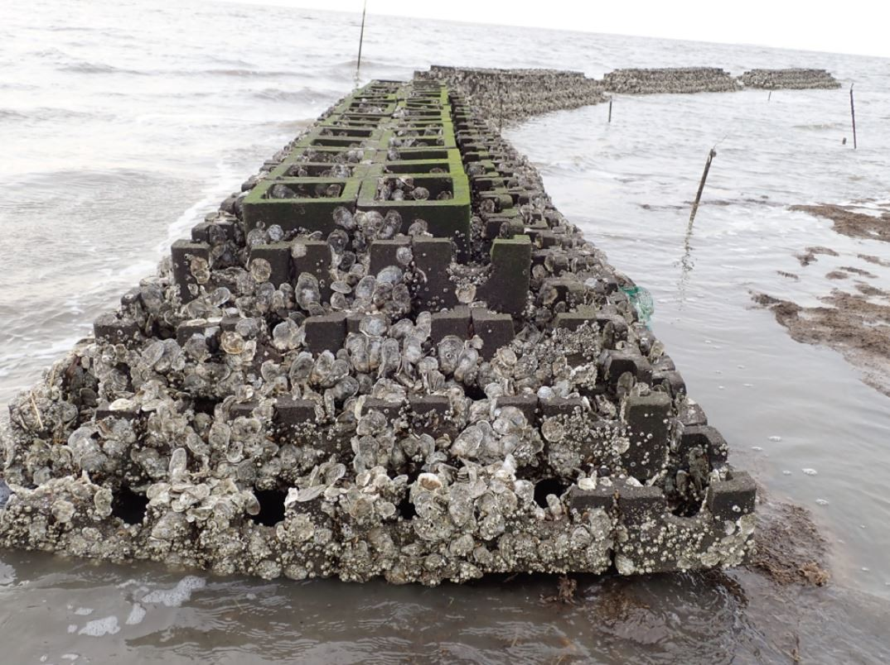
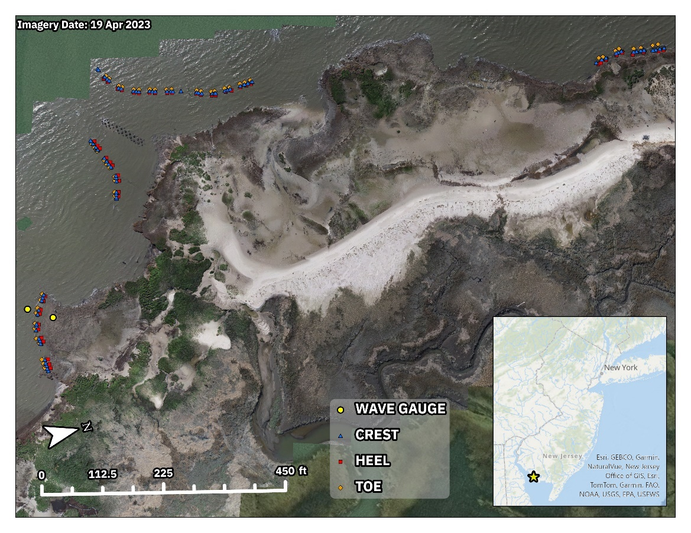
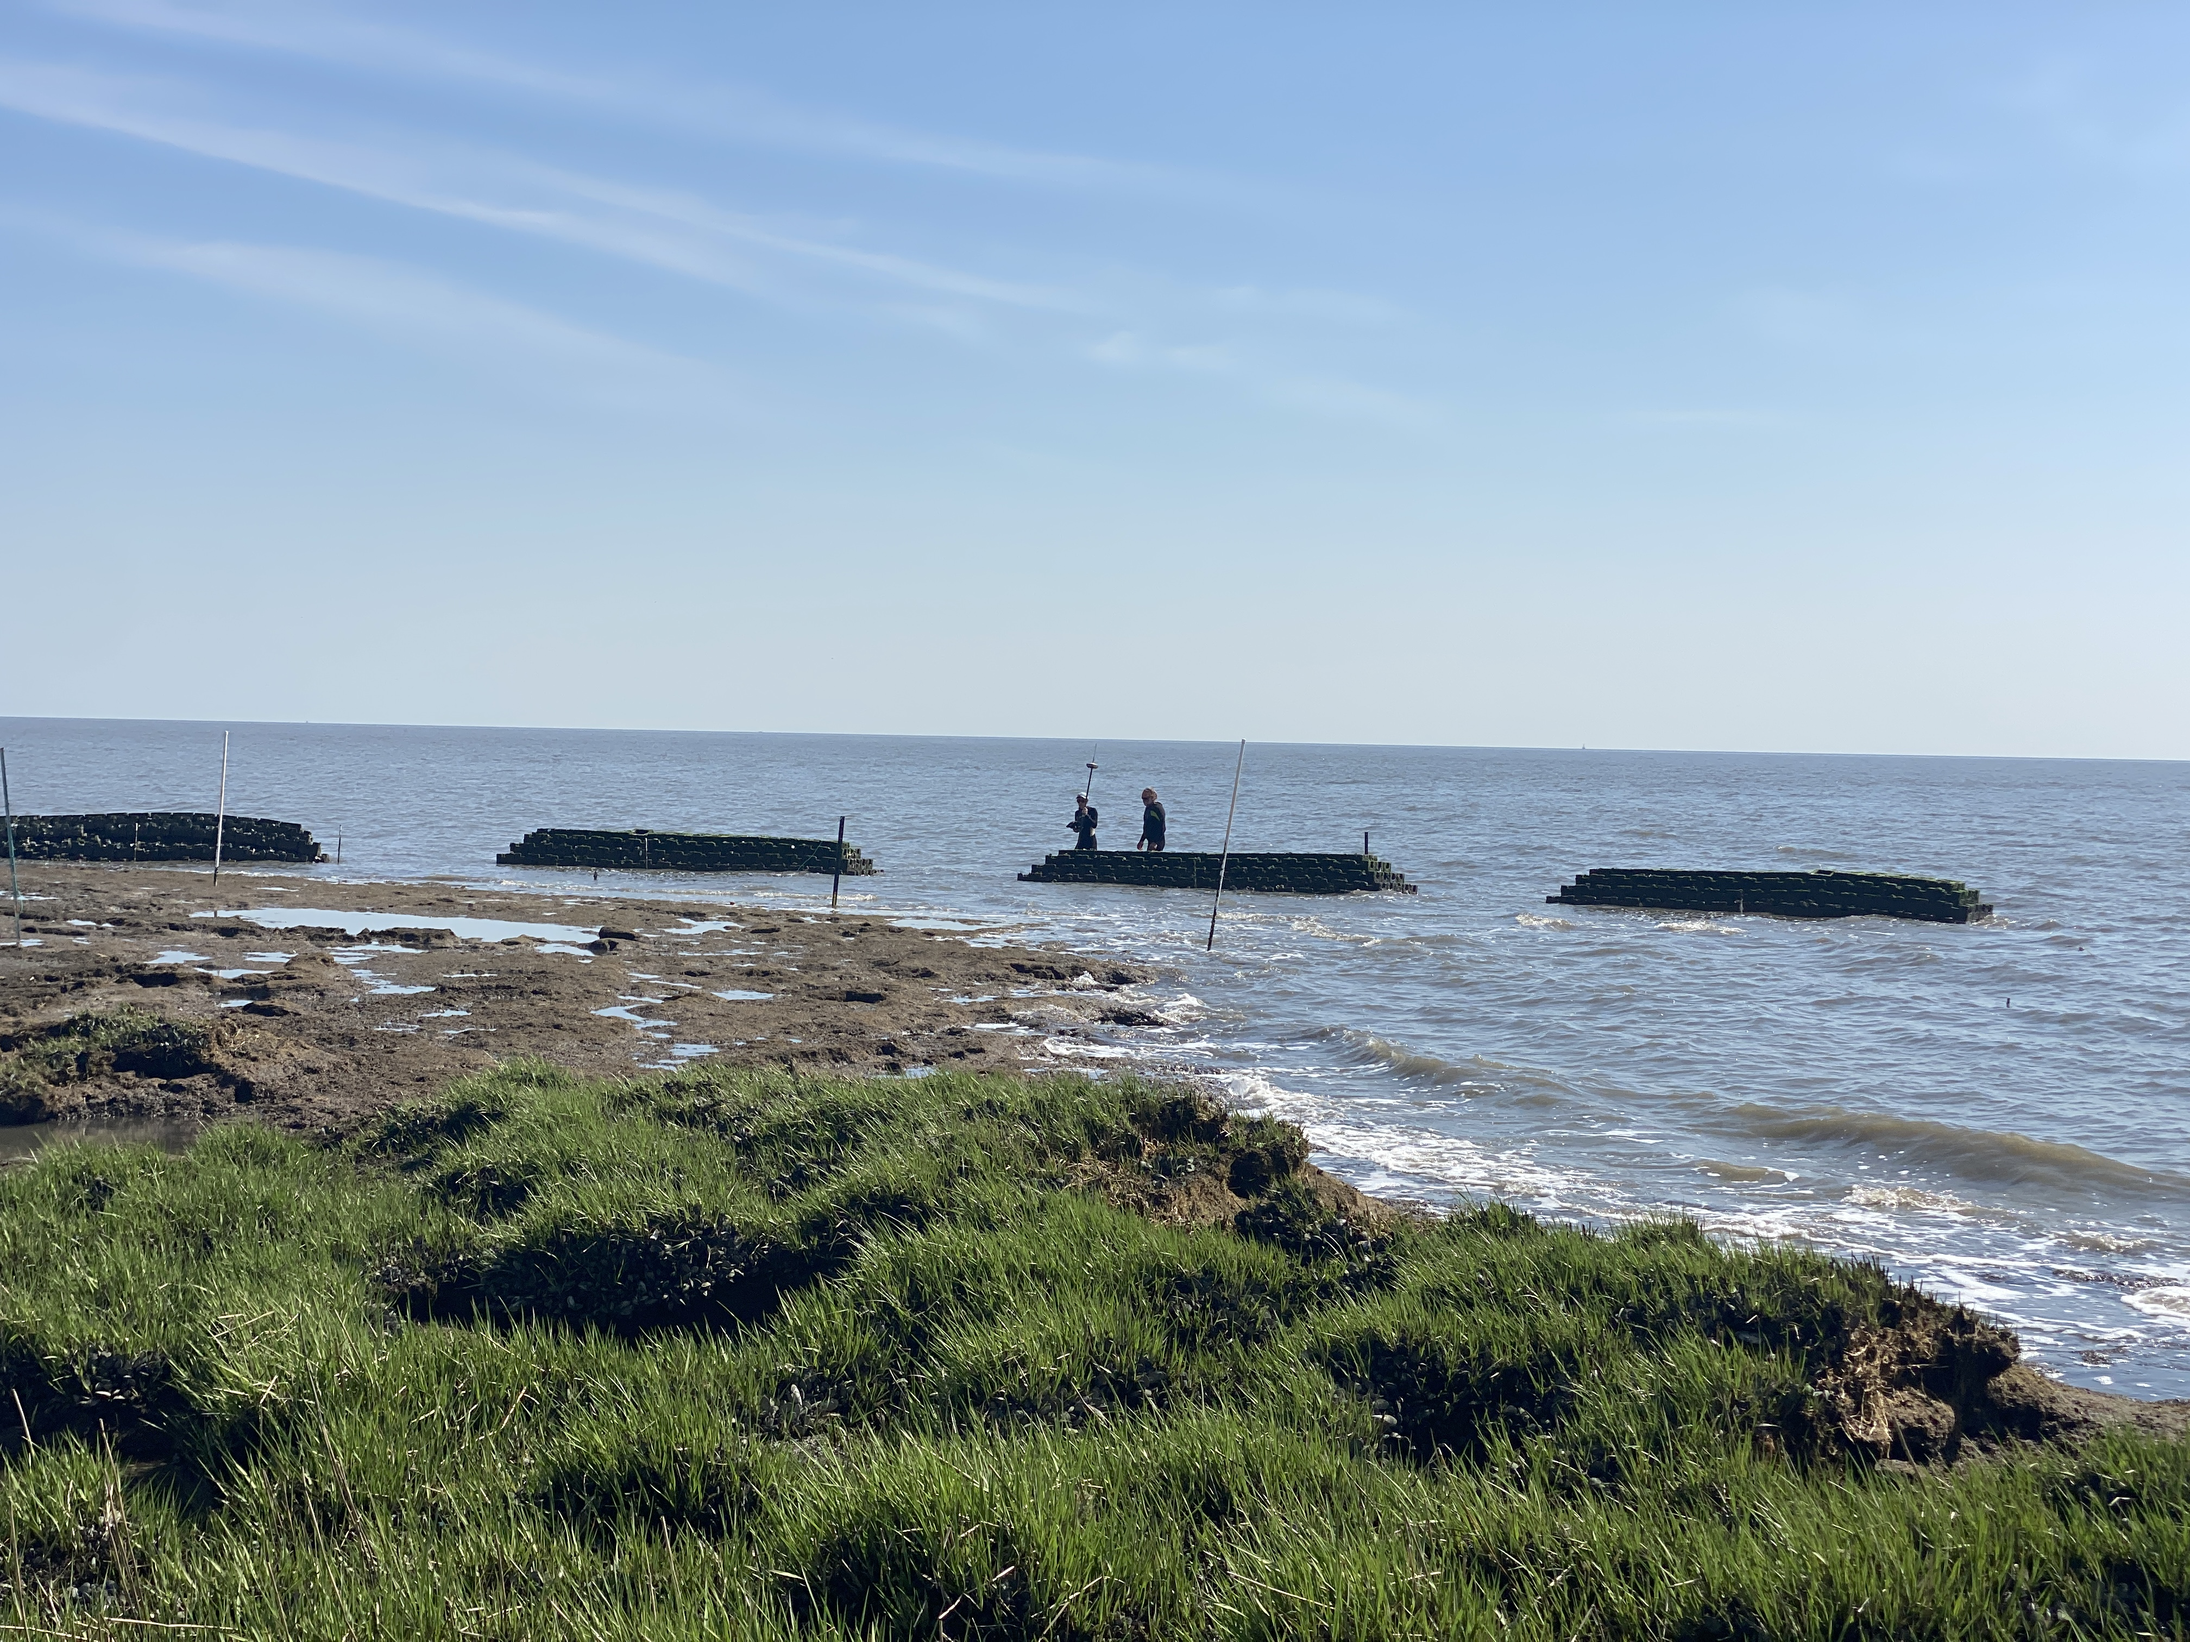

Slide 13
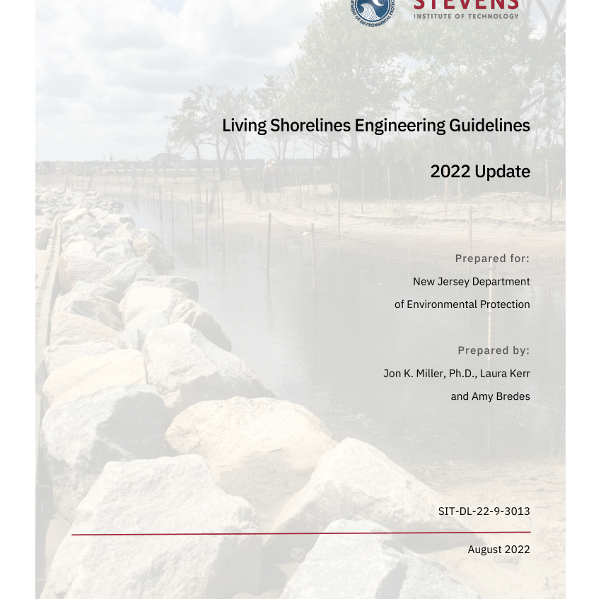
Present
Updated Design Guidance

Slide 14
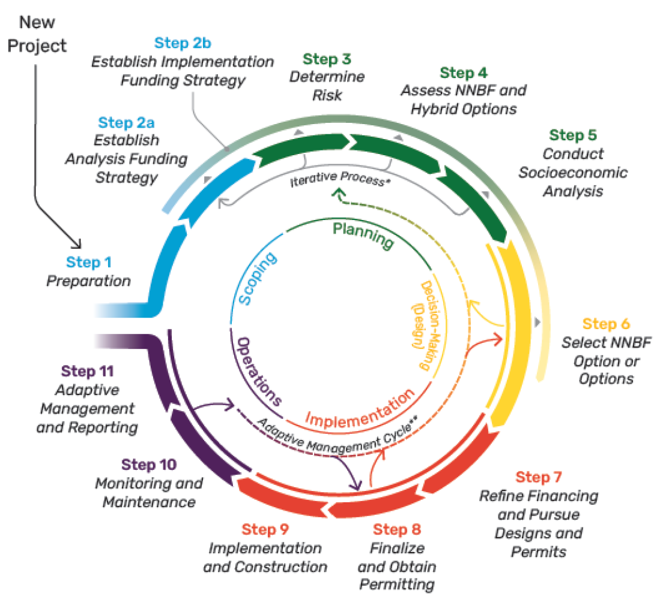
2022 Traditional LS Update
Design Approach
Design process must be adapted to account for the dynamic nature of projects
International Guideline on Natural and Nature-based Features (IGNNBF) used as a guide
  Scoping - initial information gathering; screening
  Planning – desktop study; conceptual design(s)
  Decision Making/Implementation – data collection/modeling; final design
  Operations – monitoring; adaptive management
Framework Phases and Their Corresponding Steps in Undertaking NNBF Projects
Credit: International Guidelines on Natural and Nature-Based Features for Flood Risk Management

Slide 15
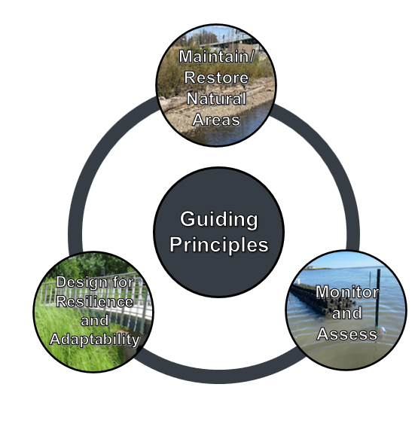
2022 Developed/Urban Shoreline Guidance
Guiding Principles
Core to the philosophy of developing sustainable, resilient shorelines along developed coasts
Help designers, engineers, planners, and regulators set high level goals for each project, and it is recommended that they be incorporated into every project
Ecoshorelines on Developed Coasts Guidance and Best Practices (Miller, et al. 2022)

Slide 16

2022 Developed/Urban Shoreline Guidance
Design Elements
Specific techniques that can be used to help create developed shorelines that more effectively balance the needs of the natural and built environment

Slide 17
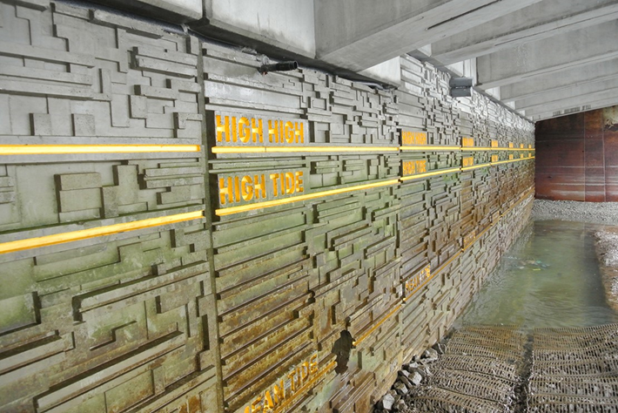
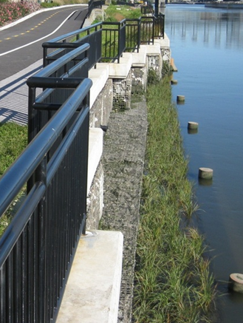
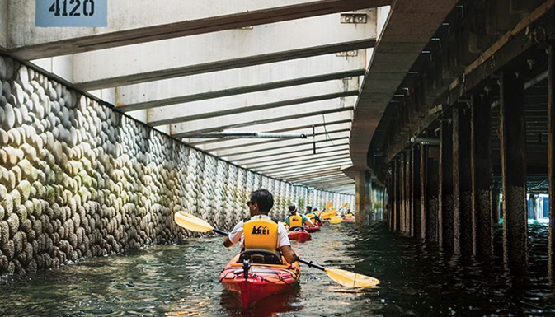
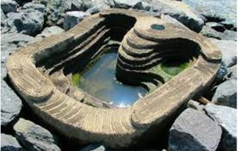
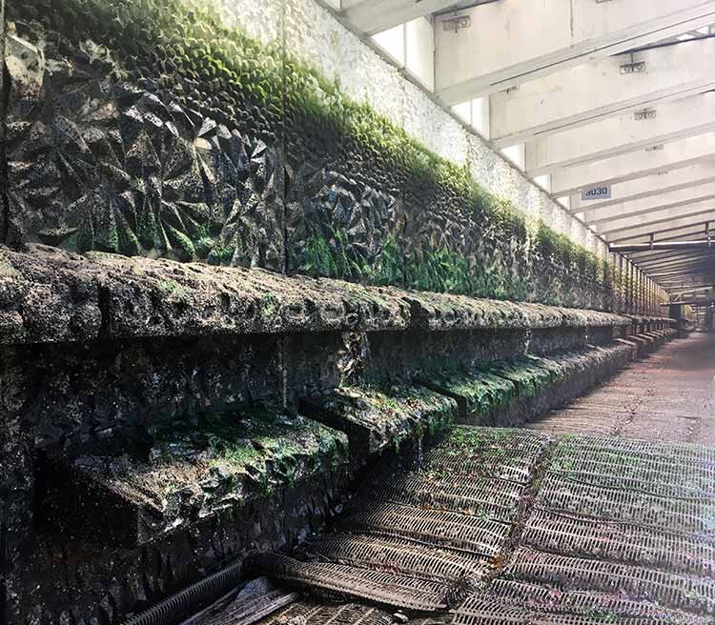
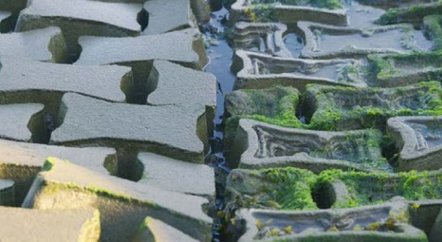

Slide 18
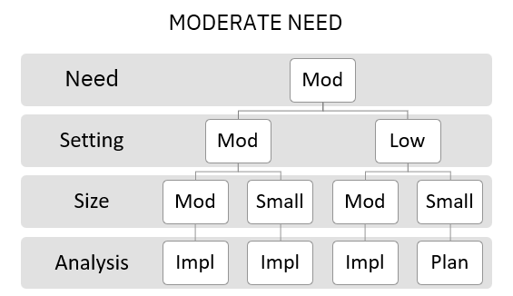
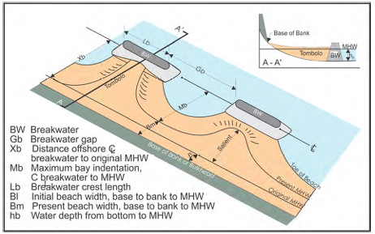

2024 Traditional LS Update (in development)
Level of Analysis and Design Appendices
Level of Analysis Appendix
  Considers project need, setting, and size to determine the level of analysis required
Engineering Design Appendix
  Provides guidance on appropriate formulas for determining project layout, cross-section, and materials
$$K_{t}=−0.4\frac{R_{c}}{H_{s}}+0.64{\left(\frac{B}{H_{s}}\right)}^{−0.31}\left(1−e^{−0.5ξ_{op}}\right)$$

Slide 19
2024 Update (in development)
Engineering Assessment Appendix
Combines a Structural Assessment (SA) based heavily on ASCE Waterfront Facilities Inspection and Assessment with a Performance Assessment based on quantifiable goals/targets
Example PA could include: reducing the erosion rate, sediment retention, reducing incident wave energy, species recruitment,
Performance Rating | Quantification | Coverage/Notes
Not Inspected | Not visible or accessible | Not visible or accessible
Good | Based on objective | At or above target (>100%)
Fair | Based on objective | Near target (50% to 100%)
Poor | Based on objective | Well below target (0% to 50%)
Serious | Based on objective | Slight adverse (-50% to 0% of target) impact
Critical | Based on objective | Significant adverse (<-50% of target) impact
Lowest Condition Rating from Previous Inspection | Low consequence of failure | High consequence of failure
New | 12 | 12
Good | 36 | 24
Fair | 24 | 18
Poor | 12 | 9
Serious | 6 | 3
Critical | 3 | Immediate

Slide 20
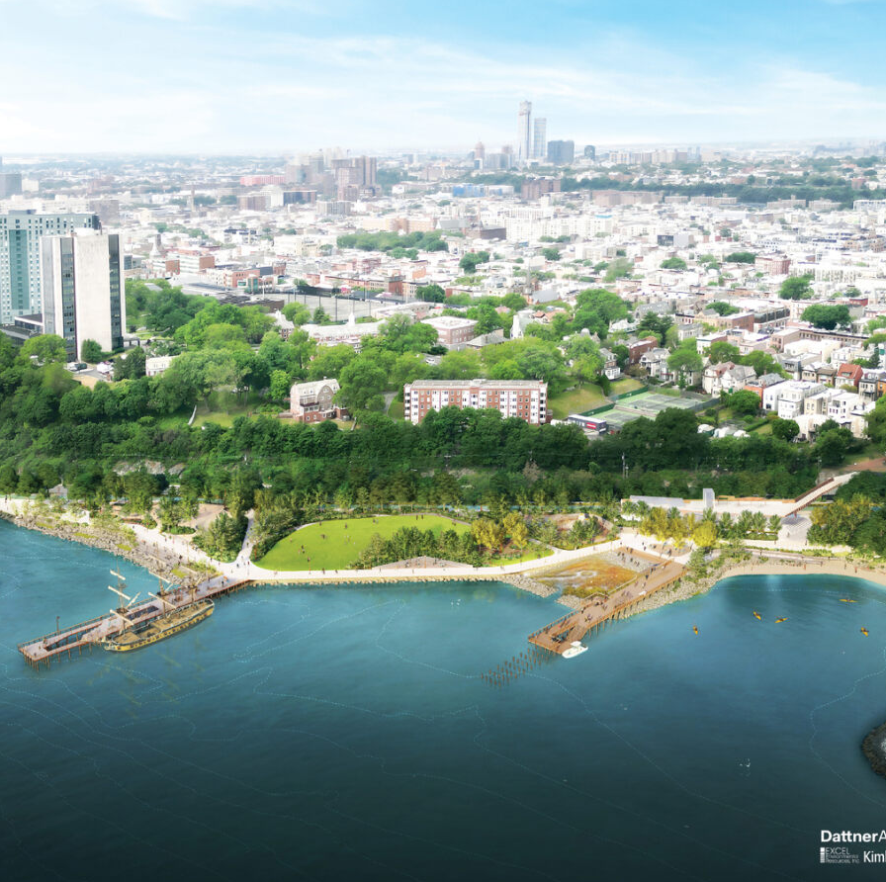
Future
Challenges and opportunities

Slide 21
Climate Change
Somewhat Effective
Very Effective
Sea level rise
More frequent and intense storms
Feedbacks
  Deeper water → larger waves
  “Modification” of wave attenuation associated with natural and engineered features
  Potential loss of habitat/natural wave attenuation
SLR
Ineffective (harmful?)

Slide 22
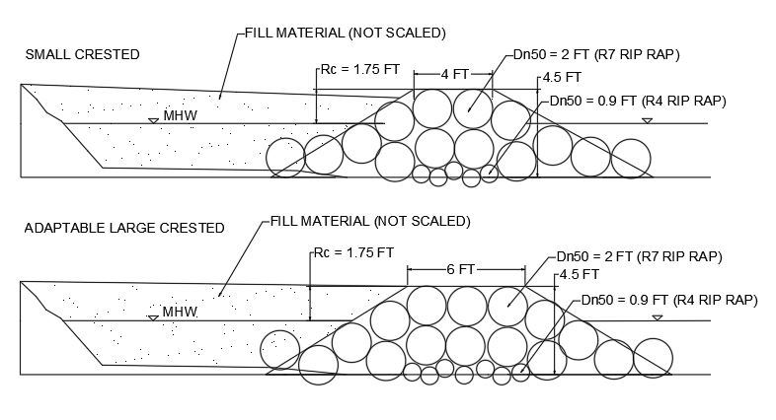
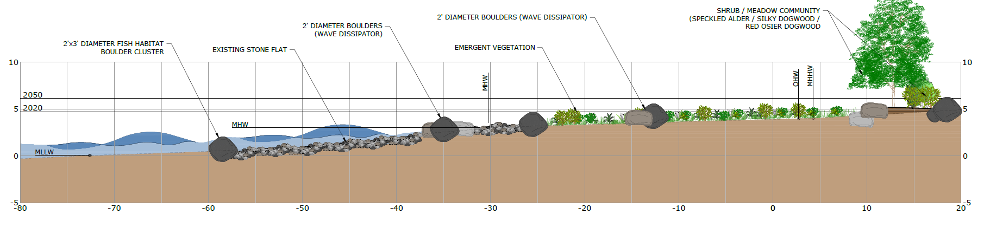
Potential Solutions
Solution 1 - build taller structures
  results in initially overbuilt structures that are more costly, unnatural, and that often provide less in terms of ecosystem services
Solution 2 – build wider adaptable structures
  provides similar wave attenuation as taller structures, more closely mimic natural reef systems, and can be adapted by adding additional layer(s) of stone
  Difficult to permit (currently)
Solution 3 – Adaptive designs that allow for habitat transitions

Slide 23
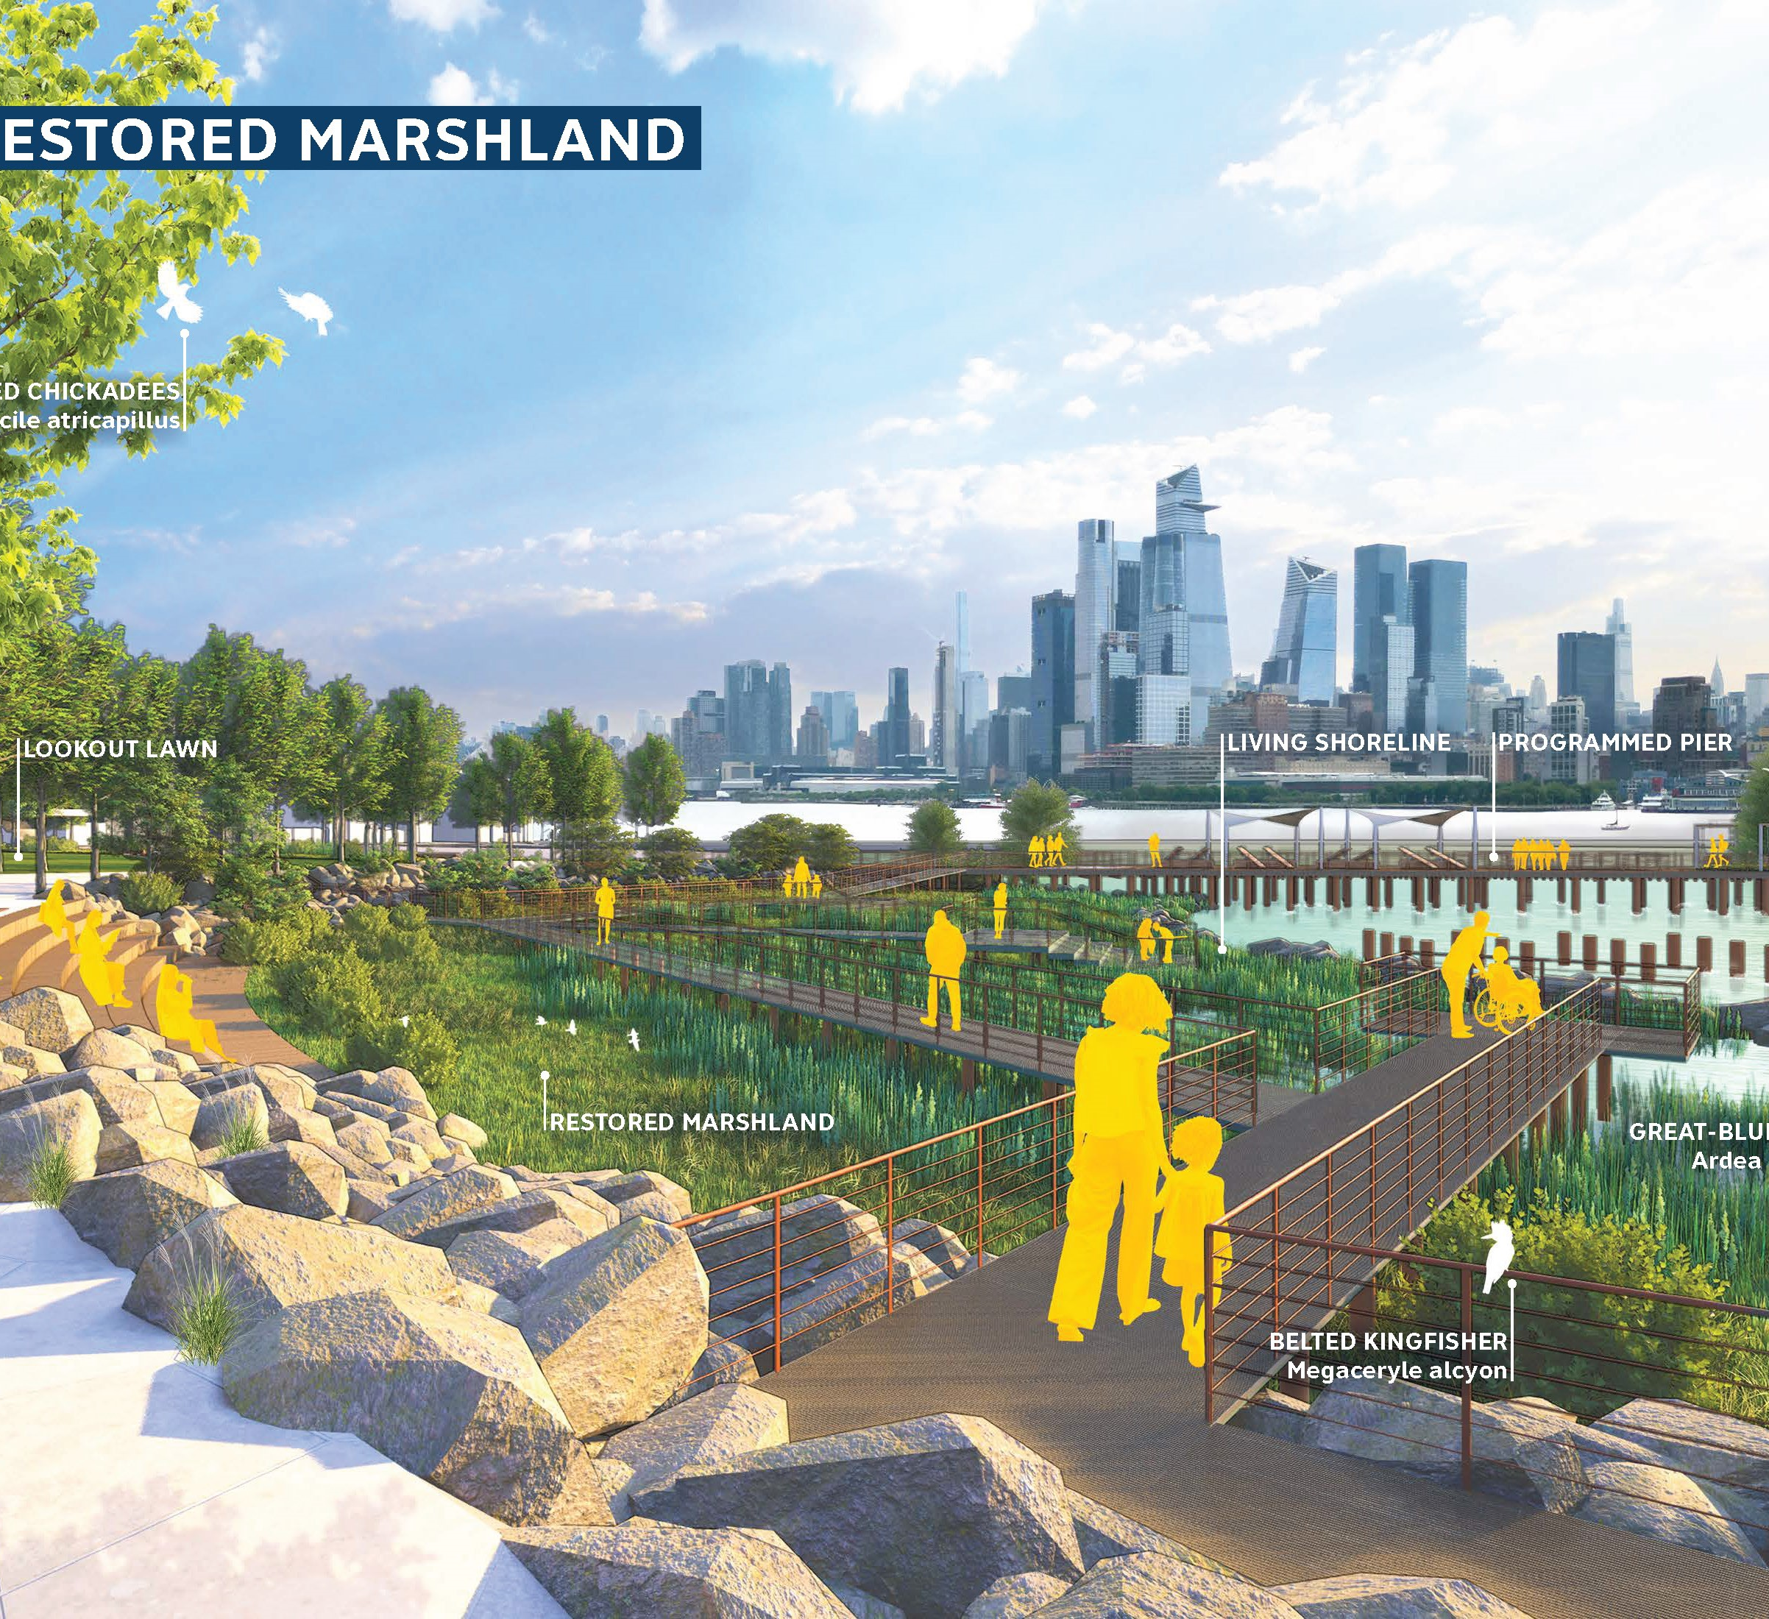
Summarizing
Past
  “Living Shorelines” in NJ began in the late 2000’s
  Significant accomplishments including GP24, Engineering Guidelines, and dozens of projects
Present
  NJ recently updated the Engineering Guidelines, with a new update coming in 2024
  NJ thinking about the application of Living Shorelines Principles to urban environments
Future
  Climate change/SLR will be a challenge
  Adaptable designs will be critical – design, construction, and regulatory challenge
  Monitoring will be essential

Slide 24
