Slide 1
Creating Flood-Resilient Landscapes in New Jersey Communities
Department of Ecology, Evolution and Natural Resources
Brooke Maslo, Ph.D.
Kathleen Kerwin
School of Design, South Dakota State University
Jeremiah Bergstrom, LLA
Shelbie Nath

Slide 2
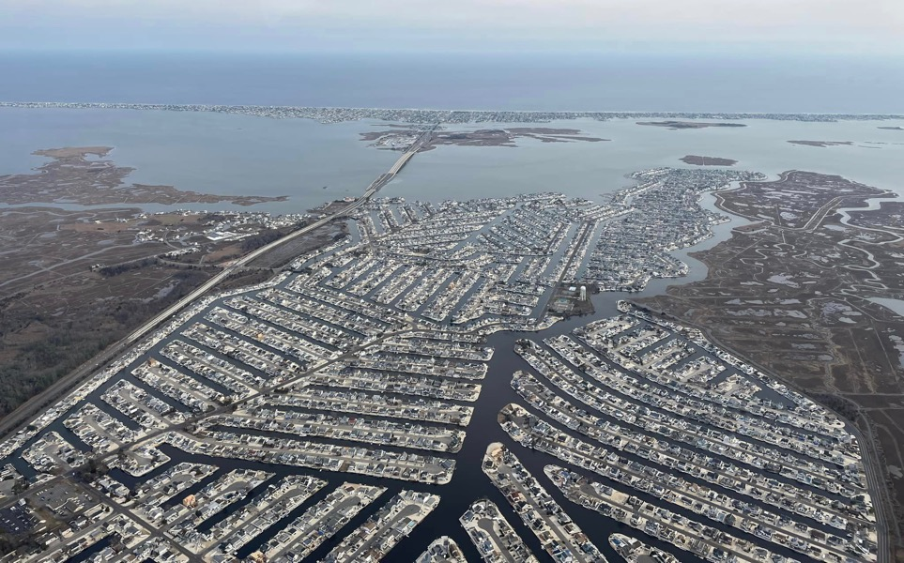
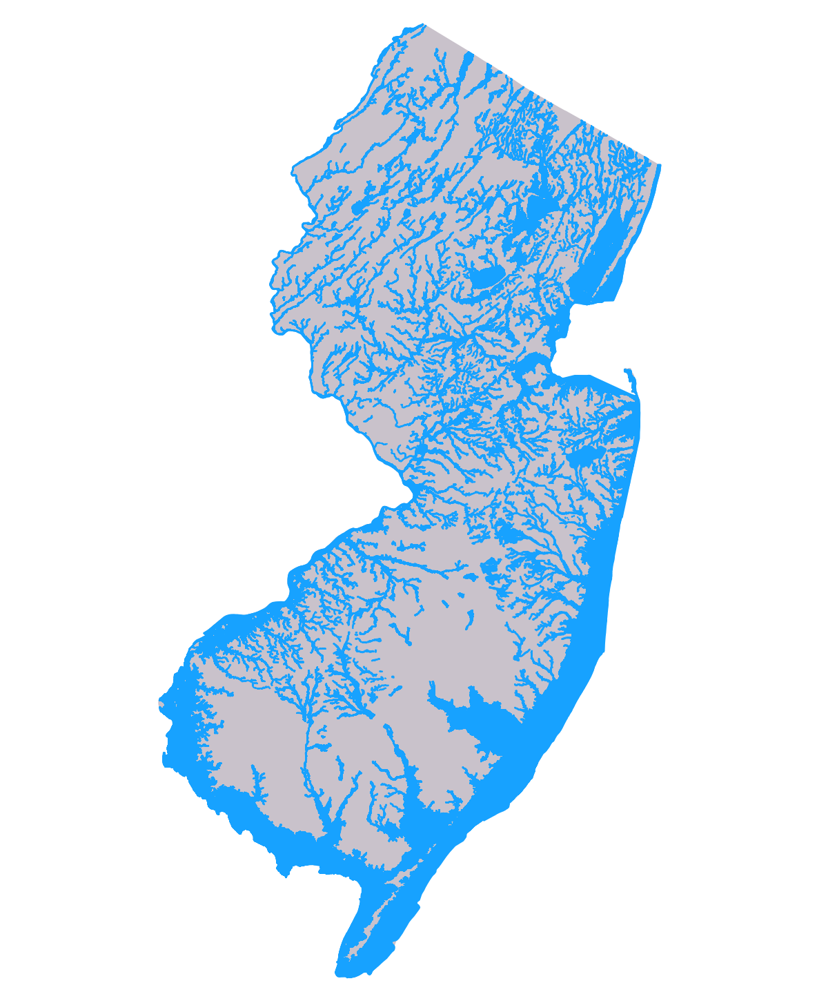
New Jersey’s Flood Vulnerability
549 of NJ’s 565 municipalities have been affected by flooding
1,792 miles of coastline; 6,450 miles of rivers
25,000 properties at risk of chronic flooding by 2035; 182,462 properties by 2100
100-year flood zones in NJ
Notes:
Despite being a relatively small state, New Jersey has almost 1,800 miles of coastline, and close to 6500 miles of rivers.The image on the right maps all 100-year flood zones across the state, and as you can there are very few places constituting higher ground. About 1/3 of the state’s total land area is developed, and much of that land is found within or in close proximity to these special flood hazard areas. As as we all know, flooding and infrastructure don’t mix well. And so most municipalities in the state have been affected by flood events, with the risk to property predicted to continue increasing over time.

Slide 3
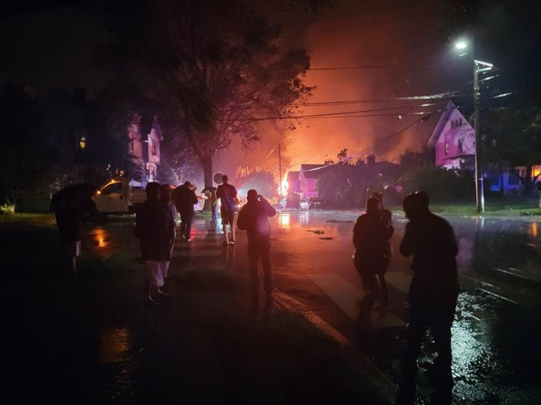
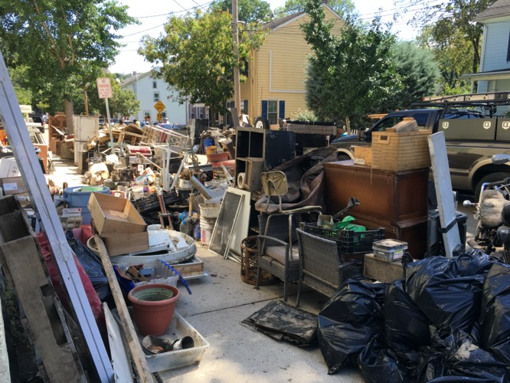
Flood Damage in New Jersey
Direct Losses Due to Flood Events (1960-2020)
Impact Category | Amount
Fatalities | 58
Injuries | 260
Property Damage | ~$23.5 billion
Crop Damage | ~$1.1 million
(Source: www.sheldus.org, accessed January 2022)
Notes:
To throw some more numbers at you, New Jersey also ranks in the upper half of the United States in casualties and property damage resulting from flooding.

Slide 4
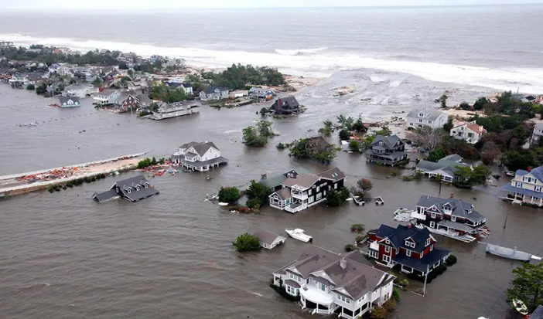
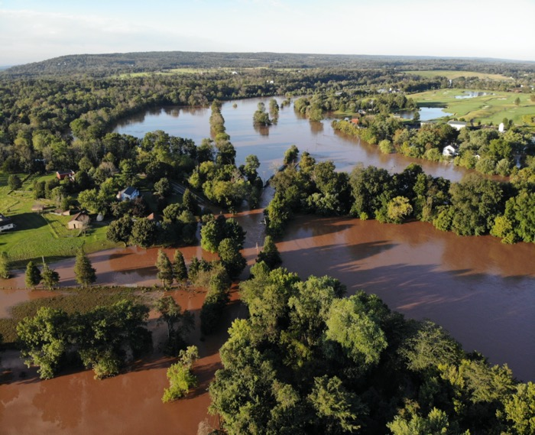
Notes:
Much of those figures are associated with Hurricane Sandy, which clearly was a catastrophic event. Even after 10 years post-storm, we all still remember the flooded NYC subway, the collapsed Mantaloking Bridge, and barrier islands where the ocean and bay met.

Slide 5
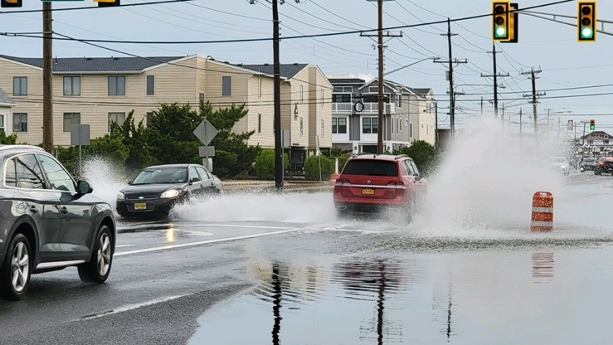
Notes:
But a sizeable portion of flood insurance claims for NJ come from flooding not associated with a major storm. Because of a combination of multiple factors, including sea level rise, land subsidence, and significant amounts of impervious cover, flooding after typical rain events or even high tides has become the norm. And so we all recognize that a managed retreat from flood zones is a necessary strategy for dealing with the effects of climate change, particularly in getting people out of harm’s way and allowing the water a place to go,

Slide 6
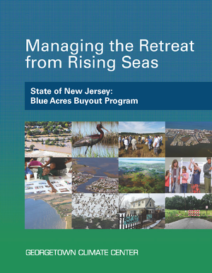
Over 760 properties acquired through the New Jersey Blue Acres Program
voluntary buyout program
acquired properties become state-owned lands to be managed by the municipality in which they are located
no new permanent structures allowed (including piping & other hard flood mitigation structures)
allowed uses of property include passive recreation, wetland management, natural areas, unpaved parking
Notes:
One of the leading initiatives in the state is the Blue Acres Program, run by the NJ Department of Environmental Protection. The Blue Acres Program is a voluntary buyout program. Funding typically comes to the state from federal sources , and properties in flood prone areas are then purchased from homeowners at fair market value. Once acquired, the land is then owned by State of New Jersey. The structures removed, and the properties are then to be managed by the municipality in which the properties are located as open space. No new permanent structures are allowed on the property, and the properties are deed restricted, with allowable uses including things like passive recreation, wetland management, natural areas, and unpaved parking.

Slide 7
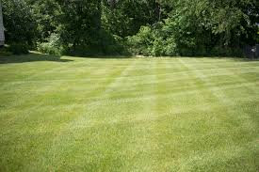
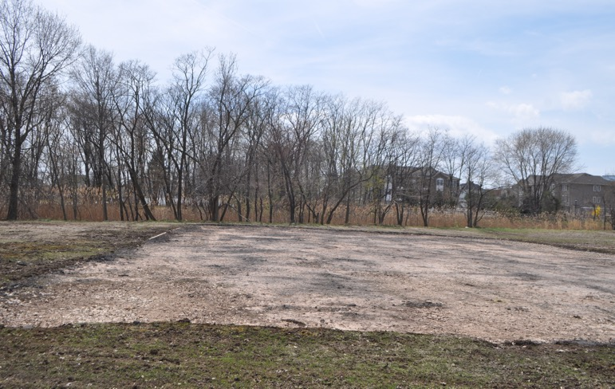
Challenges of Creating Resilient Landscapes
legacy effects of development
external environmental stressors
sense of abandonment or retreat
funding
additional maintenance burden
inappropriate human uses
differing expectations of outcomes
Notes:
With the removal structures, resilience is immediately increased. Both people and property are now out of harm’s way. And that’s a great thing. And for a long time, the buyout itself was viewed as sort of the end game. But after the buyout is complete and the structures are removed, several new challenges emerge. First, previously developed landscapes are not inherently resilient, and in many cases their ability to store and infiltrate flood waters is low. These areas often suffer from poor soils, compaction, invasive species, etc. And so there are legacy effects that need to be overcome to restore the ecological function of these areas. There are also many external stessors, again the encroachment of invasive species, perhaps runoff or pollution issues from outside the buyout area… those sorts of things. And from the social side of things, there can certainly be a sense of abandonment as some residents remain in the area because they did not accept the buyout. These areas may suffer from inappropriate uses, like ATVs or illegal dumping. And from a management perspective, although the properties are owned by the State, the onus of managing them falls on the municipality in which they are located. And so, on one hand there are residents remaining who are expecting a mowed, parklike atmosphere, while the Department of Public Works cannot keep up with the increased demands of such an unsustainable maintenance approach. And so these are considerations that munipalities think about when deciding how to approach buyout areas in their jurisdiction.
When we initially got involved in New Jersey’s buyout initiatives, we quickly realized that there simply isn’t a lot of guidance about what to do with landscape post-buyout. Our team consists of ecologists, engineers, and landscape architects, and we have been designing and implementing resilient landscape projects in New Jersey for several years now. And so we decided to combine our academic expertise along with our experience-based ‘lessons learned’ to

Slide 8
Notes:
We have been working with municipalities for several years now, designing and implementing resilient landscape projects in New Jersey. My team consists of ecologists, landscape architects, engineers, and designers. When we initially got involved in New Jersey’s buyout initiatives, we quickly realized that there simply isn’t a lot of guidance about what to do with landscape post-buyout, and what is out there does comes in kind of bits and pieces from several sources. So we decided to combine our academic expertise along with our experience-based ‘lessons learned’ to develop a comprenshive, one-stop shopping primer for creating flood resilient landscapes in New Jersey Communities.
The work is funded by the NJDEP’s Resilient NJ program, along with some seed grant money from the Rutgers Institute of Earth, Atmospheric and Oceanic Sciences. The primary audiences are local government and green team groups, and the goal is to provide background information and support for communities to understand why flood resilience is needed, how to go about doing it, and how to fund it.
And so I think now the talk becomes a bit of a commercial, but I just want to quickly walk through the chapters to give you a sense of what type of content we have included in this primer.

Slide 9
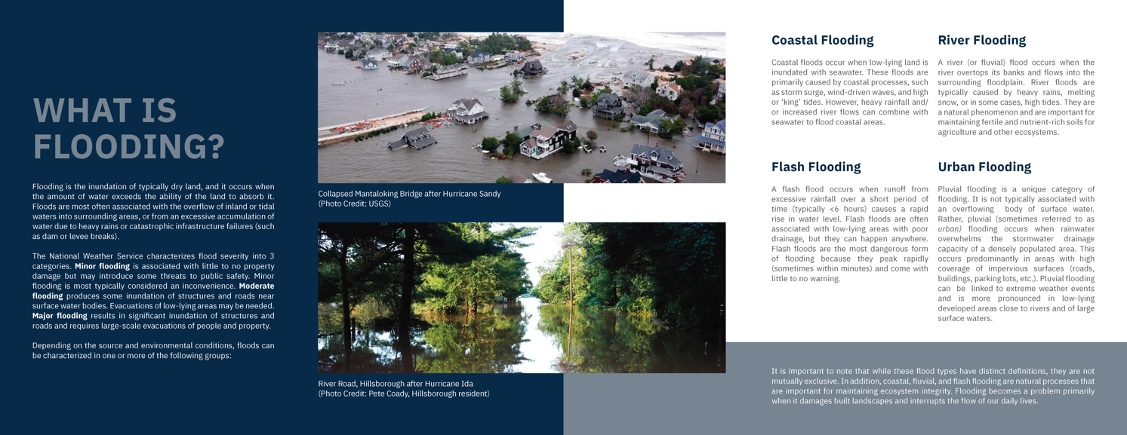
Section 1: Framing the Problem Facing
New Jersey Communities
Notes:
I should say also that the format of this manual is meant to be graphics-heavy and easily digestible, but also to drive home several important points about what is required in creating a resilient landscape.
There are 3 sections to this primer. The first section is entitled Framing the Problem Facing Communities. Here is a page from Chapter 1, which is aimed at defining flooding, flood types, severity, and NJ’s vulnerability to flooding.

Slide 10
Section 1: Framing the Problem Facing
New Jersey Communities
Notes:
Chapter 2 deals with how to create a foundation for resilience… We cover things basic things like defining resilience, understanding the difference between resilience and disaster avoidance, how to assemble a multidisciplinary project team. We also provide a strategic framework for carrying out a landscape resilience project.

Slide 11
Section 1: Framing the Problem Facing
New Jersey Communities
Notes:
Finally, we discuss in more detail several of the challenges that one may face when creating a resilient landscape, and we provide some tips on how to address those challenges.

Slide 12
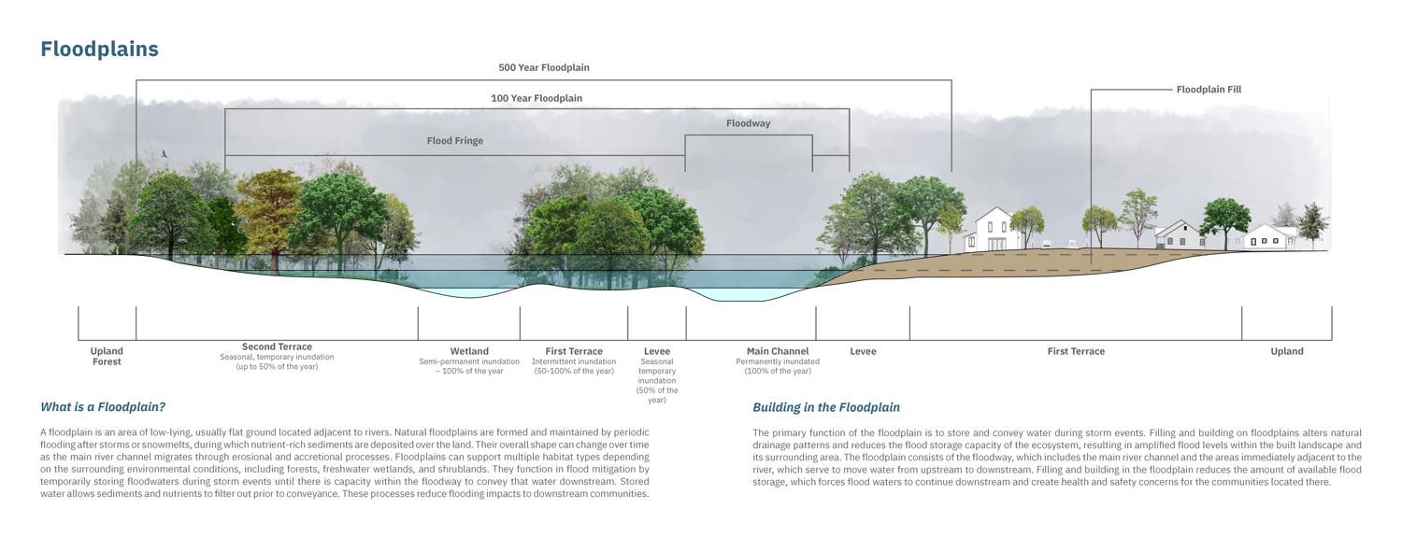
Section 2: Understanding How Flood-Prone
Ecosystems Function
Notes:
In Section 2, we spend a good deal of time on ecology. We want folks to understand how flood-prone landscapes function (right, that they are supposed to flood), and how building on them interrupts natural processes. Here from Chapter 4 I’m showing you a cross section of a river floodplain. On the left hand side, the floodplain is in its natural state. On the right it is developed. The bottom labeling defines natural floodplain zones, while the upper labeling defines those same areas but with regulatory terminology. And we have these cross sections for many different habitat types.

Slide 13
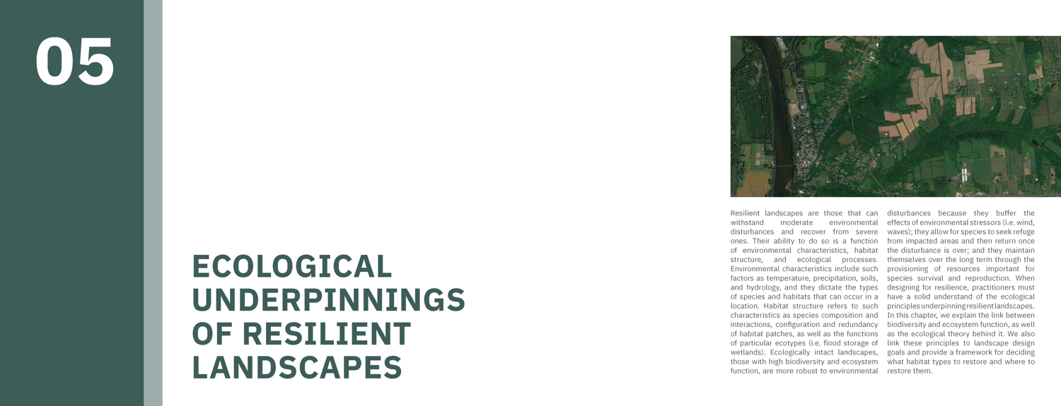
Section 2: Understanding How Flood-Prone
Ecosystems Function
Notes:
We then devote Chapter 5 to the Ecological Unerpinnings of Resilient Landscapes. This is my Ecology 101 chapter. We discuss basic concepts at the foundation of ecological restoration… things like succession, biodiversity, how biodiversity contributes to ecosystem function.

Slide 14
Section 2: Understanding How Flood-Prone
Ecosystems Function
Notes:
We also discuss topics related to habitat design, showing the importance of connectivity, buffers, hard vs soft edges, and scale. Here is just one page talking about Landscape Linkages and Habitat Corridors.

Slide 15
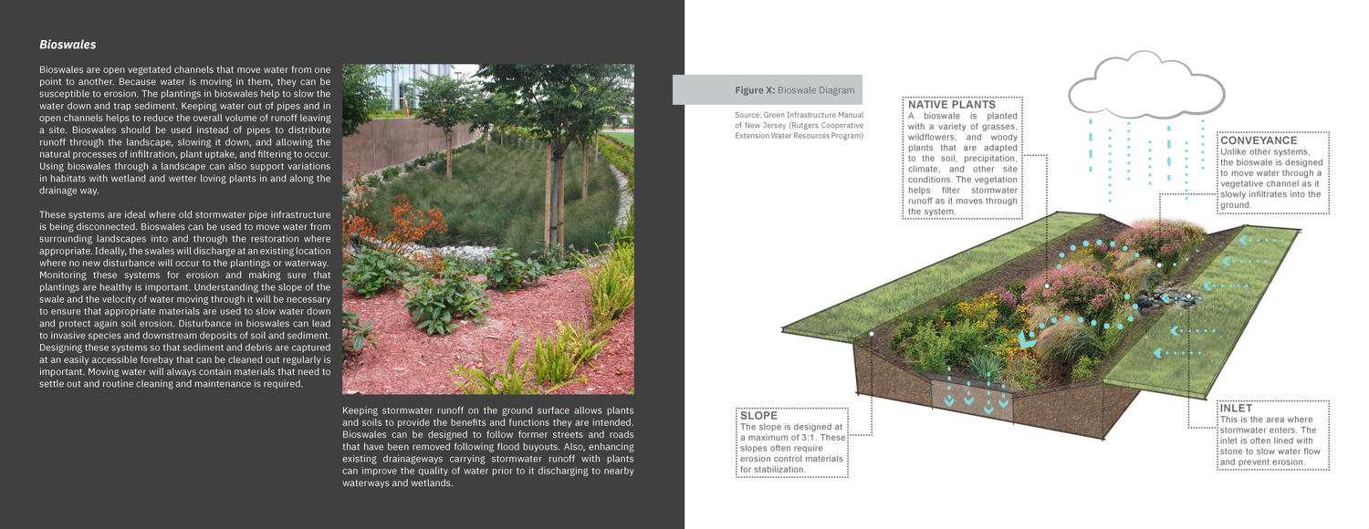
Section 3: Creating and Sustaining
Flood-Resilient Landscapes
Notes:
Section 3 is very design and implementation focused. Here we provide technical guidance on the landscape design, green stormwater infrastructure (here as an example in this 2-page spread, we are focused on bioswales).

Slide 16
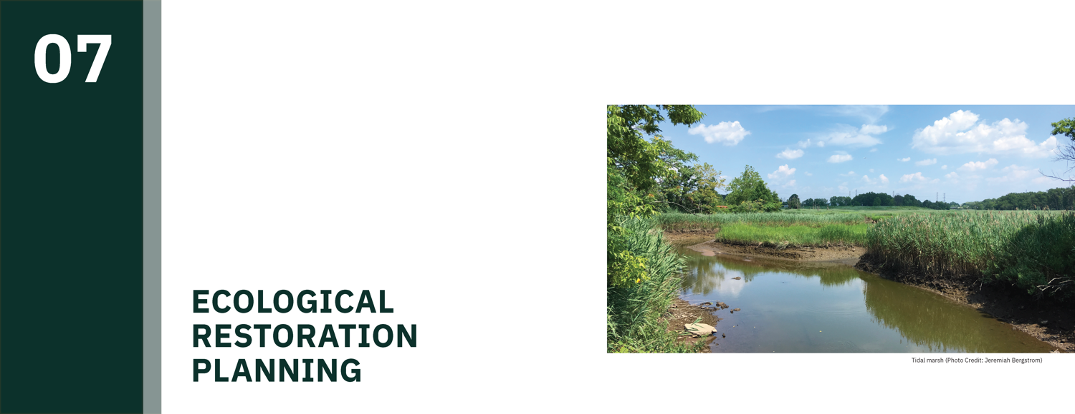
Section 3: Creating and Sustaining
Flood-Resilient Landscapes
Notes:
We then move on in Chapter 7 to Ecological Restoration Planning. Here we discuss topics such as the use of native species, decision support about what to plant, what size containers to purchase, how to define plant palettes that will be robust to climate change. Again, this is all presented in a very practical manner,

Slide 17
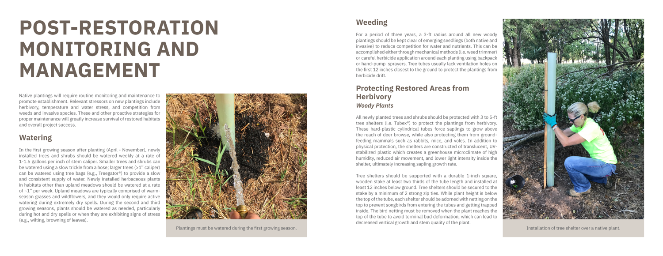
Section 3: Creating and Sustaining
Flood-Resilient Landscapes
Notes:
We also dedicate a chapter to monitoring and maintenance, both before implementation activities and after (as this 2-page spread illustrates). We discuss site preparation, soil amendments, planting and plant protection strategies, and we end the chapter with a series of graphical timelines to show the process of, for example, creating and sustaining meadow habitats or wetland habitats.

Slide 18
Section 3: Creating and Sustaining
Flood-Resilient Landscapes
Notes:
Finally, we end with a chapter on why investing in landscape resilience is important, and we highlight several programs that provide funding to support landscape resilience projects. These are categorized by order of magnitude, from small, community-scale projects, to significant federal programs for assistance.

Slide 19
For a hard copy, email brooke.maslo@rutgers.edu
Available online:
https://rcei.rutgers.edu/resources/flood-resilient-new-jersey/

