Slide 1
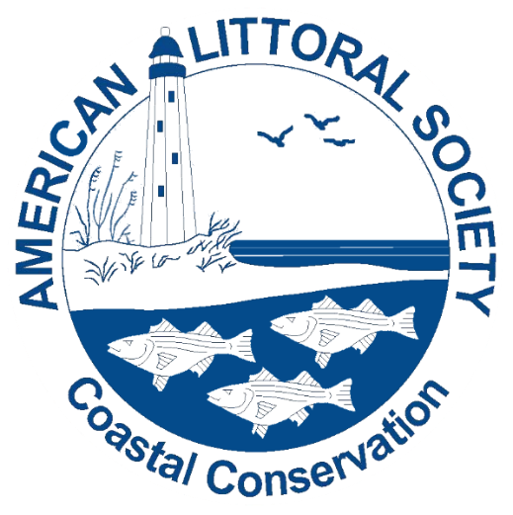

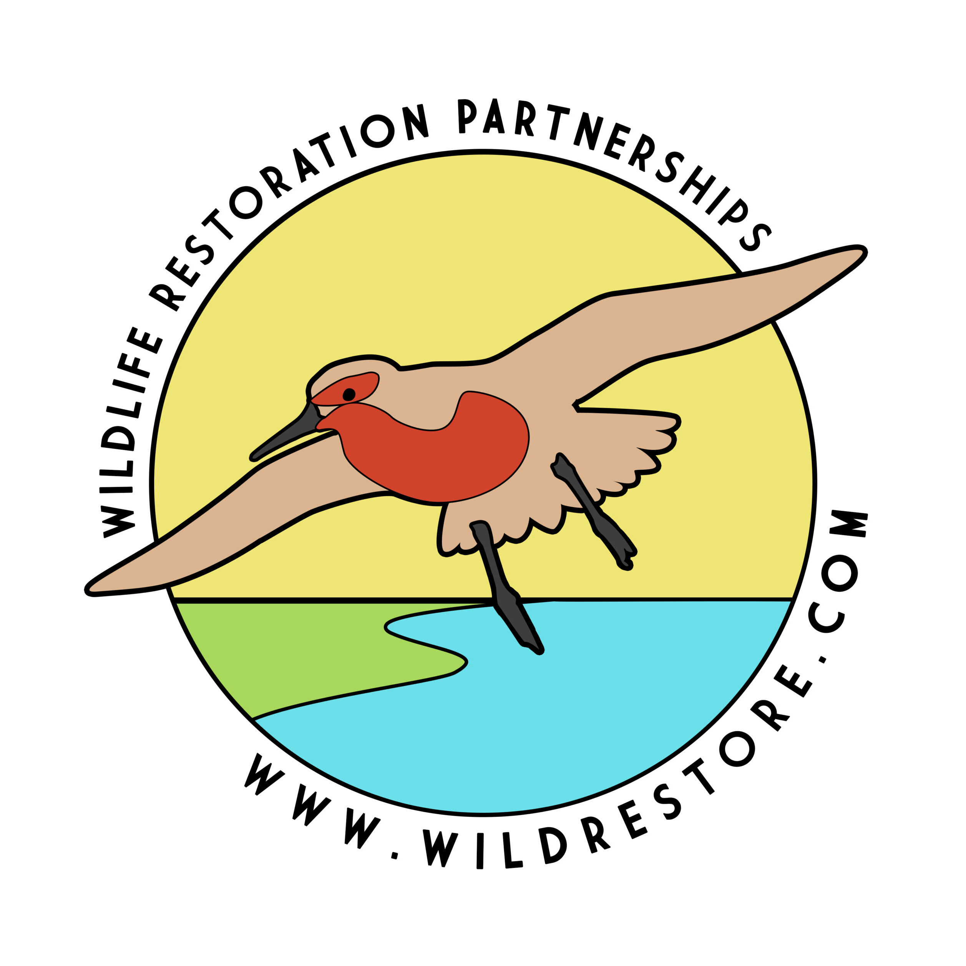
Creating Resilient Marsh and Beach Habitat in Delaware Bay: The Emergence of a Regional Restoration Strategy in the Face of Climate Change
Capt. Alek Modjeski
Habitat Restoration Program Director
Certified Ecological Restoration Practitioner/Coastal Ecologist
American Littoral Society
alek@littoralsociety.org
Steven Hafner
Assistant Director Coastal Research Center
Certified Floodplain Manager, Coastal Geologist, Env. Scientist
Stockton University
steven.hafner@stockton.edu
Stephanie Feigin
Wildlife Ecologist
Wildlife Restoration Partnerships
Stephaniefeigin@gmail.com
www.littoralsociety.org
Notes:
Introduce yourself
Quick Littoral Society intro – Coastal Conservation non-profit since 1961 – advocacy, education, restoration
Presentation intro -Check out our new website We care for the coast and empower others to do the same

Slide 2
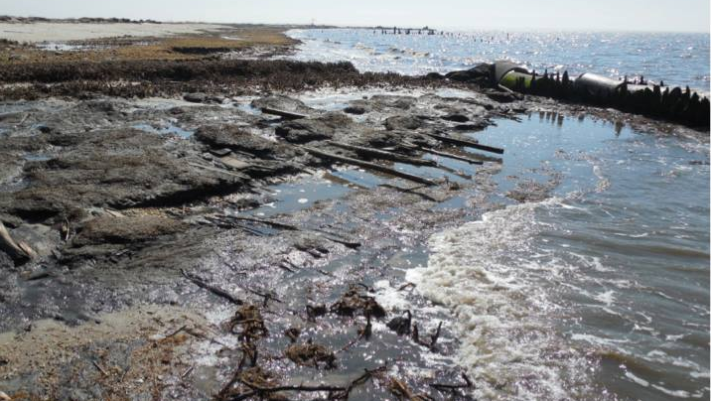
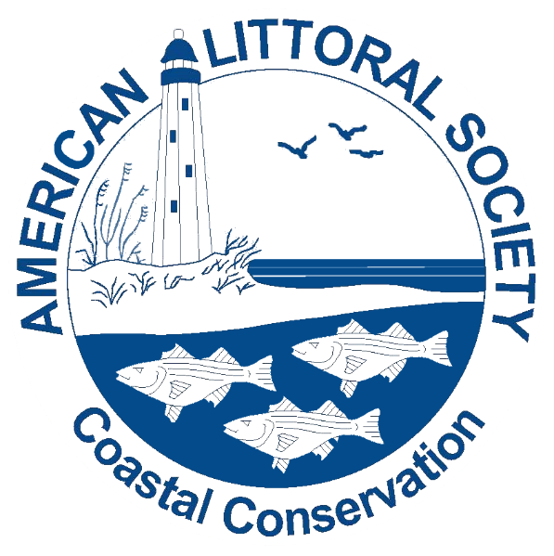
Delaware Bay Resiliency Restoration Core Partners and Funders
Core Partners
Stockton University Coastal Research Center
Wildlife Restoration Partnership
Funding provided by
National Fish and Wildlife Foundation
Department of Interior (US Fish and Wildlife Service)
NJDEP
William Penn Foundation
Geraldine R. Dodge Foundation
NJCWRP
Notes:
Core Partners and funders – It takes innovative partnering to get the job done

Slide 3
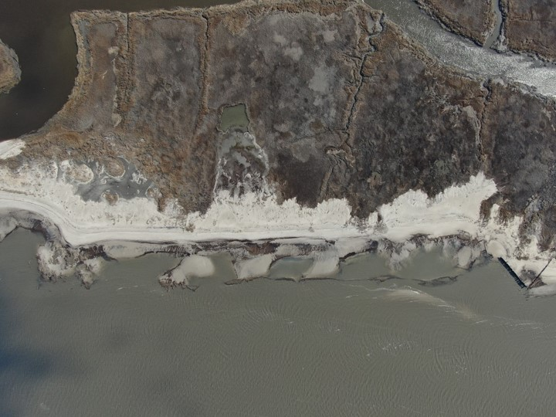
What are we talking about today?
Goals of our Habitat Restoration
Evolution of our Habitat Restoration in Delaware Bay since Sandy
  What’s been done
  What’s changed to address a changing environment
  How do we get more Programmatic?
Monitoring/Adaptive Management/Innovation
    Using what we have learned to improve strategies
Salt Marsh Restoration and Carbon Sequestration
  Planning ahead

Slide 4
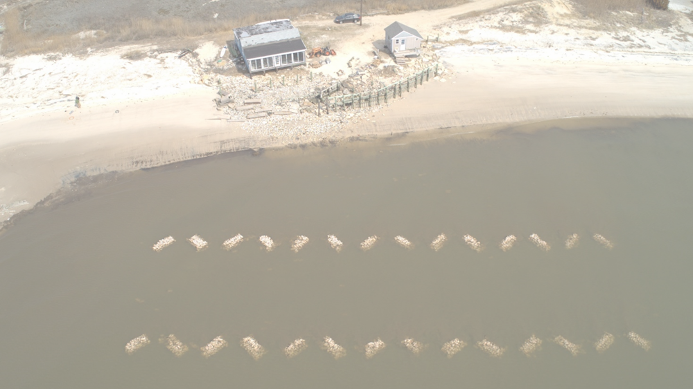
Promote and undertake restoration of habitats and creation of living shorelines
    Vegetated Berms
    Beaches
    Oyster Reefs
    Salt Marsh
Provide ecological uplift and improve community resiliency
    Flood and Storm (Climate Change)
    Water Quality and Carbon Sequestration
Inform, involve, and engage the public on our restoration projects
    Social Media
    Volunteers and US Veterans
    Outreach
    Engage Future Practitioners - Restoration Corps
Our Habitat Restoration Goals

Slide 5

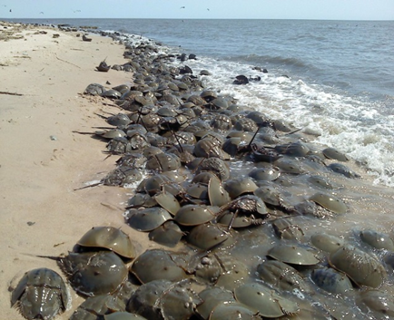
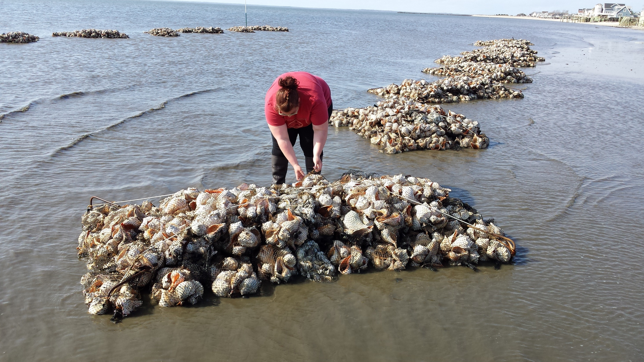
Delaware Bay Restoration Projects
5.49 Miles of Beach Restored (85.5+ acres)
2,051 Tons of Rubble Removed
228,000 Cubic Yards of Sand Trucked and Placed
8 Intertidal Oyster Reefs (3,210 lf)
Delaware Bay Sediment Transport Analysis Tool (D.B.S.T.A.T.)
30,000 horseshoe crabs tagged
Regional 10-year permit -Goals
Regional State Blanket Permit - Goals
Mouth of the Maurice River
But where do we go from there in the face of climate change?
We monitor, we learn, we adapt, and the restoration evolves
Notes:
Core Partners and funders. Non Federal match includes $423K from CWF (3
years of Avian Study support, $30,000 from
NJDEP for egg density surveys, $106,216 from
volunteers through December 31, 2017. Includes
$550 from Weggel Engineering.

Slide 6
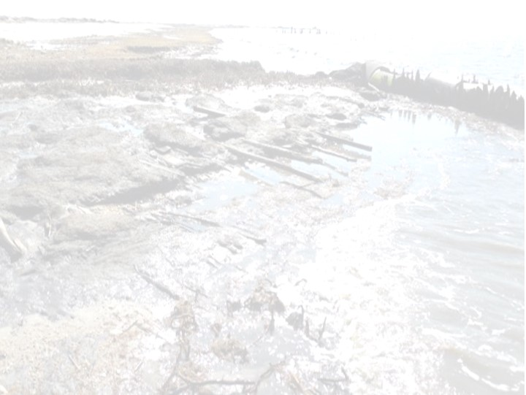
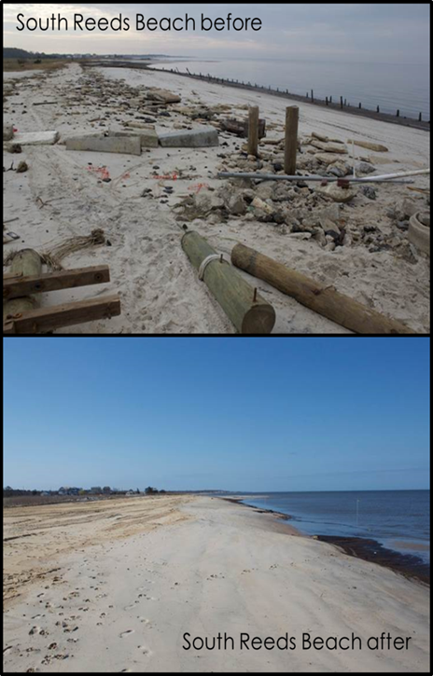
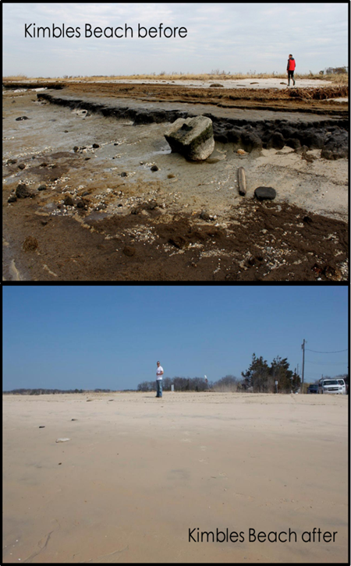
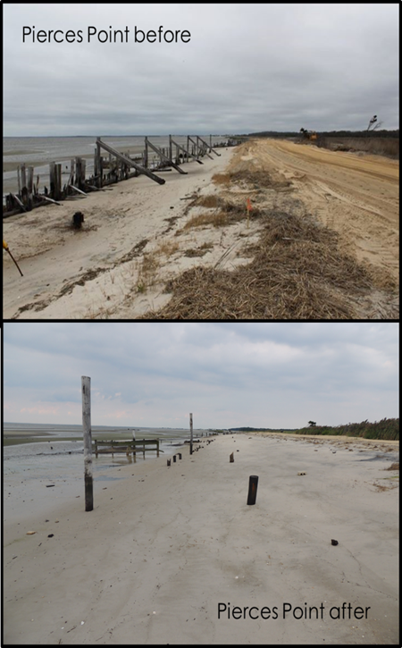

Our restoration began within months after Hurricane Sandy at 5 beaches…..
Moores Beach before
Moores Beach after
We learned beach restorations have a 5-year life span and need to be revisited
Notes:
Funded by USFWS and NFWF, here are some of the before and after photos of our fist 5 beaches

Slide 7
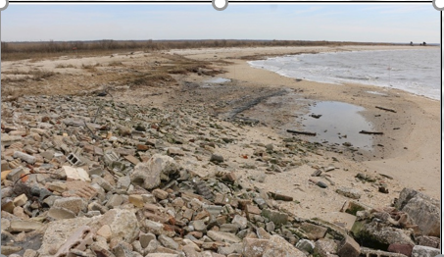
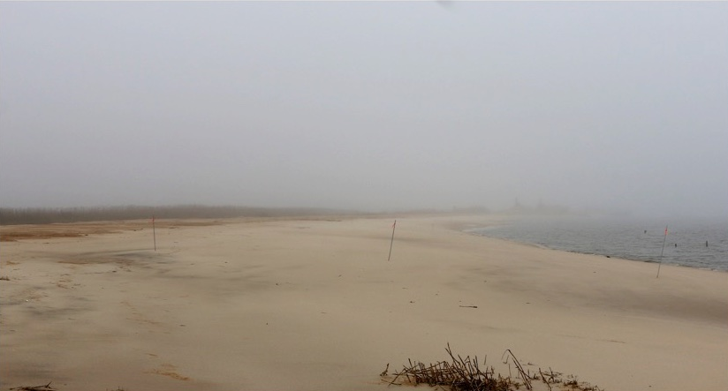
Thompsons Beach – Maurice River Township
….. And 3 others through 2017 (taking what we had learned)
2 out of 4 cells complete – Reef build completed spring 2017 – ASBPA Best Restored Beach in US 2018
Notes:
Thompsons, one of the more productive hc spawning beaches was devastated, but over 40,000 cy later it is now the most productive beach we have monitored

Slide 8
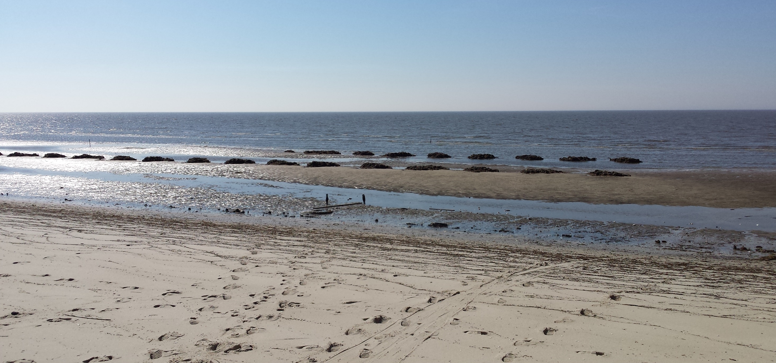
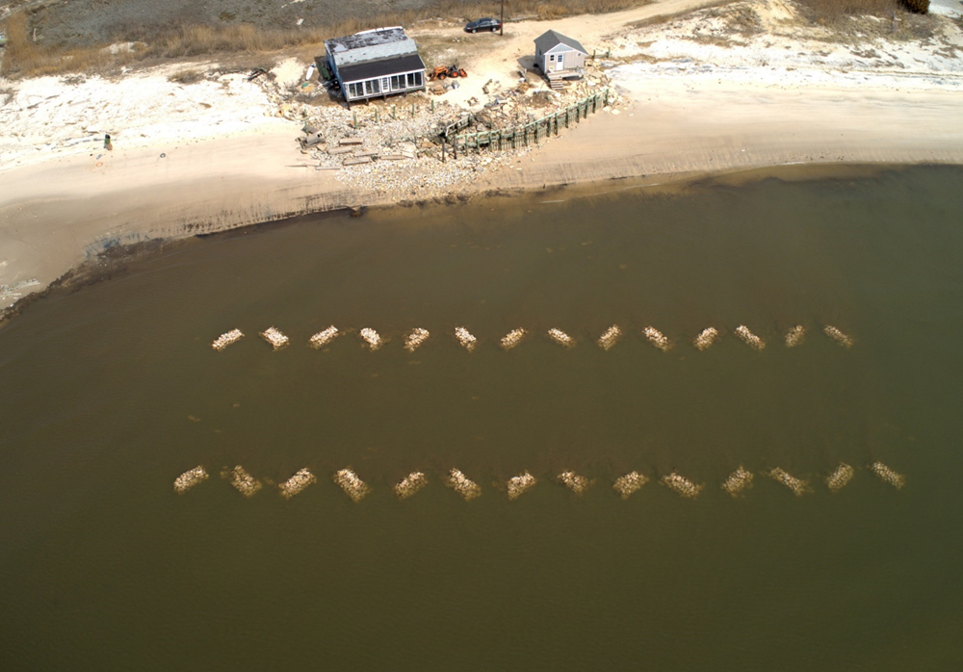
Keeping Sand on the Beach
Single Reefs (double-rowed)
100s of Volunteer
25,000 Shell Bags
Tides
Outreach/Engagement
US Veteran Monitoring

Slide 9
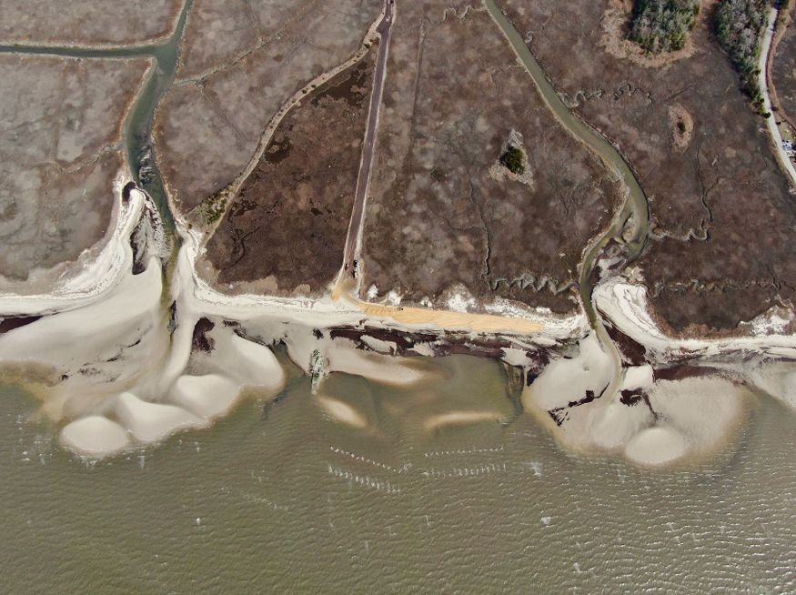
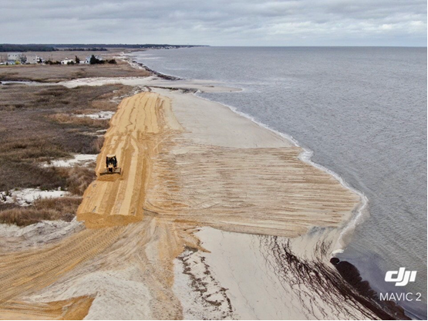
Cooks Beach 2020 (multiple reefs)
Shoals
Double-rowed

Slide 10
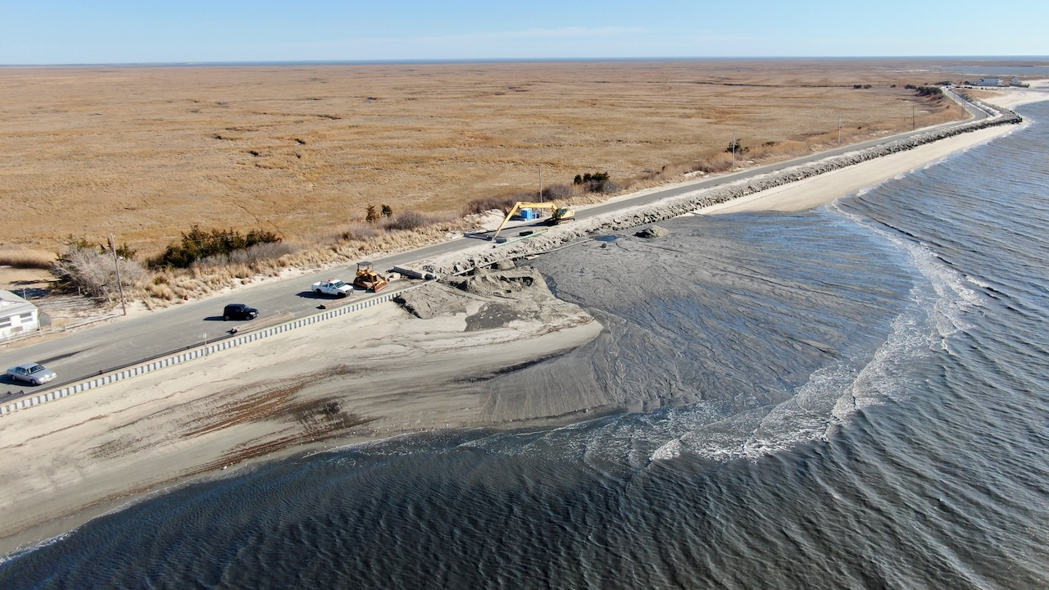
Fortescue Beach 2022 (new sources and new partnerships)

Slide 11
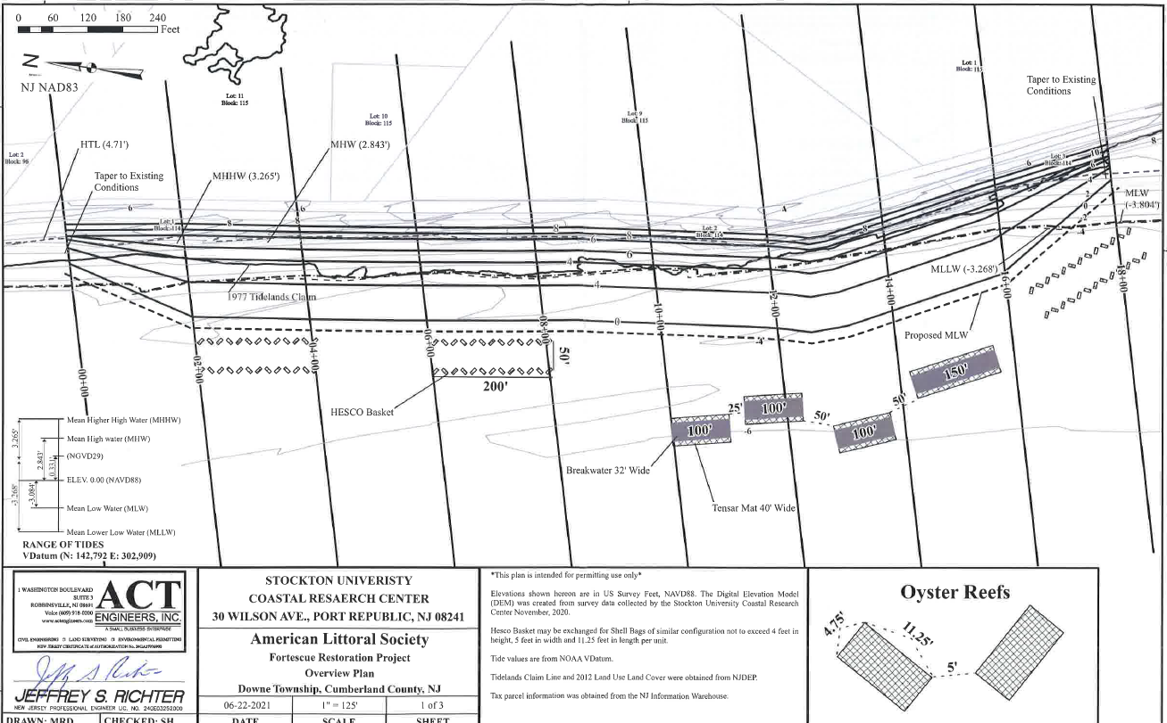
Fortescue 2024 - Combination of Hybrid Breakwaters and Shell Bag Reefs at Fortescue

Slide 12
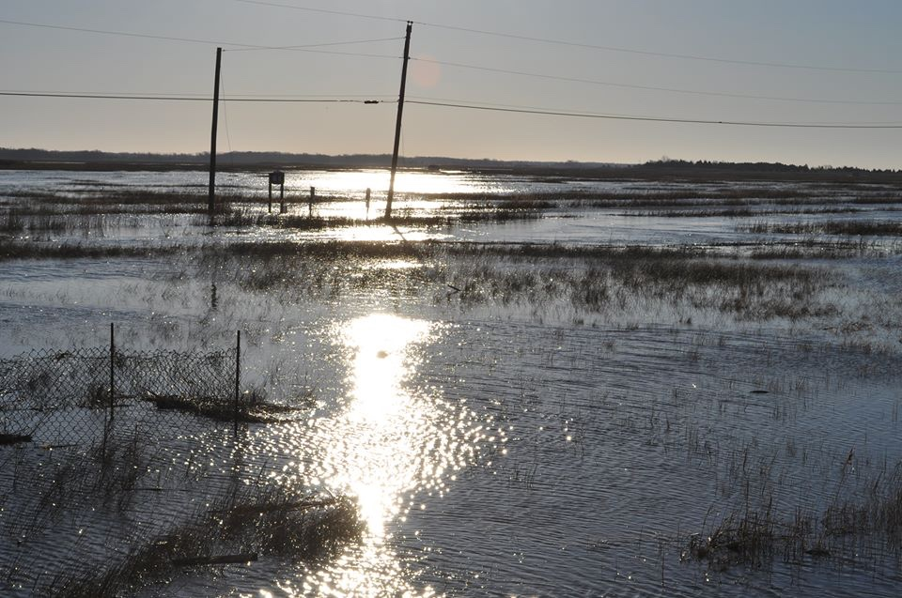
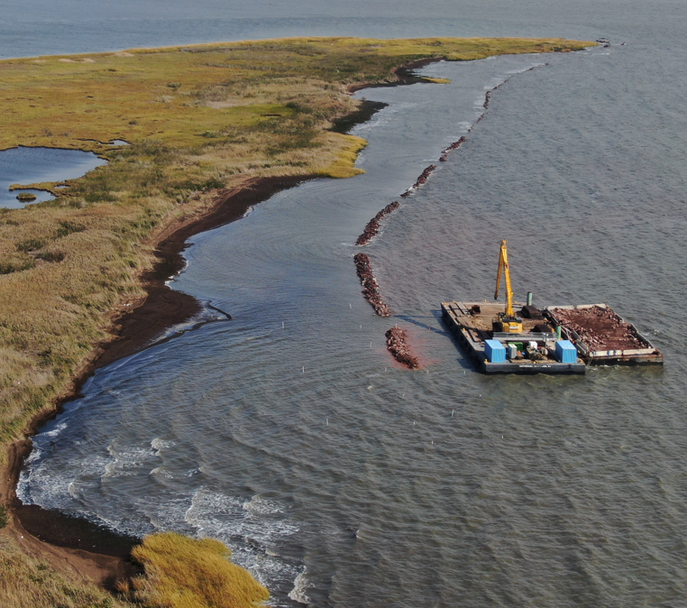
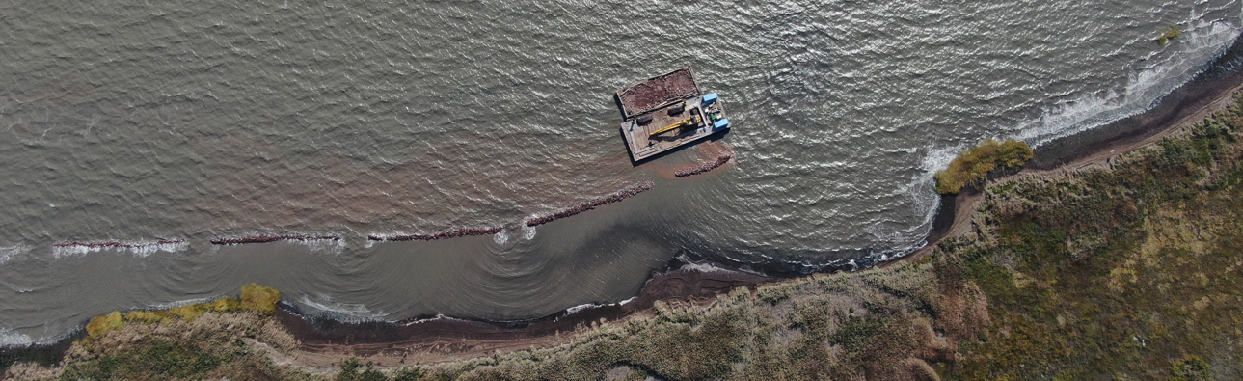
Mouth of the Maurice River: Mattresses, Rock, Geo-Grid, Shell, Coir, and Vegetation
6,400 lf of hybrid breakwaters
600 lf revetment
Marsh restoration
Ribbed mussels
Oyster beds
NFWF/NJDEP funded
How did we adaptively manage when we lost 150 feet of shoreline in 3 years?

Slide 13
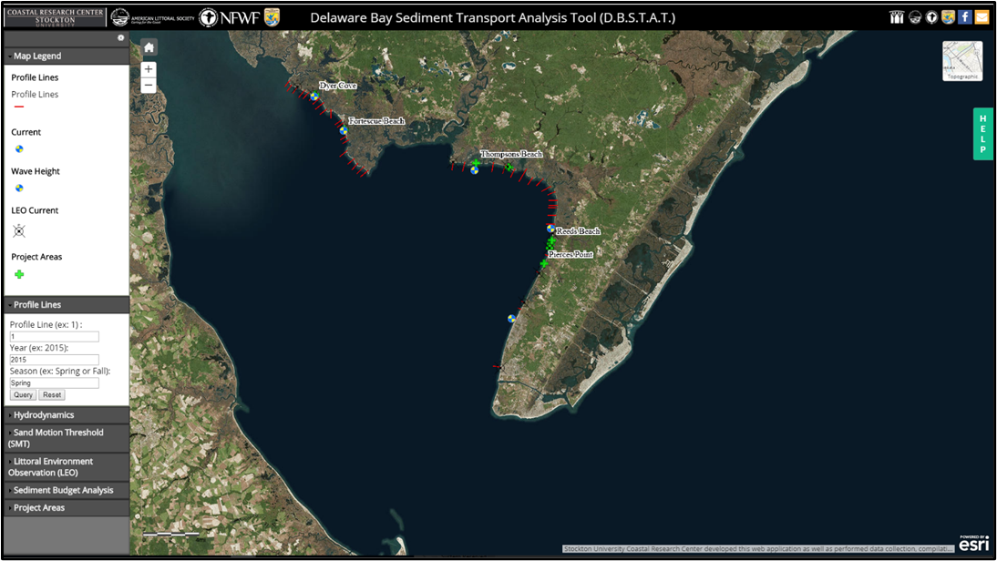
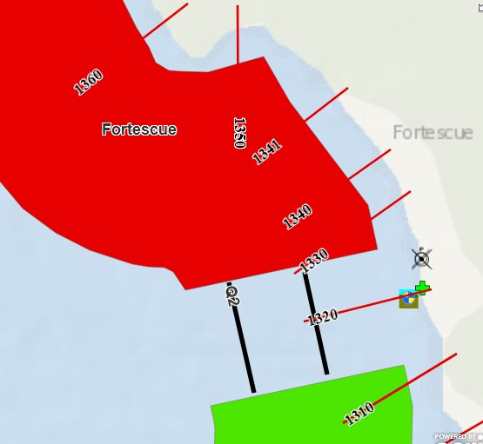
User Friendly Interactive Web Application
Displays data collected geographically
ESRI based platform
55 Beach Profile Lines
5 ADCP Sites
10 LEO Sites
8 Project Sites
7 Regional cells – initial sediment budget analysis

Slide 14
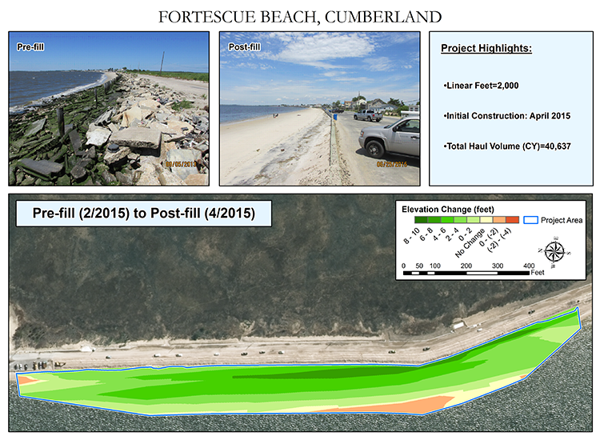
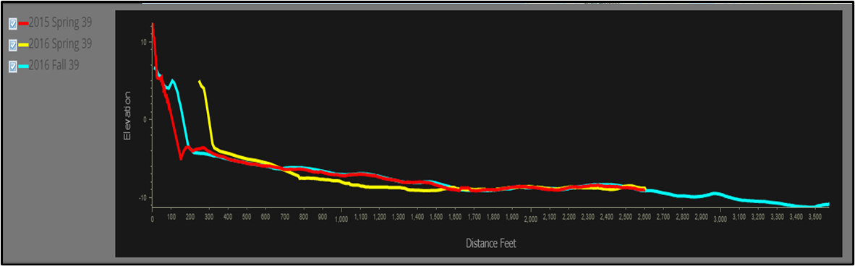
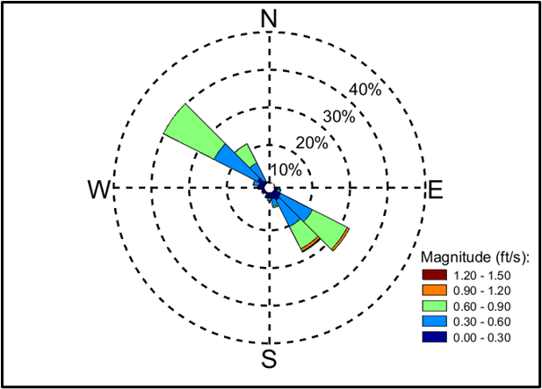
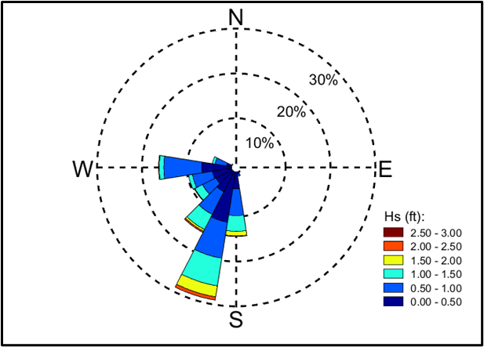
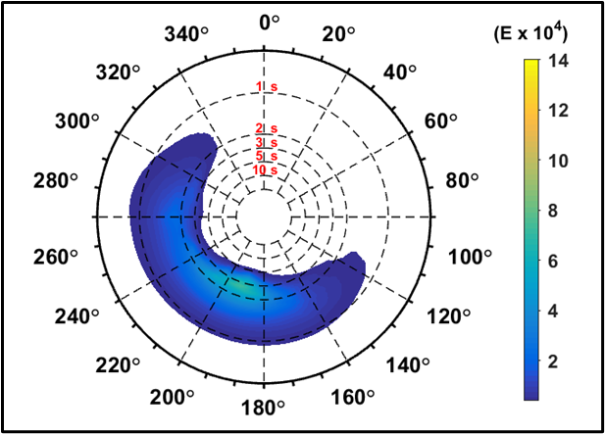
DBSTAT Typical Data Display
Project Data
Profile Viewer
Directional Current Rose
Directional Wave Rose
Full Directional Energy Spectra (FDS)

Slide 15
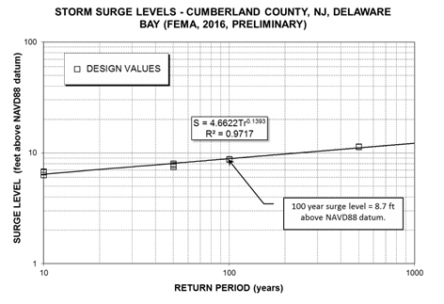
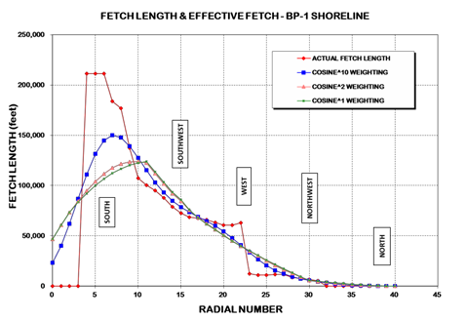
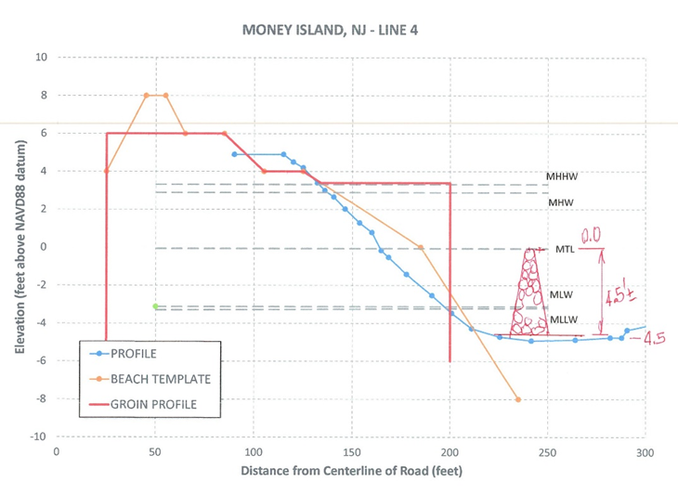
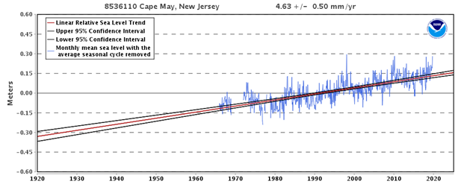
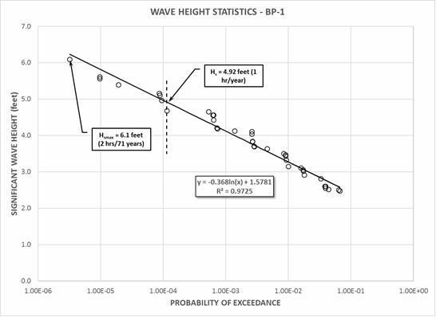
Project Development & Design
Addressing Wave and Water Level Environments in Project Design
Identify Environmental Forces
Sediment Transport Rates
Project Design Influnces
Dr. J. Richard Weggel
Design Engineer

Slide 16
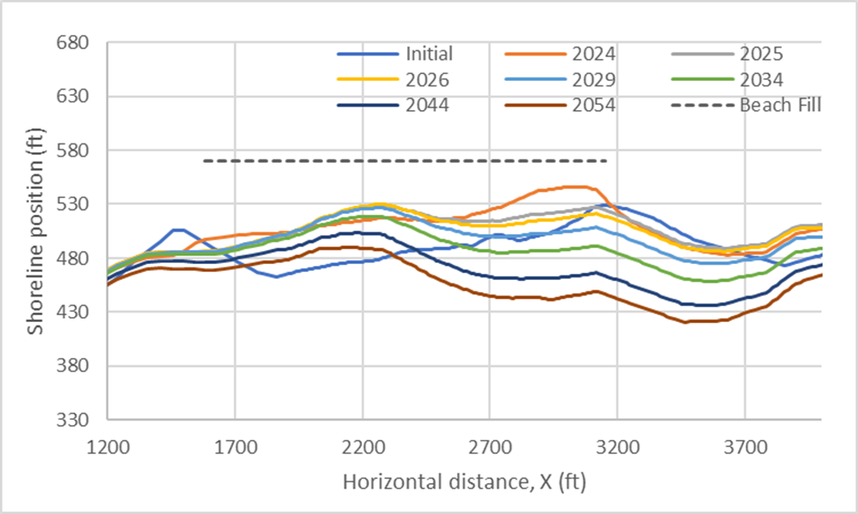
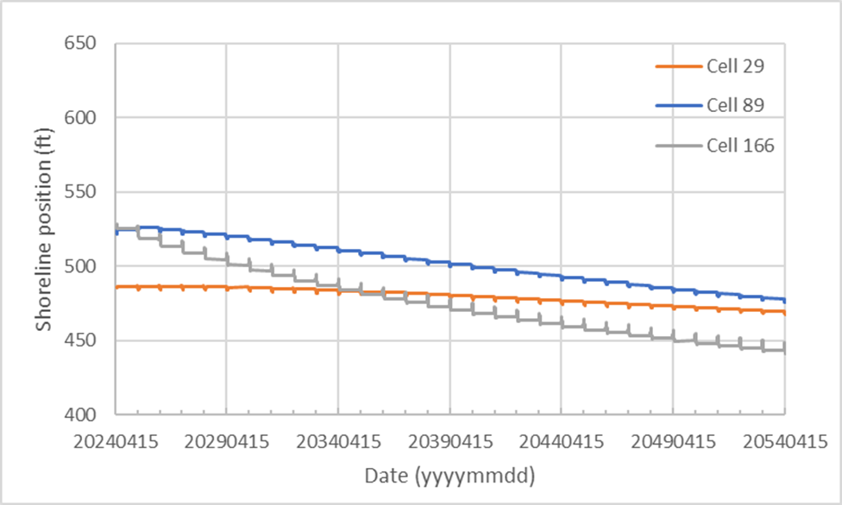
Modeling Shoreline Response to Proposed Interventions
Historical Shorelines
Model Run
Model Runs Typically Include:
No Action
Partial Planned Intervention (Beachfill)
Planned Intervention (Beachfill & Structure)
Modified Planned Interventions
Model Run Summary
Dr. M. Shah Alam Khan
Stockton University
Additional Data Inputs Include:
Regional Contours - Current
Wave Forcing – height, period, angle
Grain Size
Proposed Beach Dimensions
Breakwater (Reef) Dimensions
Lateral and Seaward Boundaries

Slide 17
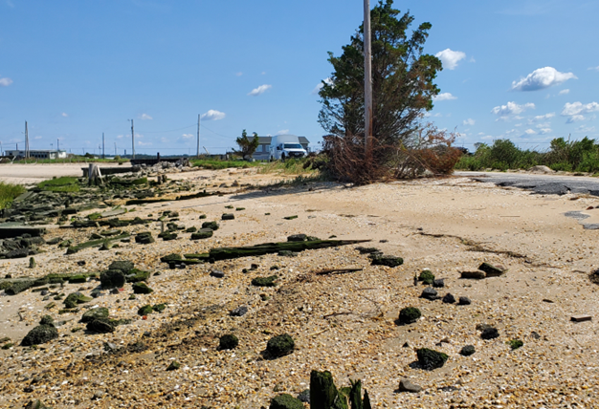
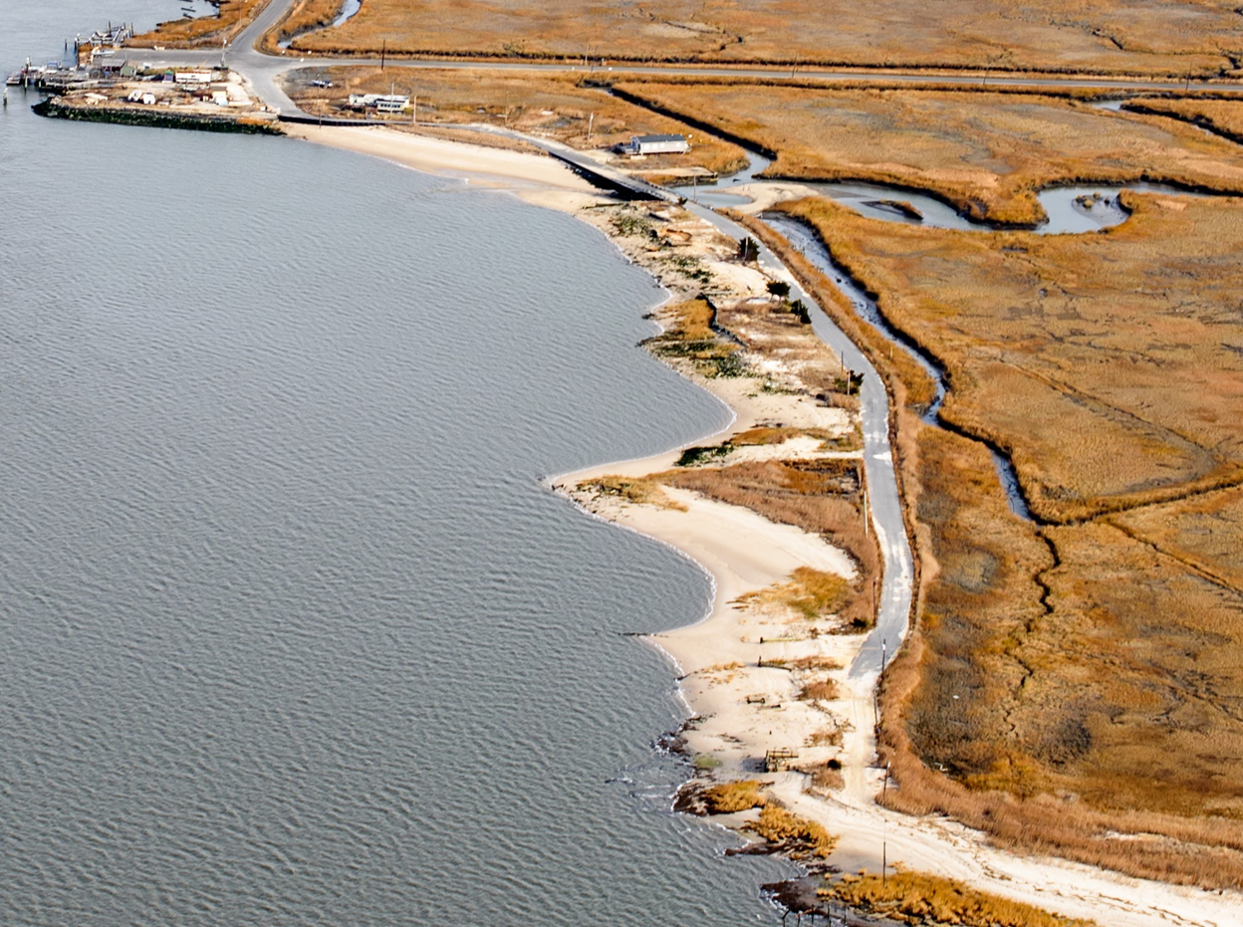
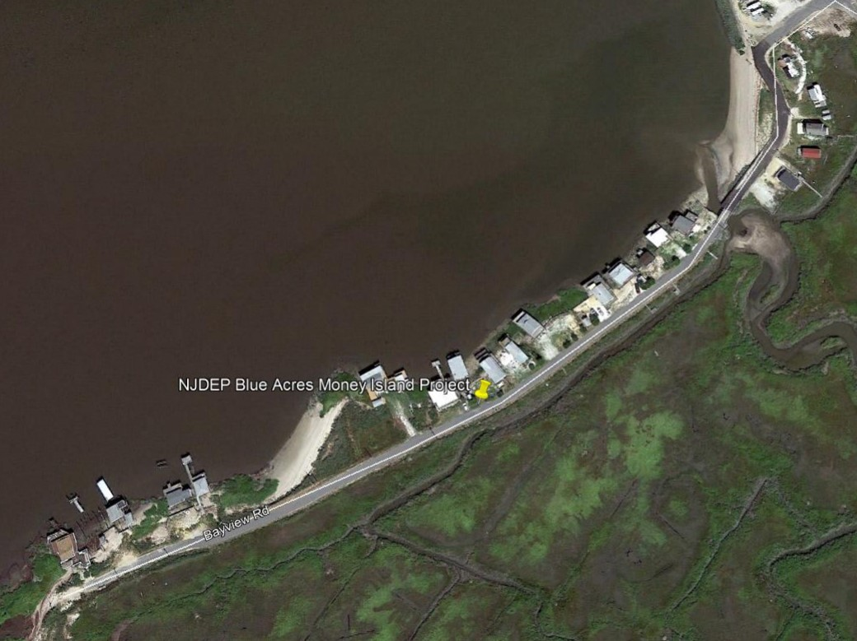
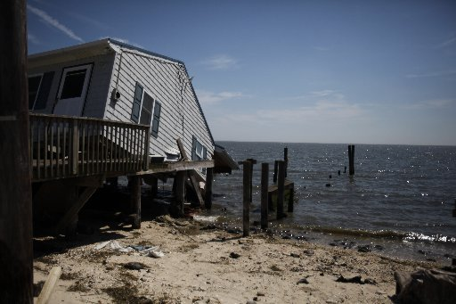
NJDEP Blue Acres Program
Money Island Habitat Restoration Projects, Downe Townships, NJ
Superstorm Sandy Buy Out Program
Acquire and Remove Damaged and Flood Prone Properties
Project Partners:
NJDEP Division of Fish & Wildlife
NJDEP Division of Coastal Engineering
Funding Source : FEMA Disaster Recovery Hazard Mitigation Grant
Consultants:
Stockton University Coastal Research Center
J. Richard Weggel Engineering/ Drexel University
Act Engineering
American Littoral Society
T. Kingston for CRC

Slide 18
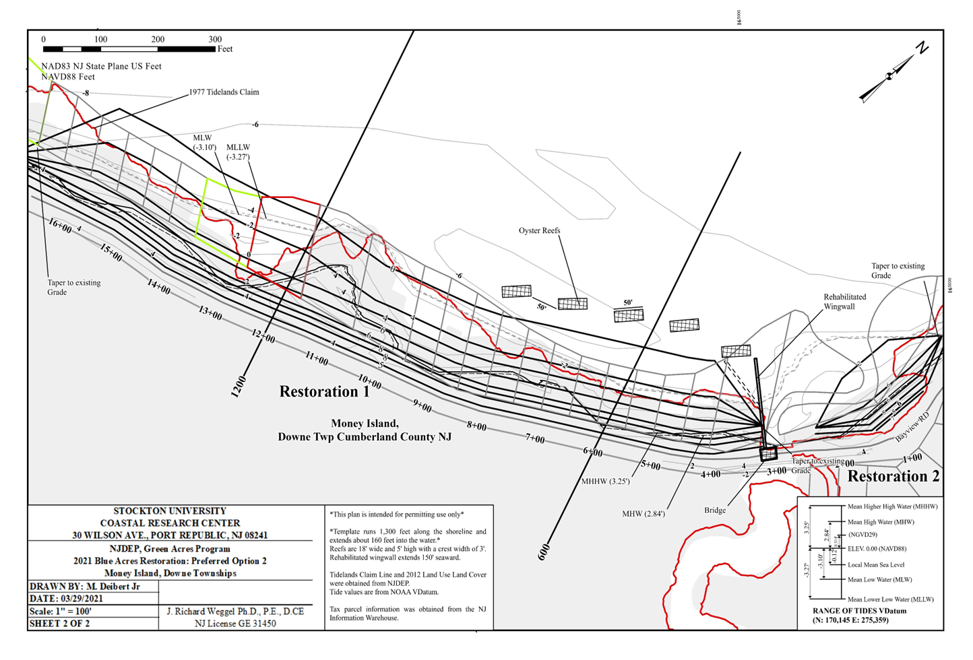
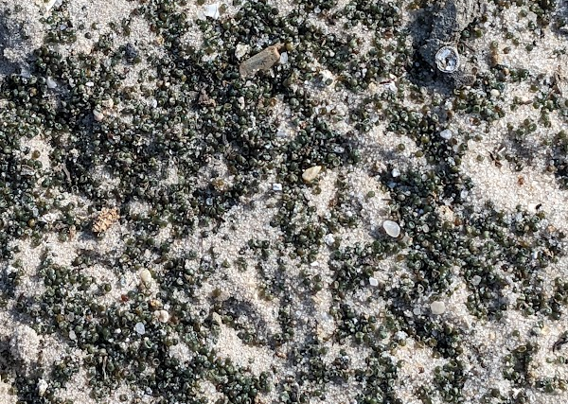
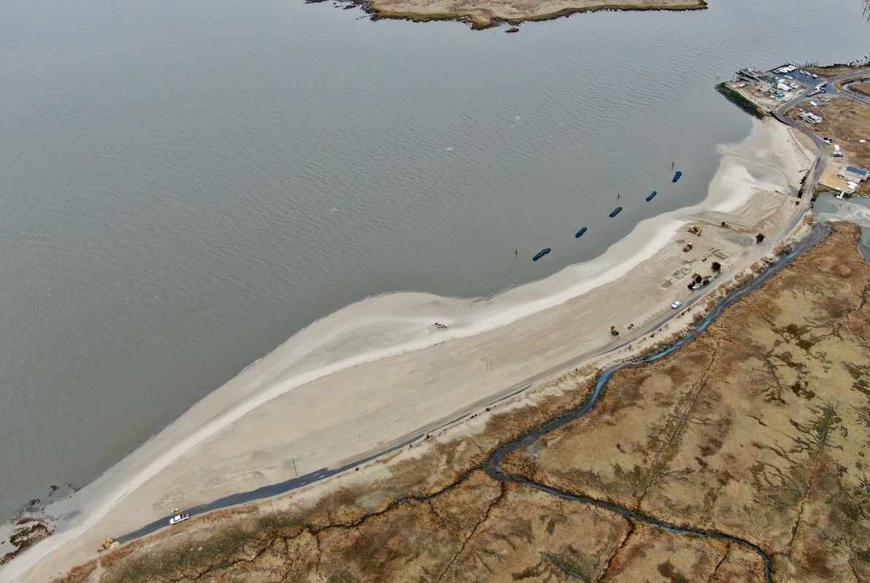
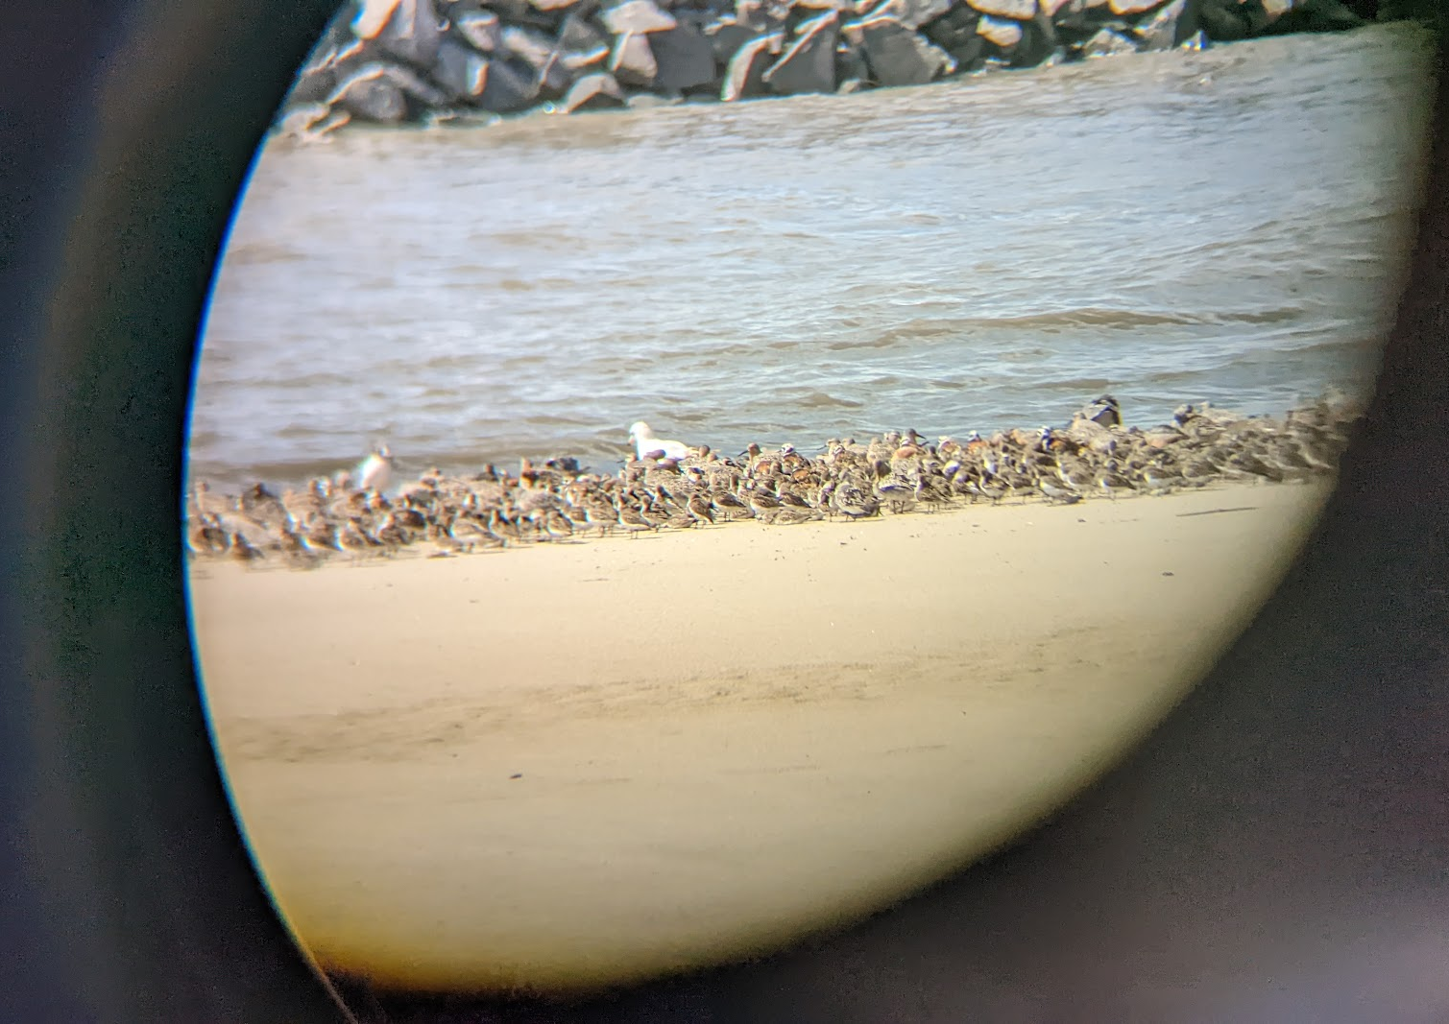
NJDEP Blue Acres Program
Money Island Habitat Restoration Project
Beach Template 1,300 LF
Estimated Volume 36,000 yd³
Beneficial Reuse of Dredge Material (NJDOT OMR)
Quarry Sand Complete Template
Five Nearshore Breakwater Reef
Wing Wall - Rehabilitation & Extension
Completed Winter 2022
Ecological Uplift
Improved Horseshoe Crab Spawning Habitat
Improved Shorebird Foraging Habitat
Enhanced Community and Ecological Resilience
Bay Point Habitat Restoration to Commence Fall 2024
Courtesy L. Niles
Courtesy S. Godshall

Slide 19
Shorebird Use & Distribution Shifts

Slide 20
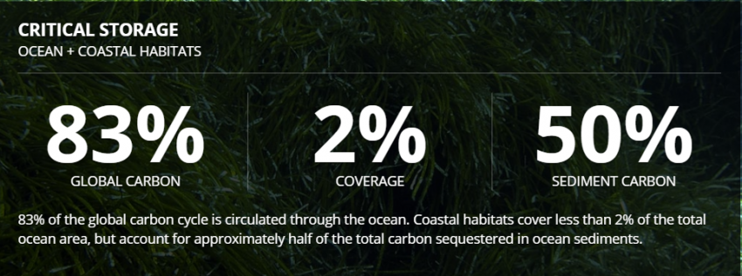
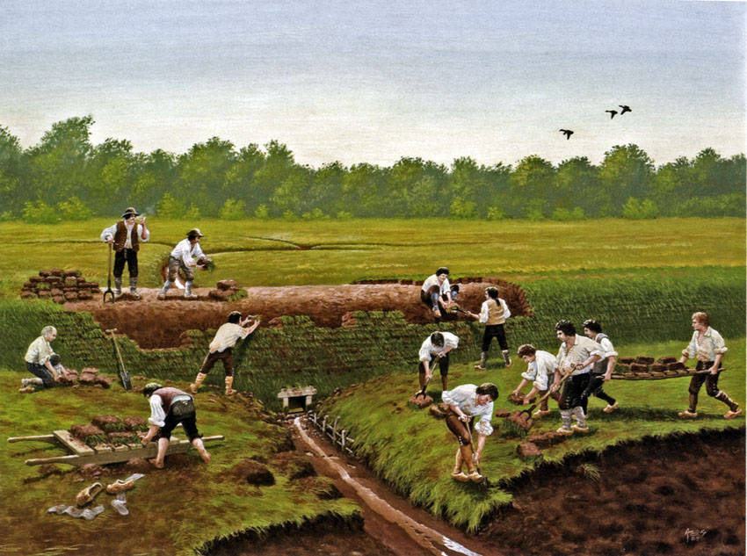
Importance of Salt Marsh Restoration & Carbon Sequestration
Notes:
83% of global carbon circulated through the ocean, even though salt marshes only cover 2% of ocean area they account for 50% of total carbon sequestered in ocean sediments (blue carbon)
Past management practices in the bay impounded and ditches natural marshes, changing their hydrology and natural function. The abandonment of these farms and dikes left these marshes 2-3ft lower in elevation and highly vulnerable to total loss.
About 50% of the worlds salt marshes have either been lost or degraded by past management practices

Slide 21
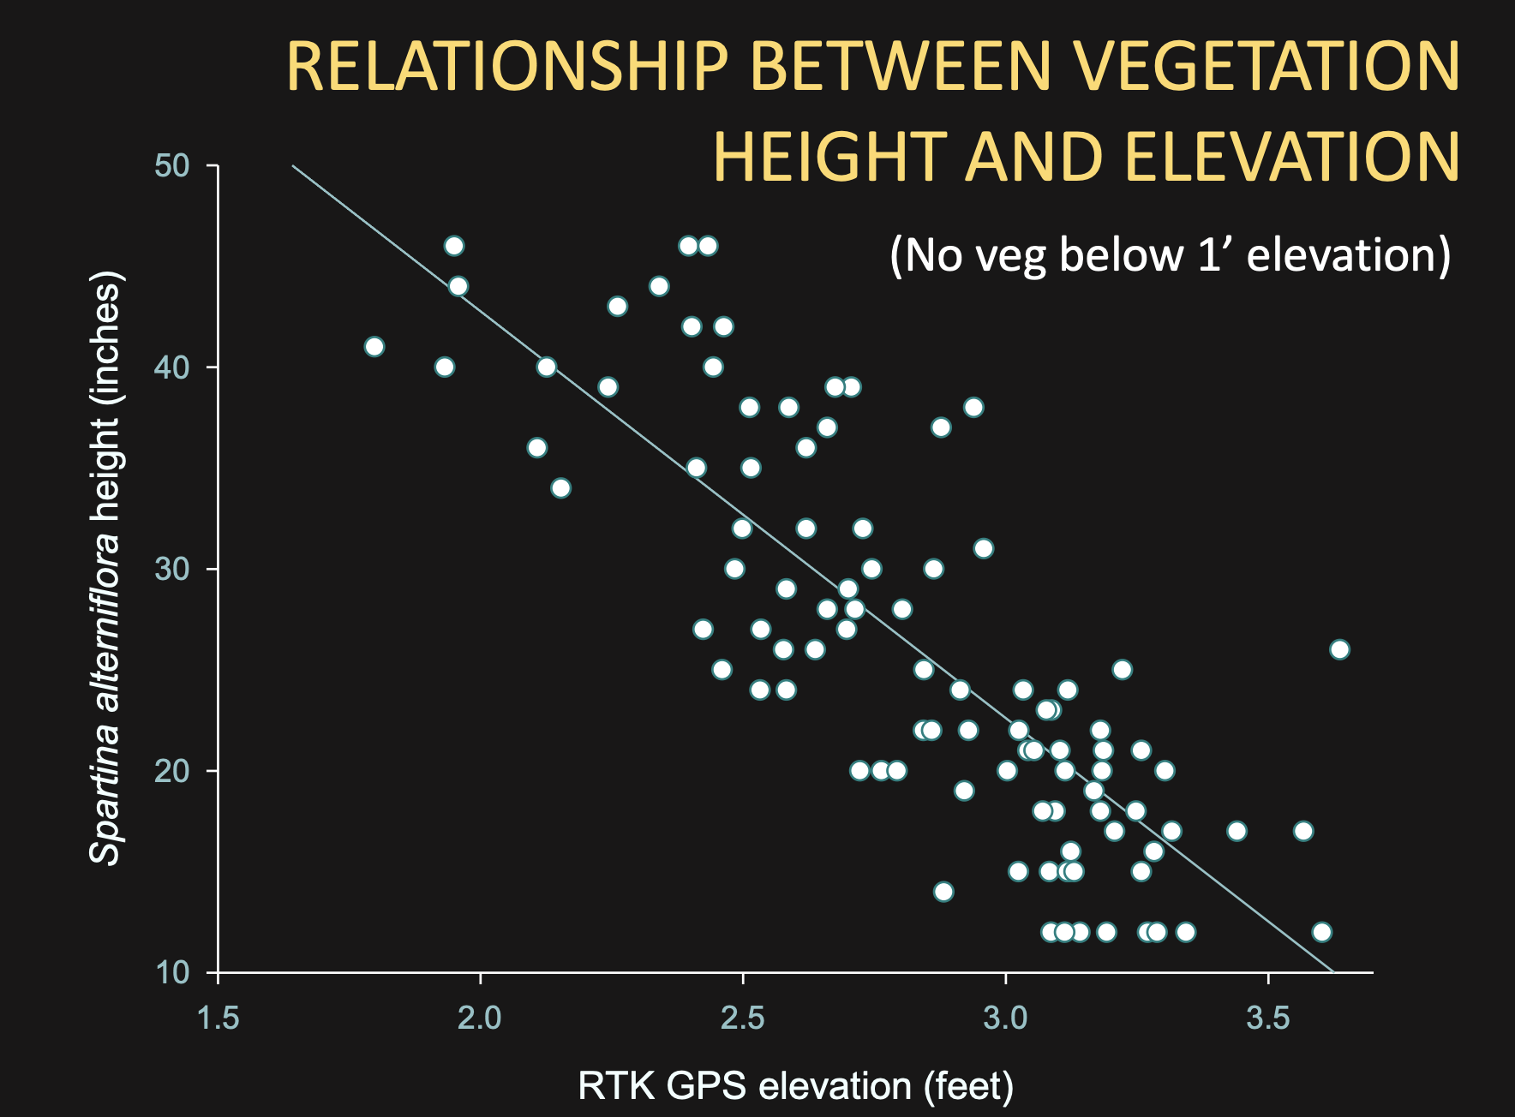
Notes:
Salt marsh plants are highly impacted by elevation levels and thus the amount of flooding during tide events. Low marsh systems are frequently flooded every tide and exposed during low tide, they are predominantly dominated by tall form of Spartina alterniflora or smooth cordgrass. High marsh systems are typically only flooded during higher-than-average tides, but their soils are mostly saturated (Psuty, Norbert P, 1986, Martínez et al. 2008). They are dominated by plant species such as spartina patens (salt hay grass), Juncus geradii (black grass), Distichlis spicata (spike grass), and short form Spartina alterniflora (Geden et al., 2009).
High marsh habitats exist at the upper range of tidal marsh elevations and are less frequently flooded than low marsh habitats dominated by Spartina alterniflora. This infrequent flooding allows high marsh to contain a more diverse suite of plant species including grasses, rushes, sedges, wildflowers, and shrubs. High marsh is also a key breeding, stopover, and foraging habitat for many rare bird species and being at the extreme upper range of marsh elevation, it is also the most resilient to sea level rise
Thin layer placement of dredge spoil material over the surface is a restoration tool used for saltmarsh habitats. It is the application of sediment hydraulically dredged from an adjacent water source and sprayed across the marsh surface (Punchkoff & Lawrence 2022). However, thin layer placement is limited in its ability to obtain specific thickness or target elevation levels due to technique
Thin layer placement is mainly successful at sites needing 5cm-10cm of elevation increase, but with sites that need greater than 10cm to achieve proper elevation levels this technique may not be as effective
High marsh habitats exist at the upper range of tidal marsh elevations and are less frequently flooded than low marsh habitats dominated by Spartina alterniflora. This infrequent flooding allows high marsh to contain a more diverse suite of plant species including grasses, rushes, sedges, wildflowers, and shrubs.

Slide 22
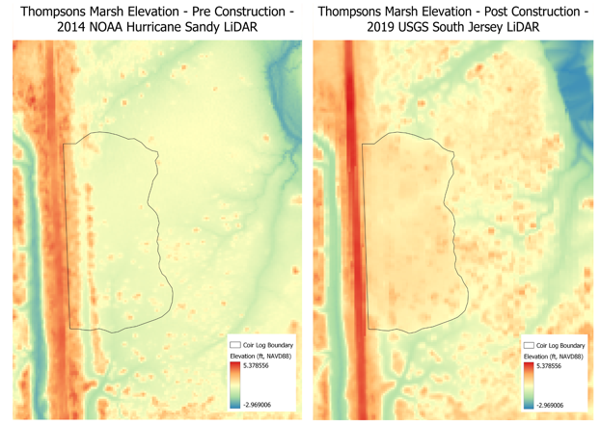
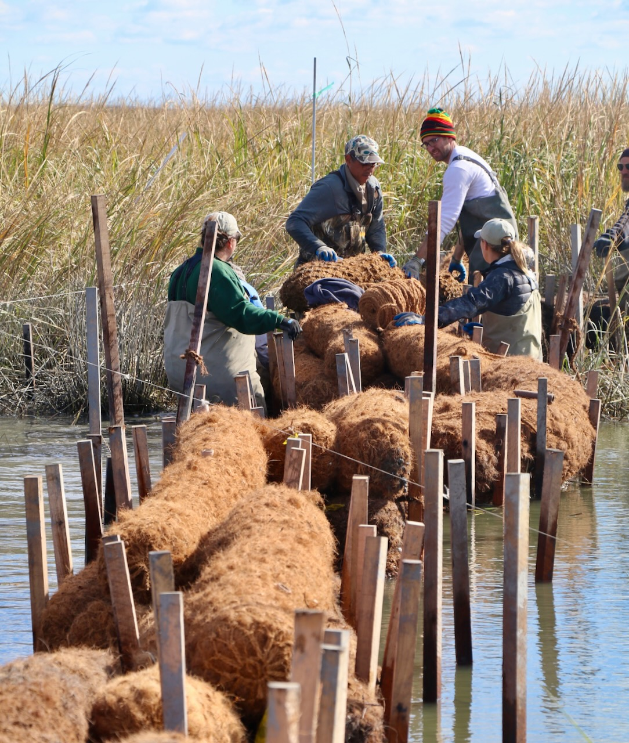
Restoration Methods
Notes:
In 2018 our team conducted a pilot restoration project at Thompsons marsh, testing methods to increase the elevation of marsh by 2ft or greater.
There have been efforts to restore formerly degraded New Jersey salt marshes, using dredge material to increase surface elevations of marshes that have subsided due to former salt hay farming
Originally PSEG restoration project – restored hydrology in 1990 – did not restore elevation

Slide 23
Results
Notes:
Burden et al. 2019, and Punchkoff & Lawrence 2022 found that carbon sequestration in restored marshes was higher than in unmanaged damaged marshes and similar to levels of a natural marsh. Burden et al. found that the average carbon accumulation rate globally is 2.42 (±0.26) t C ha⁻¹ yr⁻¹ (Burden et al. 2019). Carbon storage increases with plant diversity, as well as soil type and climate however, high plant productivity is the main contributor to carbon sequestration (Burden et al. 2019). Within a healthy marsh system having different elevation and plant zonations are key as different plants are able to grow within these different zones. Punchkoff and Lawrence 2022 found that the “goldilocks principle” is key to salt marsh restoration, in that sediment application at levels that are “just right” promote rapid plant growth (Punchkoff & Lawrence 2022). Their study showed that CO2 uptake was increased with rapid vegetation growth and CH4 emissions decreased in salt marsh restoration sites. They found that the addition of sediment “promoted rapid vegetation growth, alleviated phytotoxic sulfides, alleviated phytotoxic sulfides, enhanced CO₂ uptake and reduced CH₄ emissions” (Punchkoff & Lawrence 2022).
Salt marshes naturally sequester on average 917 Mg CO2e/ha or 1010.82 tons of CO2 per ha (Pendleton, et al. 2012). Carbon sequestration has been valued at almost $4.50 per ton meaning the value of a saltmarsh is around $4,548.69 per ha per year. A key component of a healthy marsh is total above ground biomass or root mass within the marsh (Punchkoff & Lawrence 2022). This is also indicative of carbon cycling as the majority of carbon is sequestered within a robust root system of a salt marsh. By restoring our site to optimal elevation levels – the goldilocks principle, we were able to achieve rapid revegetation and therefore achieved high levels of primary productivity and carbon cycling. It has been found that restoring salt marshes to optimal elevations can also restore their microbial communities and their natural functions such as sequestering carbon close to that of a natural undamaged marsh, showing the importance of restoration at these sites (Punchkoff & Lawrence 2022).

Slide 24

Results
Notes:
Burden et al. 2019, and Punchkoff & Lawrence 2022 found that carbon sequestration in restored marshes was higher than in unmanaged damaged marshes and similar to levels of a natural marsh. Burden et al. found that the average carbon accumulation rate globally is 2.42 (±0.26) t C ha⁻¹ yr⁻¹ (Burden et al. 2019). Carbon storage increases with plant diversity, as well as soil type and climate however, high plant productivity is the main contributor to carbon sequestration (Burden et al. 2019). Within a healthy marsh system having different elevation and plant zonations are key as different plants are able to grow within these different zones. Punchkoff and Lawrence 2022 found that the “goldilocks principle” is key to salt marsh restoration, in that sediment application at levels that are “just right” promote rapid plant growth (Punchkoff & Lawrence 2022). Their study showed that CO2 uptake was increased with rapid vegetation growth and CH4 emissions decreased in salt marsh restoration sites. They found that the addition of sediment “promoted rapid vegetation growth, alleviated phytotoxic sulfides, alleviated phytotoxic sulfides, enhanced CO₂ uptake and reduced CH₄ emissions” (Punchkoff & Lawrence 2022).
Salt marshes naturally sequester on average 917 Mg CO2e/ha or 1010.82 tons of CO2 per ha (Pendleton, et al. 2012). Carbon sequestration has been valued at almost $4.50 per ton meaning the value of a saltmarsh is around $4,548.69 per ha per year. A key component of a healthy marsh is total above ground biomass or root mass within the marsh (Punchkoff & Lawrence 2022). This is also indicative of carbon cycling as the majority of carbon is sequestered within a robust root system of a salt marsh. By restoring our site to optimal elevation levels – the goldilocks principle, we were able to achieve rapid revegetation and therefore achieved high levels of primary productivity and carbon cycling. It has been found that restoring salt marshes to optimal elevations can also restore their microbial communities and their natural functions such as sequestering carbon close to that of a natural undamaged marsh, showing the importance of restoration at these sites (Punchkoff & Lawrence 2022).

Slide 25

Scaling Up:
Mouth of the Maurice River NJDEP Natural Climate Solutions Grant
20+ Acres

Slide 26




Thank You!
Capt. Alek Modjeski
Habitat Restoration Program Director
American Littoral Society
alek@littoralsociety.org
Steven Hafner
Assistant Director Coastal Research Center
Stockton University
steven.hafner@stockton.edu
Stephanie Feigin
Wildlife Biologist
Wildlife Restoration Partnerships
Stephaniefeigin@gmail.com
For More Information www.littoralsociety.org
Notes:
2018 – Reefs, Ghost Pots, Living shorelines, and continue our monitoring efforts
If you’d like more info check out our website LittoralSociety.org or the project website restoreNJbayshore.org

