Slide 1
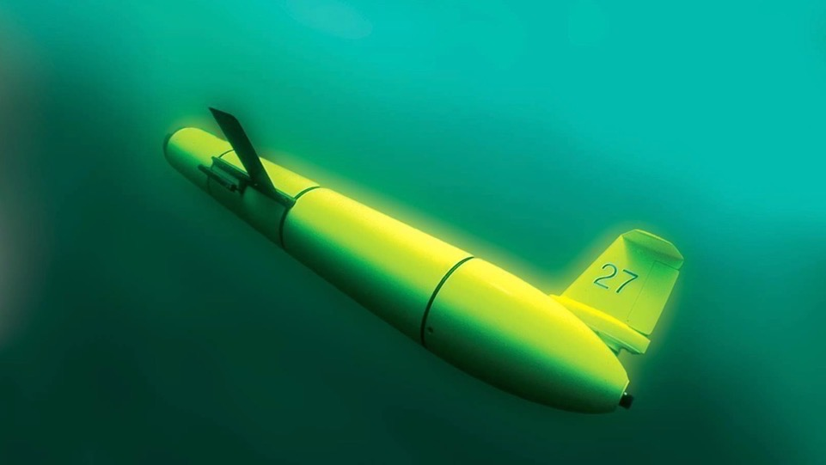



An autonomous-based oceanographic and ecological baseline to inform offshore wind development
Josh Kohut and Grace Saba
Kira Lawrence
Caitlin McGarigal
and Many Many Many Others

Slide 2
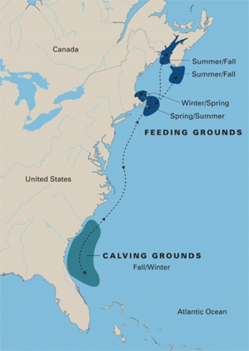
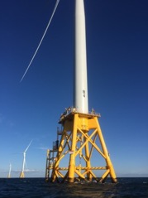

Offshore Wind along the U.S. East Coast
The Evolving Plan
The Dynamic Environment
The Dynamic Ecology
Right Whale Migration
Federal Goal: 30 GW by 2030
Sources: DOE 2021 Offshore Wind Market Report and NCSL
As of August 2021
Notes:
For comparison, Oyster Creek was 636 MW
NJ commitment is about 50% of NJ total electricity use
Maine coming soon

Slide 3




Rutgers University Center for Ocean Observing Leadership (RUCOOL)
Data QA/QC
4 Day Ocean
Forecast
Run Daily
4DVAR Data Assimilation

Slide 4
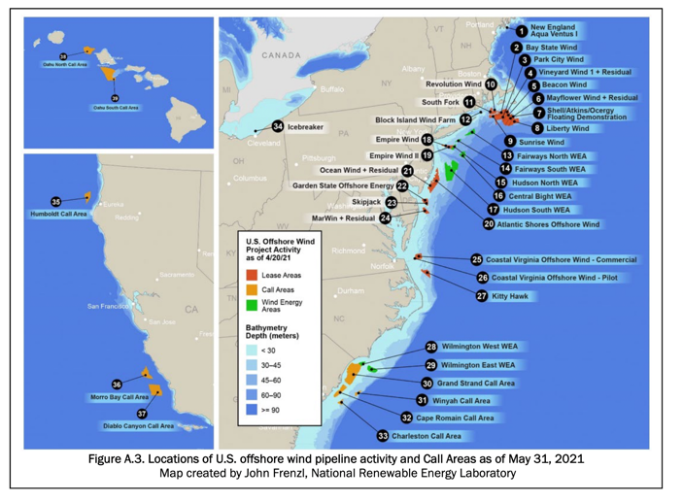
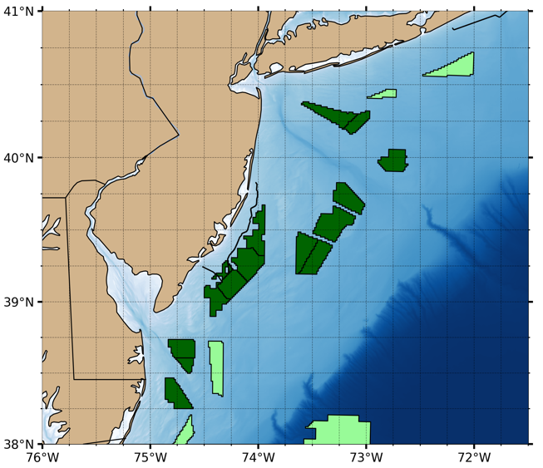
Offshore Wind In the United States
Federal goal of 30 GW by 2030.
States have established nearly 74,000 MW of offshore wind procurement targets to date.
Will trigger more than $12 billion per year in capital investment.
Offshore wind could create 83,000 new well-paying jobs by 2030.
There are more than 35,000 megawatts (MW) of offshore wind potential under development on the East Coast
Lease Area
Planned Area
Source: Offshore Wind Strategies Report, DOE

Slide 5
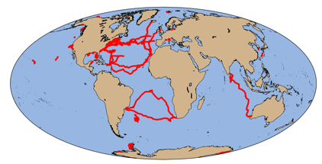
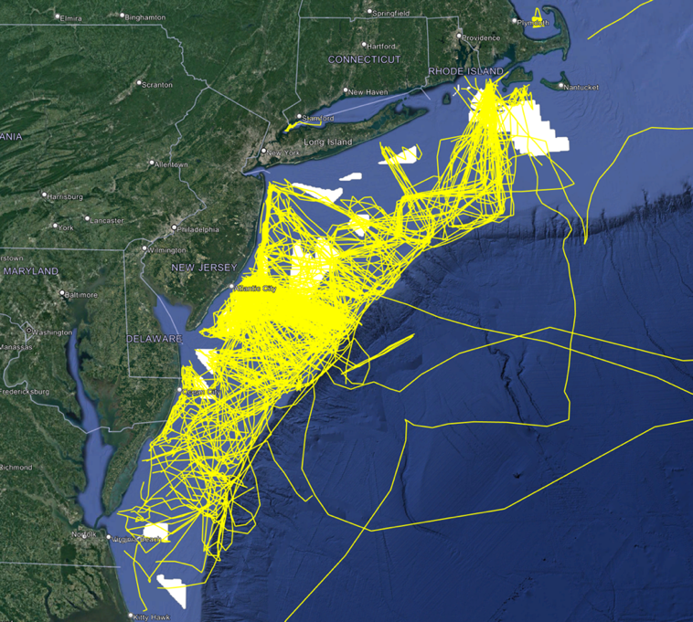
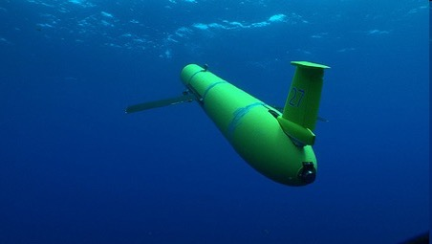
Autonomous Underwater Gliders – Since 1998
Corporate Partner: Teledyne Webb Research
~643 Global Deployments
> 336,525 km flown
RU and Partner Totals
634 glider deployments
332,415 km (>8x Earth)
17,311 days (>47 years)

Slide 6
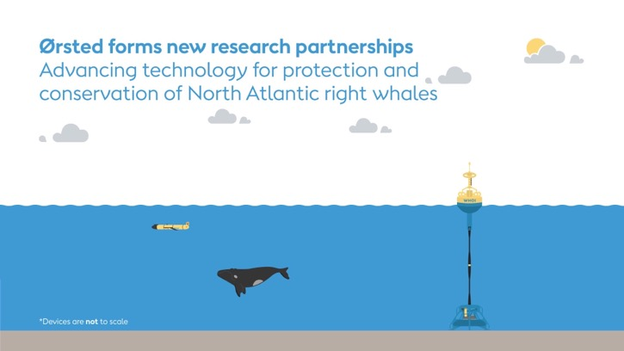
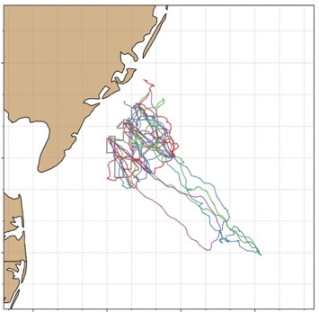
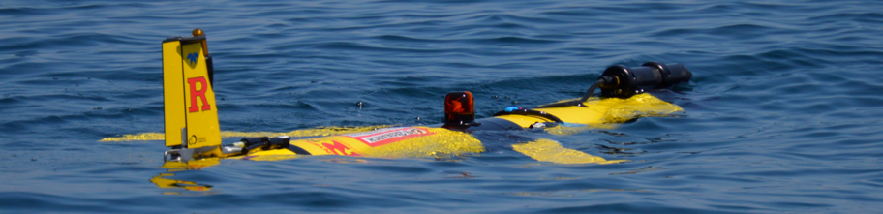


Ocean robots: Tracking dynamic seascapes to inform offshore wind development
ECO-PAM Project
Our ecological scout
https://go.rutgers.edu/ECO-PAM

Slide 7
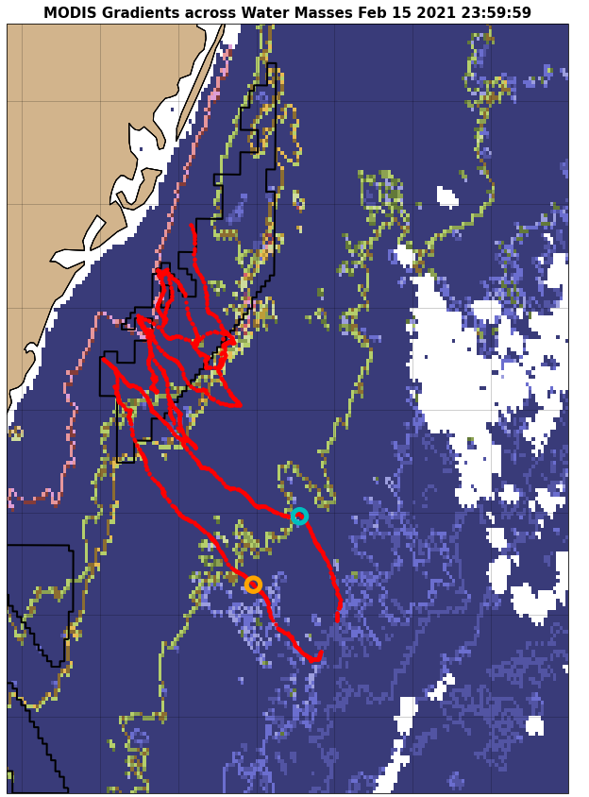
Offshore Wind along the U.S. East Coast
The Dynamic Ecology
The Dynamic Environment
Informing the Plan
Notes:
For comparison, Oyster Creek was 636 MW
NJ commitment is about 50% of NJ total electricity use
Maine coming soon

Slide 8

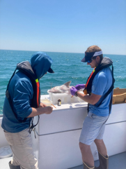
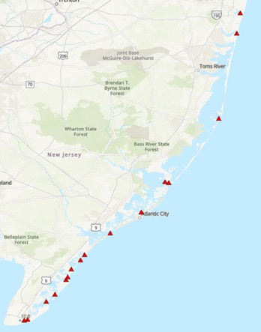
High Resolution Mapping focused on the Ocean Wind Site:
Fish Telemetry
Fixed Receiver Array

Slide 9


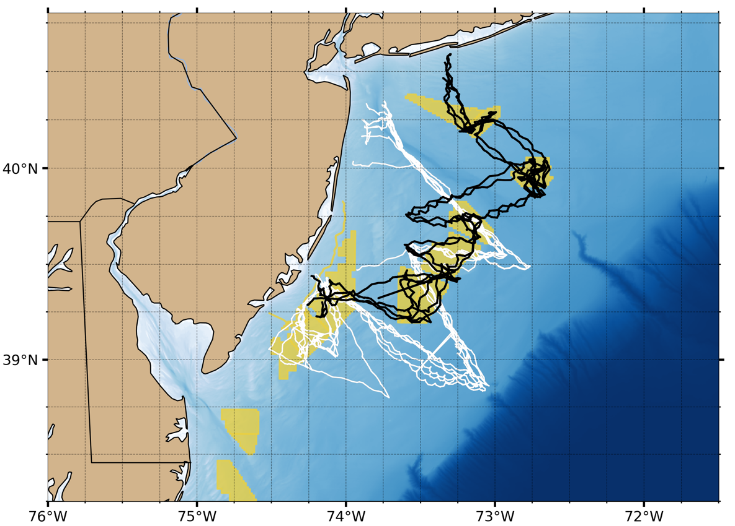
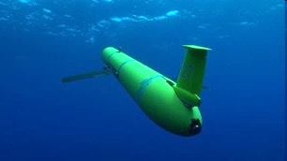


Eco-Glider: Oceanographic and Ecologic Sampling
Preliminary Data
Baseline seasonal deployments (2 years)
Research and Monitoring Initiative (New Jersey)
NYSERDA (New York)
Temperature
Salinity
Density
pH
Dissolved oxygen
Chl
CDOM
Optical backscatter
Active acoustics - fish
(38, 120, 200 kHz)
Active Acoustics - zooplankton
(120, 200, 455, 769 kHz)
Passive acoustics – mammals
Fish Telemetry
Glider Coverage (Since April 2023):
17 Missions
346 Glider Days
43,776 Water Column Profiles
…. and counting

Slide 10
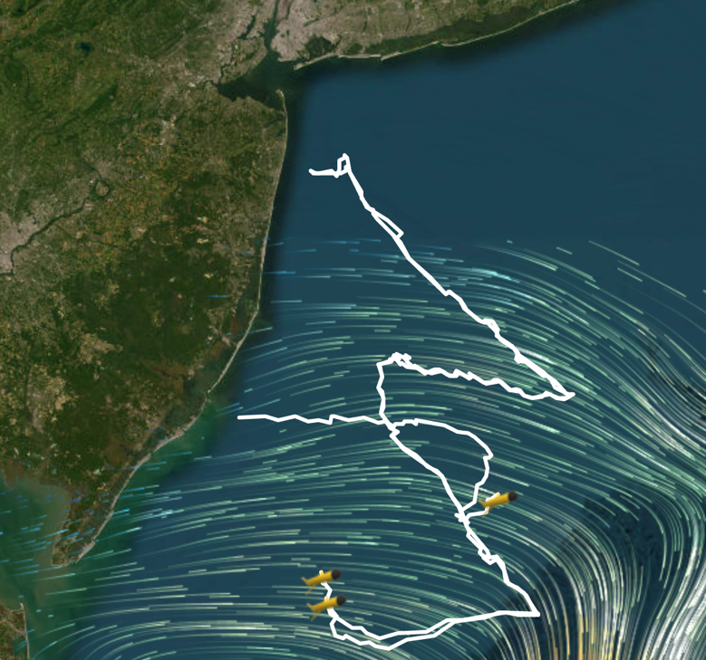
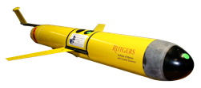



Eco-glider Baseline Study: Research Monitoring Initiative
4 seasonal deployments (multi-year) of paired gliders with a full complement of available sensors to simultaneously capture oceanographic and ecological variables
3rd glider – 3 deployments in between paired deployments; to capture stratification set-up to fall breakdown
Deployed on February 15, 2024
and still sampling

Slide 11
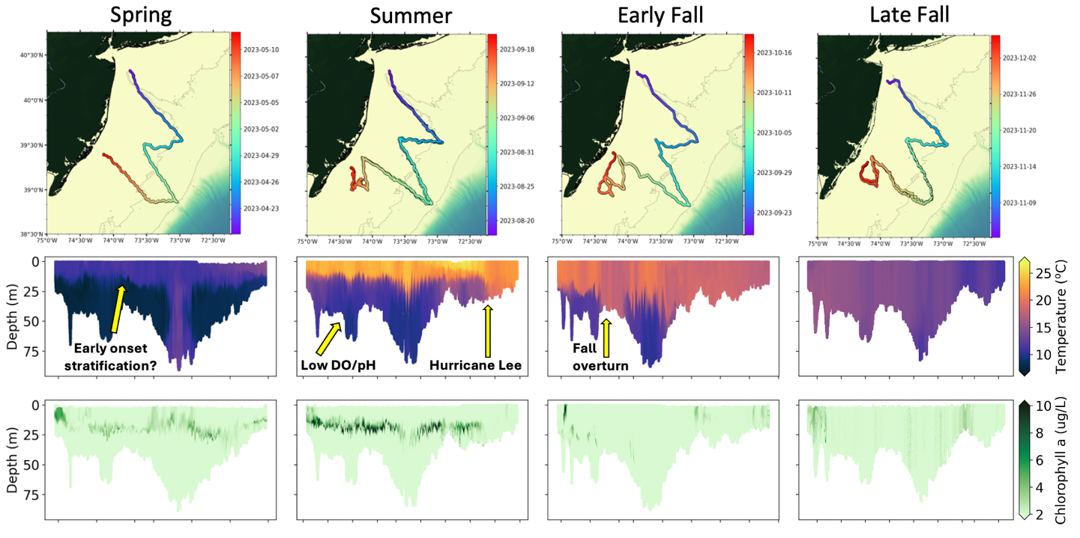
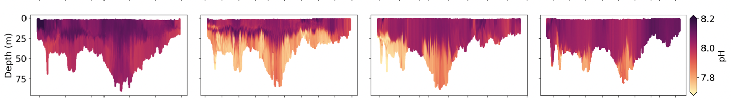

Seasonal Evolution of Oceanographic Properties
Monitoring strategy increases our ability to:
Characterize the true variability of the system
Relate the physical, chemical, biological variables
Temperature
Chlorophyll a
pH

Slide 12
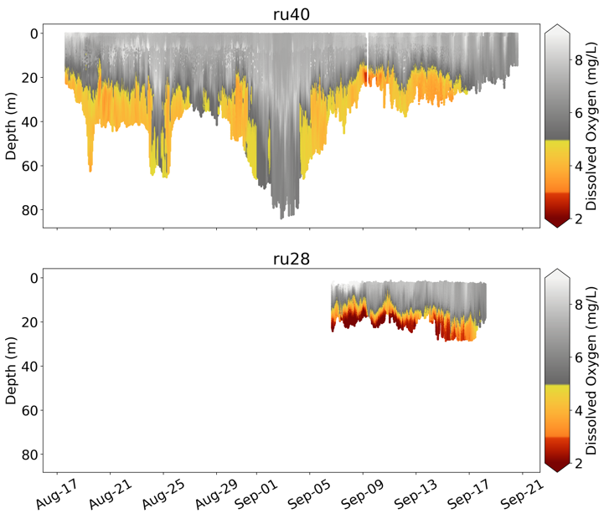
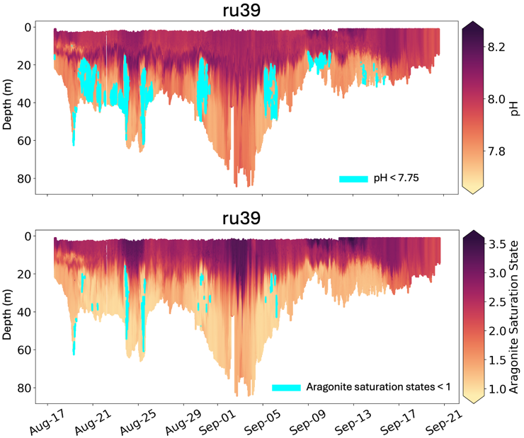
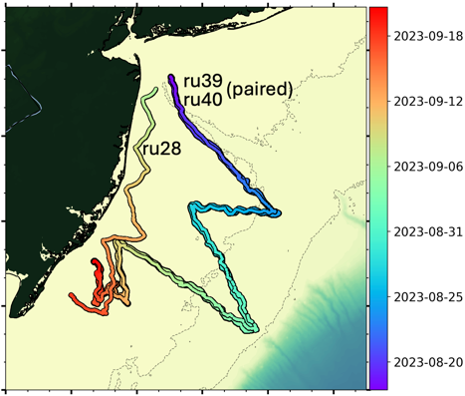
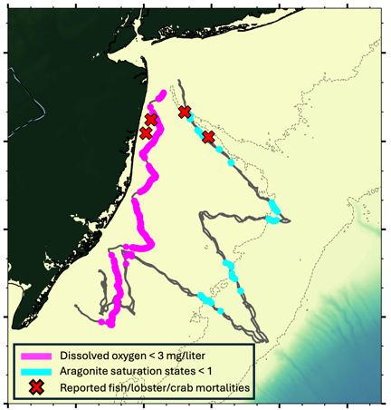
Observation of Multi-stressor Events
Extensive shelf area with low DO & pH
Reported fish, lobster, & crab mortalities from fishers
Persistent throughout deployment, minimized & alleviated once strong storms occurred
Notes:
pH: minimum = 7.66 (max = 8.27 in chl maximum)
Ωarag: minimum = 0.88 (max = 3.60 in slope surface water)

Slide 13
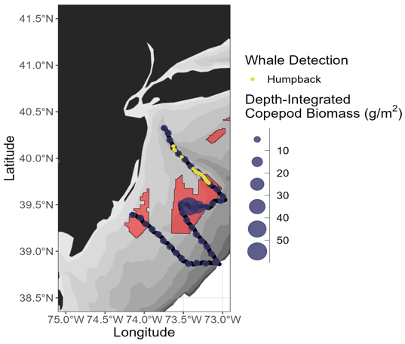
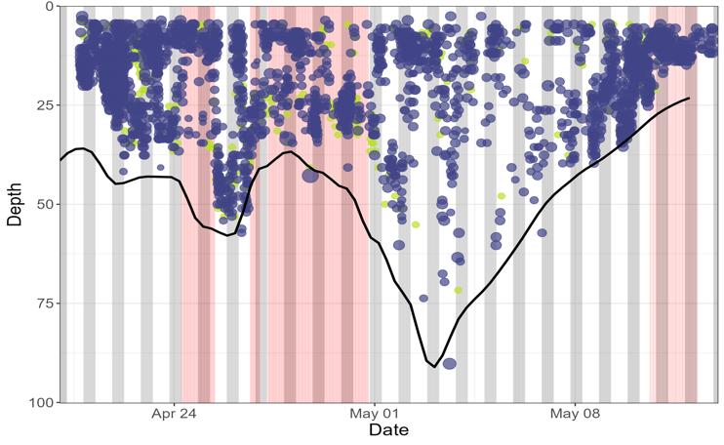
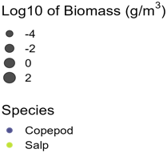

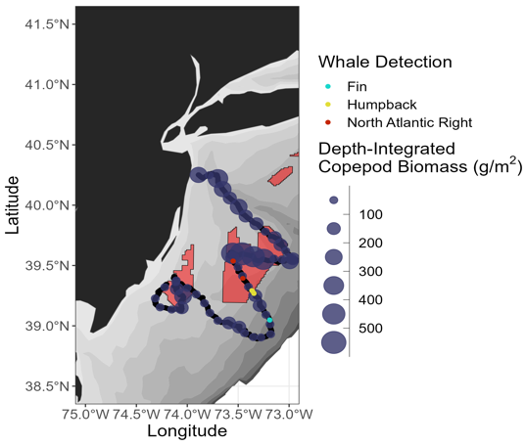
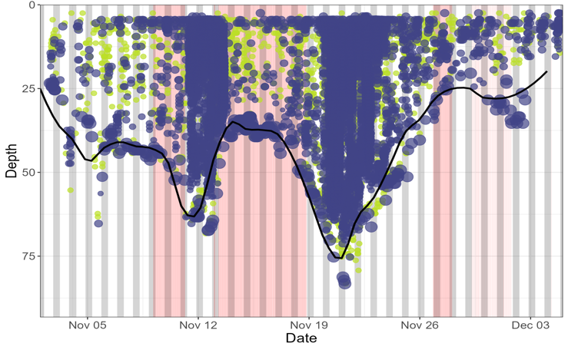

Co-location of Zooplankton & Whale Distributions
SPRING
Exploring overlap between:
Oceanographic features
Zooplankton
Fishes
Marine mammals
FALL
Notes:
NOTE: Biomass estimates correspond to copepods only; salps are presence/absence (don’t have good enough salp TS models to estimate biomass/abundance)
Spring zooplankton distributions were more horizontally homogenous, but concentrated in surface waters
Fall zooplankton distributions were concentrated in areas below the 50 m isobath

Slide 14
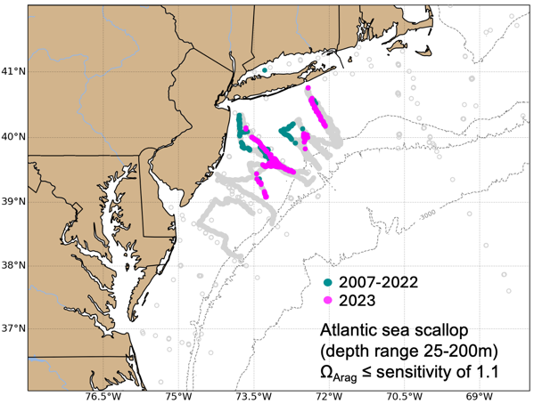
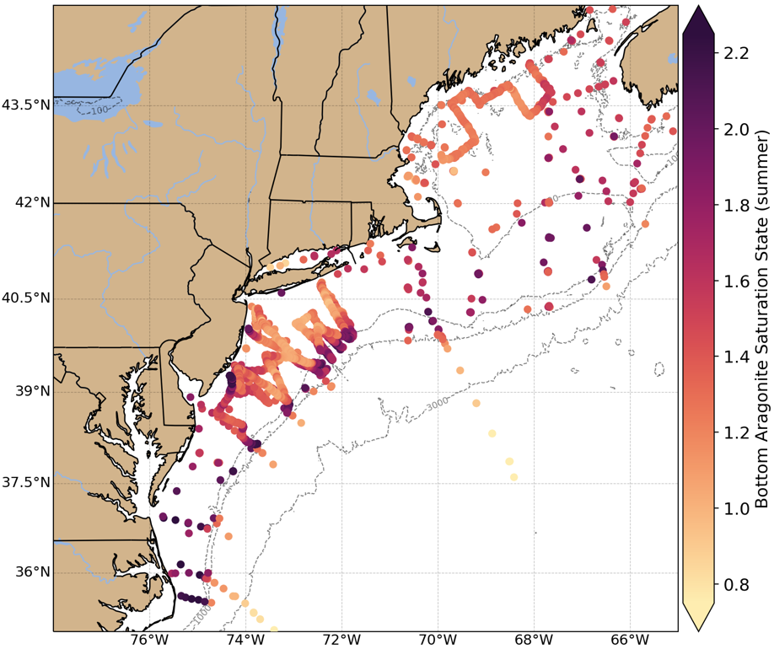
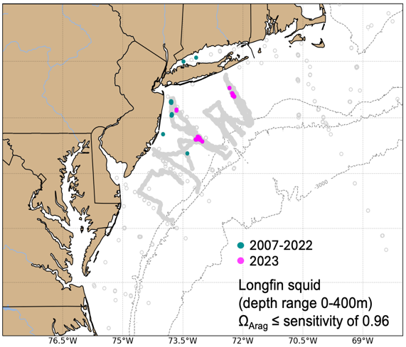



Conveying Information for Management
NOAA State of the Ecosystem: Mid-Atlantic and New England (reports for MAFMC and NEFMC)
2007-2023

Slide 15

Summary
Eco-Gliders are providing a seasonally-resolved 3D view of regional ocean and ecological conditions that spans multiple trophic levels – from physics, chemistry, phytoplankton and zooplankton to pelagic fish and marine mammals.
Next steps
  Examine seasonal habitat use of fishes and marine mammals and drivers of those patterns
  Examine impacts of OSW development on oceanographic variables and organism biomass/distribution/connectivity

