Slide 1
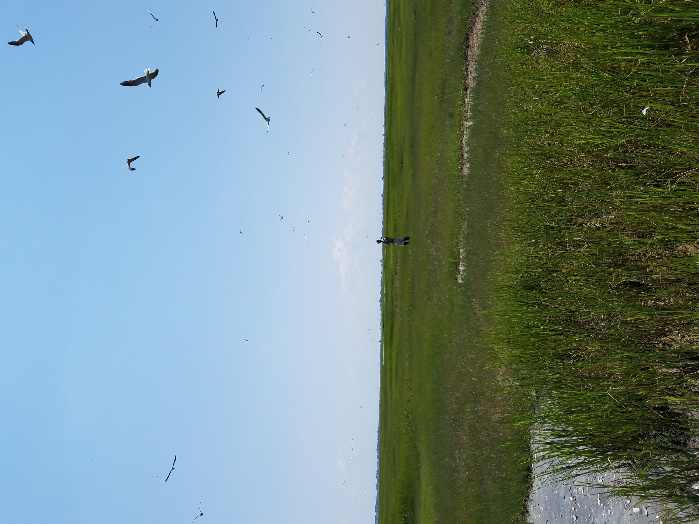
SEVEN MILE ISLAND LIVING LABORATORY: ADVANCING BENEFICIAL USE PRACTICES TO SUPPORT COASTAL SYSTEM RESILIENCE:
SMILL & OTHER NBS PROJECTS INFORMING THE REGULATORY REVIEW
COLLEEN KELLER - NJDEP DIVISION OF LAND RESOURCE PROTECTION

Slide 2
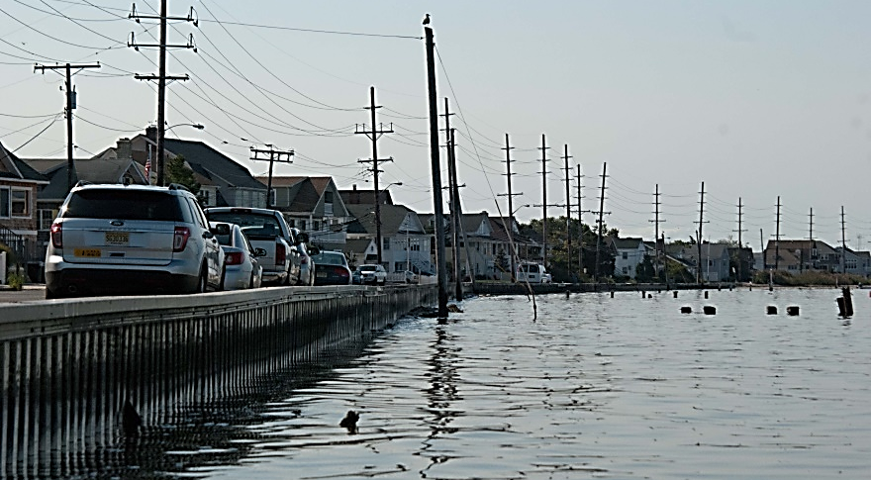
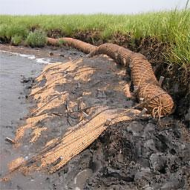
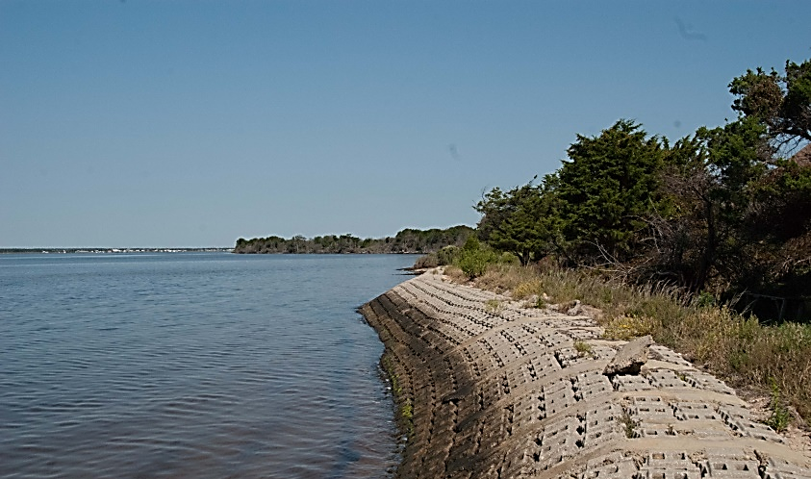
Pre-Sandy Permitting Constraints
Courtesy of the Partnership for the Delaware Estuary

Slide 3
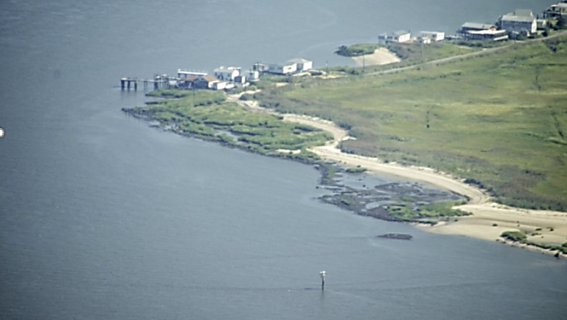
Revised Coastal Rules
June 2013 – Emergency adoption of New Coastal Zone Management Rules
Revisions made to Coastal Regulations to facilitate the establishment of living shorelines:
The general permit for habitat creation and enhancement was modified to include living shoreline activities (General Permit #24 - N.J.A.C. 7:7-6.24)
A new general water area rule was added for living shorelines (N.J.A.C. 7:7-12.23)

Slide 4
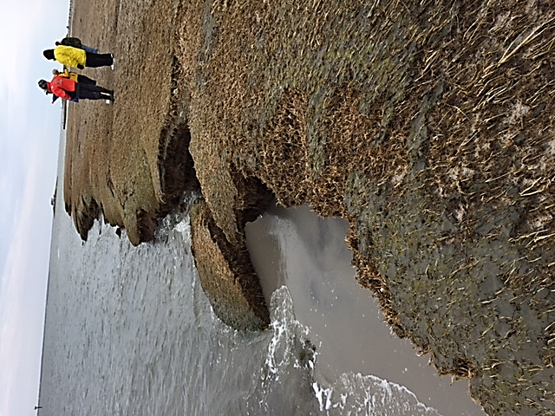
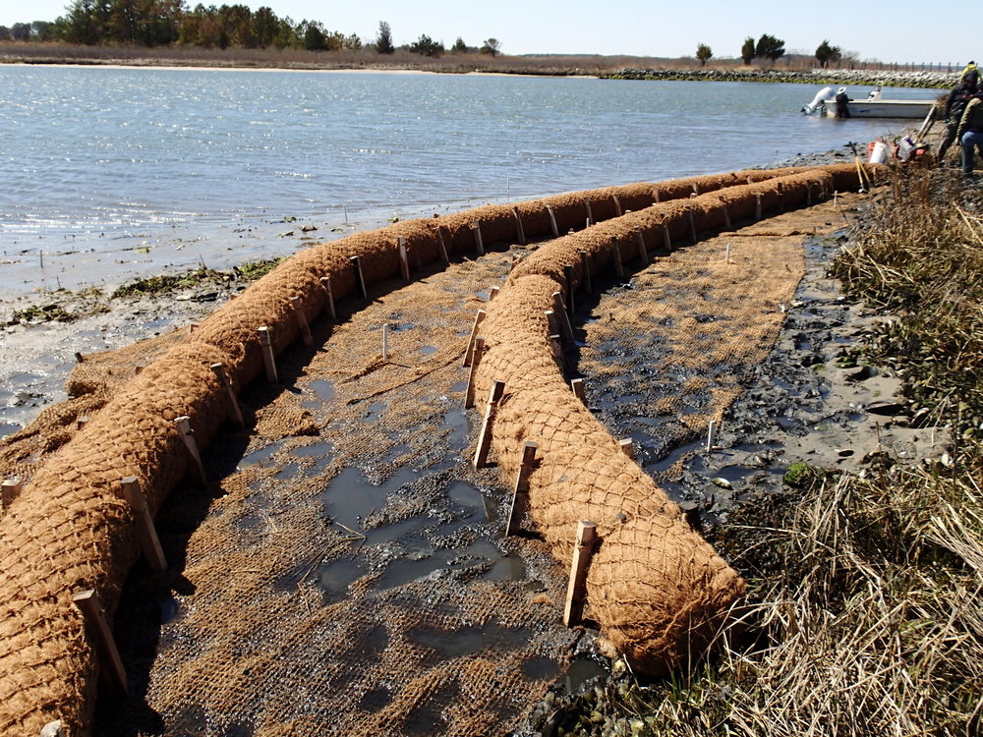
Initial NBS Projects
Techniques to Address Marsh Edge Erosion

Slide 5
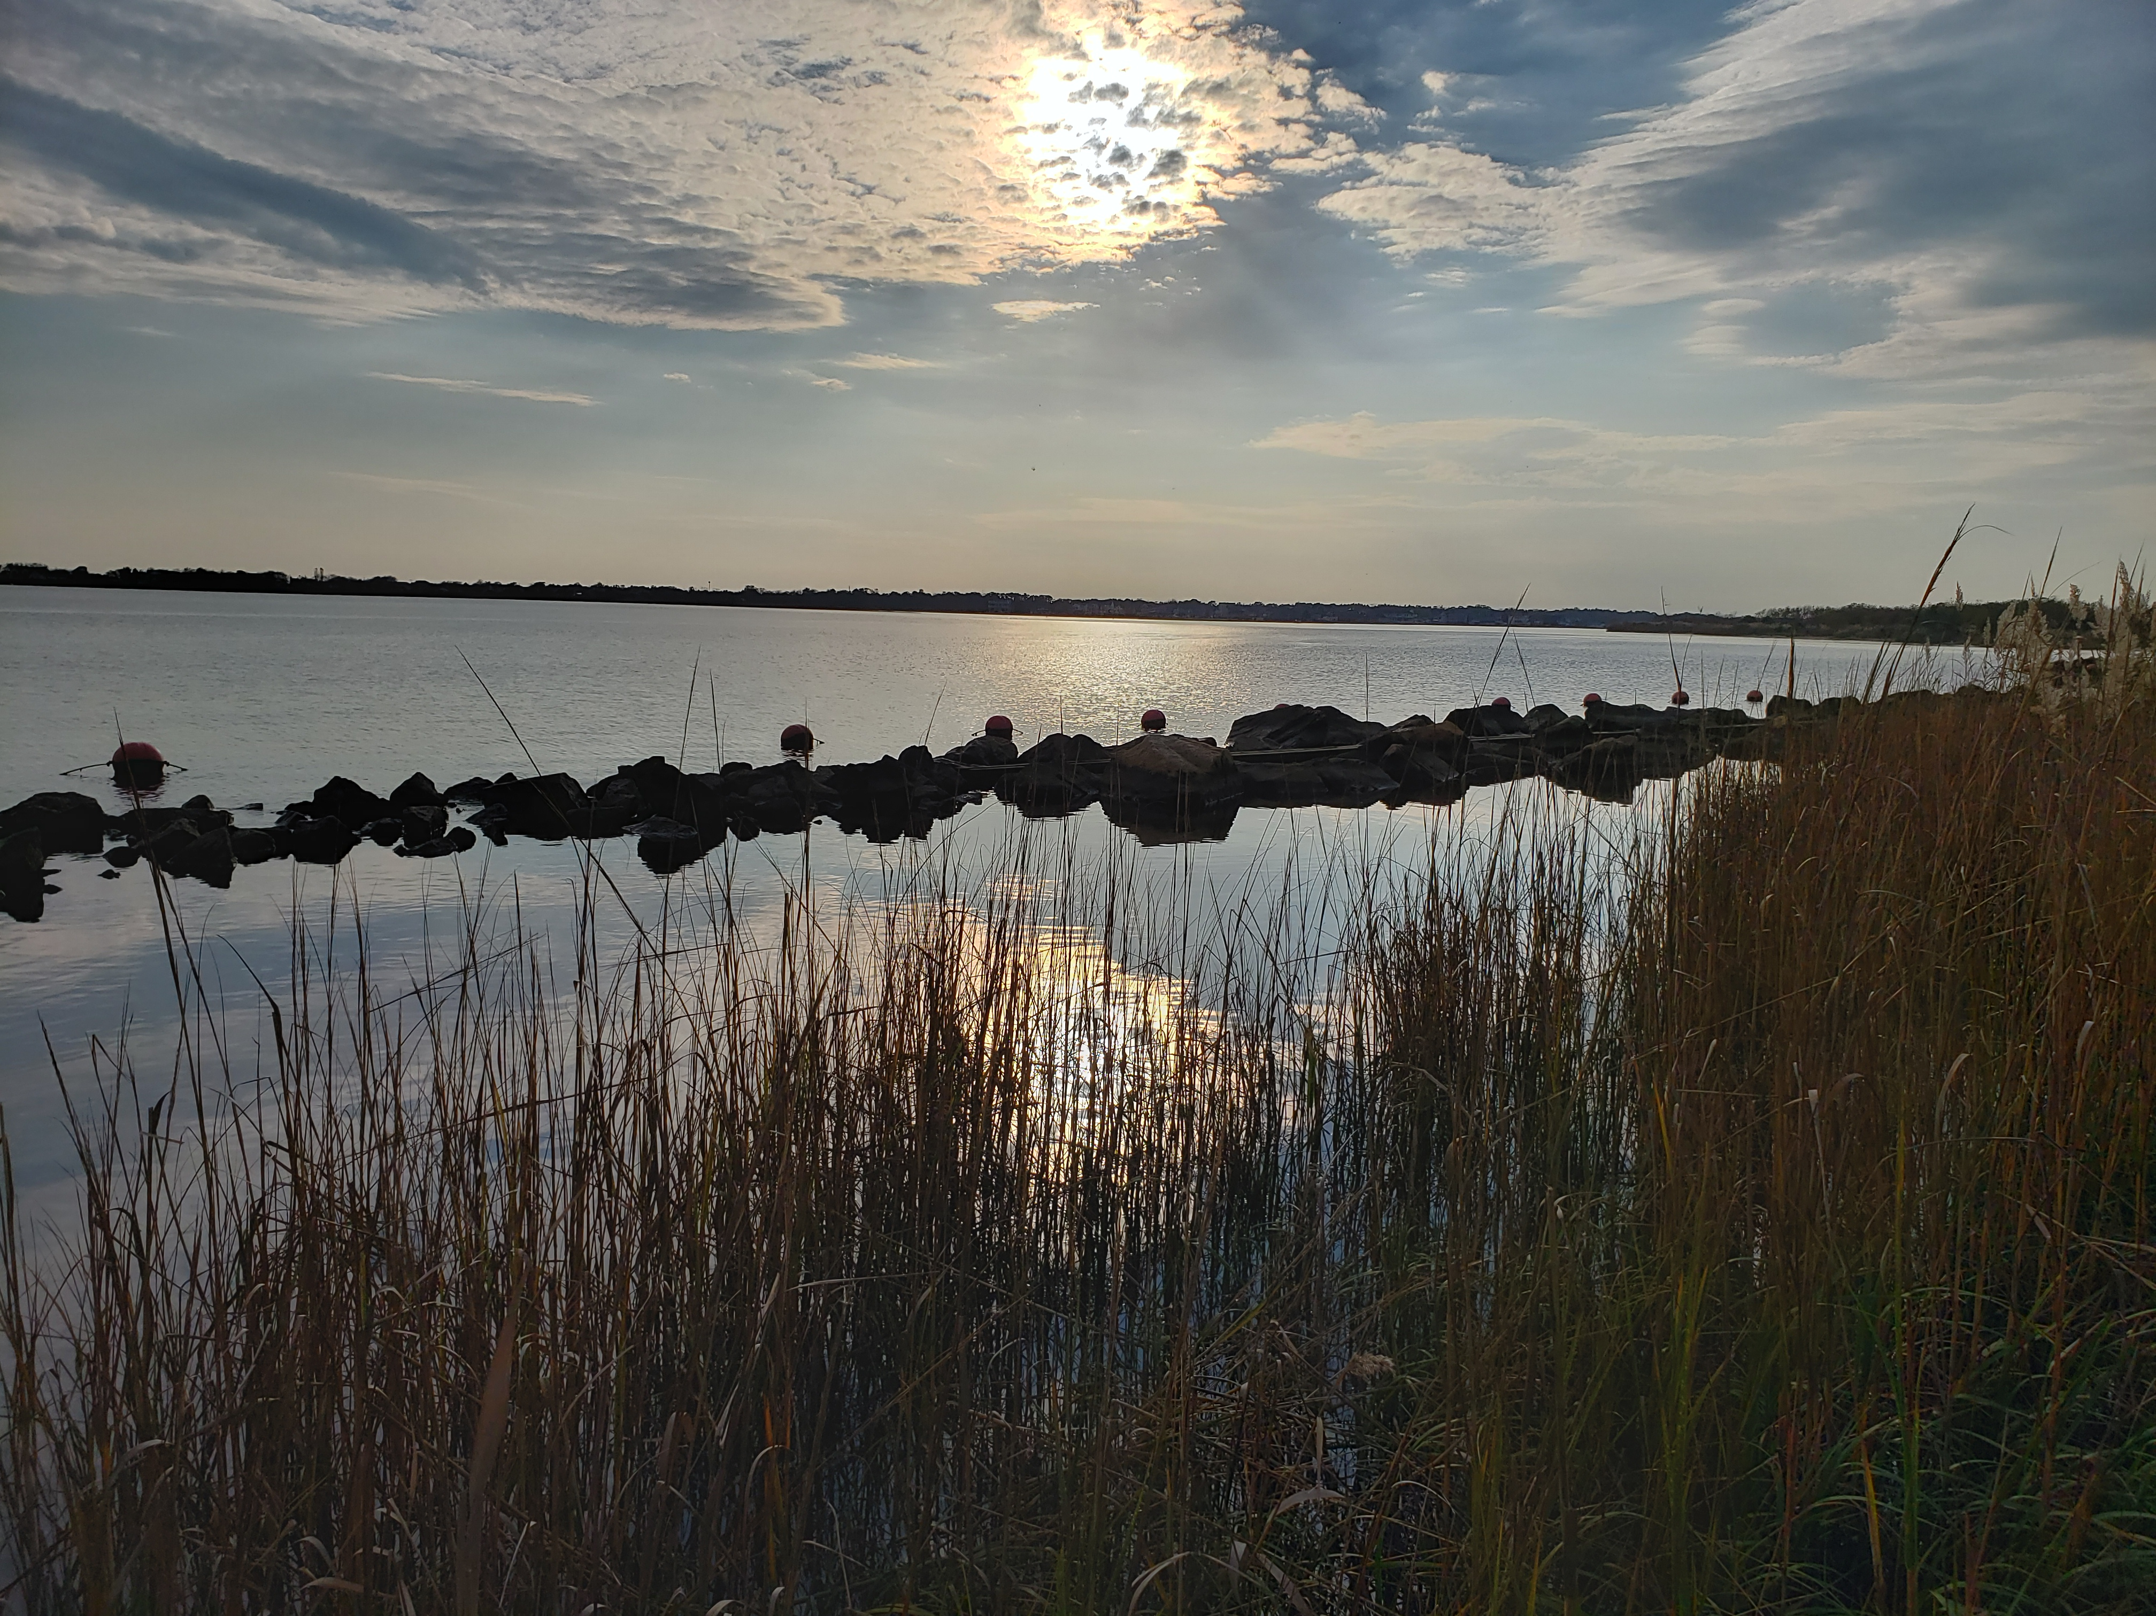
Initial NBS Projects
Traditional Rock Sill Shore Protection

Slide 6
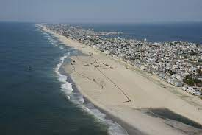
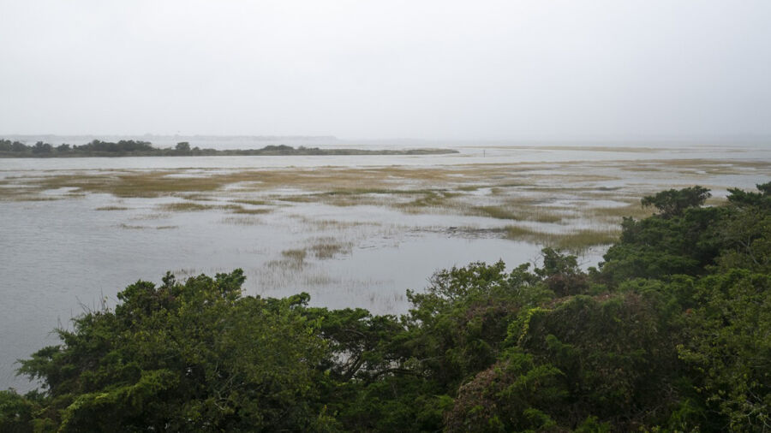
Beneficial Use of Dredged Material
NJ’s Historical BU - Beach Nourishment
NJ ICWW Dredged Material Available
Keeping Sediment in the Natural System not Placing into an Upland CDF
Strategic Dredged Material Placement for Storm Resiliency &To Restore/Create Habitat

Slide 7
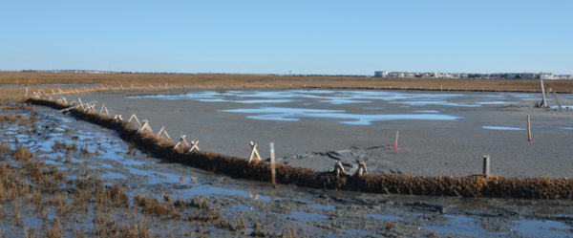
Dredged Material Placement- Initial Thin Layer Projects
Avalon - Thin Layer Placement
Federal Consistency Required Containment
Many Lessons Learned From this Initial Placement

Slide 8
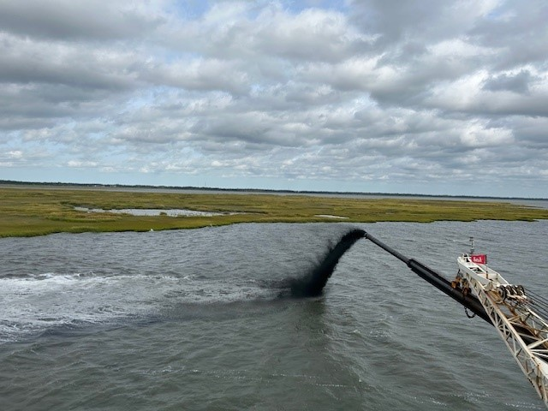
Seven Mile Island Living Laboratory
Innovative Marsh Restoration Techniques
Great Flats
Ring Island
Sturgeon Island
Gull Island
ACOE Partnered with The Wetlands Institute
& NJDEP Fish & Wildlife
Regional Sediment Management
between Townsend & Hereford Inlets for
Bird Habitat Creation, Marsh Elevation for
Resilience and Nearshore Placement for
Marsh Edge Protection and Shallow Intertidal Habitat

Slide 9
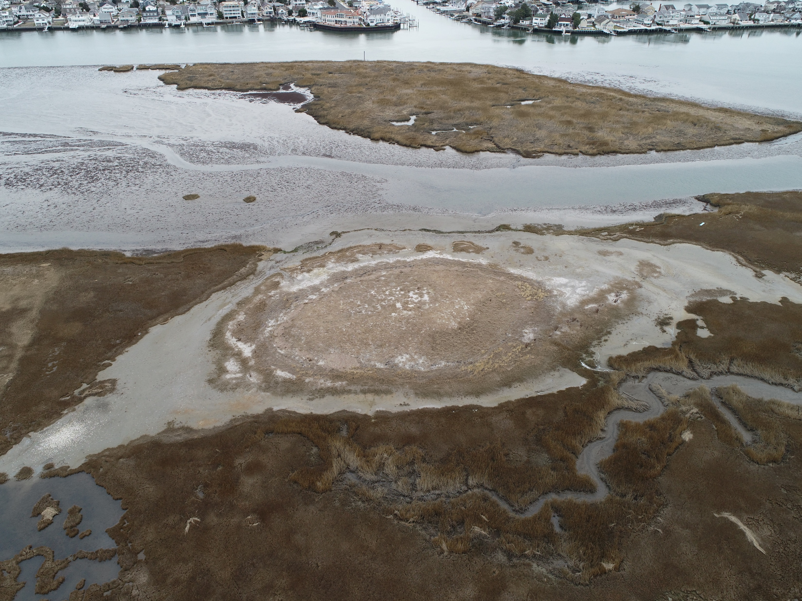
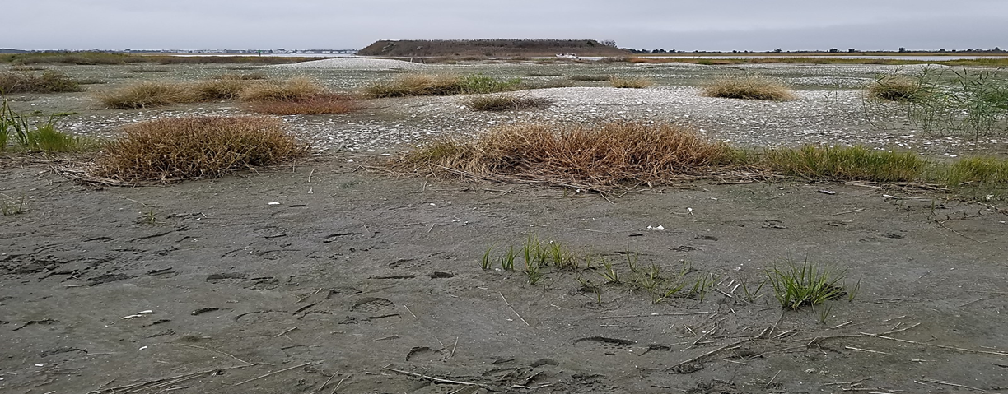
SMILL Great Flats & Ring Island
Great Flats – Direct Placement on Marsh with Sandy Containment Berm
Ring Island – Direct Placement and Spray from Marsh Edge with Containment

Slide 10
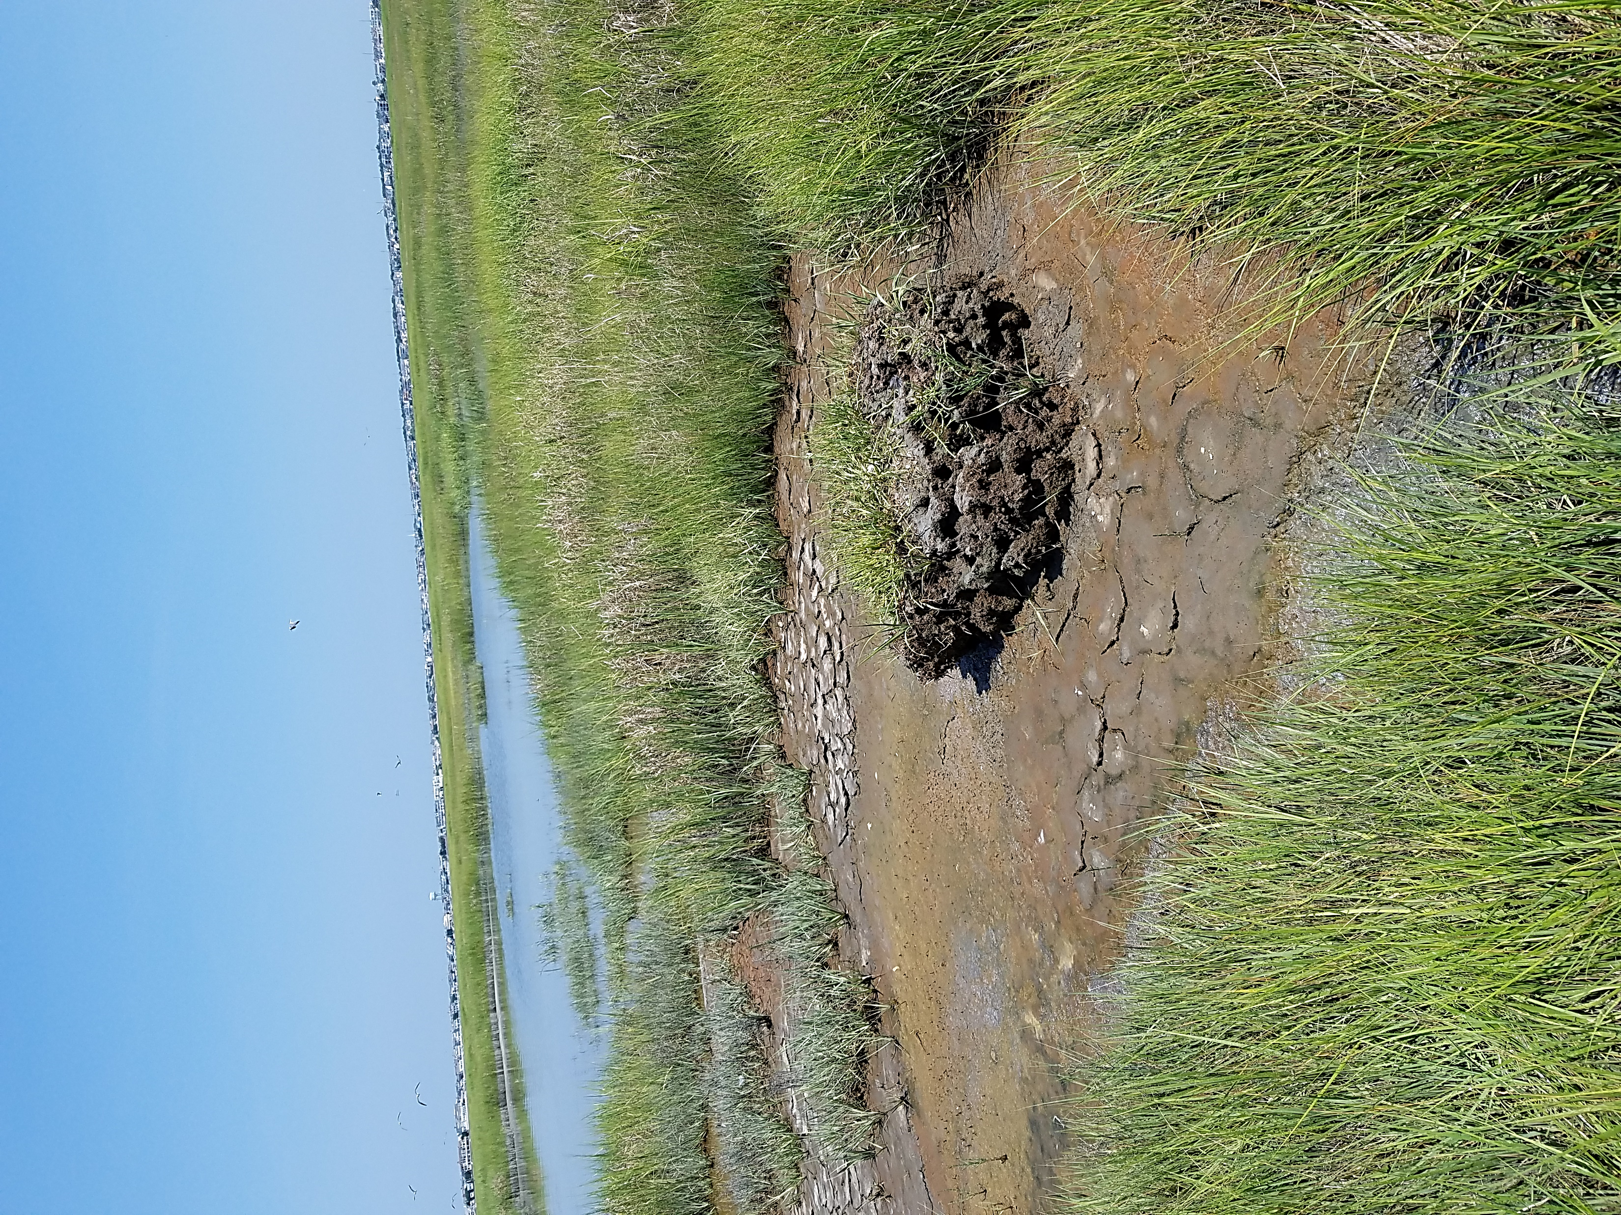
Federal Consistency Review – Sturgeon Island
Creation of Elevated Bird Nesting Habitat While Increasing the Resiliency of the Marsh through the Placement of Dredge Material from NJ’s ICWW

Slide 11
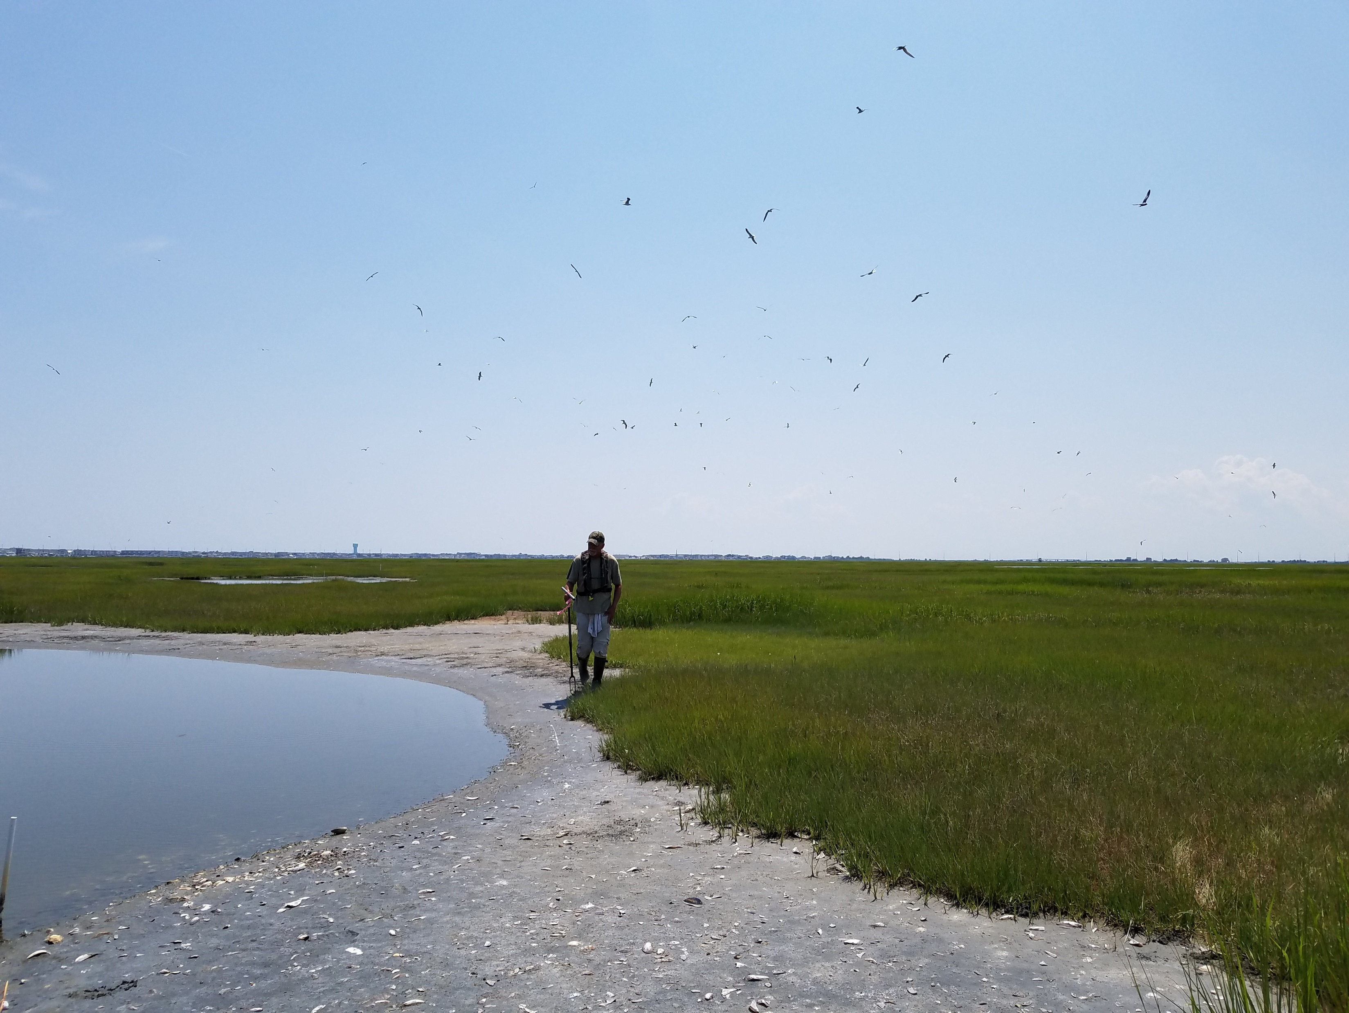
STURGEON ISLAND COORDINATION & FEDERAL CONSISTENCY REVIEW
Great Communication/Coordination with DLRP Prior to Regulatory Review, During and After Placement
Used Best Available Science & Thorough Pre-Placement Assessment in Design/Implementation
SMILL Did the Homework/Defined Restoration Need/Goal & Understood Existing Site Conditions
Hydrologic Assessment: Wave, Current, Turbidity Analysis
Sediment Composition Assessment of Site and Dredged Material for Placement
Ecological Studies: Vegetation & Benthic Community Assessment, and Habitat Usage
Minimized Use of Containment/No Planting Requirement Post Placement – Vegetation Naturally Regenerated

Slide 12
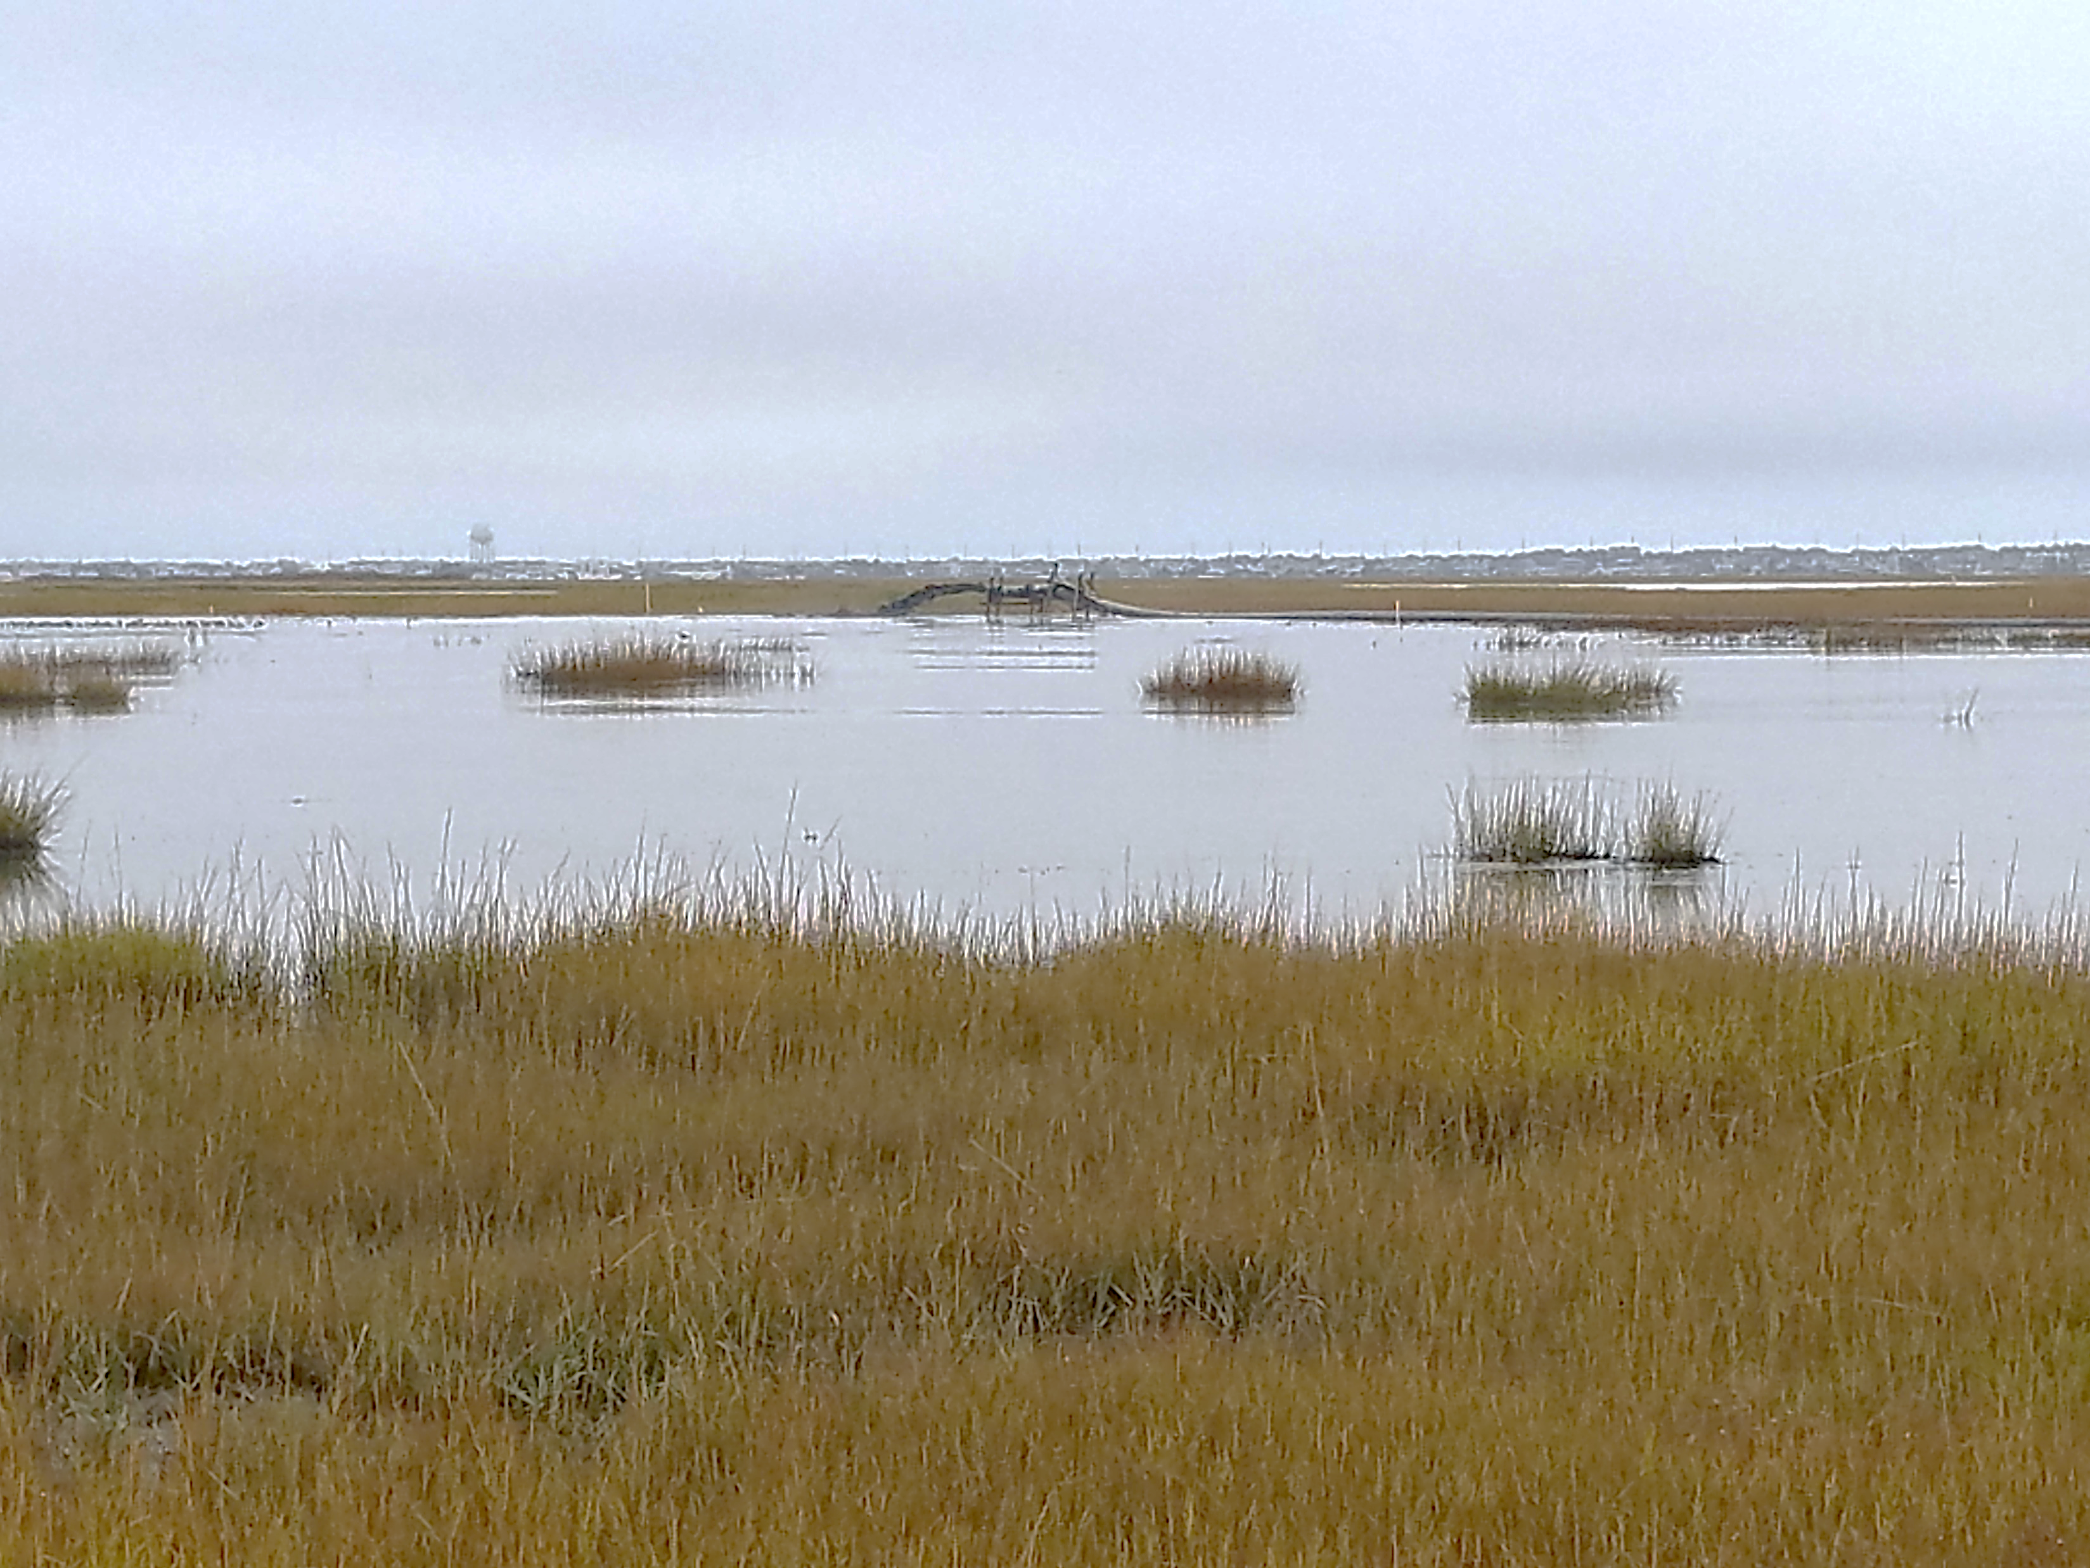
GULL ISLAND
Used Site Condition Assessment & Lessons Learned from Sturgeon Island to Inform Gull Island Project (Same System/Adjacent Island)
-Innovative Placement Technique Using Natural Flow Pathways
-No Containment Measures – previous containment measures trapped sediment/unnaturally building it up in certain areas, & no containment measures allowed material to move naturally on marsh
-Nearshore Placement to Create a Natural Feeder Berm to Protect the Marsh Edge & Create Shallow, Intertidal Areas for SAV Habitat
- Concerns about Off-Site Shellfish Leases – Not An Issue
Low levels/Short Lived Turbidity observed while pumping

Slide 13
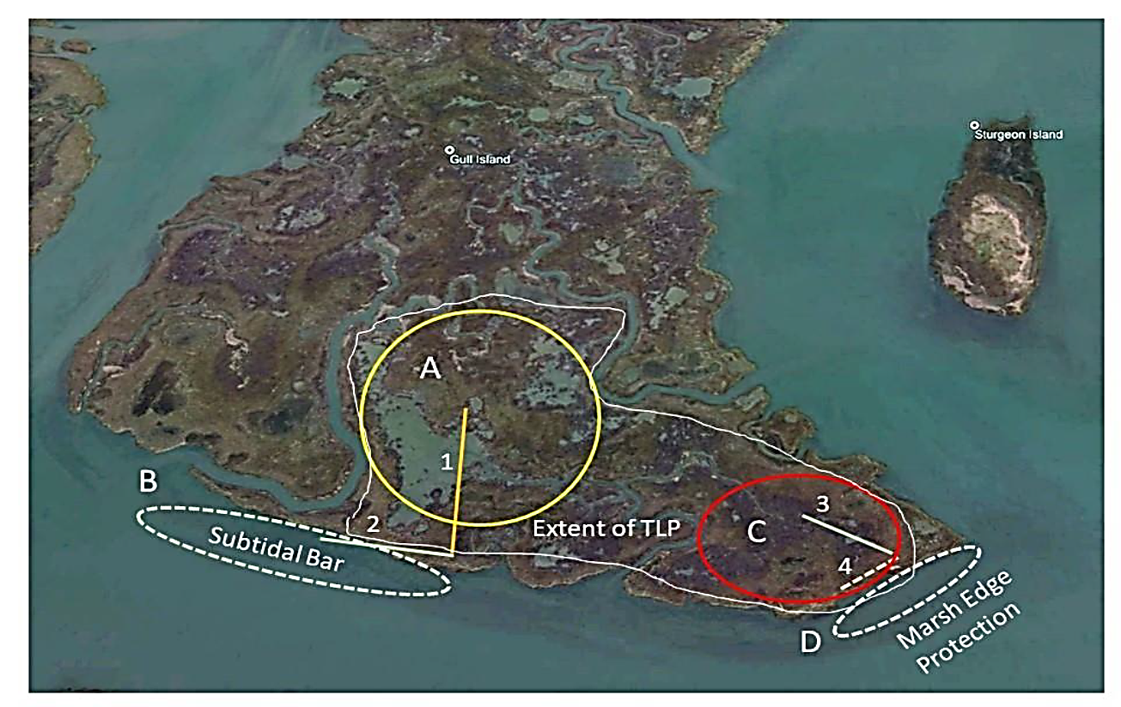
LESSONS LEARNED FROM
A REGULATOR’S PERSPECTIVE
Communication between applicant & DLRP before, during
and after the project is key
-Minimizes surprises during design, regulatory review and
implementation (if adaptive management is necessary)
Thorough preplacement assessment of existing site conditions &
hydrodynamics is key
-Provides expectation about how the material
will naturally move when placed
-Helps to Minimize Concerns of Material Moving
Off-site/Impacting Other Areas
Better understanding of the use of/need for different containment
techniques vs no containment

Slide 14
LESSONS LEARNED FROM
A REGULATOR’S PERSPECTIVE (CONT.)
Turbidity Concerns During Placement Minimized
-Monitoring during placement showed low/short lived turbidity level
-More Turbidity Generated from Boat Wake Observed During Placement
Requirements for Installation of Plantings Post-Placement
-May not be necessary - Natural Vegetation Reestablishment
Monitoring after Project Completion – Supports & Informs future similar projects

Slide 15
DEVELOPING REGULATORY GUIDANCE FOR FUTURE
PERMIT/FEDERAL CONSISTENCY SUBMITTALS

Slide 16
FOR MORE INFORMATION: DLRP’S WEBSITE - https://dep.nj.gov/wlm/lrp CONTACT INFO: COLLEEN.KELLER@DEP.NJ.GOV

