Slide 1
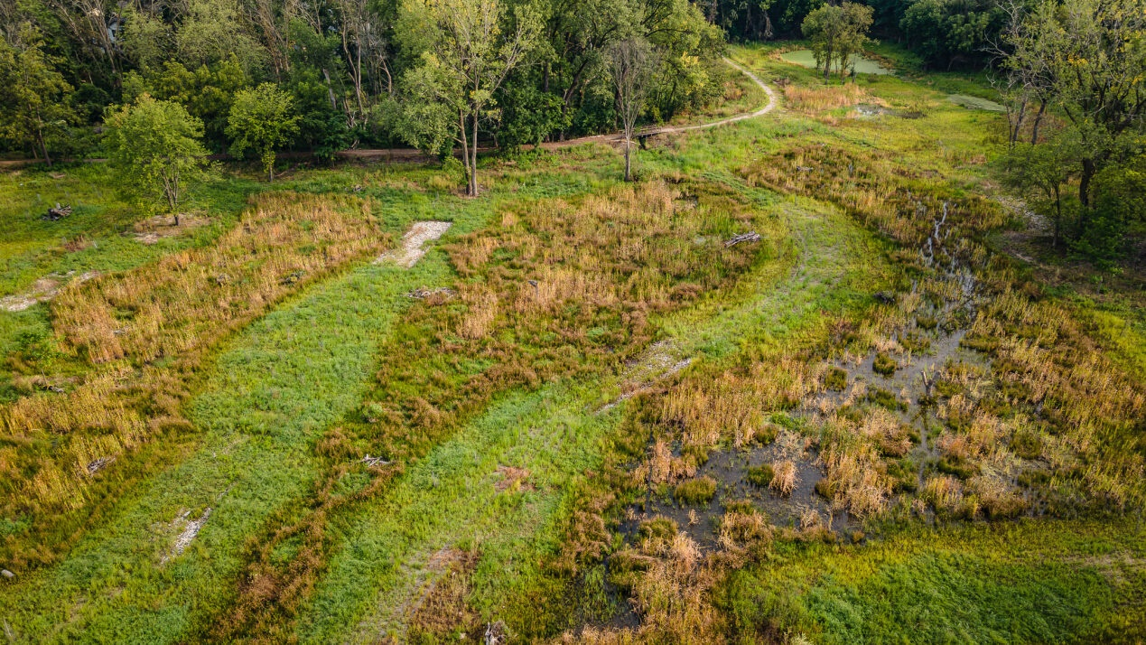

Regenerative Stormwater Conveyance & Sand Seepage Wetlands
Nature-based strategies to improve surface water resources and increase our wetland inventory
March 13, 2024
NJ Coastal & Climate Resilience Conference - 2024
Monmouth University, West Long Branch, NJ
Kevin Dahms, PE, Biohabitats
Joe Berg, PWS, CSE, Biohabitats

Slide 2
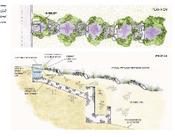
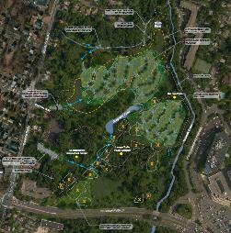
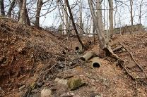
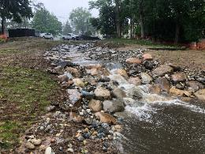
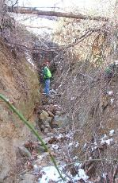
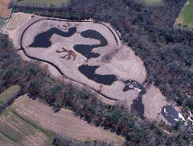
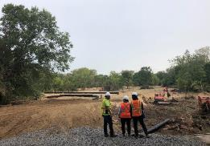
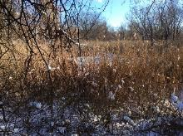
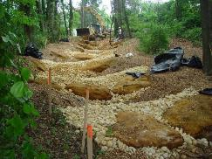

OVERVIEW
PROJECT DRIVERS
DESIGN APPROACHES
CASE STUDIES
LESSONS LEARNED
OVERVIEW
2

Slide 3

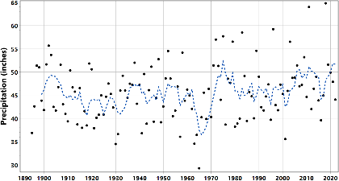
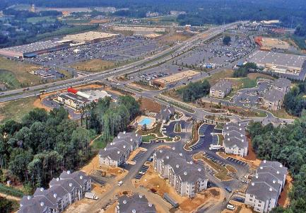
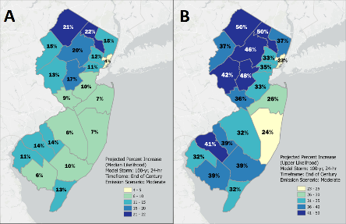
PROJECT DRIVERS
Office of the New Jersey State Climatologist. (2022)
DeGaetano, A. (2021)
Courtesy of USGS
PROJECT DRIVERS
3
Notes:
Increased frequency and amount of precipitation, increased intensity precipitation/extreme events, combined with increased impervious area and development, plus degraded and deteriorating infrastructure

Slide 4
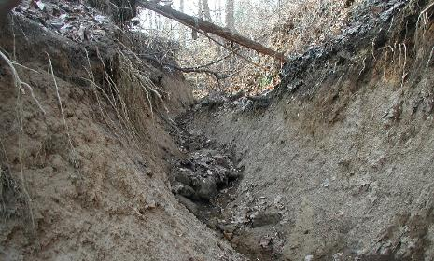
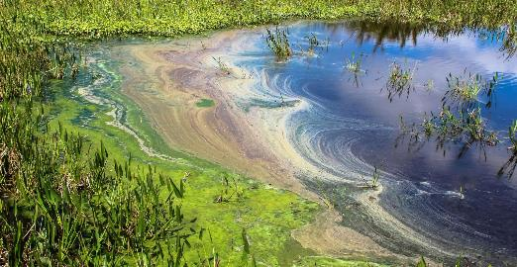
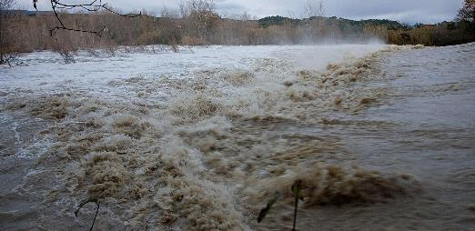
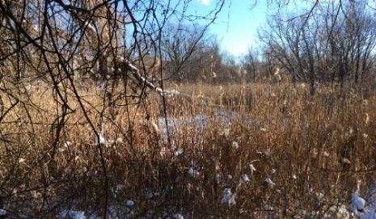
PROJECT DRIVERS
NJDEP
NJDEP
PROJECT DRIVERS
4
Notes:
Lead to issues such as water quality impairments, flooding, erosion, and pervasive invasive species

Slide 5
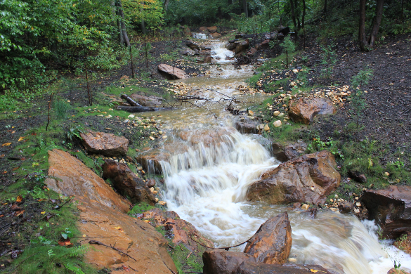
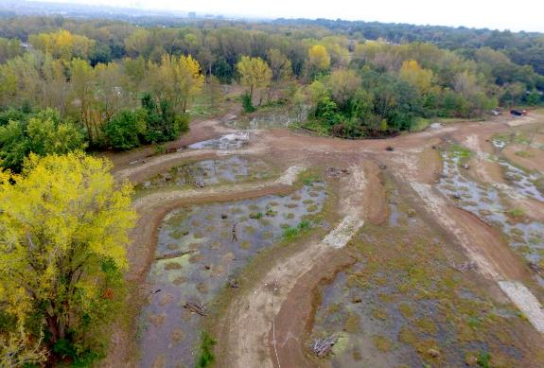
DESIGN APPROACHES
Regenerative Stormwater Conveyance (RSC)
Sand Seepage Wetlands
Photo Credit: SiteWorks
DESIGN APPROACHES
5
Notes:
Regenerative Stormwater Conveyance and Sand Seepage Wetlands offer an opportunity address these issues and provide multiple co-benefits through a nature-based approach

Slide 6
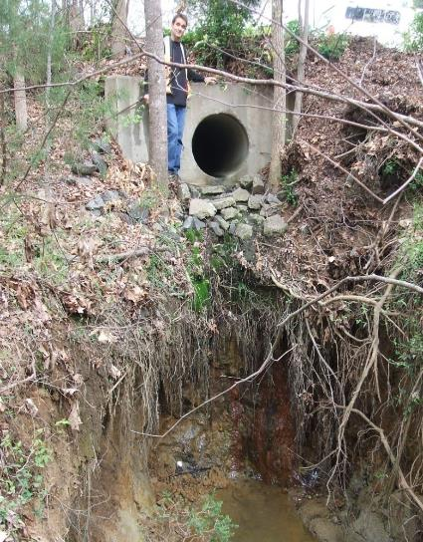
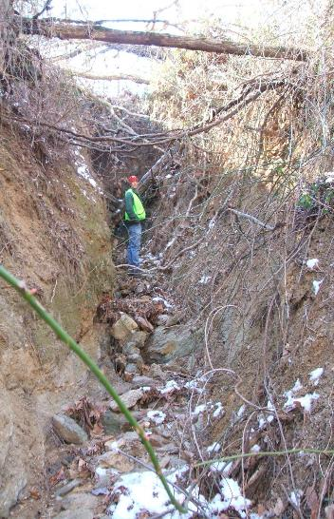
REGENERATIVE STORMWATER CONVEYANCE
Eroding outfalls
Sediment runoff
Flashy systems
Risk & liability
DESIGN APPROACHES
6

Slide 7
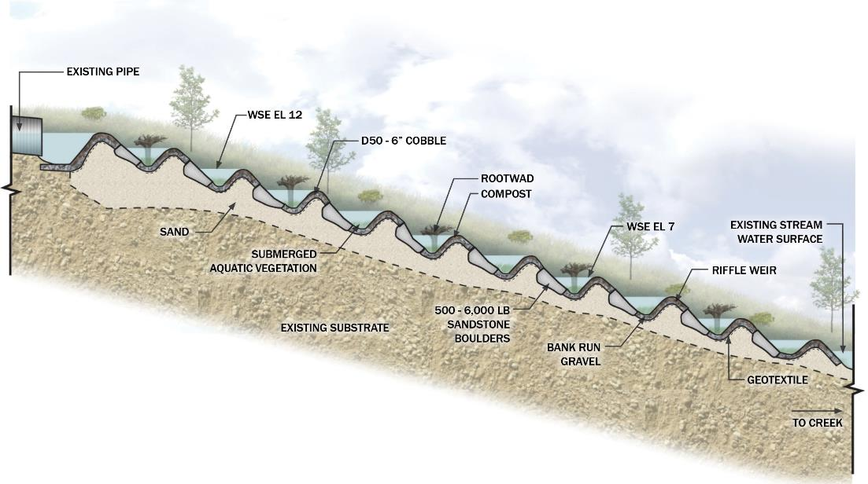
REGENERATIVE STORMWATER CONVEYANCE
DESIGN APPROACHES
7
Notes:
Sand is 80% Sand and 20% woodchips

Slide 8
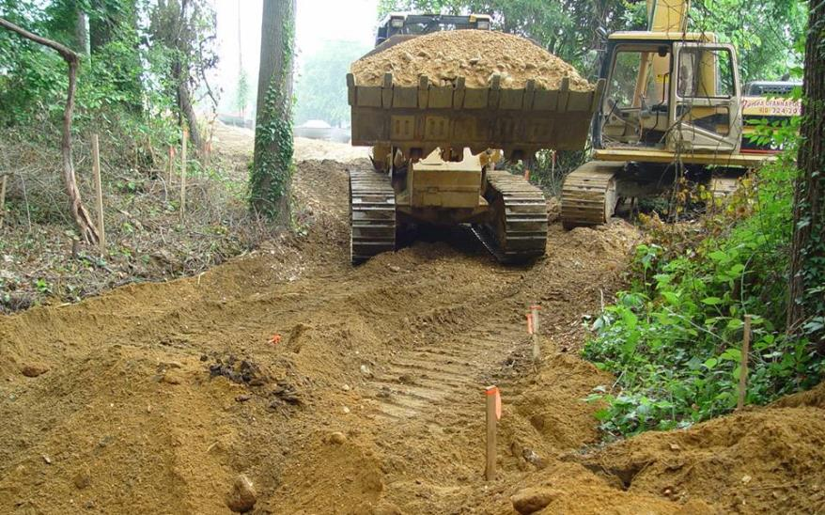
REGENERATIVE STORMWATER CONVEYANCE
Sand Seepage Bed
DESIGN APPROACHES
8
Notes:
Can mix sand and woodchips mixed in-situ – 4 truckloads of sand, 1 truckload of woodchips

Slide 9
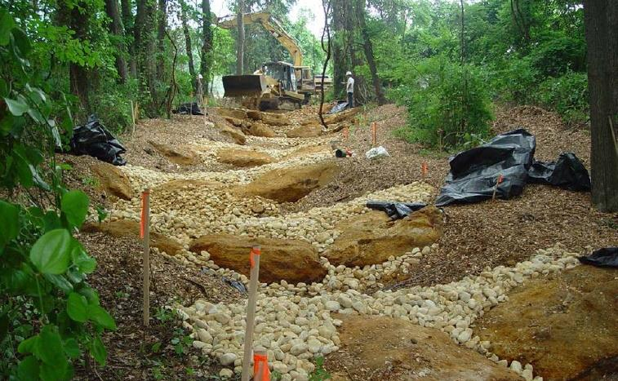
REGENERATIVE STORMWATER CONVEYANCE
Riffle Grade Controls
DESIGN APPROACHES
9
Notes:
100-year storm so it doesn’t transport a 1-inch particle

Slide 10
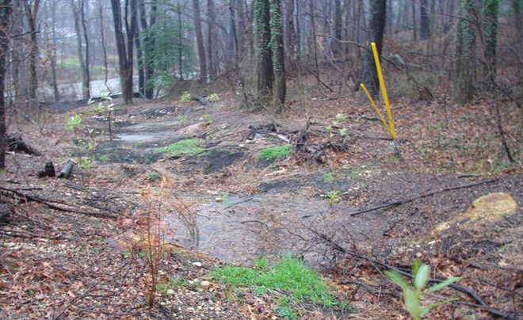
REGENERATIVE STORMWATER CONVEYANCE
During Runoff Event
DESIGN APPROACHES
10

Slide 11
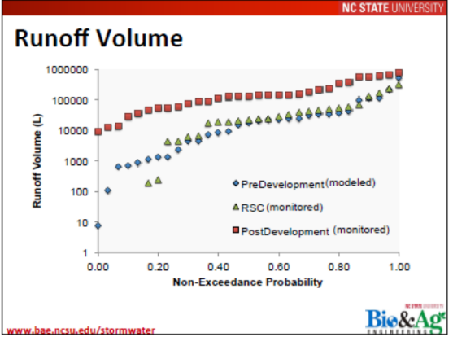
REGENERATIVE STORMWATER CONVEYANCE
DESIGN APPROACHES
11
Notes:
Red are monitored post development of full suite of LID BMPs

Slide 12
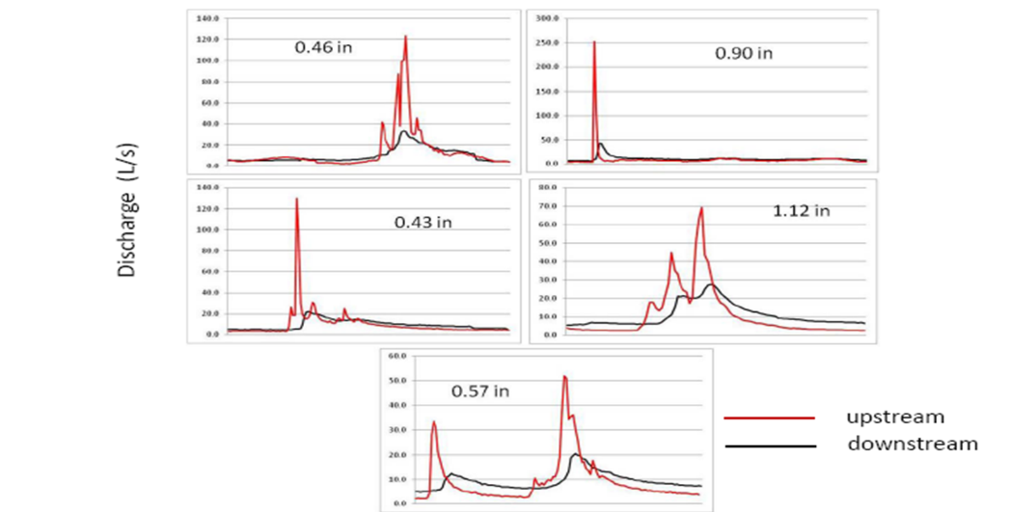
REGENERATIVE STORMWATER CONVEYANCE
Source: Solange Filoso, University of Maryland
DESIGN APPROACHES
12

Slide 13
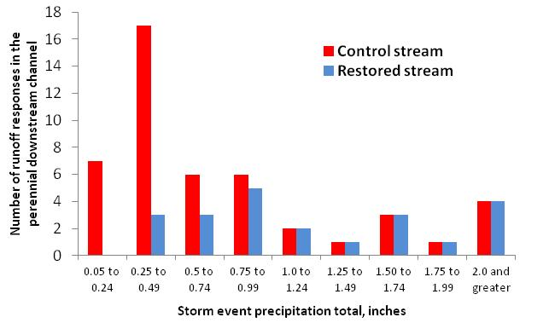
REGENERATIVE STORMWATER CONVEYANCE
17
Source: Solange Filoso, 2012
36 vs. 11
7
6
6
5
3
3
DESIGN APPROACHES
13
Notes:
Reduce # of runoff events up to 1 inch, draining 11 acres of 35% impervious surface – this is just one site, 2/3 reduction in runoff events for WQV or less

Slide 14
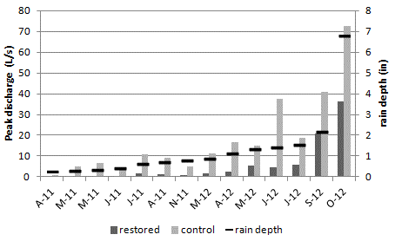
REGENERATIVE STORMWATER CONVEYANCE
Sandy
Source: Solange Filoso, 2012
DESIGN APPROACHES
14

Slide 15
REGENERATIVE STORMWATER CONVEYANCE
Source: Solange Filoso, 2012
DESIGN APPROACHES
15

Slide 16
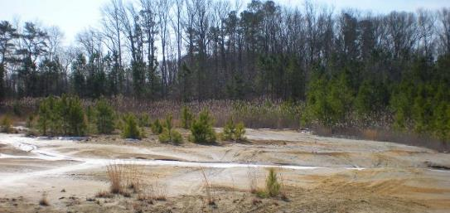
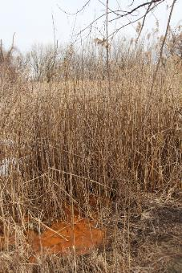
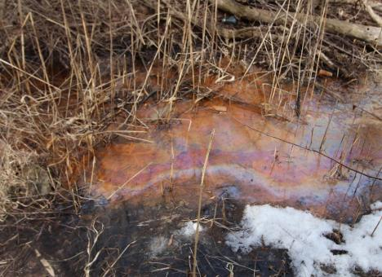
SAND SEEPAGE WETLANDS
Poor water quality
Eroded channels and gullies
Concentrated flow paths
Degraded habitat
Low biodiversity
DESIGN APPROACHES
16
Notes:
RSC is more focused on vertical treatment, whereas Sand Seepage is horizonatal

Slide 17
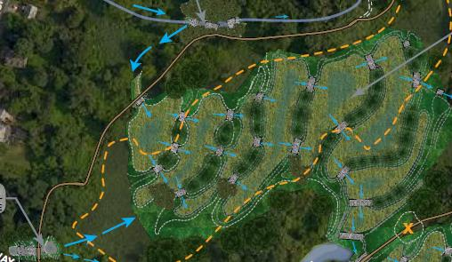
SAND SEEPAGE WETLANDS
DESIGN APPROACHES
17
Notes:
Spread flow out across the site, elongate flow paths
Surface area that water is in contact and time that water is in contact with – which contribute to the functional value and ecosystem services

Slide 18
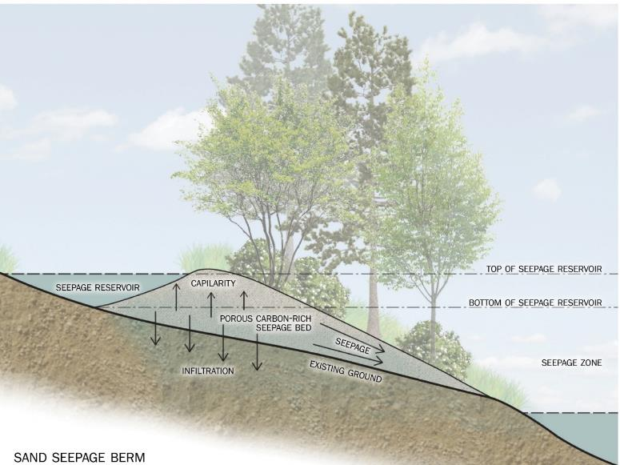
SAND SEEPAGE WETLANDS
DESIGN APPROACHES
18
Notes:
Allowing us to use stormwater runoff to create wetland hydrology – more natural hydrology

Slide 19
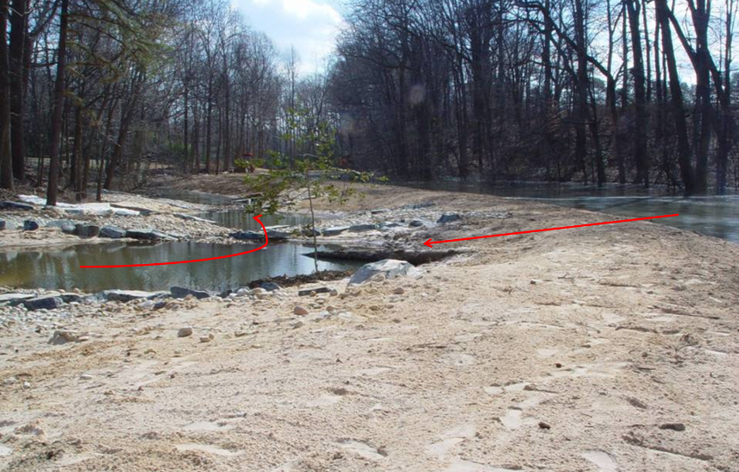
SAND SEEPAGE WETLANDS
Seepage reservoir
Seepage berm/trail during construction
DESIGN APPROACHES
19

Slide 20
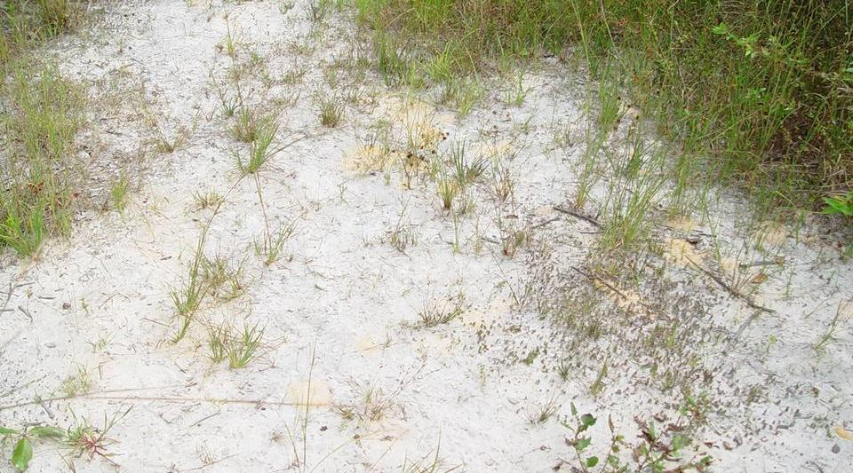
SAND SEEPAGE WETLANDS
Dynamic soil system, not static sand bed
DESIGN APPROACHES
20

Slide 21
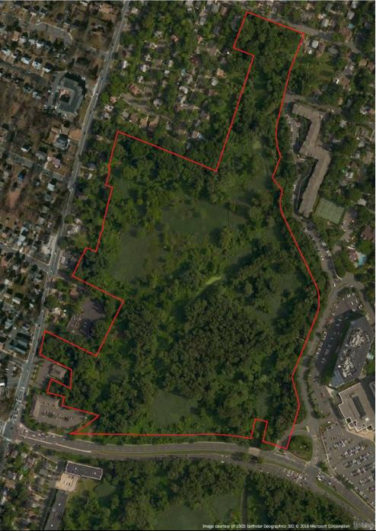
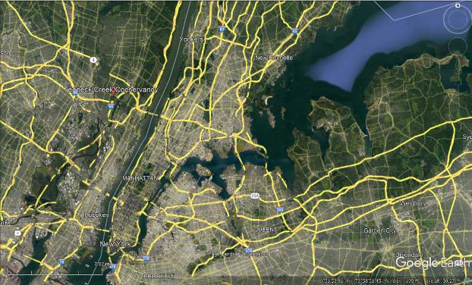
TEANECK CREEK PARK RESTORATION
Teaneck Creek Park, Teaneck, NJ
Part of Overpeck County Park
Case Study 1 – Teaneck Creek Park Restoration
21
21

Slide 22
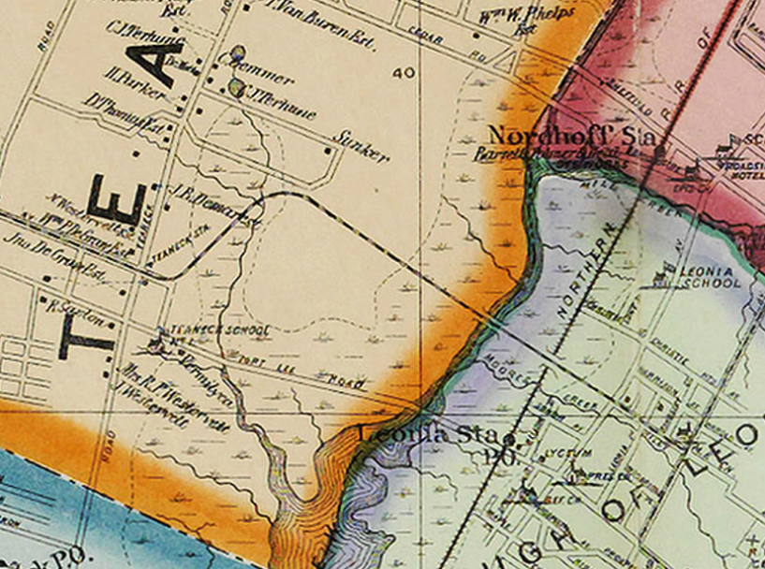
SITE LAND USE AND CONTEXT
Case Study 1 – Teaneck Creek Park Restoration
22
Notes:
It was a slated dump

Slide 23
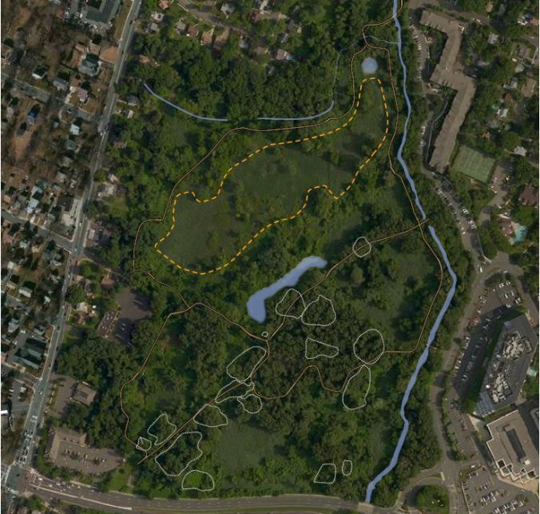
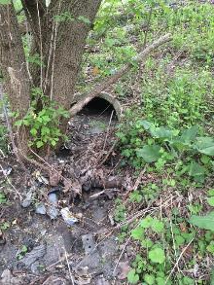
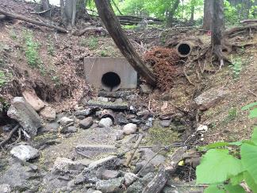

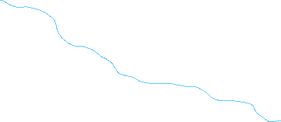
EXISTING CONDITIONS
Eroding brook
Eroding stormwater gullies
Case Study 1 – Teaneck Creek Park Restoration
23

Slide 24
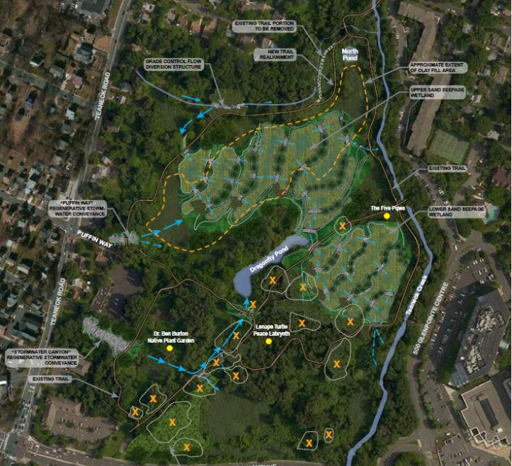
RESTORATION PLANS
Regenerative stormwater conveyance
Sand seepage wetlands
Invasive species management (mechanical/chemical)
Native plantings
Trail rehabilitation
Debris pile removal
Lookout berm creation
Case Study 1 – Teaneck Creek Park Restoration
24

Slide 25
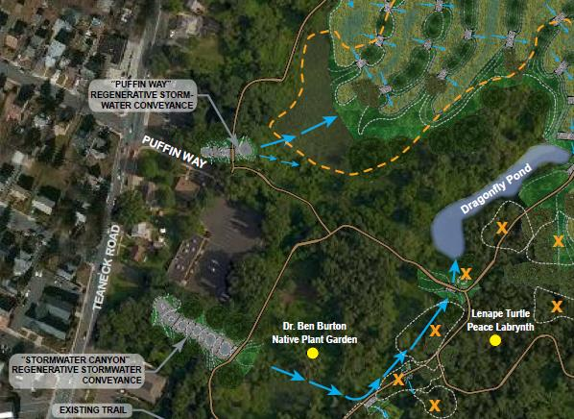
REGENERATIVE STORMWATER CONVEYANCE
Case Study 1 – Teaneck Creek Park Restoration
25

Slide 26
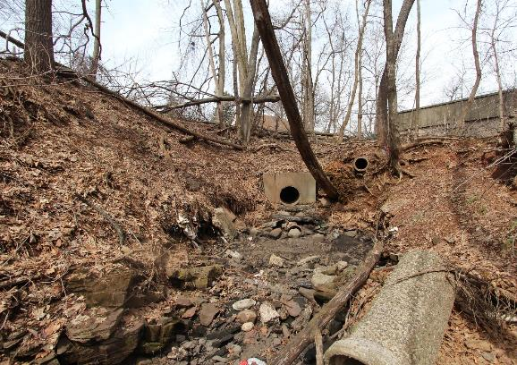
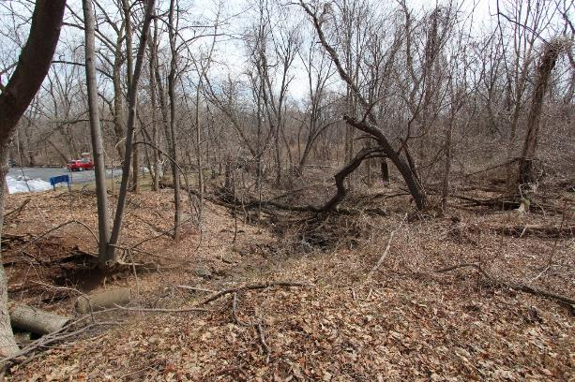
HILLSIDE RSC - BEFORE
Case Study 1 – Teaneck Creek Park Restoration
26

Slide 27
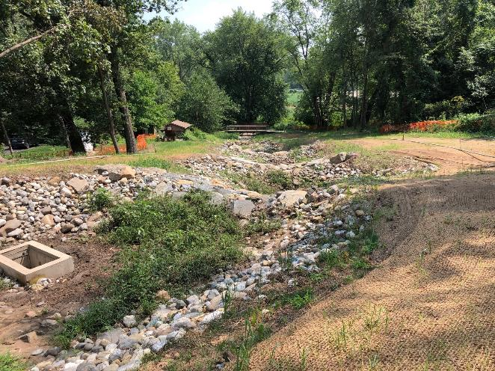
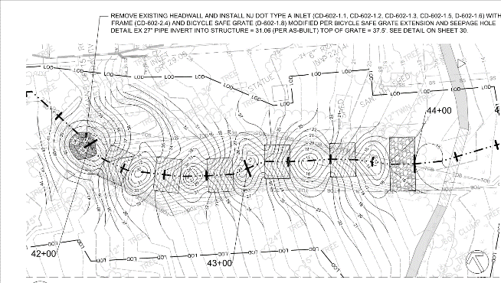
HILLSIDE RSC – DURING CONSTRUCTION
Case Study 1 – Teaneck Creek Park Restoration
27

Slide 28
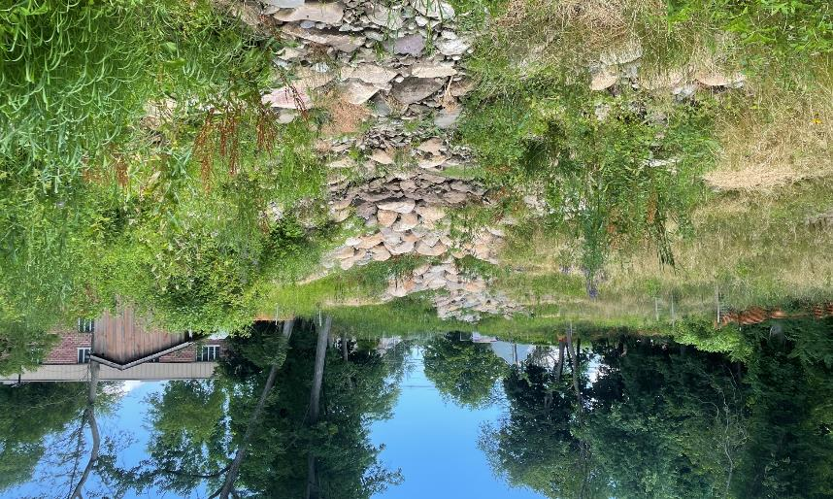
HILLSIDE RSC – POST PLANTING
Case Study 1 – Teaneck Creek Park Restoration
28

Slide 29

HILLSIDE RSC – DURING RUNOFF EVENT
Case Study 1 – Teaneck Creek Park Restoration
29

Slide 30

SAND SEEPAGE WETLANDS
Case Study 1 – Teaneck Creek Park Restoration
30

Slide 31


SAND SEEPAGE WETLANDS - BEFORE
Case Study 1 – Teaneck Creek Park Restoration
31

Slide 32


SAND SEEPAGE WETLANDS – POST EXCAVATION
Photo Credit: SiteWorks
Case Study 1 – Teaneck Creek Park Restoration
32

Slide 33


SAND SEEPAGE WETLANDS – DURING
Case Study 1 – Teaneck Creek Park Restoration
33

Slide 34

SAND SEEPAGE WETLANDS – DURING/POST PLANTING
Photo Credit: SiteWorks
Photo Credit: David Ike
Case Study 1 – Teaneck Creek Park Restoration
34

Slide 35


SAND SEEPAGE WETLANDS – POST PLANTING
Case Study 1 – Teaneck Creek Park Restoration
35

Slide 36


SAND SEEPAGE WETLANDS – 1-YEAR
Photo Credit: David Ike
Photo Credit: David Ike
Case Study 1 – Teaneck Creek Park Restoration
36

Slide 37


SAND SEEPAGE WETLANDS – 1-YEAR
Photo Credit: David Ike
Photo Credit: David Ike
Case Study 1 – Teaneck Creek Park Restoration
37

Slide 38

LIZARD HILL SAND MINE RECLAMATION & RESTORATION
Ocean City, MD
Case Study 2 – Lizard Hill Sand Mine Reclamation & Restoration
38
Notes:
Knoll between 2 streams that was mined for sand

Slide 39


SAND SEEPAGE WETLANDS - EXISTING CONDITIONS
Case Study 2 – Lizard Hill Sand Mine Reclamation & Bishopville Pond Restoration
39

Slide 40


SAND SEEPAGE WETLANDS - EXISTING CONDITIONS
Case Study 2 – Lizard Hill Sand Mine Reclamation & Bishopville Pond Restoration
40

Slide 41


SAND SEEPAGE WETLANDS - DURING CONSTRUCTION & PLANTING
Case Study 2 – Lizard Hill Sand Mine Reclamation & Bishopville Pond Restoration
41

Slide 42


SAND SEEPAGE WETLANDS – 10 YEARS POST PLANTING
Case Study 2 – Lizard Hill Sand Mine Reclamation & Bishopville Pond Restoration
42

Slide 43


SAND SEEPAGE WETLANDS
Case Study 2 – Lizard Hill Sand Mine Reclamation & Bishopville Pond Restoration
43

Slide 44


SAND SEEPAGE WETLANDS - DURING CONSTRUCTION & PLANTING
Case Study 2 – Lizard Hill Sand Mine Reclamation & Bishopville Pond Restoration
44

Slide 45


SAND SEEPAGE WETLANDS – 2-3 YEARS POST PLANTING
Case Study 2 – Lizard Hill Sand Mine Reclamation & Bishopville Pond Restoration
45

Slide 46


LESSONS LEARNED
Communication to stakeholders
Collaboration between project partners
Understanding timeline and schedule
Phasing of large projects
Site stabilization and vegetation establishment
Multi-pronged invasive species control (and long-term stewardship)
Restoration takes time
Monitoring is valuable for communication and buy-in
Photo Credit: David Ike
Lessons Learned
46

Slide 47

Thank You
Questions?
Kevin Dahms, PE – Biohabitats
kdahms@biohabitats.com
Photo Credit: David Ike
47

Slide 48

DESIGN APPROACH
Remove historical fill and debris and import sand and woodchips
to create more natural soil conditions that better support native plants
Slow water flow and redirect surface flows
to promote infiltration that will raise groundwater table
and to better resemble historic and create longer flow paths
Enhance Teaneck Creek connections
with improved riparian/floodplain habitat
Create more open water and wet areas
to enhance how wetland, stream and riparian habitats function
Enhance public experience
improve trail design, create diversity of habitats, block noise from Degraw Avenue
PROJECT APPROACH
48

Slide 49


PROJECT DETAILS – REGENERATIVE STORMWATER CONVEYANCE
PROJECT APPROACH
49

Slide 50


PROJECT DETAILS – REGENERATIVE STORMWATER CONVEYANCE
Hillside RSC - After
PROJECT APPROACH
50

Slide 51


PROJECT DETAILS – REGENERATIVE STORMWATER CONVEYANCE
Oakdene RSC - Before
PROJECT APPROACH
51

Slide 52


PROJECT DETAILS – REGENERATIVE STORMWATER CONVEYANCE
Oakdene RSC - After
PROJECT APPROACH
52

Slide 53
PROJECT DETAILS – SAND SEEPAGE WETLANDS
Sweet Flag
Big Bluestem
Tussock sedge
Virginia Wild Rye
Swamp Rose Mallow
Soft Rush
Hardstem Bulrush
Common Threesquare
Swamp Milkweed
Harlequin Blueflag
Green Arrow Arum
Pickerel Weed
Lizard's Tail
Northern sea oats
Wild Blue Indigo
Common boneset
Purple Joe-Pye
Switchgrass
Black-Eyed Susan
New England Aster
Butterfly Weed
Wild Bergamot
Spotted Beebalm
Indiangrass
Broomsedge Bluestem
Canada Goldenrod
Little Bluestem
Tufted Hairgrass
White Wood Aster
Pennsylvania Sedge
Silver Maple
Sweet Pepperbush
Silky Dogwood
Witch-hazel
Common Winterberry
Spice Bush
Black gum
Arrowwood viburnum
Chestnut Oak
Atlantic White Cedar
Eastern Red Cedar
Eastern Redbud
Blackhaw Viburnum
Common persimmon
Lowbush Blueberry
White Oak
Gray Dogwood
New Jersey Tea
Bearberry
Shadbush
Smooth Sumac
PROJECT APPROACH
53

Slide 54


Photo Credit: David Ike
PROJECT METRICS
Over 20 acres of habitat restoration
430 linear feet of stormwater channel restoration
16 debris piles removed or capped
Photo Credit: David Ike
PROJECT APPROACH
54

Slide 55




Wetlands Research & Restoration Design
Environmental Data Collection
Groundwater Sampling
  Nitrogen and Phosphorus Concentrations
Surface Water Sampling
  Low Flow/Stormwater and Nitrogen/Phosphorus
Vegetation Survey
  Floristic Quality Evaluation
Sediment/Soil Sampling
  Soil Characteristics and Carbon/Nitrogen/Phosphorus
Atmospheric Deposition Data
  Dry and Wet Weather Nitrogen Deposition

Slide 56


Wetlands Research & Restoration Design
Soils and Floristic Quality Index
Soil Quality of Each 100m x 100m Teaneck Creek Sampling Unit
Floristic Quality of Each 100m x 100m Teaneck Creek Sampling Unit
TCC Office

Slide 57


Wetlands Research & Restoration Design
Hydrologic Model & Water Budget
Surface Water Routing Through Teaneck Creek Wetlands
Teaneck Creek Wetland Areas

Slide 58
PROJECT COSTS
Construction - $5.6M (plus...)
Planning, Design, Permitting (restoration only) – $445,000

Slide 59
TYPICAL COSTS
RSC
$400-$800 per LF for construction
  Dependent on length, slope, cross sectional area, access, etc.
  Could be double if difficult conditions
$130-$160 per LF for design
  Very dependent on site conditions
Sand Seepage Wetlands
Very site dependent
Costs associated with site clearing, invasive control, excavation, fill material, planting

Slide 60
Design Details
RSC
Hillside RSC
  56.5 acre drainage area
  210 CFS for 100-year event
Oakdene RSC
  19.0 acre drainage area
  74 CFS for 100-year event

Slide 61

PROJECT DETAILS – REGENERATIVE STORMWATER CONVEYANCE
61

Slide 62


PROJECT DETAILS – REGENERATIVE STORMWATER CONVEYANCE
62

Slide 63

PROJECT DETAILS – REGENERATIVE STORMWATER CONVEYANCE
63

Slide 64

PROJECT DETAILS – REGENERATIVE STORMWATER CONVEYANCE
64

Slide 65



PROJECT DETAILS – REGENERATIVE STORMWATER CONVEYANCE
65

Slide 66



PROJECT DETAILS – REGENERATIVE STORMWATER CONVEYANCE
66

Slide 67

PROJECT DETAILS – SAND SEEPAGE WETLANDS
67

Slide 68


PROJECT DETAILS – SAND SEEPAGE WETLANDS
PROJECT APPROACH
68

Slide 69

PROJECT DETAILS – SAND SEEPAGE WETLANDS
PROJECT APPROACH
69

Slide 70


PROJECT DETAILS – SAND SEEPAGE WETLANDS
5.61 ac, 28%
9.73 ac, 48%
1.78 ac, N/A
0.6 ac, 3%
0.21 ac, 1%
0.12 ac, N/A
1.18 ac, 6%
0.19 ac, 1%
1.53 ac, 8%
0.90 ac, 4%
0.27 ac, 1%
0.04 ac, <1%
70

Slide 71




PROJECT DETAILS – CONSTRUCTION

Slide 72




PROJECT DETAILS – CONSTRUCTION

Slide 73



PROJECT DETAILS – CONSTRUCTION

