Slide 1
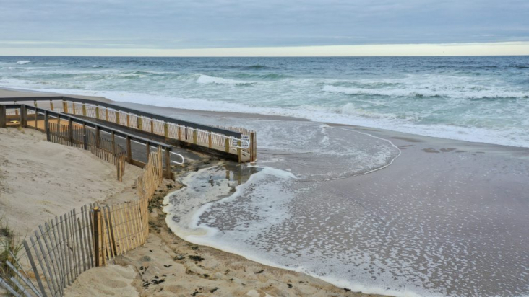
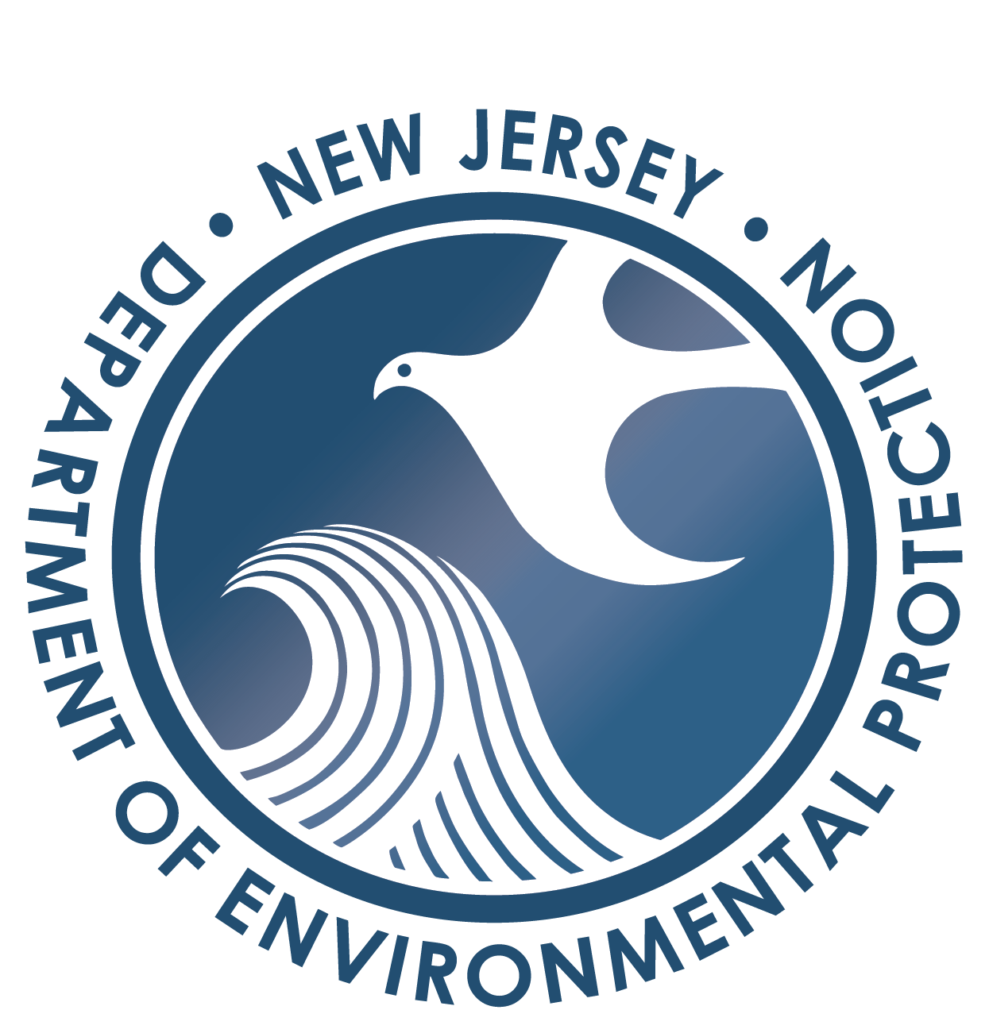
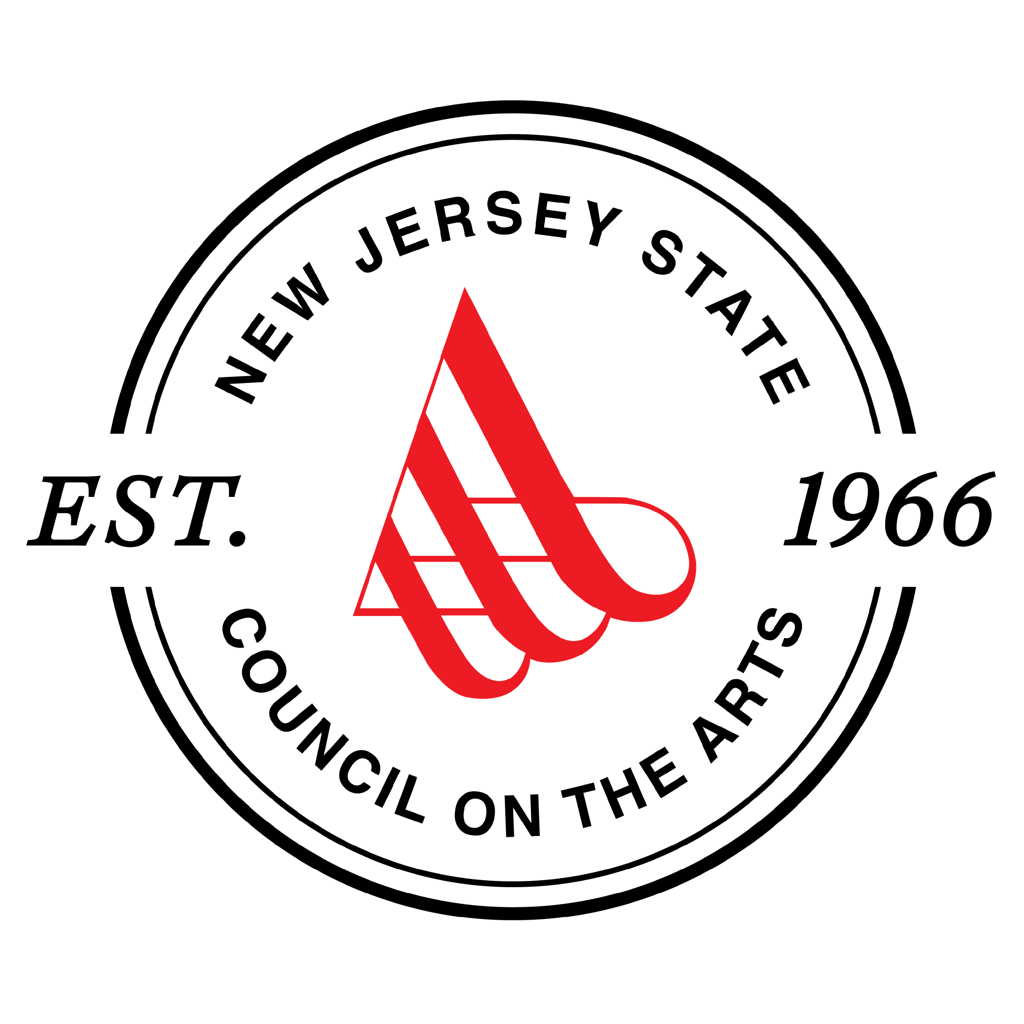
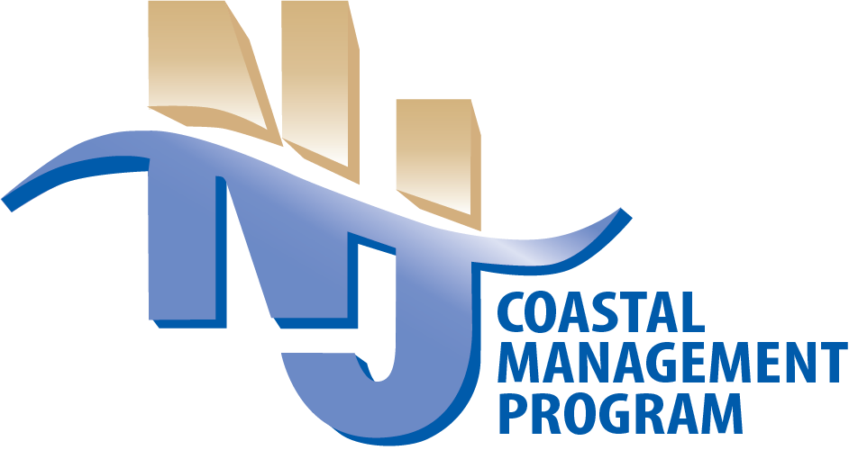
Risk Communication: A Campaign for Coastal New Jersey Community-Based Art Grant Program
Tuesday March 12, 2024

Slide 2
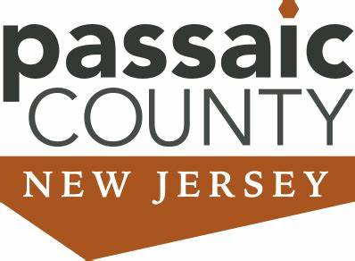
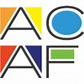
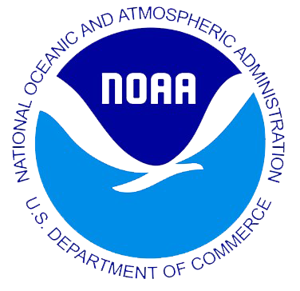
Community-Based Art Grant Program Background
Involve and inform the public about the coastal hazards impacts they will face and what actions they can take to better prepare.
Funding from NOAA Project of Special Merit Program
Arts Council Creates Call for Artists
NJCMP Creates Notice of Funds Available
CBO and Artists create and share their project
Notes:
New notes: our program is funded though NOAA CZM annual funding and the CMP wanted to work closely with another group to be able to reach communities and communicate the projects with them easily. how we selected the arts council, how we work with them, these are some of the projects
The community-based art grant program was formed because we recognized that we needed to communication about CC in a different way
Not everyone understands information in the same way
Complicated topics
Address the need to involve and inform the public about the coastal hazards impacts they will face and what actions they can take to reduce their risk.
Funding from NOAA through PSM
Reached out to the New Jersey State Council on the Arts (Arts Council) for their assistance
Create NOFA
Create Call Artists
The community-based organizations and artists will work together to address
the theme of climate resilience/coastal flooding
site-specific artwork and community engagement and events.
Each CBO and artist group is required to hold at least one community event and one installation event.
Chose CBOs to host these projects because they have firsthand coastal experiences in their communities and know what their community is interested in and want to get involved in.

Slide 3
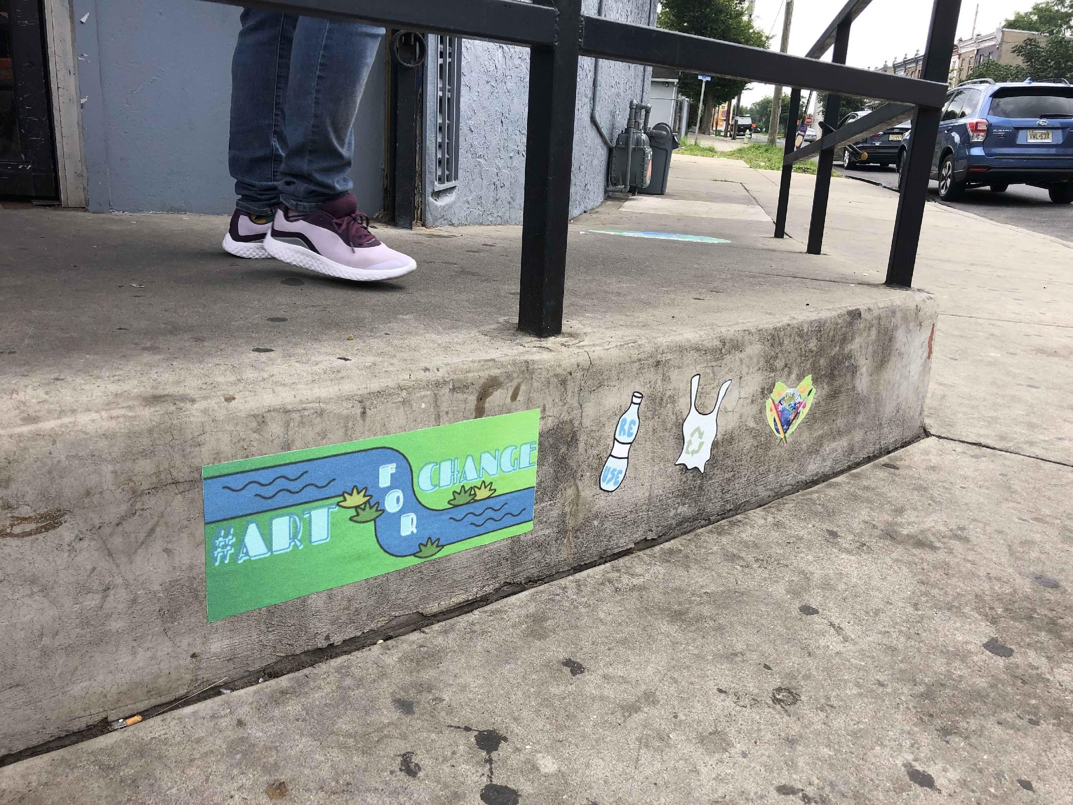
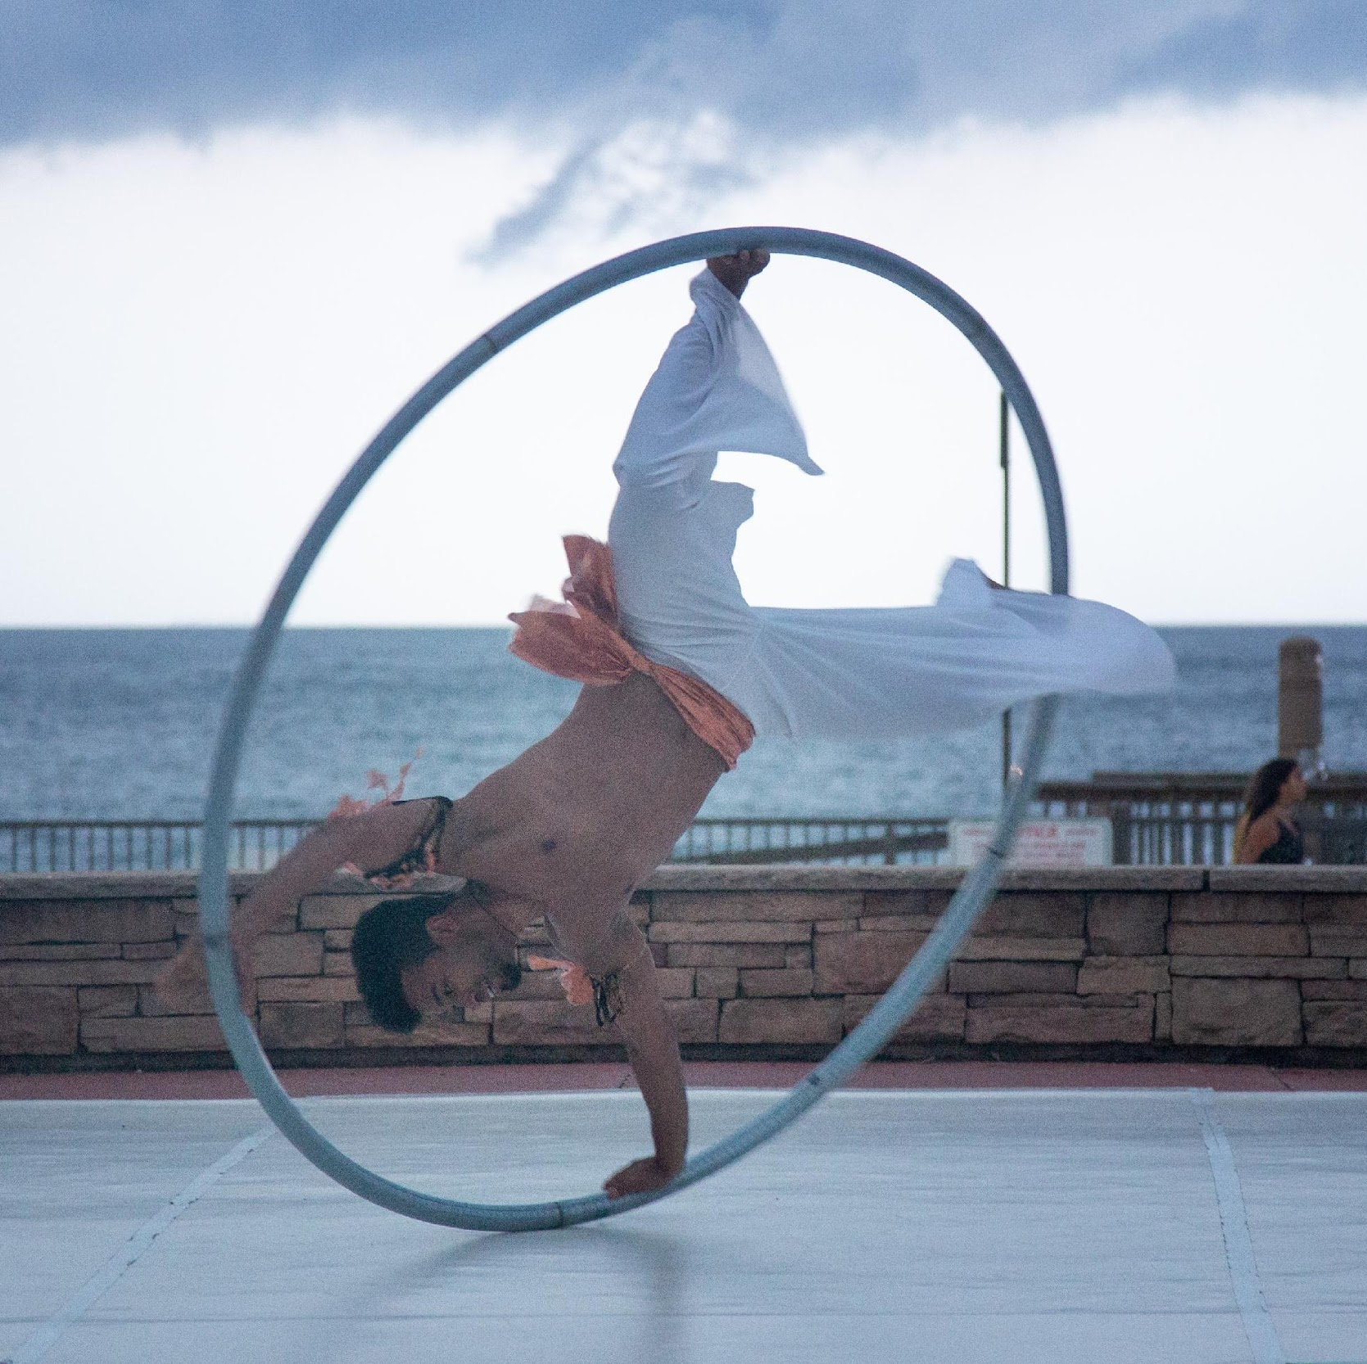
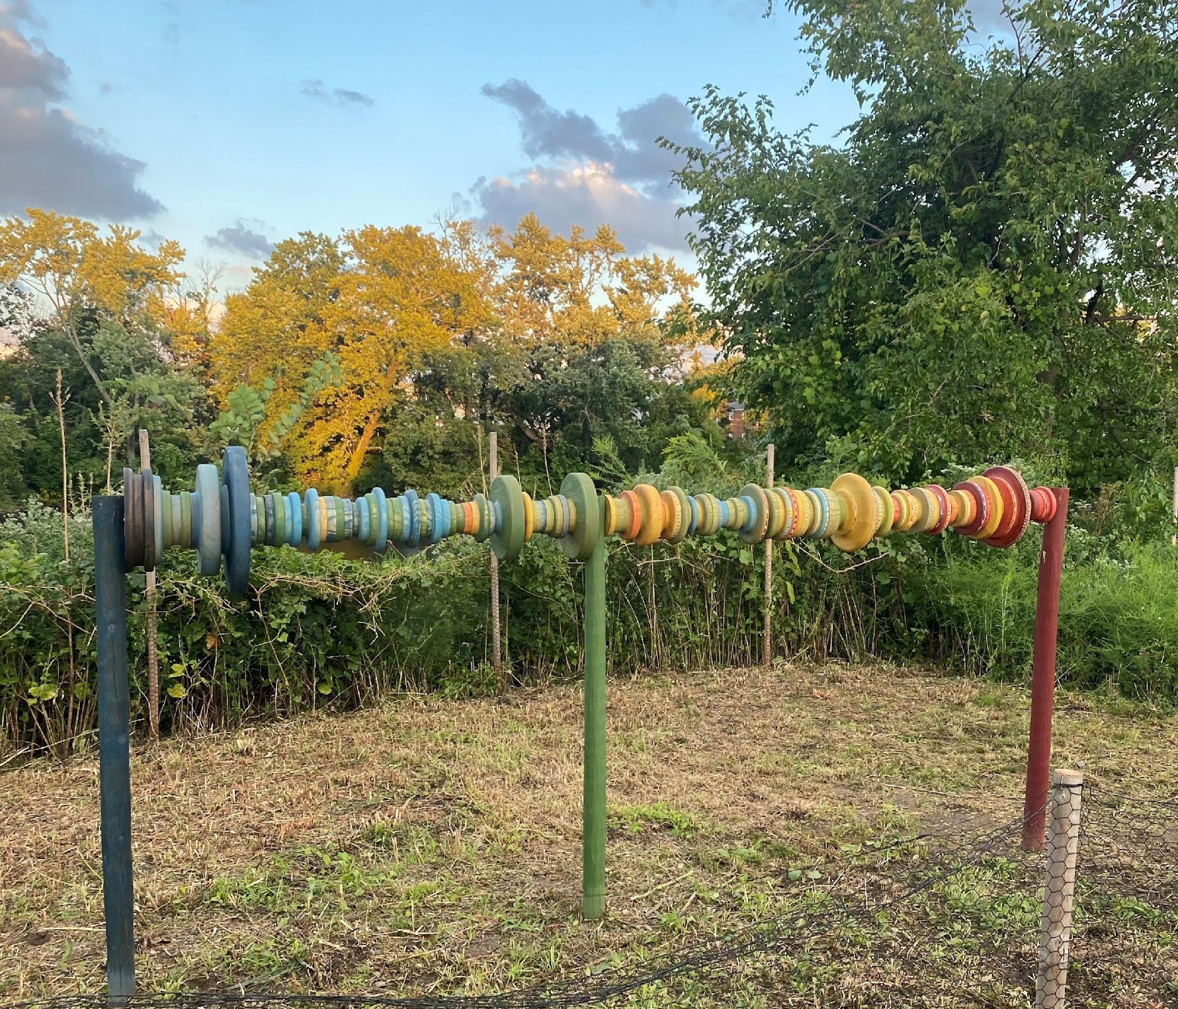
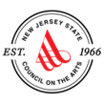
Community-Based Art Grant Program Project Partner: New Jersey State Council on the Arts
Community-based organizations
Atlantic City Arts Foundation 2021, 2022
Bayshore Center at Bivalve 2021
Monmouth Arts 2021, 2024
Passaic County 2021
Four Corners Public Arts 2022
Camden County Partnership 2022, 2023
Ocean City Arts Center 2023
City of Rahway 2023
Monmouth Conservation Foundation 2023
Northern NJ Community Foundation 2023
Perkins Center for the Arts 2024
Artworks Trenton 2024
Wheaton Arts & Cultural Center 2024
Round 5 coming soon!
Notes:
NJDEP lead the NOFA process; State Arts Council lead the call for artists process; CBOs were part of the jury to select the artists
Call for artist allowed for one artist or group of artists to be paired with one CBO.
CBO & Artist teams worked together to plan artists' work to reflect community settings. Artworks addressed specific coastal hazards impacts and what actions community members can take to reduce their risk.
Each of the CBOs selected were spread throughout the state to represent that each risk can be perceived very differently by how populations that experience similar kinds of events based on culture, economic practices, education, and length of flooding events.
A Fifth Round of funding is currently under way for new CBOs and Artists more details to come soon.

Slide 4
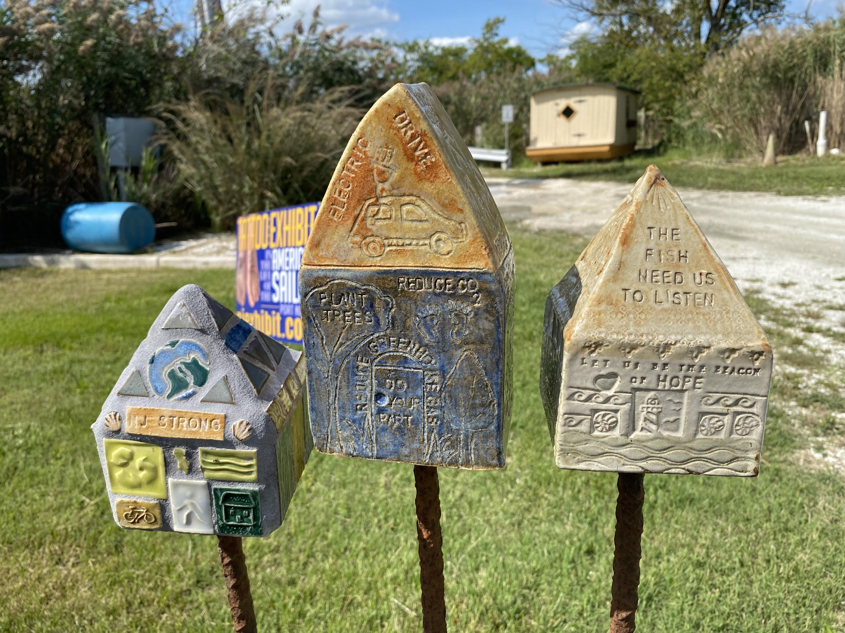
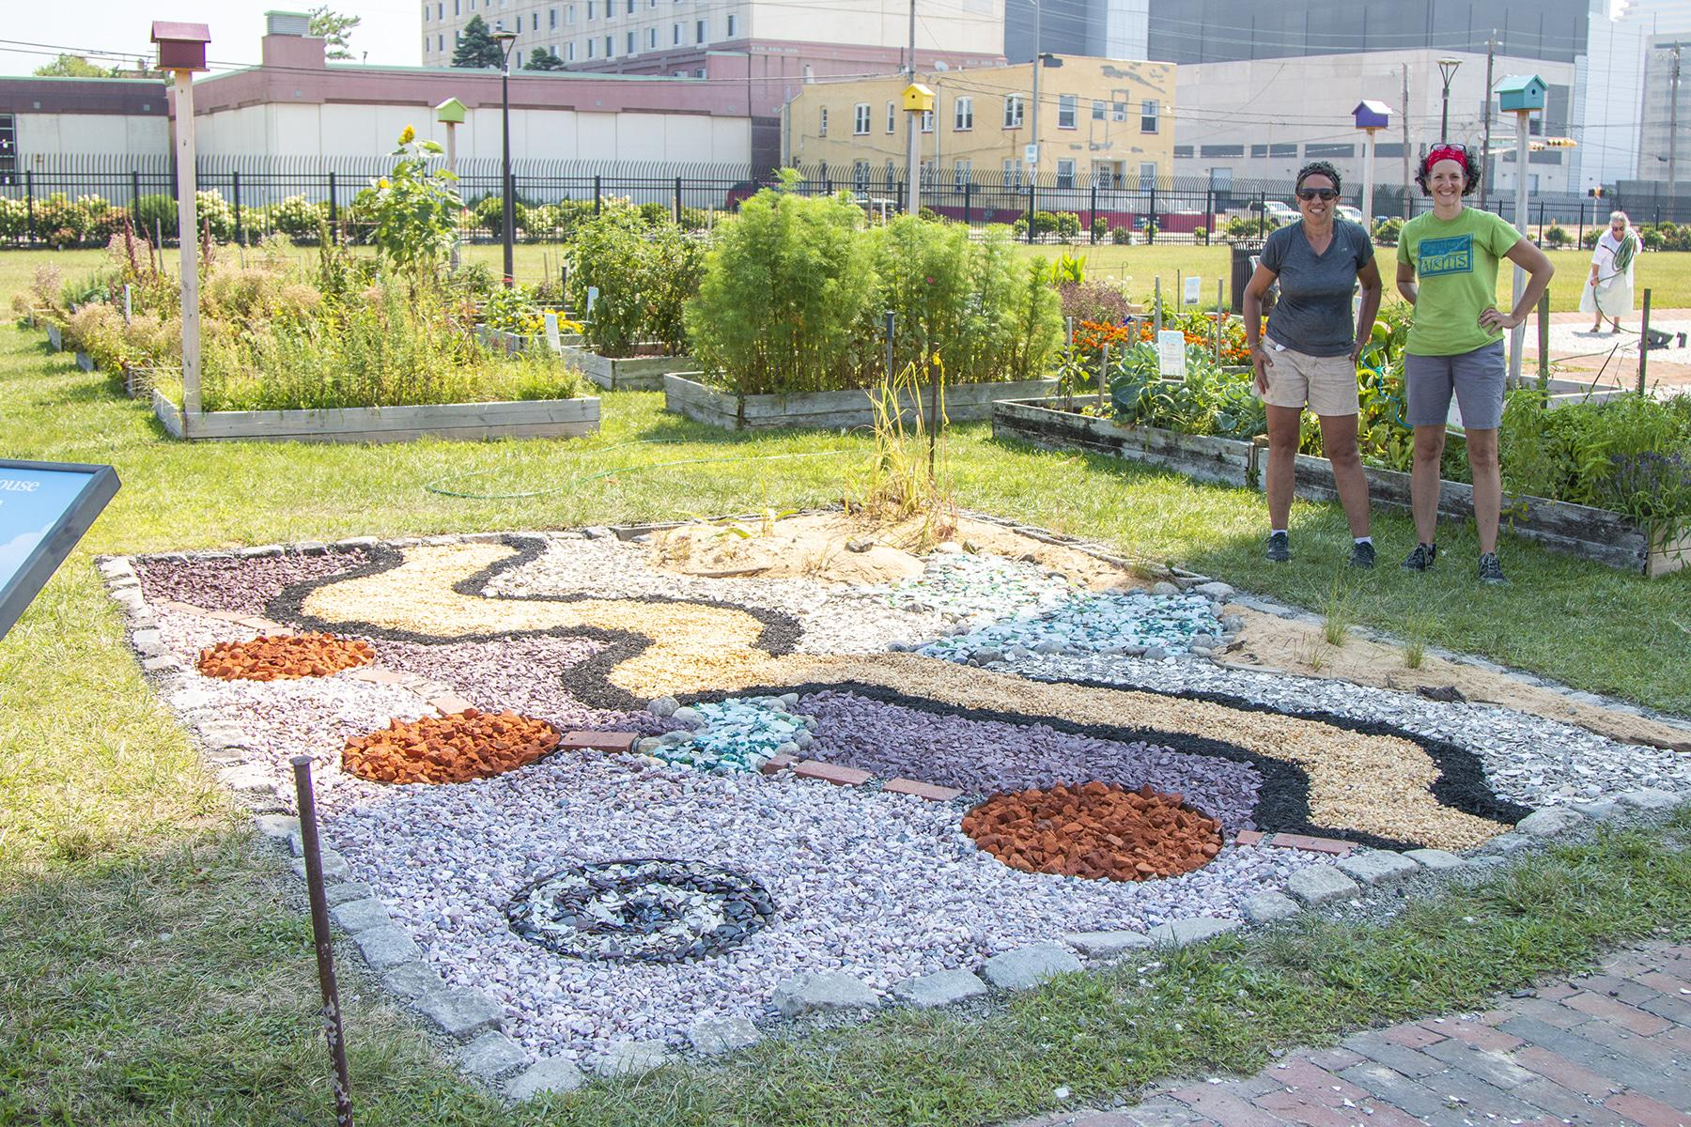
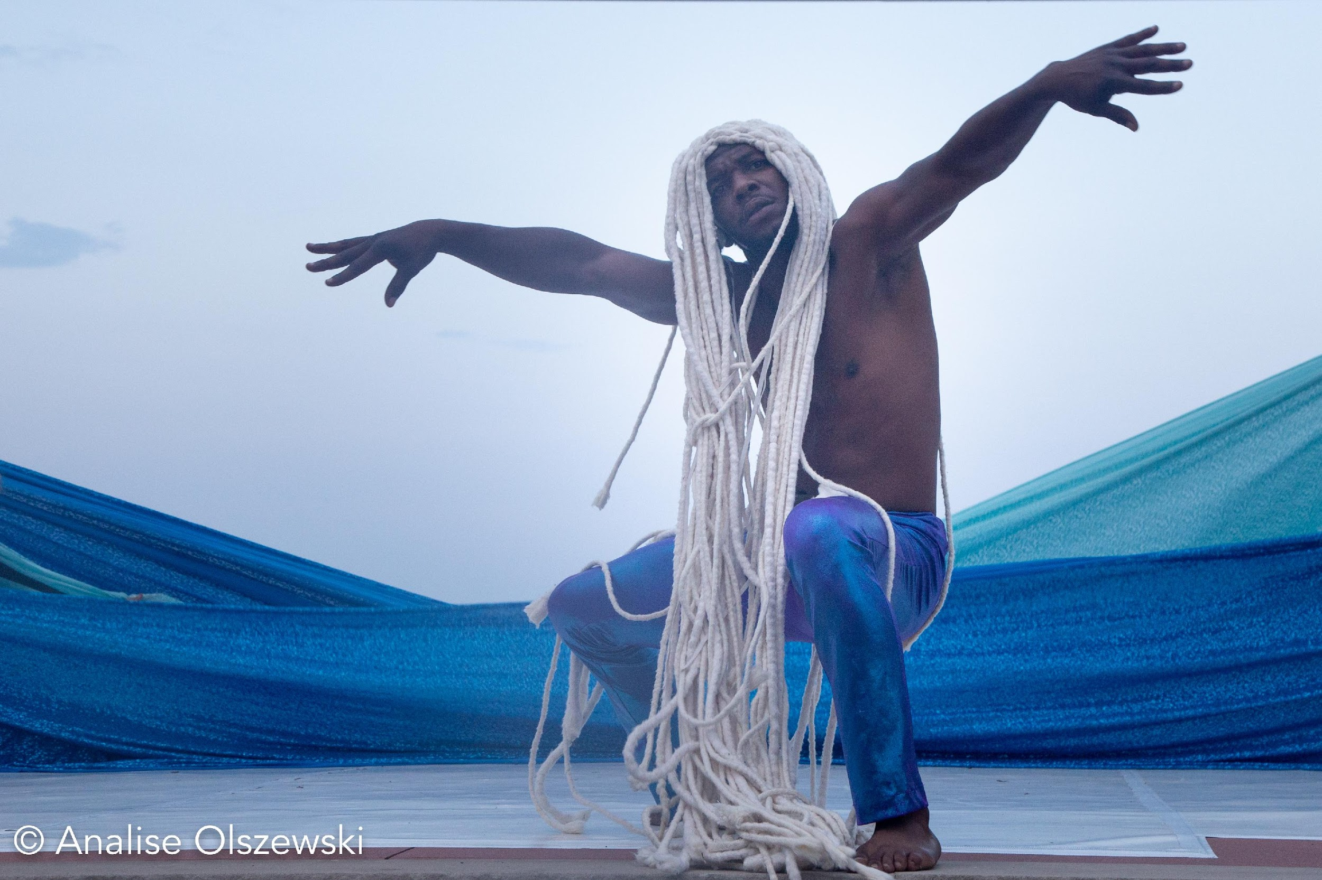
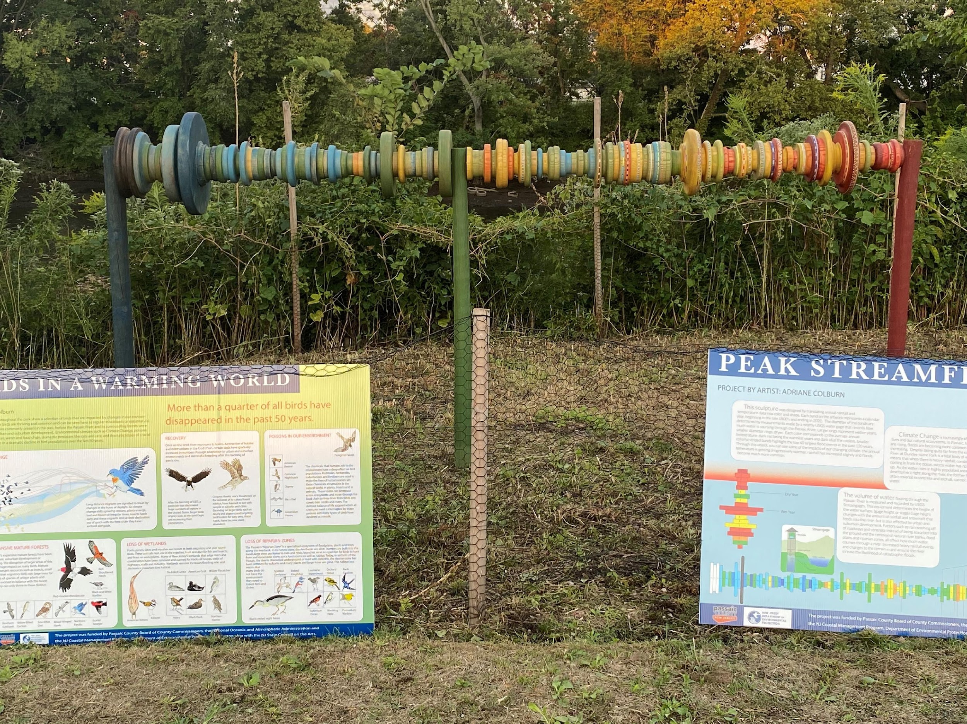
Round 1
2020-2022

Slide 5
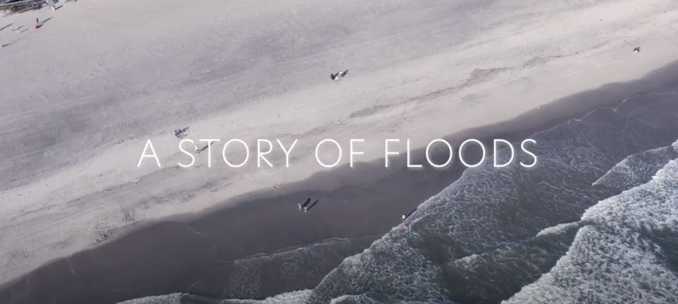
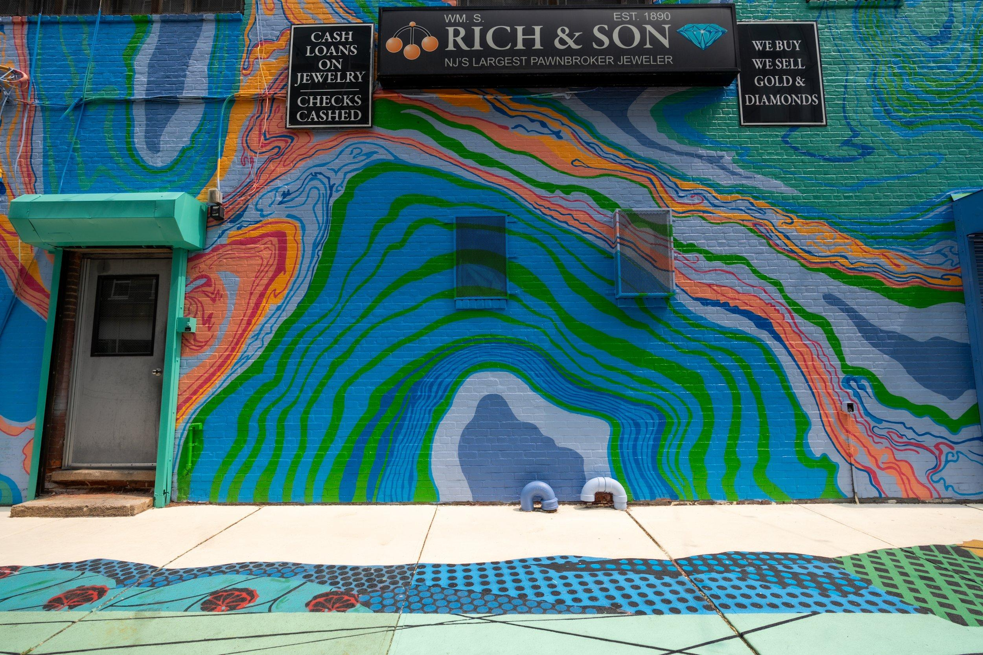
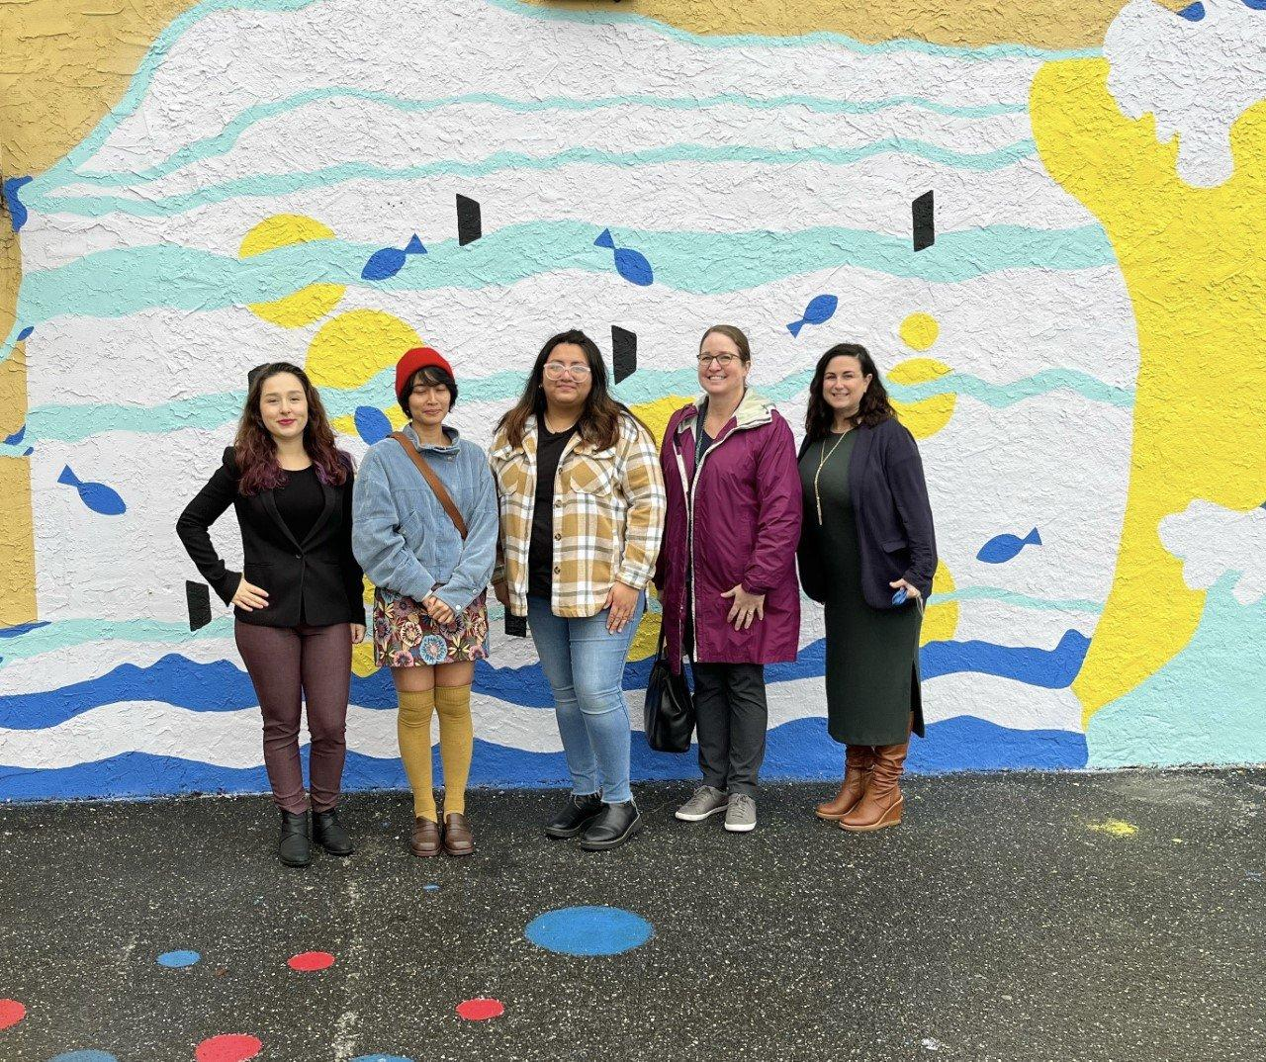
Round 2
2021-2023

Slide 6
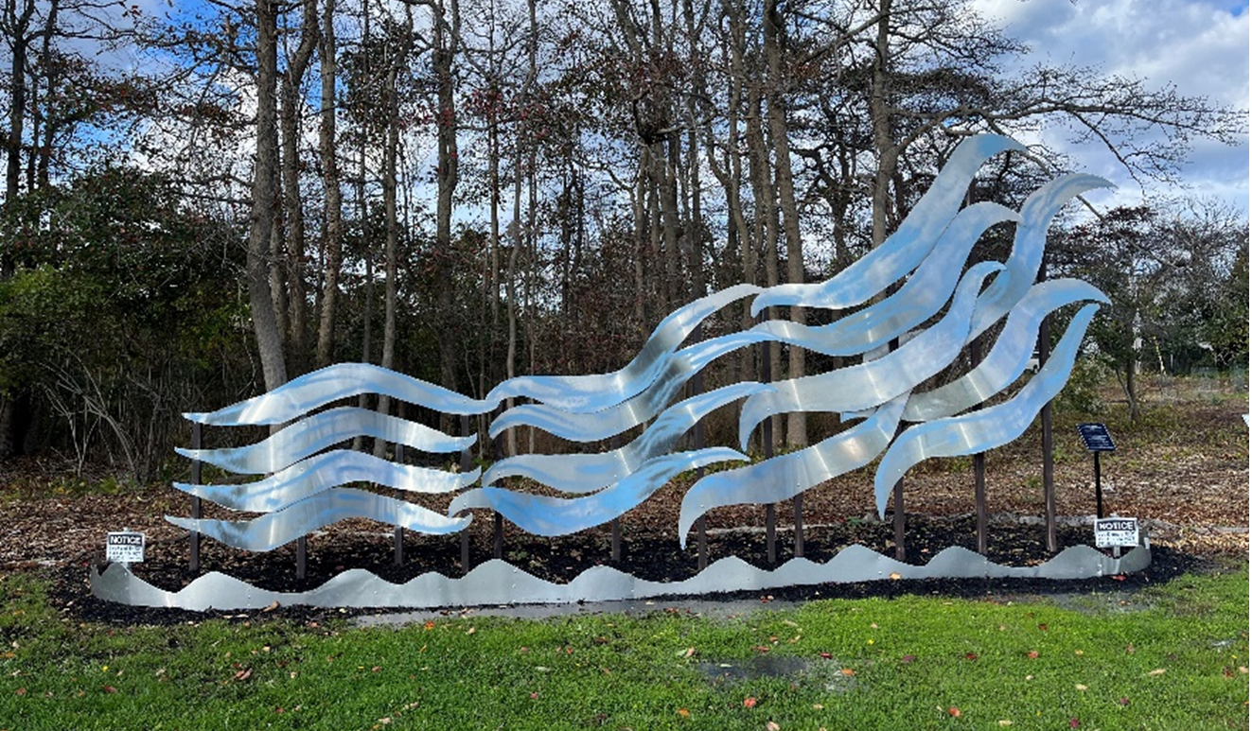
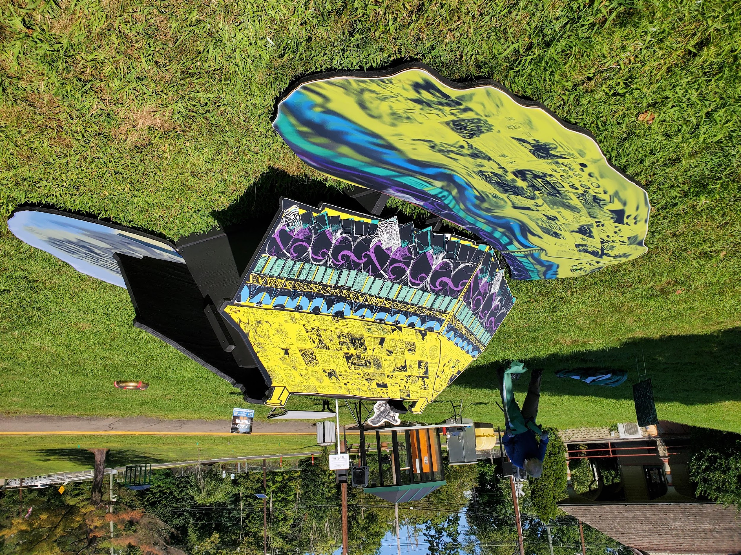
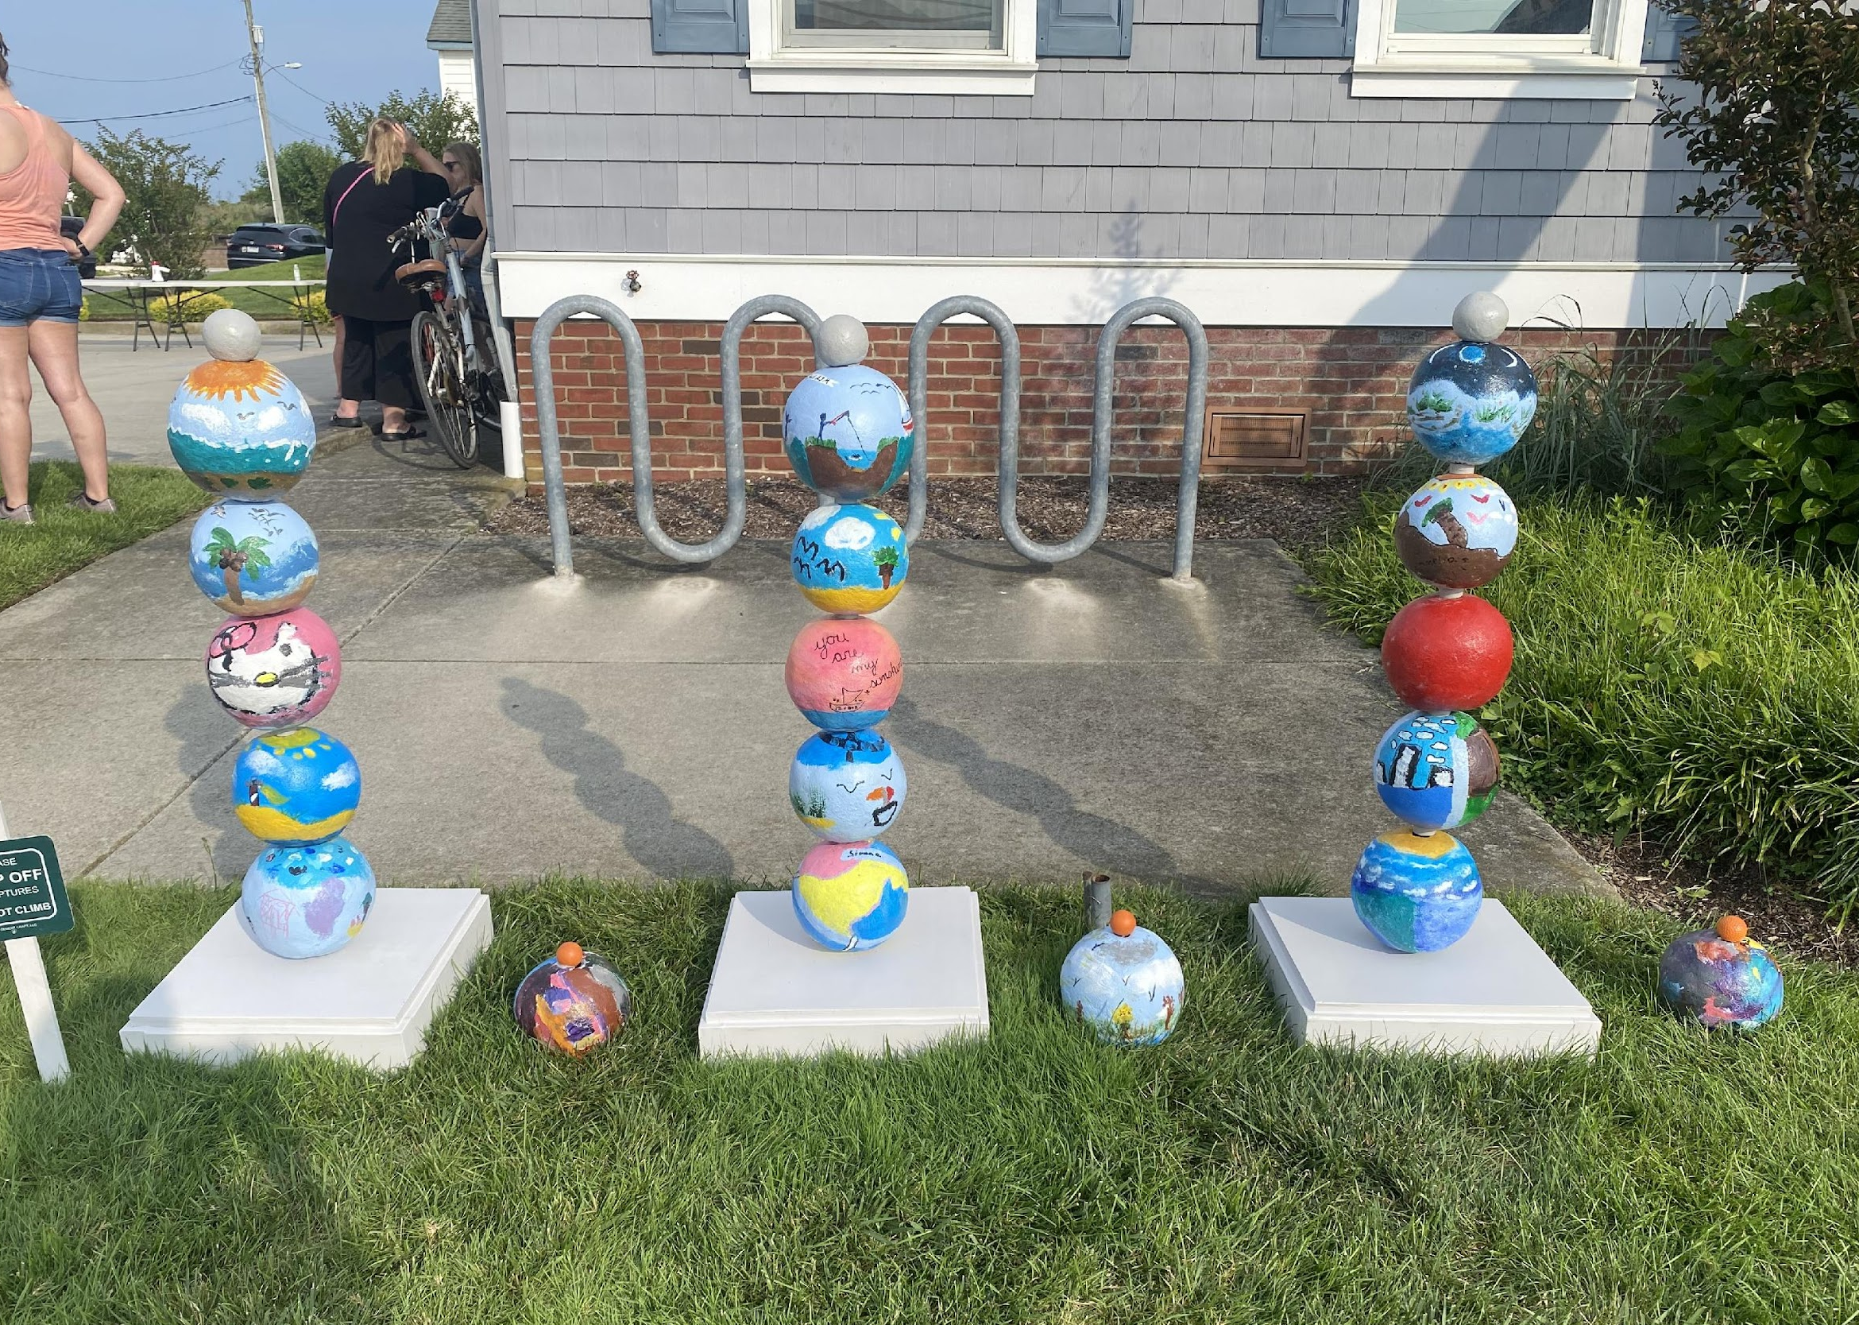
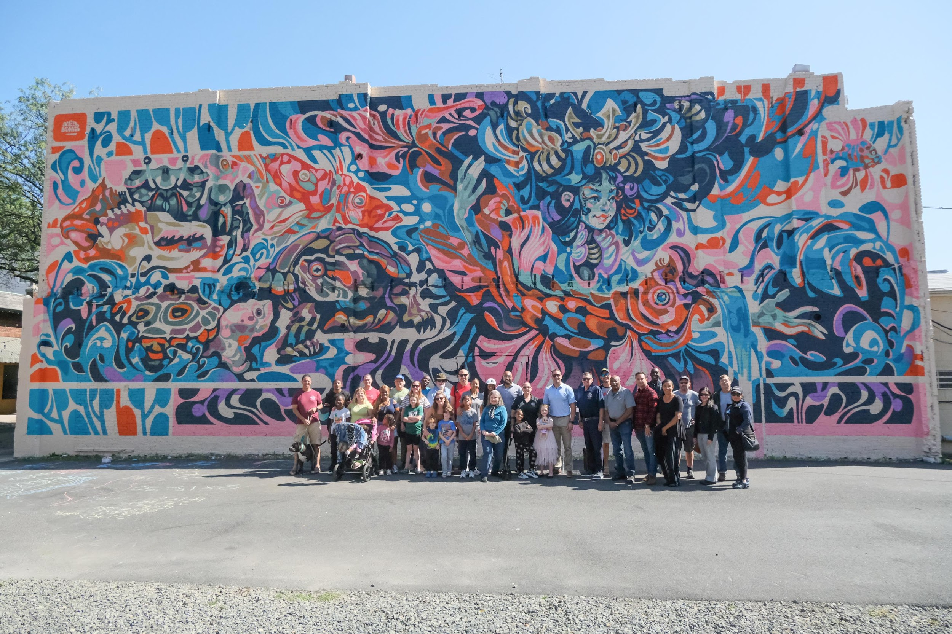
Round 3
2023-2025

Slide 7
Next Steps
Installation Surveys
Analytics
Reaching New Locations
Future Installations
Camden Community- Partnership Summer/Fall 2024
Wheaton Arts- September 2024
Monmouth Arts Foundation- Feb-March 2025
Future NOFA/Call for Artist
NOFA Release- March 18, 2024
Call for Artist- Tentative September 2024

Slide 8
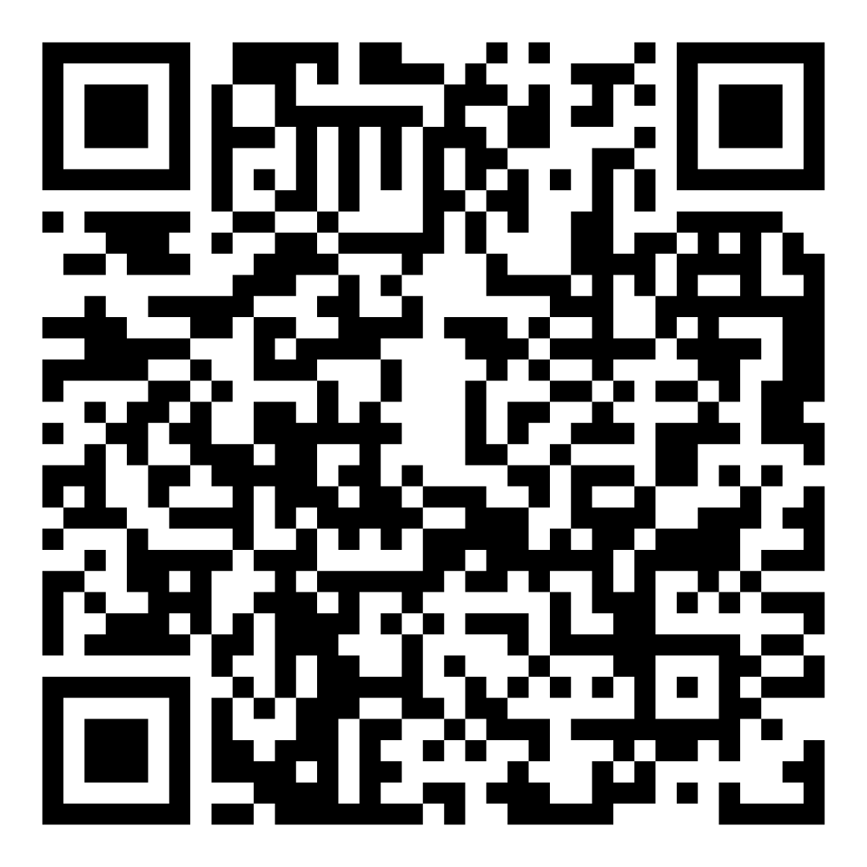
Thank you!
NJ Department of Environmental Protection
Devon Haines- Devon.haines@dep.nj.gov
NJ State Council on the Arts
Stephanie Nerbak- Stephanie.Nerbak@sos.nj.gov
Scan to Receive Email Updates on the Program
Notes:
Thank NJSCA for partnership
-reliable partnerships, easy to work with and great partners who want to improve the projects every year
Thank everyone for attending
Our contact information and way to receive updated

