Slide 1
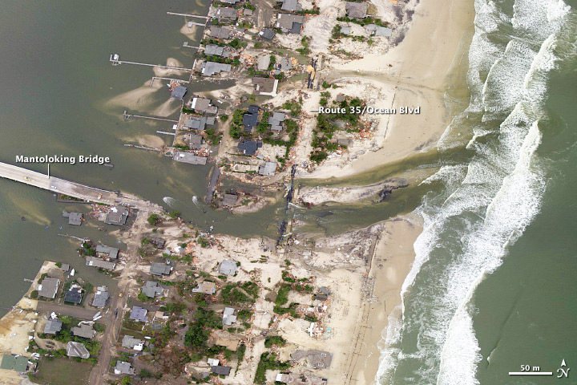
COASTAL CLIMATE CONCERN CATEGORIES
NEW JERSEY COASTAL CLIMATE & RESILENCY CONFERENCE
Glenn “Hurricane” Schwartz
Senior Consultant for Climate Change & Resiliency
Glenn “Hurricane” Schwartz
AKRF, Senior Consultant
NEW JERSEY COASTAL CLIMATE & RESILIENCY CONFERENCE

Slide 2
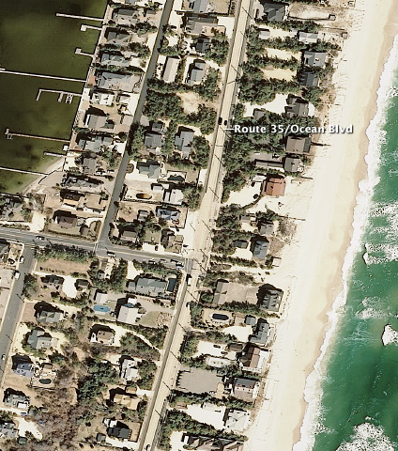

Slide 3
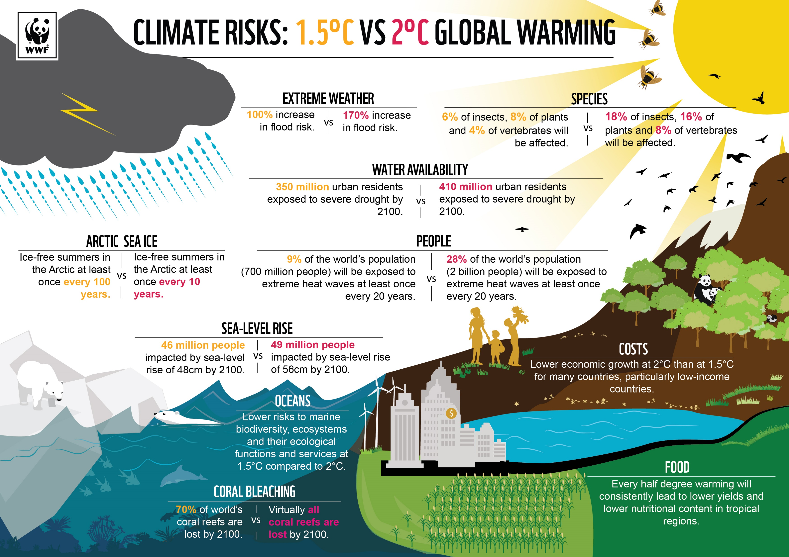
INCREDIBLY COMPLEX SUBJECT

Slide 4
FILTER OUT THE GARBAGE……

Slide 5
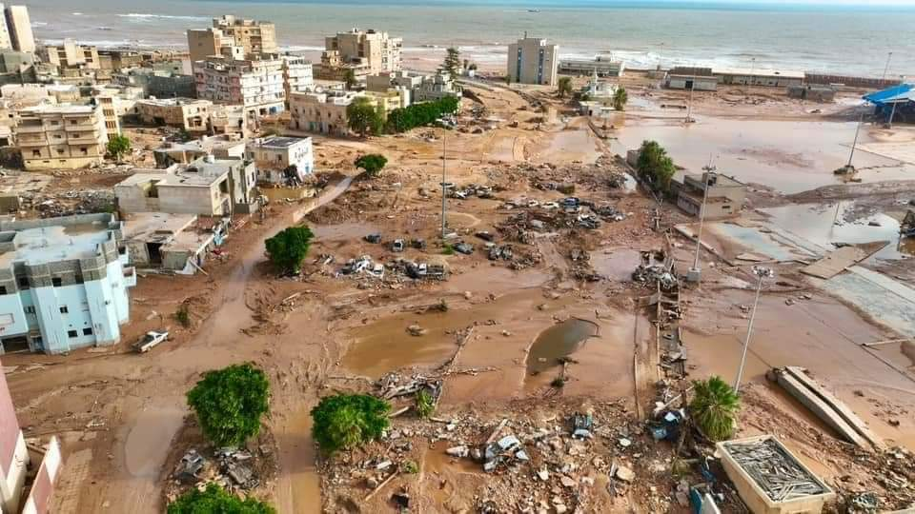
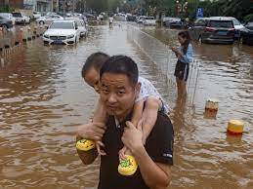
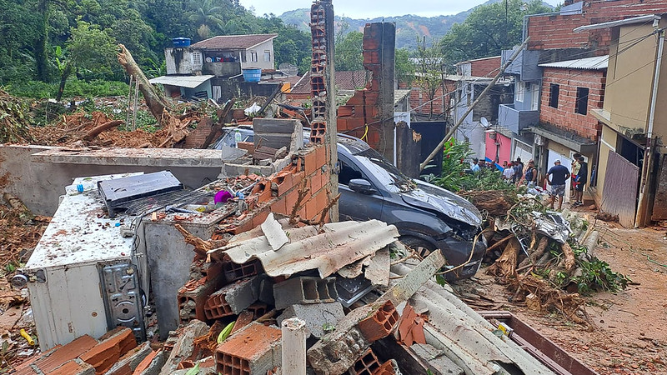
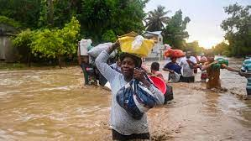
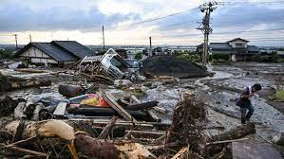
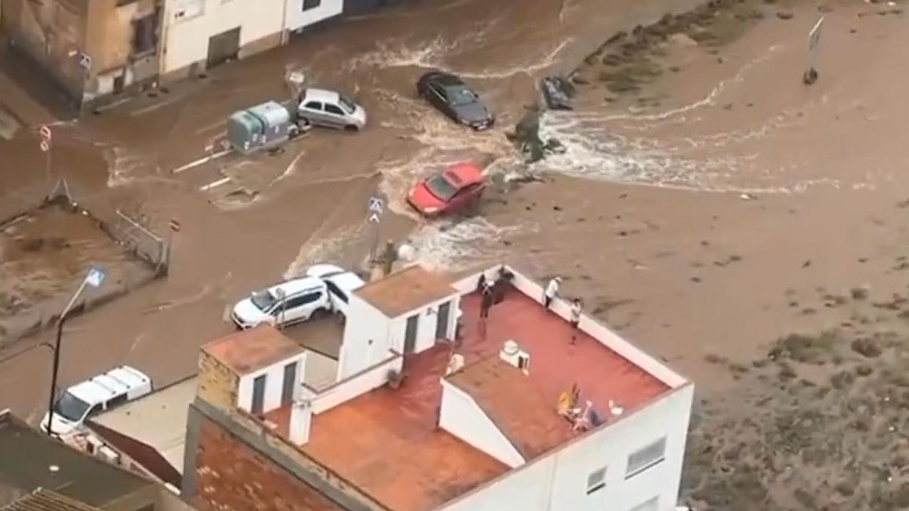
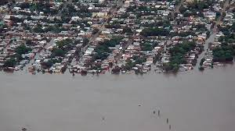
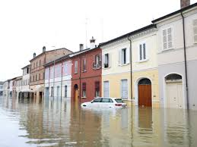
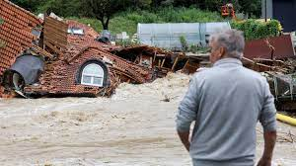
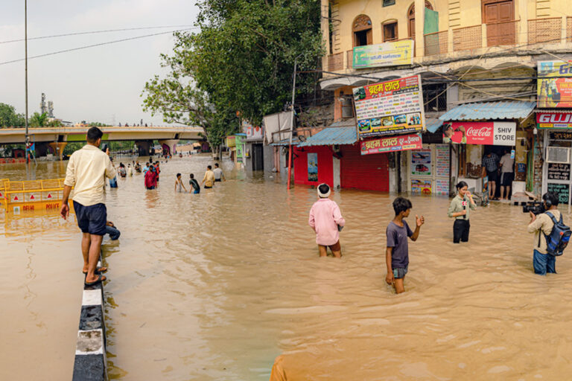
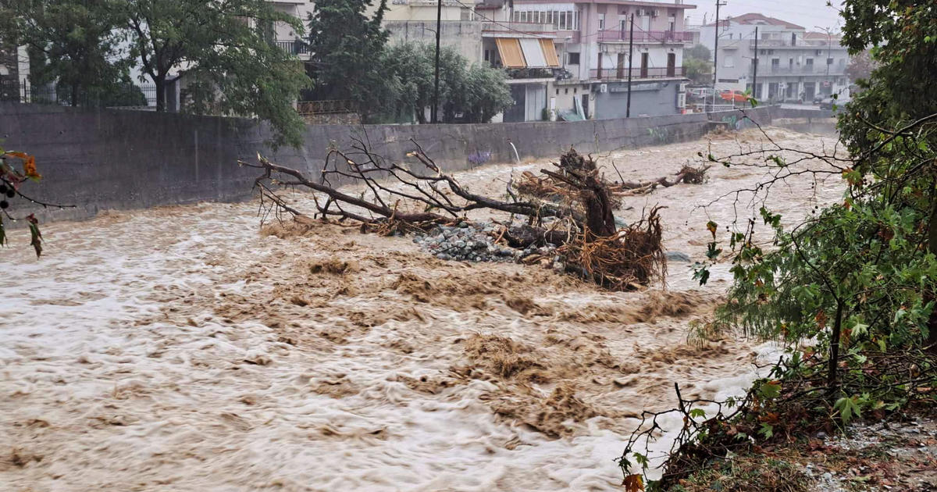
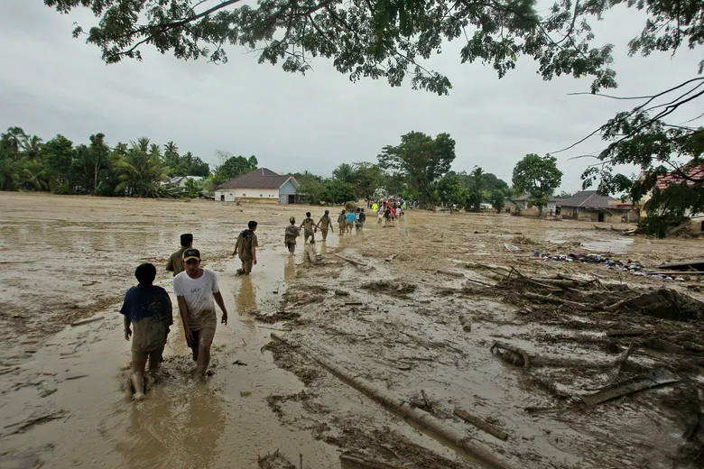
FLOOD DISASTERS WORLDWIDE
LIBYA BEIJING BRAZIL HAITI
JAPAN
SPAIN
URUGUAY
ITALY
SLOVENIA
INDIA
GREECE
INDONESIA
Notes:
Cliff

Slide 6
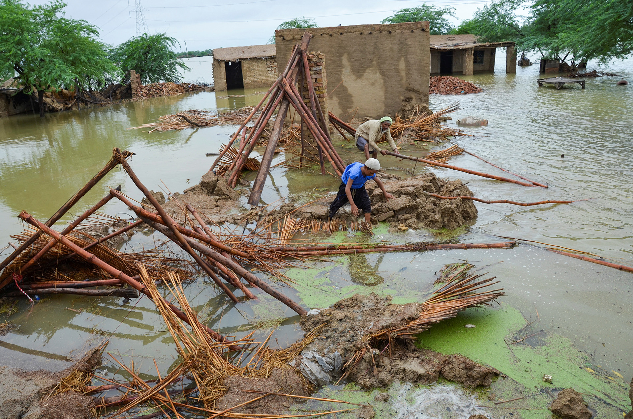
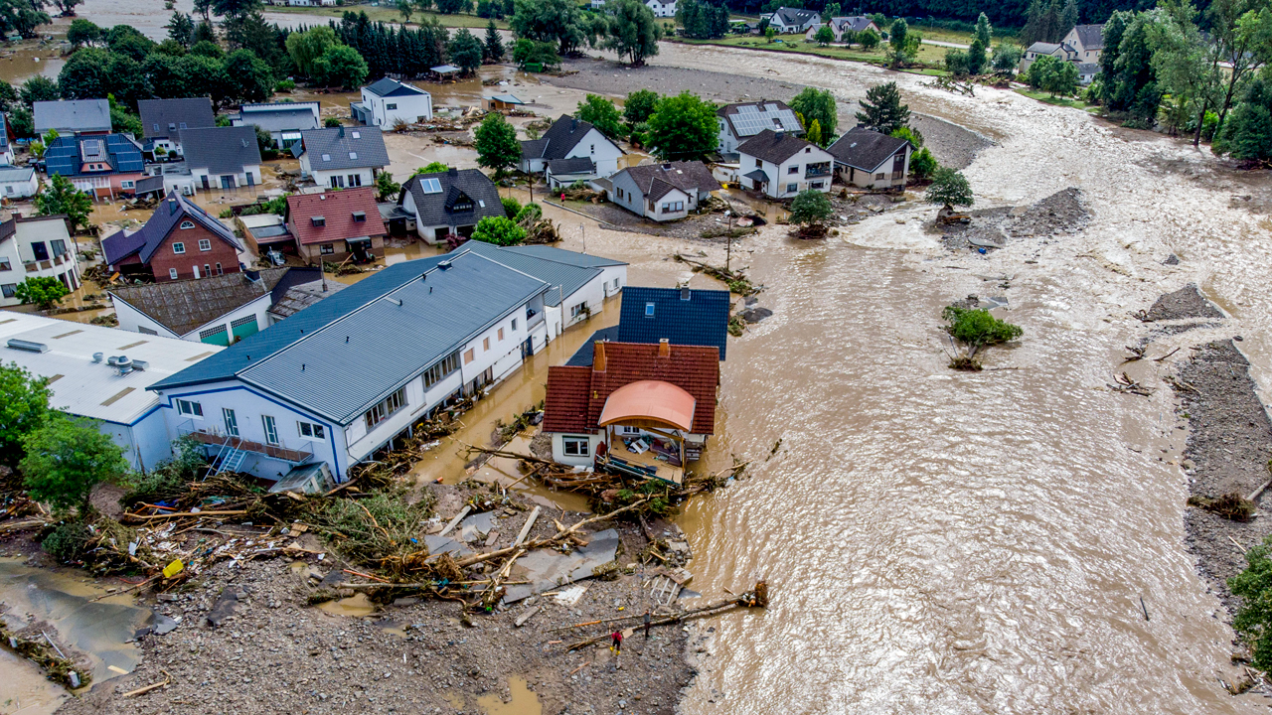
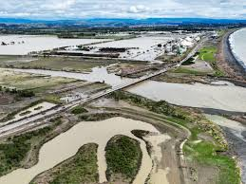
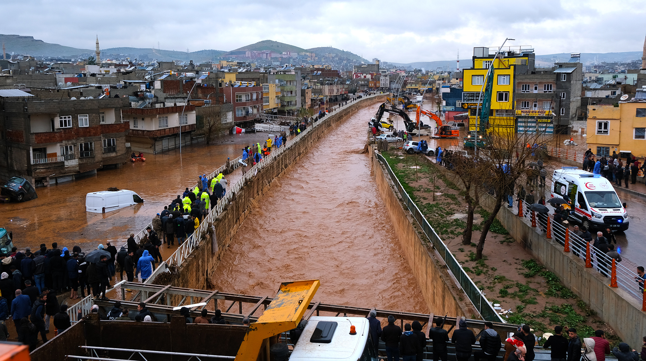
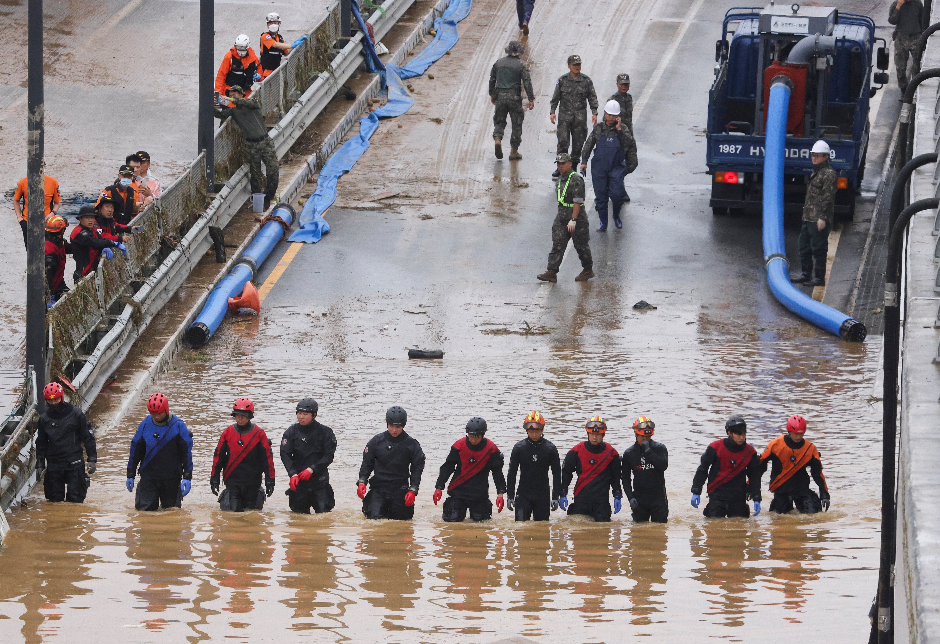
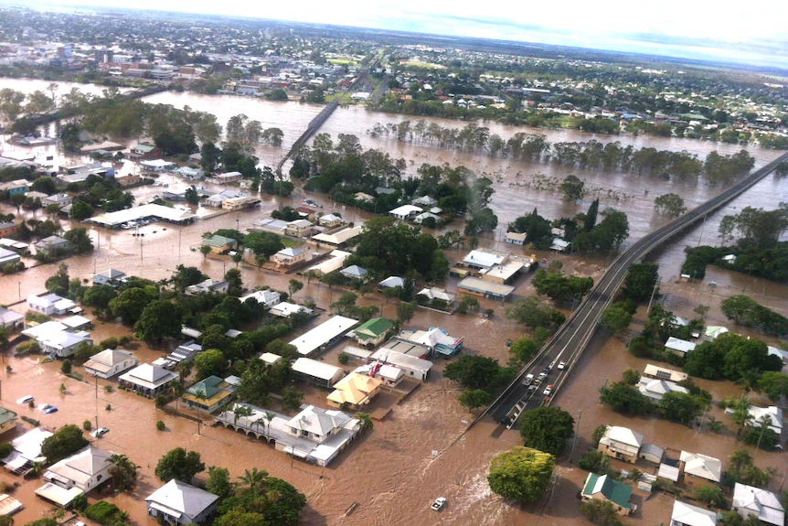
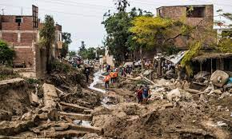
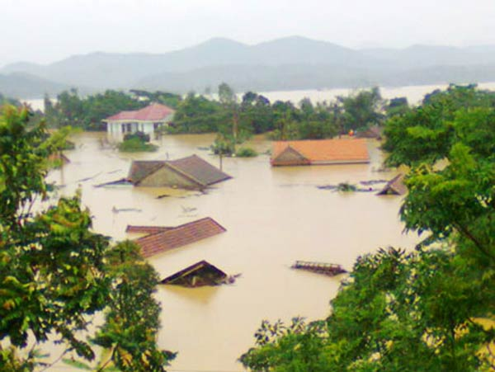
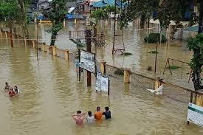
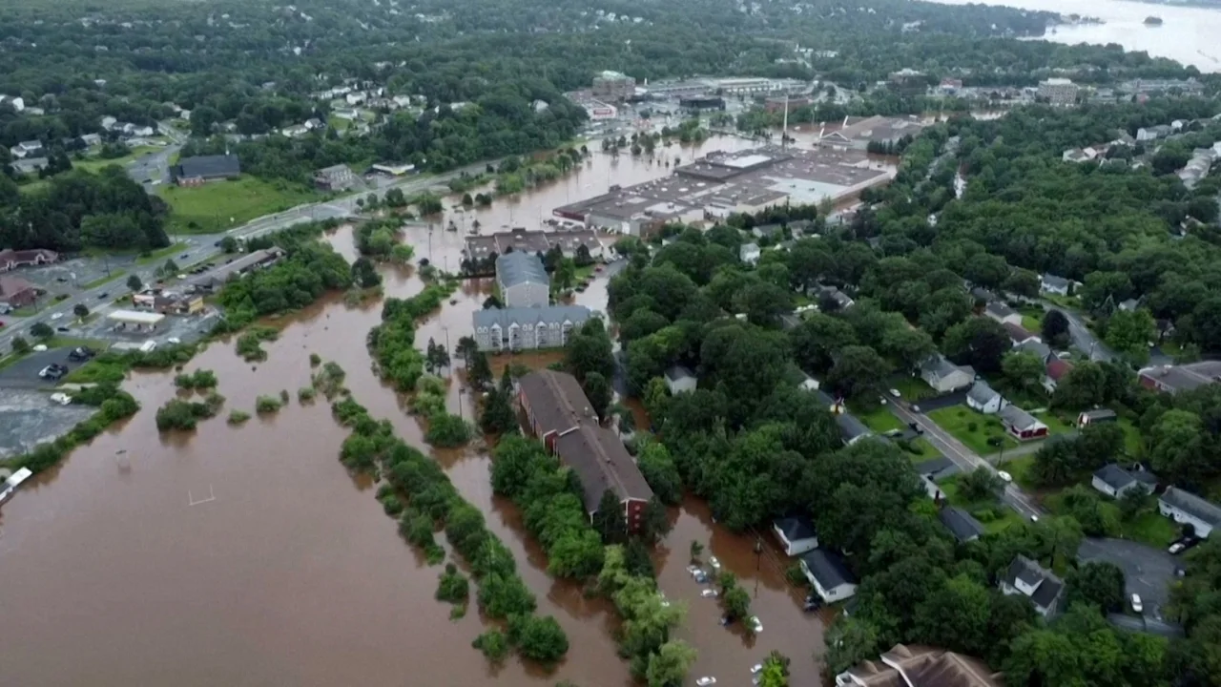
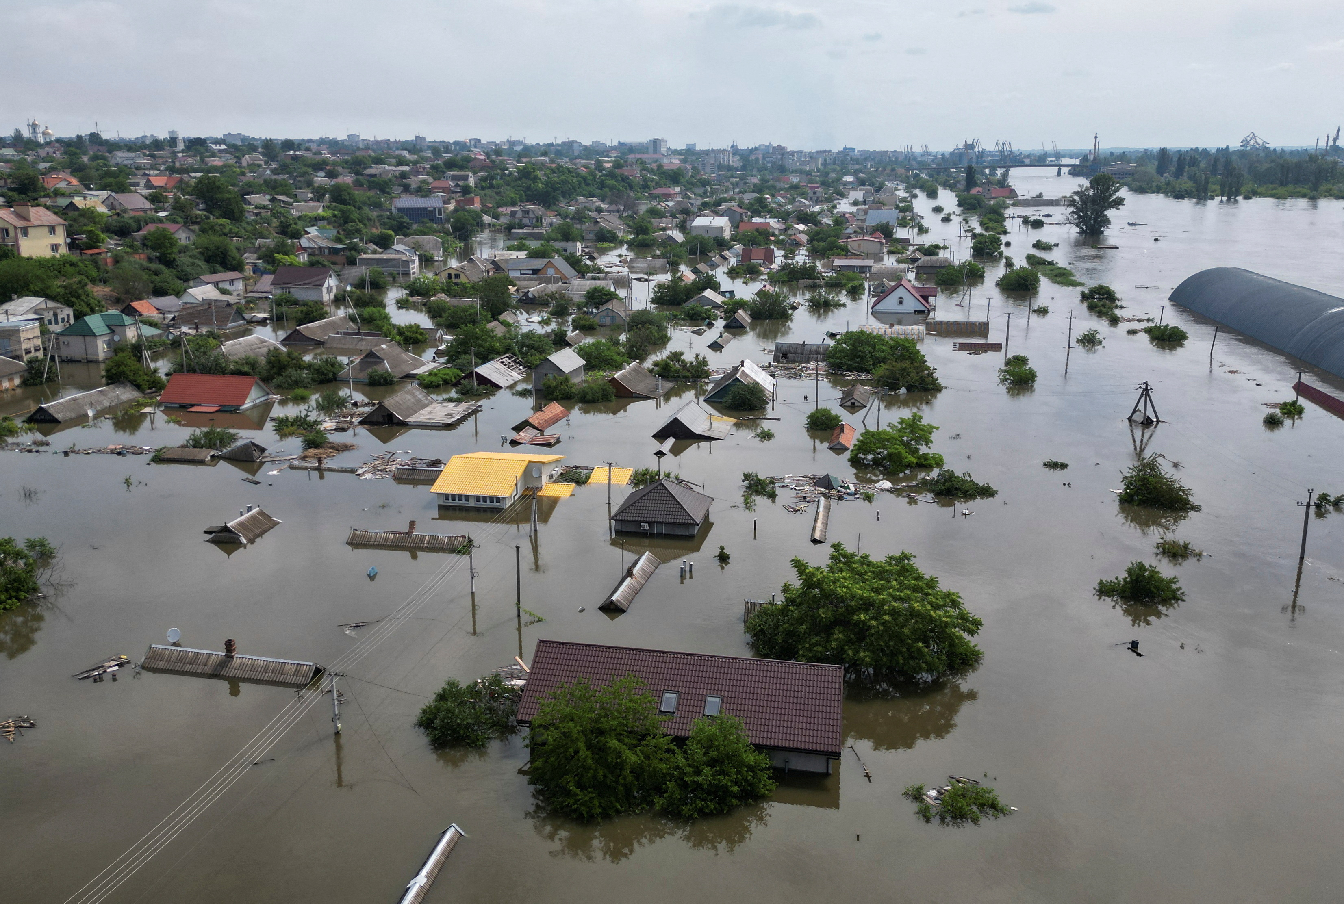
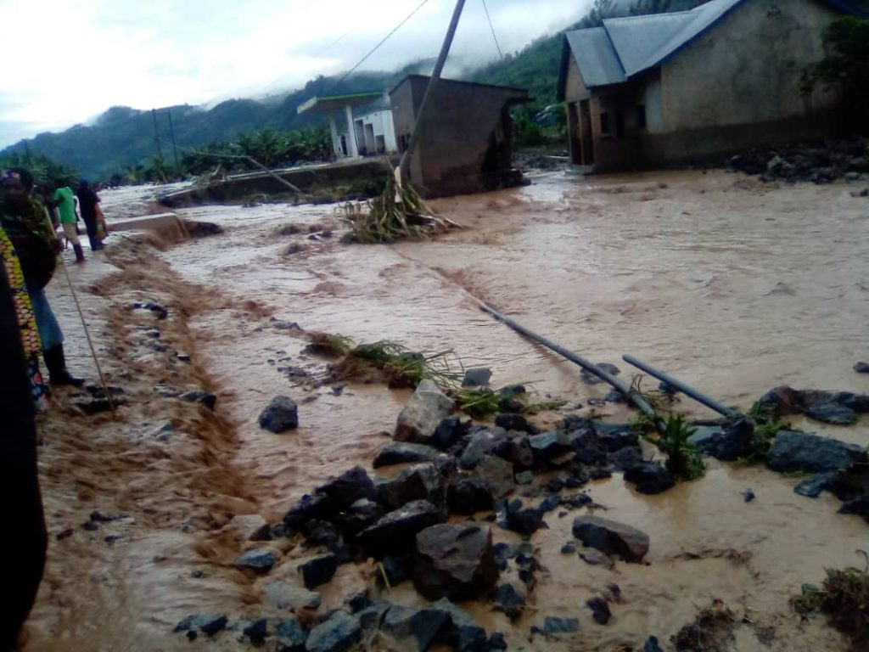
FLOOD DISASTERS WORLDWIDE-MORE
PAKISTAN GERMANY NEW ZEALAND TURKEY
SOUTH KOREA
AUSTRALIA
PERU
VIETNAM
PHILLIPINES
NOVA SCOTIA
UKRAINE
RWANDA
Notes:
Cliff

Slide 7
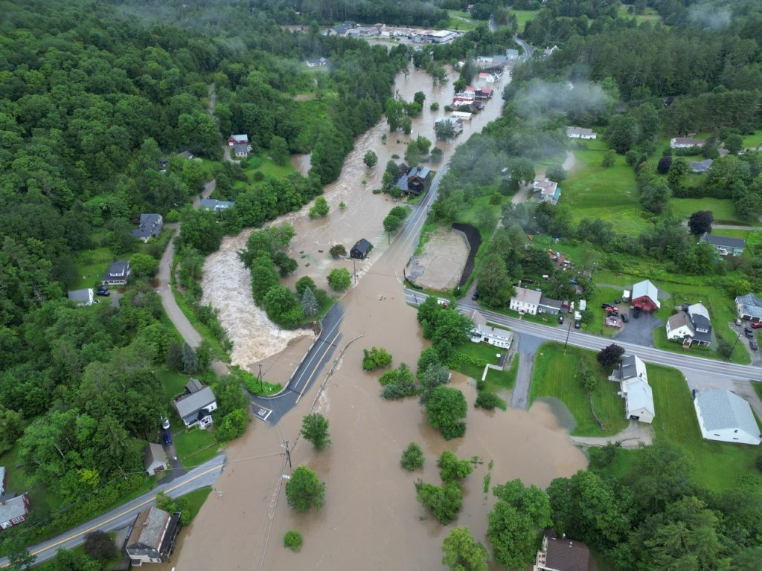
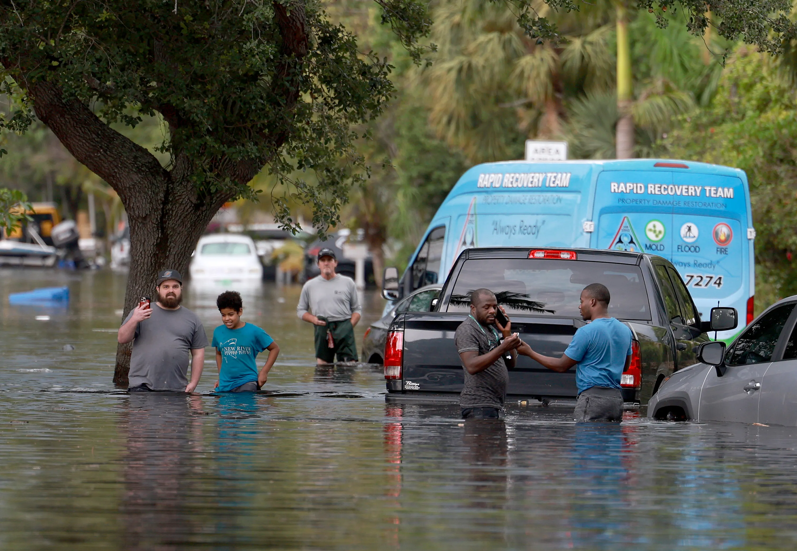
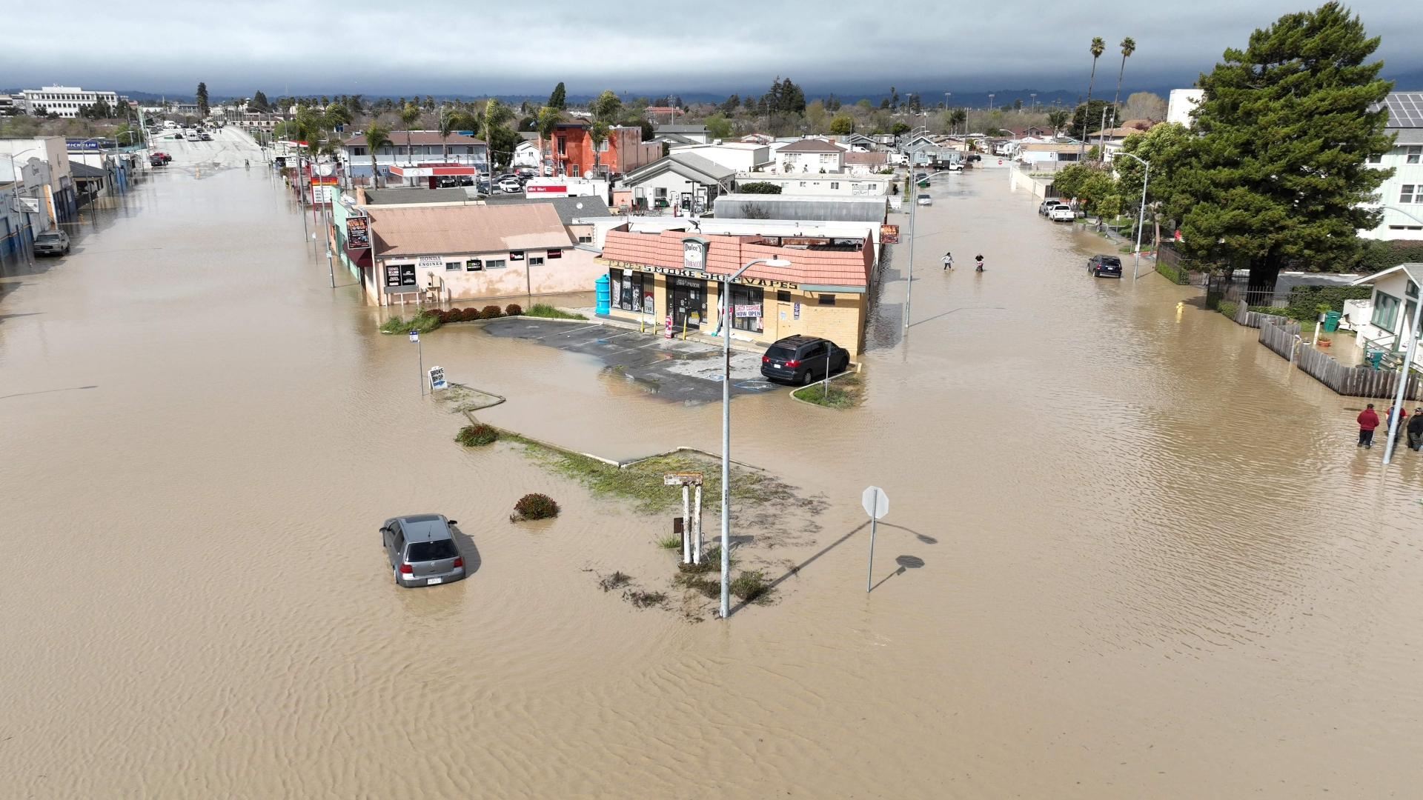
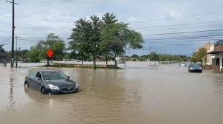
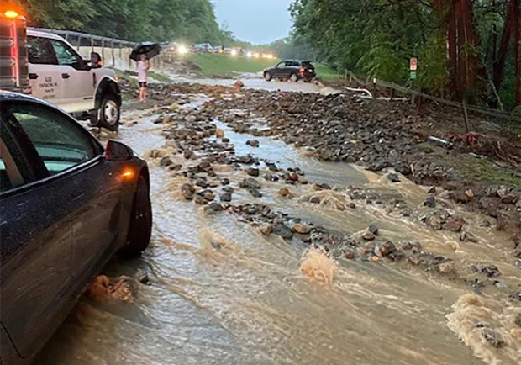
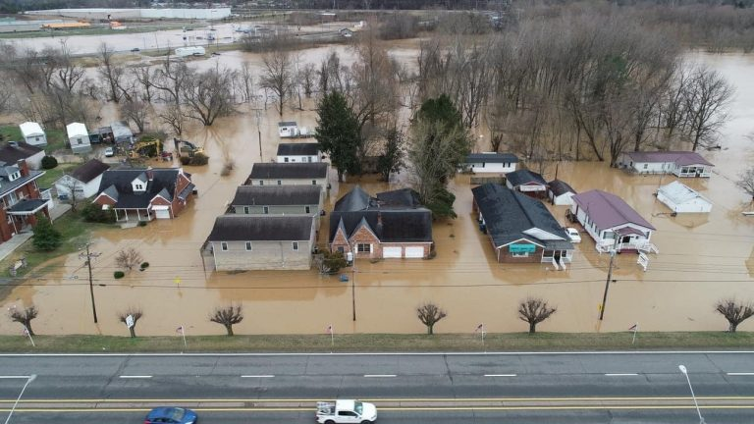
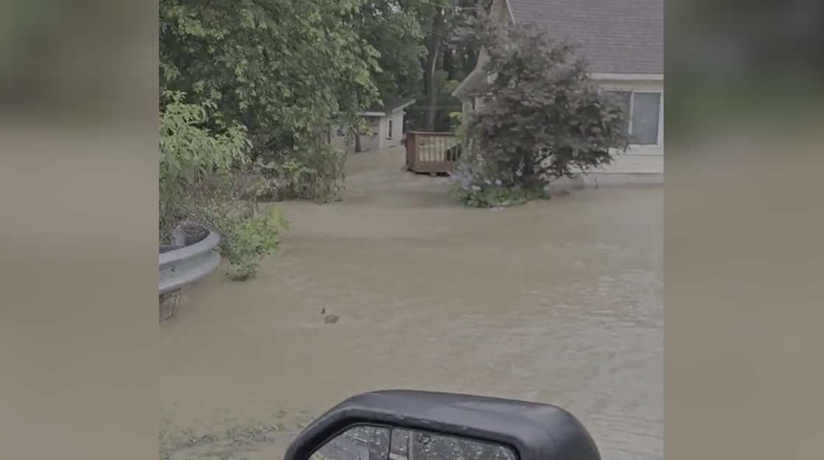
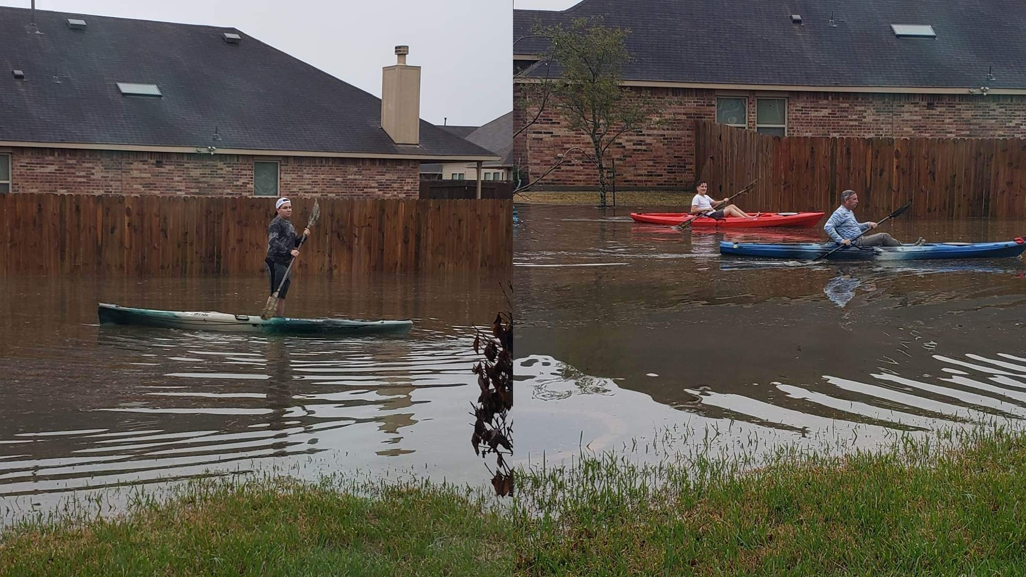
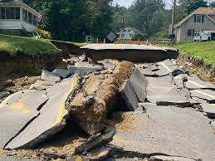
FLOOD DISASTERS WORLDWIDE-U.S.A.
VERMONT FT. LAUDERDALE CALIFORNIA DETROIT
NEW YORK
W. VIRGINA
BUCKS COUNTY
TEXAS
NEW HAMPSHIRE
Notes:
Cliff

Slide 8
THEY ALL HAPPENED IN 2023!!!
GERMANY
SOUTH KOREA
PERU
PHILLIPINES
NOVA SCOTIA
Notes:
Cliff

Slide 9
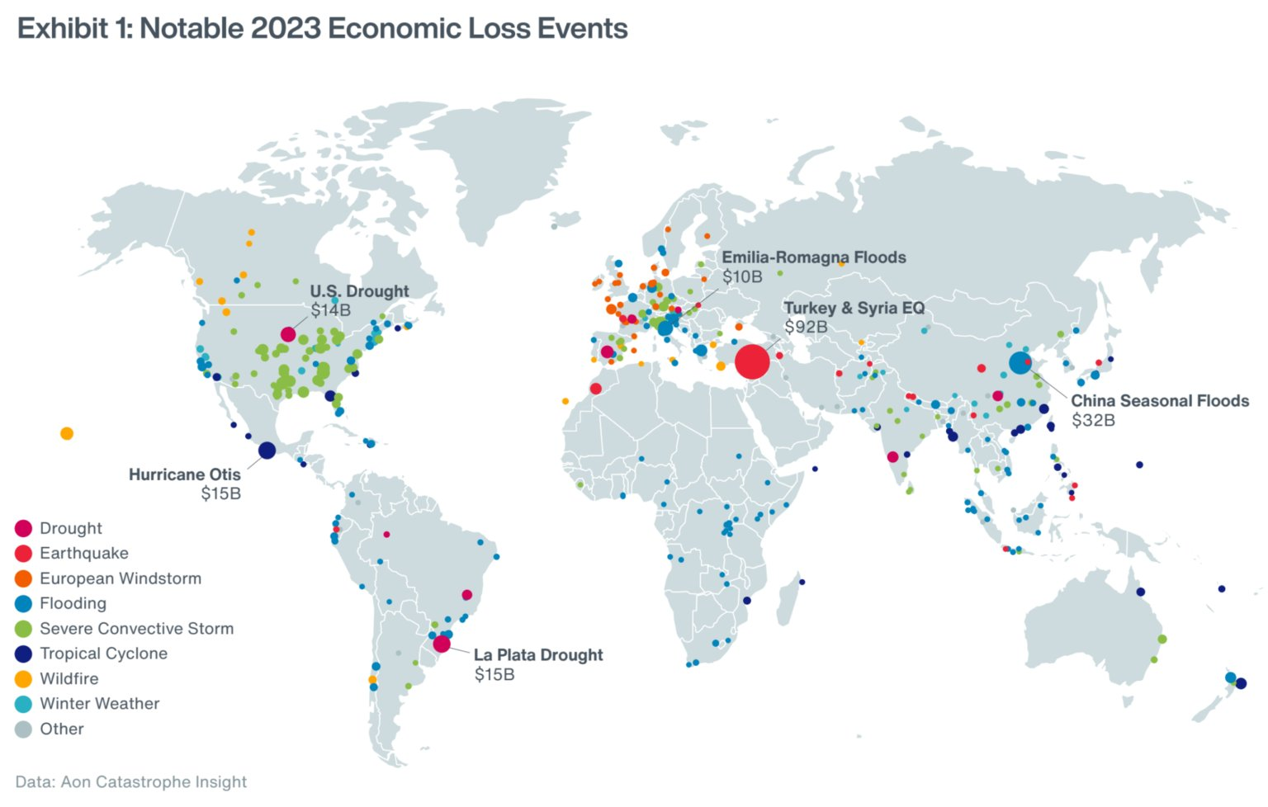
2023: A HISTORIC YEAR OF DISASTERS

Slide 10
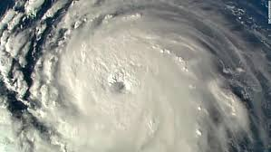
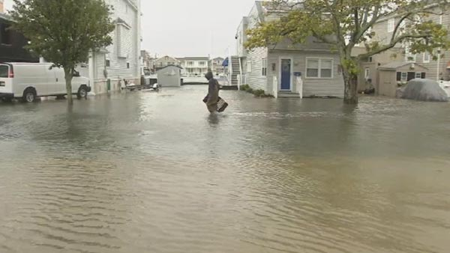
THE FOUR TO FOLLOW
HURRICANES
COASTAL FLOODING
Notes:
Cliff

Slide 11
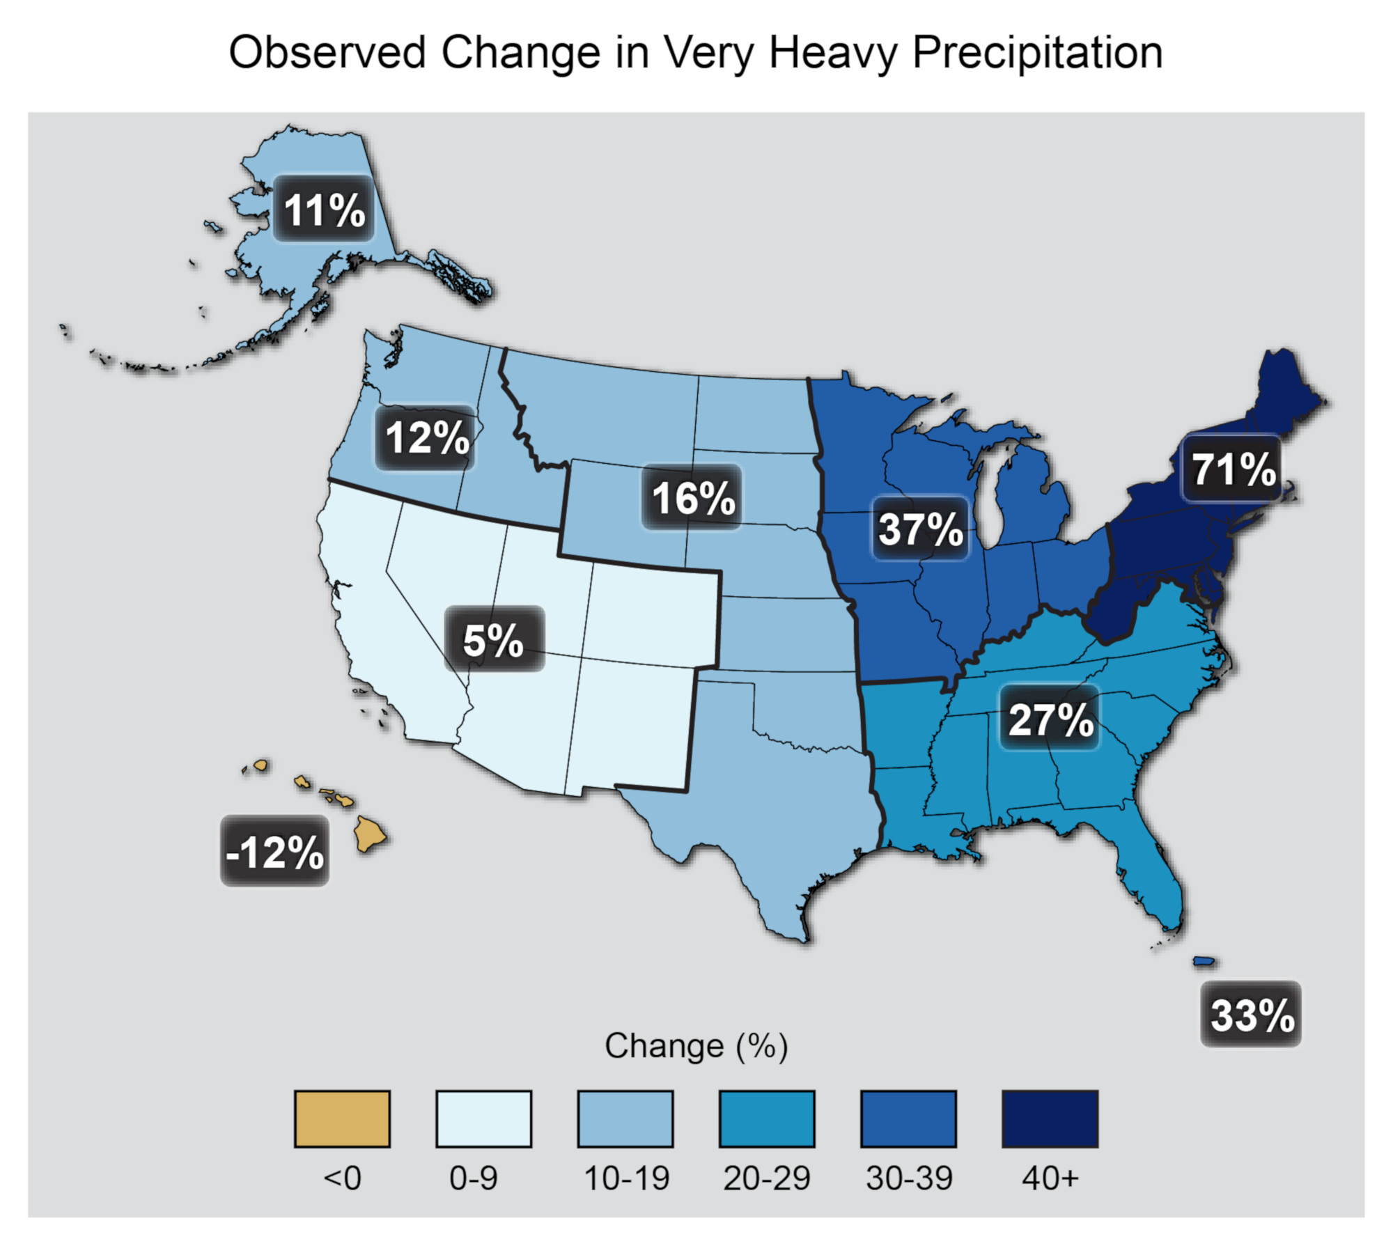
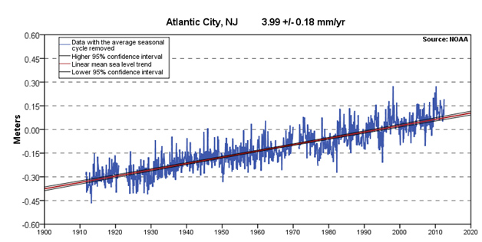
THE FOUR TO FOLLOW
HEAVY RAIN FLOODING
SEA LEVEL RISE
Notes:
Cliff

Slide 12
BEWARE OF……..
NON-SCIENCE MEDIA
YES, “MEDIA HYPE” DOES EXIST
EXAGGERATION FOR BETTER HEADLINES
LOCAL & NATIONAL MEDIA ISSUE
Notes:
Cliff

Slide 13
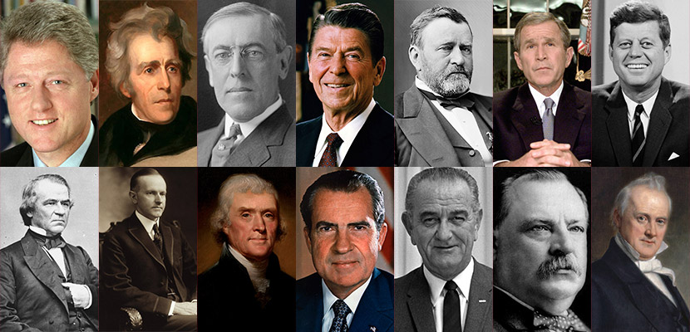
BEWARE OF……..
POLITICIANS
EVEN IF SMART, UNBIASED, & WELL-INTENTIONED
EXAMPLE: NYC Mayor’s comments during Sandy added to confusion
Notes:
Cliff

Slide 14
BEWARE OF……..
CELEBRITIES
Notes:
Cliff

Slide 15
BEWARE OF……..
BLOGGERS & SOCIAL MEDIA
EVEN IF THEY HAVE 1 MILLION+ FOLLOWERS
Google them and check who they follow for biases
Notes:
Cliff

Slide 16
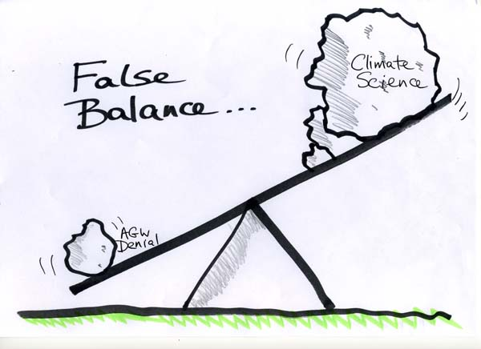
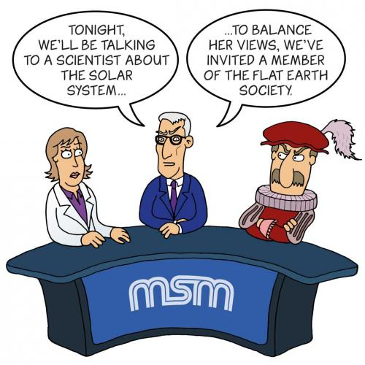
BEWARE OF……..
FALSE BALANCE
LOOKS LIKE “50-50” EVEN WHEN IT’S 97-3
“DENIERS” USE PROFESSIONAL COMMUNICATORS
IT SIMPLY MAKES FOR “GOOD TV”
Notes:
Cliff

Slide 17
BEWARE OF……..
“CONFIRMATION BIAS”
IN WEATHER IT’S CALLED
“WISHCASTING”
UNDERSTAND YOUR OWN BIASES
START WITH CONCLUSION, THEN
ONLY LOOK AT WHAT CONFIRMS IT
Notes:
Cliff

Slide 18
SO, WHO SHOULD WE TRUST?
CLIMATE SCIENTISTS
THOUSANDS AROUND THE WORLD
NEARLY ALL IN AGREEMENT ON THE BASIC SCIENCE
CRIPPLING HEADACHES? GO TO THE BRAIN SURGEON, NOT THE GP, OR YOUR UNCLE, OR SOME GUY ON SOCIAL MEDIA
Notes:
Cliff

Slide 19
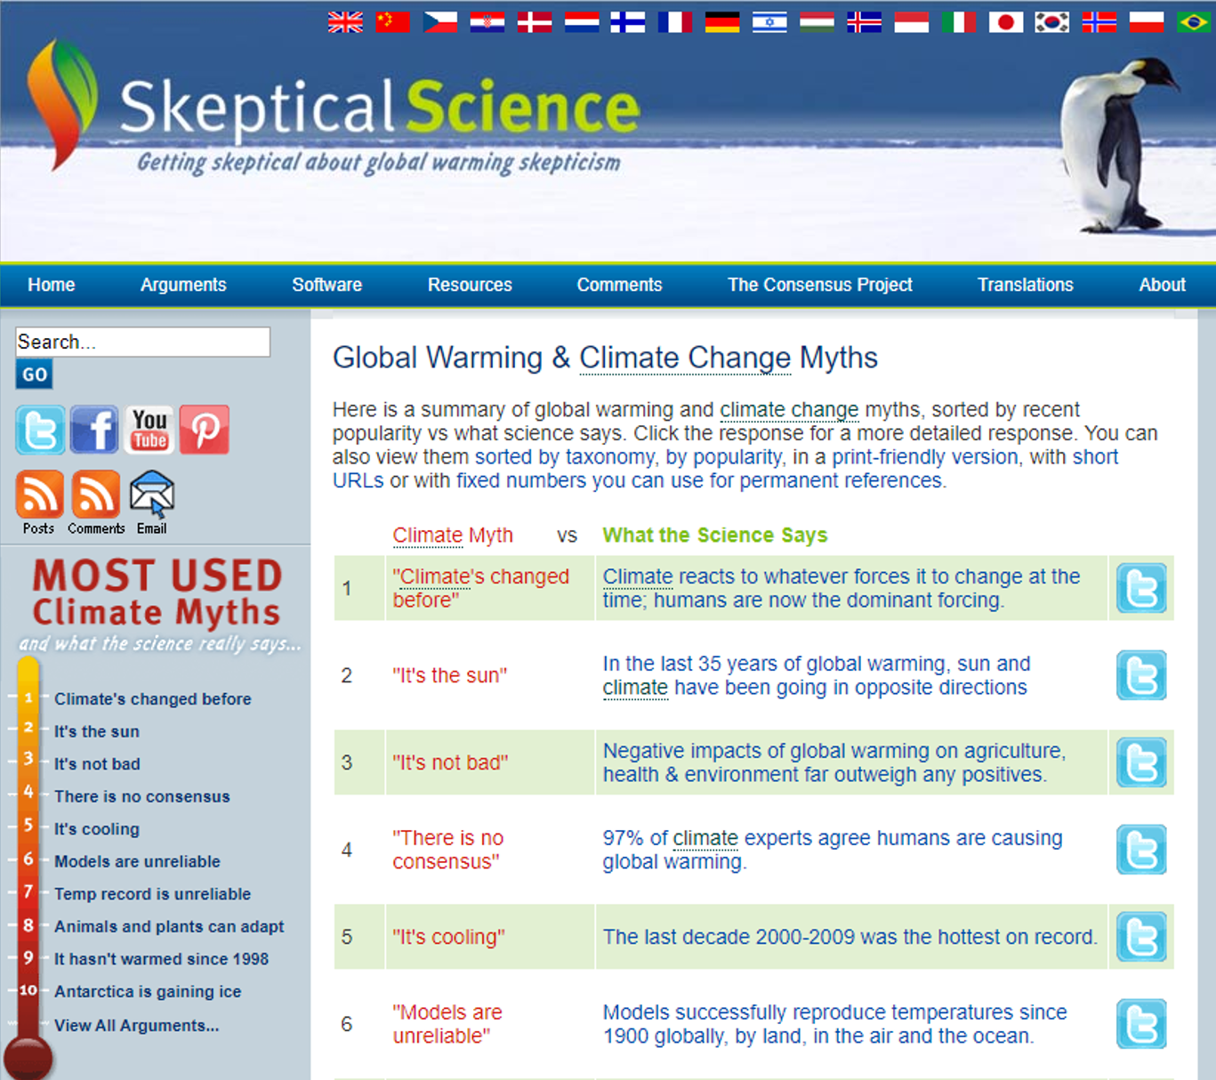
SITES TO TRUST – “BEST OF THE BEST”
SKEPTICALSCIENCE.COM
Answers 100+ myths about
climate change
Notes:
Cliff

Slide 20
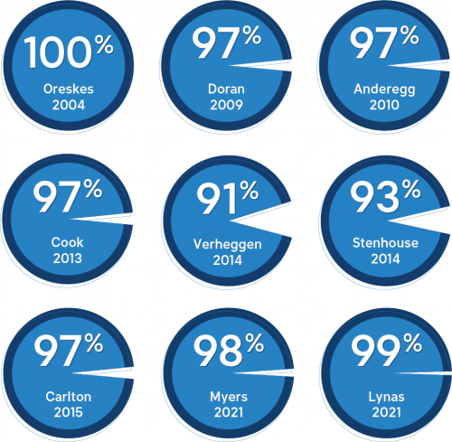
SITES TO TRUST – “BEST OF THE BEST”
Multiple Studies Show Near Unanimous Agreement on Human-Caused Global Warming
SKEPTICALSCIENCE.COM
Answers 100+ myths about
climate change
Notes:
Cliff

Slide 21
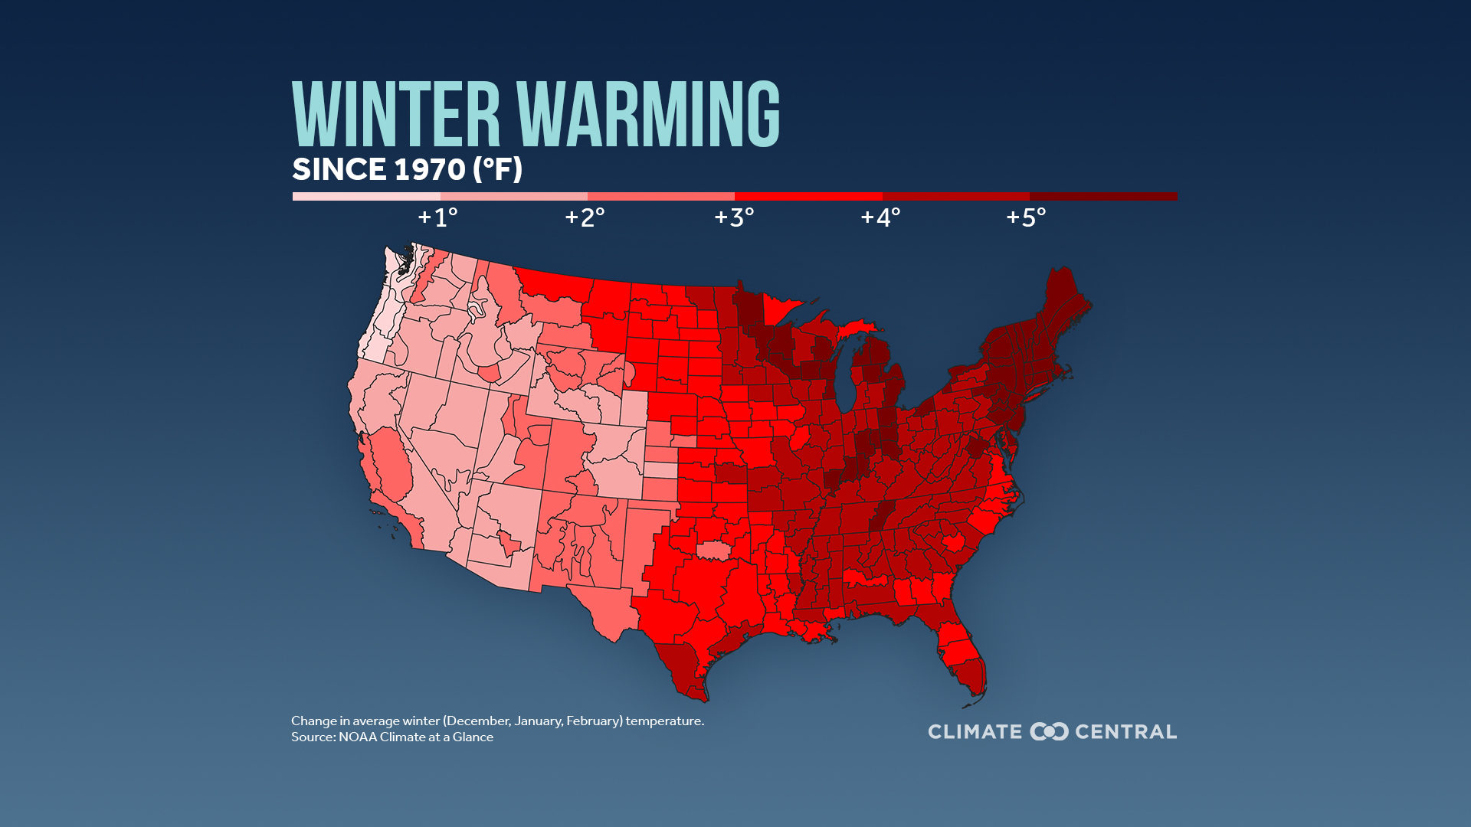
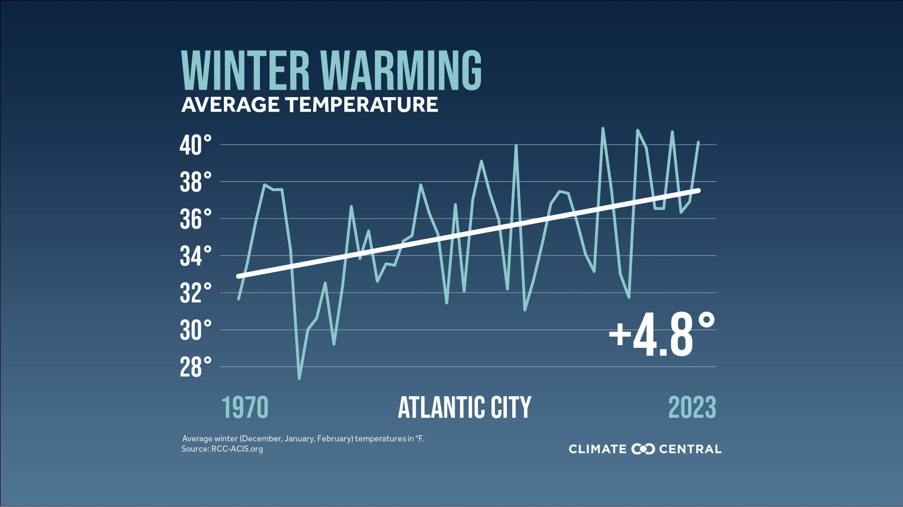
SITES TO TRUST – “BEST OF THE BEST”
CLIMATE CENTRAL.ORG
GREAT, SIMPLE GRAPHICS
DATA FOR INDIVIDUAL CITIES
Notes:
Cliff

Slide 22
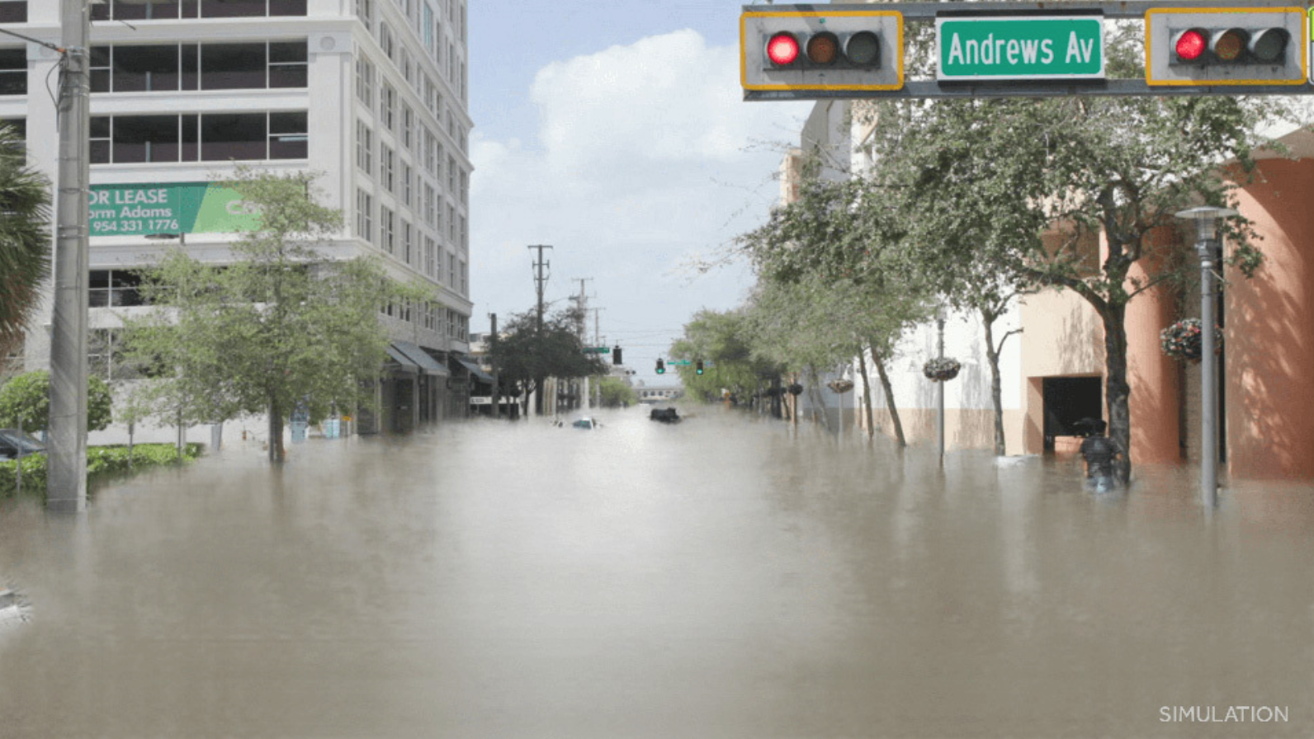
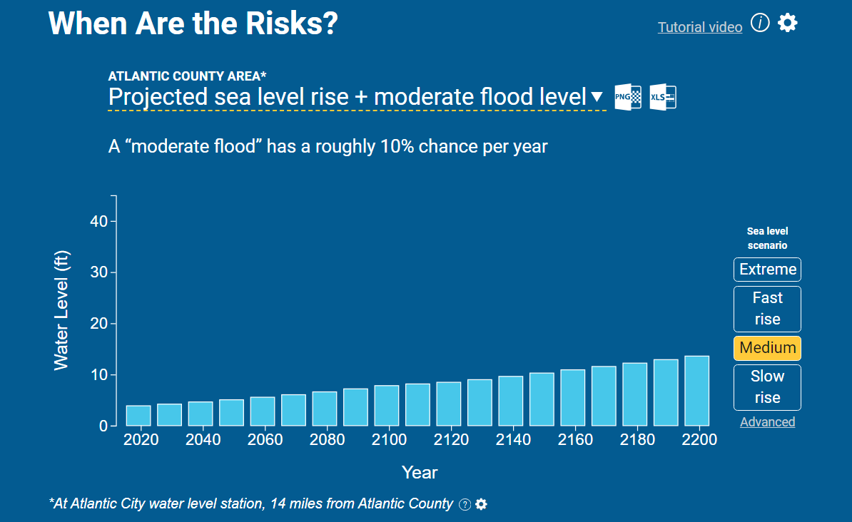
SITES TO TRUST – “BEST OF THE BEST”
CLIMATECENTRAL.ORG
Visual simulations of future floods
Specific flood risk sea level rise + flood
Notes:
Cliff

Slide 23
SITES TO TRUST – “BEST OF THE BEST”
CLIMATECENTRAL.ORG
Visual simulations of future floods
Example: Trenton, NJ -with 1.5° and 3.0° of warming
Notes:
Cliff

Slide 24
“NO ONE STORM CAN BE BLAMED…”
NO LONGER TRUE!
“ATTRIBUTION SCIENCE”
IS A REAL THING
“Attribution Science Linking Warming to Disasters Is Rapidly Advancing” (Scientific American, 2022)
Notes:
Cliff

Slide 25
ATTRIBUTION SCIENCE
News from the Columbia Climate School
CLIMATE, NATURAL DISASTERS
Attribution Science: “Linking Climate Change to Extreme Weather”
https://www.worldweatherattribution.org/
Notes:
Cliff

Slide 26
SO, WHO SHOULD WE TRUST?
NATIONAL
National Climate Data Center ncei.noaa.gov/monitoring
National Climate Assessment nca2023.globalchange.gov
National Oceanic & Atmos. Admin. noaa.gov/climate
NASA Global Climate Change climate.nasa.gov
Climate.gov climate.gov
Notes:
Cliff

Slide 27
SO, WHO SHOULD WE TRUST?
LOCAL/REGIONAL
Rutgers Climate Institute climatechange.rutgers.edu
New Jersey Climate Resource Center njclimateresourcecenter.Rutgers.edu
Department of Environmental Protection dep.nj.gov
Northeast Power Coordinating Council npcc.org
Northeast Regional Climate Center nrcc.cornell.edu
Notes:
Cliff

Slide 28
IGNORE THE “DOOMERS”
Notes:
Cliff

Slide 29
Notes:
“Format Background” to change background image (Right-click→Format Background)

