Slide 1
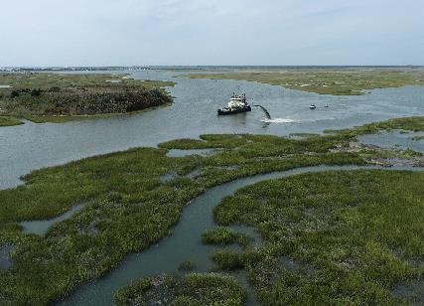
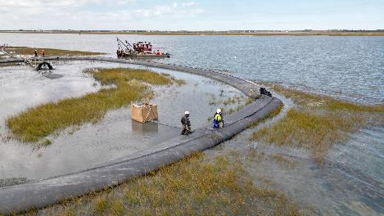
Seven Mile Island Innovation Laboratory
Structure, Function, & the Advancement of Beneficial use of Dredged material within USACE
Monica Chasten
Project Manager
U.S. Army Corps of Engineers
Philadelphia District
Operations Division
Government Dredge Merritt working near Ring Island
New Jersey Intracoastal Waterway Maintenance Dredging with Sturgeon Island Beneficial Use Placement

Slide 2
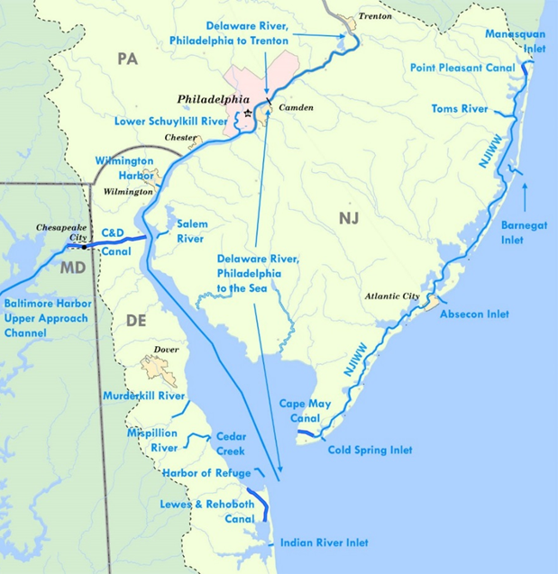
USACE Navigation Mission
Nationally, USACE dredges 200 to 300 Million cubic yards annually. Over 5 Billion cubic yards over the last 25 years
Philly District maintains federal channels, including the Delaware River & Bay, coastal channels through 4 tidal inlets and the 117-mile New Jersey Intracoastal Waterway
In order to dredge, USACE needs:
  Authorization (law)
  Appropriation ($$)
  Placement Area (State)
Navigation O&M is fast time scale!
Regional Sediment Management and Engineering with Nature Programs important to success
Philadelphia District Navigation Projects
Notes:
Here’s a closer look at the navigation channels that we maintain in our District. We maintain the Delaware River from Trenton all the way to the bay; we maintain the Chesapeake & Delaware Canal which connects the Port of Baltimore with Philadelphia. And we also maintain a number of coastal waterways and inlets, including the New Jersey Intracoastal Waterway, which is 117 miles from Manasquan Inlet to Cape May.
Provide safe, reliable, efficient and environmentally sustainable waterborne transportation systems for movement of commerce, national security needs, and recreation.
We also have almost 90 miles of beach nourishment projects.
How do we “maintain” navigation channels? There’s essentially two components:
One, surveying the channel to check the depth and locate shoaling and potential blockages. You can see the HR SPIES in the top left – that’s an example of one our survey boats that does this work. It’s equipped with the latest technology.
The second component is to dredge when necessary
With dredging, we use private contractors for most of our work, but we also own and operate our own Dredge. You can see the Dredge McFarland on the bottom left. The “Mac” as we call her was built in the late 1960s but is still going strong. She works a certain number of days per year on the Delaware River, but is also often called out on “urgent” dredging missions around the country. In recent years, she’s been used to dredge the lower Mississippi River; and also has been used in Texas and North Carolina. Currently, she’s in a shipyard in Norfolk, Virginia undergoing a number of repairs to ensure she is ready to support our dredging needs.

Slide 3
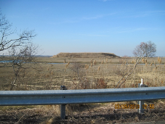
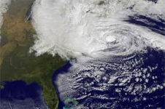
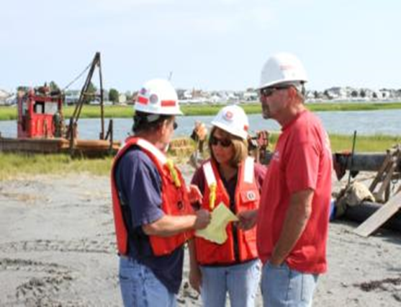
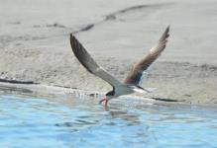
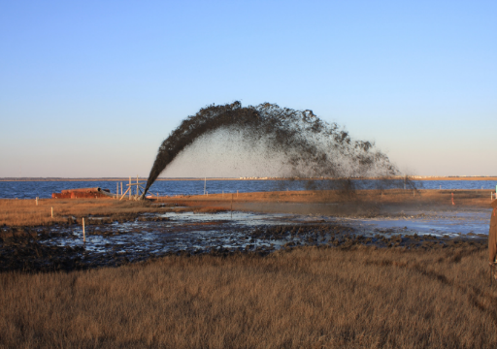
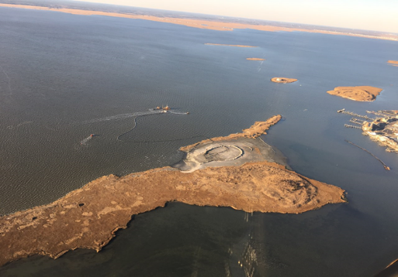
A “Persistent” Approach
Navigation and Nature
“Sediment is the currency of marsh ecosystems” ~ Dr. Lenore Tedesco, The Wetlands Institute
USACE is perhaps the largest national “sediment broker” due to navigation mission and dredging
Challenge to Change
How can we improve our stewardship of that clean sediment “currency” and improve system resilience?
Need to challenge our thinking and continue to evolve benefits in a progression from caution and risk- aversion to being cost-effective, proactive and innovative
Planning, Design, Permitting, Construction, Monitoring, Adaptive Management
RSM and EWN Programs have and continue to support evolving principles and practices for sediment management and NNBF
Notes:
Need to challenge our thinking and update and evolve benefits.

Slide 4

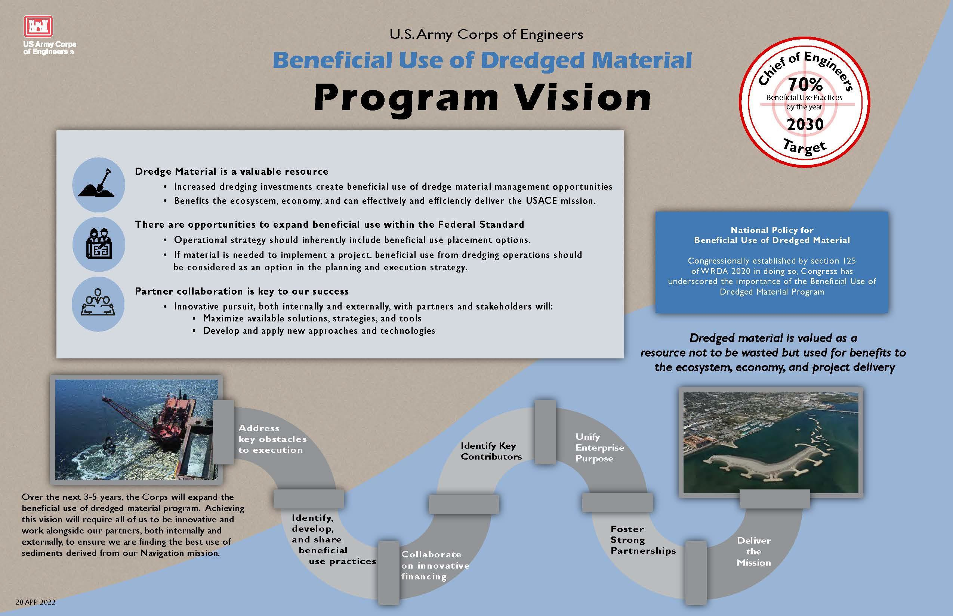

Beneficial Use of Dredged Material in USACE

Slide 5
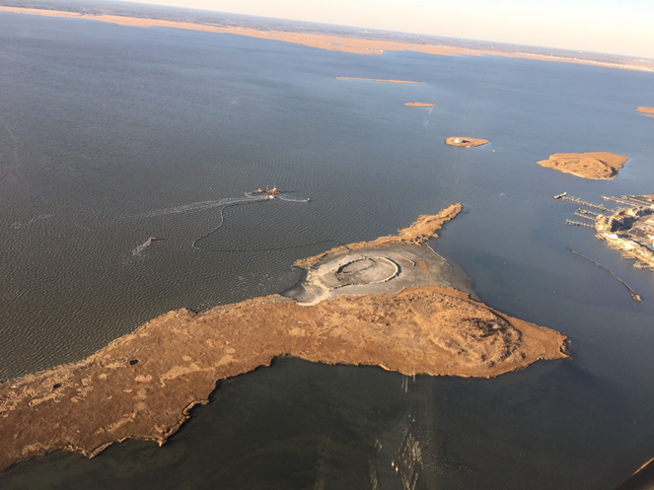
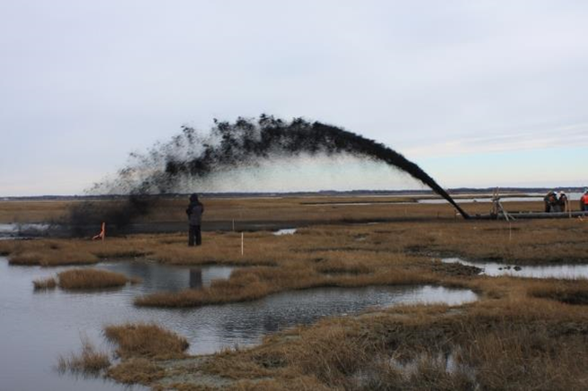
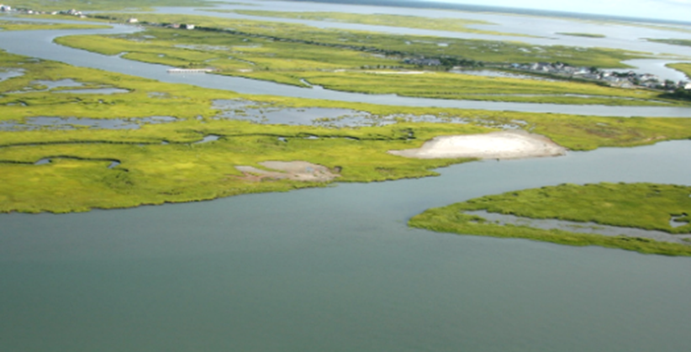
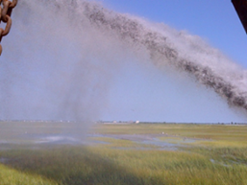
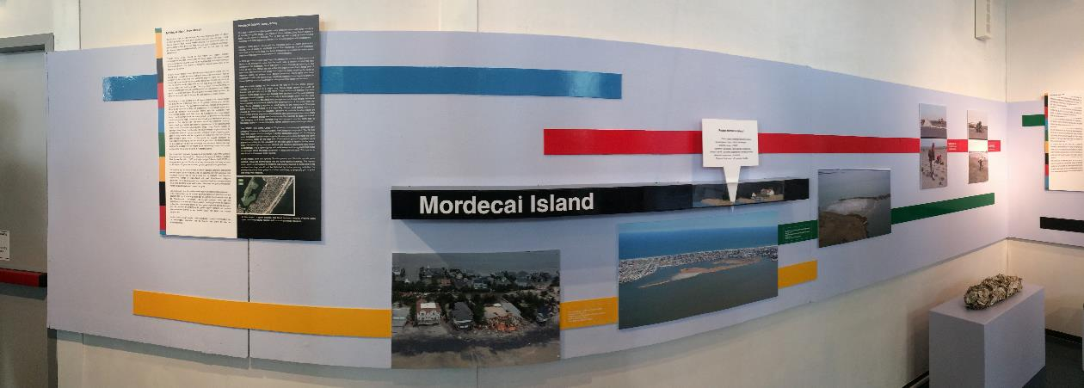
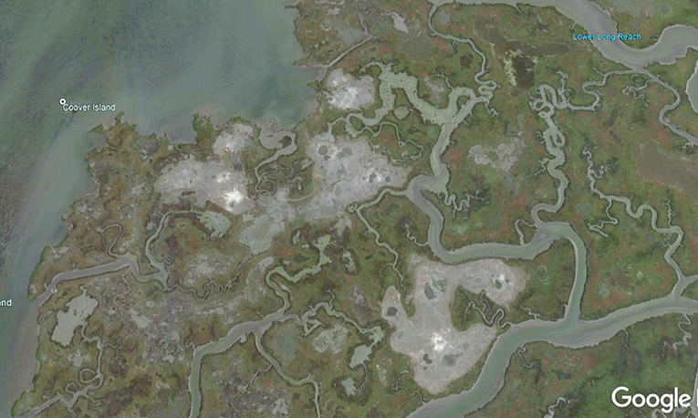
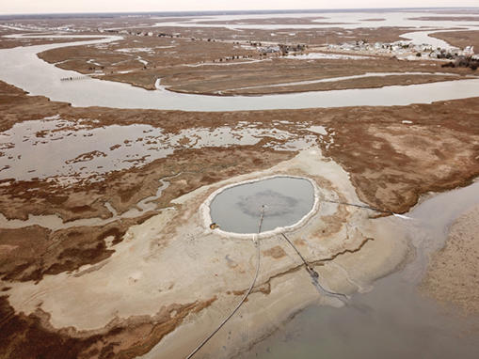
NJ Back Bay Pilots After Hurricane Sandy
“Thin” Layer Placement
(Sediment Enrichment)
Avalon NJ
(2014 and 2016)
Elevated Habitat
& TLP
Ring Island NJ
(2014 and 2018)
Mordecai Island Restoration
Beach Haven NJ
(2015 and 2017)
Dredge working in channel
CDF
Notes:
First project is Mordecai Island. This is our poster child for an RSM approach. The blue line is the NJIWW which required dredging after Hurricanes Irene and Sandy. Past practice was to put material into the Parkers Island CDF…baby CDF shared by Corps, state and locals with limited capacity. At the same time, we have had a CAP study to restore Mordecai Island that has been trying to get off the ground for 15 years. No brainer that this sediment would be wasted in the CDF, so we developed a project to place the dredge material to restore the island. Relatively small placement, but started a huge paradigm shift for policy in our state. It took over 2 years for us to get this permit….even after Sandy. We had to overcome CZM policies in the state that prohibited open water placement. We were told “no” go to the CDF repeatedly, but stayed persistent. From the beginning, we had a team from ERDC supporting the work, technical, policy, social aspects. We built the project, have continued to monitor. The bottom slide shows another way ERDC has supported us….this project was included in a Dredging Museum in the Netherlands, the cover of dredging publications, included in the EWN Atlas. Now being monitored under the MCNP Program and Planning is incorporating innovative placement in the project.

Slide 6
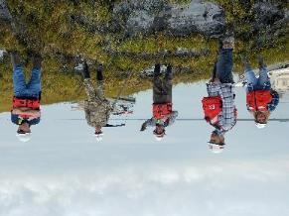
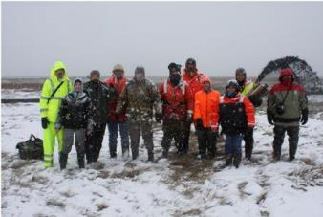
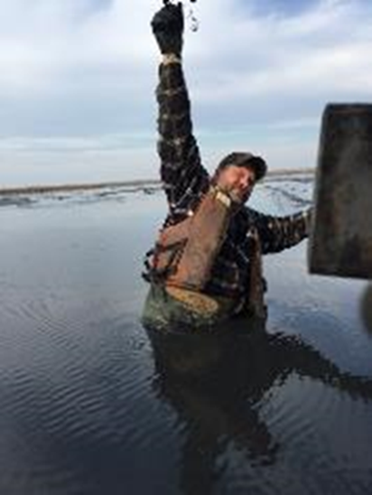
Building Momentum: from pilots to system OF solutions through the Seven Mile Island Innovation Lab
Notes:
Transition slide to SMIIL. When Pilots were done, SMIIL wasn’t formed yet

Slide 7
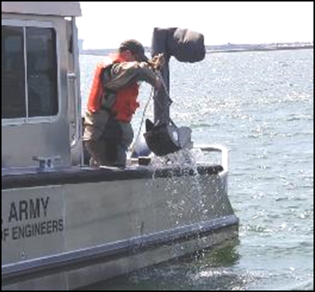
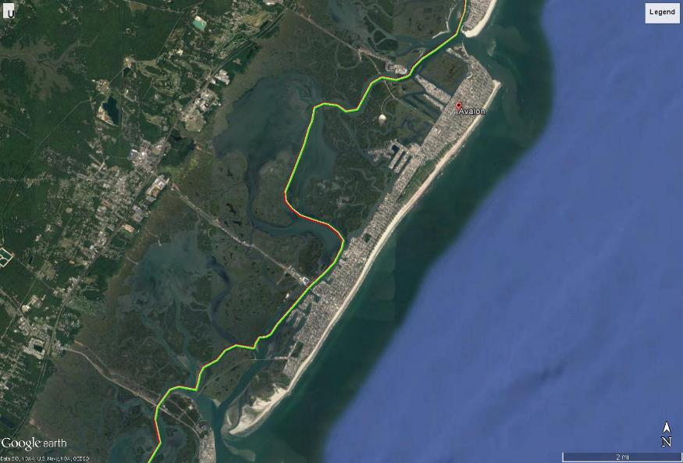
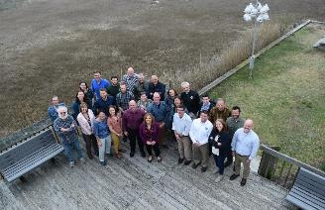
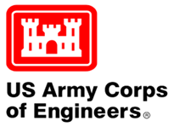
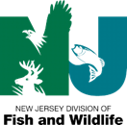


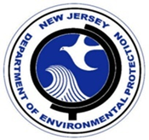
Seven Mile Island Innovation Laboratory
Established 2019
Notes:
Providing Ecological Uplift and Enhanced Resilience for Ecosystems and Coastal Communities using Natural and Nature-Based Features

Slide 8
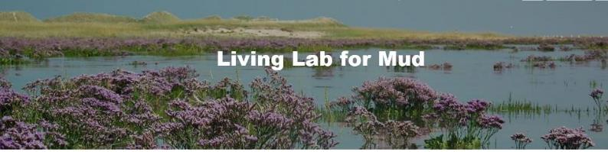
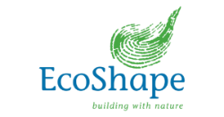
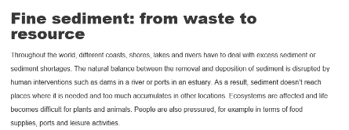
https://www.ecoshape.org/en/projects/living-lab-mud
Inspired by the Dutch

Slide 9
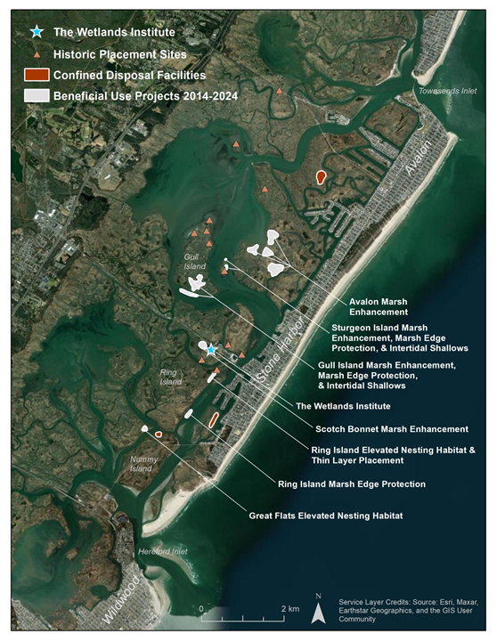

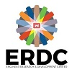
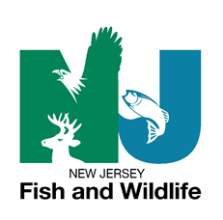
Seven Mile Island Innovation Lab
Background
Established in 2019 as partnership between USACE, NJDEP and TWI
A Proving Ground using Natural and Nature-Based Features to provide ecological uplift and enhanced resilience for ecosystems and coastal communities
Test Bed to advance and improve dredging techniques and marsh restoration and coastal feature creation techniques in coastal NJ
24 sq mi Back Bay Marsh Dominated System with shallow bays, sounds and tidal inlets bisected by the NJ Intracoastal Waterway
50+ Member Working Group for knowledge sharing
More than 30 Scientists Working in SMIIL
Publications, presentations, fact sheets shared on TWI and USACE Websites

Slide 10
SMIIL Overview References
American Shore and Beach Preservation Association National Conference, 2022, Long Beach, Presentation, “Advancing Navigation Dredging and Innovative Placements to Support Coastal System Resilience in USACE's Philadelphia District”
Chasten, M., Tedesco, L. and Kopkash, G. (2022). “Advancing Sediment Solutions in the Seven Mile Island Innovation Laboratory,” Proceedings, 37th International Conference on Coastal Engineering, December 2022, Sydney, Australia, in press
Chasten, M., Tedesco, L. and Kopkash, G. (2023). “Seven Mile Island Innovation Laboratory: Advancing Beneficial Use Practices to Support Coastal System Resilience,” Proceedings, Coastal Sediments 23, New Orleans, in press
Additional Info and Fact Sheets:
https://www.nap.usace.army.mil/Missions/Civil-Works/Coastal-Dredging-Beneficial-Use/
https://wetlandsinstitute.org/smiil/
Notes:
Tell ‘em what you’re going to tell ‘em.

Slide 11
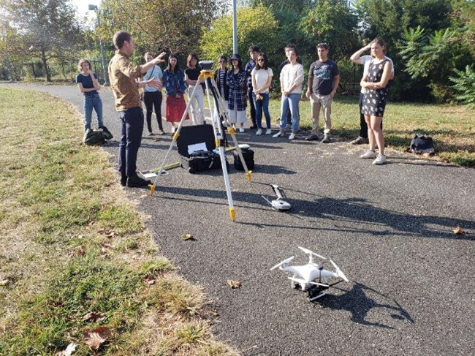
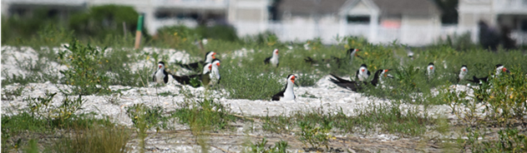
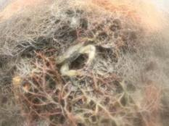
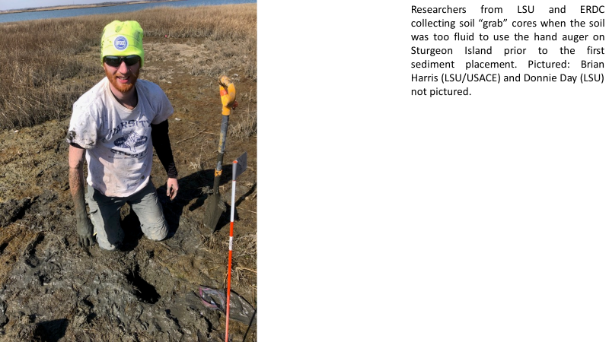
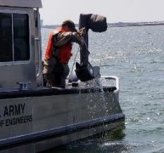
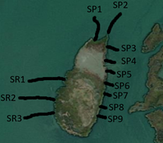
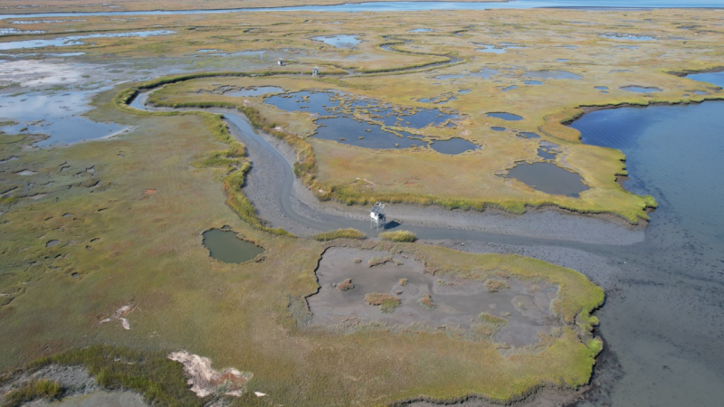
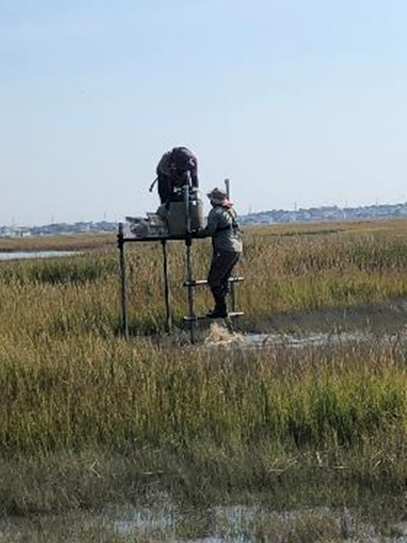
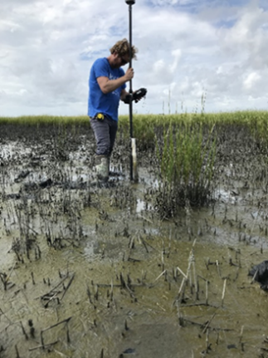
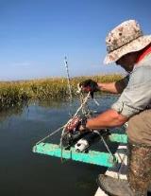
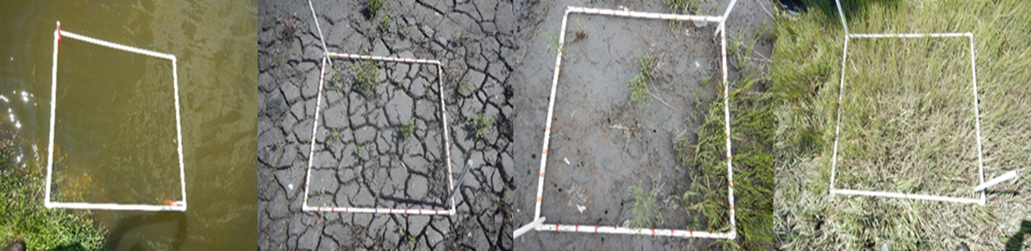
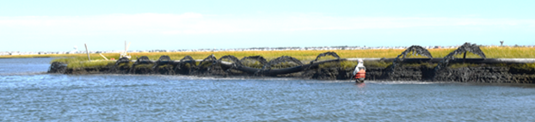
Importance of Monitoring & Research in SMIIL
USACE, State of NJ, TWI, UPENN, BC and Others
Notes:
One Year starting now. Can’t think of these as one and done projects Need adaptive management.

Slide 12
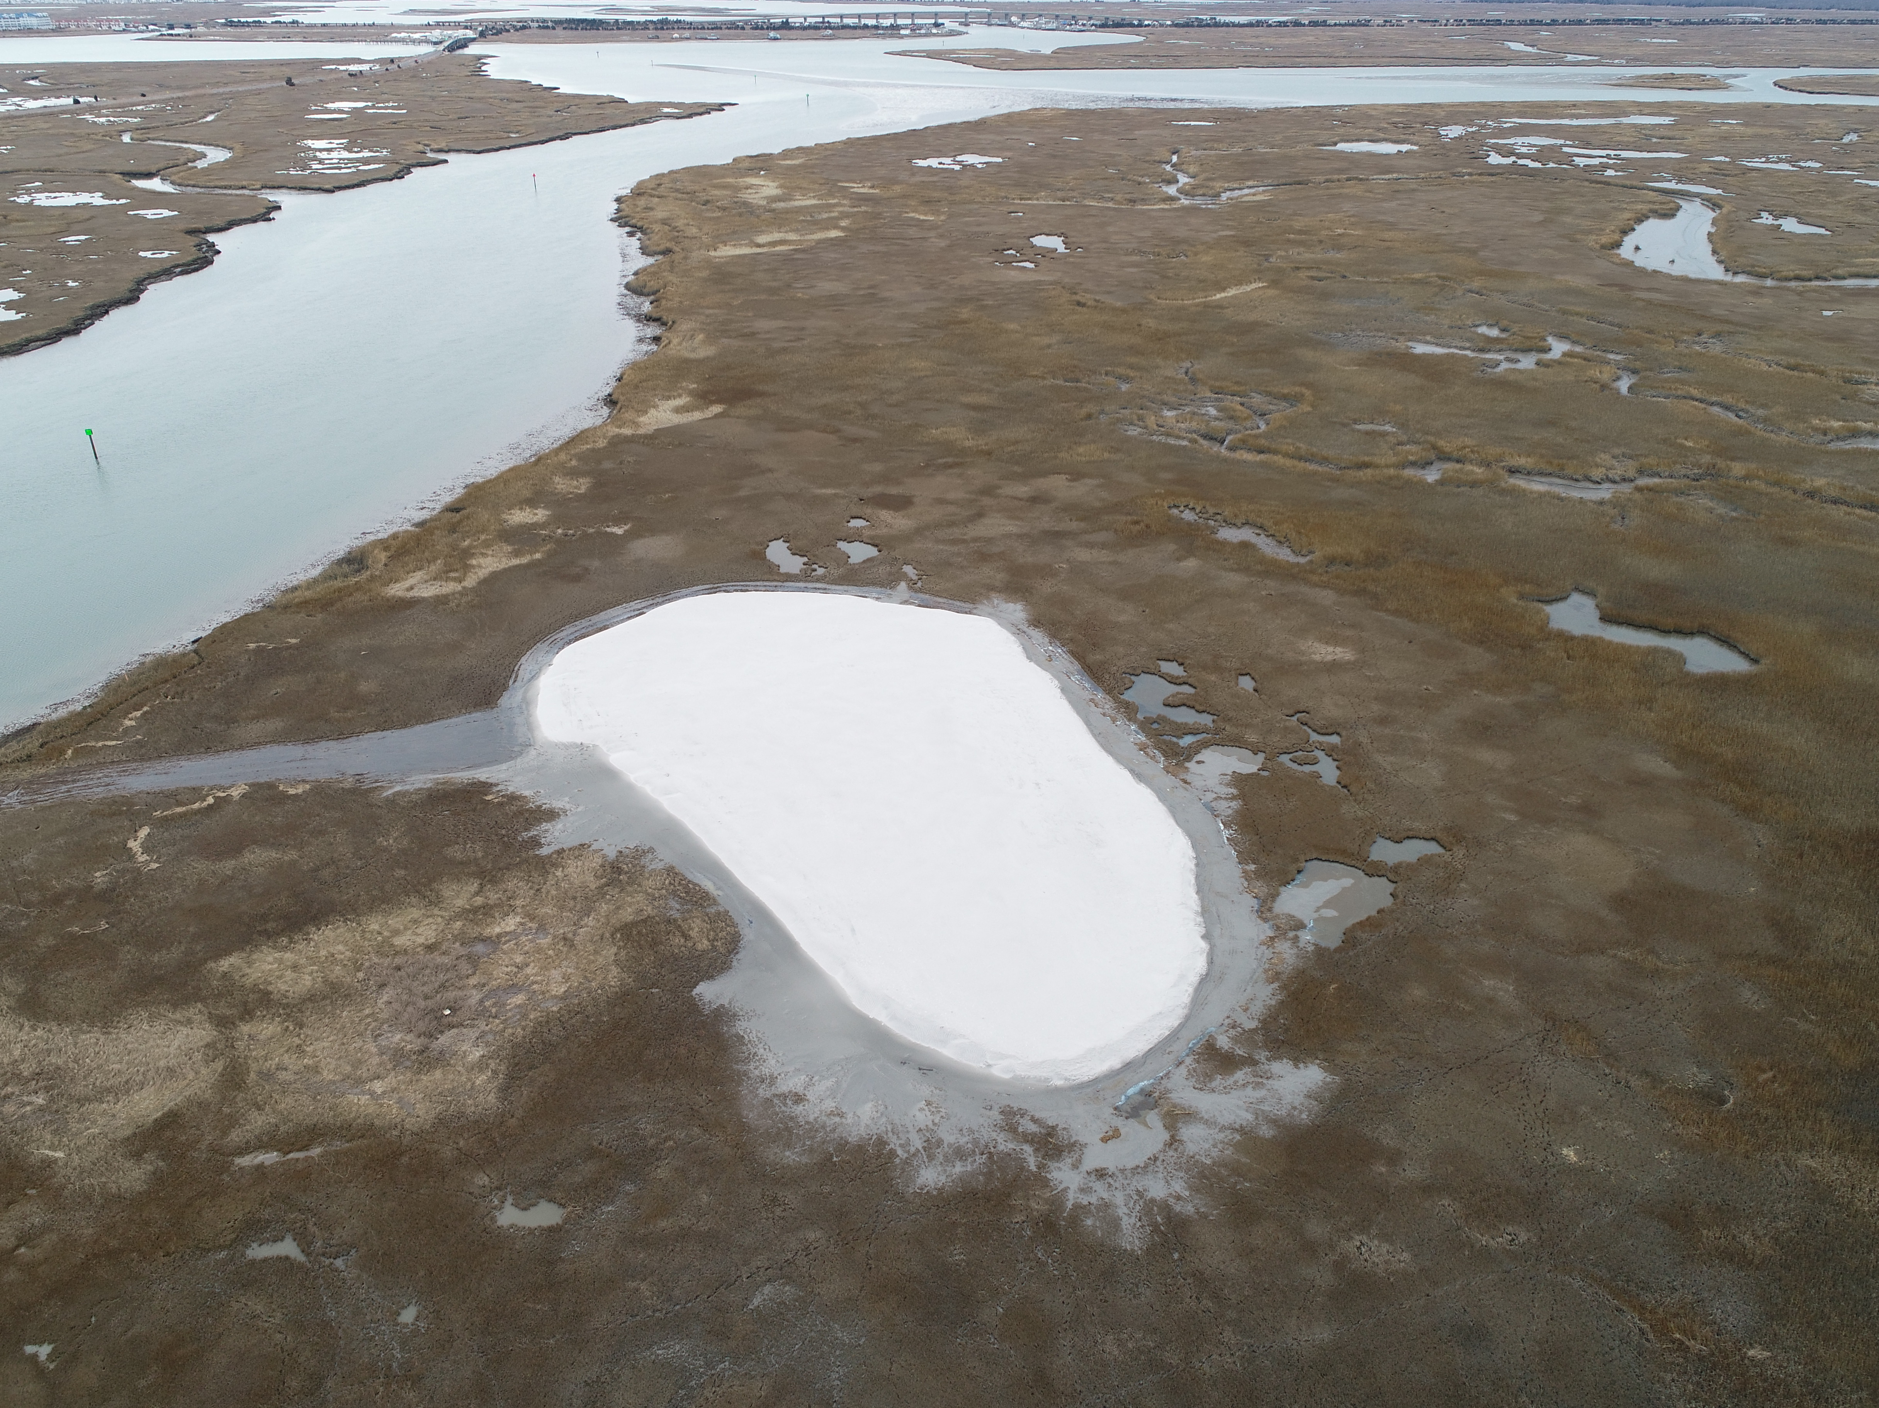
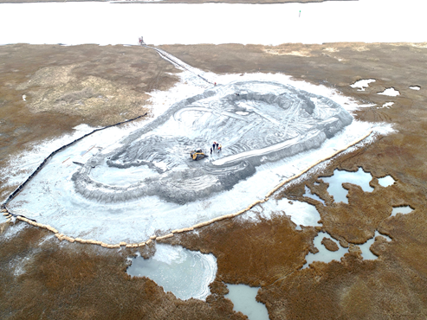
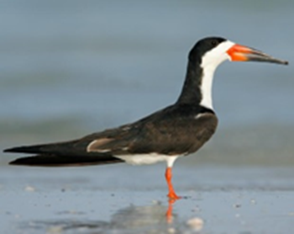
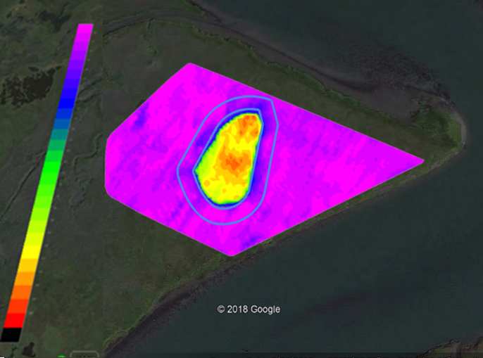

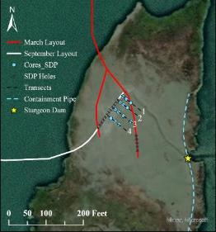
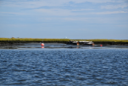




Advancing Dredging & Placement Techniques in SMIIL
Learning from the Past, Innovating Now and Evolving to the Future
Ring Island
Avalon
The Original Pilots & Beyond
Great Flats and a System of Solutions for the NJIWW
Taking it to the Next Level at Gull and Sturgeon Islands
Landscape Approach at Gull Island, RSM/EWN!
Notes:
This is a summary slide of projects advanced in SMIIL beyond pilots. Upper left shows Ring Island and Avalon pilots. Upper right shows Great Flats which was follow on to Ring and part of the “system of solutions”. Lower left shows first placement of cohesive sediments on Sturgeon Island, including trial of ERDC’s Sediment Distribution Pipe to separate fines and sands (material was 40% sand) and use of SDP to build edge restoration. Also shows use of Y-valve. Lower Right is most innovative placement yet at Gull Island near Stone Harbor. No containment was used, project was not “engineered” and natural landscape and channels moved the sediment. A Y-valve was used and a landscape of habits/features were created including Intertidal Subtidal Shallows (ISS) and new mudflats (created with a pontoon and pipe pointing to bottom off marsh edge )

Slide 13




Government Dredge Merritt in SMIIL: Sept 2023
Keeping Sediment in the System
CDF

Slide 14



What’s Next for Nav in SMIIL and Beyond?
Publish results from sidecast Government Dredge Merritt approach
Track shoaling rates and patterns for long-term strategies that are EWN-based and less “big” construction efforts
Sharing lessons learned with Maurice River (Dec 2023), Salem River (Summer 2024) and Scotch Bonnet (Fall 2024)
Utilize techniques in remaining portions of 117-mile NJIWW
Sharing Lessons Learned from SMIIL for continued collaboration and advancing BUDM practices from locals to international exchanges
Maurice River dredging with placement in Heislerville WMA (75k cy in Dec 2023)
Dredge Merritt
Salem River dredging with placement in USFWS’s Supawna Meadows (200k cy in Summer 2024)

Slide 15


NJIWW Dredging & Scotch Bonnet Placement at CMWWMA: 25,000 cy in Fall/Winter 2024
Restoring low marsh for avian and terrapin habitats, use of coir logs & Y-valve, permitted for multiple lifts over time, complements larger NJDEP/TWI grant project

Slide 16
Advancing Practice for Coastal Resilience
Rapid Progress in 10 Years! But more work to do…..
  Momentum to embrace change; status quo no longer an option given climate change and the need to improve resilient systems
  USACE has goal progression of 25% (pre-Sandy) to 60% (post-Sandy) to 100% beneficial use of clean channel sediments in coastal NJ, setting bar high!
  Increasing BUDM in larger nav channels is important to sustain Chief’s 70% goal; small successes lead to larger actions
  Importance of Trusted Partnerships are key for long-term Sustainability
  Work with cross-disciplinary teams and industry to improve designs, constructability and cost efficiency
  Importance of monitoring and leveraging with R&D to develop technologies, guidance, collaboration and knowledge/data management
  Adaptive management to manage risk are key in dynamic coastal system
Notes:
Take advancing practices and implementing projects to next level. Interesting in that in the 70s we were probably at greater than 75% BU

