Slide 1
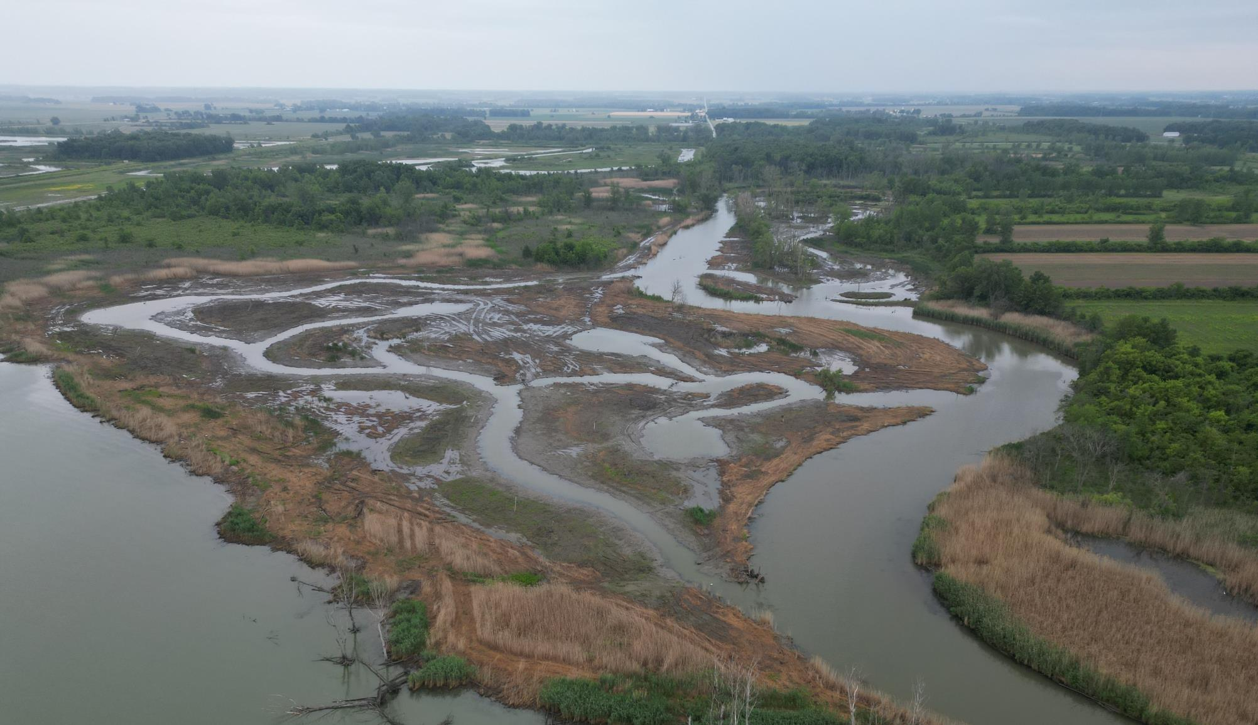
Nature-Based Solutions
Sandusky Bay Restoration
Octoboer 25, 2023
Ohio Department of Natural Resources
Notes:
Multidisciplinary team, project involved a lot of collaboration……best way for these projects…..synergy of each discipline, by collaborating we speed up the practice which is in the early stages. Trying to get to the next step, do something that more dynamic and that takes many heads.

Slide 2
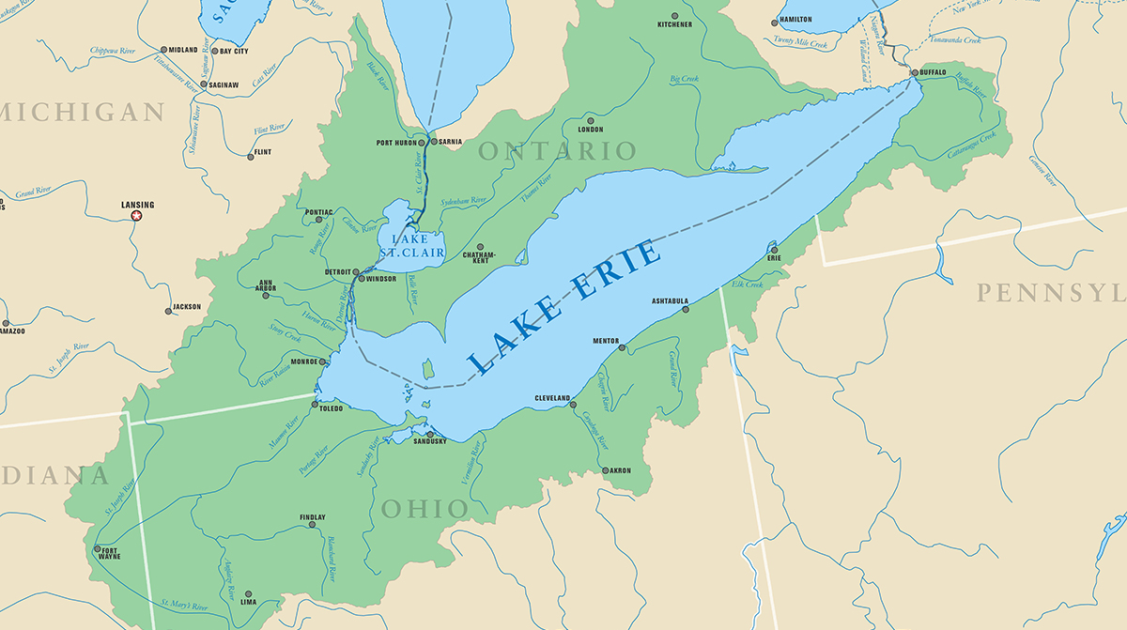
Water Levels on the Great Lakes -
4x larger than Chesapeake Bay
SANDUSKY BAY
50% larger than Barnegat Bay
Lenters, 2001
@ODNR
Notes:
Southwest Corner – red

Slide 3
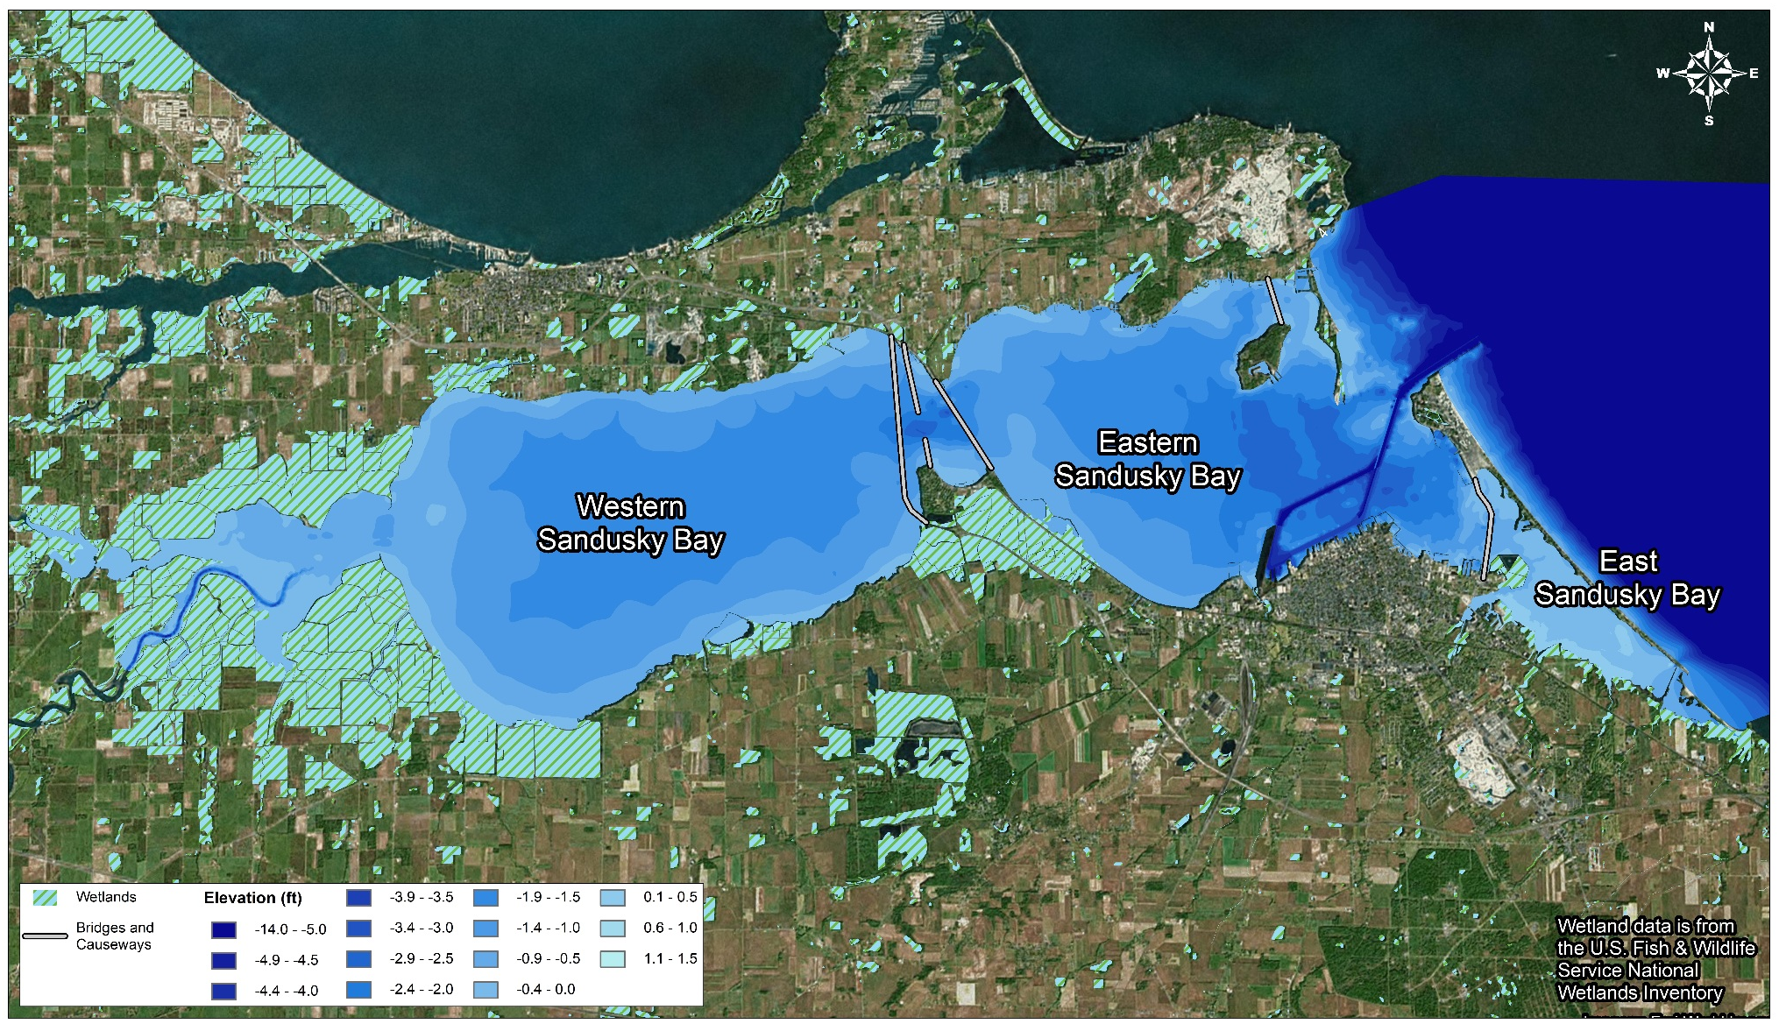
Notes:
75% of the Watershed is Agricultural

Slide 4
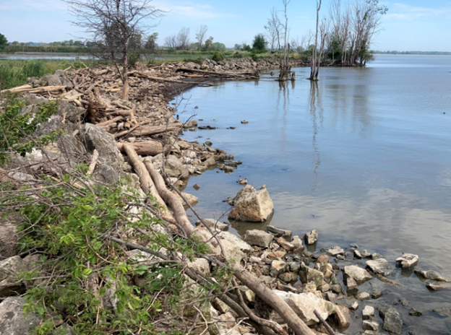
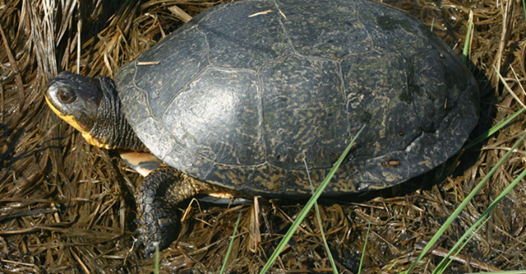
Project Goals
Reduce sediment resuspension and Harmful Algal Blooms (HABs) through shoreline and wave energy reduction
Causal link between turbidity and wave energy
High Turbidity and Nitrogen = HABs Probability
Chlorophyll A reduction
Light clarity improvements
Enhance nutrient assimilation/processing
Uptake of phosphorous and nitrogen
Create wetland, SAV, and emergent wetland habitats for fish and wildlife
Seeking heterogeneity in elevation, edge type, and vegetation
Functional based approach to design

Slide 5
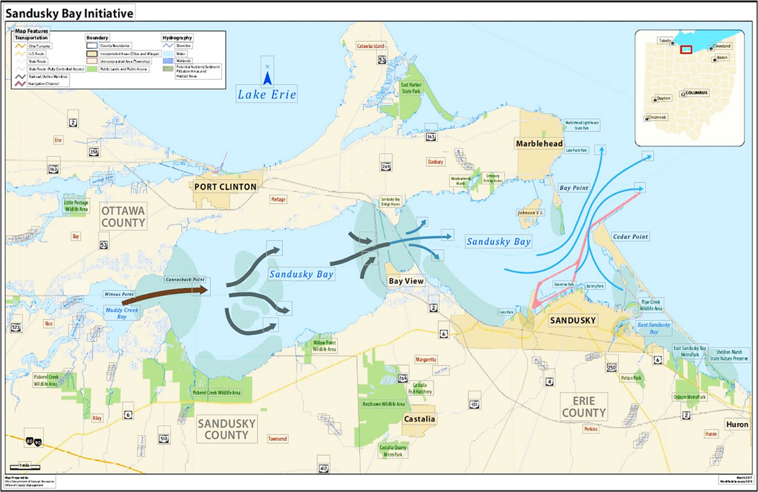
Sandusky Bay, Ohio
Source: ODNR – Coastal Management Program
Notes:
We want to focus on Sandusky Bay located west of Cleveland on the south shore of lake Erie 50% larger than Barnegat Bay
75% of its drainage area is in row crop agriculture. As water levels rose, property owners diked most of the southern and western shorelines to protect property and wetlands , with the result of loss of wetland function (especially nutrient transformation and sediment trapping), degradation of wetland community to Phrag dominated, and loss of wetland migration pathways.

Slide 6
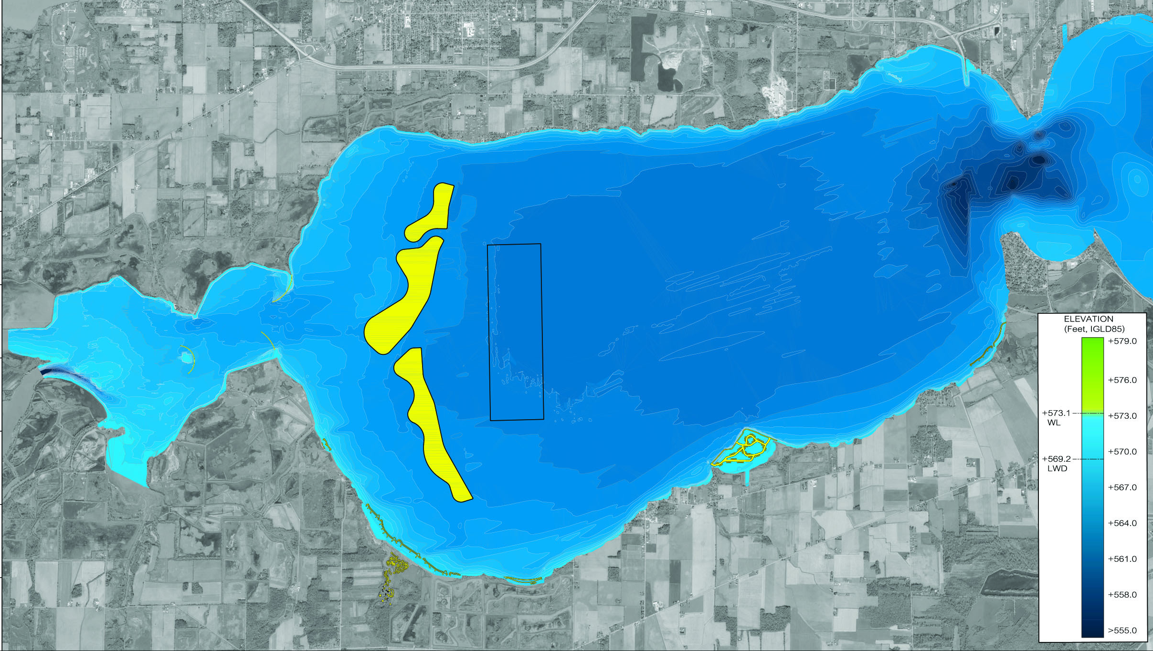
Marblehead
Sandusky Bay
Barrier Islands
Borrow Area
Standing Rush
Muddy Creek Bay
Racoon Creek
Willow Point
Bayshore Staging Area
PC West
PC Riparian
PC East
Notes:
Nature based shoreline designs
Goals
Reduce harmful algal blooms in Sandusky Bay through reduction in resuspension of bay soils and nutrient uptake
Increase ecological value and habitat within Sandusky Bay
Reduce erosion along shorelines, protect existing infrastructure (roads/berms)

Slide 7
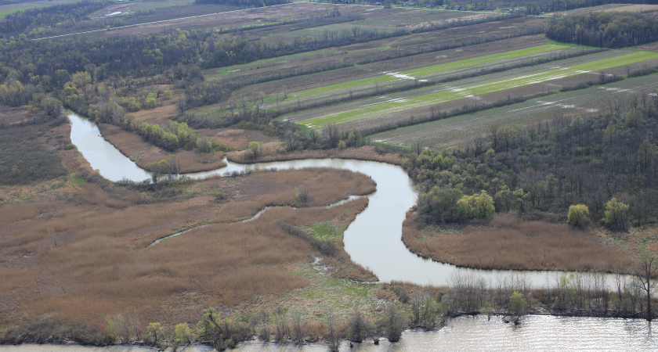
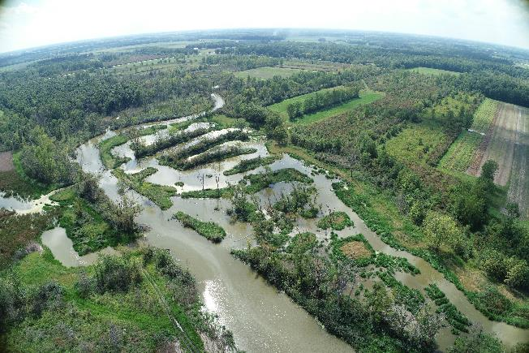
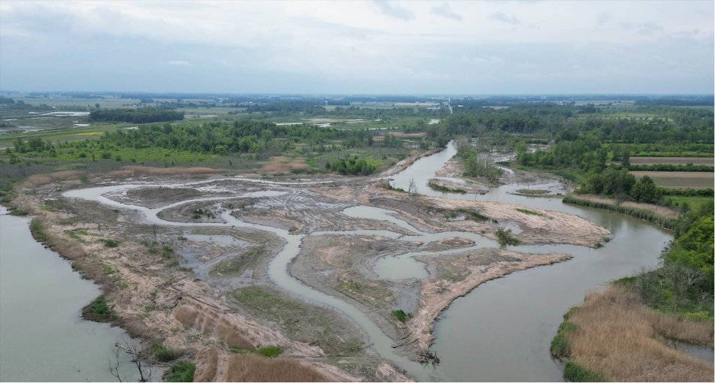
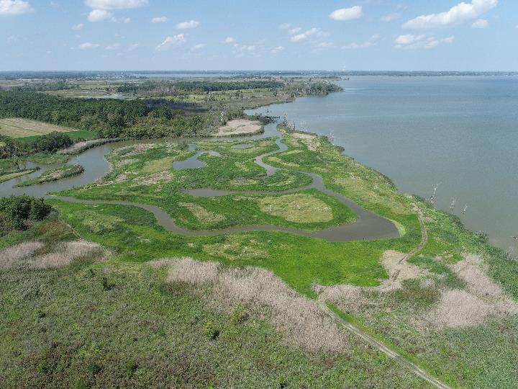
Case Study - Pickerel Creek Riparian & PCW
Before
After – Summer 2023
After – Spring 2023
After – Summer 2023

Slide 8
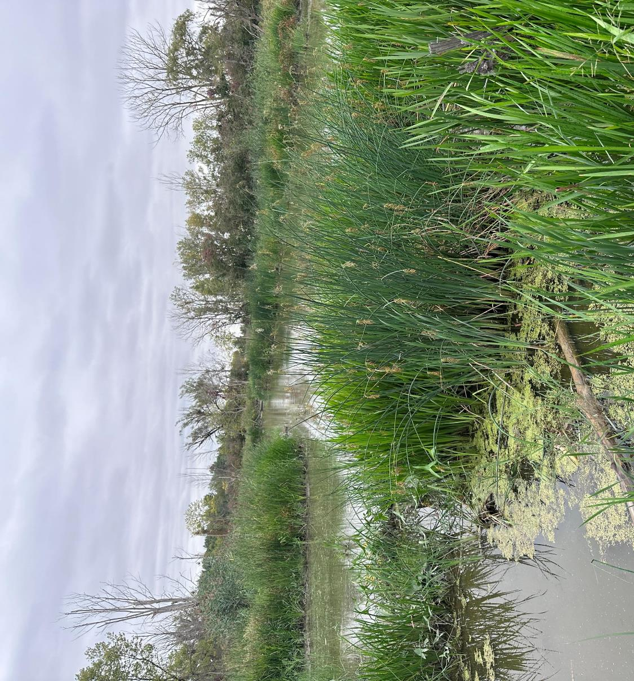
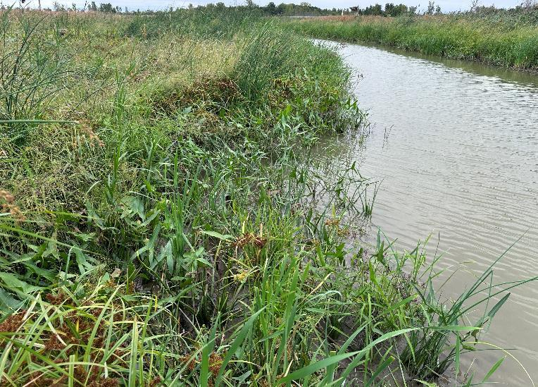
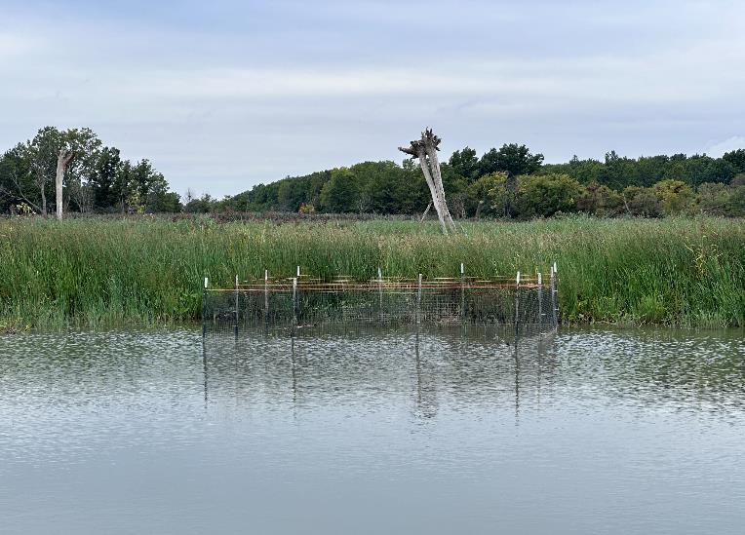
Notes:
Some ground-level photos taken last summer

Slide 9
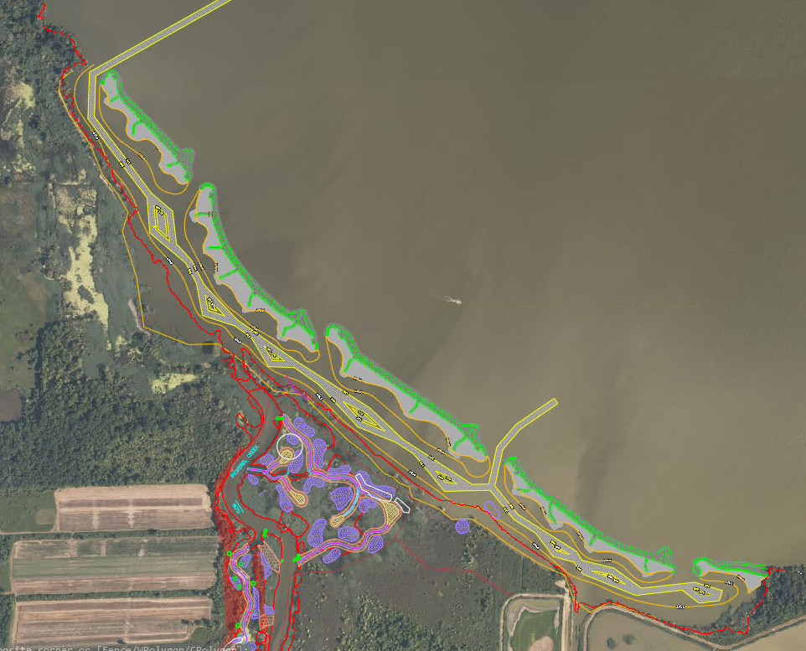
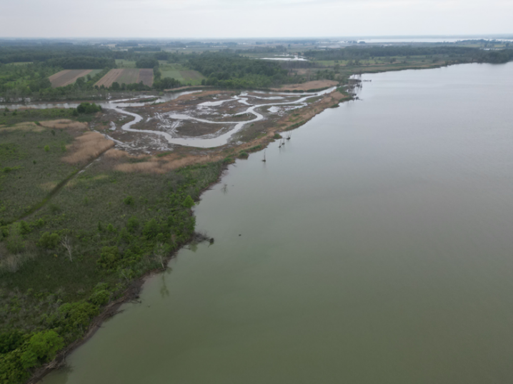
Pickerel Creek West & PC Riparian

Slide 10
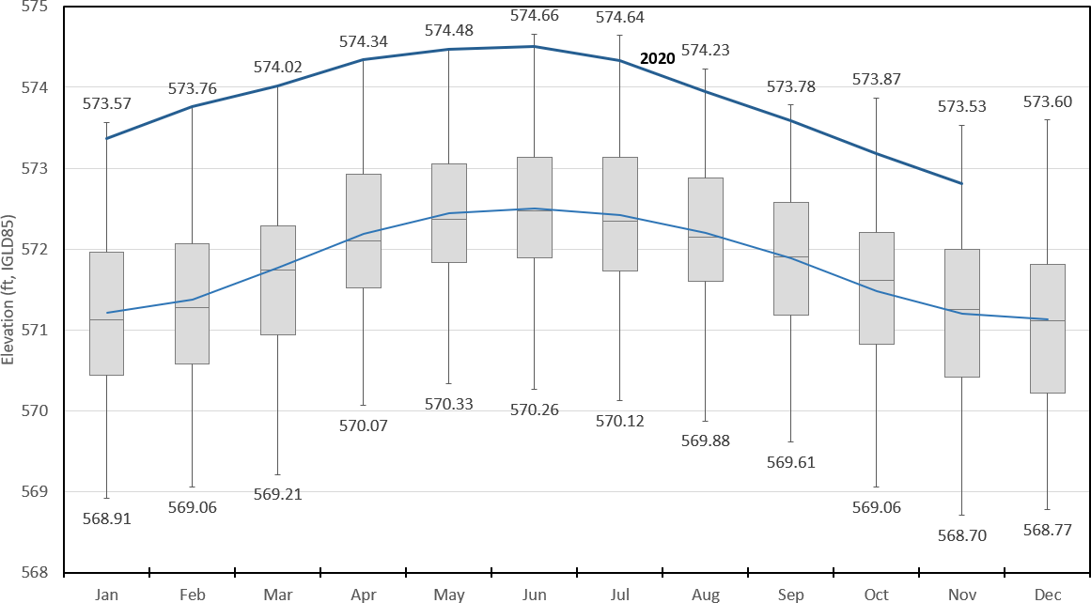
Water Levels (Marblehead, OH)
@ODNR
Figure 2: Monthly Average Water Levels over historic water level record period 1960-2020 for the Marblehead, OH NOAA Station. (Baird 2021)

Slide 11
Water Levels (Marblehead, OH)
@ODNR
Figure 1: Annual September Water Level Data (ft lGLD) over record period 1959-2019 for the Marblehead, OH NOAA Station

Slide 12
Important Design Driver – Water Levels
Predicts Upper and Lower Limits for Marsh Habitat based on historic water level data (1959-2019 Marblehead Data)
Focuses on September
low point in growing season
woody canopies at maximum
Germination can occur
Upper limit determined by dewatering, lower limit by flooding – shifts every year
Important Factors of Model
f = flooding tolerance, years until marsh disappears when flooded (=4)
S = succession time, years until woody canopy forms when dry (=15)
Based on the The Twin Limit Marsh Model: A Non-equilibrium Approach to Predicting Marsh Vegetation on Shorelines and in Floodplains (Keddy and Campbell 2019)
Notes:
Understand WL’s critical to any design. NOAA gage data essential but also understanding characteristics of long term water level data and the Twin Limit Marsh Model, set WL ranges for specific wetland habitats. Adapt to water level changes, immolate natural coastal systems response to WL elevation changes. Tom

Slide 13
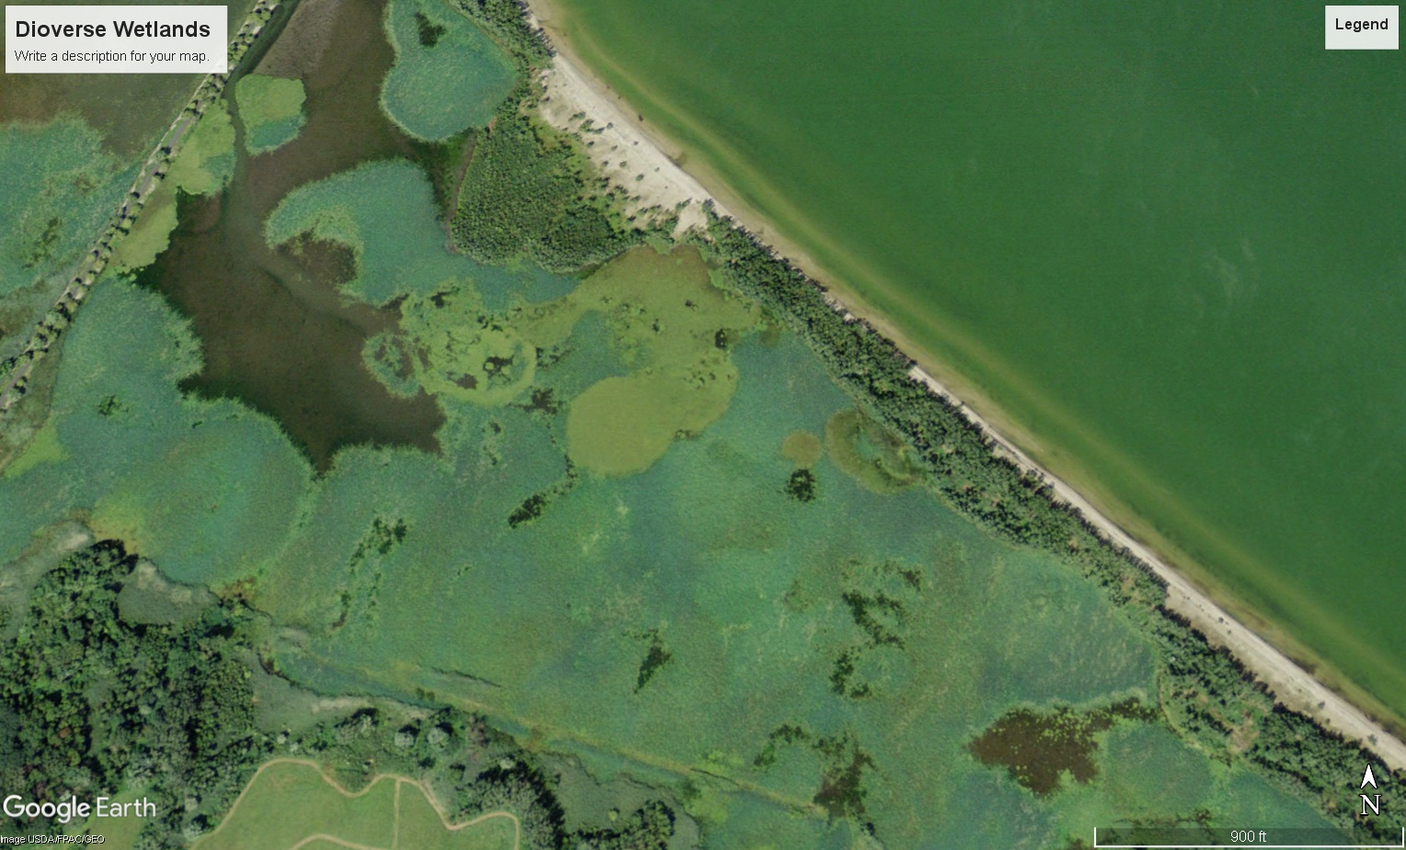
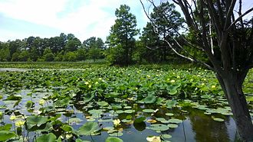
Questions?
Joe Berg, Biohabitats
jberg@biohabitats.com
Notes:
Historically, much of Sandusky Bay was covered with submersed and floating leaved wetland species, like American Lotus

