Slide 1
Top 5 Things Everyone Should Know about Beneficial Use of Sediment for Restoration
Adrianna Zito-Livingston
Beneficial Use Learning Network Chair

Slide 2
Beneficial use of dredged material for Restoration of Marshes and Coastal Habitats
Beneficial use is a restoration approach which includes many tactics
Dredging projects help make restoration possible
Clean sediment is valuable and limited resource
Its important to consider elevation, inundation, and future conditions
Projects need a strong ecological justification supported by data regulatory engagement is key to project success.

Slide 3
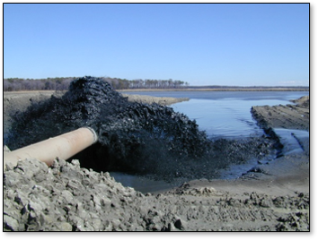
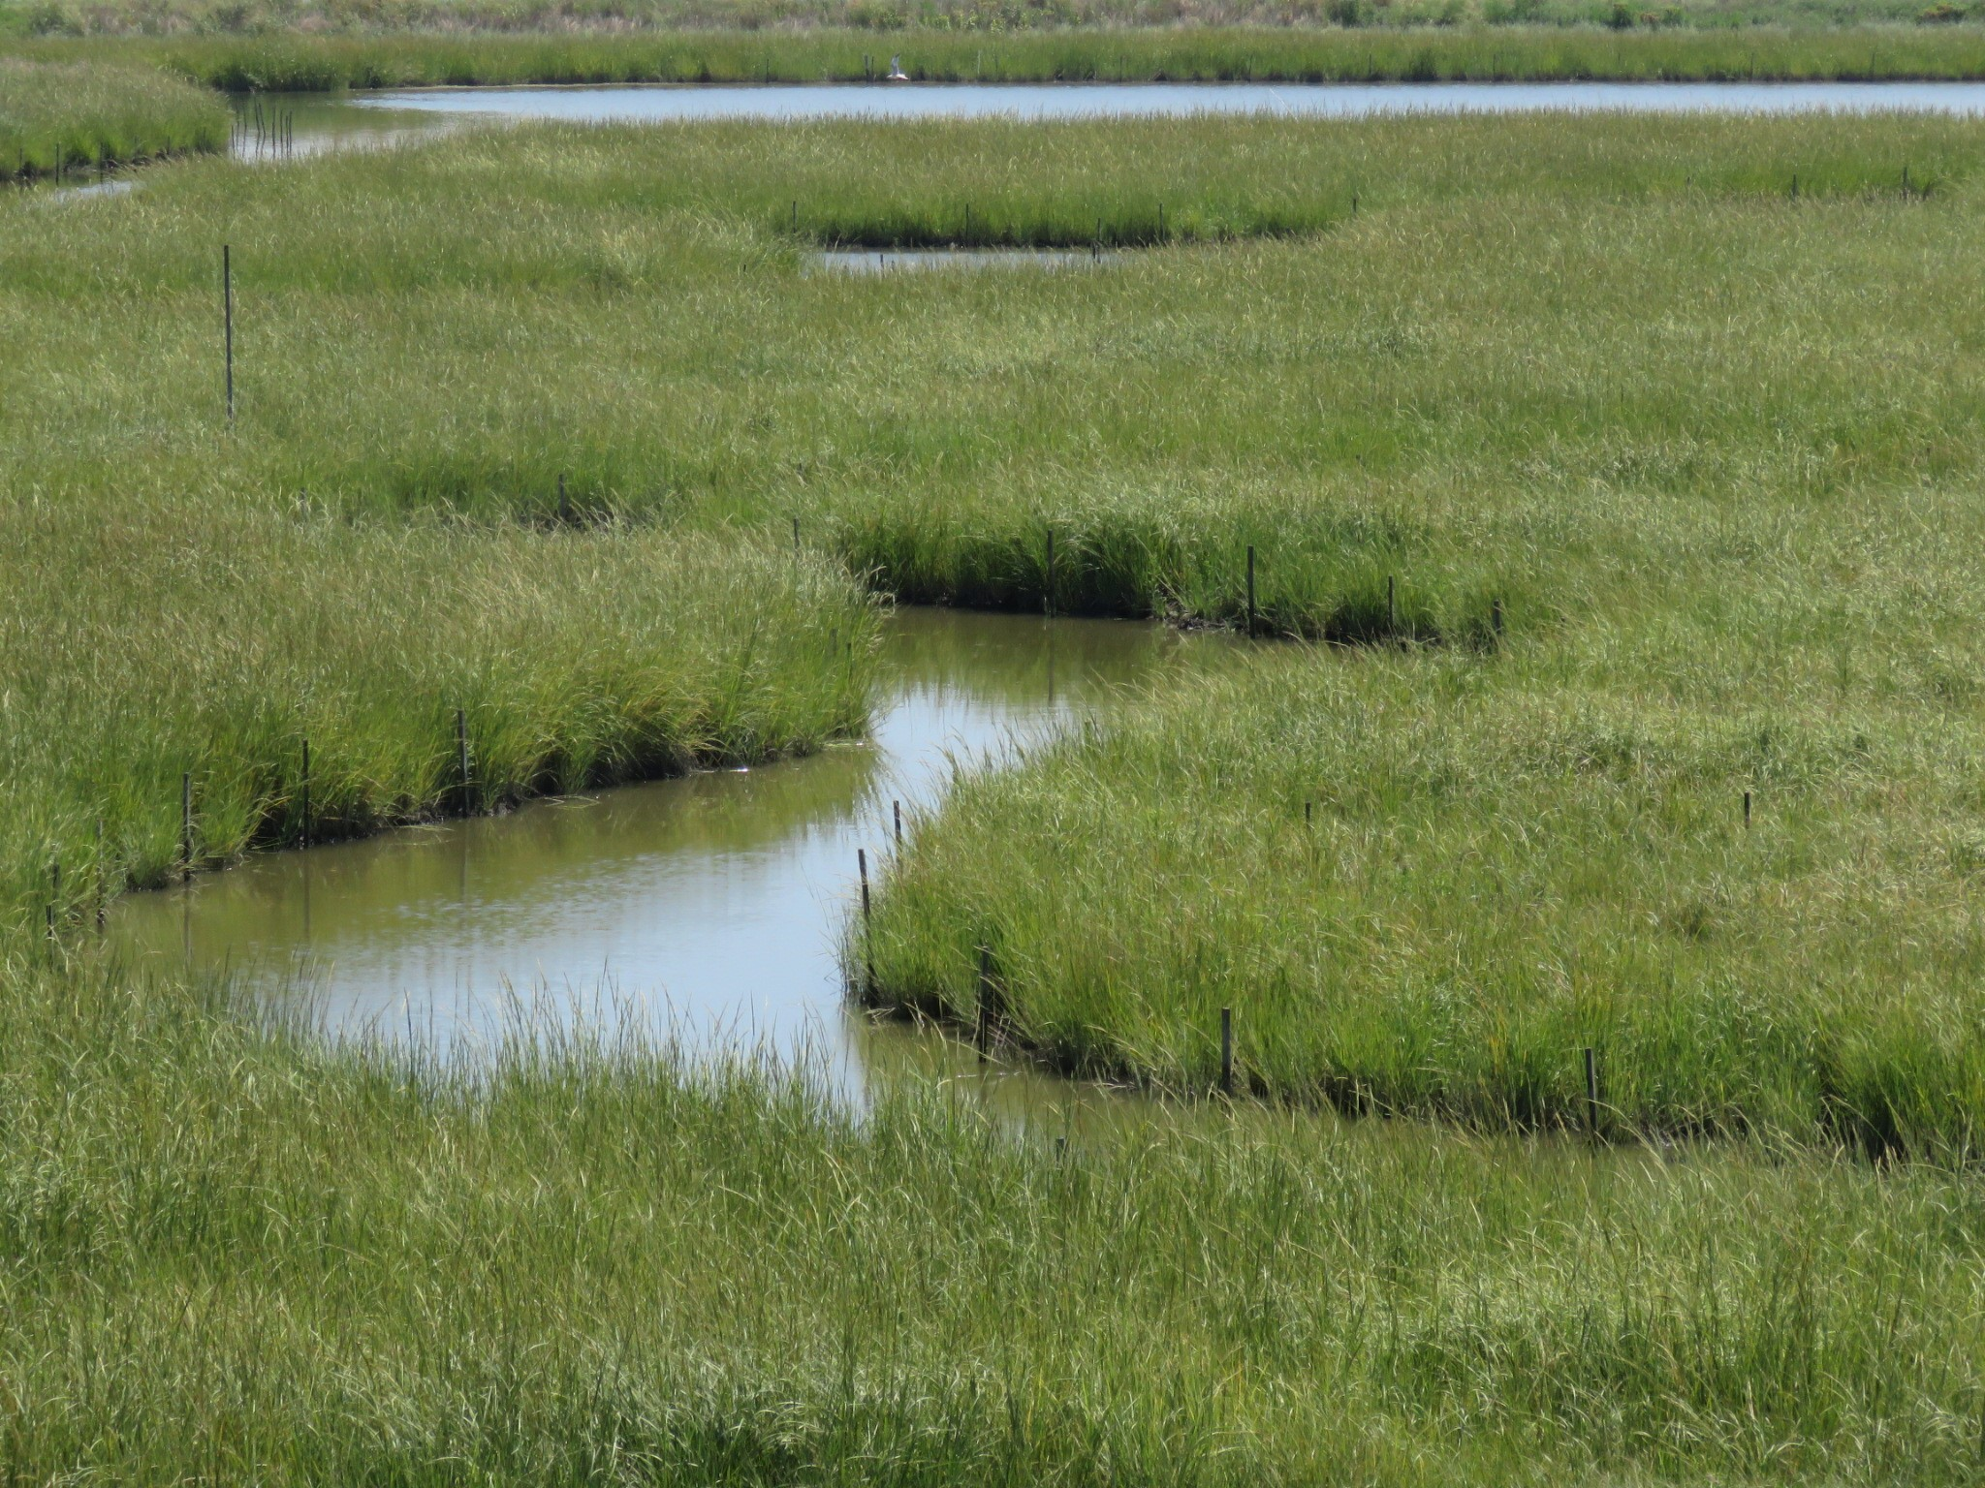
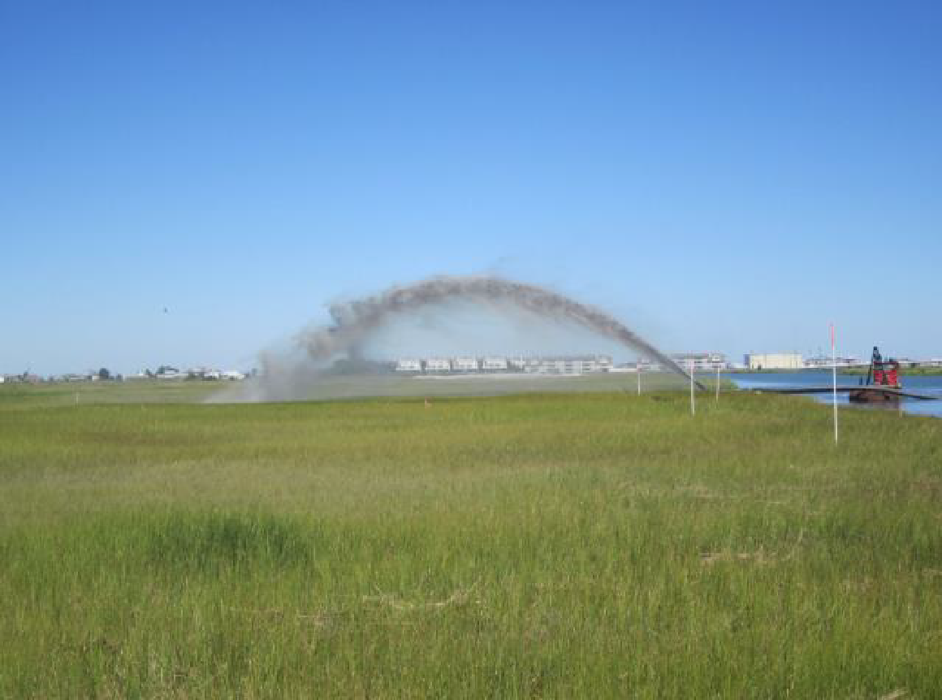
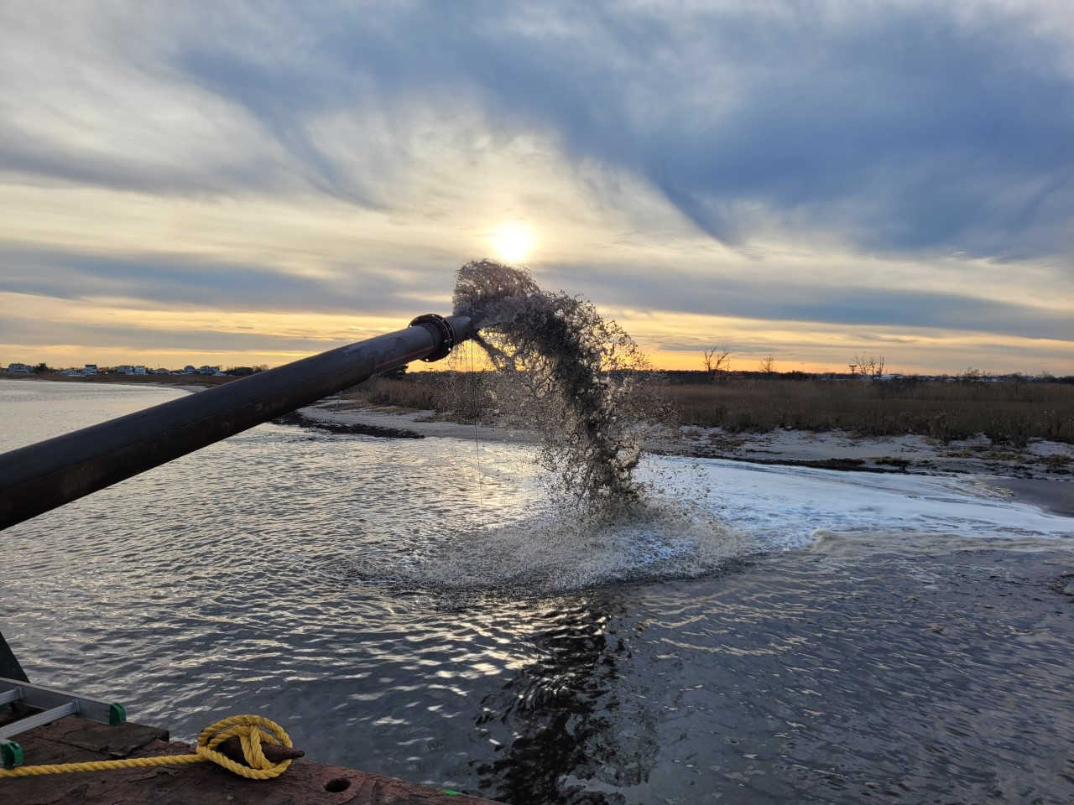
Beneficial Use (BU): A Restoration Approach, Not a Specific Tactic
Thin Layer Placement (TLP)
Created BU marsh
Large-scale inflow with containment

Slide 4
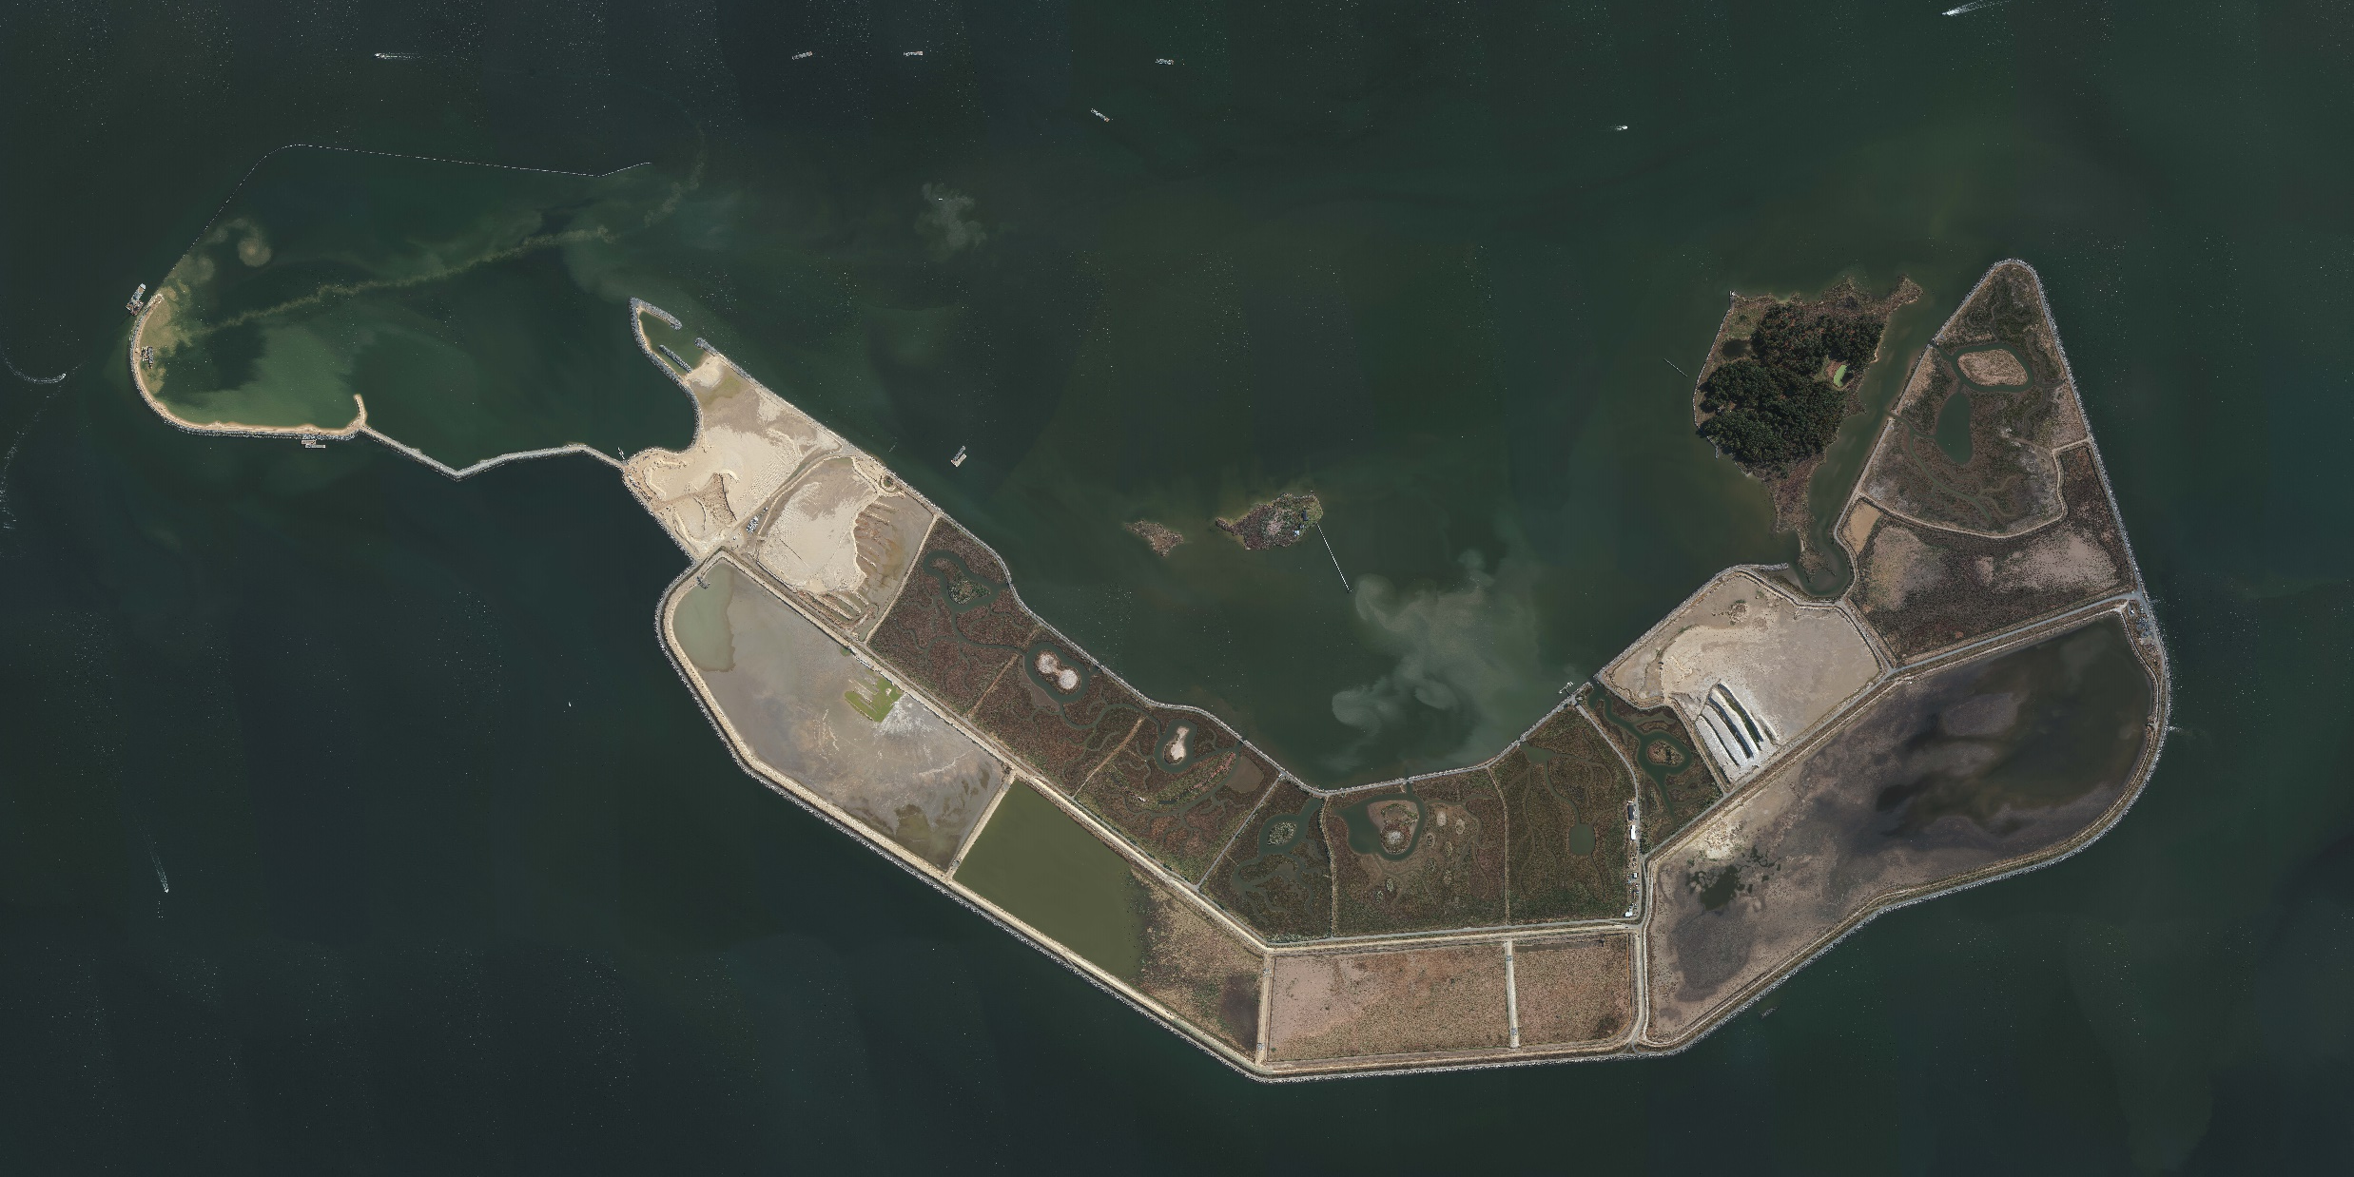
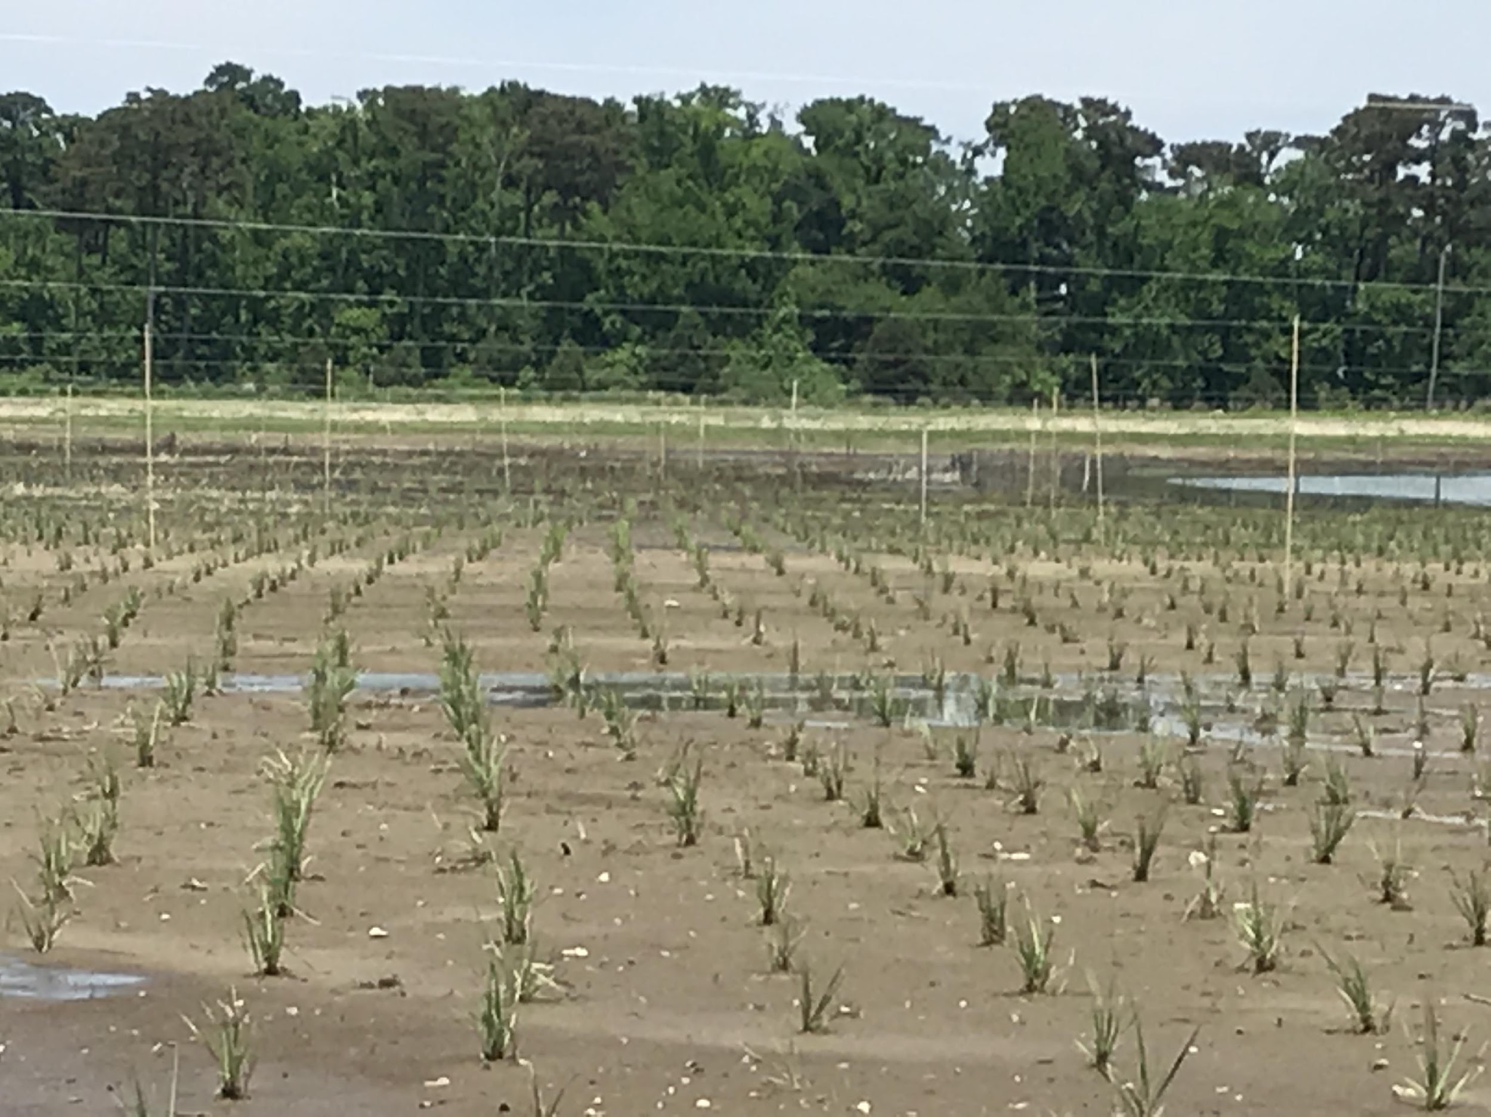
Two General Beneficial Use Approaches to Marsh Restoration
Vegetation survives placement and/or reestablishes quickly
dredged sediment is placed on existing marsh platform at low-medium depth
sediment is used to bolster existing habitats to enhance their health
Photos of TLP site
Poplar Island, MD
Habitat is being recreated or converted
dredged sediment is used to recreate habitat that has been severely degraded or lost
slower recovery is acceptable
Notes:
TLP Pic is Fortescue NJ

Slide 5
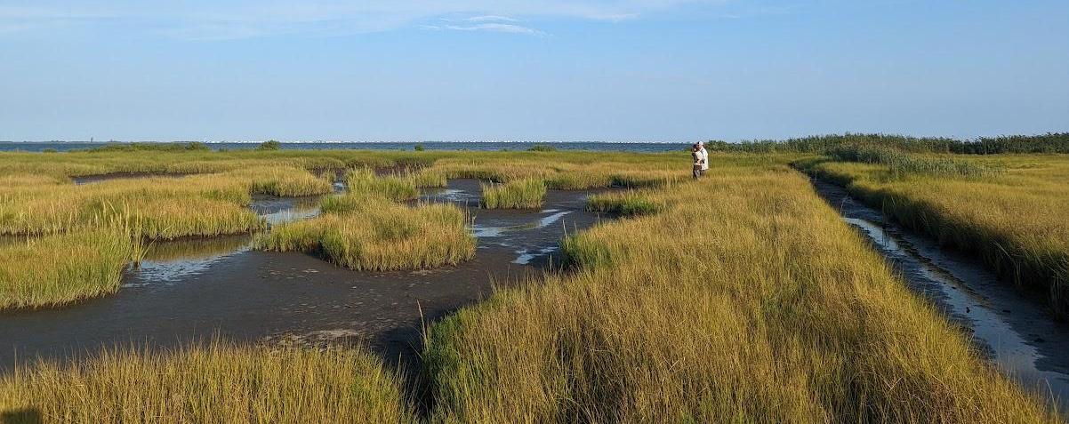
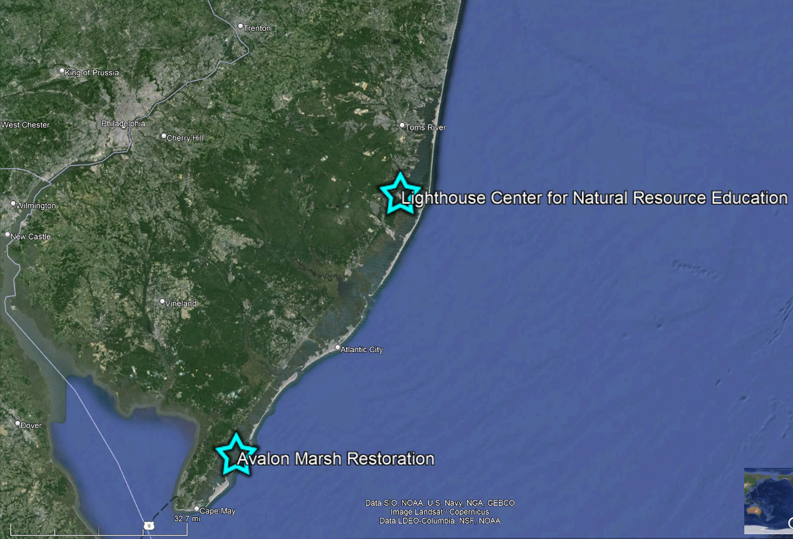
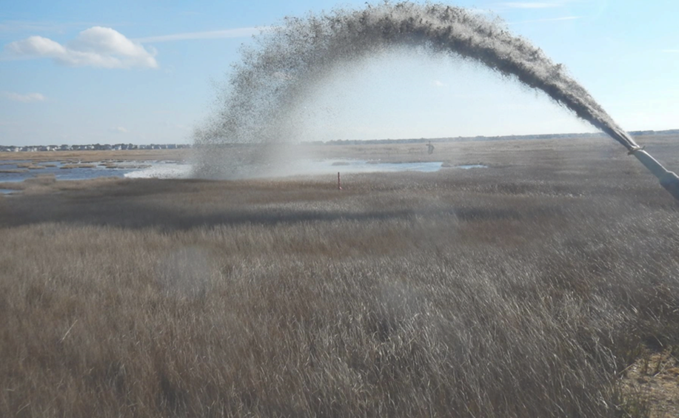
Adrianna Zito-Livingston
Lighthouse Center for Natural Resource Education
Climate Adaptation Project Manager
Site Assessment Underway
Avalon Pilot Project
Completed in 2015

Slide 6
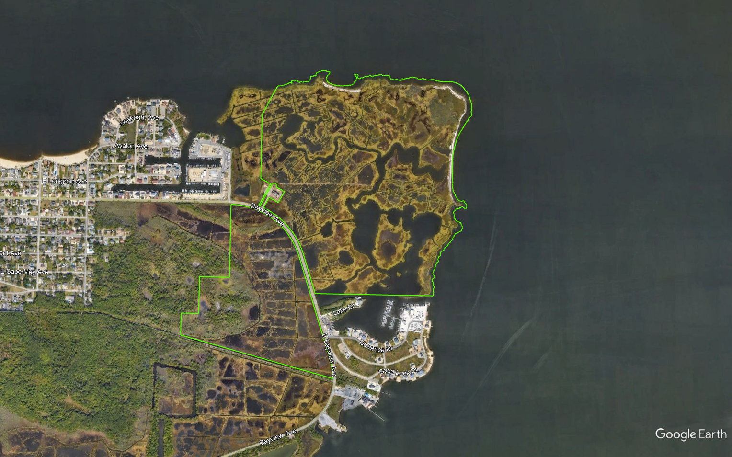
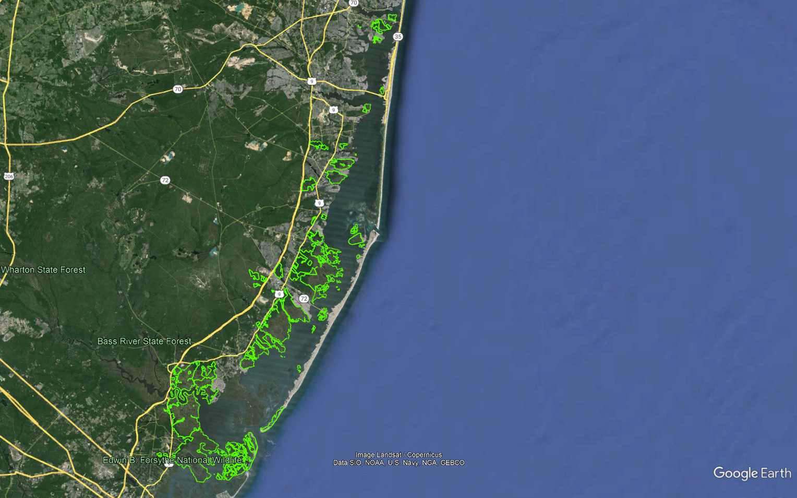
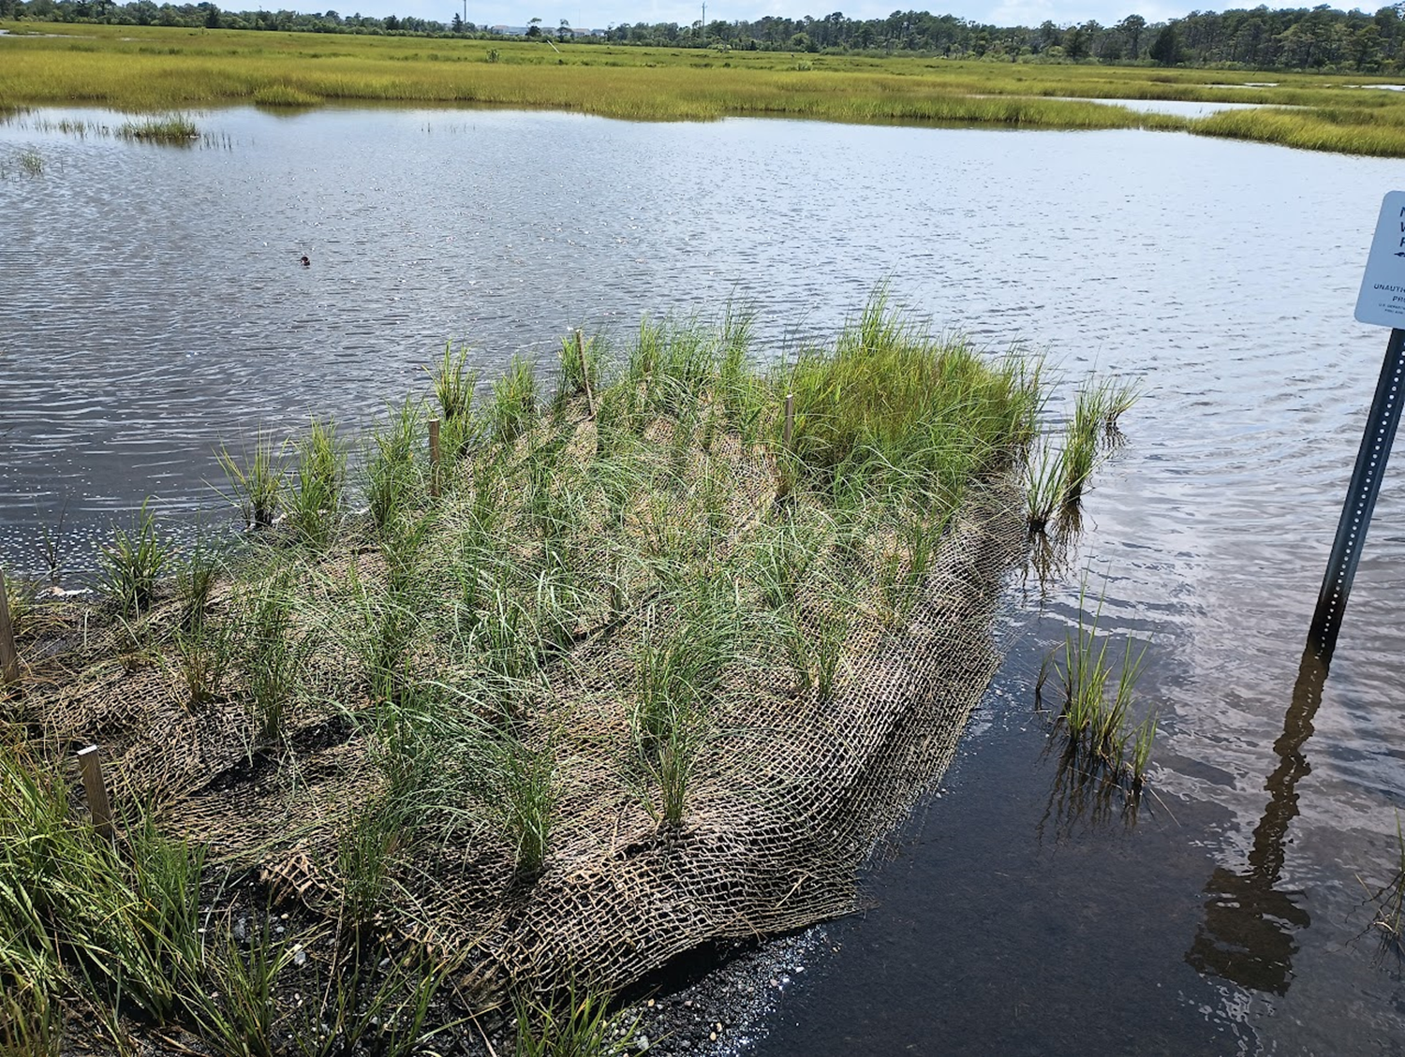
Virginia Rettig, Refuge Manager
Edwin B. Forsythe NWR
Good Luck Point
50 miles of NJ shoreline
32,000 acres of saltmarsh

Slide 7
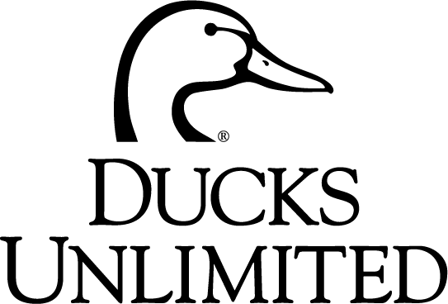
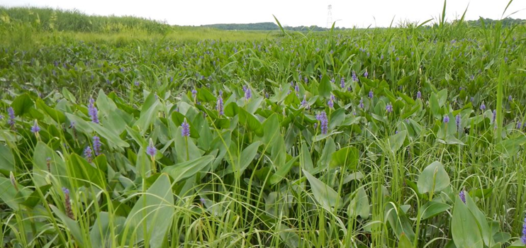
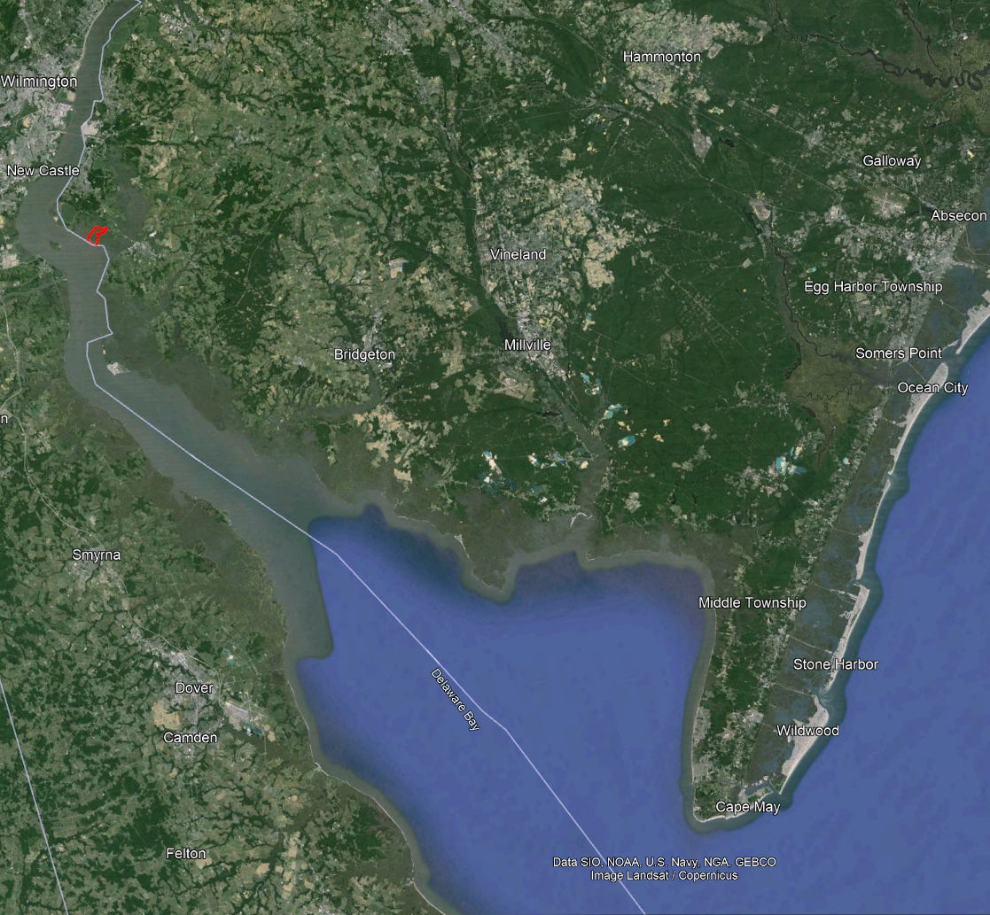
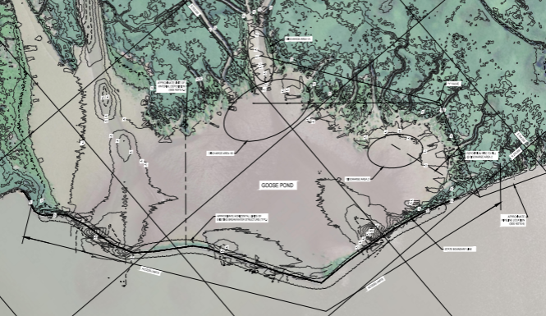
Jim Feaga
Mid-Atlantic Regional Biologist
Goose Pond
Supawna Meadows NWR
Enhanced Breakwater
Dredge Pipes
Placement Areas

Slide 9
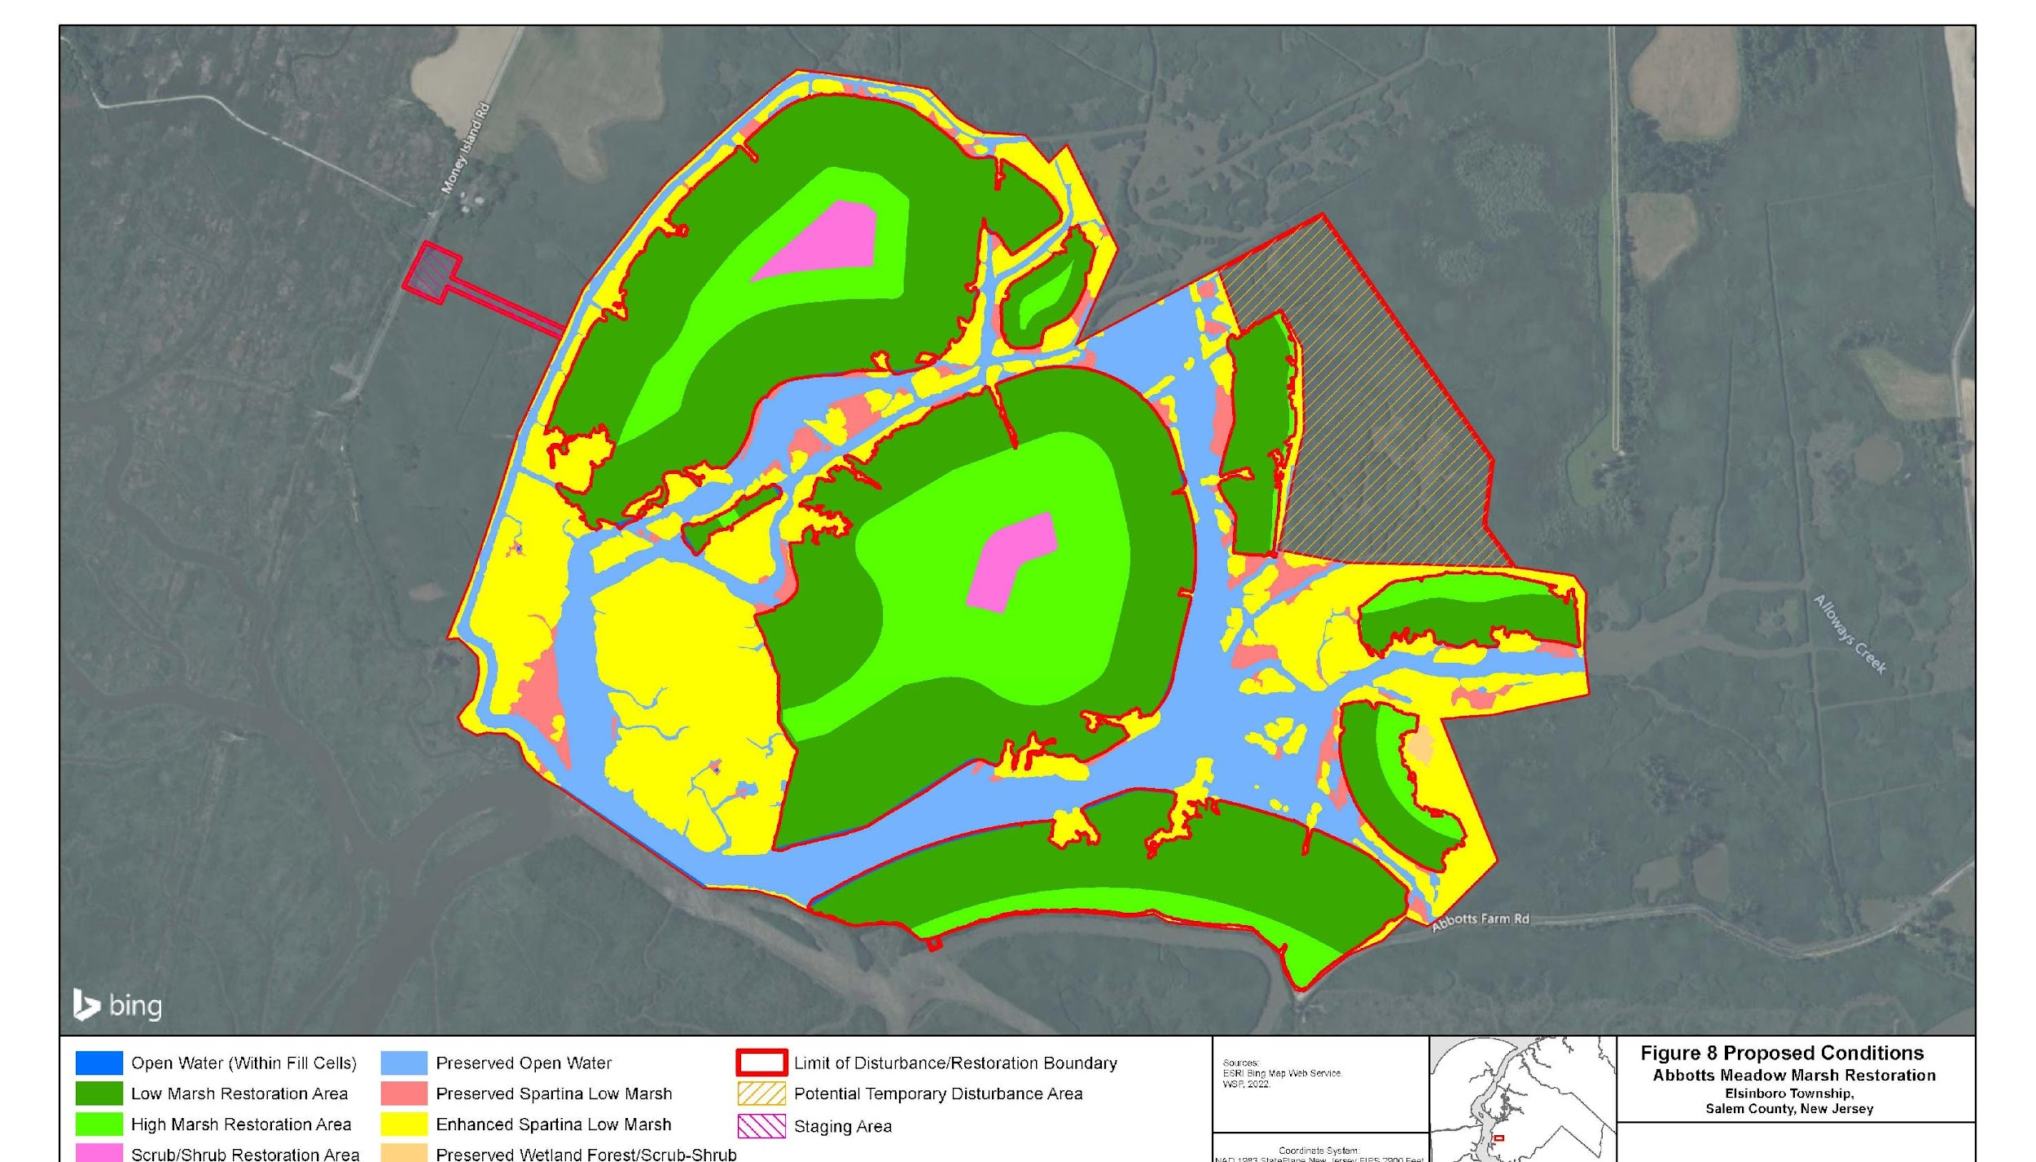
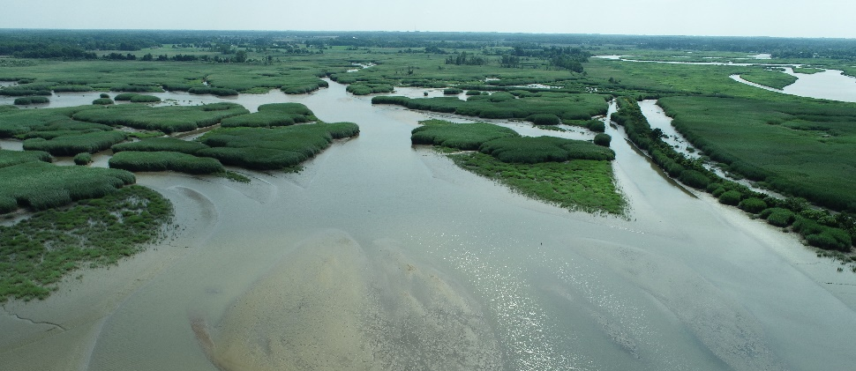
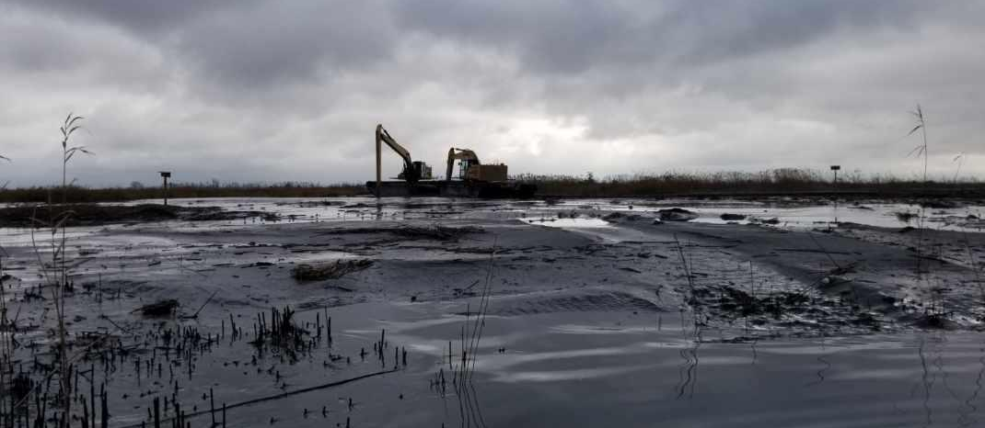
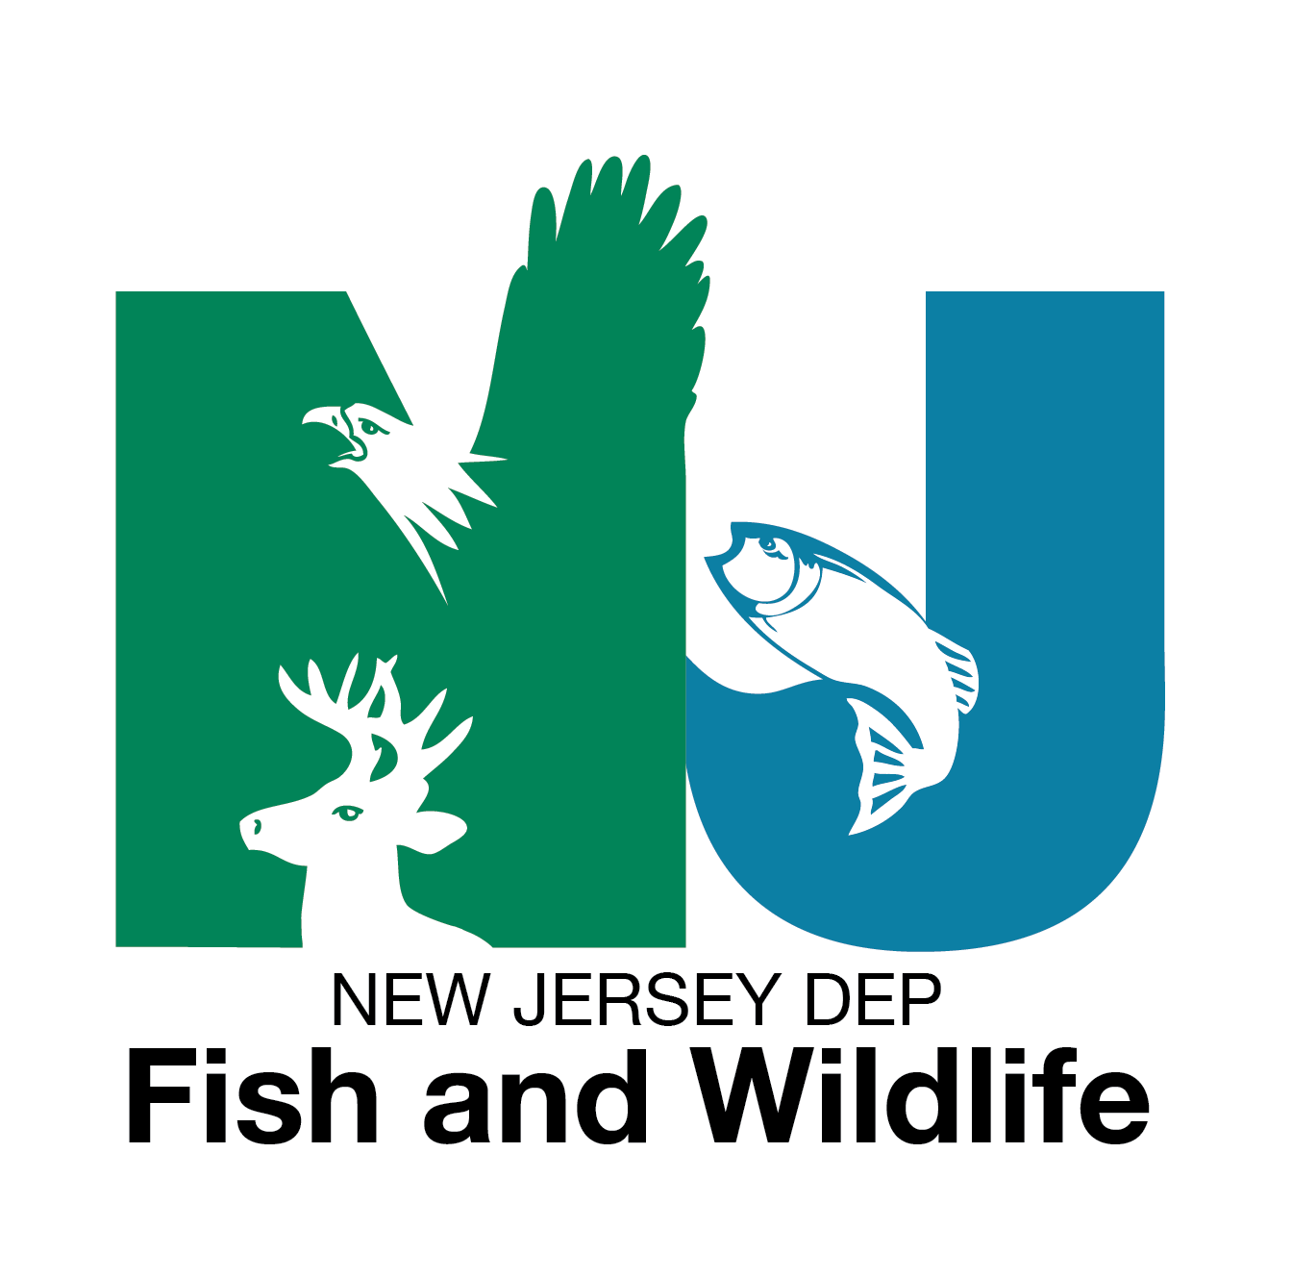
Abbotts Meadow Wildlife Management Area
Marsh Restoration
Formerly ditched & diked for agriculture and mosquito control.
Ditching and dike dilapidation negatively impacted the hydrology & sedimentation of site
Result was a degradation of marsh to mudflat
Tyler J. Kinney
Coastal Unit Lead
New Jersey DEP Fish and Wildlife
Bureau of Land Management
Material Placement – December 2023
Site 1 and Site 2 Complete
>600,000 CY, 147 acres
Post-Placement Monitoring

