Slide 1
Bringing together researchers and stakeholders to effectively inform the critical challenges of
equitable climate risk management
March 13, 2024
Lisa Auermuller
Award ICER-2103754
www.coastalhub.org

Slide 2
Lisa Auermuller
Administrative Director

Slide 3
Outline:
Who we are
What we are aiming to do
How we do our work
Where we are focused
What we are focused on
What we are learning

Slide 4
Outline:
Who we are

Slide 5
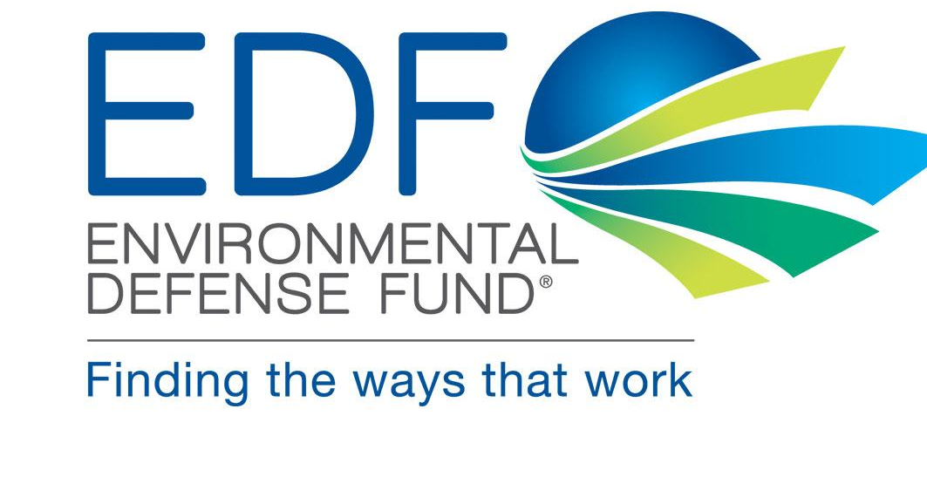
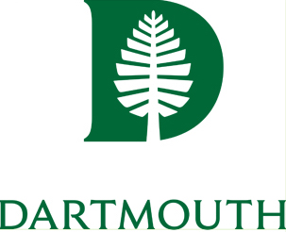
Notes:
MACH has four goals:​
​
1.To do useful science that advances understanding of how changing coastal climate hazards, landforms, and human decisions across household, municipal, market, and policy scales interact to shape climate risk​
2.To facilitate flexible, equitable and robust long-term planning to manage climate risk within our focal region of Philadelphia, New Jersey, and New York City — In a manner cognizant of the deep uncertainty in future climate and socioeconomics, and of the diverse values of people within our region​.
3.In doing this, to build a successful model for academic/stakeholder partnership that advances just, equitable and inclusive climate action.
4.To train the next generation of leaders in transdisciplinary climate research and engagement.​

Slide 6
MACH by the Numbers
13 Universities/Institutions
18 Faculty
14 Other Professionals/Senior Personnel/Staff
12 Postdoctoral students.
25 Graduate /Undergraduate Students

Slide 7
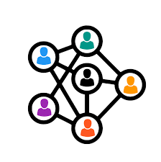
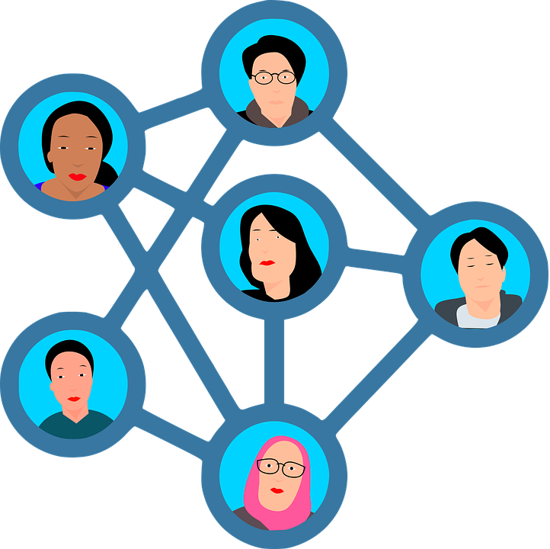
Broadening Our Perspectives’ through Partners
Collaborative Stakeholder Advisory Panel (CSAP)
External Advisory Board
Individuals with expertise and knowledge of transactional research, funding allocation decisions, co-production of knowledge with community-based and other stakeholders
Community Members
Direct engagement through Household System Dynamics team
Highly engaged non-profit, academic and social sector representatives based in the region
Emerging Communities of Practice
Government Advisory Committee
Exchanging knowledge on the intersection of climate impacts and affordable housing.
Highly engaged public and sector representatives based in the region
Notes:
we have a Collaborative Stakeholder Advisory Panel, composed of 27 highly engaged public and social sector representatives.
we also view community members themselves, engaged directly in conversation by the social scientists on our household system dynamics team, as key stakeholders.​
And we are building emerging communities of practice to network together stakeholders and decision-makers across the region, around themes such as the interconnection of climate impacts and affordable housing.

Slide 8
Outline:
What we are aiming to do

Slide 9
Our Goals
3
Develop the workforce that does #1 and #2: Train the next generation of leaders in transdisciplinary climate research and engagement.
1
Do science that is useful and used
Do science that advances human understanding of how coastal climate hazards, landforms, and human decisions interact to shape climate risk
Learn how to do #1, #2, and #3 better: Build a sustainable academic/ stakeholder co-production partnership model
2
4
Notes:
MACH has four goals:​
​
1.To do useful science that advances understanding of how changing coastal climate hazards, landforms, and human decisions across household, municipal, market, and policy scales interact to shape climate risk​
2.To facilitate flexible, equitable and robust long-term planning to manage climate risk within our focal region of Philadelphia, New Jersey, and New York City — In a manner cognizant of the deep uncertainty in future climate and socioeconomics, and of the diverse values of people within our region​.
3.In doing this, to build a successful model for academic/stakeholder partnership that advances just, equitable and inclusive climate action.
4.To train the next generation of leaders in transdisciplinary climate research and engagement.​

Slide 10
Outline:
Where we are focused

Slide 11
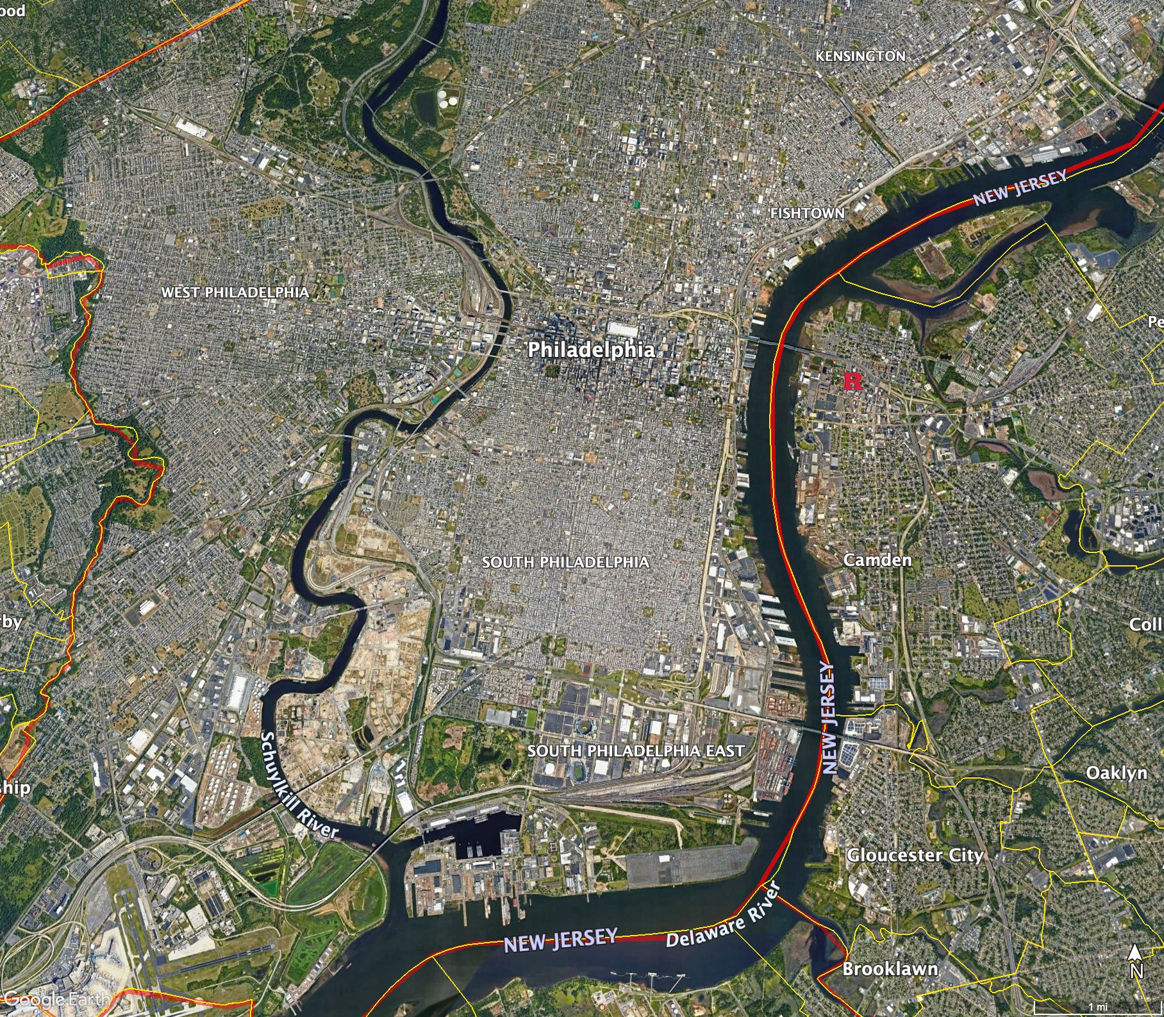
Our Initial Focal Areas and Partners
Ongoing exploratory work in New York City/North Jersey, including planning for a convening that brings research groups together around HATS
Notes:
We have key partners and stakeholders both geographically focused and thematically based. Geographically, our current decision partners are based in the City of Philadelphia and in Camden County,

Slide 12
Outline:
How we do our work

Slide 13
What we have learned
Established Principles of Engagement
Overarching
Delivery
Design
Trust is built and sustained through relationships over time.
Engagement should provide meaningful benefits to communities. Research results should be shared with communities in a way that is beneficial to them.
Systems must be put in place to ensure engagement efforts end when appropriate for stakeholders as well as the research team and not just when funding ends.
Full principles: https://go.rutgers.edu/mach-engage
Notes:
The MACH Principles of Engagement is a living document guiding the project that has evolved considerably since the project was initially proposed in October 2020. These changes are a result of our collaboration with our CSAP members, which led to refinement and additions from what was first proposed. Of the resultant 18 Principles of Engagement, I would like to highlight there of them, 1 from each of our categories of engagement :​
1.​Trust is built and sustained through relationships over time. Those relationships are a central piece of infrastructure, and the professional boundary workers who maintain them play roles as essential – if not more essential – to the enterprise of transdisciplinary research as more ivory-tower intellectuals like me.​
2.Systems must be put in place to ensure engagement efforts end when appropriate for stakeholders as well as the research team, not just when funding ends. For successful climate action, we have to maintain relationships for decades, not five years.
3 MACH research is not just about studying communities. It is about understanding with them. Research peer reviewed articles are not going to help communities understand our results. Engagement should provide meaningful benefits to communities. Research results should be shared with communities in a way that is beneficial to them.

Slide 14
Outline:
What we are focused on

Slide 15
What benefit does the MACH Team bring?
To achieve our goals, we want to: - Do science that is useful and used
Advance the human understanding of how coastal climate hazards, landforms, and human decisions interact to shape climate risk.
+
+
=
… so given the distinction between governance of funding and governance of work, it’s not surprising that the students and postdocs are confused.

Slide 16
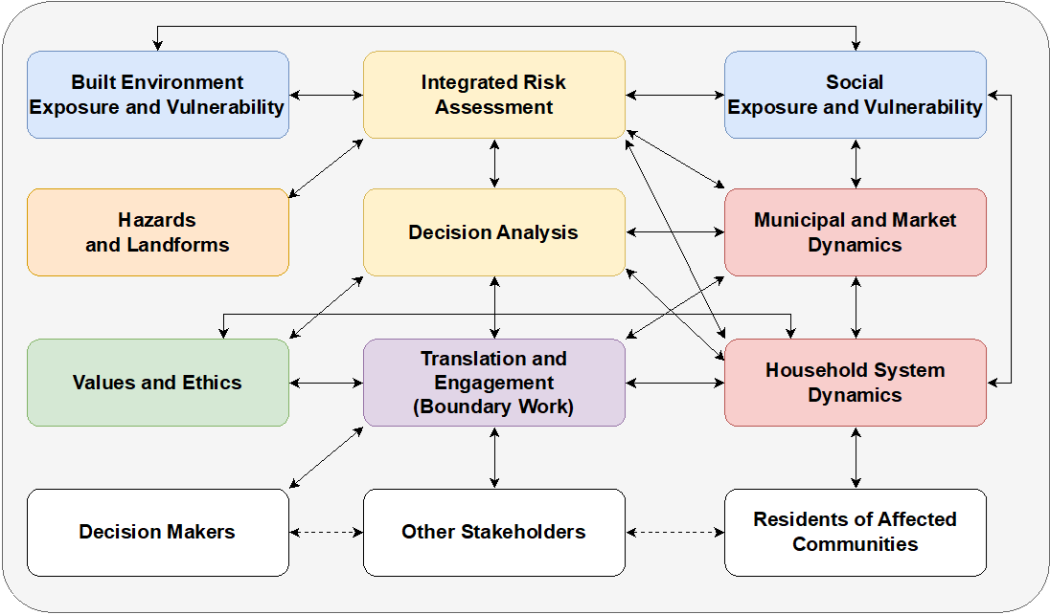
The MACH Team as a system
This is how we envisioned our work happening…..
… so given the distinction between governance of funding and governance of work, it’s not surprising that the students and postdocs are confused.

Slide 17
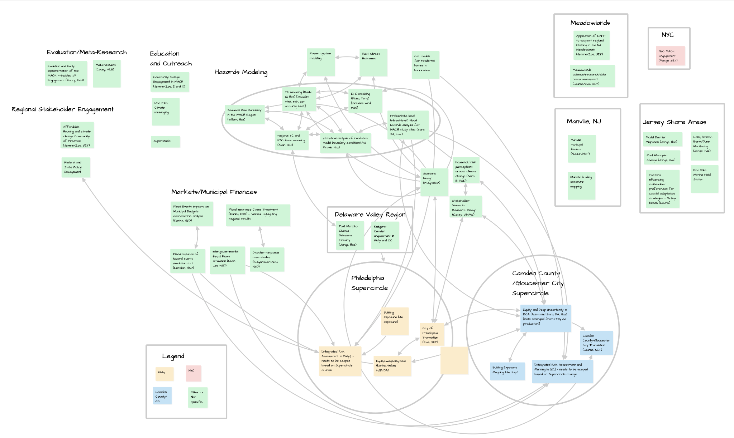
The MACH Team as a system

Slide 18
Breaking down the MACH system into its parts….
- Do science that is useful and used
Advance the human understanding of how coastal climate hazards, landforms, and human decisions interact to shape climate risk.
+
+
=
… so given the distinction between governance of funding and governance of work, it’s not surprising that the students and postdocs are confused.

Slide 19
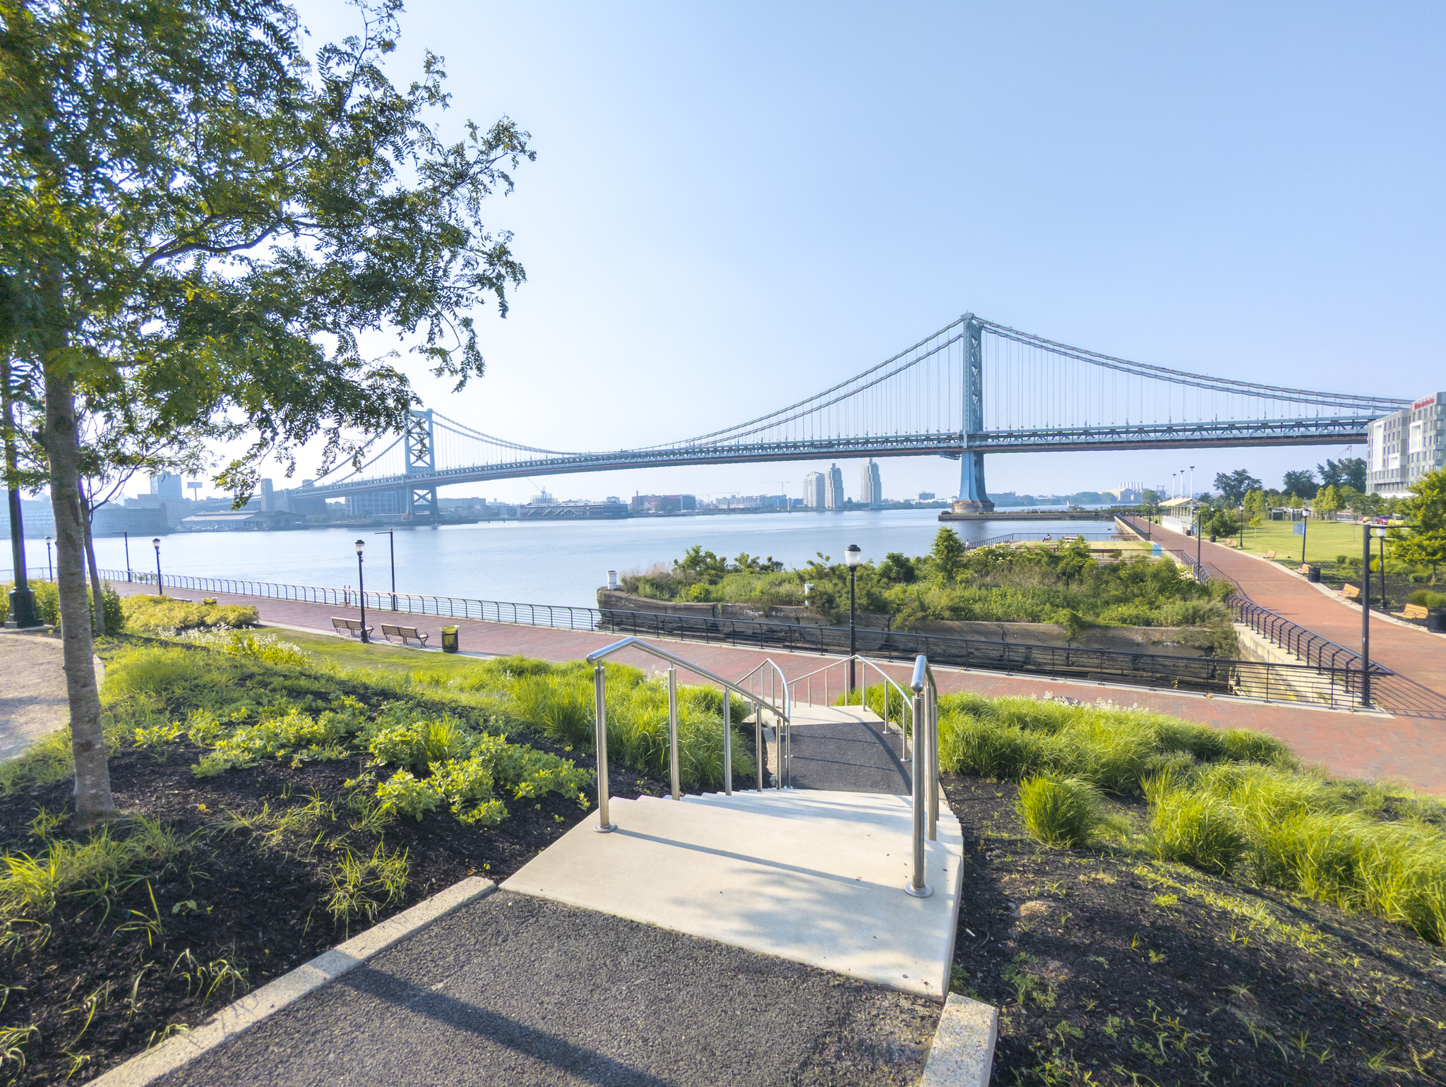
Our evolving, co-produced integrative themes
Characterization of compound flood and heat + flood risk

Slide 20
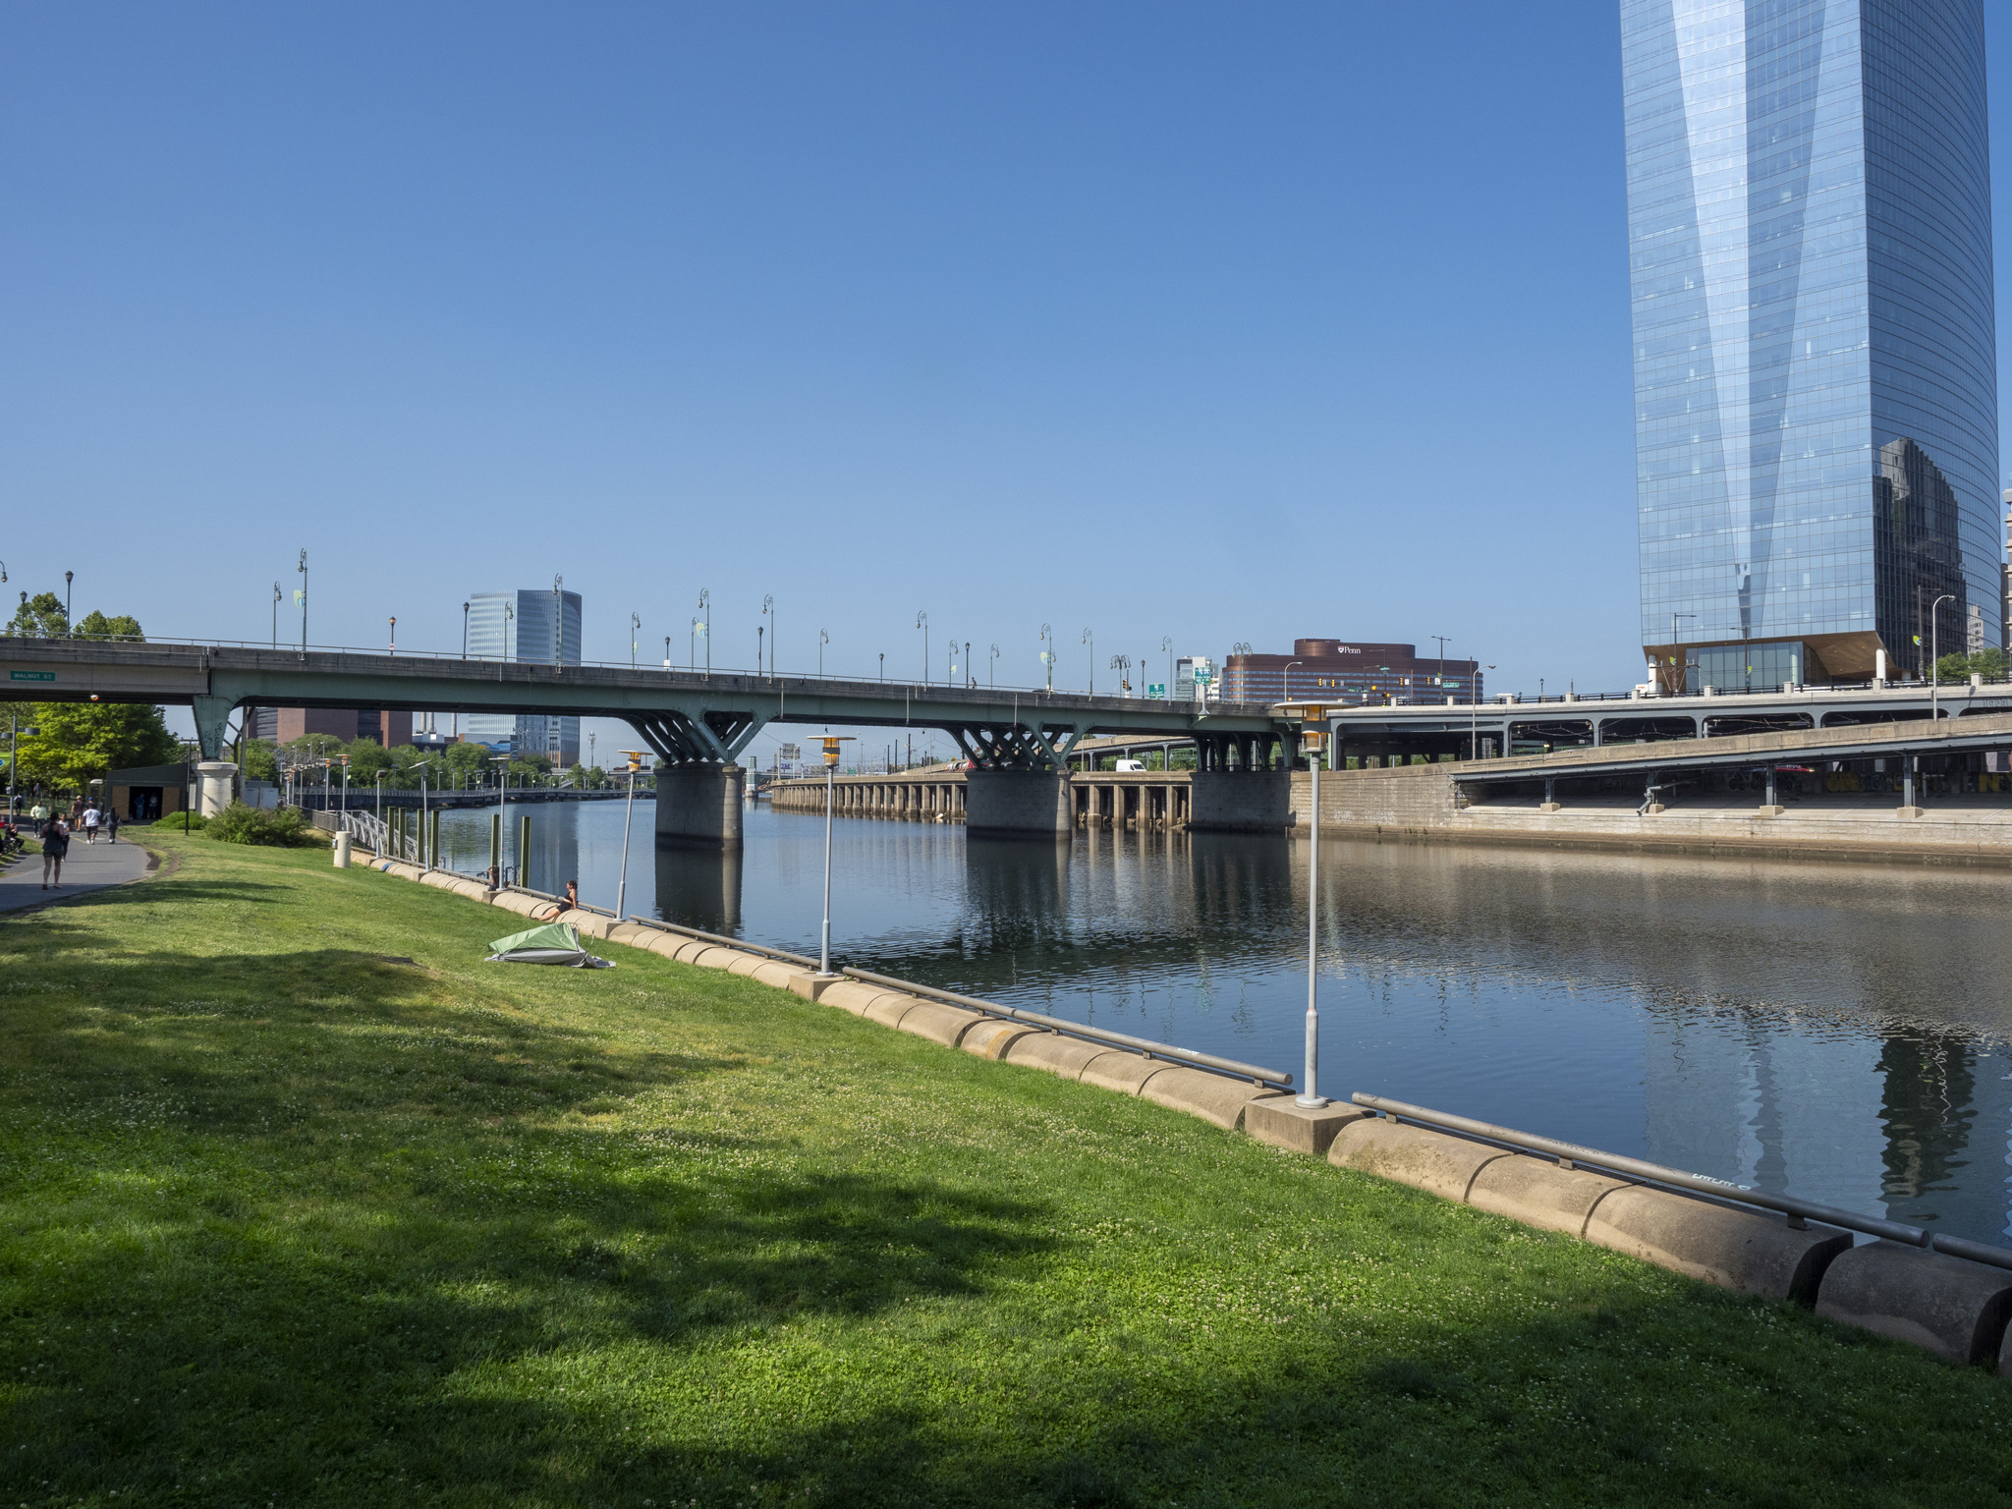
Our evolving, co-produced integrative themes
The impacts of flood risk on municipal finances

Slide 21
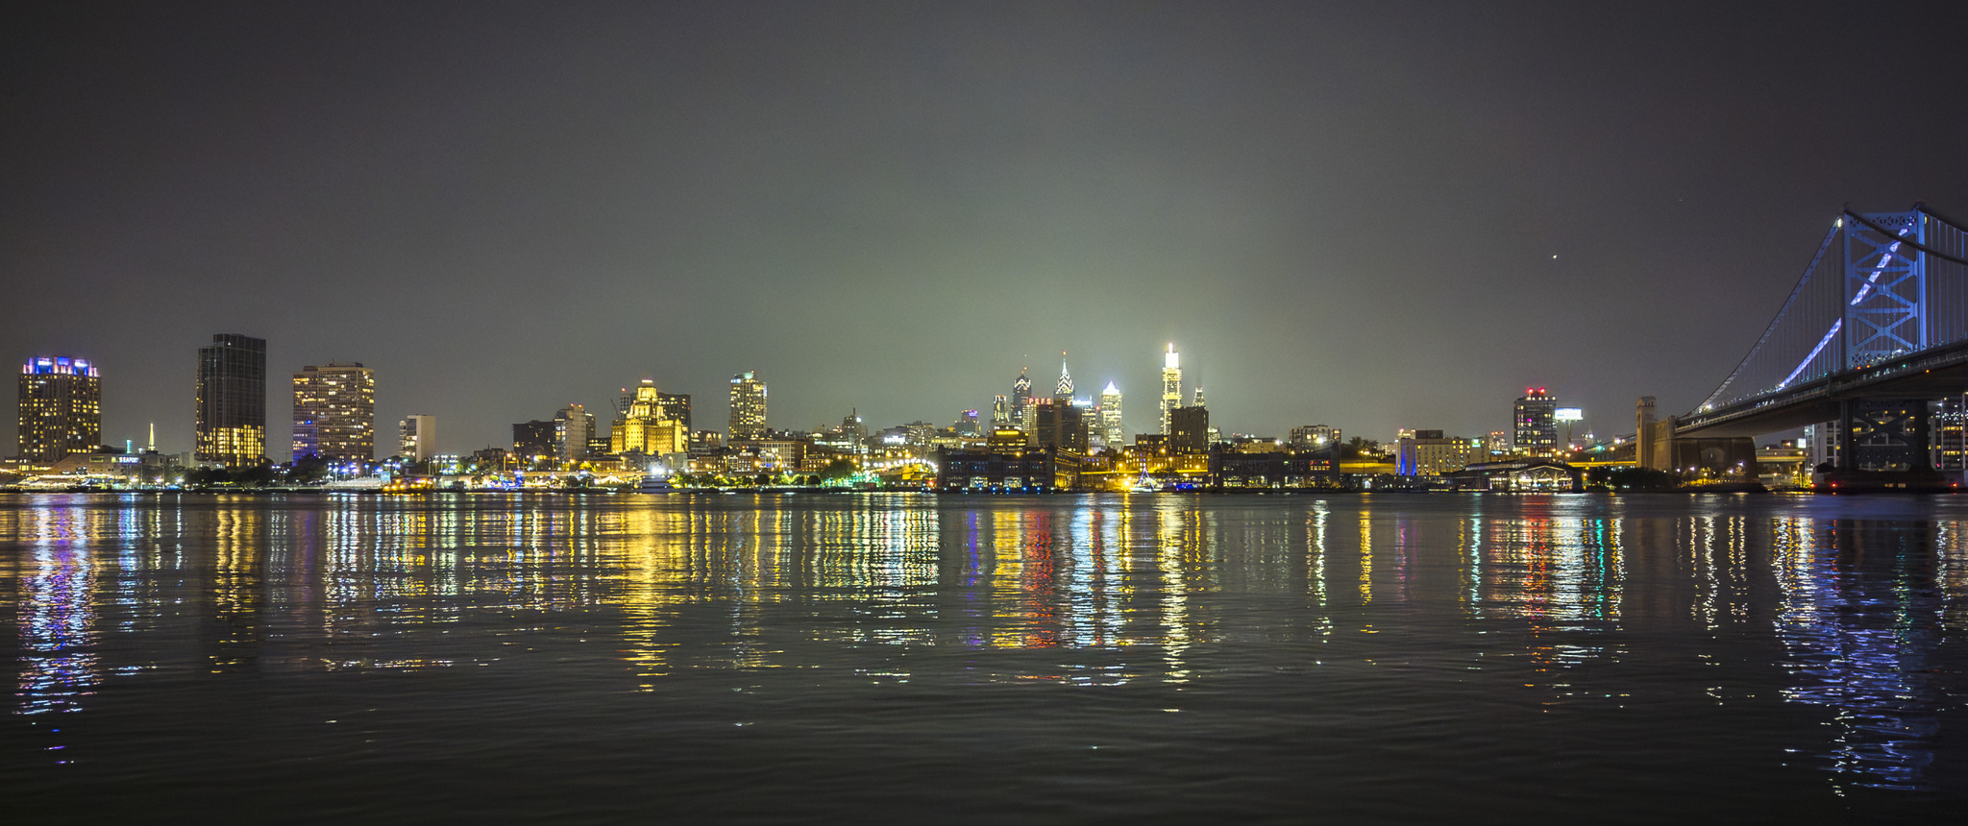
Our evolving, co-produced integrative themes
The role of insurance in the interrelated insurance/mortgage/ housing markets

Slide 22
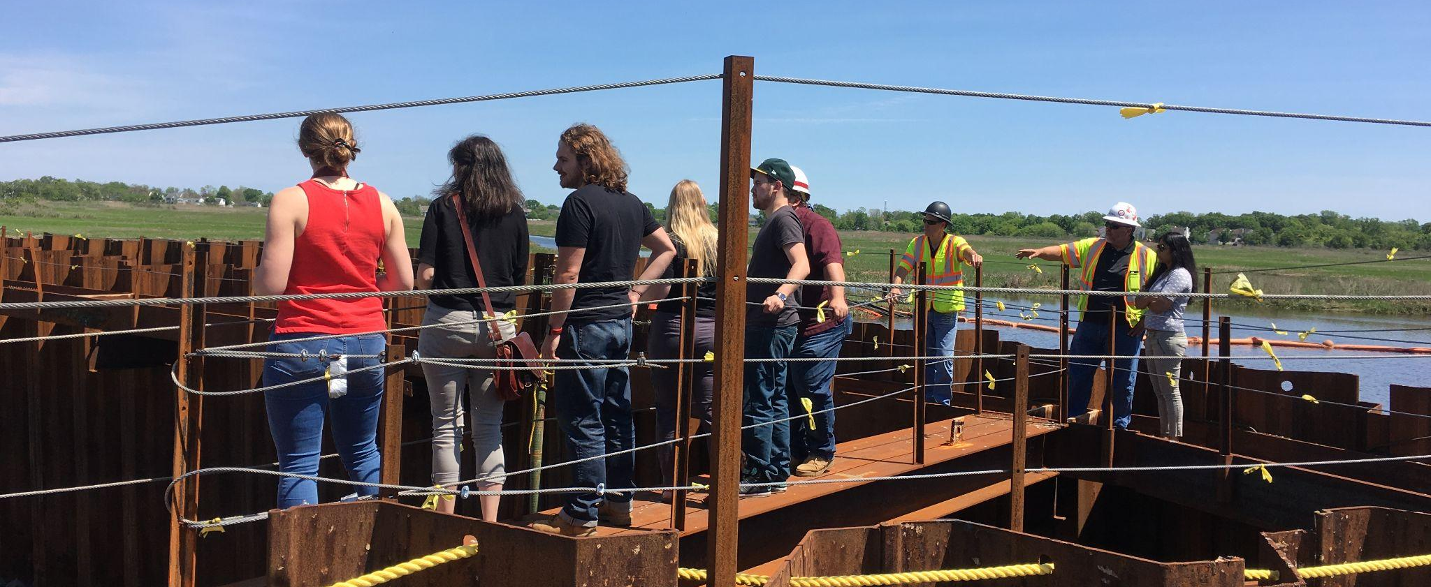
Our evolving, co-produced integrative themes
Improving equity considerations
in the design of strategies to manage flood-risks

Slide 23
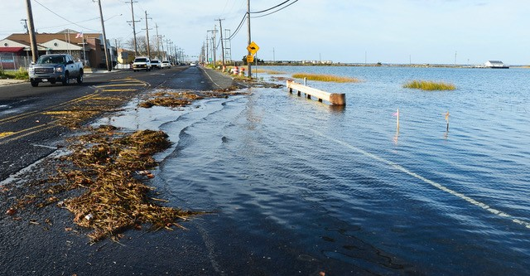
Our evolving, co-produced integrative themes
Household decision- making regarding flood risk in low-income, renter-dominated neighborhoods

Slide 24
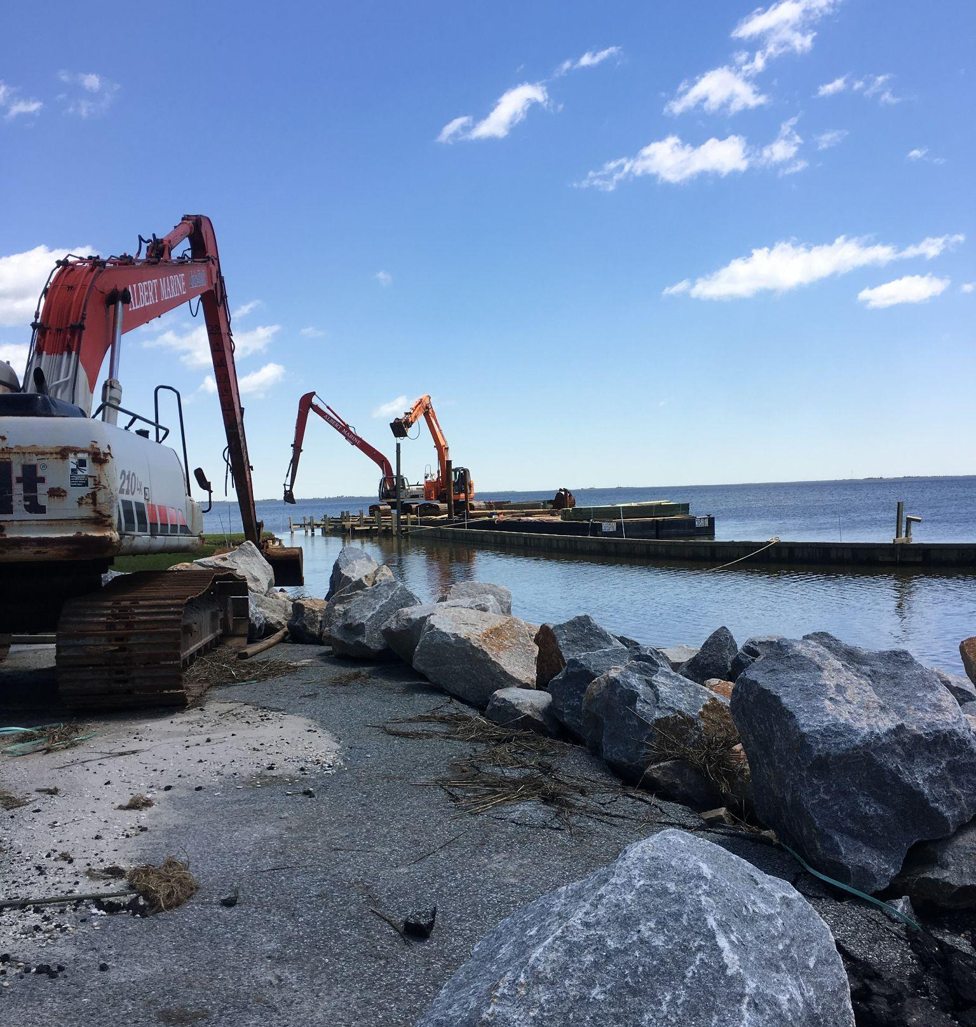
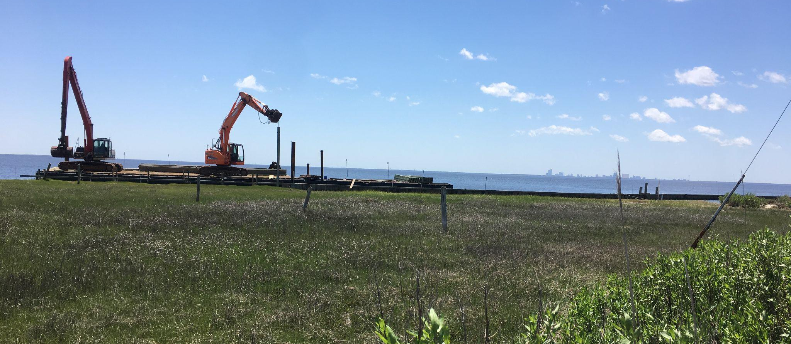
Our evolving, co-produced integrative themes
Emerging….Impacts of risk-reduction mega-infrastructure on our other themes*
*Potential topic of interest in NYC/North Jersey, in the context of USACE HATS

Slide 25
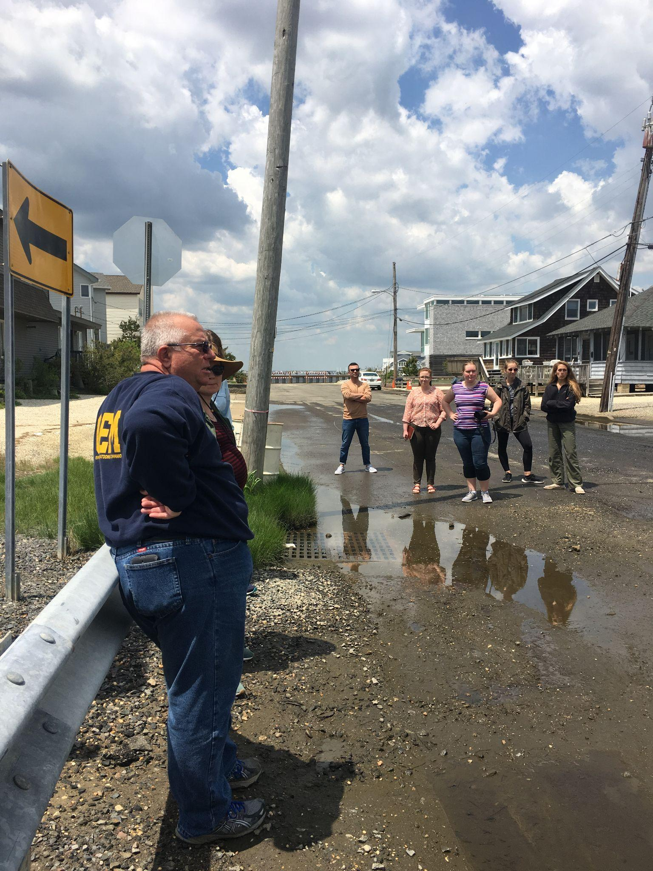
We are, ourselves, an experiment.
Transdisciplinary research and co-production design
&
Transdisciplinary student and postdoc training

Slide 26
Outline:
What we are focused on
Goal 3: Train the next generation of leaders in transdisciplinary climate research and engagement.

Slide 27
Broader Impacts: Student and Postdoc Training
Climate Transformation Super Studio
Summer School
The Super Studio will link graduate students in scientific, planning and design disciplines through interdisciplinary studio course work, research and real-world projects. Work will be done alongside case study communities to translate technical expertise and community-led needs into investments in adaptation.
Building off of previous and effective designs, students and postdocs are offered a one-week summer course on coastlines and people that brings together practitioners, students and faculty. Participants will be introduced to concepts, tools and approaches in convergent research
Notes:
we have a variety of mechanisms to broaden our impacts.
we have been listening to regionally relevant community colleges to understand the best ways MACH can engage with their faculty and students, across disciplines.
We also have been working with the Mason Gross Film school at Rutgers to produce documentaries about what we are learning in the MACH project, including digging into the topic of climate science interpretation and climate adaptation decision making.

Slide 28
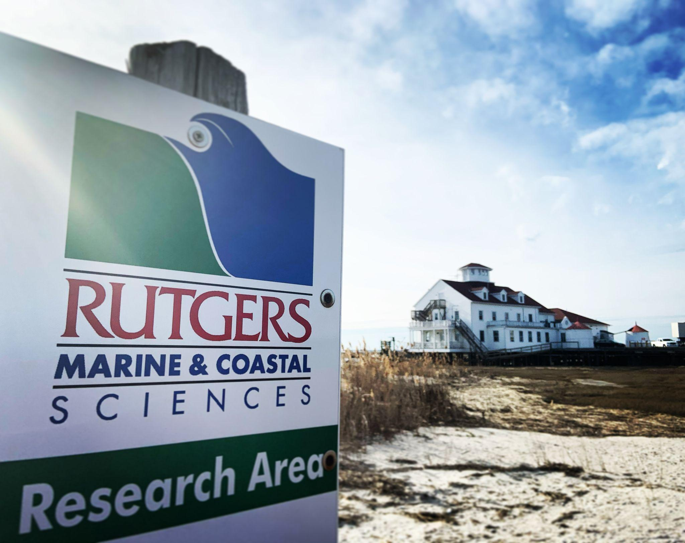
Broader Impacts: Education and Outreach
Community College Engagement
Documentary Film Production and Education
Emerging partnerships with community colleges seek to bring students with ties to affected communities into the research process.
Documentary films, focused on how people interpret climate information and how groups make climate adaptation decisions.
Notes:
we have a variety of mechanisms to broaden our impacts.
we have been listening to regionally relevant community colleges to understand the best ways MACH can engage with their faculty and students, across disciplines.
This year, Rutgers reached out to six community colleges in the region and set up meetings where Rutgers was in “listen mode” to learn from each college how they would like to engage with MACH and what kinds of projects their faculty/students would benefit the most from. From the five schools we’ve talked to so far, we’ve learned that our engagement with each school will not be a “one size fits all” approach. The requests for support run the gamut from enhancing outdated environmental lab curriculum, helping to set up and bring guest lecturers to an “Interdisciplinary Climate Day,” to buying out faculty time so they can complete their own ongoing MACH related research. We have not committed to any projects yet but will engage MACH leadership moving forward to decide what projects to prioritize and mobilize.
We also have been working with the Mason Gross Film school at Rutgers to produce documentaries about what we are learning in the MACH project, including digging into the topic of climate science interpretation and climate adaptation decision making.

Slide 29
Outline:
What we are learning

Slide 30
What we have learned
Challenge: Meaning of Words
Risk assessment
Words have different meanings depending on the discipline.
Spending time truly understanding one another takes effort.
The time upfront could be worth the investment in the long run.
Community
Co-production
Integration
Success
Notes:
TTimescales of Action: A fundamental management challenge is the distinctive timescales associated with MACH’s four goals. While adaptation planning has a multidecadal time frame, the opportunities for co-production of research to influence adaptation planning may be identified with lead times of weeks, months, or years. For postdocs and graduate trainees, shifts in direction in response to the co-design process pose challenges to their career objectives. MACH continues to iteratively refine a co-production framework that responds to both near-term and long-term stakeholder needs while also providing clear direction to postdocs and graduate trainees.

Slide 31
What we have learned
Challenge: Integration Fatigue
Integration requires an investment of time
Without this effort, science that critically depends on integration will not happen
Science that can stand alone will happen in silos.
This would be a failure mode of MACH.
How do we reduce costs and enhance benefits of integration for project members?
Notes:
TTimescales of Action: A fundamental management challenge is the distinctive timescales associated with MACH’s four goals. While adaptation planning has a multidecadal time frame, the opportunities for co-production of research to influence adaptation planning may be identified with lead times of weeks, months, or years. For postdocs and graduate trainees, shifts in direction in response to the co-design process pose challenges to their career objectives. MACH continues to iteratively refine a co-production framework that responds to both near-term and long-term stakeholder needs while also providing clear direction to postdocs and graduate trainees.

Slide 32
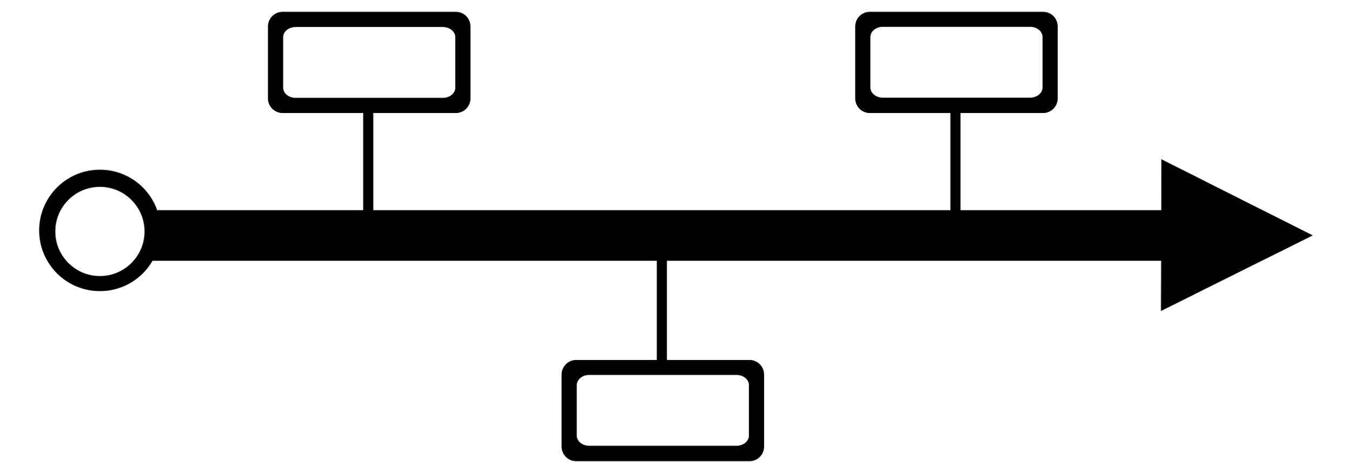
What we have learned
Challenge: Reconciling Timescales of Action
Adaptation planning has a multidecadal time frame
Opportunities for co-production of research to influence adaptation planning may be identified with very little lead times
For postdocs and graduate trainees, shifts in direction in response to the co-design process pose challenges.
We need to be responsive to stakeholders needs both in the near-term and long-term while also providing clear direction to postdocs and graduate trainees.
Versus
Notes:
TTimescales of Action: A fundamental management challenge is the distinctive timescales associated with MACH’s four goals. While adaptation planning has a multidecadal time frame, the opportunities for co-production of research to influence adaptation planning may be identified with lead times of weeks, months, or years. For postdocs and graduate trainees, shifts in direction in response to the co-design process pose challenges to their career objectives. MACH continues to iteratively refine a co-production framework that responds to both near-term and long-term stakeholder needs while also providing clear direction to postdocs and graduate trainees.

Slide 33
What we have learned
Challenge: Co-Production with Stakeholders with “now” Problems
The communities that are in most need of science to inform their adaptation planning are the communities with the least amount of time to invest in co-produced research.
Historically under-resourced communities have even more of a disadvantage when it comes to informed adaptation planning.
Versus
Notes:
small communities (like many we have in NJ) have the desire to improve their adaptation decision making, and they are often home to underserved populations, which, at first glance, would make than an ideal fit for co-producing climate science to inform their decision making. what we have come to appreciate, is that the small capacity community, while they have the desire and the need, they often don't have the time and resources to work in the co-production space. GC is an example of this dynamic.
in contrast, a large city like Philadelphia has multiple staff working in the space of climate adaptation and resilience. They have the desire to want to use the science and they have the time to put into the co-production process.
These capacity issues can create a dynamic where the “have nots” don’t have the capacity to benefit from the co-production process simply bc they lack the capacity from a staffing and resource side.
and, in both cases we have found there is short-term decision needs and longer term decision needs. how a large science enterprise best works at both times scales is something we have been navigating with best available science in the short term and co=produced science in the longer term.

Slide 34
What we have learned
Challenge: Co-Production and Polycentric Governance
Most co-production models are not aligned with the polycentric nature of adaptation governance, but this may be key to addressing these issues.
Notes:
small communities (like many we have in NJ) have the desire to improve their adaptation decision making, and they are often home to underserved populations, which, at first glance, would make than an ideal fit for co-producing climate science to inform their decision making. what we have come to appreciate, is that the small capacity community, while they have the desire and the need, they often don't have the time and resources to work in the co-production space. GC is an example of this dynamic.
in contrast, a large city like Philadelphia has multiple staff working in the space of climate adaptation and resilience. They have the desire to want to use the science and they have the time to put into the co-production process.
These capacity issues can create a dynamic where the “have nots” don’t have the capacity to benefit from the co-production process simply bc they lack the capacity from a staffing and resource side.
and, in both cases we have found there is short-term decision needs and longer term decision needs. how a large science enterprise best works at both times scales is something we have been navigating with best available science in the short term and co=produced science in the longer term.

Slide 35
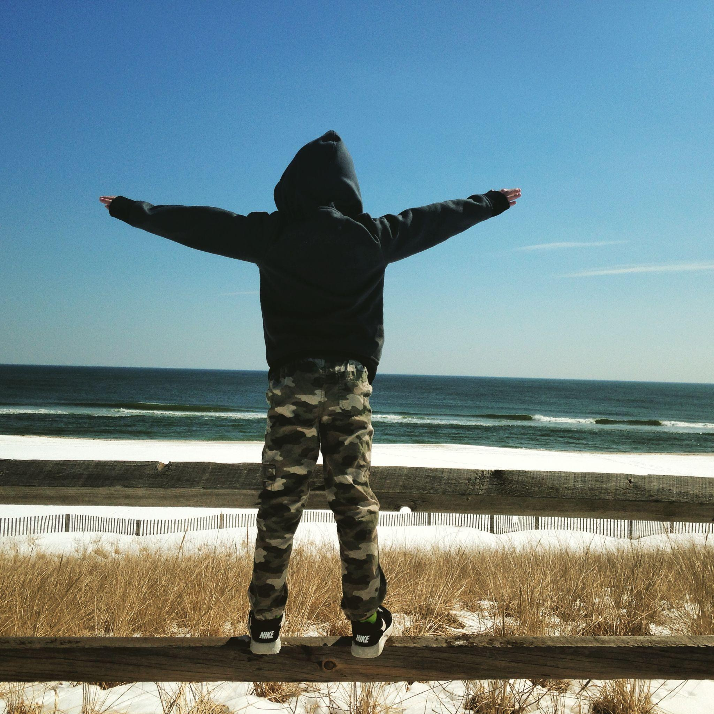
Closing Thoughts
MACH is itself an experiment.
We are working through integration challenges with an eye towards contributing to the knowledge of how co-produced research is best done.
Sustainability of MACH is key to our success and the success of our co-production partners.
NSF will not renew CoPe Hubs, so sustainability depends upon generating new funding sources to support network.
We are consistently assessing and evaluating progress and challenges – and adaptively managing.

