Slide 1
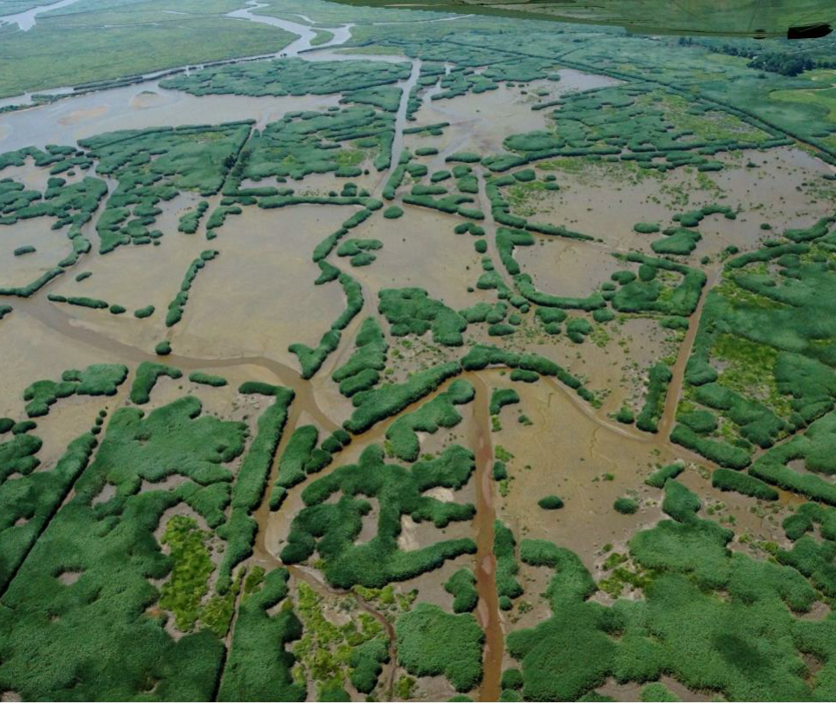
Abbotts Meadow Wetland Restoration Project
Notes:
6- feet of sediment over 185 acres
3-feet over 100 acres
1- foot over 115 acres

Slide 2
Vicinity Map

Slide 3
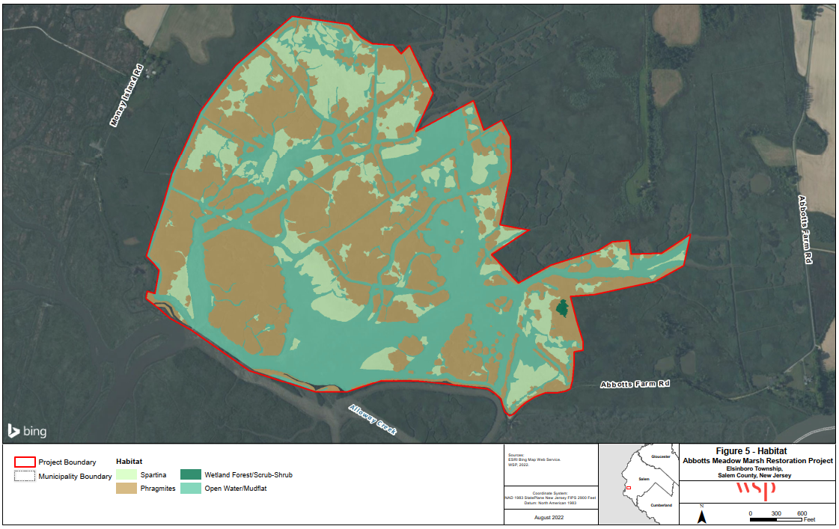
Project Site

Slide 4
Project Opportunity
Dredged material generated from NJ Wind Port Project could provide an opportunity to restore Abbotts Meadow Marsh
Deteriorating conditions and accelerating sea level rise threaten habitat for sensitive species
Project Area was covered by more than 50% water at high tide
NJ coastal wetlands experiencing sea level rise at an average rate of 0.21” a year
Abbotts Meadow has very high risk for additional marsh loss due to future sea level rise
Project area has key elements for wetland stability – large complexes of undeveloped land, large tide swing, low elevations, sediment supply, and open space for migration
Notes:
Almost 6’ tide range – from -2.97’ to +2.87’ NAVD’88

Slide 5
Abbotts Meadow Restoration Goals
Restore Site to improve ecological health and resiliency
Reuse clean dredged material to build up large open water and mudflat areas
Reestablish tidal marsh vegetation and increase sedimentation rates
Facilitate inland marsh migration to offset loss due to sea level rise
Prioritize high-quality restoration to support sensitive species (Northern Harrier; Black Rail)
Evaluate a range of elevations and a matrix of habitats

Slide 6
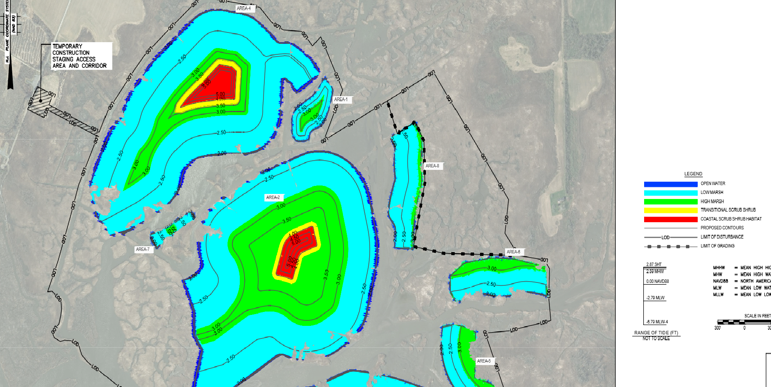

Slide 9
Thank you!

