Slide 1
SMIIL: Supporting restoration with research
Brian Harris
Coastal and Hydraulics Laboratory (CHL)
US Army Engineer Research and Development Center (ERDC)
NJ Coastal & Climate Resilience 2024
March 14, 2024

Slide 2
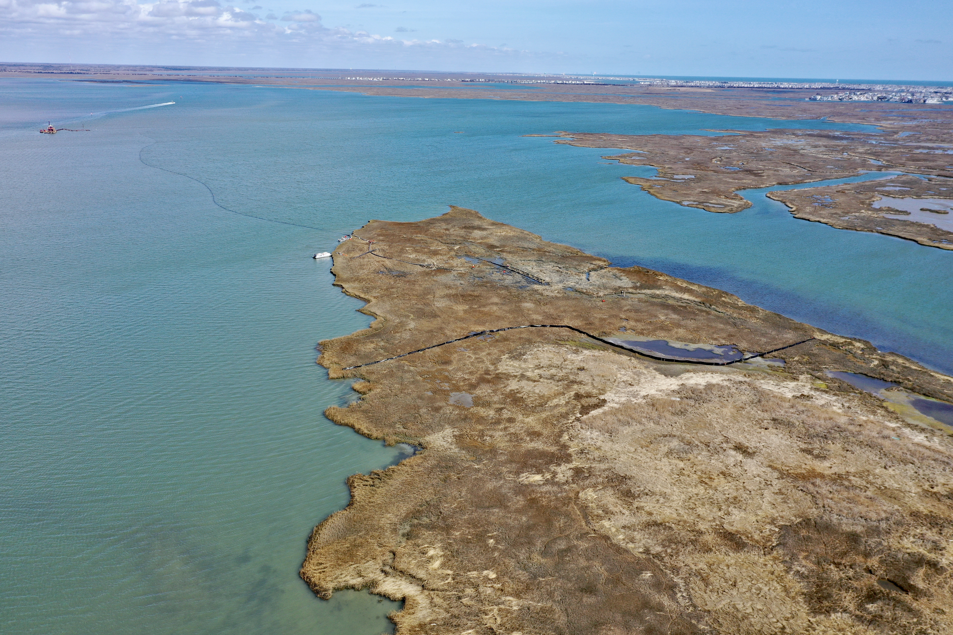
Outline
Unknowns and Overview of Research
Work Unit Highlights
Path Forward – Continuing Research
Acknowledgements
Sturgeon Island, NJ

Slide 3
Unknowns
During Placement:
What are the best methods and times to nourish wetlands?
How will the dredged material deposit across the site?
Confined vs unconfined?
How will the placement impact surrounding areas?
Turbidity
How do we monitor the placement?
Post Placement:
What is the resultant surface elevation?
How will the site re-establish?
How will created features respond and influence adjacent areas?
Nearshore

Slide 4
Overview of Research
Marsh Vegetation Surveys | ERDC: Piercy/Russ
Hydrodynamic and Suspended Sediment within the SMIIL | ERDC: ERDC/CHL TR-21-9, Fall, Perkey, Tyler and Welp
Gull-Sturgeon Turbidity | ERDC: Fall, et al., 2022, WEDA Journal of Dredging, Volume 20, No. 1
Sediment Distribution Pipe: Sturgeon-Gull | ERDC: Beardsley, et al., WEDA Journal of Dredging, Volume 20, No. 1
Sturgeon/Gull Sediments/Consolidation | ERDC: Harris/Bailey
GCM Observations & Model Development | ERDC: Perkey/Fall
Sediment/Vegetation Interactions | ERDC: J. Smith/Ramirez
Vessel Wake Impacts on Marshes | ERDC: Priestas/Styles/Bain
Macroalgae/Benthic Surveys | ERDC: Altman/Balazik/Reine
Water Quality and Hydrodynamic Modeling | ERDC: Kim/Ding
Remote Sensing & EWN Landscape Architecture Applications | Univ of Pennsylvania: Burkholder & VanDerSys and The Wetlands Institute
Monitoring and Adaptive Management of Elevated Nesting Habitats | The Wetlands Institute, NJ Fish & Wildlife
Monitoring and Adaptive Management of Gull and Sturgeon Islands | The Wetlands Institute, NJ Fish and Wildlife
Community Engagement Using Mental Modeling | ERDC: Thorne, et al., ERDC TR-22-12
Bathy/Topo/Currents/Sediments/Remote Sensing | USACE Philadelphia
Varied University Research | Univ of Penn, Boston College, Texas State, Louisiana State, Stevens, Univ of Washington, US Naval Academy

Slide 5
Outline
Unknowns and Overview of Research
Work Unit Highlights
Sediment Delivery
Turbidity
Consolidation
Vessel Wake Impact
Path Forward – Continuing Research
Acknowledgements
Sturgeon Island, NJ

Slide 6
Sediment Delivery – Sediment Distribution Pipe (SDP)
Importance:
Construct features (in-line separation), offer greater control during placement
Methods:
Tested multiple configurations on Sturgeon (elevated, on-ground, nearshore)
Findings:
Limited separation capabilities and experienced clogging
Reduced exit velocity, restricted scour, increased sediment retention!
Elevated
On-ground
Nearshore Placement

Slide 7
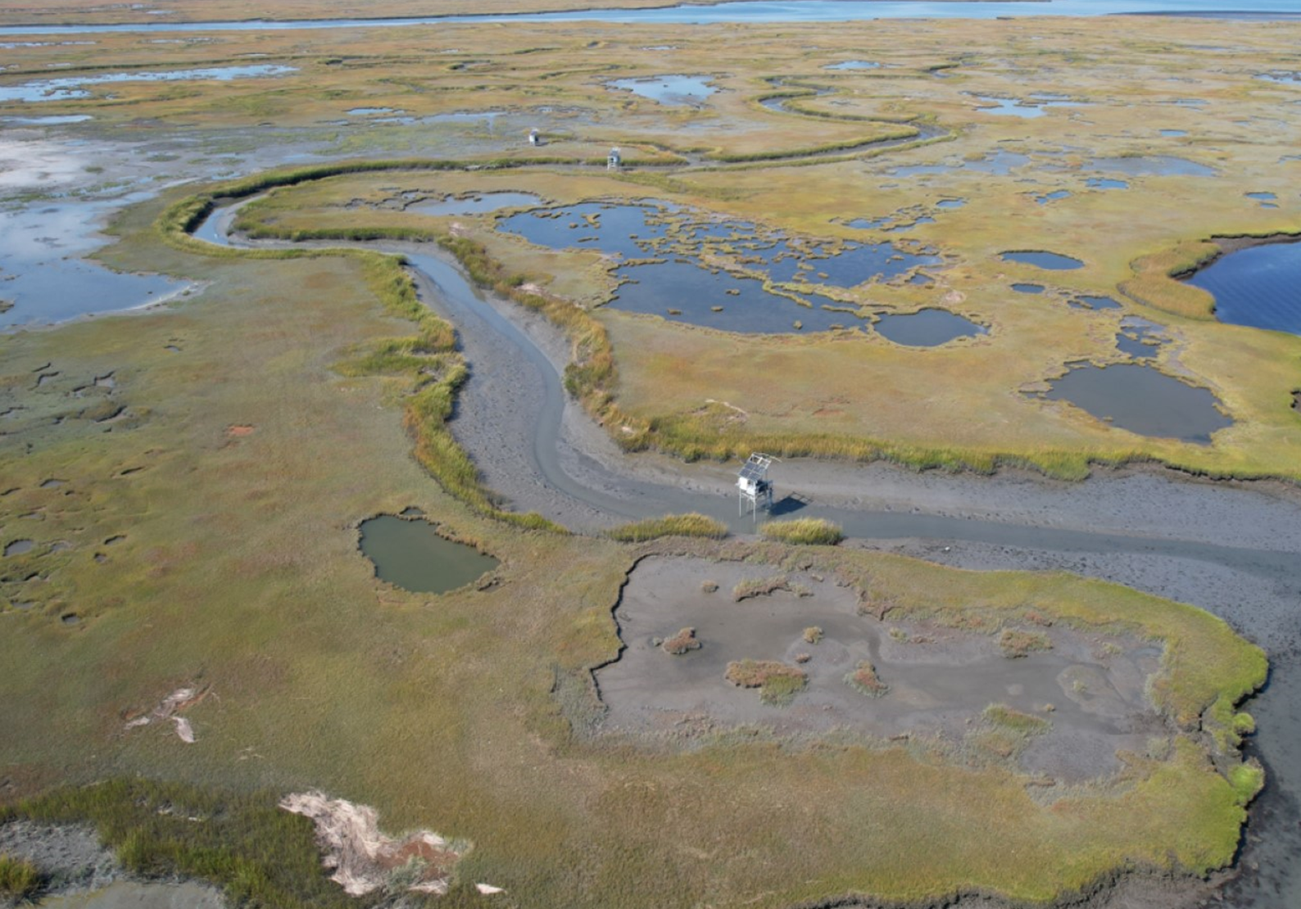
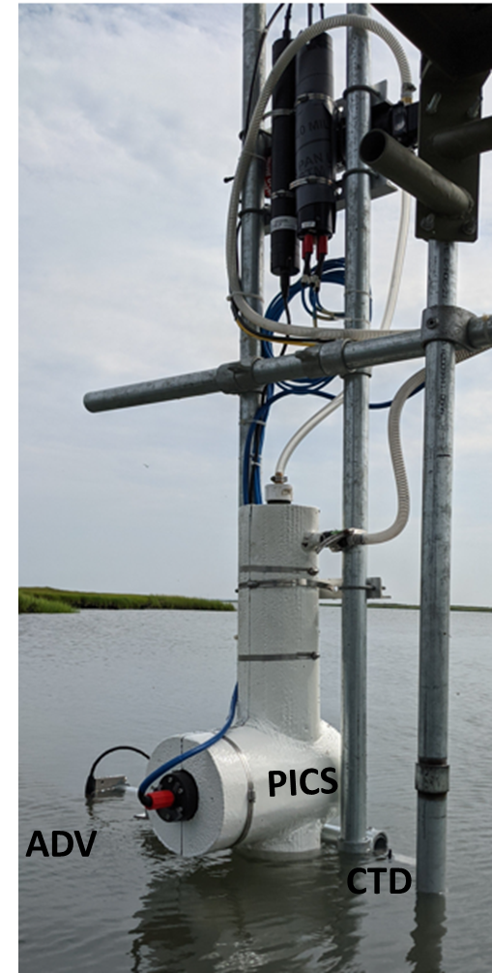
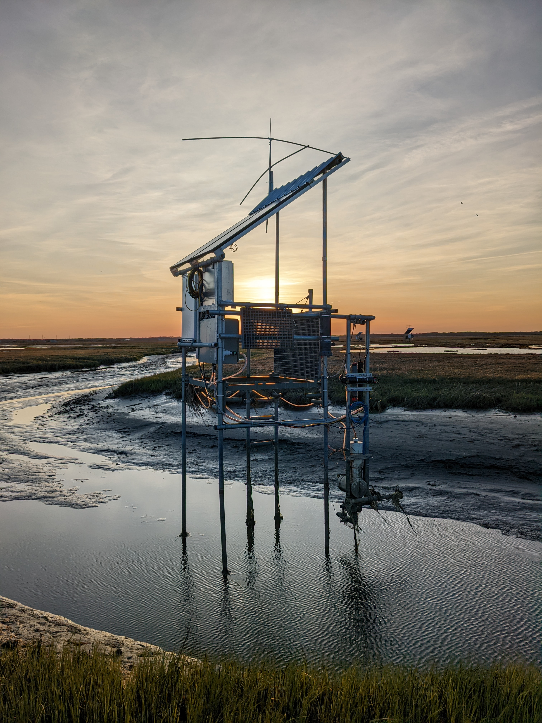
Sediment Delivery – Engineering with Nature (Tidal Creek)
Importance:
Understand if we could utlize tidal forces to deliver sediment
Methods:
Instrumented platforms to measure suspended sediment flux, size, settling velocity
Findings:
Warm Season: Increased sea level, greater tidal exchange, and increased sediment mobility produced sediment export
Cool Season: Lower sea level, lower sediment mobility produced near neutral exchange
Tower Array
Sunset on the Marsh…

Slide 8
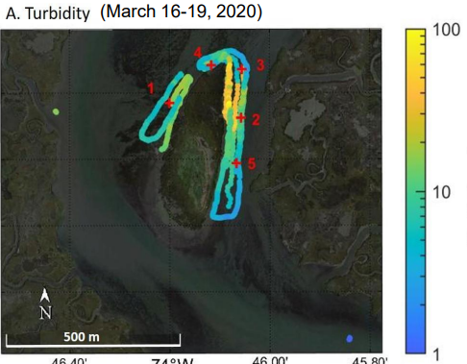
Turbidity
Importance:
Turbidity can affect SAV photosynthesis, impact essential habitats and dissolved oxygen levels
Objective:
Monitor turbidity in the nearshore of BUDM at Sturgeon and Gull Islands
Findings:
Minimal turbidity recorded both temporally and spatially and levels were similar to storm conditions!
Little to no turbidity plume monitored outside of the eastern tidal creek during Sturgeon BUDM
Pre-Placement Monitoring
~380 ntm!
Sensor
Failure
Sturgeon Island

Slide 9
Consolidation
Importance:
Elevation controls wetland function and resiliency
Dredged material and wetland will consolidate post placement
Objective:
Predict and monitor consolidation of BUDM
Findings:
Overpredicted consolidation (salinity vs freshwater?)
Captured wetland (foundation) consolidation
Modeling discrepancies compound with time and placements!
Salinity
(Too High)
Sulfides
(Too Low)
Inundation (~Elevation)
5 cm
10 cm

Slide 10
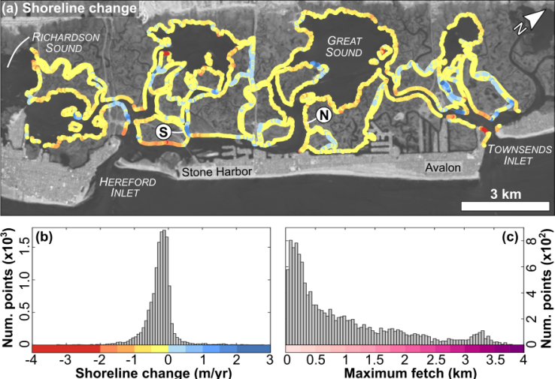
Vessel Wake Impact
Importance:
Unknown how vessel wakes impact rates of marsh edge erosion
Objective:
Deploy sensors to monitor forces experienced by marshes adjacent to AICWW
Findings:
Average edge erosion ~0.5 m/yr regardless of fetch or channel width
Requires ~400 MJ/m to erode 0.5 m and average vessel induces 1 KJ/m
During study, sites saw ~100 vessels/day so it’d take ~11 yrs to induce this erosion
0.5 m/yr
Marsh Edge Erosion
Strain Gauges

Slide 11
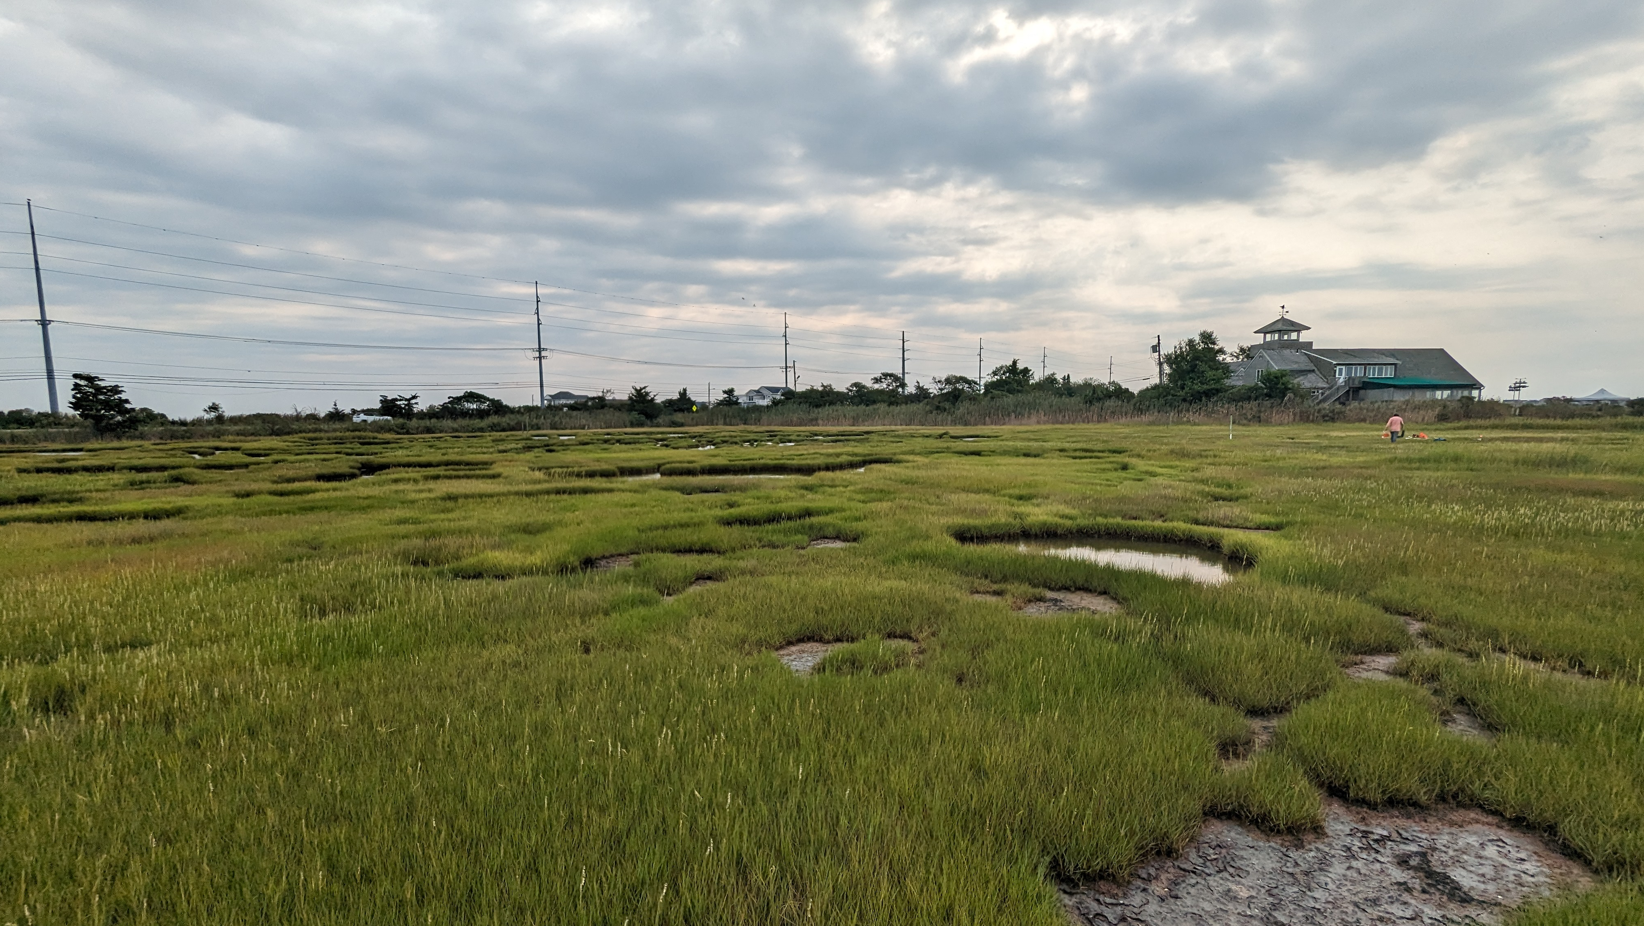
Outline
Unknowns and Overview of Research
Work Unit Highlights
Path Forward – Continuing Research
Improving Methods and Tools
Acknowledgements
Scotch Bonnet, NJ

Slide 12
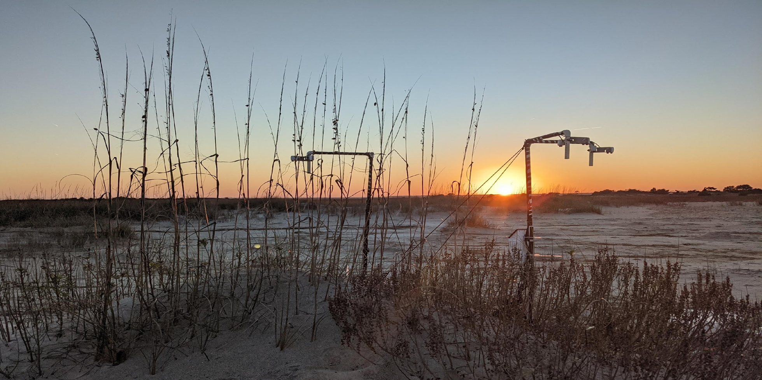
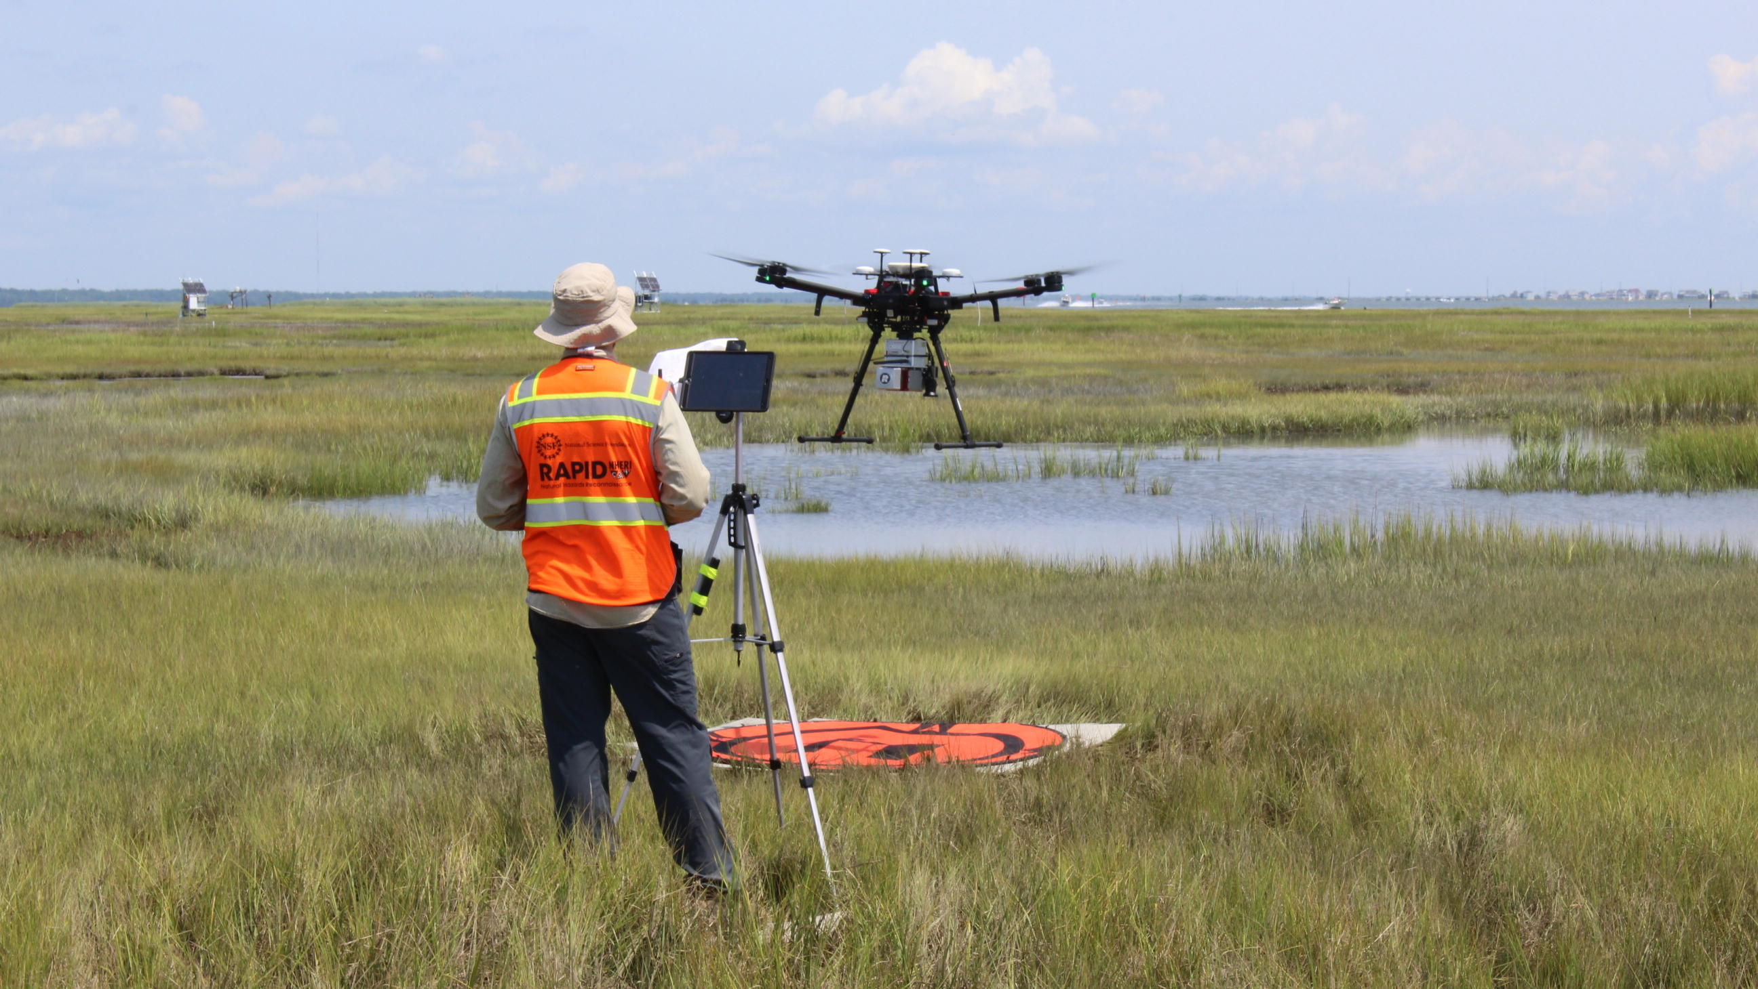
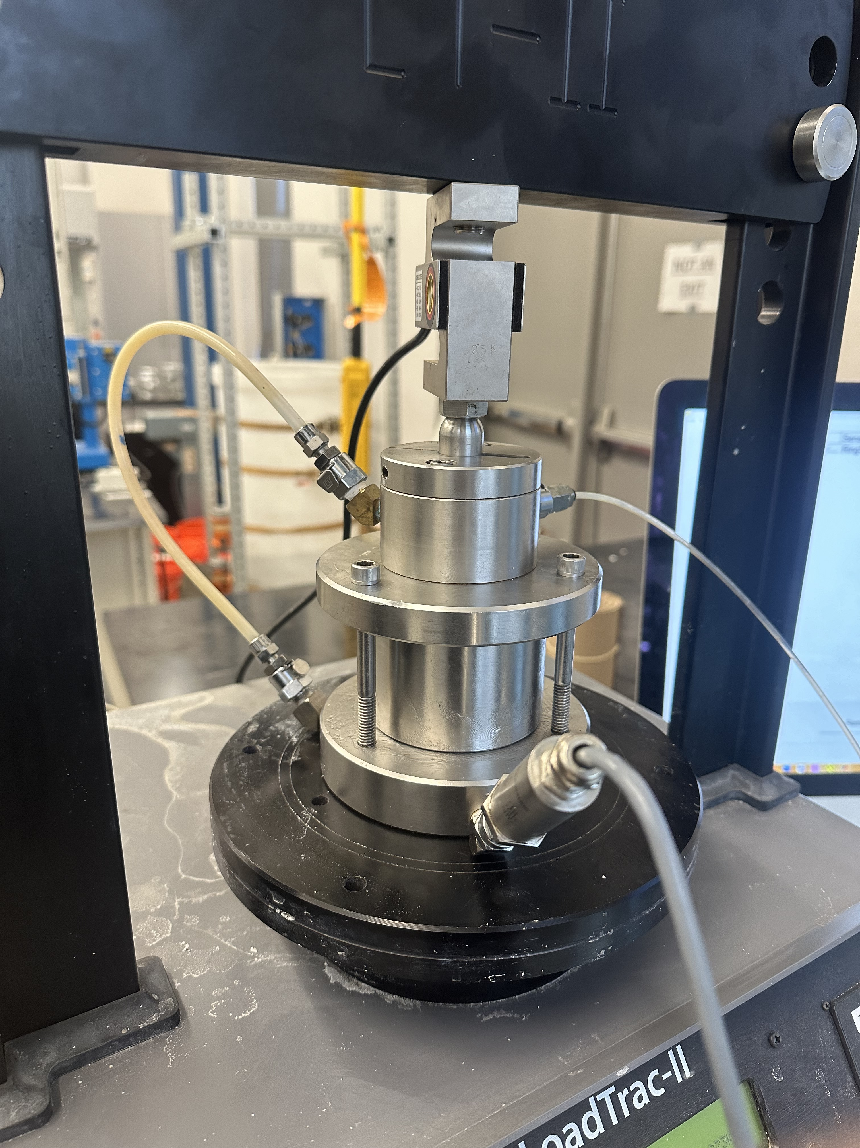
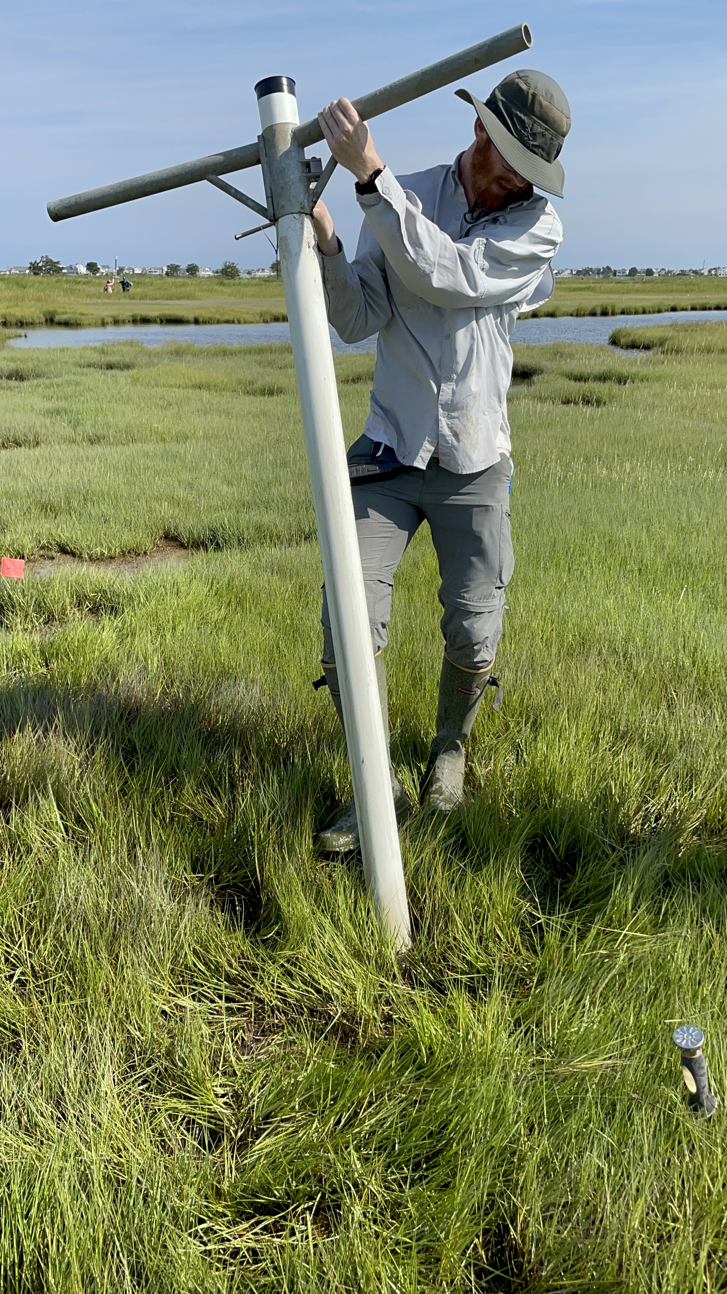
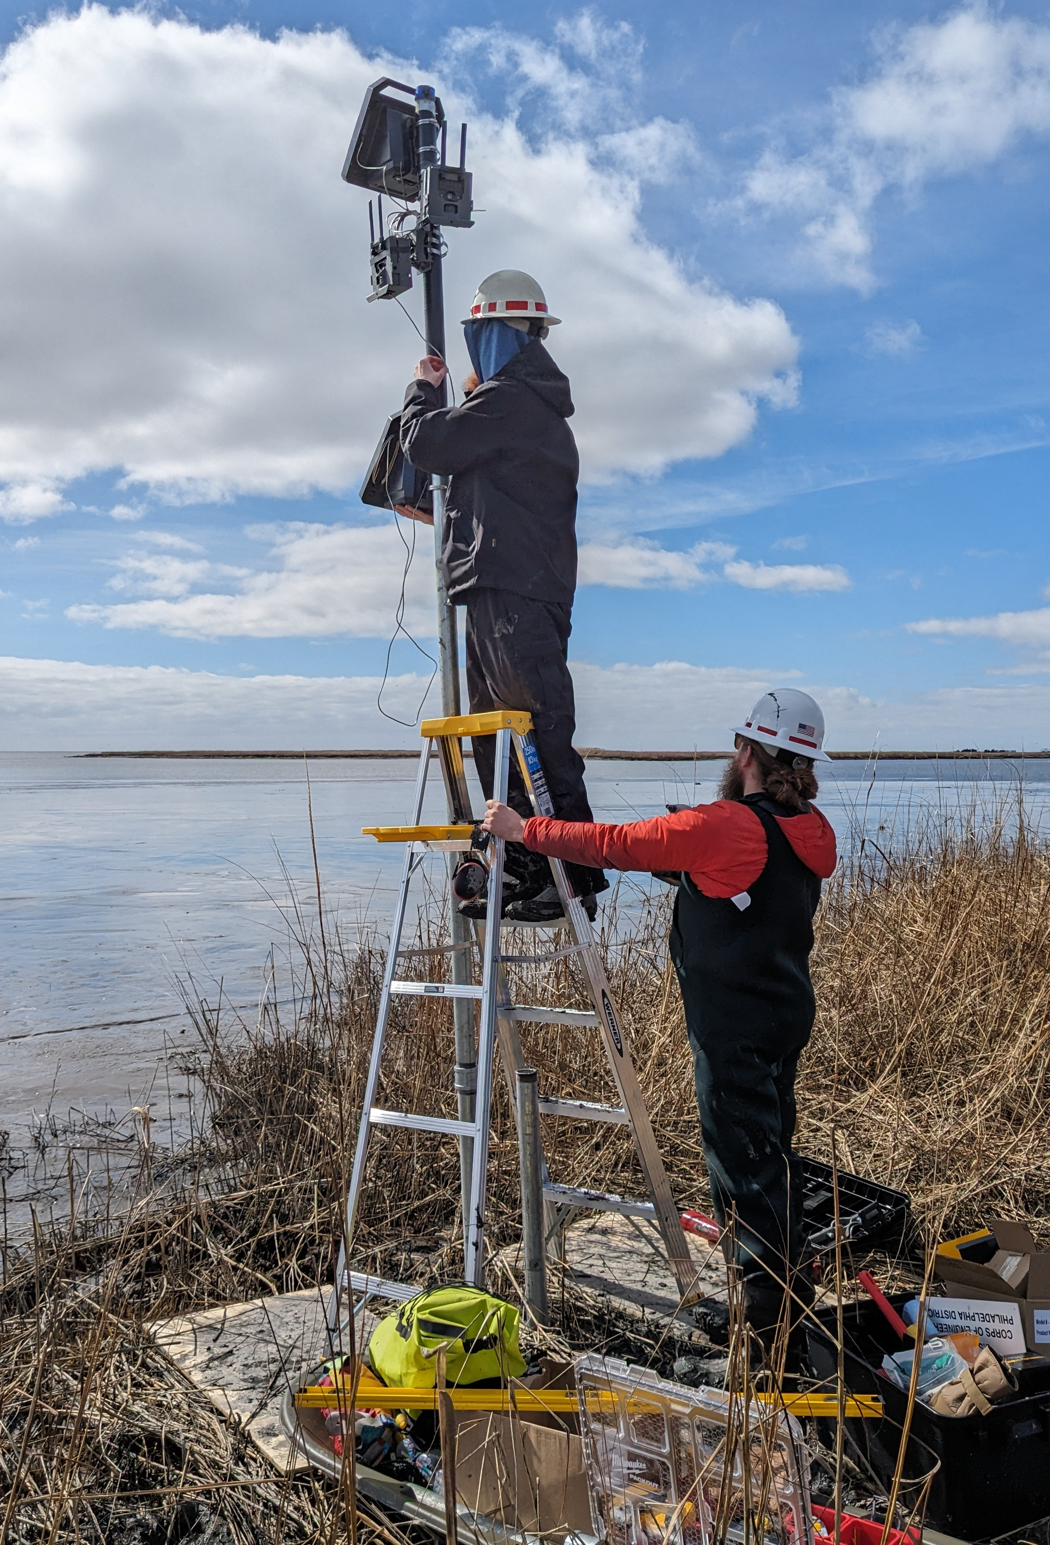
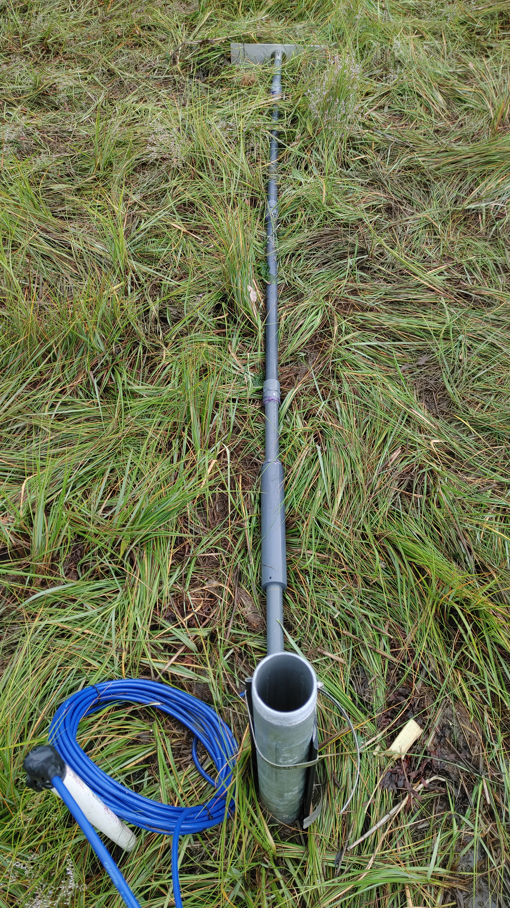
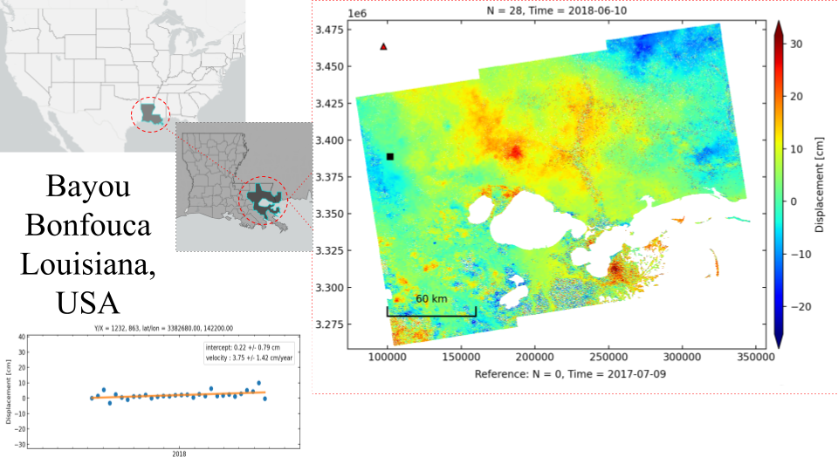
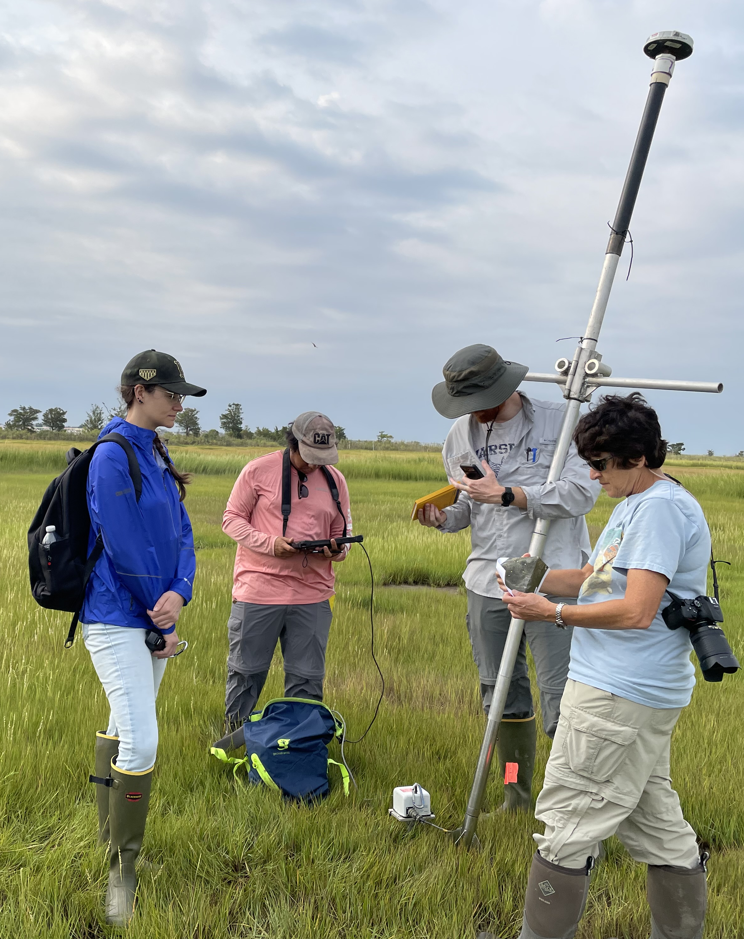
Path Forward – Improved Monitoring
Low-Cost Monitoring
Remote Sensing
Geotechnical Testing
Multispectral and Acoustic Sensors
UAS Lidar and Photogrammetry
CRS
Soil Cores
Drive-point Piezometers and Extensometers
CorpsCam Stations
DCP
CPT
Vertical Change via InSAR

Slide 13
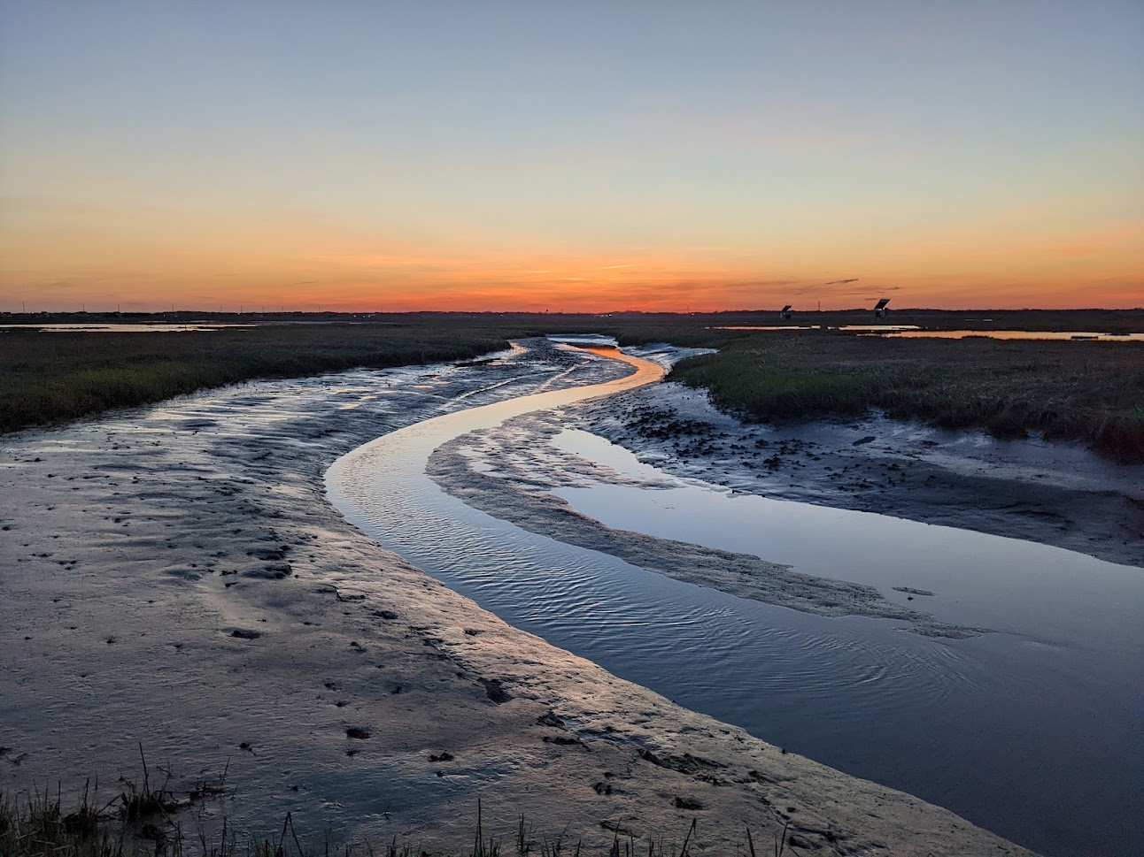
SMIIL: Supporting Restoration with Research
Including more geotechnical parameters into predicative models
Thank You!
Brian.D.Harris@usace.army.mil
Jafari, Harris et al. (in progress)
Coastal Hydraulics Laboratory

Slide 14
Data collection in Southeast Creek
Current meter deployed Jul 2021 – Aug 2022
Measurements of discharge and sediment concentration made every 30 minutes
Sediment fluxes calculated from discharge and concentration
Notes:
We conducted tidal phase averaging of our data to frame our 30-minute measurements within phase of the tide.
I’ve labeled these as low slack, peak flood, high slack, and peak ebb for simplicity. But they’re also 0, 90, 180, 270, and 360 degrees within an idealized sinusoidal tide.
So if we do that for say, velocity, and average them across all the tidal cycles in the 13-month deployments, it looks like this
Notice peak flood velocities don’t occur exactly at 90 deg, nor do peak ebb velocities occur at 270 degrees. That’s due to distortion of the tide by wind effects, etc.
We can also unfold these and look at velocity as a function of tidal phase over the course of the entire deployment. Here positive/ebb velocities are red and negative/flood velocities are blue. The black line represents the tidally-averaged or residual velocity over the course of the tidal cycle.

Slide 15
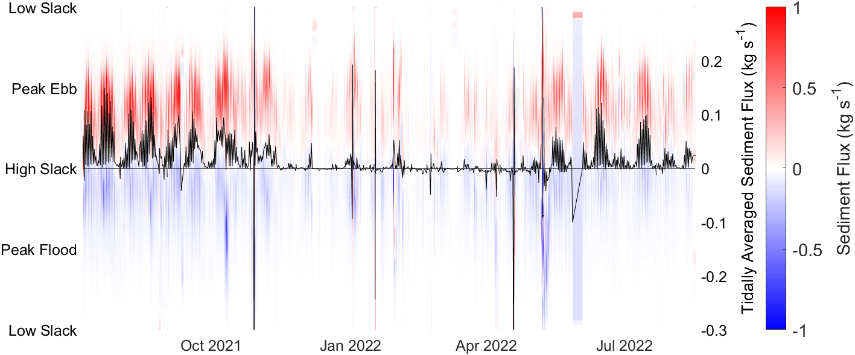
Tidal Creeks Export Sediment
Sediment export during ebb tides often exceeds import during floods
But only May-Oct when temperatures are warmer and water levels are elevated
Notes:
1. This figure shows the sediment flux. Reds are ebb fluxes and blues are flood directed. The black line is the tidally averaged flux. This shows us that there’s lots of export Jul-Nov and May-Aug when water levels are elevated, and that in between those periods there was hardly any flux through Southeast Creek

Slide 16
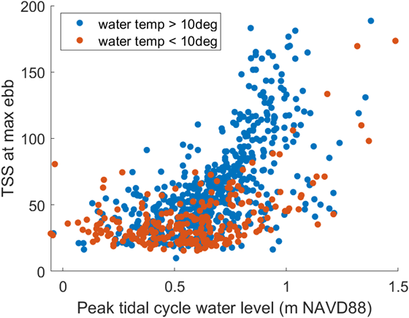
Tidal Creeks Export Sediment
Sediment concentrations during ebb tide are higher when water levels are elevated
The trend of higher ebb sediment concentrations with higher water levels is more pronounced when water temperatures are elevated
The elevated sediment export during warmer months may reflect impacts of bioturbation by burrowing invertebrates such as fiddler crabs
Notes:
1. This figure shows the sediment flux. Reds are ebb fluxes and blues are flood directed. The black line is the tidally averaged flux. This shows us that there’s lots of export Jul-Nov and May-Aug when water levels are elevated, and that in between those periods there was hardly any flux through Southeast Creek

