Slide 1
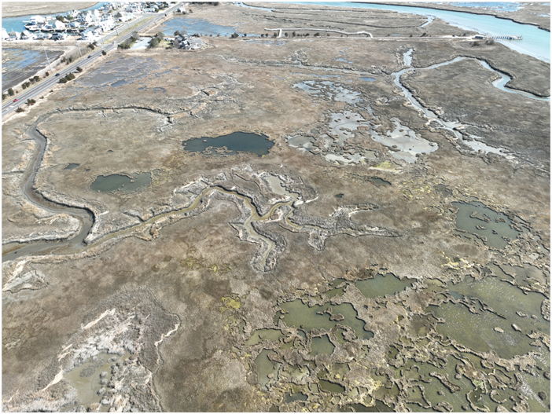
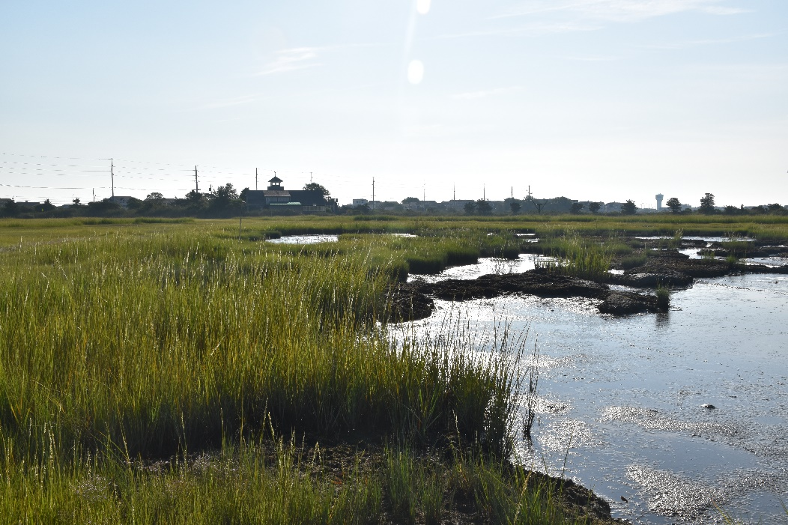
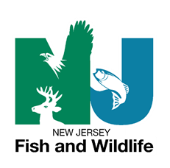
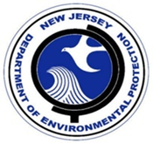
Scotch Bonnet Island
Marsh Elevation Enhancement: Beneficially Using Dredged Sediments to Stabilize Drowning Marshes
Lenore P. Tedesco, The Wetlands Institute
Monica Chasten, Jeff McAleer - USACE – Philadelphia District
Julie Blum, Amanda Lyons, Lisa Ferguson, Samantha Collins, Brian Williamson - The Wetlands Institute
Ginger Kopkash, Jason Hearon - NJDEP Fish and Wildlife
Brian Harris – USACE – ERDC
Keith VanDerSys and Sean Burkholder – University of Pennsylvania

Slide 2
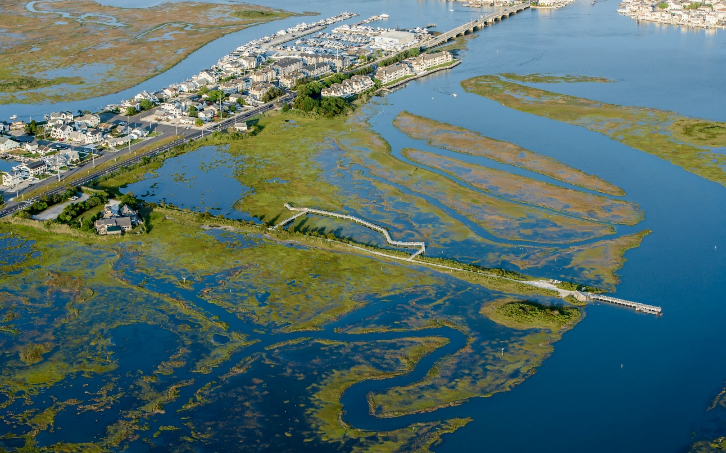
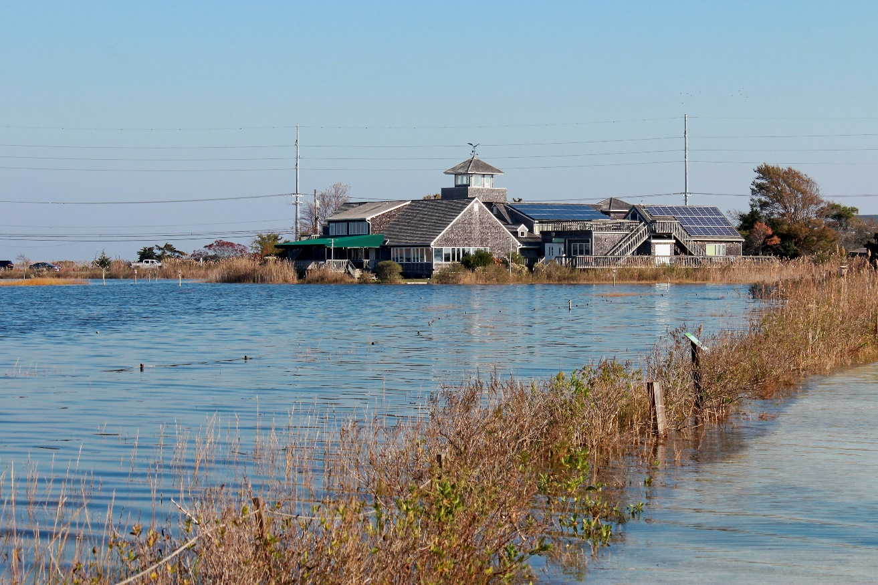
Sunny Day Flooding
10/30/2023 3.89’NAVD88
Photo: Devin Griffiths
6/2/2023 2.86’NAVD88
Image Courtesy Ted Kingston

Slide 3
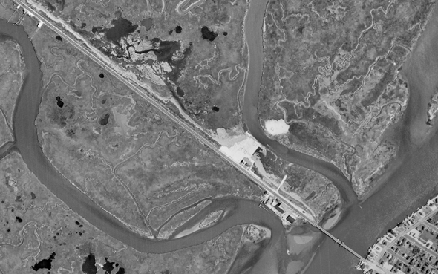
Fresh Placement and Early Fill
1956
Cape May Wetlands Wildlife Management Area
Broad marsh plain with a few isolated pools
Relatively narrow tidal channels

Slide 4
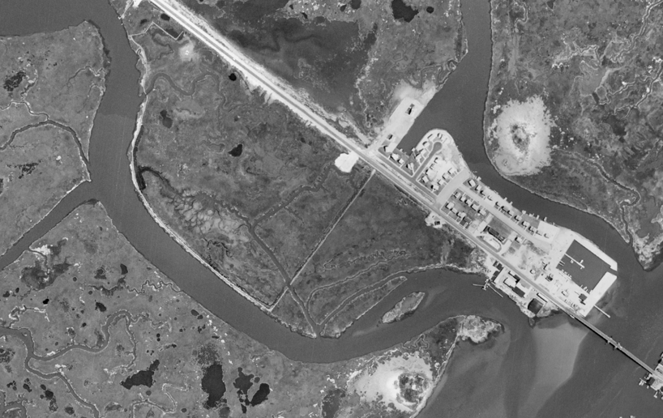
TWI Future Site
Stone Harbor Manor/Marina Development
Blocked Tidal Channel
Road Along Scotch Bonnet Creek
Road Addition –Salt Marsh Trail
Blocked Tidal Channel with Narrow Connection
1963

Slide 5
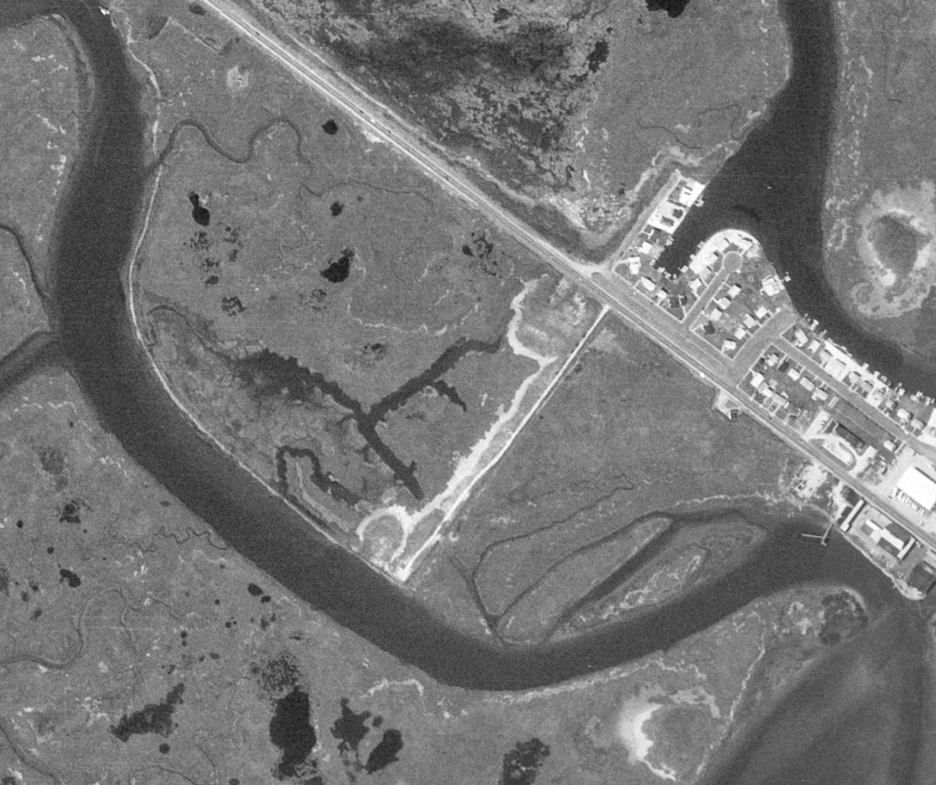
1970
Tidal Creek Breach
Marsh Pools
Future TWI
Marsh Pools
Marsh Conversion
Creek Expansion/
Disruption from Road
Tidal Creek Dead End

Slide 6
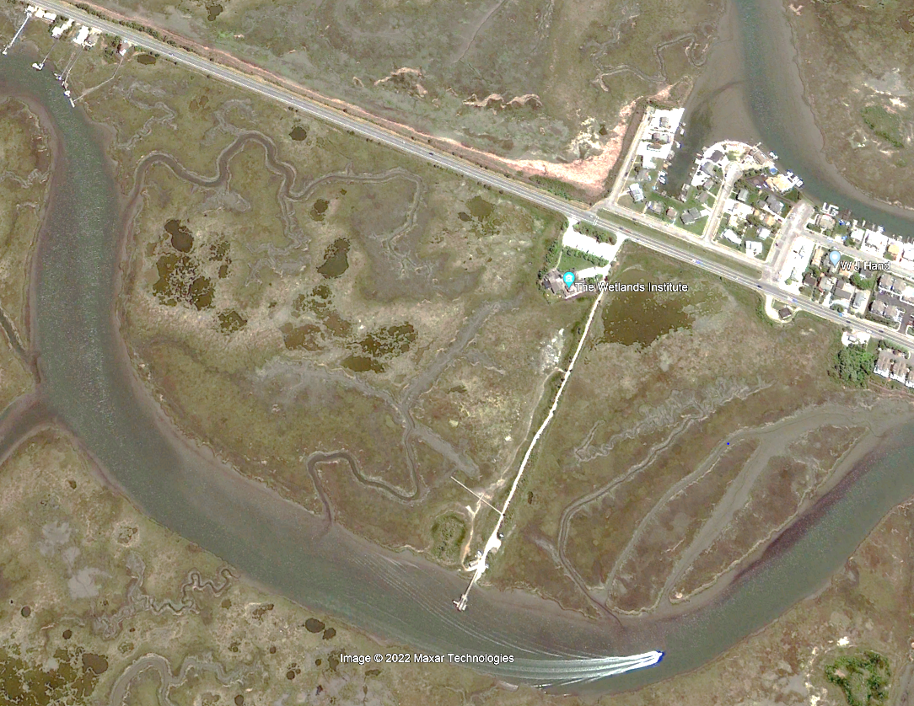
5/2009
Low Tide Image So Waterways Show as Mudflats
Tidal Creek Widening and Expansion
Pool Expansion
Significant Pool Expansion/New Pool Development and Marsh Loss
Pool Expansion
Tidal Creek Widening and Expansion

Slide 7
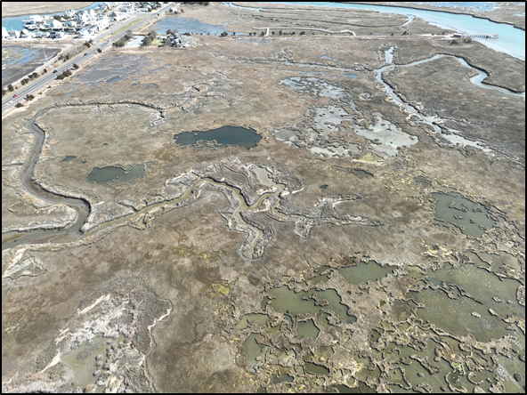
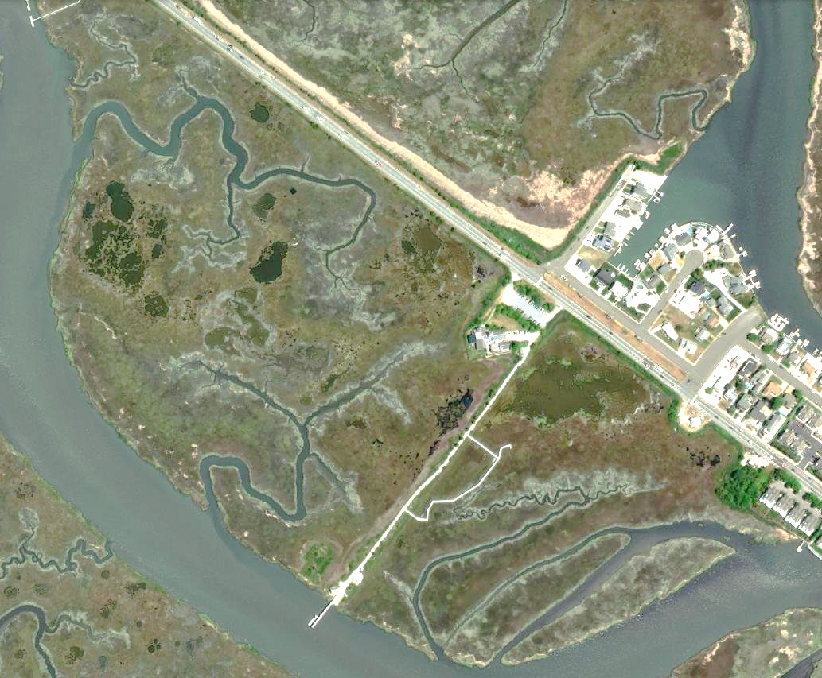
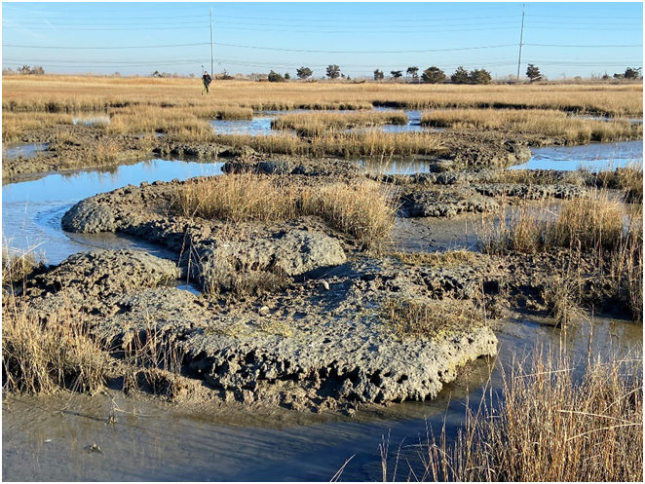
Current Marsh Platform Conditions
Tidal Creek Widening and Expansion
May 2021
New Pools/Pool Expansion
New Pools/Pool Expansion
Breached Pools
Expanding Creek Network
Channel 70’ Wider since 1970

Slide 8
Modelling Future Marsh Trajectory: Sea Level Rise Framework
 |  | 2030 | 2050 | 2070
 |  |  |  | Emissions
 | Chance SLR Exceeds |  |  | Low | Mod. | High
Low End | >95% Chance | 0.3 | 0.7 | 0.9 | 1.0 | 1.1
Likely Range | >83% Chance | 0.5 | 0.9 | 1.3 | 1.4 | 1.5
 | ~50% Chance | 0.8 | 1.4 | 1.9 | 2.2 | 2.4
 | <17% Chance | 1.1 | 2.1 | 2.7 | 3.1 | 3.5
High End | <5% Chance | 1.3 | 2.6 | 3.2 | 3.8 | 4.4
feet
feet
Utilizing SLR Predictions from Rutgers University
Values are above the year 2000 (1991-2009 average) baseline
2000 – 2022 (2001-2019 average) Observed 4” (0.3’)
Planning based on <17% Chance
Focused on 2030 and 2050 Time Horizons

Slide 9
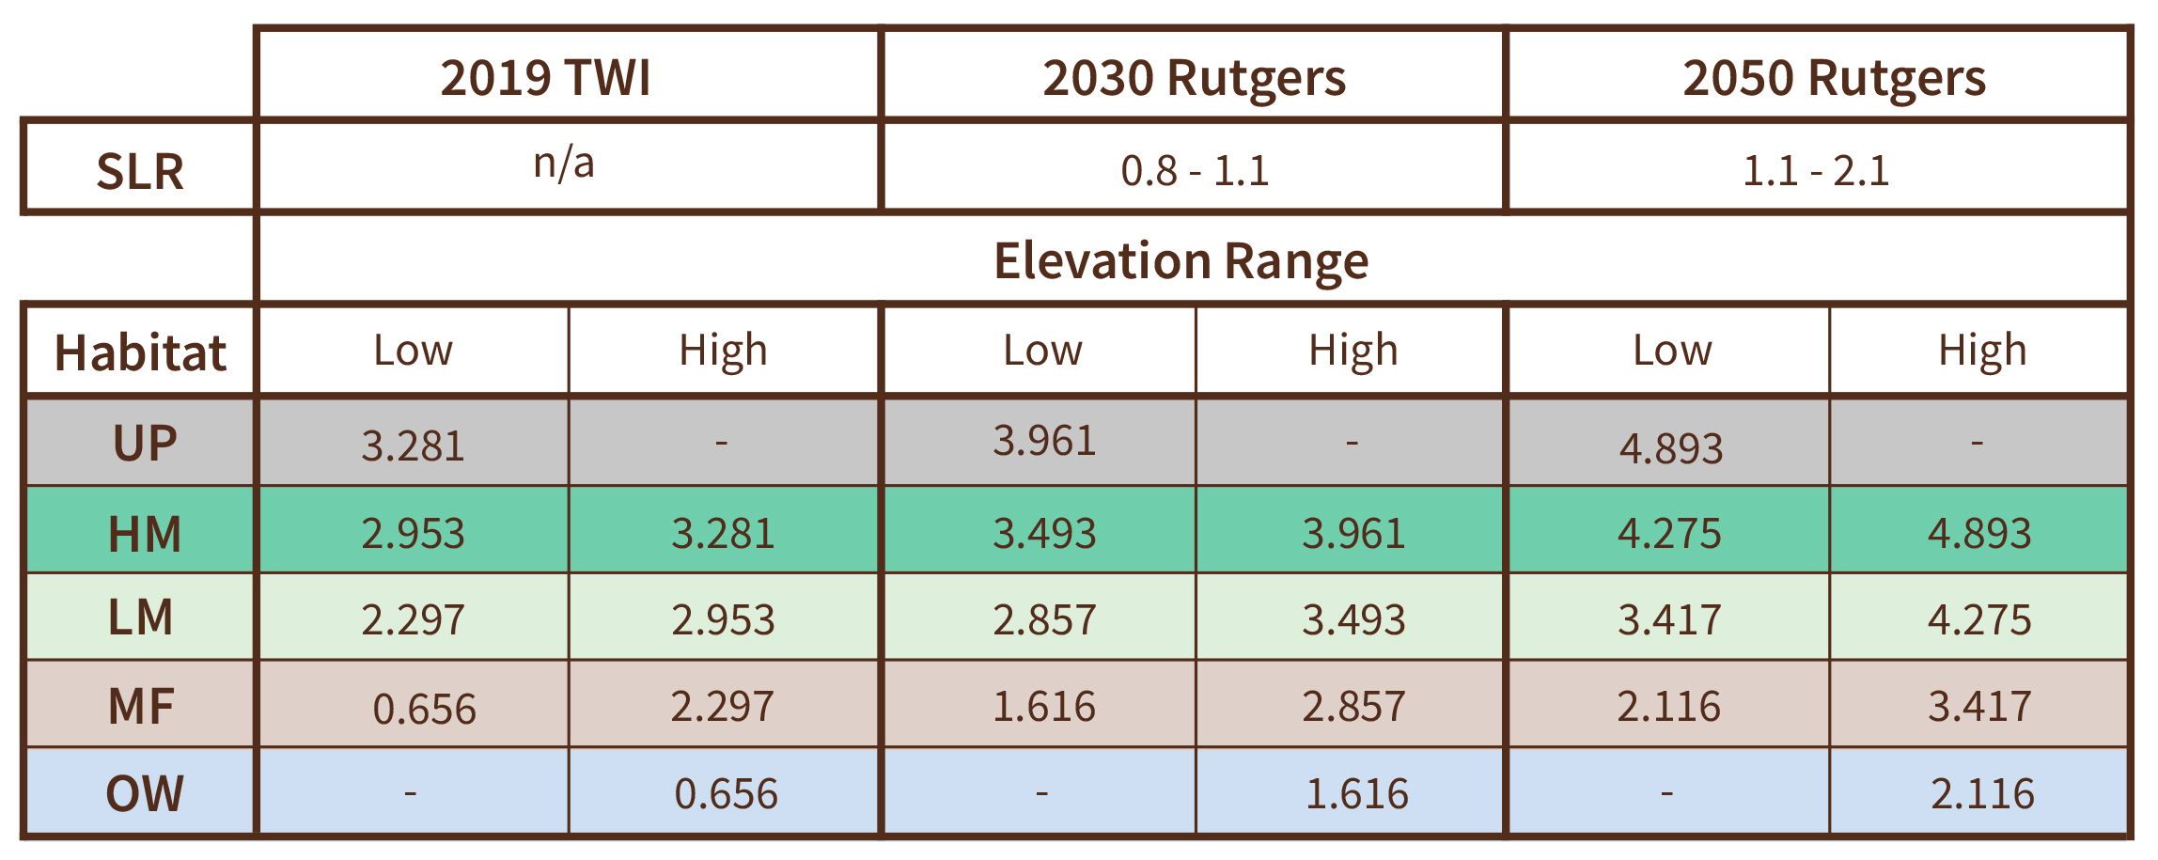
Evolution of Habitat Elevation Ranges
Habitat maintenance over time requires increasing elevations
Presumes salt marsh habitat is primarily guided by elevation related to sea level
TWI elevations determined via direct elevation measurements and USACE 2018 DEM via LIDAR
Future habitat elevation ranges are via SLAMM (Sea Level Affecting Marsh Model) to account for sea level rise, accretion, and subsidence via published resources and measured values

Slide 10
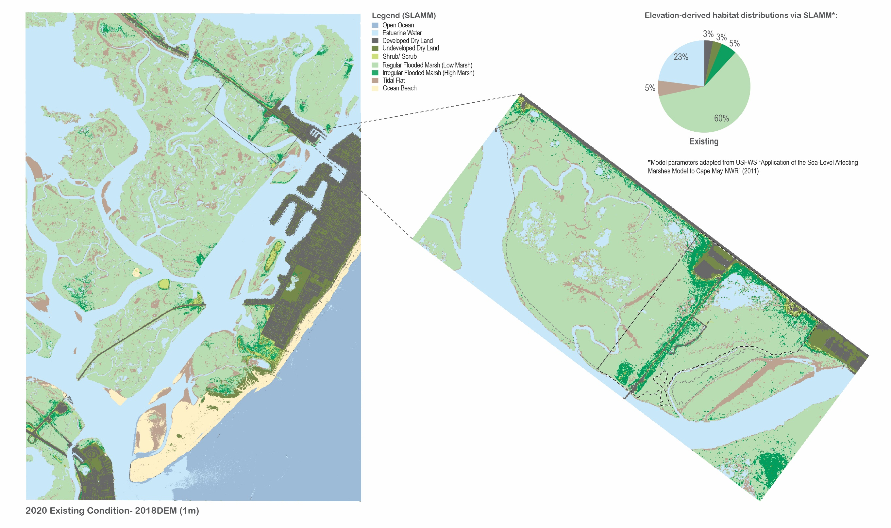
2020 Existing Conditions
Scotch Bonnet Island
Southern SMIIL

Slide 11
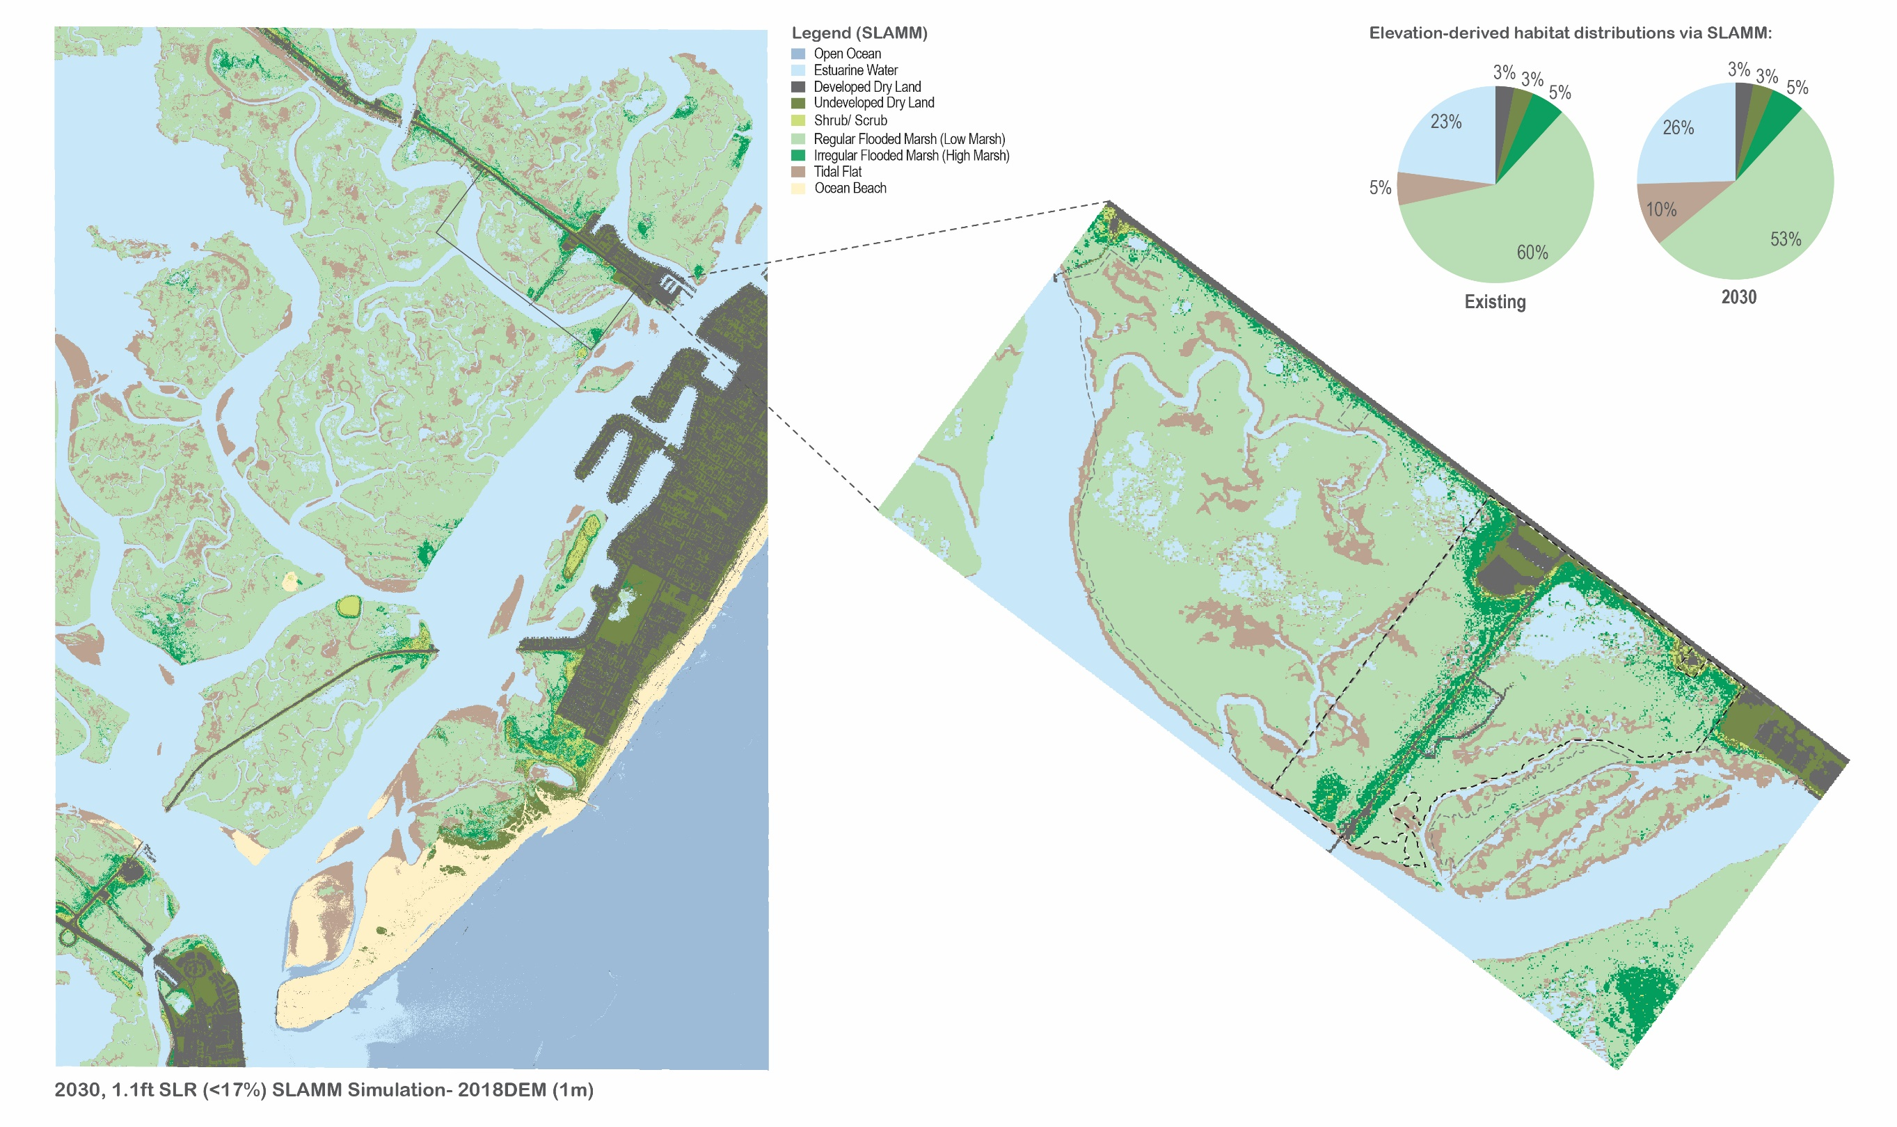
2030 Projected Conditions
Scotch Bonnet Island
Southern SMIIL

Slide 12
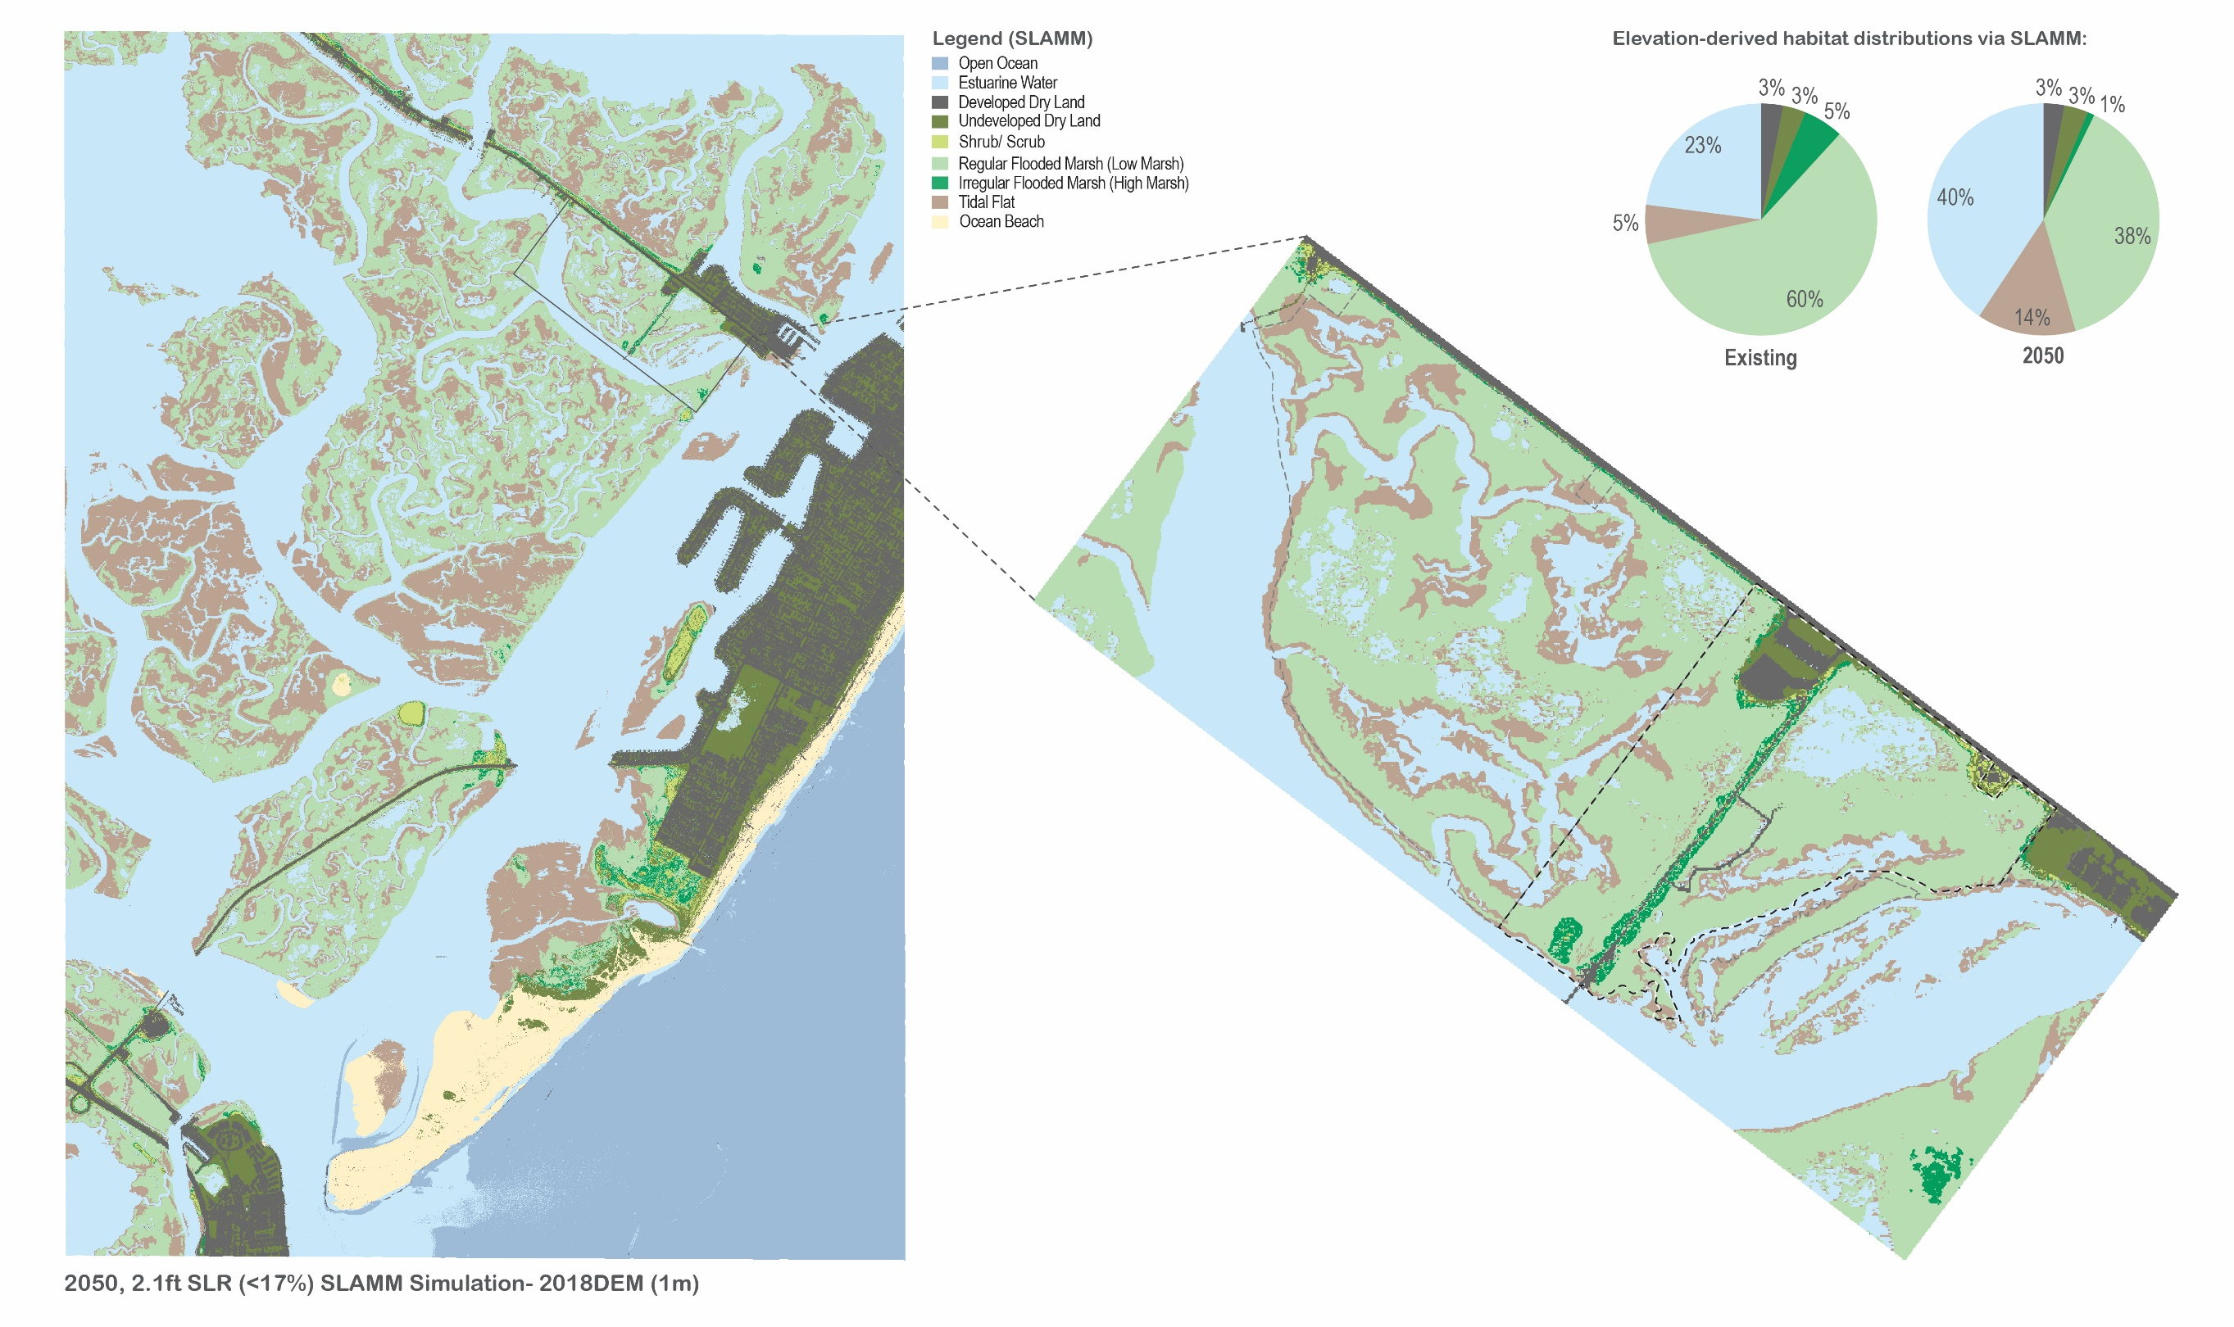
2050 Projected Conditions
Scotch Bonnet Island
Southern SMIIL

Slide 13
Scotch Bonnet Island Marsh Elevation Enhancement Project
Project Goals
Stabilize Failing Marsh Platform
Increase Marsh Elevation to Stable Low Marsh Elevation Ranges
Slow Marsh Dissection
Reverse Marsh Acreage Loss
1941 to 2019 - Lost 34% of Marsh Area (30 acres)
Projections to 2050 – Lose Additional 33% (20 acres)
2050 Projected Marsh

Slide 14
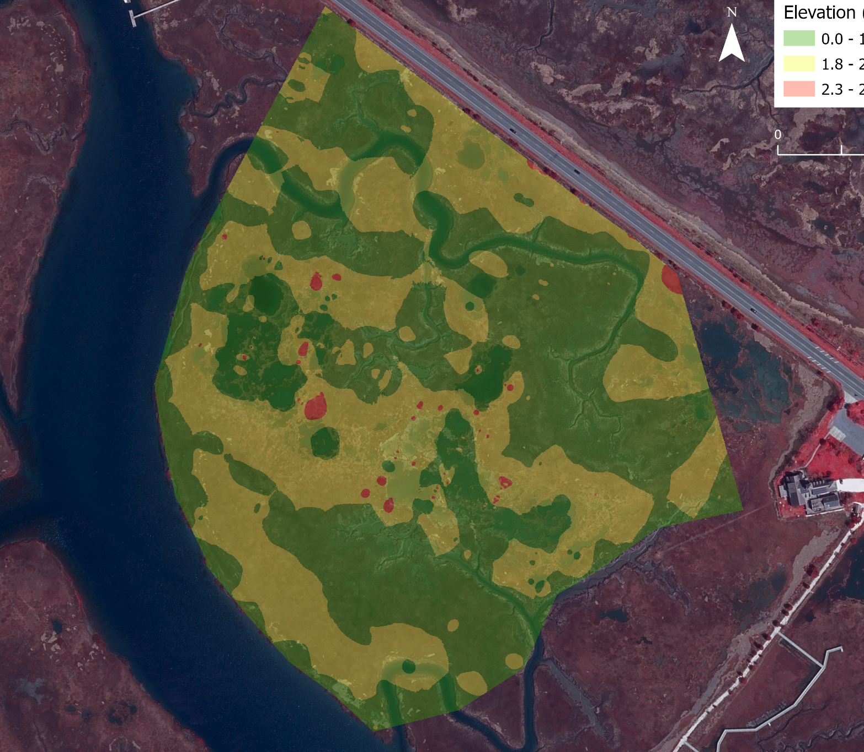
Scotch Bonnet Island Marsh Elevation Enhancement Project
Ecological Targets
Increase Marsh Platform Resilience by Raising Marsh Elevation into 2030 Low Marsh Elevation Range
Currently at the Lower Limit of Low Marsh (2.3’NAVD88) near Mudflat Boundary (<2.3’ NAVD88)
Target 2030 Low Marsh Elevations (2.8’ – 3.5’ NAVD88)
Maximize Area above 1.8’ NAVD88 – limit of Spartina colonization
Increase Low Marsh Acreage by Up to 12 acres
Slow and Reverse Tidal Channel Widening and Expansion

Slide 15
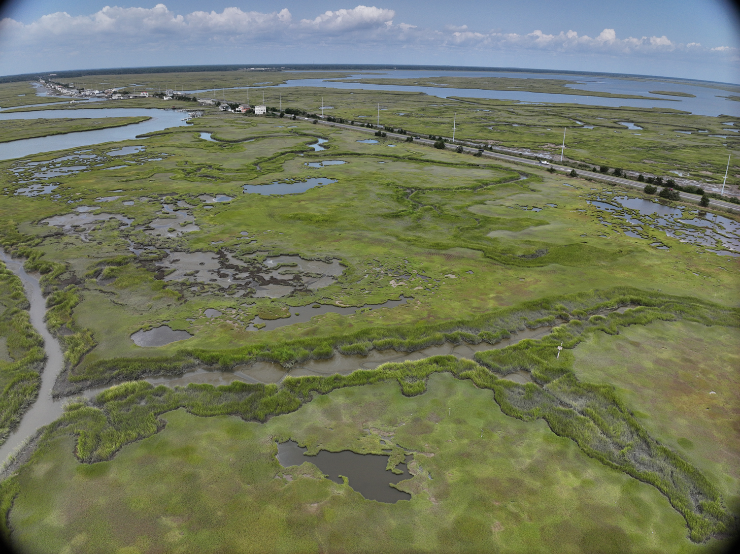
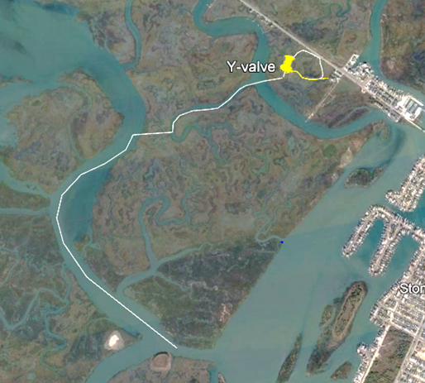
Scotch Bonnet Island Marsh Elevation Enhancement Project
Placement Method
Hydraulic cutterhead dredge pumping 25,000 cy of mixed fine sand and mud to site
Pipeline from dredge site to placement site
Nozzle outlet pumping onto marsh surface
Partial coir log containment to direct flows
Timing and Timeline
Late September - October 2024
USACE Philadelphia District NJIWW Maintenance Dredging
Critical shoal

Slide 16
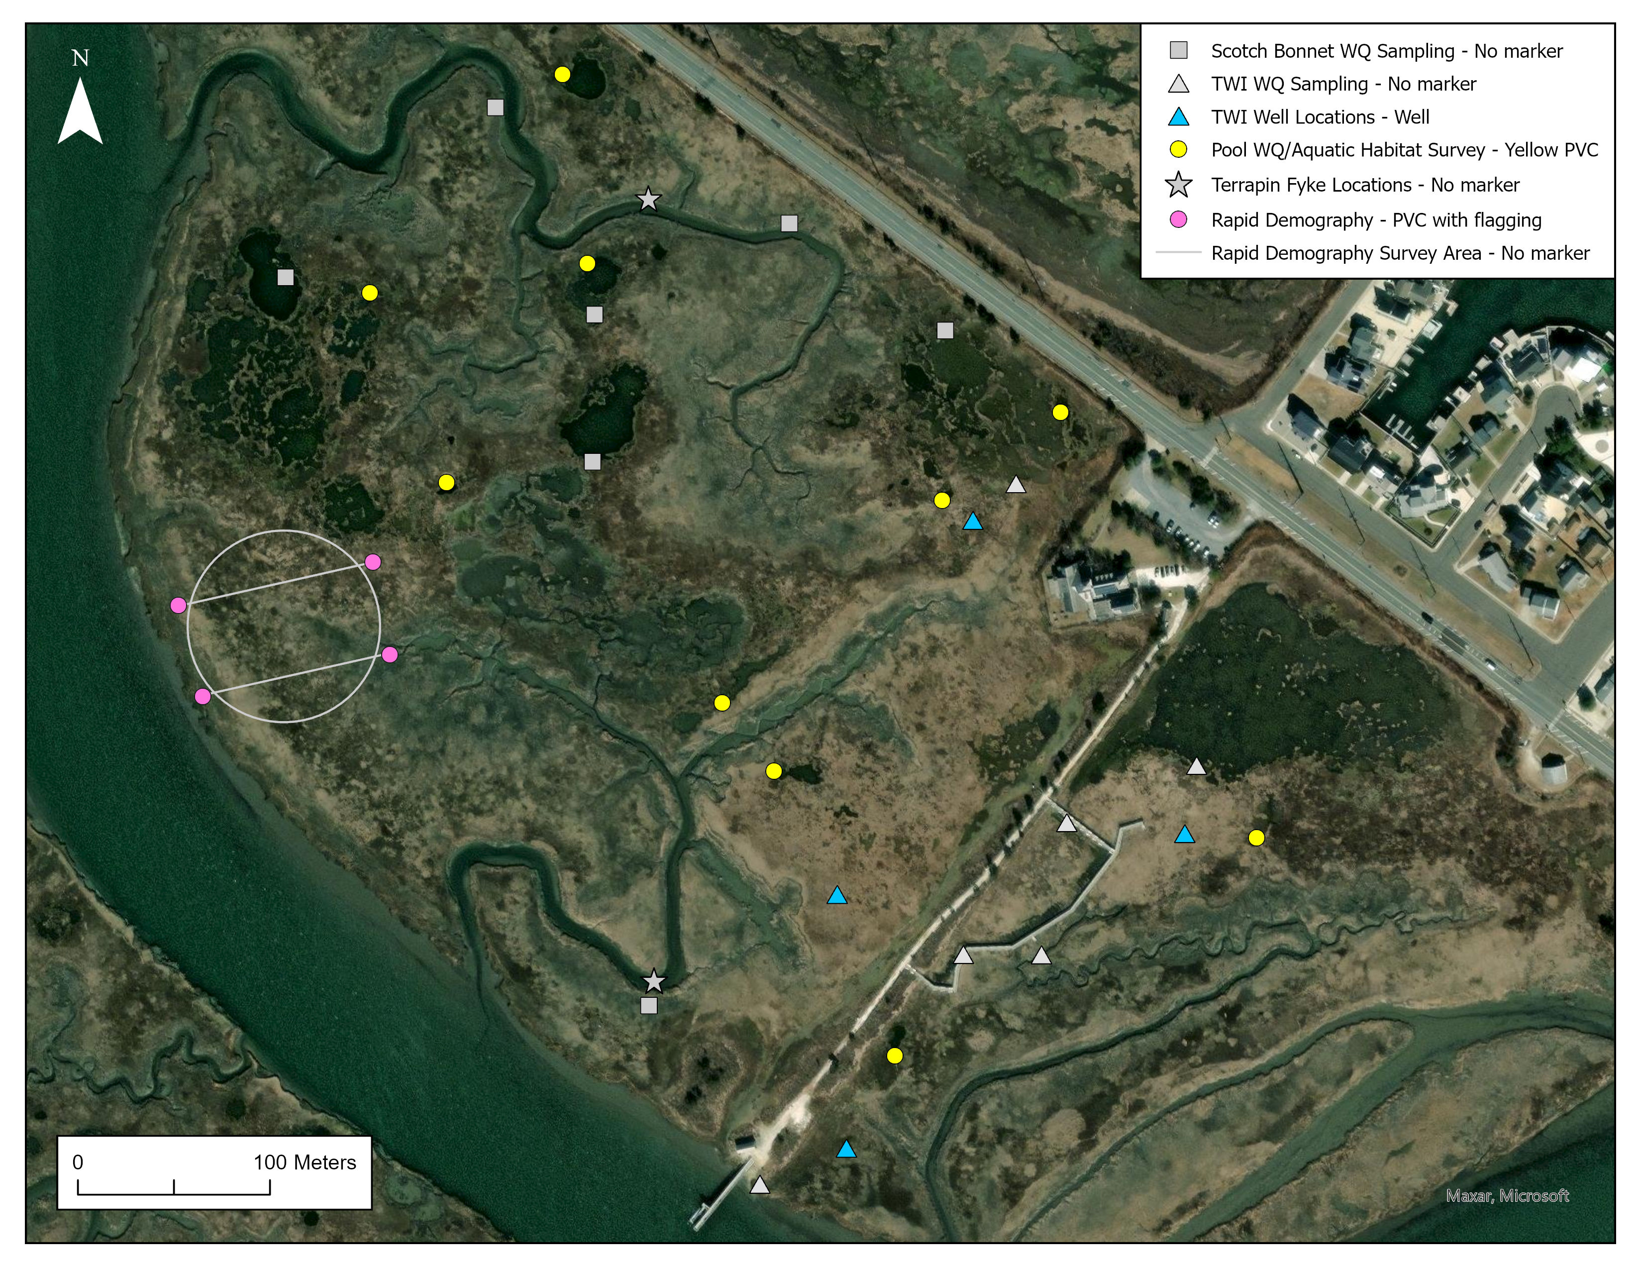
Scotch Bonnet Island Marsh Elevation Enhancement Project
TWI conducting pre- and post-construction monitoring for:
Elevation enhancement and evolution – multispectral UAV (UPenn)
Water chemistry impact and evolution
Pool aquatic habitat surveys
Vegetation impact and response
Coastal bird site usage and response to restoration
Diamondback terrapin site usage and response to restoration
Additional USACE ERDC/USNA Research
Hydrodynamics of creeks and tidal channels
Geotechnical response of platform to placement and compaction

Slide 17
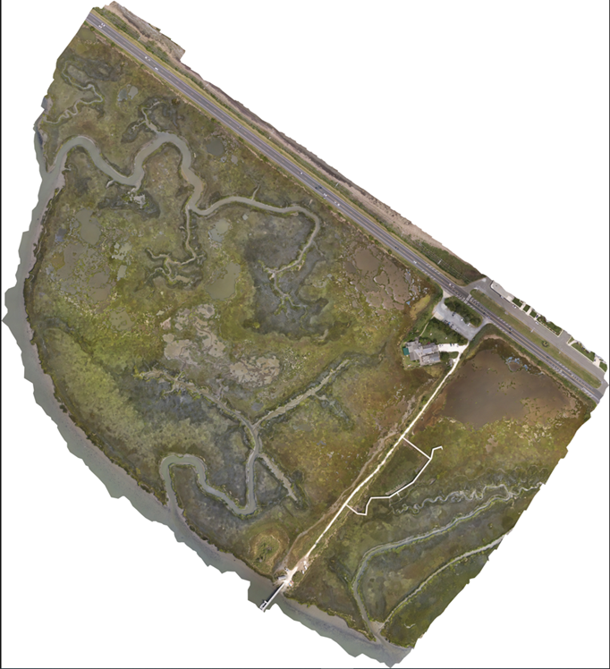
Education and Outreach
2023 Multispectral UAV Imagery
Education and outreach will be an important component of the project given the proximity to TWI
Site signage for the trail system
Educational materials for onsite programming and public education
16,000 school children annually
18,000 visitors annually
Funding provided by NJ Coastal Wetland Restoration Partnership
The
Wetlands Institute

Slide 18
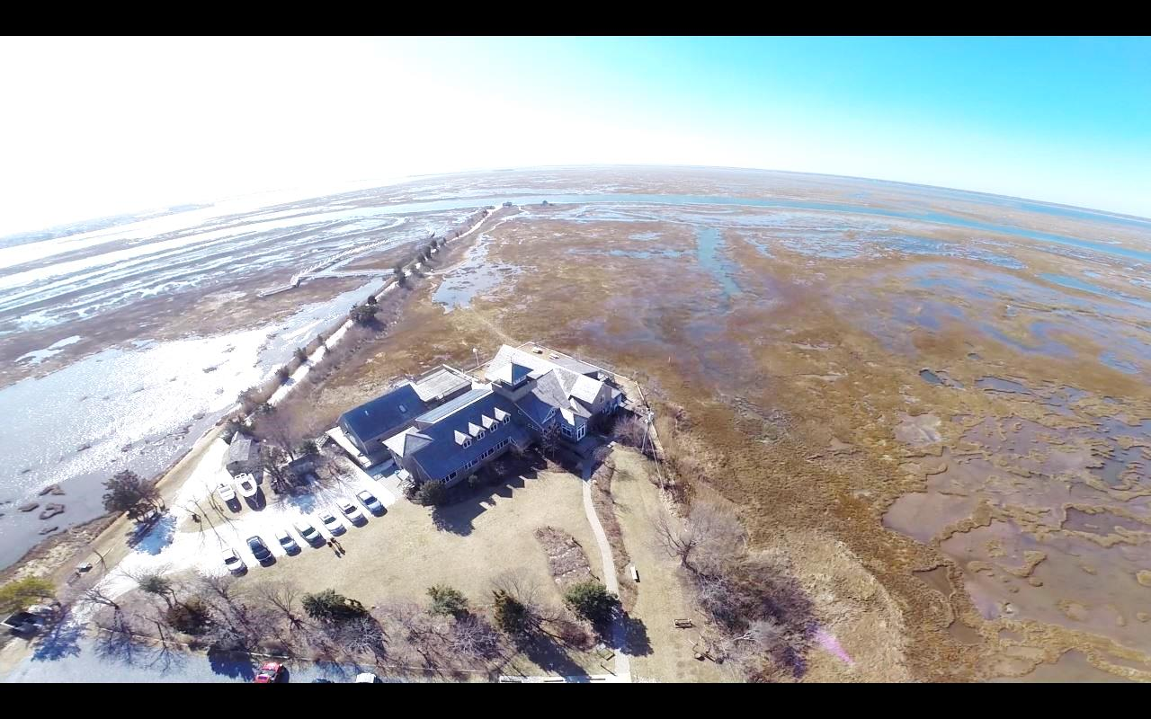
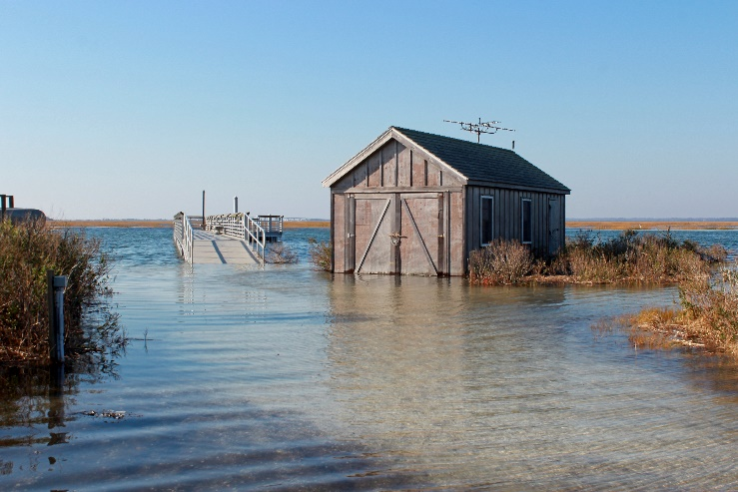
Building Resilience for Cape May Wetland Wildlife Management Area and The Wetlands Institute
Notes:
Stressing ecosystems, nuisance street flooding, eroding beaches
Drowning marshes
Drive -2x/day – I SEE CHANGE
Didn’t happen in 1980, 1990, 2000 – happening now!
Doesn’t matter if think human activities contributing – or causing Climate Change
Ice sheets melt, more water, warm water, ocean circulation – more water on land

