Slide 1
Achieving Municipal Public Education and Outreach Goals for Community Resiliency in New Jersey
1
Christopher R. Schmitt
Senior Consultant-Sustainable Communities
GZA GeoEnvironmental, Inc.
Andrea R. Schmitt
President
Philosophy Family Farm LLC

Slide 2
Adapting to Change
and
Creating Resilient Communities
by
Communicating Climate Change
Through Public Education and Outreach

Slide 3
Local Planning and Resilience to Climate Change Effects
The NJDEP has issued a climate resilience guide, the Local Planning for Climate Change Toolkit, that leads municipalities through the process of creating a climate change-related vulnerability assessment and climate resilience strategies.

Slide 4
Importance of Public Education and Outreach in Resilience to Climate Change Effects
The first step of the Toolkit is for the municipality to “Initiate and Engage” as part of public education and outreach.
Meaningful public participation
Engage diverse stakeholders
Establish 2-way communications
Maximize representation and participation from the most affected populations
Reduce barriers for equitable participation
Generate informed action

Slide 5
Whole Systems Approach to Public Education and Outreach
An effective strategy to achieve community resilience includes all aspects of a community – social, economic, and environmental.
This approach supports the idea that inclusive, community-driven processes lead to effective outcomes benefiting all residents.
Creating opportunities for all people to identify climate-related challenges is an essential element of this process.

Slide 6
Whole Systems Approach to Public Education and Outreach
Think across boundaries
Pull together seemingly dissimilar people
Value Social Capital
Engage in the democratic process
Value evidence and science
Facts matter
Bring new people to the table
Invite all stakeholders
Be open to new ideas
Innovate and be transformative
Share risks and rewards
Be inclusive and courageous
Translate ideas into action
Take bold steps for your community’s future

Slide 7
Case Study
Public Education and Outreach at The Philosophy Family Farm
60 acre abandoned Christmas tree farm regeneration project
170 years of unsustainable monocrops
Establish an ethic of connecting people with nature
Engaging in critical thinking, problem solving, and identity through nature-based educational books and programs
The Philosophy Family Farm

Slide 8
Philosophy of Change
How Do We Explain Change?
Let’s Think Philosophically!
The Philosophy Family Farm
Notes:
The Pre-Socractics turned to nature to understand change. They tried to explain Change through elements of nature like Fire, Water, Earth and Air
Change is the only thing that is constant

Slide 9
Philosophy of Regeneration
What is True?
Relationship and Connection
Interdependence
Purpose
Nature Knows Best
The Philosophy Family Farm
Notes:
Family learning

Slide 10
Philosophy of Public Education and Outreach
Community
We all are part of the community of life
Finding our collective identity through Nature
Notes:
Family learning

Slide 11
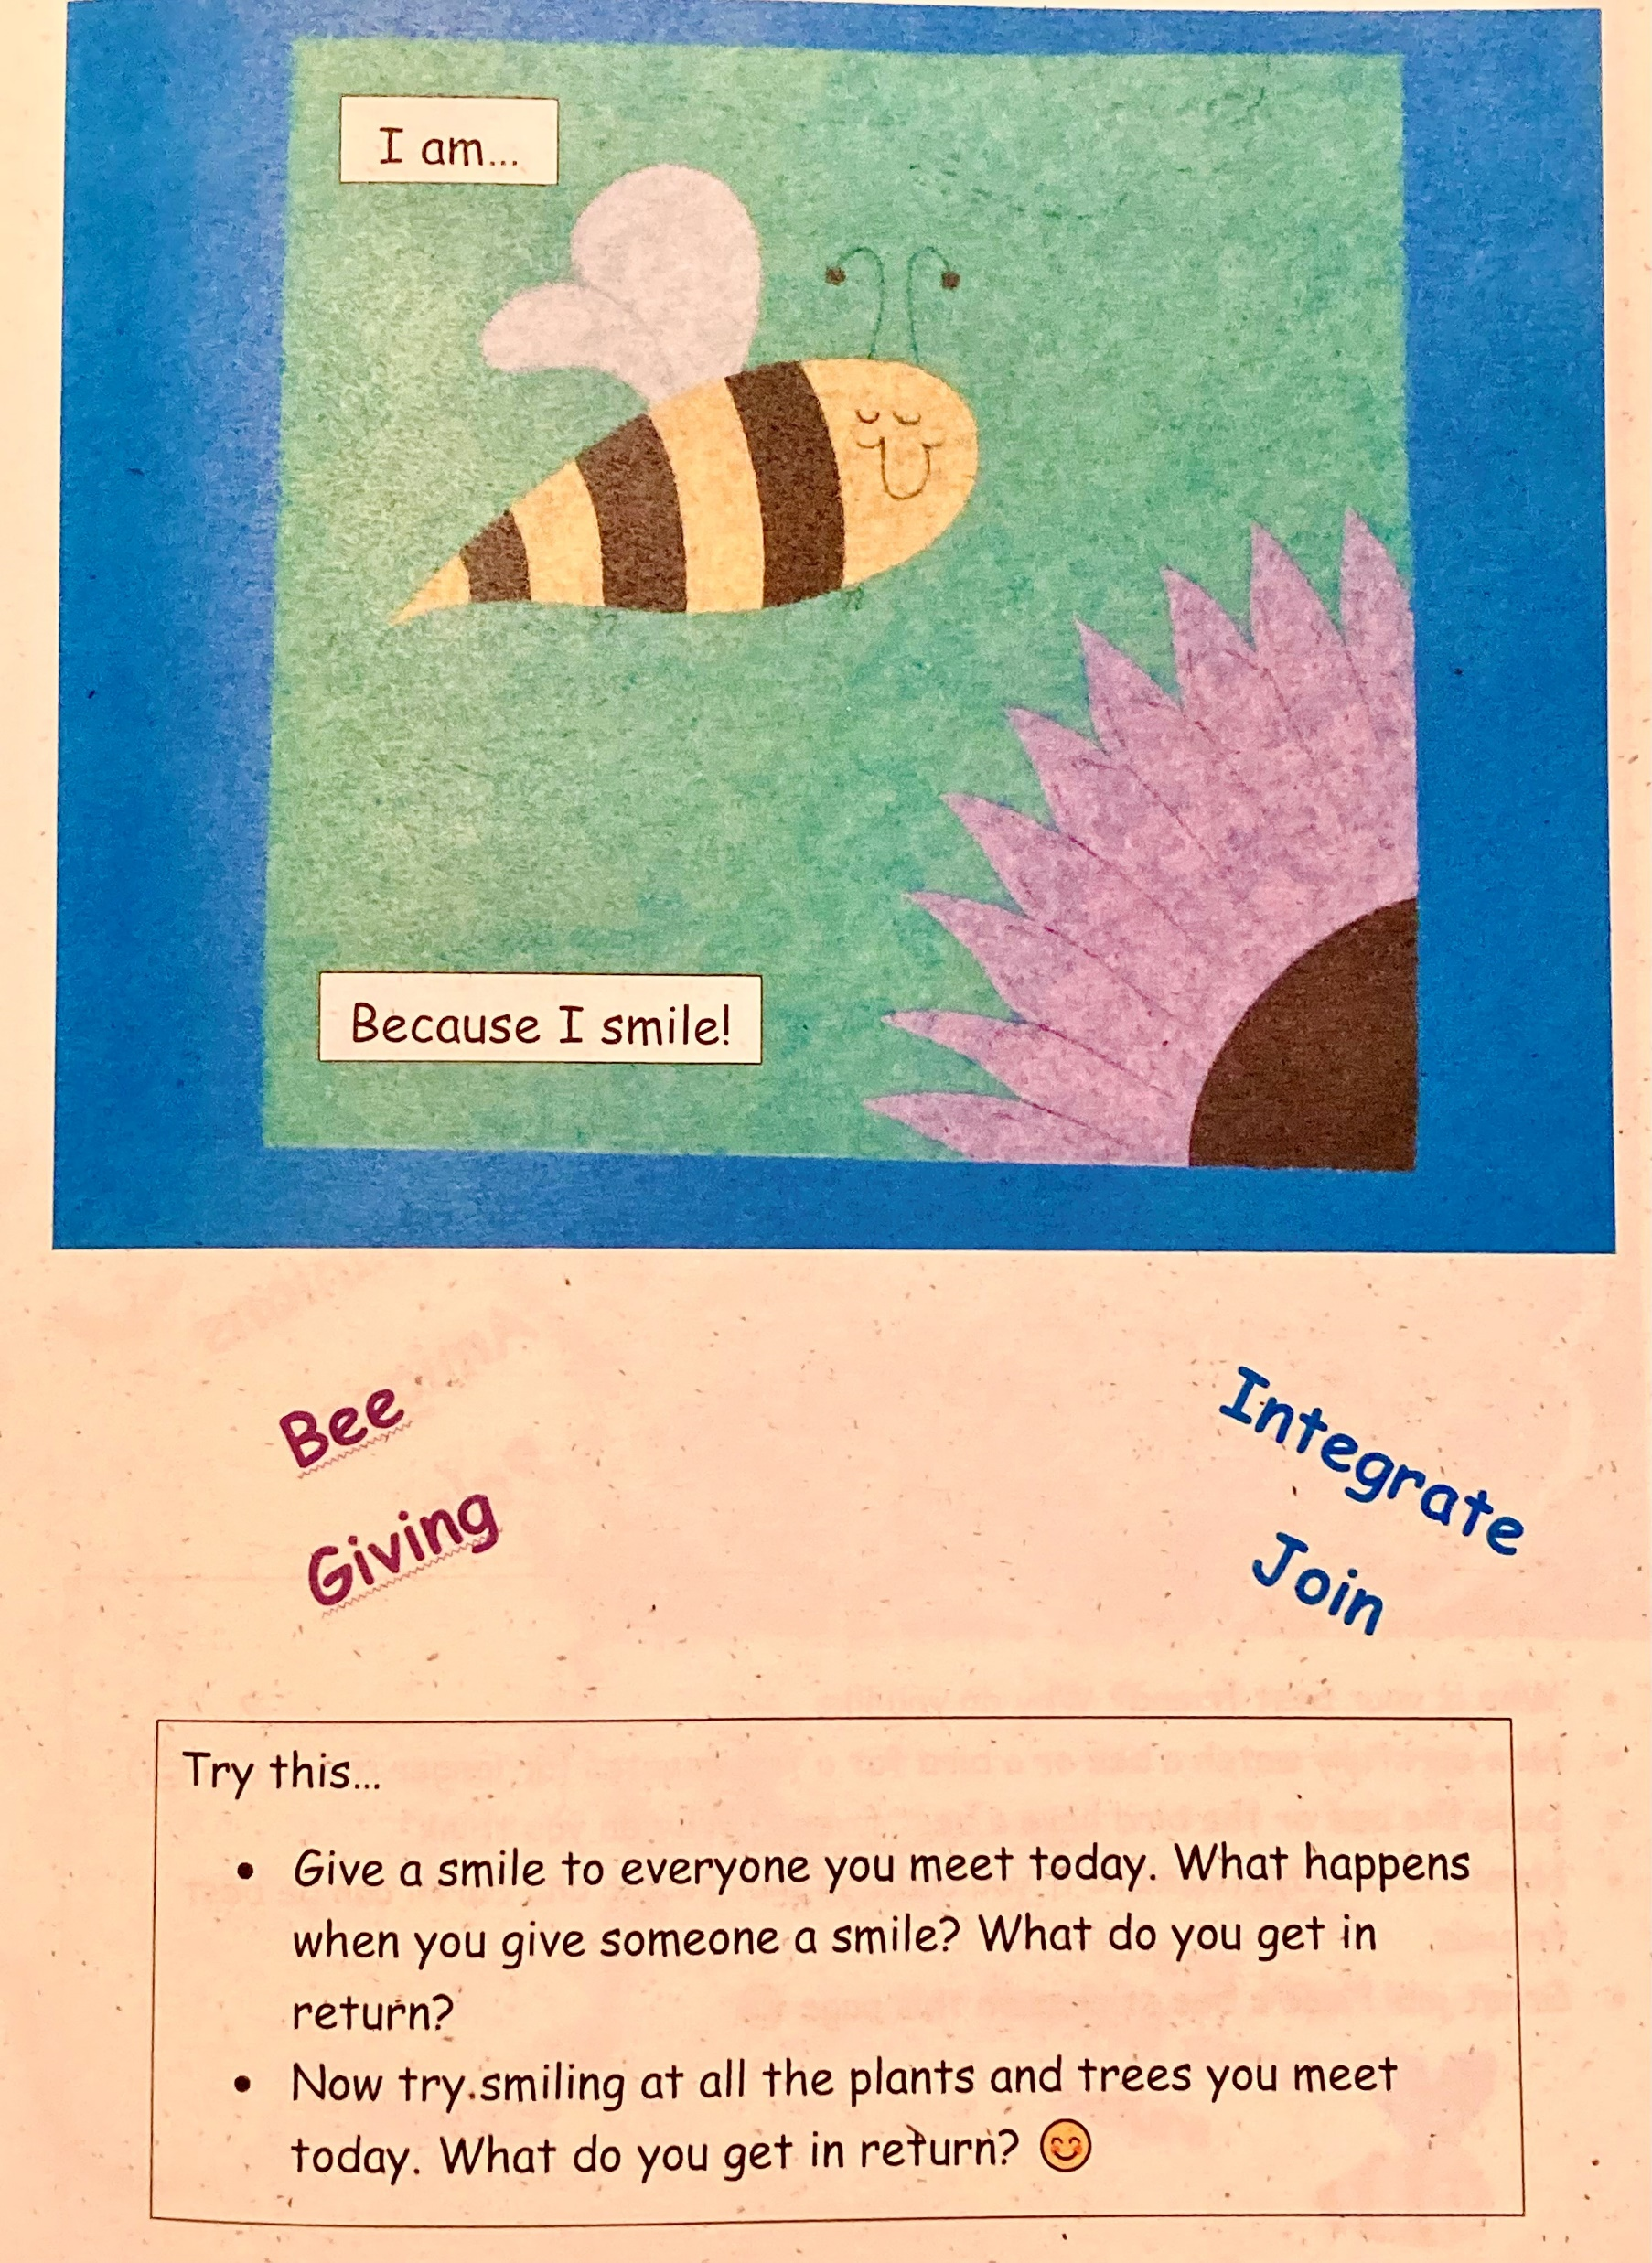
Philosophy of Public Education and Outreach
Notes:
Family learning

Slide 12
Goals of Public Education and Outreach in Resilience to Climate Change Effects
Gain critical information and insights on public education and outreach techniques.
Build partnerships with other stakeholders.
Be better able to articulate local goals and achieve success.

Slide 13
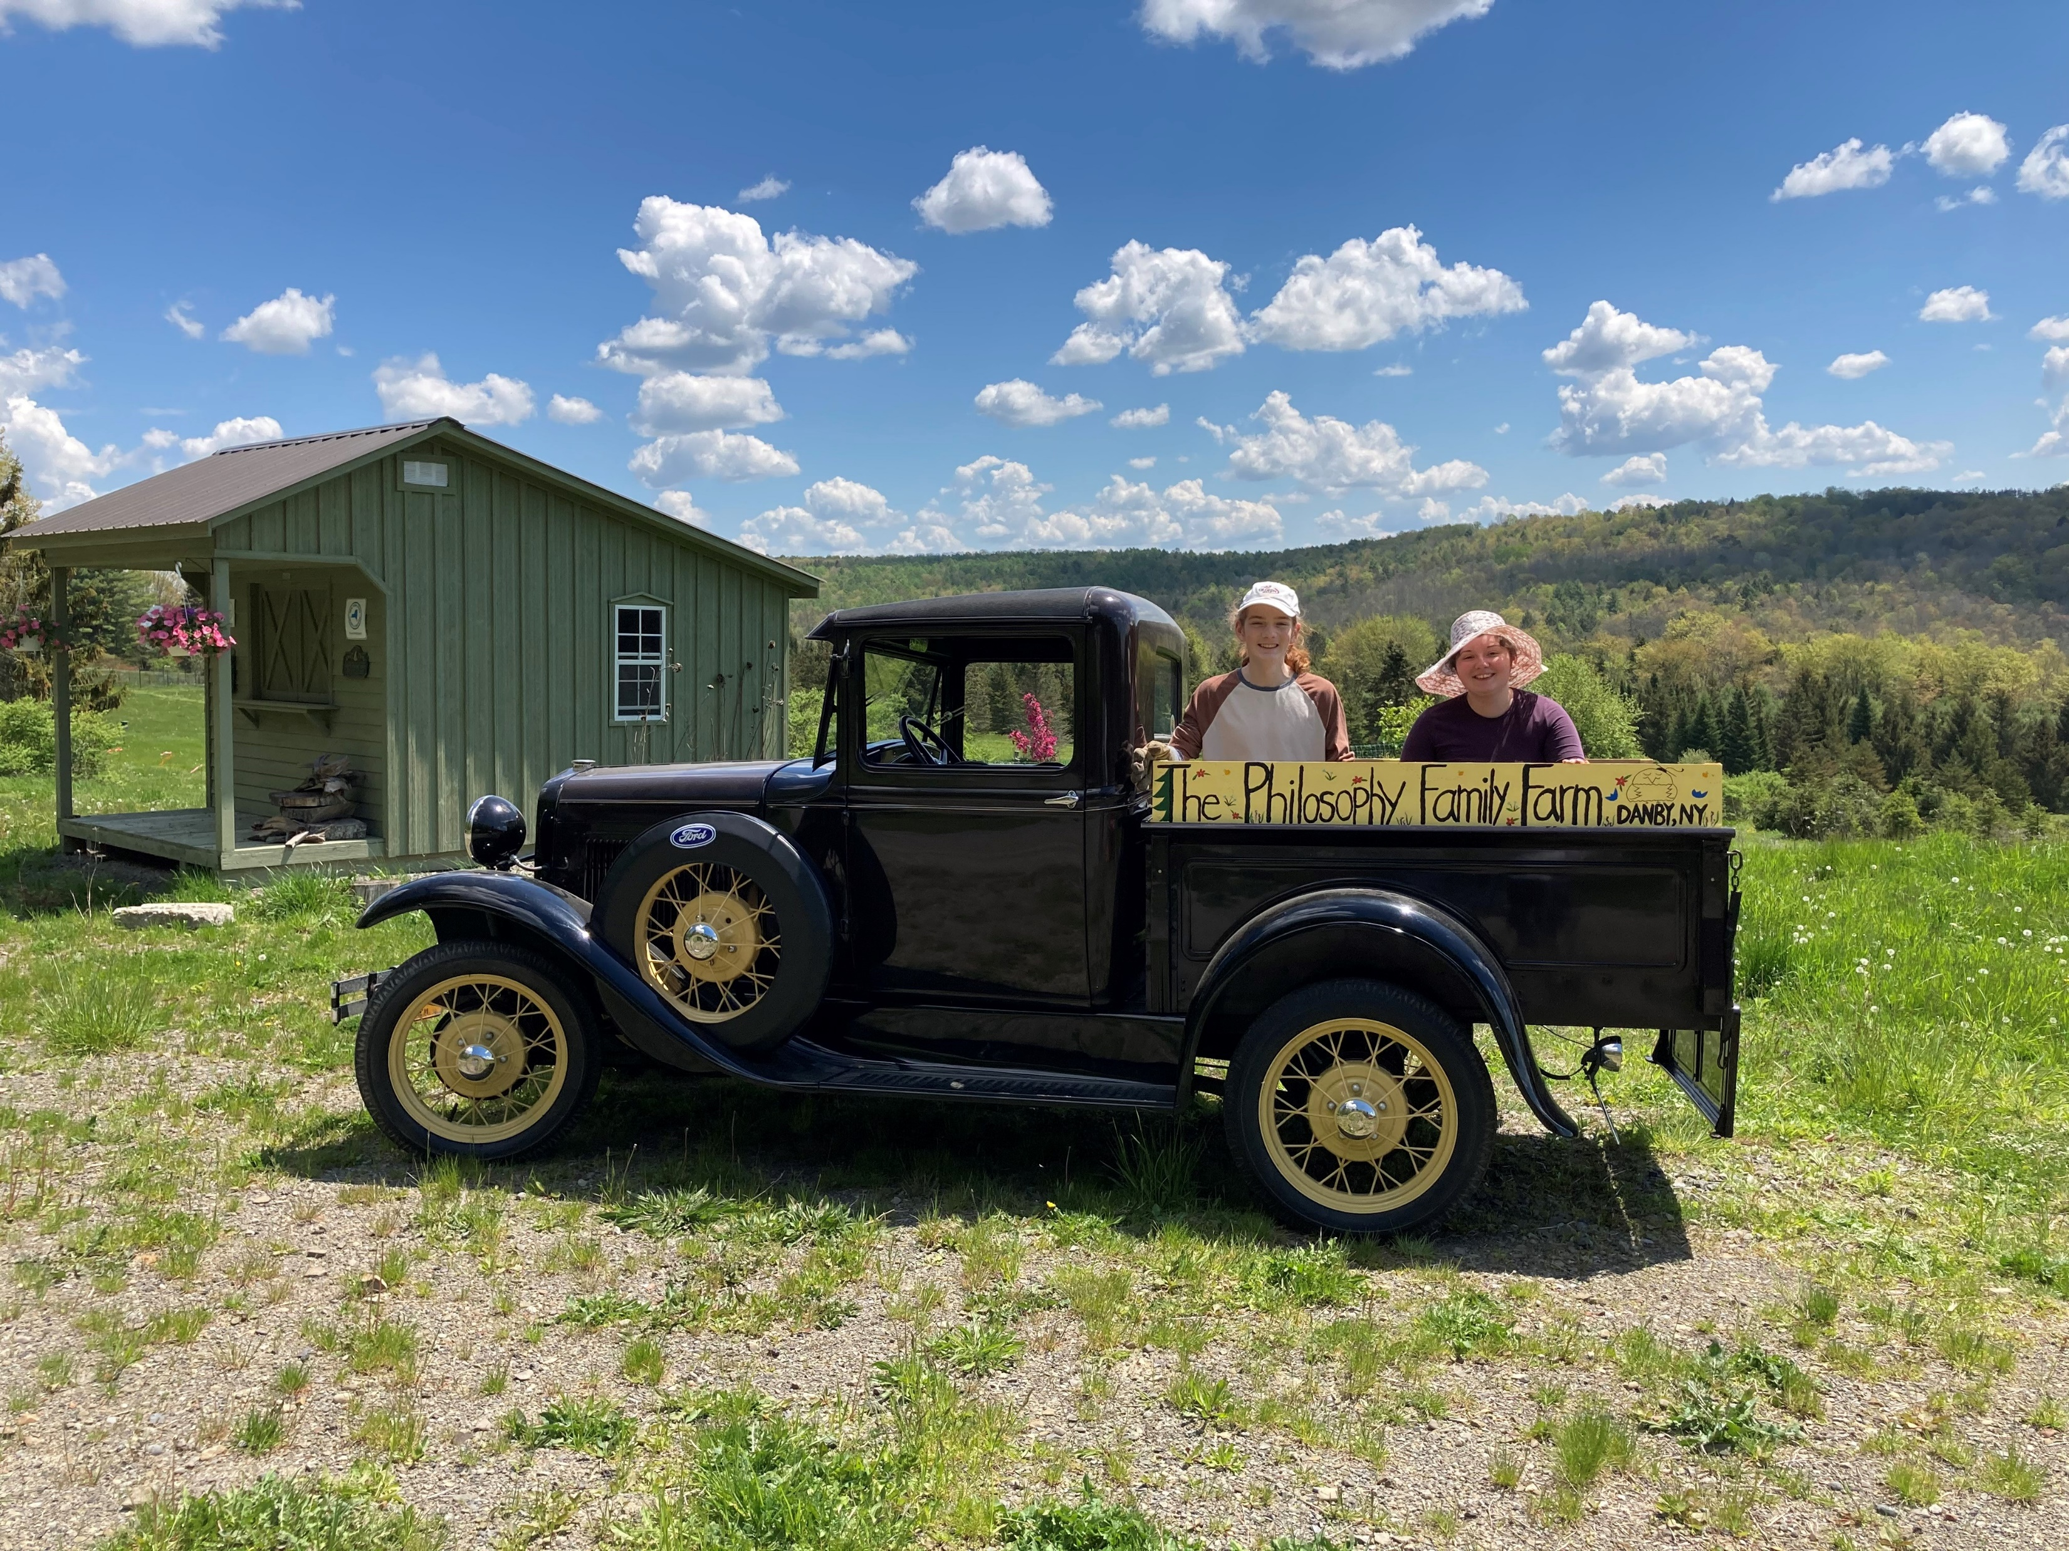
Thank You!
Christopher R. Schmitt
GZA GeoEnvironmental, Inc.
201-463-4267
Christopher.Schmitt@GZA.com
Andrea R. Schmitt
The Philosophy Family Farm, LLC
607-882-5389
Ande@PhilosophyFamilyFarm.com
The kids at the farm with their
1931 Ford Model A truck named “Sparky”

