Slide 1
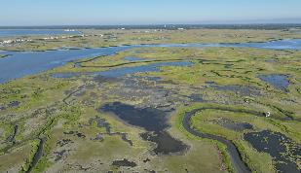
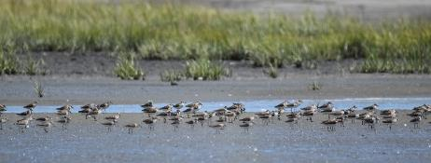
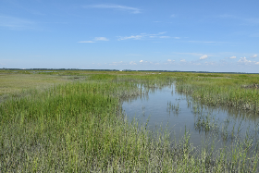
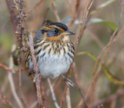
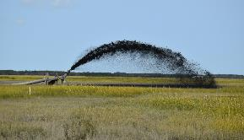
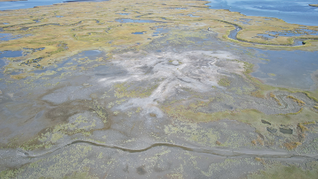
Moving Beyond Case Studies: What We Have Learned from the Seven Mile Island Innovation Laboratory
Lenore P. Tedesco, The Wetlands Institute
Monica Chasten, Jeff McAleer, USACE – Philadelphia District
David Perkey, Brian Harris, Matt Balazik, USACE – ERDC
Lisa Ferguson, Sam Collins, Julie Blum, The Wetlands Institute
Ginger Kopkash, Jason Hearon, Tyler Kinney, Colleen Keller, Dave Golden and Christina Davis, NJ Fish and Wildlife

Slide 2
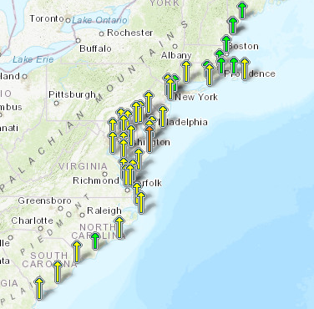
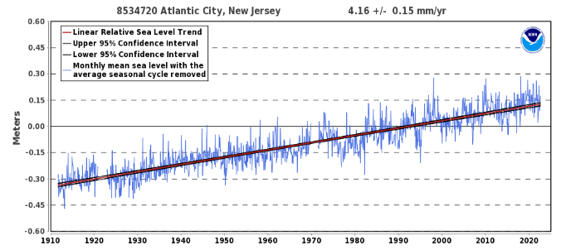
Relative Sea Level Trend
Relative Sea Level Trends
mm/year (feet/century)
New Jersey SLR is 2x Global Average
1911 – 2021 rose 1.36 feet in 100 years
Rate has increased from 2010 of 4.04 mm/year to 4.16 mm/year
Rate over the last 15 years = 6.1 mm/year
Typical marsh accretion rates in the area are 4 mm/year; measured accretion in SMIIL marshes confirm this rate
Regional subsidence rates are ~2 mm/year
https://tidesandcurrents.noaa.gov/sltrends/sltrends.html

Slide 3
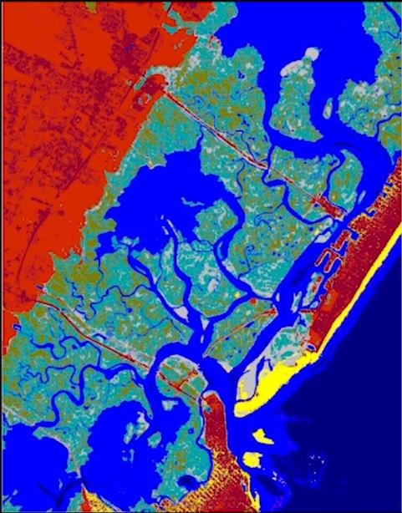
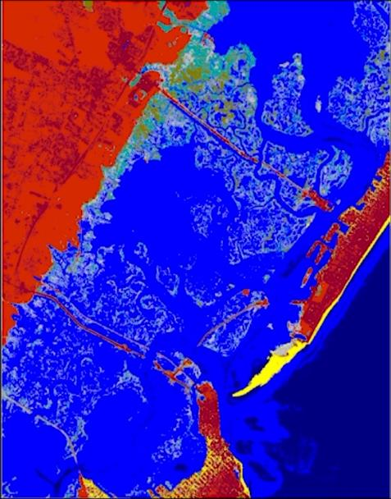
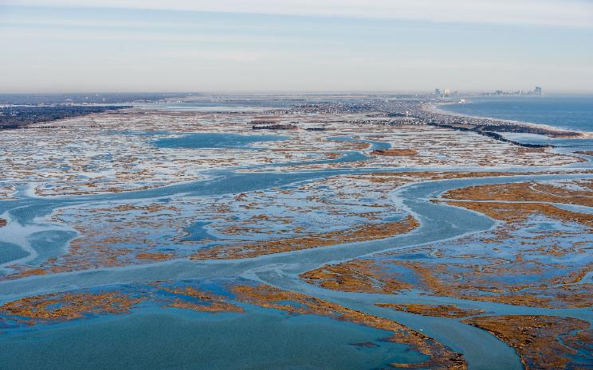
High Tide Flooding (MHW SLAMM) and Coastal Resilience
2020
2035
2.68’ NAVD88
photo Ted Kingston

Slide 4
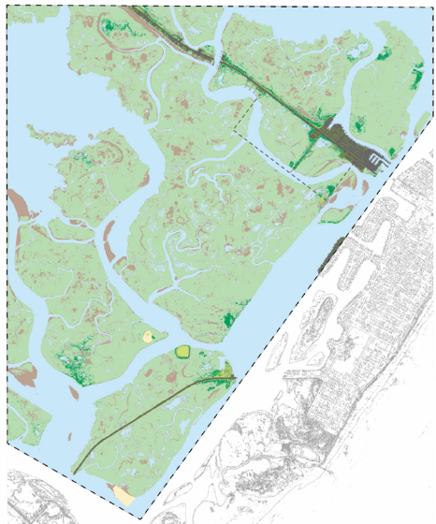
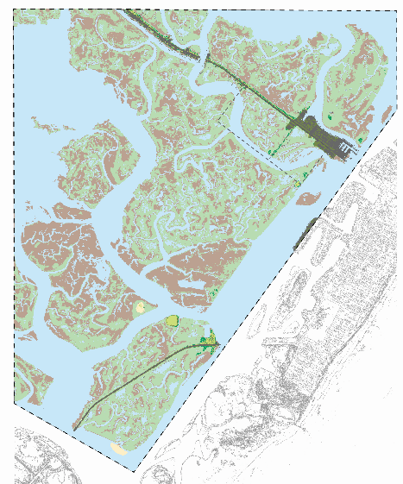
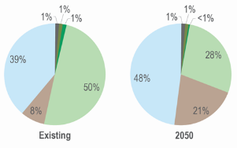
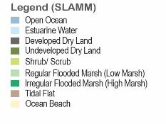
Elevation Derived Habitat Distributions Via SLAMM
2020 Existing Conditions
2050 Predicted Conditions

Slide 5
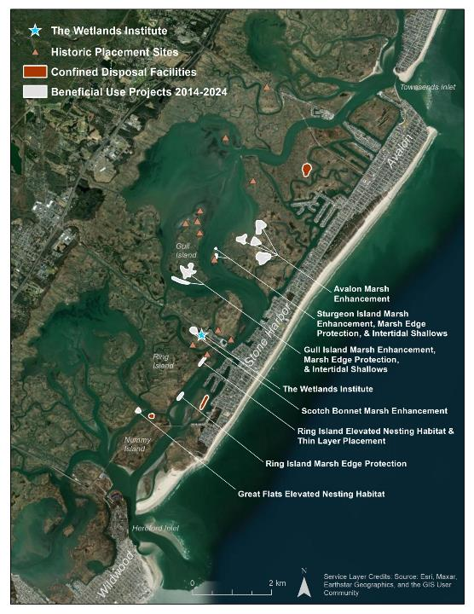
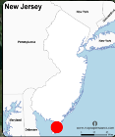
SMIIL Beneficial Use Projects
Sediment Type Mixed Fine Sand and Mud
Project drivers are maintenance dredging of NJIWW
Placement methods are hydraulic dredging and transport
Sediment Type: Fine to Medium Sand
Marry site selection with dredging needs
Sediments and their location drive site selection
Marsh condition assessment then drives project development
Marsh need is so great that marrying ecological and dredging needs is effective

Slide 6
SMIIL Take Home Messages: What Have We Learned (So Far)
Tidal marshes in significant areas of New Jersey have fallen behind rising seas and will benefit from elevation enhancement via sediment inputs.
Balance short-term impact with long-term benefits
Balance placing in thin layers to preserve existing vegetation (rare) vs thicker placement for more ecological uplift and comparable recovery time
Unconfined sediment placement enables natural process to distribute sediments more effectively and can result in better outcomes when “keeping sediment in the system”.
Creates more natural marsh gradient and habitat mosaics
Allows for maintenance or rapid establishment of tidal exchange
Adding sediment to the system reestablished tidal channel geomorphology

Slide 7
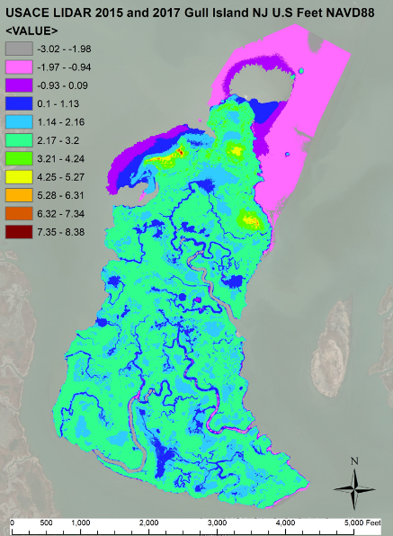
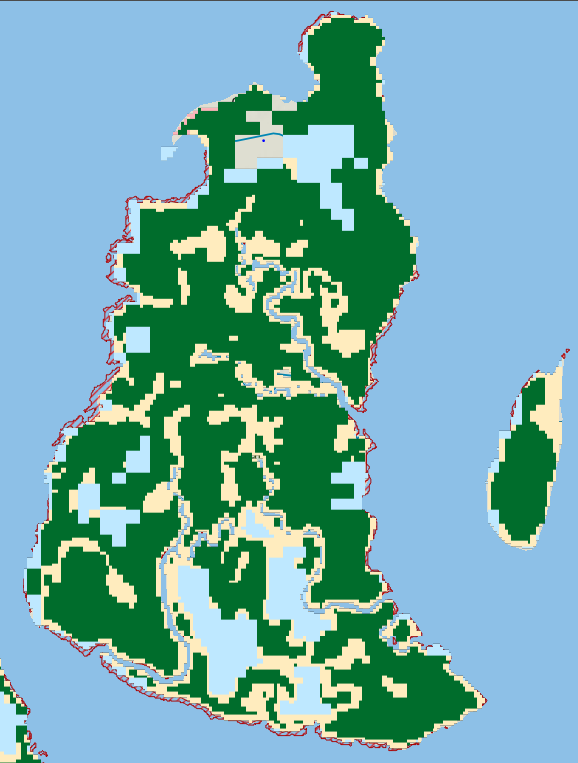
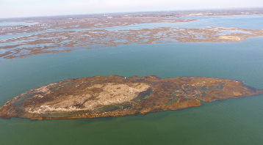
Needs Assessment Identified Both Islands for BUDM Projects
Marsh projected to convert to mud flats and open water and already happening
Marsh edge erosion and risks of breaching
Thickness of placement based on target elevation goals for marsh stability and habitat needs
Large area of coverage favored unconfined placement
2050 2’ Rise
Important Bird Nesting Areas
Gull Island
Sturgeon Island
NJ Floodmapper

Slide 8
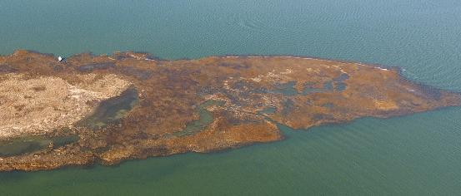
Enhancing a Marsh Landscape
Ecological Goals for Both Gull and Sturgeon Island Placements
Sturgeon Island
Raise Elevations of Marsh Platforms Across a Gradient of Elevations (MEE)
Wading Bird Nesting Elevations - Transitional Upland Shrub Habitat (>3.5’ NAVD88)
High Marsh Elevations for Salt Marsh Sparrow (2.7’ – 3.1’ NAVD88)
Low Marsh Elevation for Fish Habitat (2.0 – 2.7’ NAVD88) and Shorebird and Wader Foraging
Create Marsh Edge Protection Zone (MEP)
More Natural Marsh Edge Slope and Wave Energy Buffer
Intertidal Shoal to Marsh Edge Elevation (2.0’NAVD88)
Enhance Intertidal and Subtidal Shallows (ISS)
Target Elevations to MLLW Where Macroalgal Flats Transition from Sparse to Densely Vegetated (-1.0 MLLW – 0’ MLLW)
MEP
Failing Nesting Area
MEE
ISS
Gull Island
MEE
¥
MEP
ISS

Slide 9
SMIIL Take Home Messages: What Have We Learned (So Far)
Fine-grained sediments build vertically and are deposited locally to much higher extent than is commonly believed
Product of consolidation in source deposits
Aggregates and macro-clasts (>250 µm) form during dredging and transport process (Perkey et al, 2024)
Building elevation may require multiple lifts
Containment during construction may be needed if target elevations are notably above surrounding marsh
Vegetation recovery does not appear to be related to placement thickness but rather appropriate elevations for flood frequency
Benchmark elevations are likely relict and underrepresenting target elevations
If placement elevations are too low, may result in lack of vegetation recovery

Slide 10
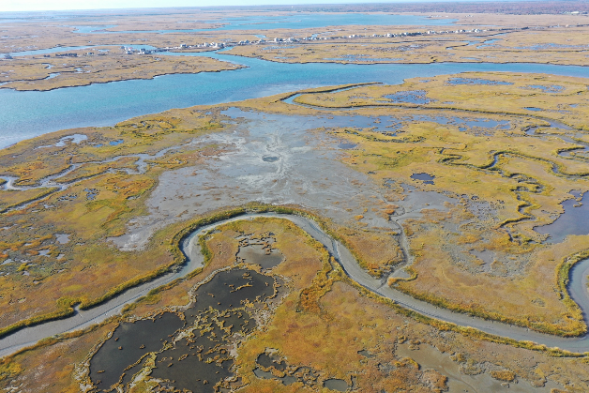
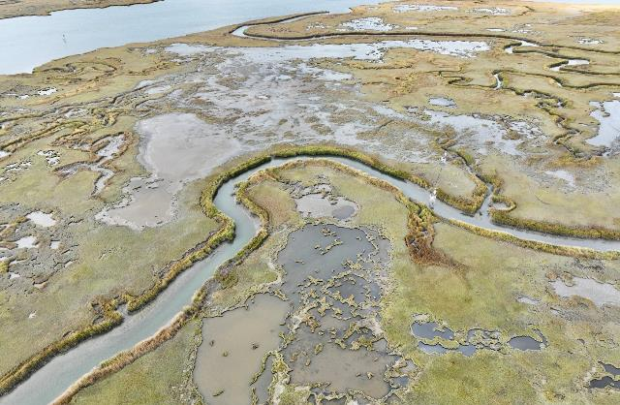
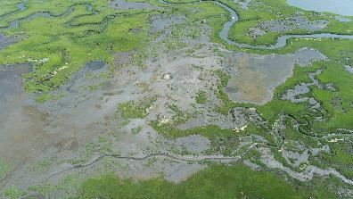
Multihabitat Unconfined Placement
September 2020
October 2022
22 acres of marsh elevation enhancement by up to 2’
Unconfined placement of 40,000 cubic yards of fine-grained sediments
Natural flow paths spread material over large portion of placement area
Lack of containment allowed for tidal connection to establish quickly
Resulted in habitat mosaic at higher elevations to offset SLR elevation losses
Excellent Spartina recovery and expansion by seedbank
July 2022

Slide 11
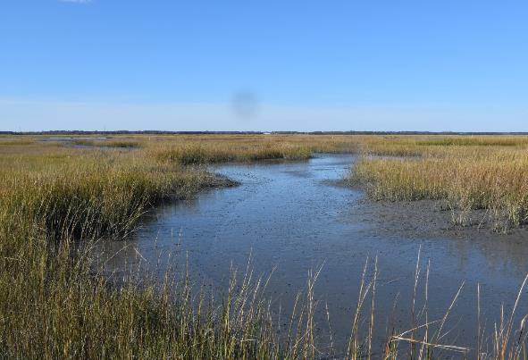
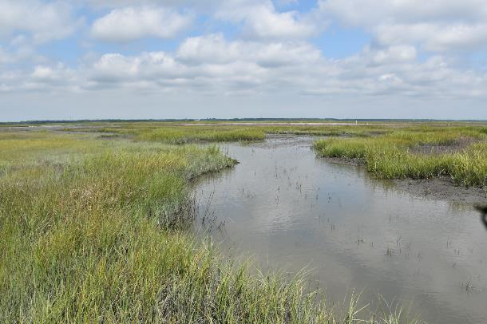
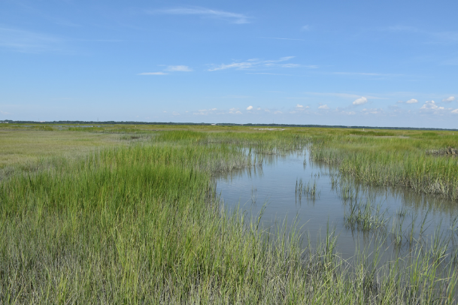
2020-11-04
View W Point 2
2021-07-12
2021-09-12
2022-08-02

Slide 12
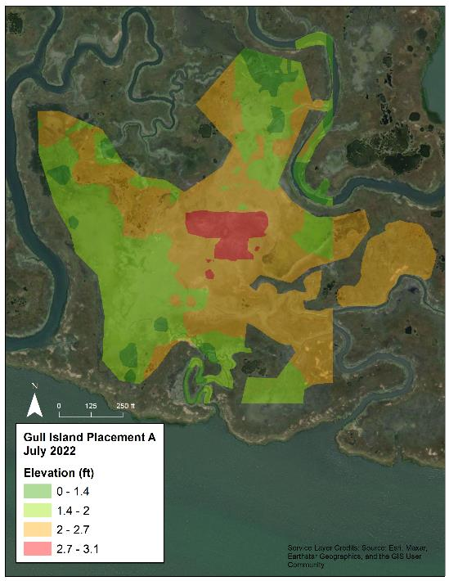
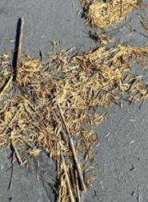
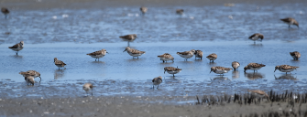
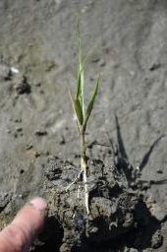
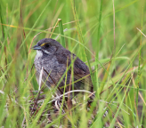
Multihabitat Unconfined Placement
Restored low marsh habitat and shallowed interior intertidal flats and pools into Spartina vegetation elevation zones
Created high tide flats for shorebirds and wading birds
Avian surveys documenting more than 25 species utilizing placement area for foraging
Created small area of high marsh but below target elevations for transitional wading bird habitat
Salt Marsh and Seaside Sparrows foraging on site
Natural vegetation recolonization and expansion proceeding well after 2-year post-placement timeframe
Southeast Creek
Jug Creek
High Marsh (2.7- 3.1’) - 1 acre
Low Marsh (2.0 – 2.7’) – 11.8 acres
Intertidal Flat and Pools (1.4 – 2.0’) – 9.7 acres
NAVD88 ft

Slide 13
SMIIL Take Home Messages: What Have We Learned (So Far)
Marsh edge loss is occurring at rapid rates in many areas and needs to be addressed along with marsh interior enhancements.
It is possible to build subtidal to intertidal berms in the near marsh environment that:
Have limited turbidity effects and benthic community impact
Persist
Provide marsh edge protection

Slide 14
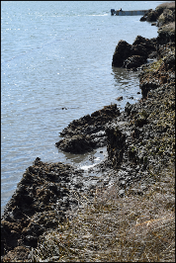
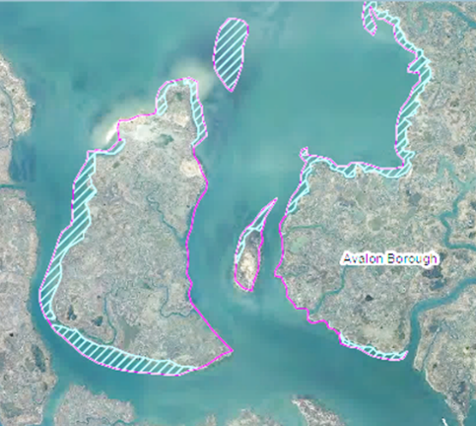
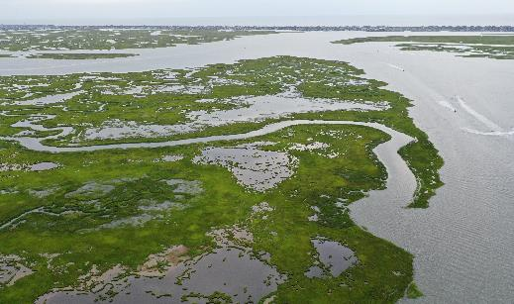
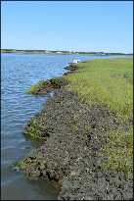
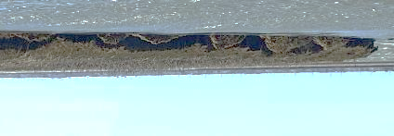
Using Fine-Grained Sediment to Build Marsh edge Protection Features
Marsh Edge Erosion is Occurring at Rapid Rates
Related to storm waves and boat wakes
Hydraulic loading of saturated marshes/seepage erosion
Accelerates marsh loss through pool breaching
Marsh Edge Loss at Gull Island
25 meters of retreat since 1937
~0.3 m/year retreat rate
Marsh Loss: 1930 – 2012
1930 Marsh Limits
8/28/2020

Slide 15
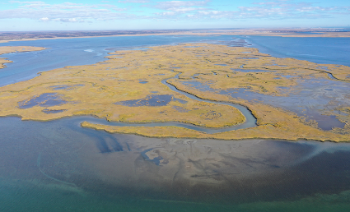
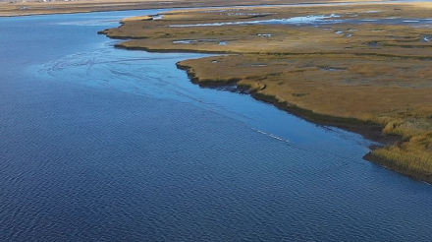
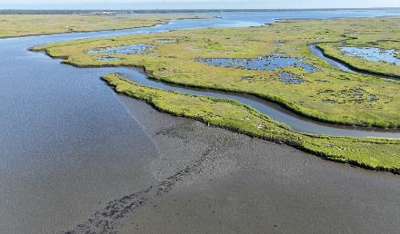
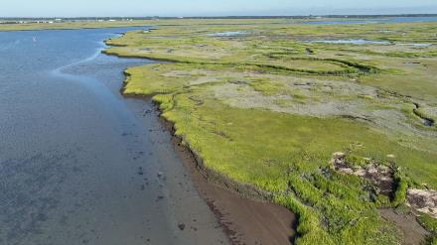
Using Fine-Grained Sediment to Build Marsh edge Protection Features
September 2020
1 Month Post Placement
August 2022
2 Years Post Placement
Marsh Edge Protection Berm
Indirect Placement – Intertidal Shallows

Slide 16
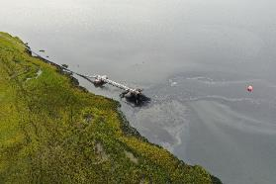
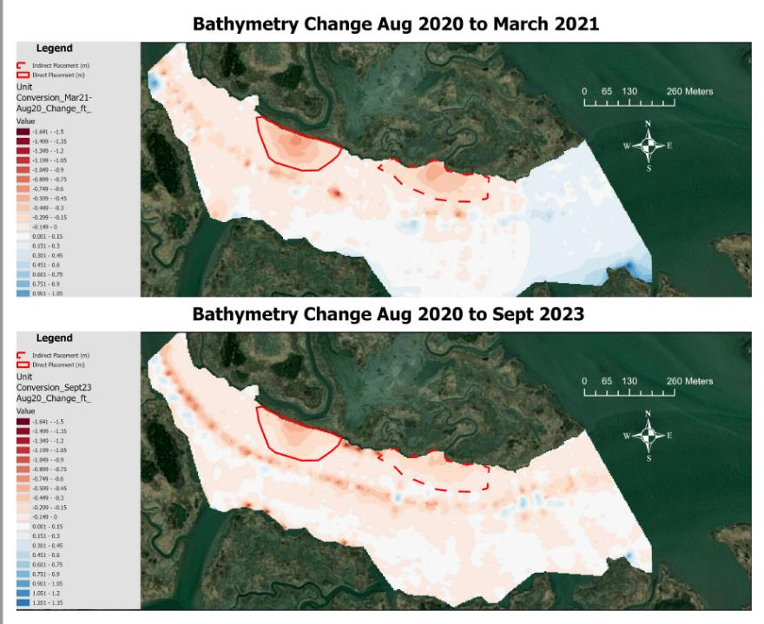
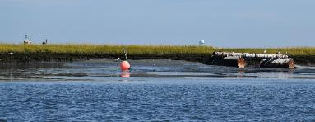
Placed ~9000 cy of fine-grained sediment (59-73%) in each feature and gained 1 – 2.5’ of elevation along marsh edge
More than 90% of directly placed material was accounted for in berm 6 mos post-placement without containment
Features show 30-40% reduction in volume after 36 months

Slide 17
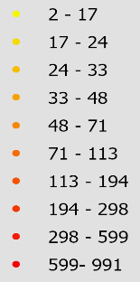
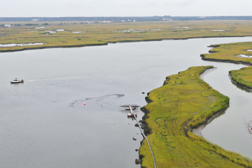
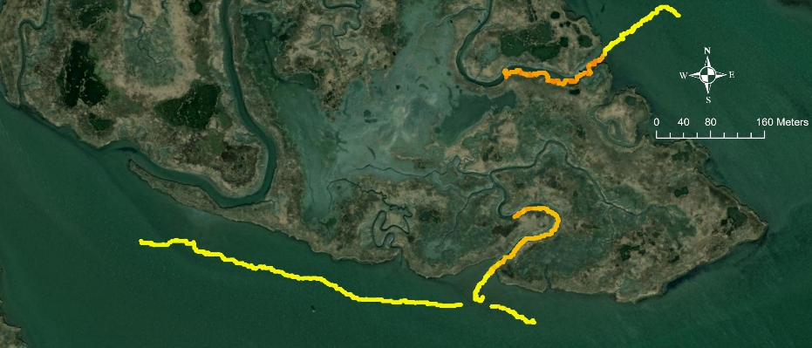
Turbidity Monitoring
Turbidity plume was localized, only extending about 40 m from the discharge pipe and <200 m along shore.
Only marginally higher than storm-induced turbidity (Fall et al. 2021)
One-week post-placement turbidity returned to background (Fall et al. 2022)
Turbidity (NTU)
9/25/2020
11/04/2020

Slide 18
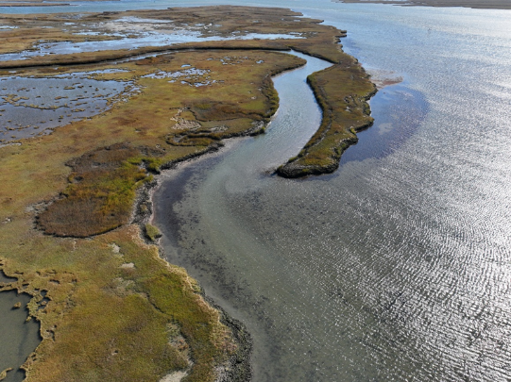
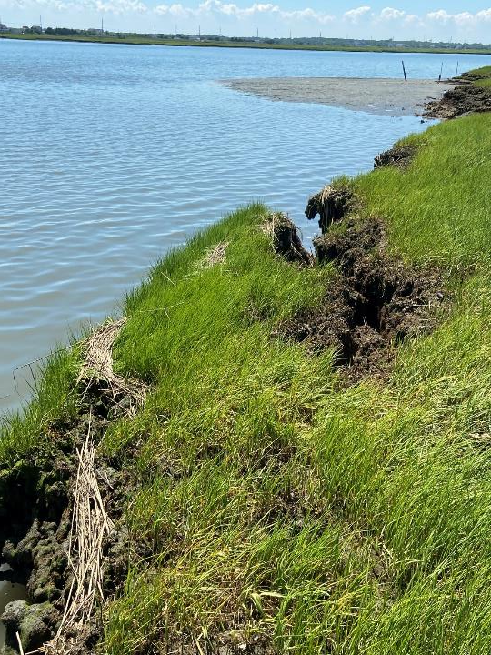
Marsh edge Protection
November 2022
Marsh edge collapse occurring away from protection feature
No block failure in areas of berms
June 25 ,2022

Slide 19
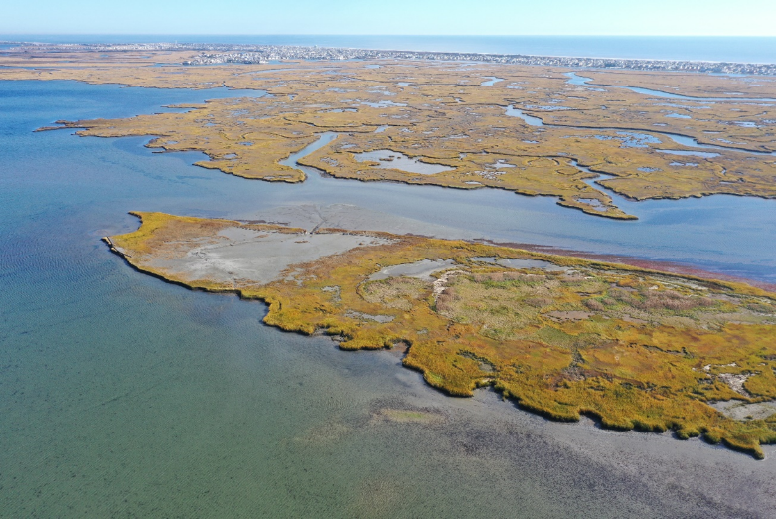
Sturgeon Island Placements: Enhancing a Marsh Landscape
Placed in Two Phases in 2020
March 2020
4,200 cubic yards
September 2020
15,000 cubic yards
Mixed fine sand and mud
Marsh Elevation Enhancement (MEE)
3.5 acres of enhancement
3.0’ NAVD88 grading down to 1.9’
Marsh Edge Protection (MEP)
Placed small sand ridge along toe of erosional slope
Enhanced Intertidal Shallows (ISS)
Shallowed above MLLW along eastern island to extend flats northward
Used repetitive placement to build elevation
Fall 2022 Phase 3 placement
Nesting Area
Intertidal Shallows and Intertidal Flats
Wading Bird Nesting Habitat
Marsh Edge Protection
Marsh Elevation Enhancement

Slide 20
Marsh Elevation Capital With Rapid Natural Vegetation Recovery
8/2022
2020 uncontained placement achieved 1.5 – 2.5’ of marsh elevation enhancement
Rapid vegetation recovery in areas with suitable hydrology driven by elevation
Vegetation response unrelated to placement thickness

Slide 21
Sturgeon Island Phase 3 – Fall 2022
Placed 24,000 CY of fine sand to create sandy marsh edge protection features
Intercepting wave energy
Used containment to elevate 0.4 acre for elevated bird nesting habitat
Placed more than 3’ of material
Built to 4.0’ NAVD88
Employed Y-valve to switch between containment and subtidal features
Maintain dredging efficiency
Allow time for contained area to dewater
Slow and manage flow volumes and velocities

Slide 22
Sturgeon Island

Slide 23
Marsh Elevation and Vegetation Relationships
9/25/2020
8/19/2022
Limited area of Spartina die-back during placement
No recovery in areas below Spartina recruitment elevations (1.8’ NAVD88 in SMIIL)
Vegetation is persisting when outside of colonization elevation
Showing importance of role of disturbance without suitable elevation target

Slide 24
SMIIL Take Home Messages: What Have We Learned (So Far)
Tidal marshes in significant areas of New Jersey have fallen behind rising seas and will benefit from elevation enhancement via sediment inputs.
Balance short-term impact with long term benefits
Balance placing in thin layers to preserve existing vegetation (rare) vs thicker placement for more ecological uplift and comparable recovery time
Unconfined sediment placement enables natural process to distribute sediments more effectively and can result in better outcomes when “keeping sediment in the system”.
Creates more natural marsh gradient and habitat mosaic
Allows for maintenance or rapid establishment of tidal exchange
Fine-grained sediments build vertically and are deposited locally to much higher extent than is commonly believed
Building elevation may require multiple lifts and if elevation is notably above surrounding marsh may require containment during construction
Vegetation recovery does not appear to be related to placement thickness but rather appropriate elevations for flood frequency
Benchmark elevations are likely relict and underrepresenting target elevations
Marsh edge loss is occurring at rapid rates in many areas and needs to be addressed along with marsh interior enhancements
It is possible to build subtidal to intertidal berms in the near marsh environment that:
Have limited turbidity effects and benthic community impact
Provide marsh edge protection

Slide 25
Advancing Science and Practice at the Seven Mile Island Innovation Laboratory
For more information:
Lenore Tedesco – ltedesco@wetlandsinstitute.org
Monica Chasten - Monica.A.Chasten@usace.army.mil
Wetlandsinstitute.org/SMIIL

Slide 26
Relevant Publications
Beardsley, Welp, Harris, McFall, Tyler, and Savant (2022): Sediment Distribution Pipe: Modeling Tool and field Application. WEDA Journal of Dredging, v. 20 (1) 16-37.
Chasten, Goldberg, Pasquale, Piercy, Welp, and Golden (2016): Recent Experience with Channel Dredging and Placement to Restore Wetlands In New Jersey, WODCON XXI PROCEEDINGS.
Chasten, M., Tedesco, L., and Kopkash, G. (2022). Advancing Sediment Solutions in the Seven Mile Island Innovation Laboratory. Coastal Engineering Proceedings, (37), 64-64.
Collins, Ferguson, Morey, and Tedesco (2021): Cape May Wetlands Wildlife Management Area Habitat Restoration Monitoring and Evaluation, https://wetlandsinstitute.org/wp-content/uploads/2022/11/FG19-057_TWI_2019-2021_FINAL.pdf
Ecoshape (2018): Living Lab for MUD Brochure, www.ecoshape.org.
Fall, Perkey, Tyler, and Welp (2021): Field Measurement and Monitoring of Hydrodynamic and Suspended Sediment with the Seven Mile Innovation Laboratory, New Jersey, ERDC/CHL TR-21-9, https://permanent.fdlp.gov/gpo185925/ERDC-CHLTR-21-9(1).pdf
Fall, Perkey, Tedesco and Chasten (2022): Impact of Strategic, Unconfined, Dredged Material Placement on Turbidity Within a Shallow Back Bay System: observations from Seven Mile Island Innovation Laboratory, NJ, WEDA Journal of Dredging, v. 20 (1) 38-49.
Perkey, D. W., Smith, S. J., Fall, K. A., Tarpley, D. R., and Friedrichs, C. T. (2024). Production and abundance of macro-aggregate bed clasts from moderately consolidated cohesive beds and their implications for sediment management. Journal of Sedimentary Research, 94(1), 37-50.
Rochette, Chasten, Tedesco, and Kopkash (2019): Seven Mile Island Innovation Laboratory, Overview and Purpose Fact Sheet, www.nap.usace.army.mil.
Sea Level Rise in New Jersey: Projections and Impacts – New Jersey Climate Change Resource Center,” https://njclimateresourcecenter.rutgers.edu/climate_change_101/sea-level-rise-in-new-jersey-projections-and-impacts/.
Tedesco, Chasten, Ferguson, Collins, and Davis (2021): Using Dredged Sediments to Uplift Marshes, Build Subtidal Shallows and Provide Marsh Edge Protection in the Seven Mile Island Innovation Lab, Delaware Estuary Science and Environmental Summit, https://delawareestuary.org/delaware-estuary-science-and-environmental-summit/

