Slide 1


Monmouth County coastal lakes, beaches and stormwater
Dr. Jason E. Adolf
Endowed Associate Professor of Marine Science
Monmouth University

Slide 2
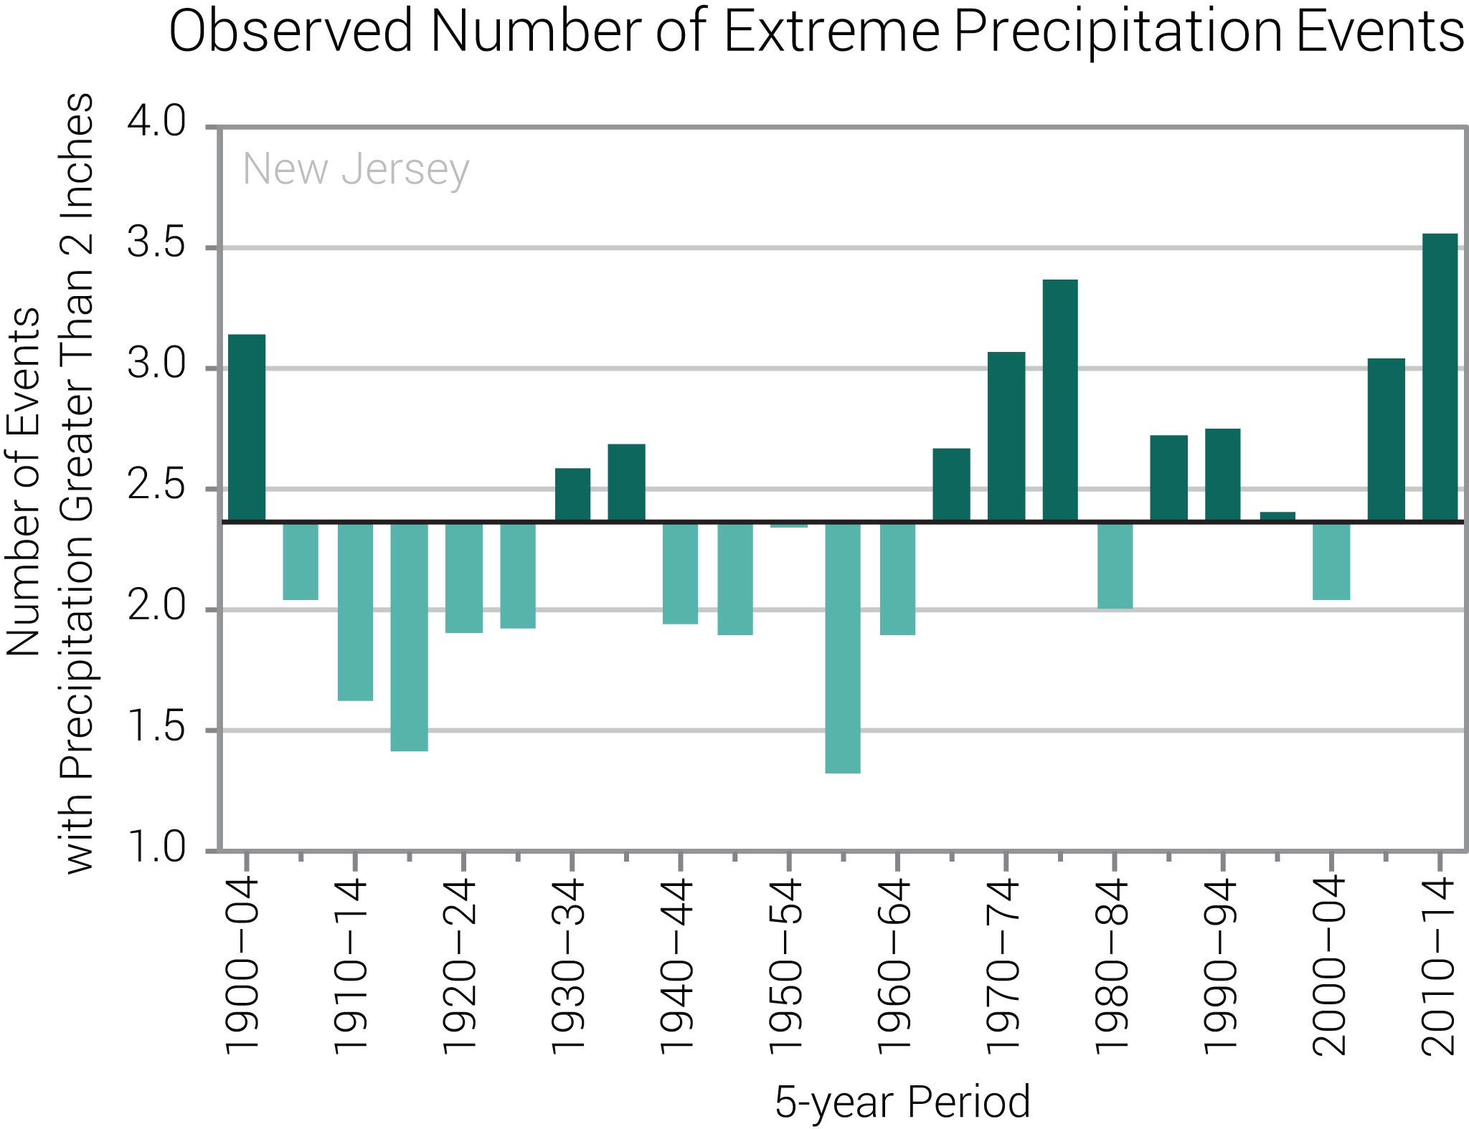
Environmental drivers of ecosystem change
In coastal ecosystems runoff is an important driver of ecosystem variability
  Rainfall is a proxy for stormwater runoff
https://statesummaries.ncics.org/chapter/nj/

Slide 3
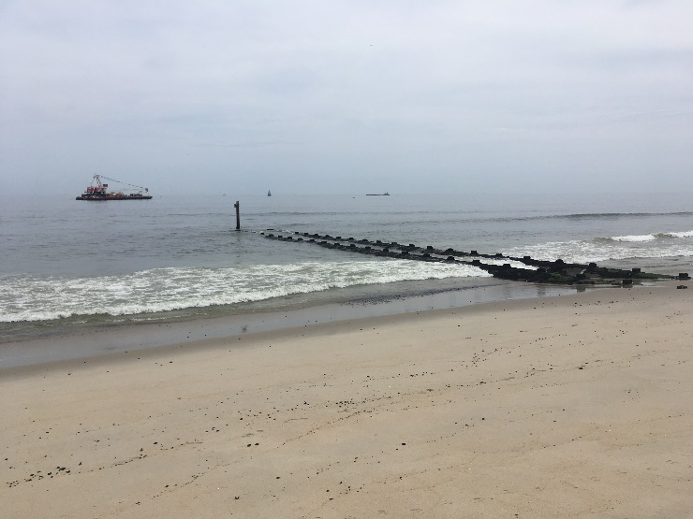
Coastal Lakes and Beaches are two examples of stormwater-impacted ecosystems
Monmouth County Coastal Lakes
Roosevelt Ave. (Deal Fishing Beach)

Slide 4

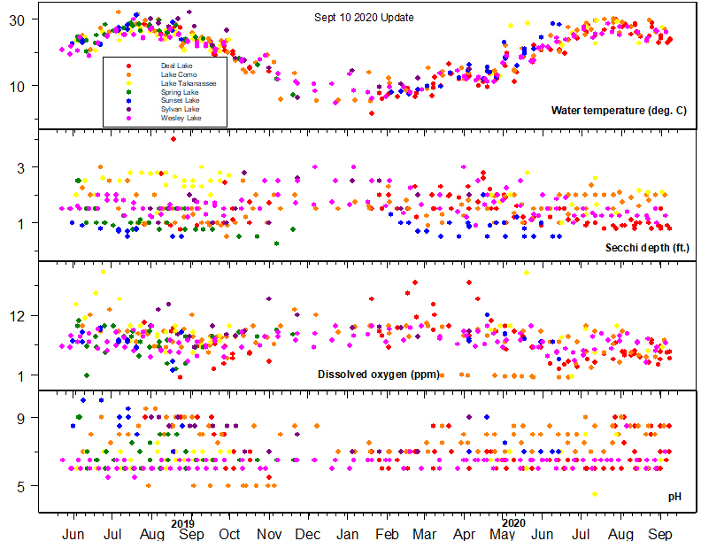
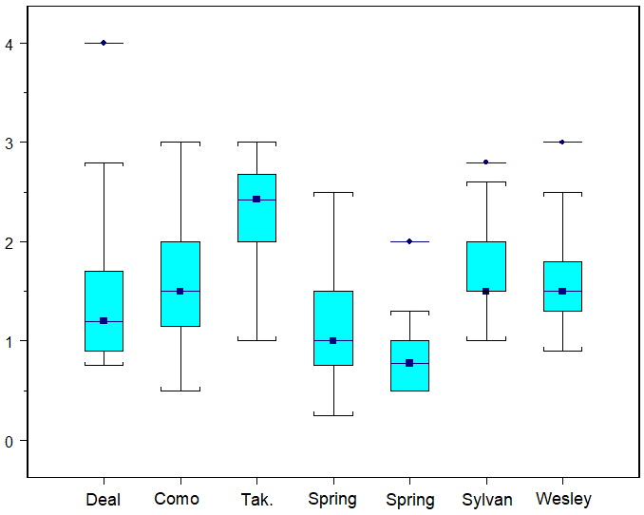



Water quality varies between coastal lakes and within individual lakes (over time)
Research question: What causes differences?
Secchi depth (ft.)
Dr. Jason E. Adolf
Monmouth University
Thanks to the Jules L. Plangere Foundation for support
Provisional data collected by CLONet citizen scientists

Slide 5
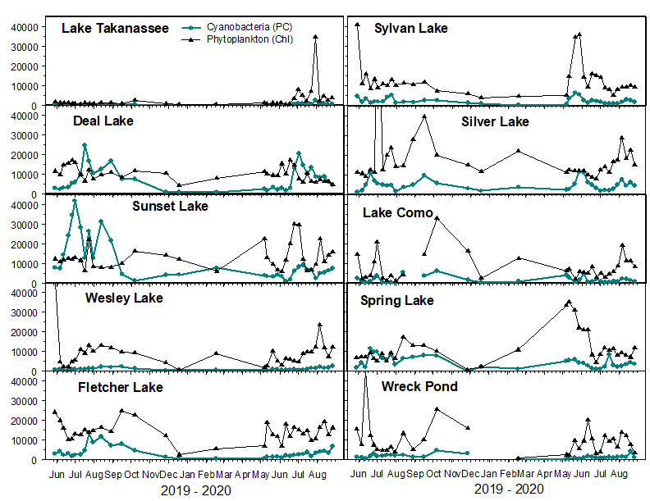
Harmful algal bloom (HAB) abundance varies between lakes and within lakes (time)
Phytoplankton or HAB abundance (RFU)

Slide 6
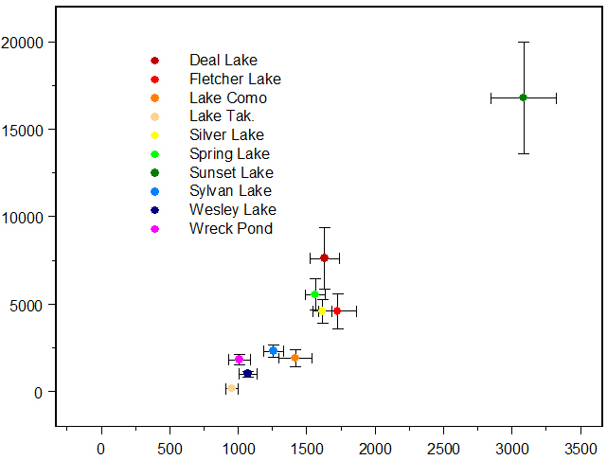
Which environmental factors correlate best with HAB abundance across coastal lakes?
Total Nitrogen (TN)
Also tested Total Phosphorus, inorganic N and P, pH, water clarity, temperature
  These are important but N-loading of coastal lakes is the main environmental driver of HABs
Our data suggested ample P is already in the lake sediments where HABs form
Storm water can be a source of N and P to lakes, especially lakes found in urbanized watersheds
HAB abundance (RFU)
Each point is the average of 16 measurements of HABs and TN, May 2019 – Feb 2020
Total N (mg L⁻¹)

Slide 7
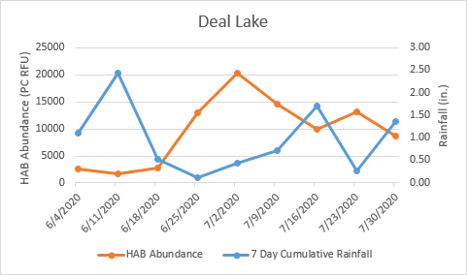
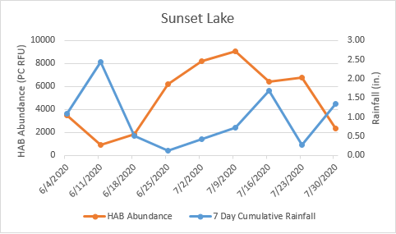
We are now focusing on short-term dynamics between rainfall and HABs in coastal lakes
Karly Nolan and Maria Riley, Monmouth University MEBP students
2020 Summer Research Program

Slide 8
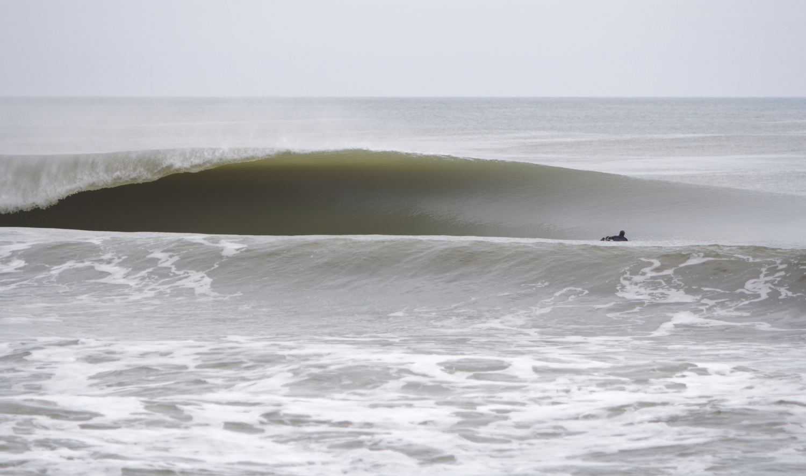
Let’s talk about microbial pollution and rainfall at surfing beaches
Anecdotal links between FIBs, rainfall and stormwater outfalls
Research questions: How well can rainfall predict FIBs at surfing beaches?

Slide 9
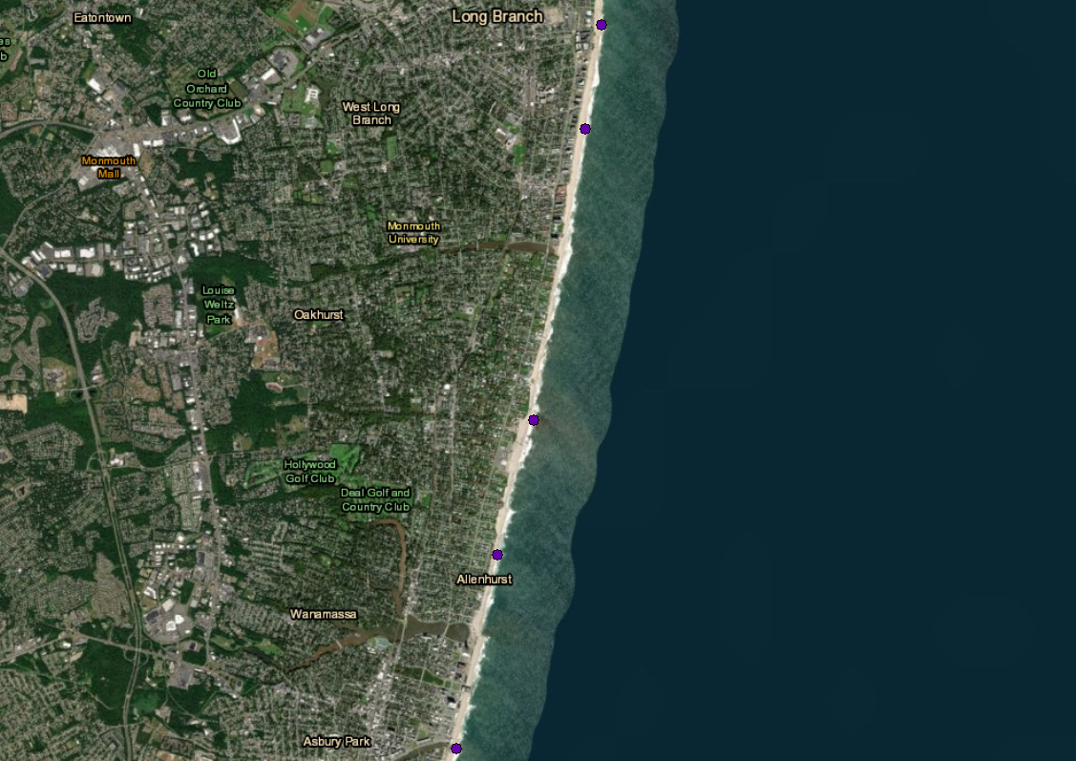

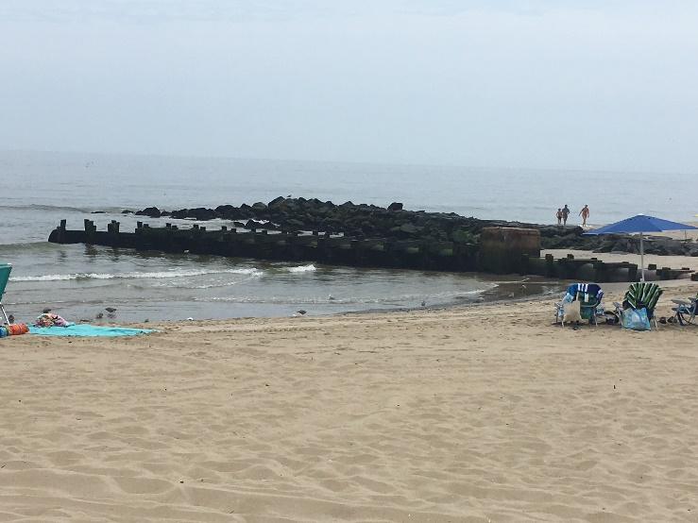
All sites had stormwater outfalls but were not equivalent
‘Ocean Place’
Long Branch
East Long Branch Rainfall Station
(Not Visible)
S. Bath Ave.
Long Branch
Roosevelt Ave. drainage pipe. Representative of stations 4 and 5.
Lake Takanassee Rainfall Station
Neptune Ave. drainage pipe (arrow) opening out to sand, rocks and some brush.
Roosevelt Ave.
Deal
Neptune Ave.
Deal
Deal Lake
Rainfall Station
Wesley Lake
Asbury Park
Wesley Lake drainage pipe connected to Wesley Lake.

Slide 10
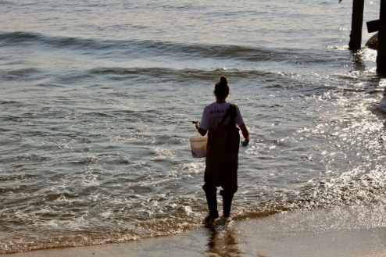
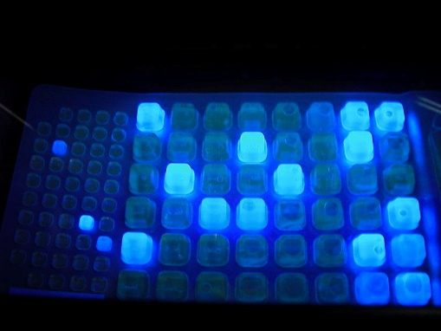
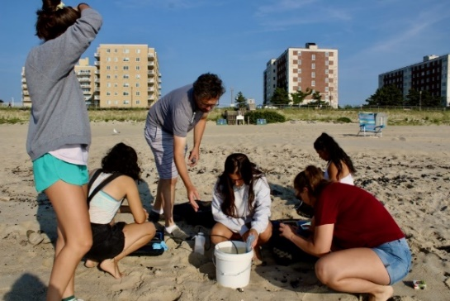
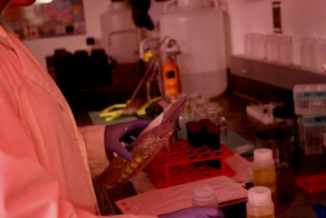
Collect at beaches (between 7am – 10am)
Hourly rainfall data from http://njdep.rutgers.edu/rainfall/
Sterile 50 mL tube for IDEXX
Bucket / 1L bottle for water quality
East Long Branch, Lake Takanassee, and Deal Lake stations
24h incubation to determine Enterococcus abundance
Water temperature
Salinity
Dissolved oxygen
Turbidity
pH
Chl a
-US EPA approved method
-Official ATSM Method (#D6503-99)
Tested different cumulative rainfall (6, 12, 24h) as well as time-weighted indices as predictors of Enterococcus sp.

Slide 11
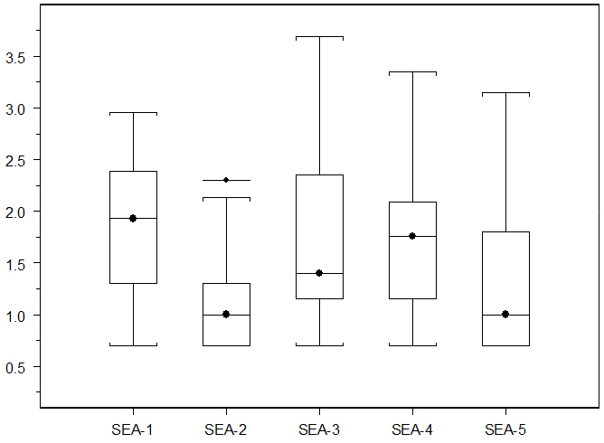
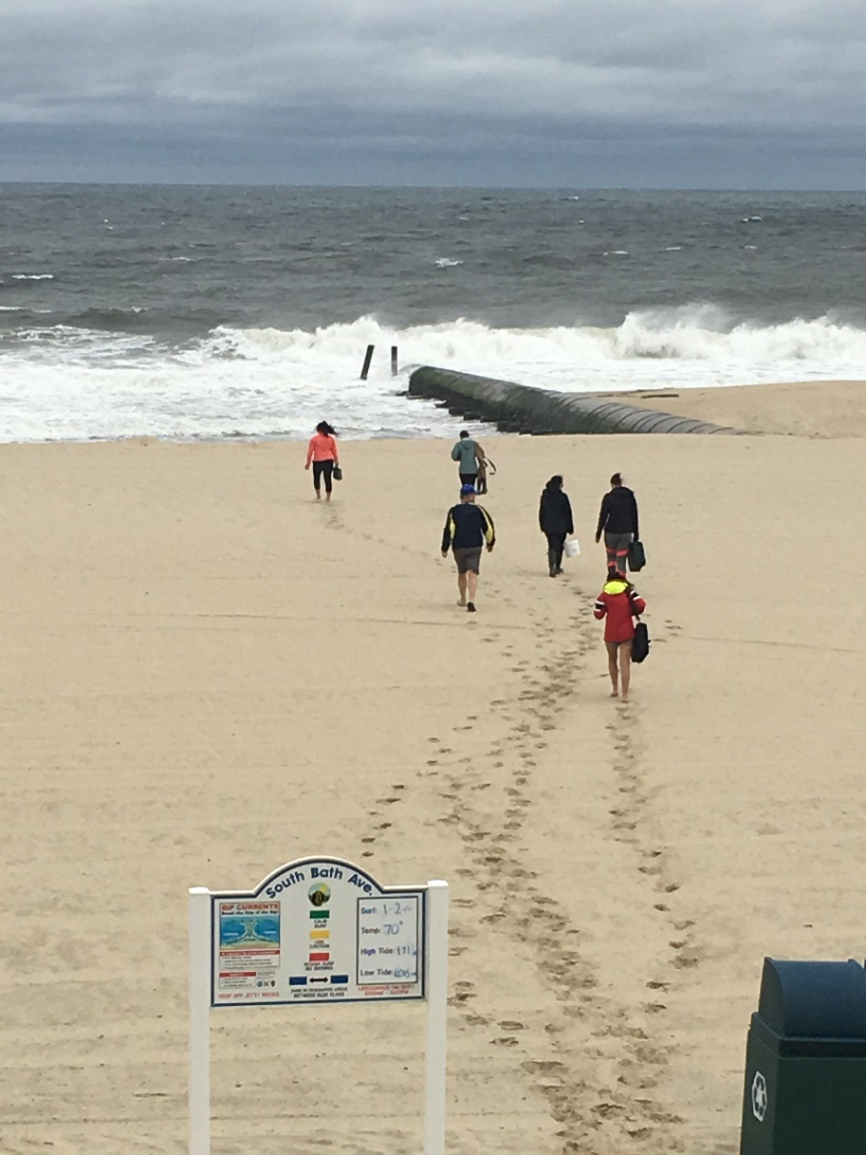



Fecal indicator bacteria (Enterococcus) varies beach to beach and within beaches
125 observations
May 2019 – March 2020
F = 5.4
P < 0.001
We used 104 cfu / 100 mL as a threshold value for Enterococcus
a
a
a
Enterococcus sp. (CFU per 100 mL)
a, b
b
Wesley Lk. outfall
Neptune Ave. (Deal)
Roosevelt Ave. (Deal)
S. Bath
Ave. (Long Branch)
‘Ocean Place’ (Long Branch)

Slide 12
Logistic regression models predicted high FIB at 2 of the 4 sites tested
‘Ocean Place’
Long Branch
P = 0.04
S. Bath Ave.
Long Branch
n.s.
Probability of exceeding safety standard for Enterrococcus
Conclusions so far:
Rainfall is a good predictor of Enterococcus
However, even at low / no rainfall sometimes sites were positive
Differences among sites were obvious
These sorts of models can lead to real-time ‘nowcasting’ of microbial pollution based on publicly available rainfall data
Roosevelt Ave.
Deal
P = 0.01
Neptune Ave.
Deal
n.s.
Cumulative rainfall (6h)

Slide 13

Conclusion / Synthesis
Coastal ecosystems are complex, but rainfall (e.g. stormwater runoff) appears to explain some of the variability observed in
  Coastal Lake water quality and HABs
  Microbial pollution at surfing beaches
  More to do on both!!
Understanding mechanisms leads to better management
  Predicting effects and measuring efficacy of actions taken
    How well can we quantify (stats!!) the effect of one driver amongst so many?
Good stormwater management will very likely help coastal lakes and beach water quality
  Imagine how many other systems would likewise benefit from good stormwater management!
Watershed characteristics
Stormwater management
ECOSYSTEM EFFECTS

Slide 14

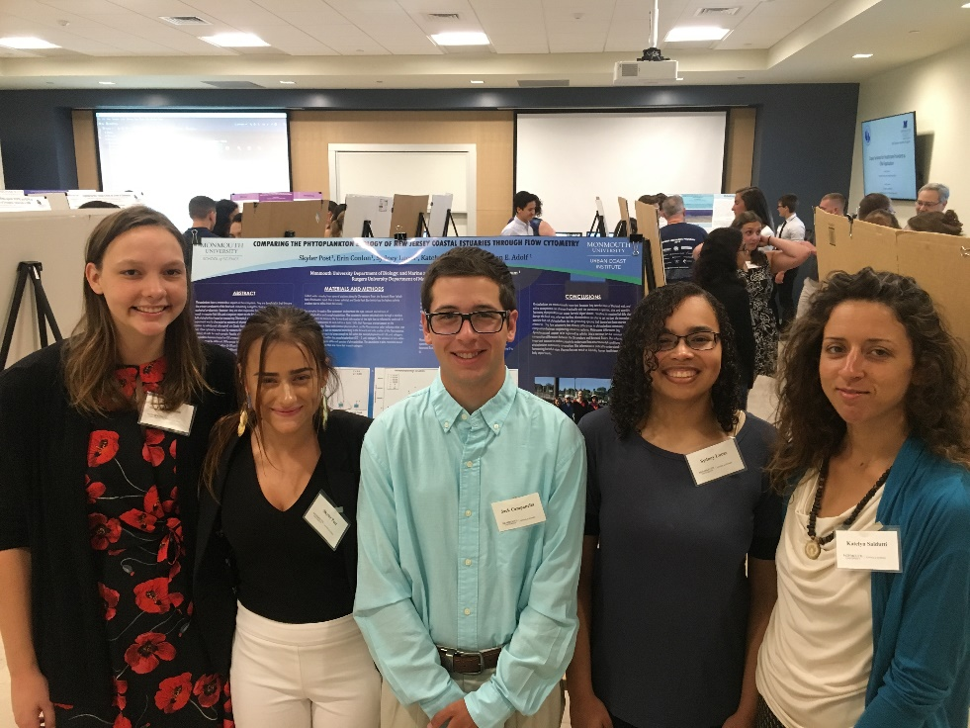
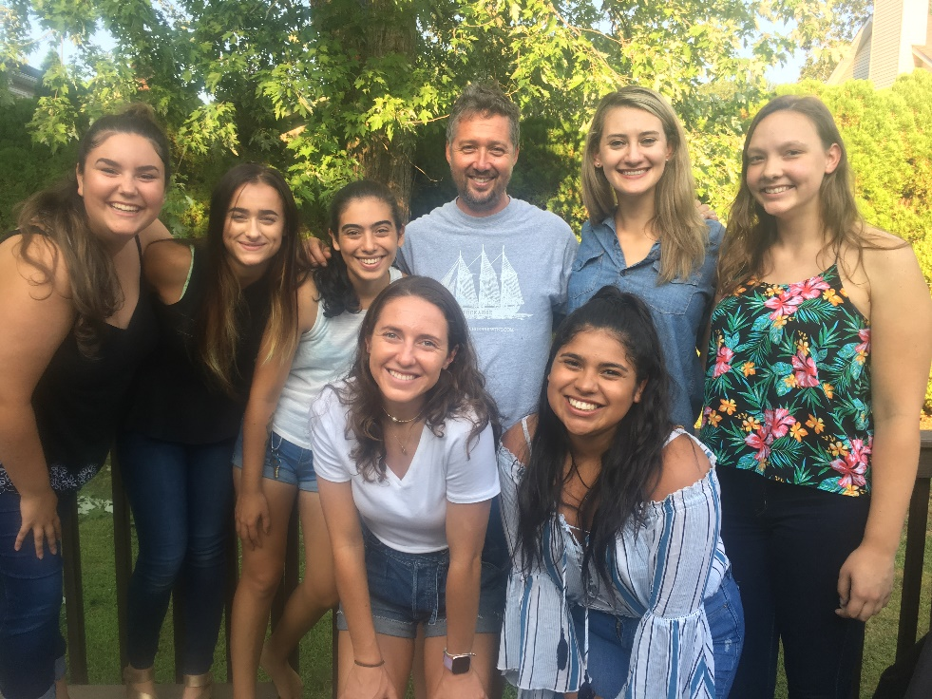
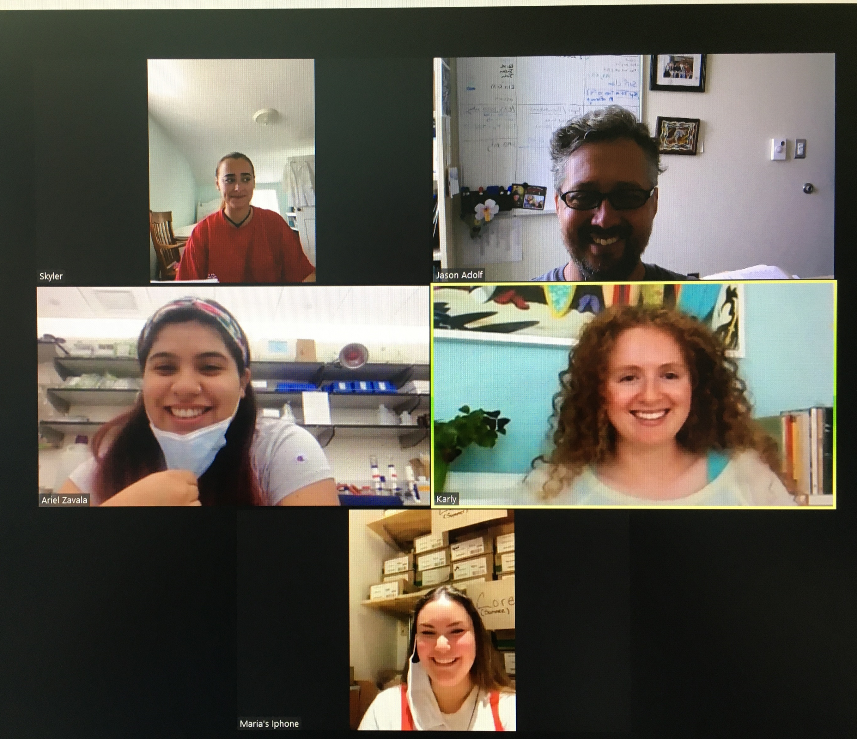




Thank you for your attention
Acknowledgements
2018
Erin Conlon, Skyler Post, Ariel Zavala, Maria Riley, Karly Nolan, Kelly Hanna, Tori Lohnes, Kaitlyn Saldutti, Sydney Lucas, Jack Campanella, Dr. J. Weisburg
Questions?
  Jason Adolf, PhD
  Monmouth University
  Biology Department & Urban Coast Institute
  jadolf@monmouth.edu
  732-263-5687
  E274
2019
Richard Lee, John Gossart, Jamian Laviola
2020
Robert Schuster, Bill Heddendorf, Eric Ernst, Sherri Shifrin
monmouth_phab_lab
https://jadolf.wixsite.com/phytoplankton

