Slide 1
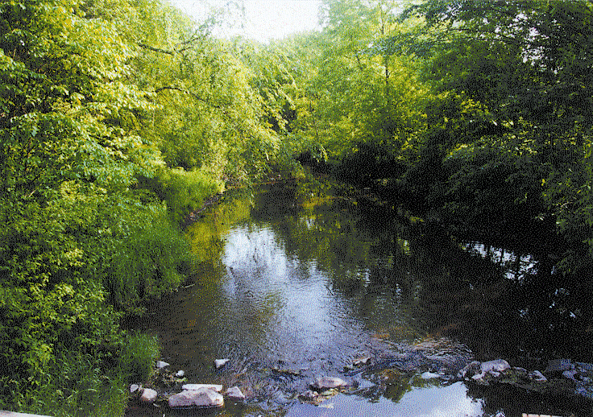
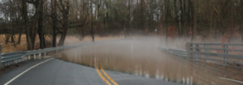
Combat Flooding & Water
Pollution in Your Town

Slide 2
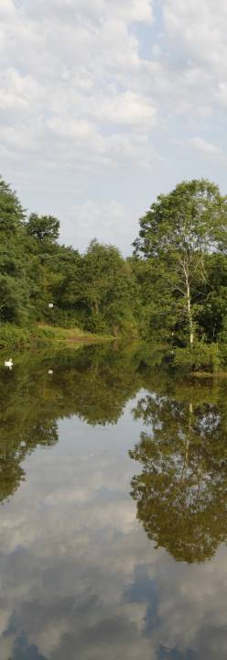
Our Mission
Keeping water clean, safe and healthy is the heart of our mission.
We work to protect and restore our water and natural environment in central New Jersey through conservation, advocacy, science and education.

Slide 3
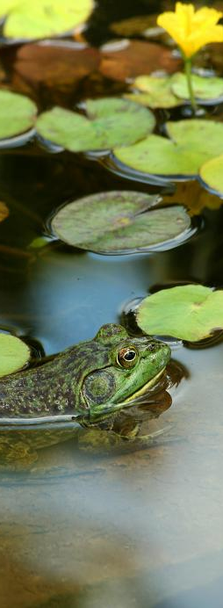
Our Strategies
Scientific investigation & monitoring
Advocacy for protection and restoration
of water & watersheds
Environmental education
Modelling best stewardship practices at
our Watershed Center and 950-acre
Watershed Reserve

Slide 4
Presentation Outline
The problem of flooding & water pollution
How to make a difference in your town
What does success look like?

Slide 5
Flooding is a major problem

Slide 6
Average Annual Precipitation Has Increased
Ave. Annual Precip. for 1st 7 decades of 20th Century: 44.16”
Ave. Annual Precipitation for 21st Century: 47.62”
Ave. Annual Precipitation Increase: 3.45”
Source: Office of the NJ State Climatologist David Robinson http://climate.rutgers.edu/stateclim/
526.74 billion more gallons per year in NJ!

Slide 7
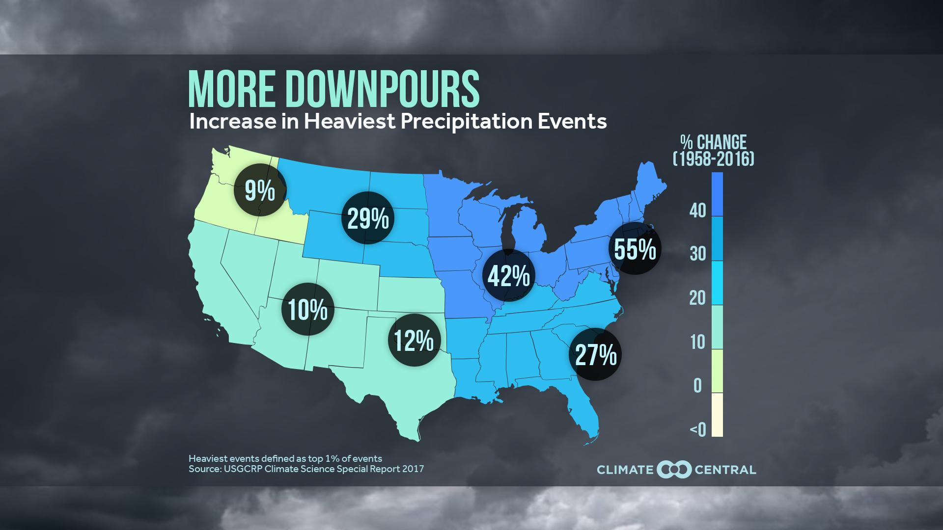
There are more heavy rain events

Slide 8
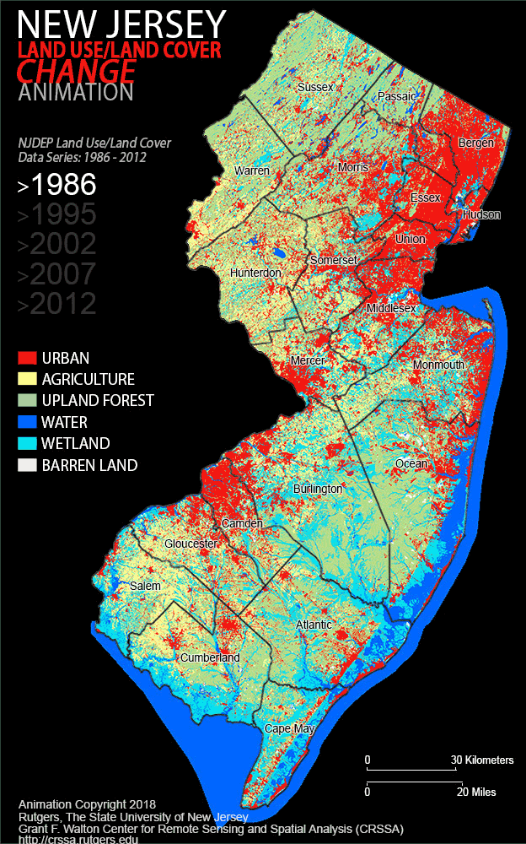
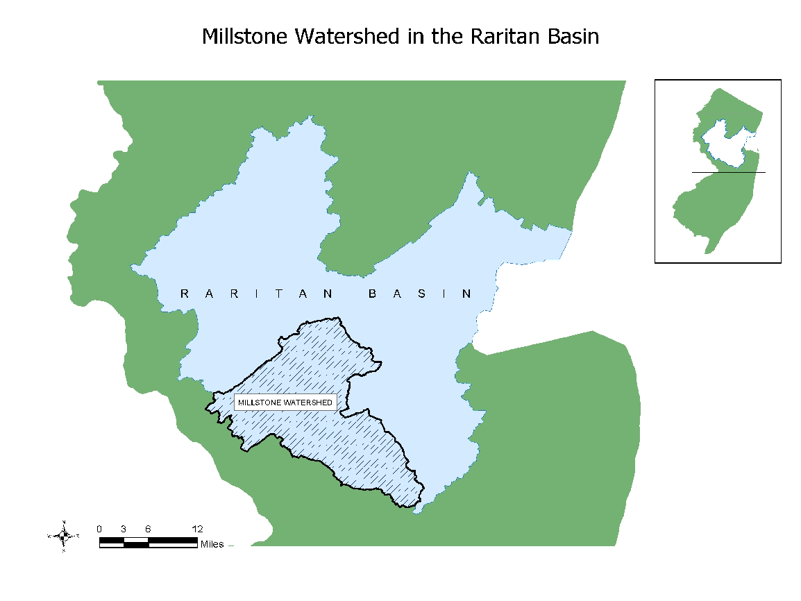
Development pressure continues
Between 1995 and 2012, impervious surfaces in the Millstone Watershed increased by more than
30 percent to 20,878 acres
Source: Grant F. Walton Center for Remote Sensing and Spatial Analysis, Rutgers University

Slide 9
The Water Cycle has been altered
“Natural” Watershed
Urban Watershed

Slide 10
Changes in impervious cover

Slide 11
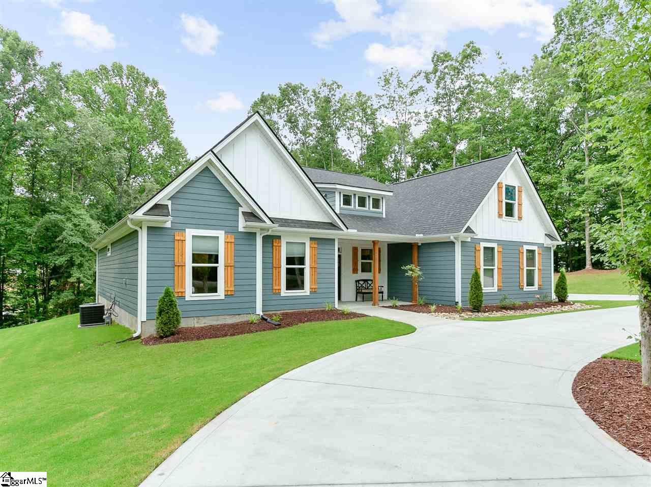
Residential Impact
Should we be concerned?
2800 SF Roof + 1” Rain Storm = 1,680 gallons of water
We all contribute to stormwater runoff.

Slide 12
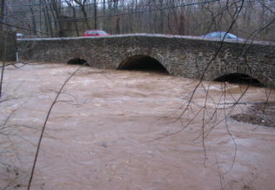
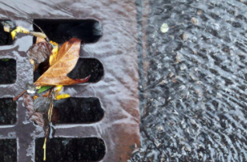
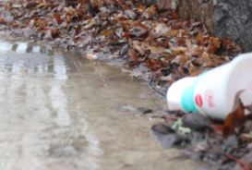
Understanding the problem
Climate Change
Impervious Surface
Pollution
Polluted stormwater runoff

Slide 13
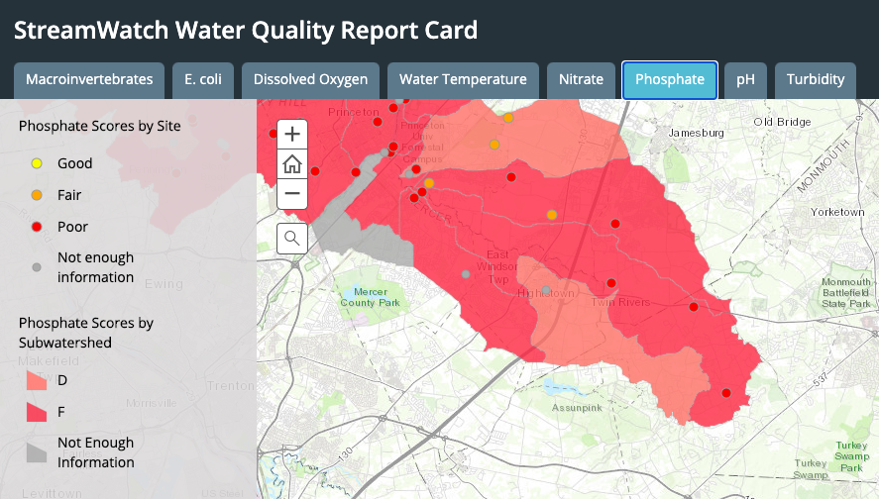
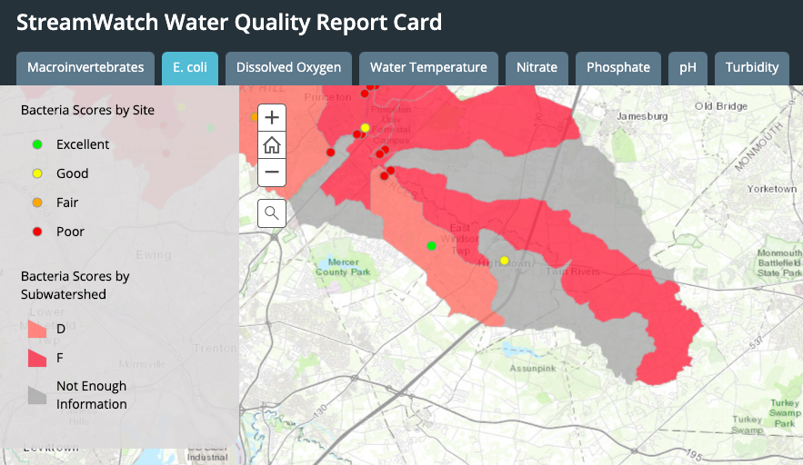
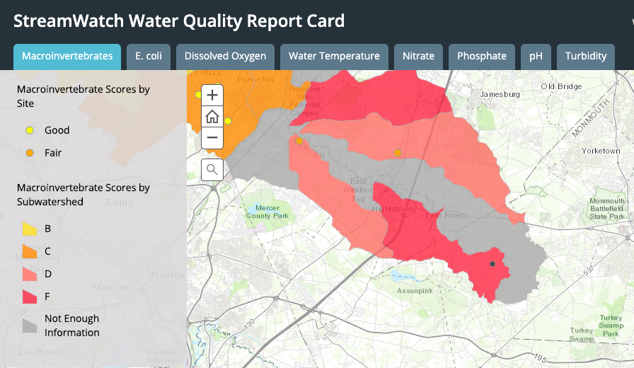
Local data shows impaired water quality
Phosphate
E Coli
Aquatic Life

Slide 14
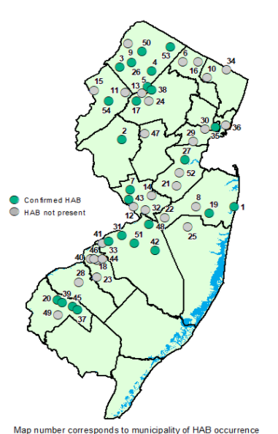
Harmful Algal Booms are increasing
Harmful Algal Blooms (HABs) occur when colonies of algae — simple plants that live in the sea and freshwater — grow out of control and produce toxic or harmful effects on people, fish, shellfish, marine mammals and birds. The human illnesses caused by HABs, though rare, can be debilitating or even fatal.
CyanoHAB events
Summary 2019
Source: NJ DEP

Slide 15
Why Work at the Local Level?
Local
State
Federal
In NJ, local governments play a particularly important role

Slide 16
What is the governance process for stormwater management?
Stormwater management ordinance (local law)
Created on a town by town basis often working from a template created by the state (a model ordinance)
Ordinance drafting often overseen by municipal engineer
Planning Board provides comment
Ordinance is considered by municipal governing body

Slide 17
The Opportunity
Each town in New Jersey must adopt and receive county approval for a new stormwater management ordinance by March 2021.
Local ordinances can be stronger than the state standard.
We need your help!

Slide 18
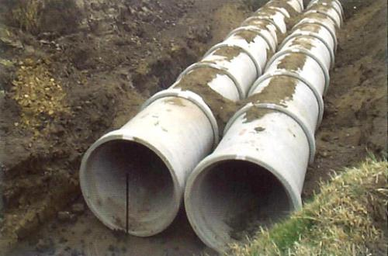
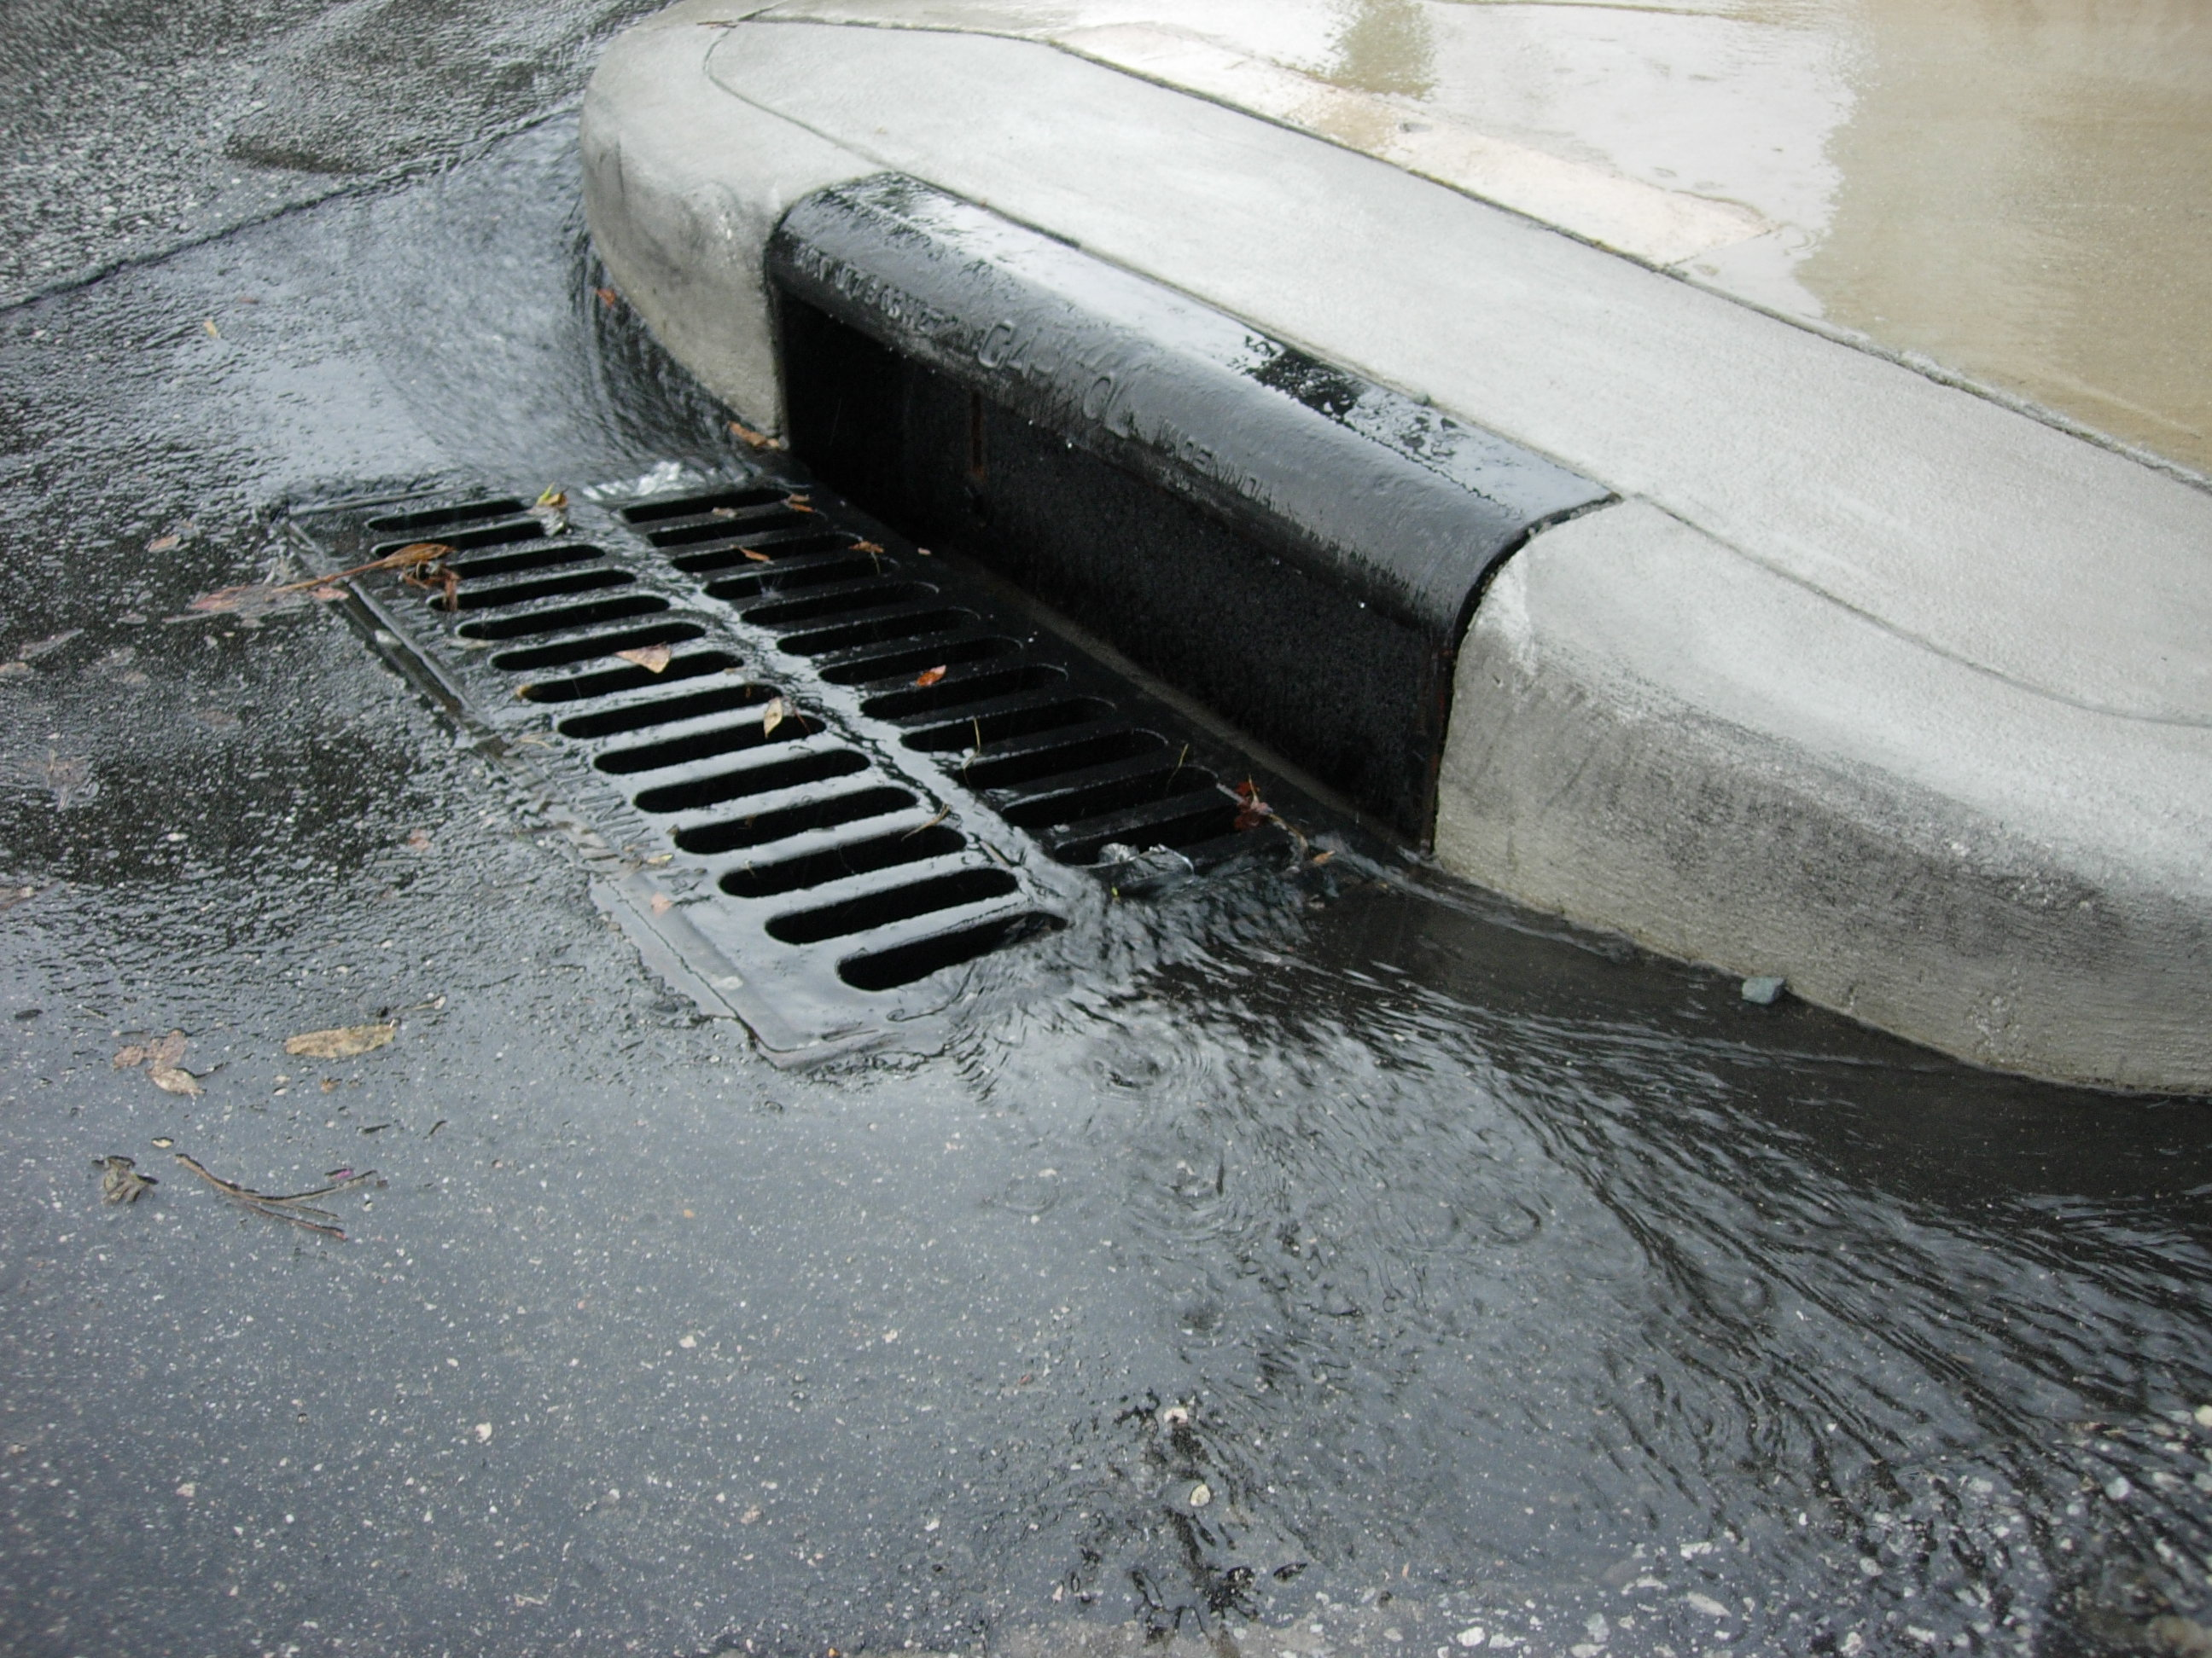
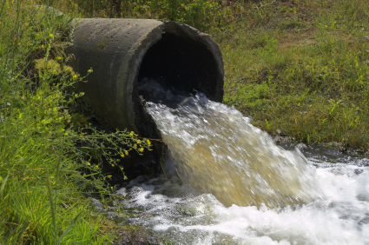
Stormwater Management
Old thinking:
Remove standing water from developed
properties as quickly as possible
Problems:
Flooding problems are just pushed “downstream”
Pollutants picked up by stormwater and carried to streams
Reduction in groundwater “recharge” can harm aquifer

Slide 19
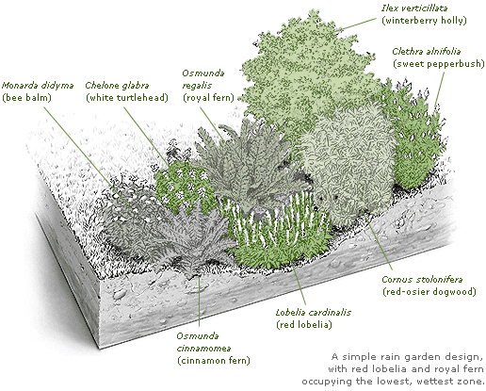
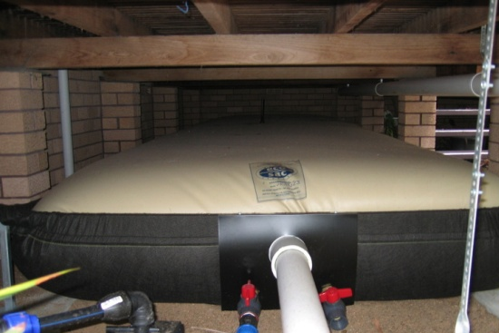
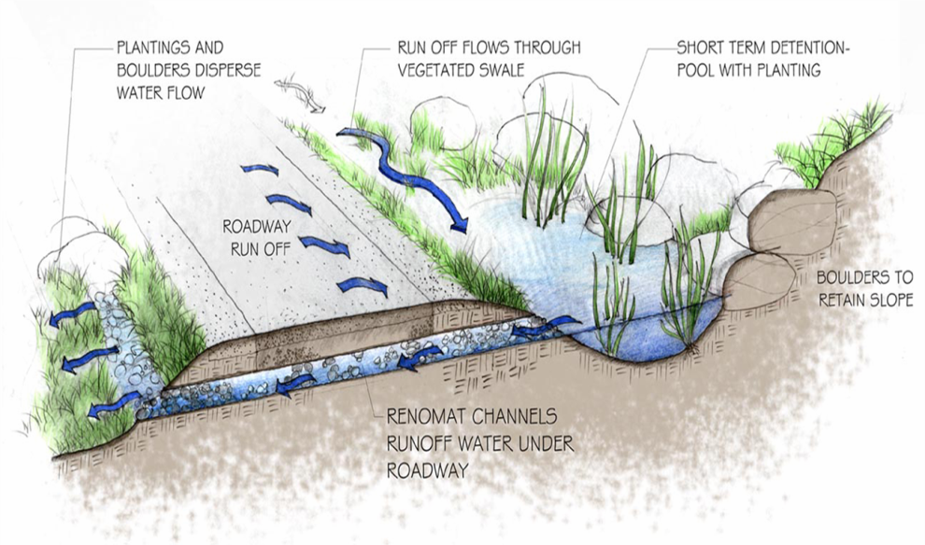
Stormwater Management
New thinking:
Retain water on site and infiltrate to groundwater
Rain Gardens
Rain Bladders & Cisterns
Vegetated Swales
Benefits:
Reduce flooding
Reduce water pollution
“Recharge” aquifers

Slide 20
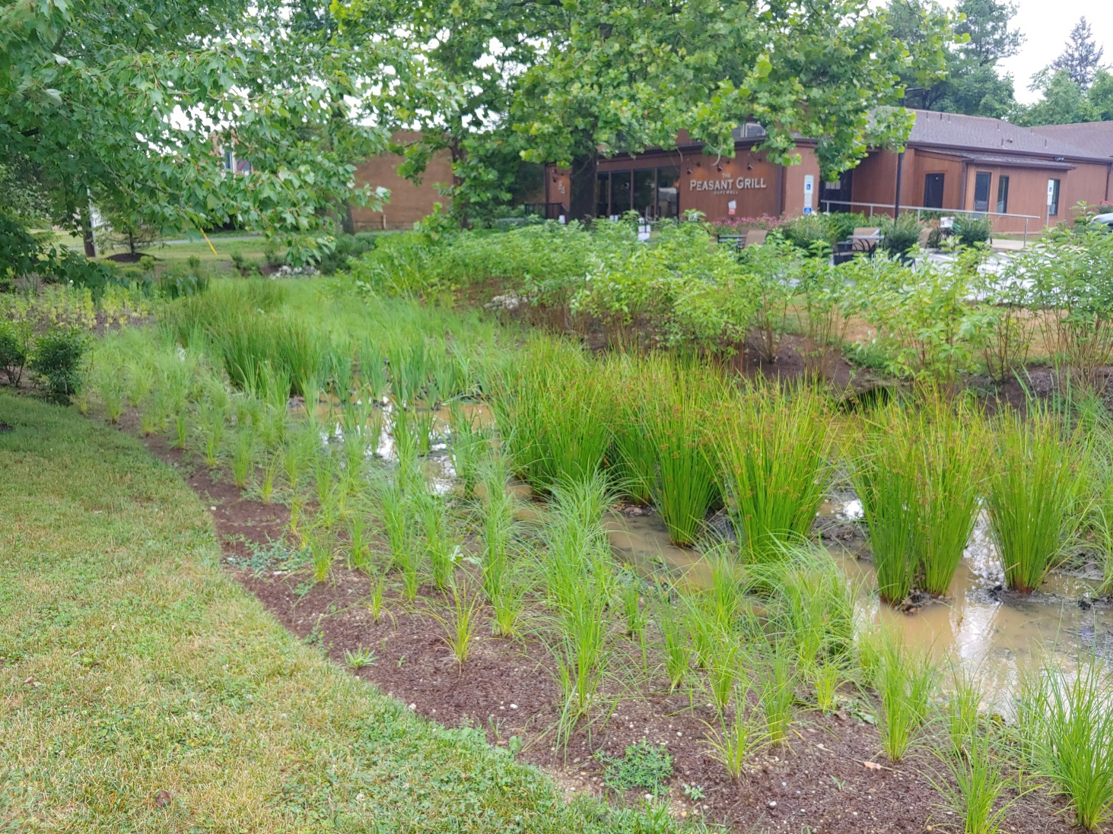
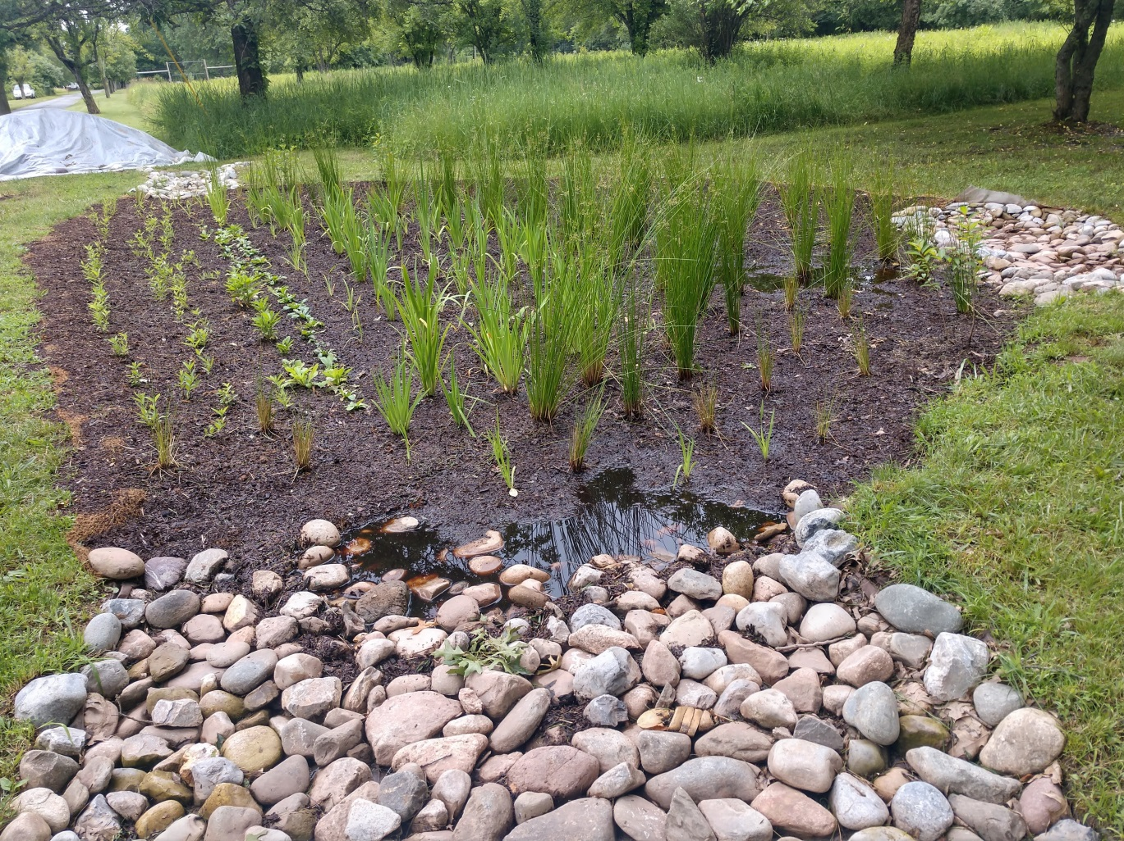
Examples of Green Infrastructure
Notes:
Would be great to show Steve’s Hopewell video here.

Slide 21
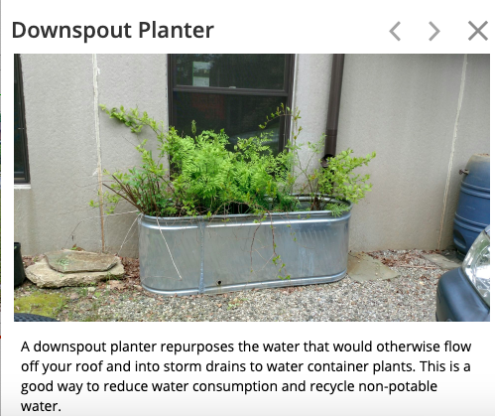
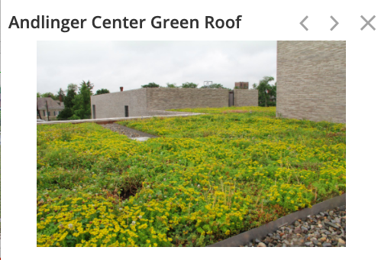
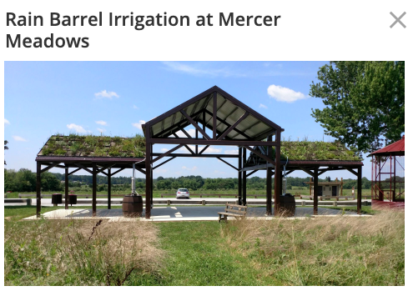
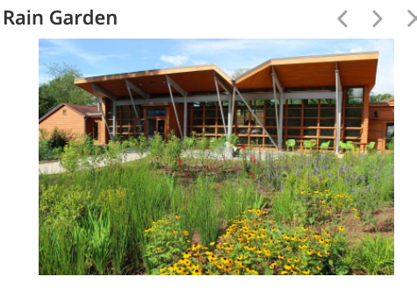
Examples of Green Infrastructure

Slide 22
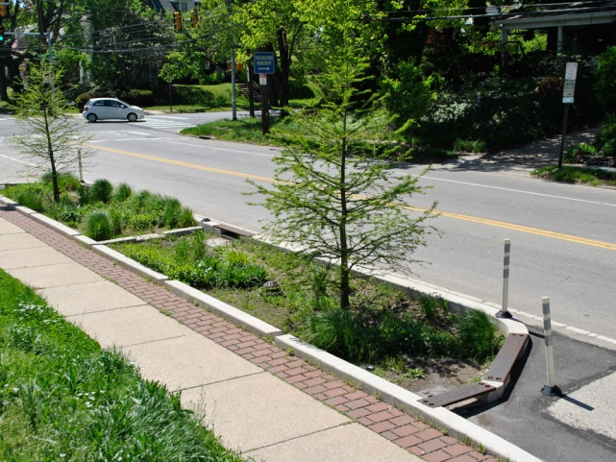
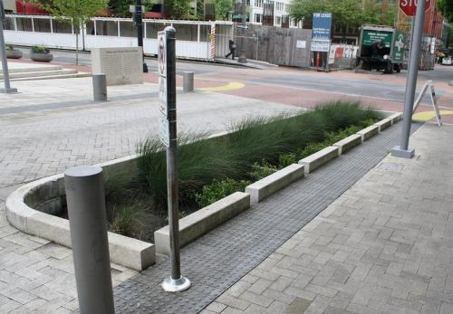
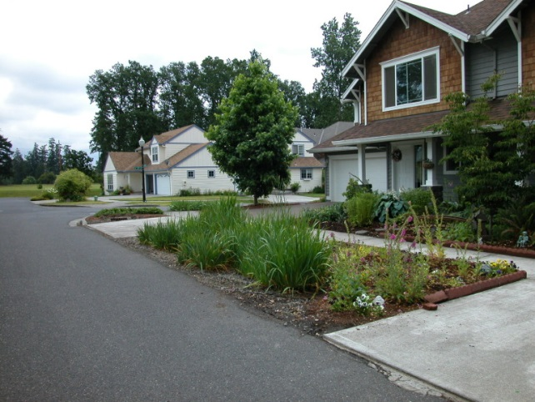
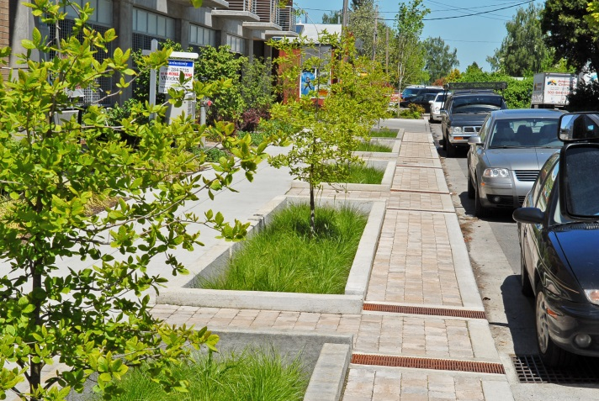
Green Stormwater Infrastructure
Green Streets

Slide 23
State Stormwater Management Goals and Challenges
Since 2004 NJ stormwater management ordinances have required:
stormwater management for ”major” developments
Quantity, quality, recharge
The use of green infrastructure suggested but not required
No requirement for ”minor” development or redevelopment

Slide 24
NJDEP Green Infrastructure Rule
What the Rule Does:
Requires the use of green infrastructure
Encourages smaller systems that treat stormwater closer to its source
Applies to new “major” development (over 1 acre of soil disturbance or ¼ acre of impervious cover added)
Requires treatment for quantity, quality and recharge

Slide 25
NJDEP Green Infrastructure Rule
What the Rule Doesn’t Do:
Address residential development
Address redevelopment
Leverage natural features of the site like native ground cover and existing trees
Require treatment for quality for runoff from all impervious surfaces for major developments

Slide 26
How You Can Help
Contact your local Environmental Commission and local elected officials.
Tell them this issue matters to you
Ask what the process will be to develop the ordinance and when the opportunity will be for community input
Share The Watershed Institute model ordinance
Educate your community
Raise the ”Water IQ”
What is local water quality?
What is impervious cover?
Where are flooding issues?
Implement green infrastructure projects

Slide 27
Metrics for success
How many towns will adopt strong stormwater management ordinances
New ordinances must be adopted by March 2021
How much education has been done on green infrastructure for municipal employees, engineers, landscape architects and the public?
How many public and private green infrastructure projects have been installed?

Slide 28
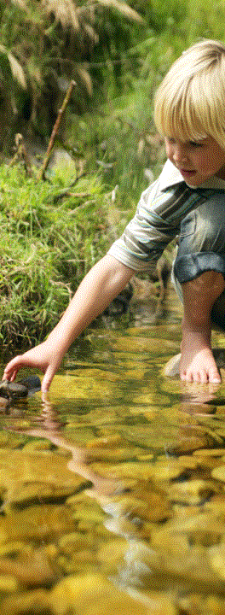
Thank You
Mike Pisauro
Policy Director
mpisauro@thewatershed.org
(609) 737-3735 x 18
Sophie Glovier
Municipal Policy Specialist
sglovier@thewatershed.org
(609) 737-3735 x 29
Your water. Your environment. Your voice.
Notes:
I know this is a lot of information. I’m available by phone or email if anyone has any more questions about any of this.

