Slide 1
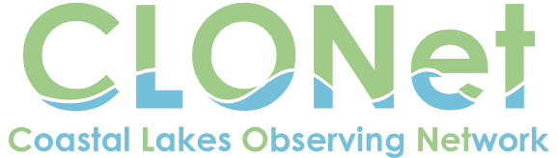


Dr. Jason E. Adolf
Endowed Associate Professor of Marine Science
Monmouth University
Biology Department
March 15, 2019

Slide 2
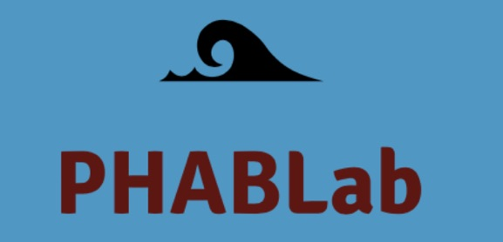
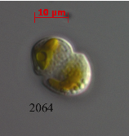
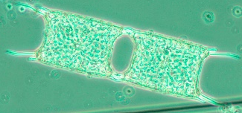
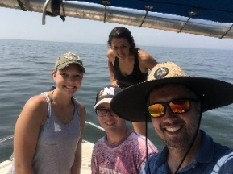
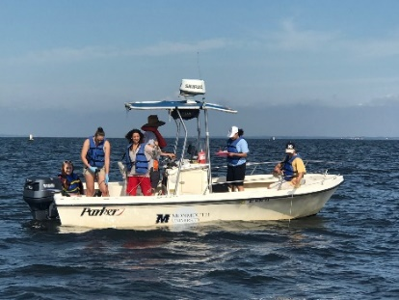
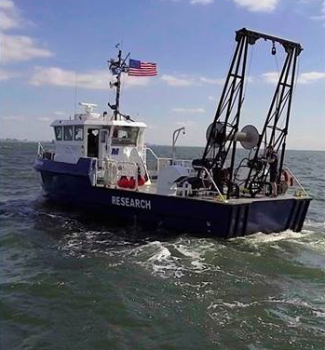
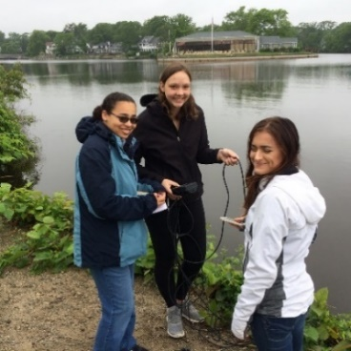
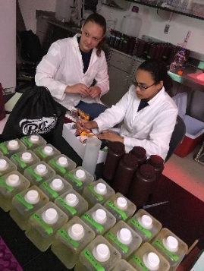
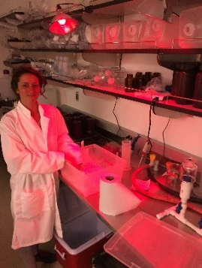

A ‘harmless’ diatom from the ocean off Monmouth County, NJ
A fish-killing dinoflagellate (Karlodinium veneficum)
Monmouth University
Phytoplankton and Harmful Algal Blooms Research Lab
We research phytoplankton dynamics and harmful algal blooms in NJ costal waters, estuaries and coastal lakes.
To get involved contact Dr. Jason E. Adolf (jadolf@monmouth.edu)
monmouth_phab_lab
https://jadolf.wixsite.com/phytoplankton

Slide 3
What is CLONet?
The UCI proposes to foster the development of community-based, participatory research and restoration groups that will allow communities to address coastal lake issues based on their own knowledge and use of the underlying scientific data.
Participation
Action!
Science
Local knowledge
Knowledge
Ownership
Policy
Multiple perspectives

Slide 4
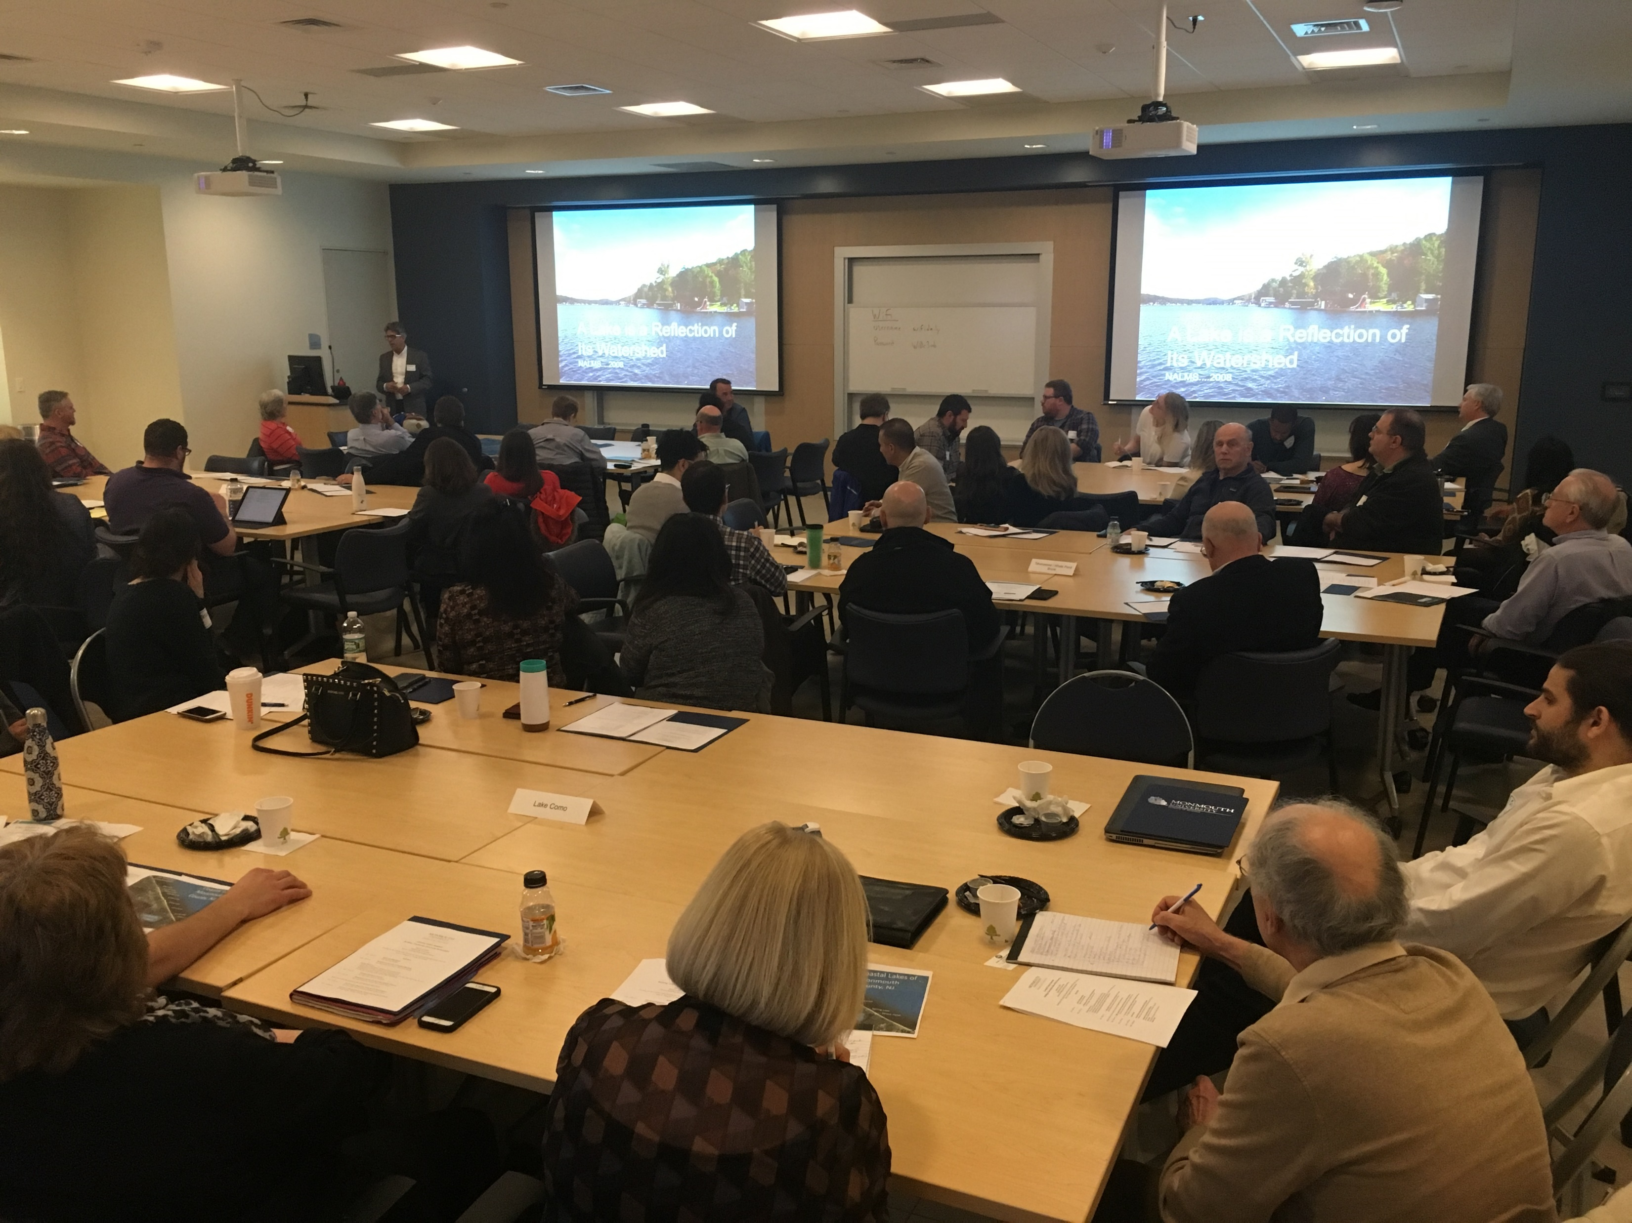
Coastal Lakes Summit 2019
Monmouth University

Slide 5
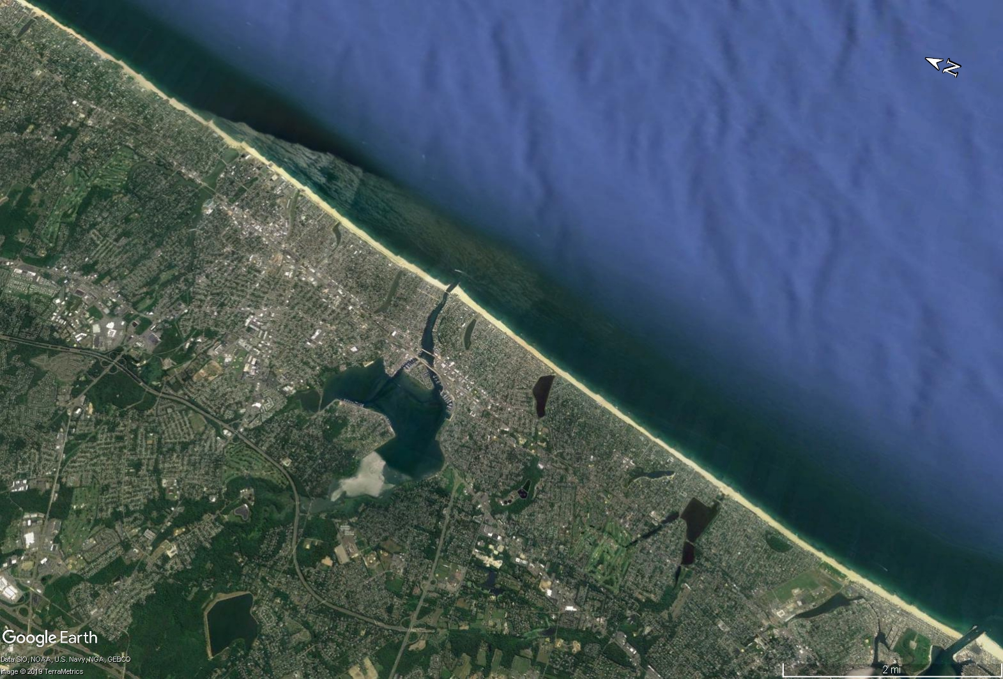
Lake Takanassee /
Whale Pond Brook
Coastal Lakes of Monmouth County, NJ
Deal Lake
Sunset Lake
Wesley Lake
Fletcher Lake
Sylvan Lake
Silver Lake
Lake Como
Spring Lake
Wreck Pond
CLONet: Let’s move from a piecemeal to a regional, community-driven approach

Slide 6
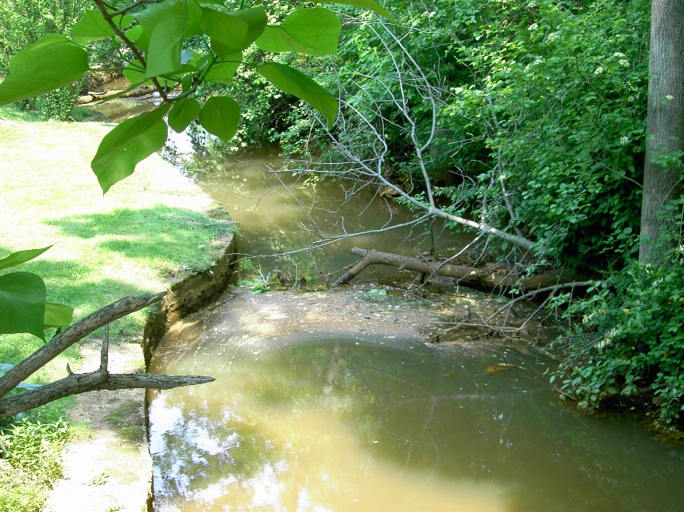
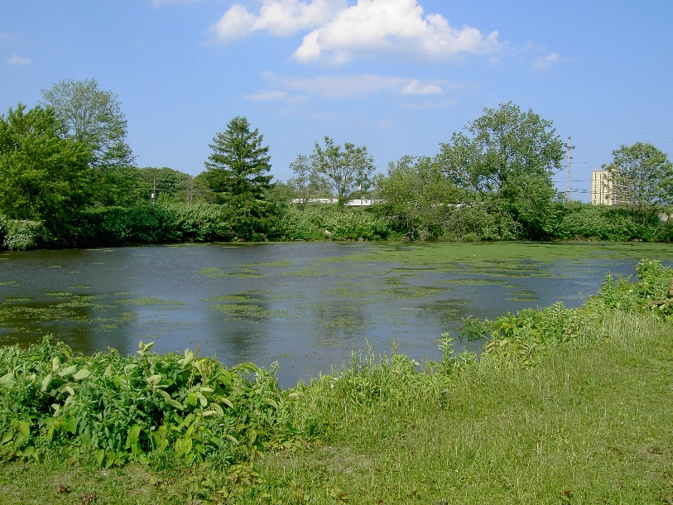
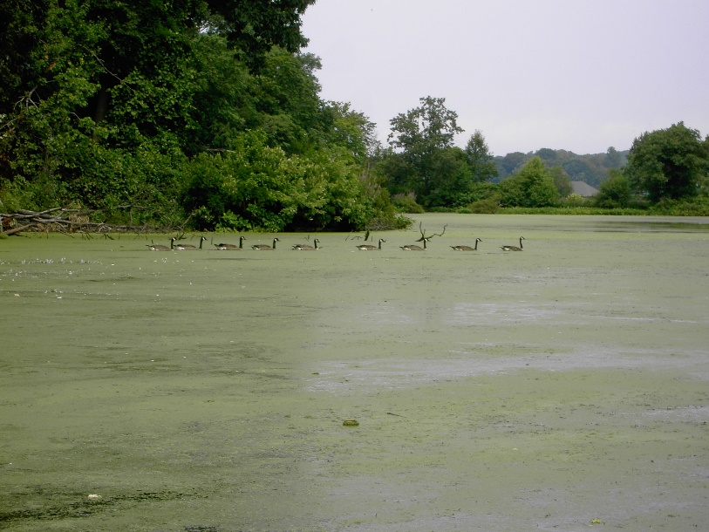
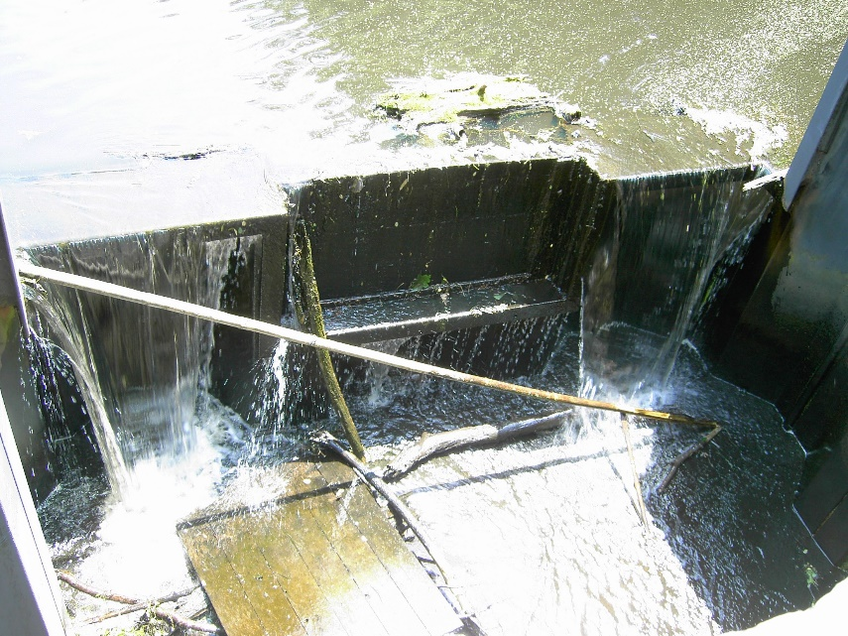
Coastal Lakes have a history of problems
(and solutions)
PROBLEMS:
Algal overgrowth
HABs
Nutrients / Eutrophication
Storm runoff
Sediment in-filling
Microbial pollution
‘Floatables’
SOLUTIONS:
Lake by lake, problems are addressed
NEED:
Central leadership / coordination of group efforts

Slide 7

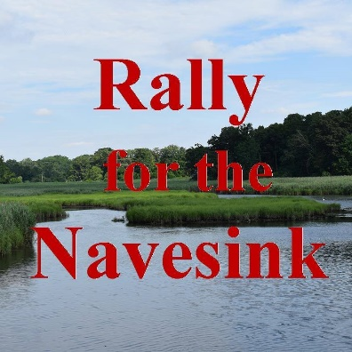
Citizen science has a history in New Jersey and the nation as an effective approach to environmental issues
Barnegat Bay Partnership – ‘…work together with the communities of the Barnegat Bay watershed to help restore, protect, and enhance the natural resources of the Barnegat Bay ecosystem.’
Clean Ocean Action – Coordination of Rally for the Navesink, a collection of Groups dedicated to improving water quality in the Navesink River

Slide 8
Participatory models of citizen science will work for coastal lakes
Who defines the problem?
Who designs the study?
Who collects the samples?
Who analyzes the samples?
Who interprets the data?
Community
Community
Community
Community
Community
Professional scientists
Professional scientists
Professional scientists
Professional scientists
Professional scientists
after Wilderman 2007

Slide 9
Implementation of CLONet, a participatory model of community science
Starts here: Identify common goals / objectives among groups
Establish leadership by Monmouth University to coordinate and support Lake groups’ efforts
Lake
Lake
Lake
Monmouth University UCI
Lake
Lake

Slide 10
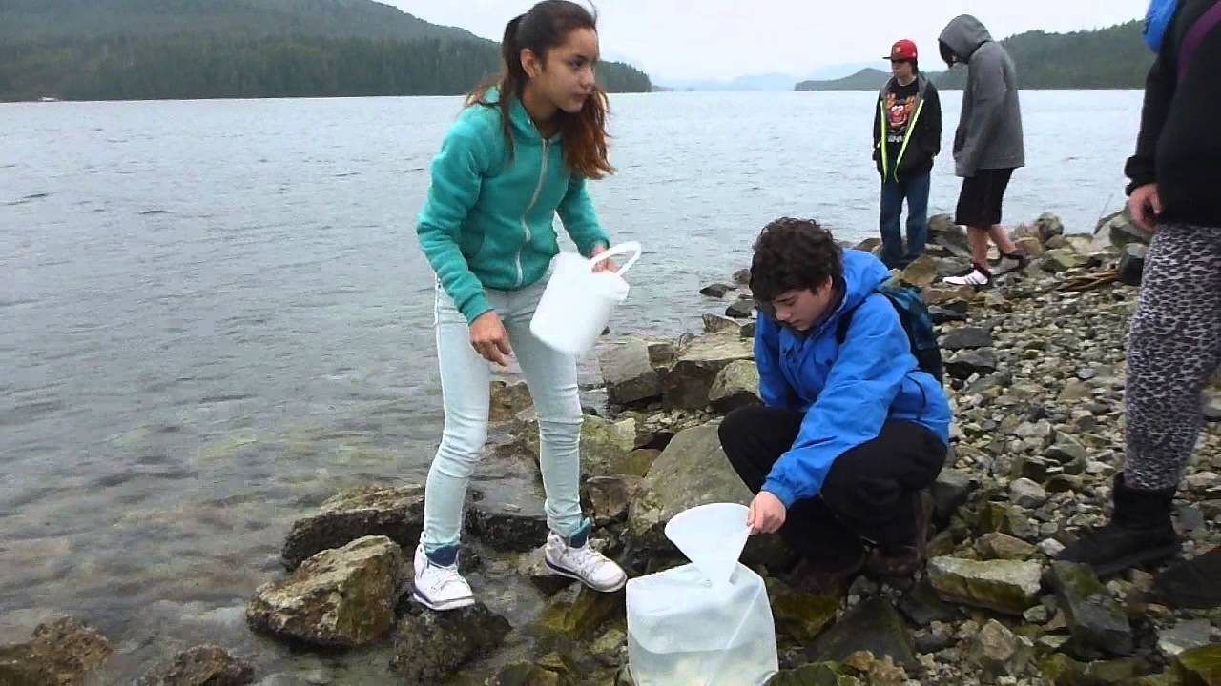
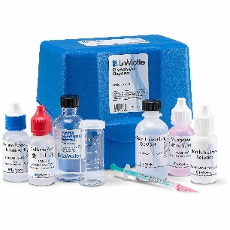

Lake group leadership: identify citizens willing to participate in data collection
Who lives in a strategic area that will allow easy access?
Are there local school groups that can be brought in?
Are there local camps (summer) that can get involved?
Scout troops looking for projects?

Slide 11
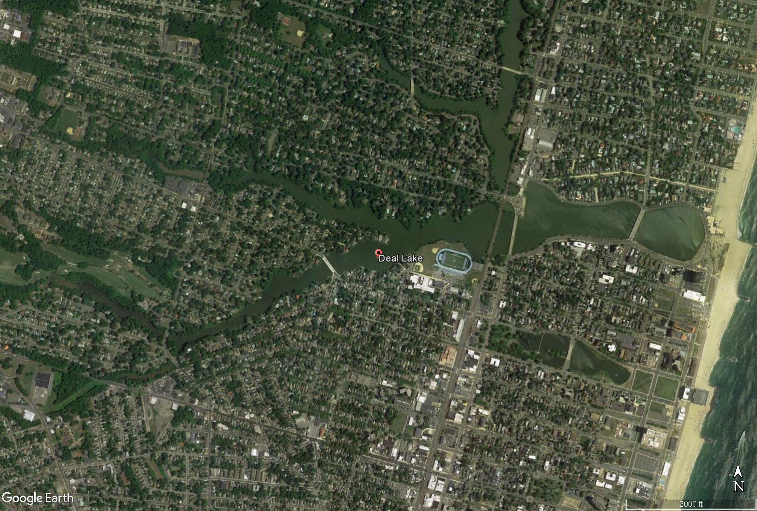
Generate sampling strategies for lakes
Where? When? (how frequently?) Which parameters? (beyond the starter kits)
QA / QC?
A proposed sampling schedule per station
Time period | Frequency | Samples
Jan - Mar | 2-week | 6
Apr - Oct | Weekly | 28
Nov - Dec | 2-week | 4
 | Sum | 38

Slide 12
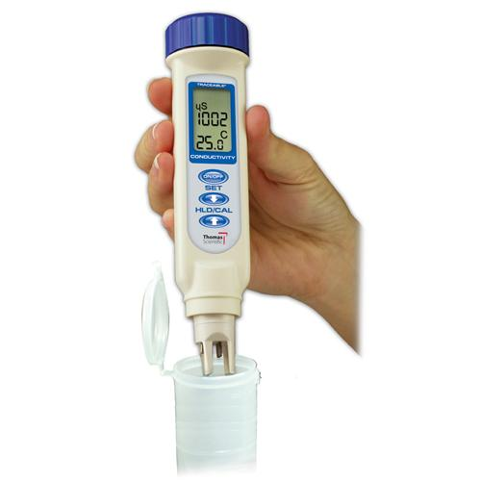
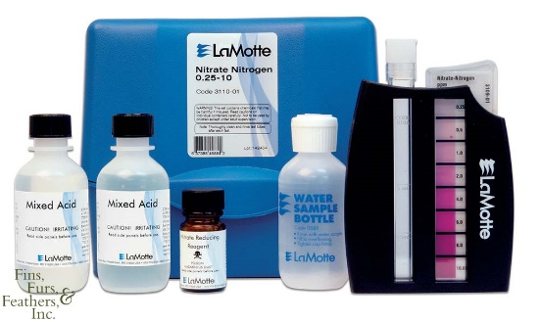
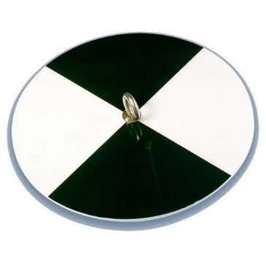
CLONet will supply volunteers with water quality sampling kits
Conductivity / temperature ‘pen’
Colorimetric nutrient analysis kits
  Inorganic N
  Inorganic P
  Dissolved oxygen
pH
CO₂
Turbidity (Secchi disk)

Slide 13
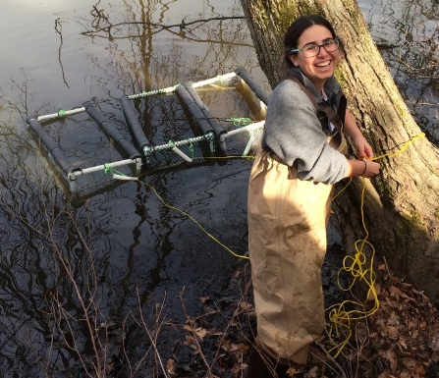


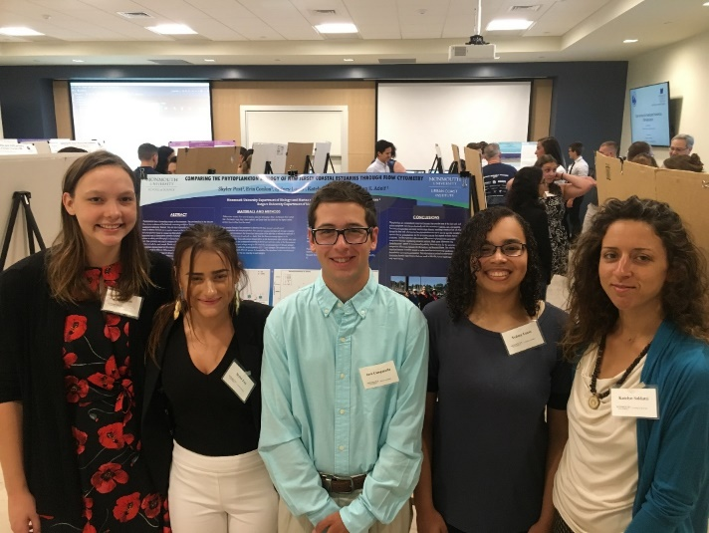
Water quality kit???
What the heck do I do with this thing?
Monmouth faculty / students train community members how to use water quality kits
Will do QA/QC sampling in parallel with Lake groups

Slide 14
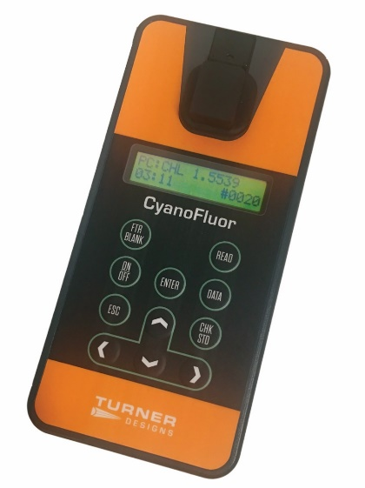
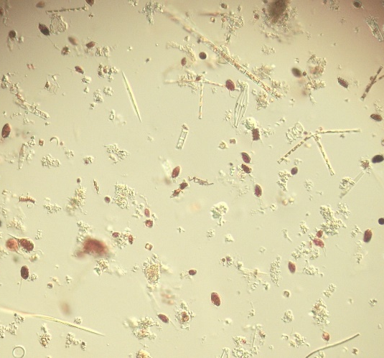
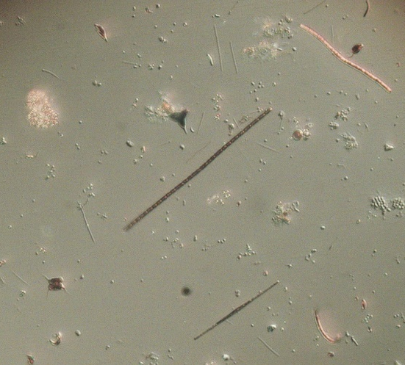
Monmouth University students / faculty will do supplemental sampling at each lake
QA /QC of data
Additional samples that require laboratory analyses
  ‘ground truth’ samples
  Phytoplankton samples
  Microbial pollutant samples
May
July
Microscope image of changing Deal Lake phytoplankton
A handheld cyanobacteria-meter

Slide 15
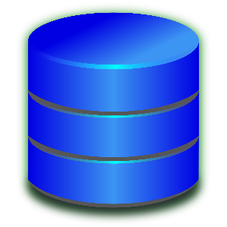
What happens to all the data?
Monmouth University CLONet website
  Web-based form for inputting data (can be done from your phone, in the field!)
  Monmouth University students / faculty do quality assurance of data
  Data will be publicly available
CLONet database
And we have an email:
clonet@monmouth.edu

Slide 16
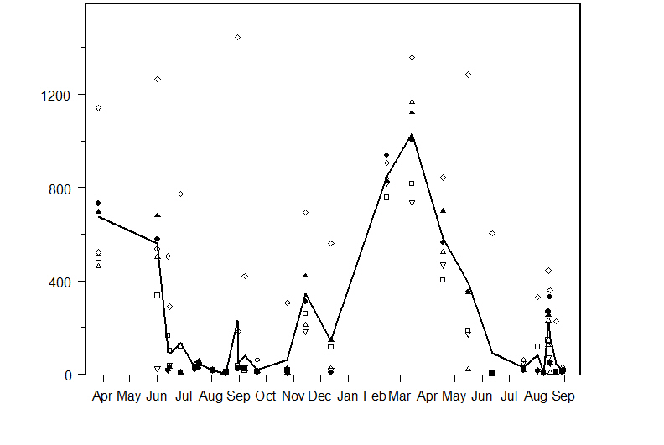
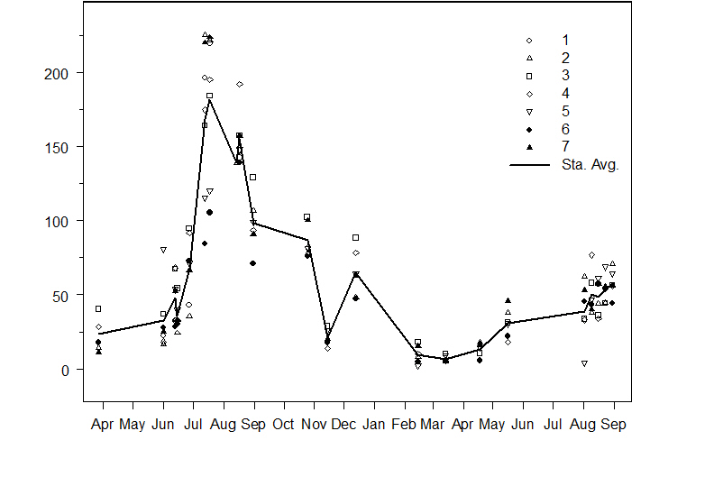
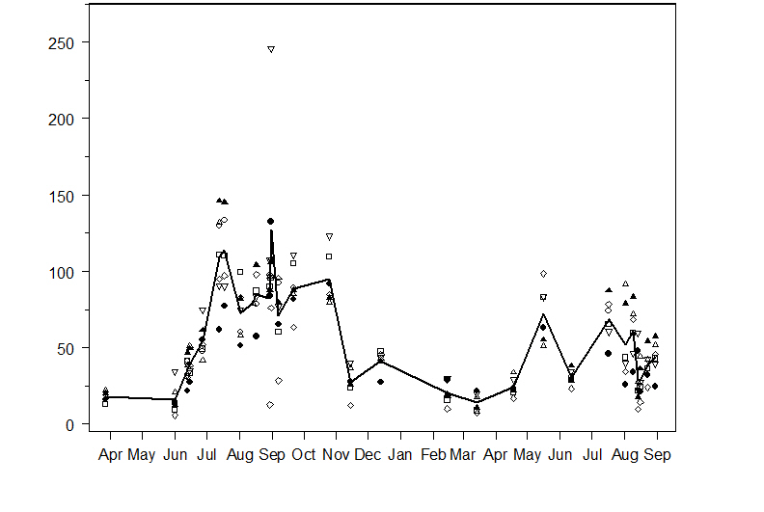
Future outcomes: an example related to HABs
Deal Lake
NJ DEP data
Inorganic N (mg L⁻¹)
Deal Lake
NJ Dep data
Algal abundance (μg Chl a L⁻¹)
CyanoHAB
Inorganic P (mg L⁻¹)
2017
2018
2017
2018

Slide 17
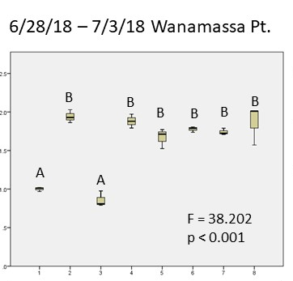
Nutrient bioassays show effects of nutrients on HABs
Additions of inorganic P to lake water had no effect on HAB
Relative cyanobacteria abundance
(PC:Chl)
Additions of inorganic N to lake water stimulated HAB during this time
control
+NO₃
+PO₄
+NH₄
+NO₃
+NH₄
+PO₄
+NH₄
+NO₃
+PO₄
+NO₃
+PO₄
+NH₄

Slide 18
So… what was happening in other lakes?
We have limited data, but the data suggests some big differences worth following up on…
Simple question:
What’s up with Sunset Lake?

Slide 19
CLONet outcomes
Lake Takanassee /
Whale Pond Brook
Change approach to coastal lake work:
  Encourage increased communication between different Lake Groups
    Issues, ongoing work, solutions
  Apply for further funding as a consortium of Lake advocates rather than one lake at a time, with a solid regional dataset in hand
Deal Lake
Sunset Lake
Wesley Lake
Fletcher Lake
Sylvan Lake
Silver Lake
Lake Como
Spring Lake
Wreck Pond
Let’s move from a piecemeal to a regional, community-based approach

Slide 20
Acknowledgements
Thank you to the Jules L. Plangere, Jr. Family Foundation for a grant to the Monmouth University Urban Coast Institute supporting our CLONet project!
Thanks to all of you for your enthusiasm, support and participation!
Questions? Discussion?

