Slide 1
Sunset Lake Asbury Park, NJ
Coastal Lakes Summit at Monmouth University March 15, 2019
Eileen Chapman & Chester Boles
Sunset Lake Commission

Slide 2
Birdseye View of Sunset Lake 2018

Slide 3
1881 Map of Sunset, Deal and Wesley Lakes

Slide 4
Sunset Lake was larger on the Western Side - 1910

Slide 5
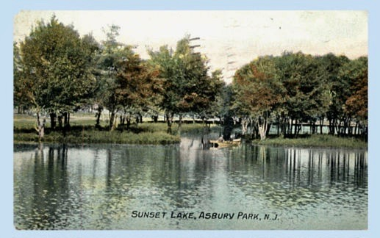
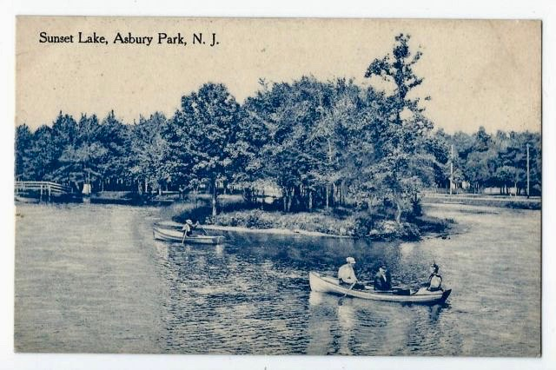
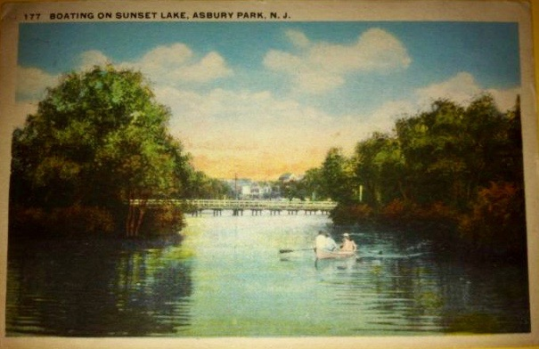
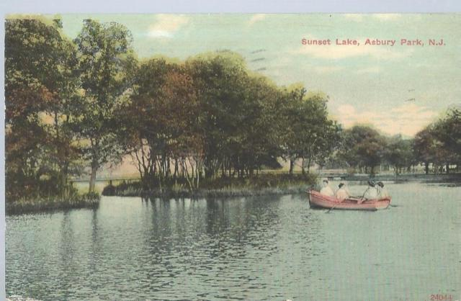
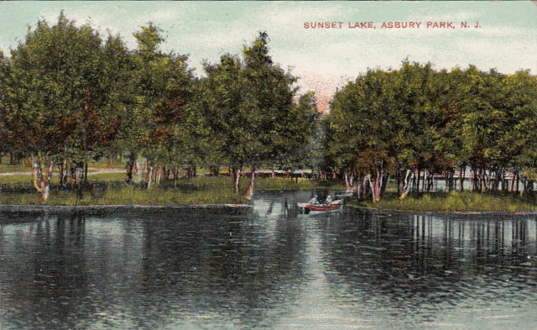
Sunset Lake Photos 1900-1920

Slide 6
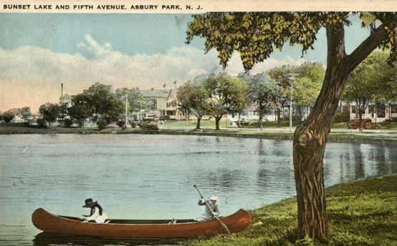
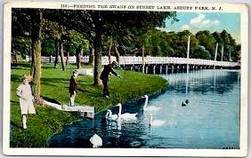
Sunset Lake has a history of Ecology and Recreation

Slide 7
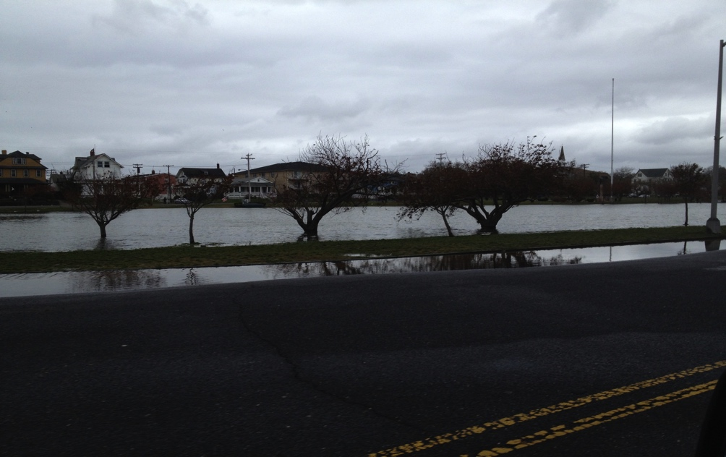
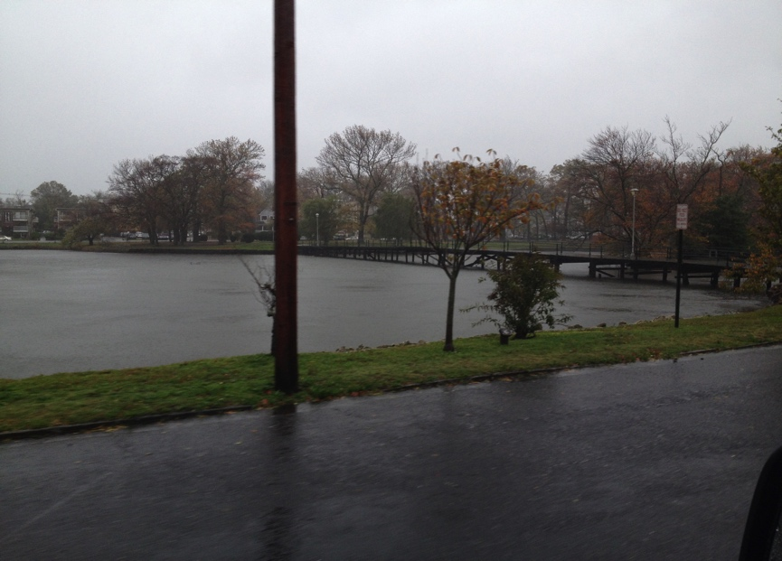
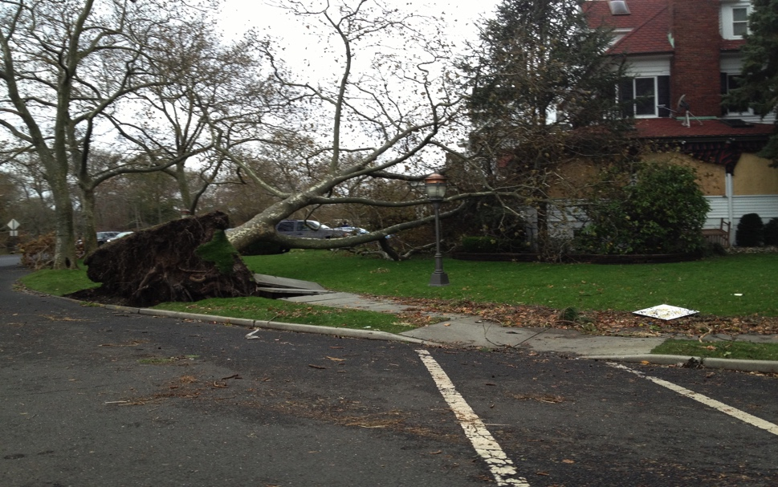
Superstorm Sandy Overwhelmed Sunset Lake in 2012 -1 Day Later

Slide 8
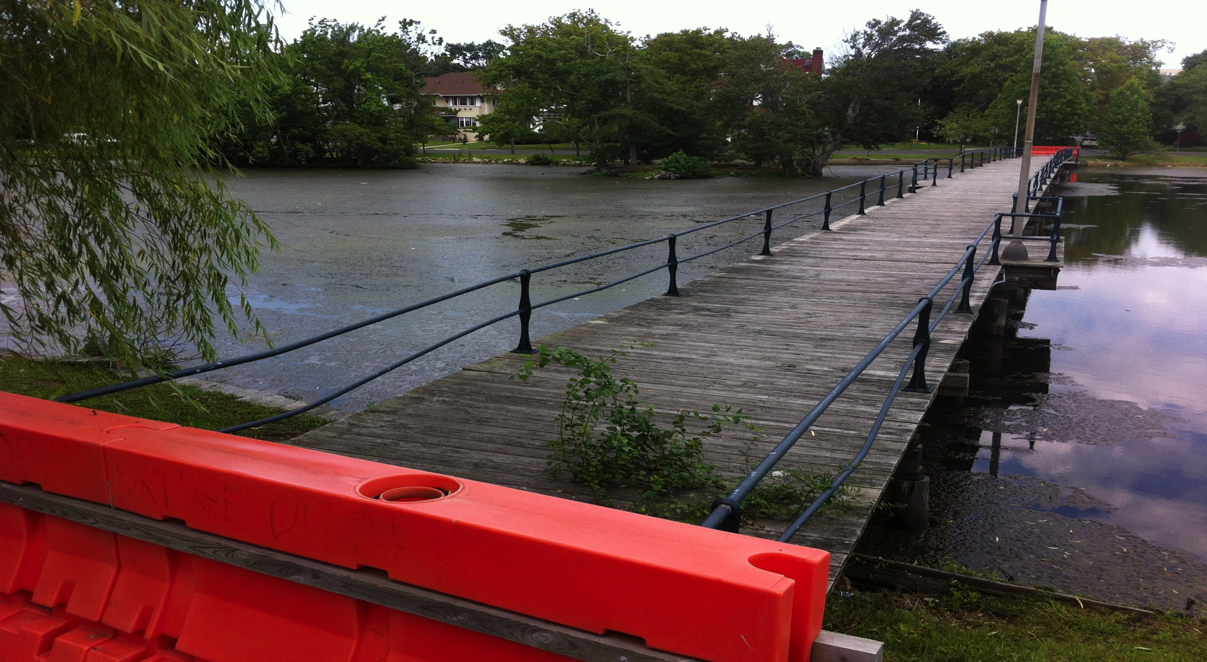
Sandy Destroyed Pedestrian Bridge 2012

Slide 9
New Pedestrian Bridge Completed 2017

Slide 10
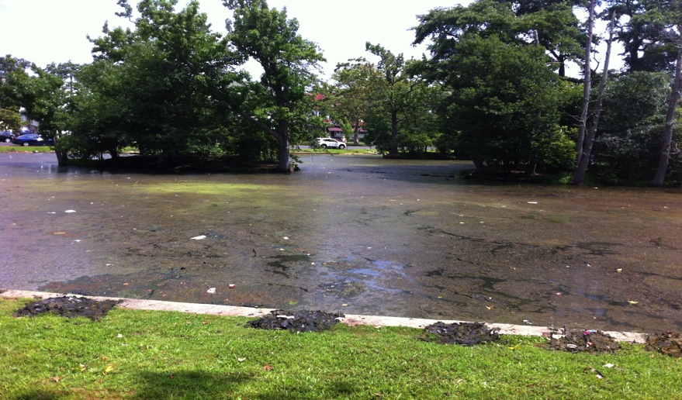
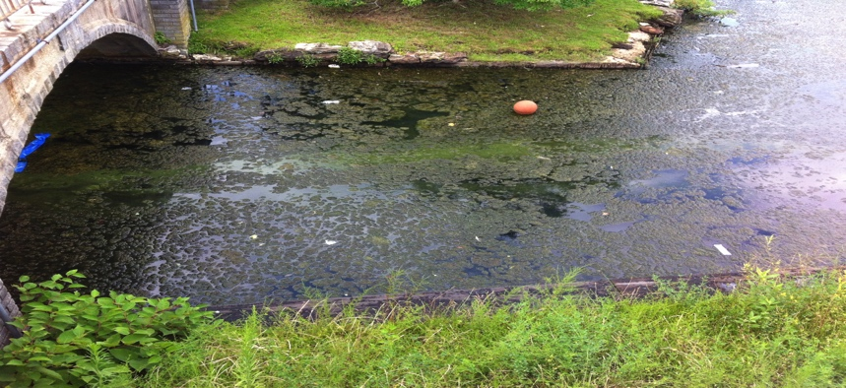
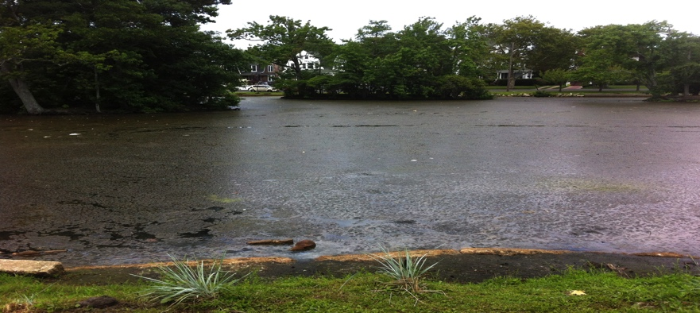
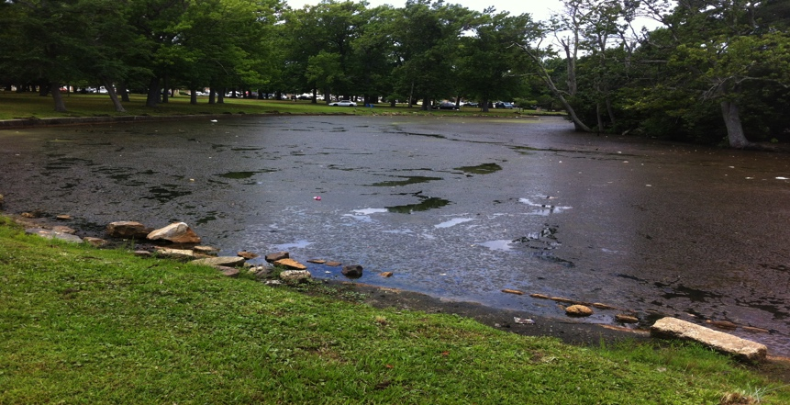
Algae Blooms 2016 –Wildlife Died or Fled

Slide 11
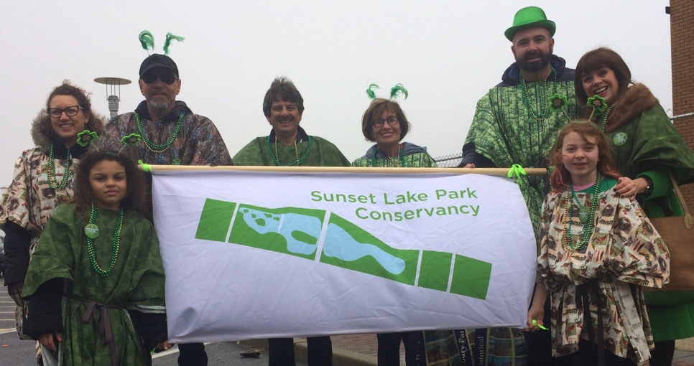
Originated in 2017 to Organize Community Efforts.
Non Profit established to revitalize, rehabilitate, restore, sustain the historical integrity, beauty and vitality of Sunset Lake Park in Asbury Park NJ.

Slide 12
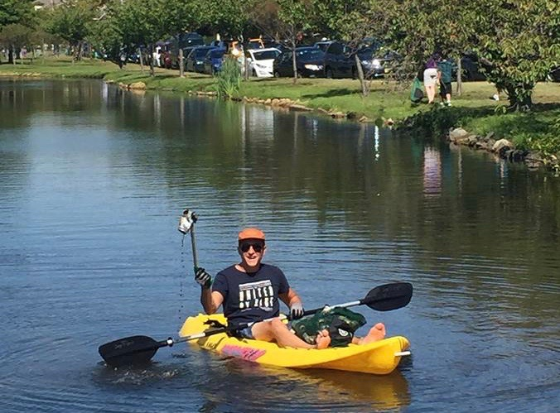
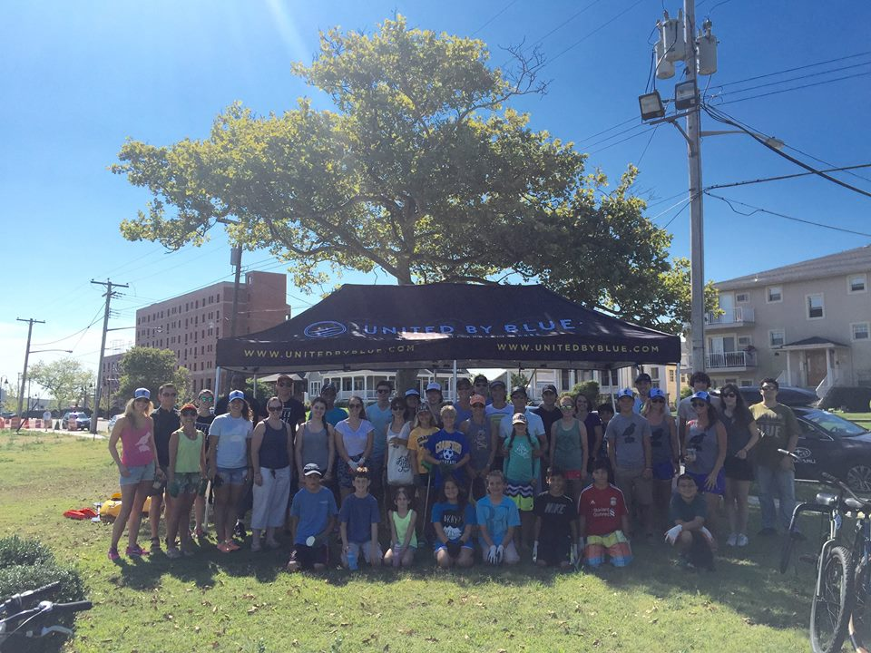
Multiple Cleanup Efforts by Volunteers

Slide 13
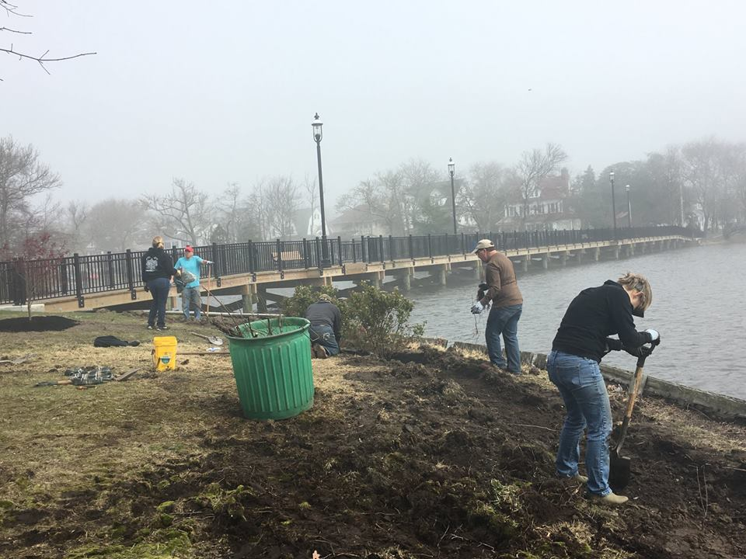
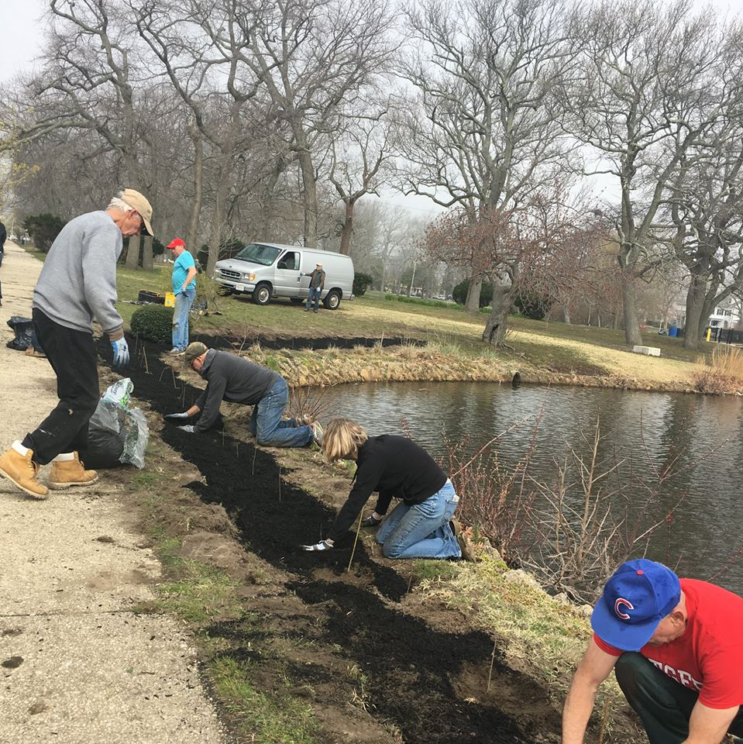
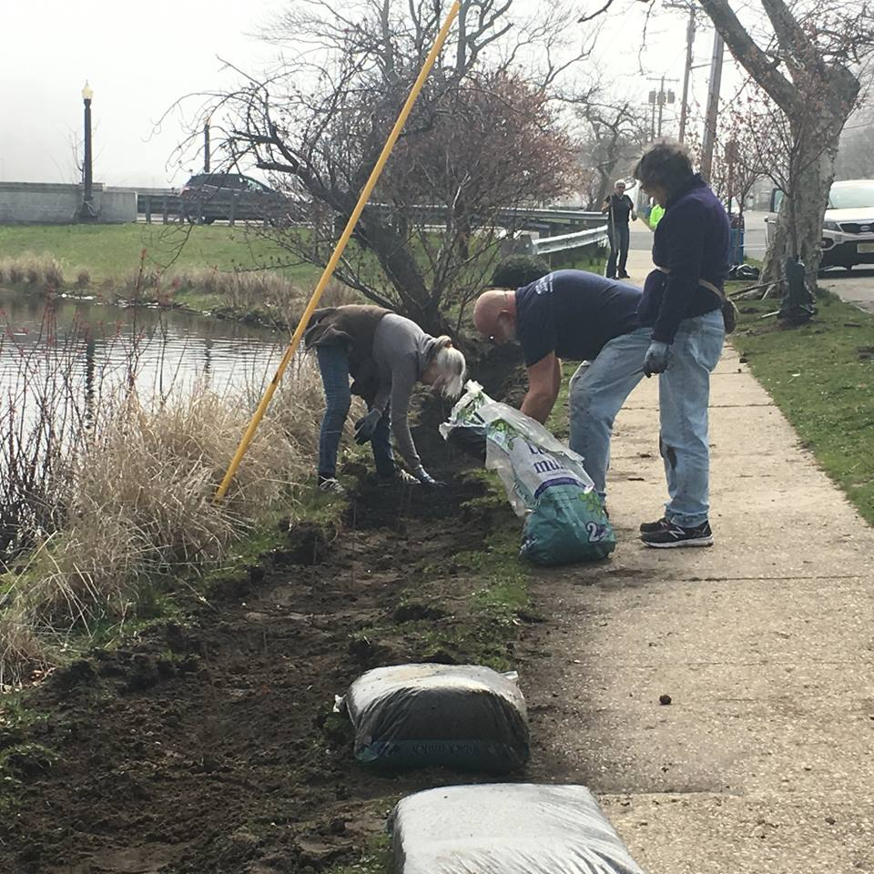
Multiple Natural Shoreline Plantings

Slide 14
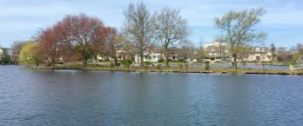
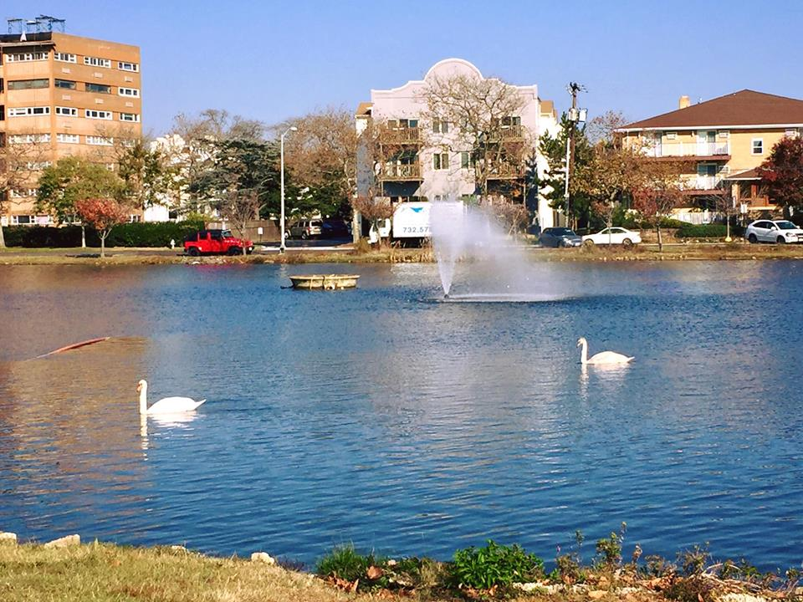
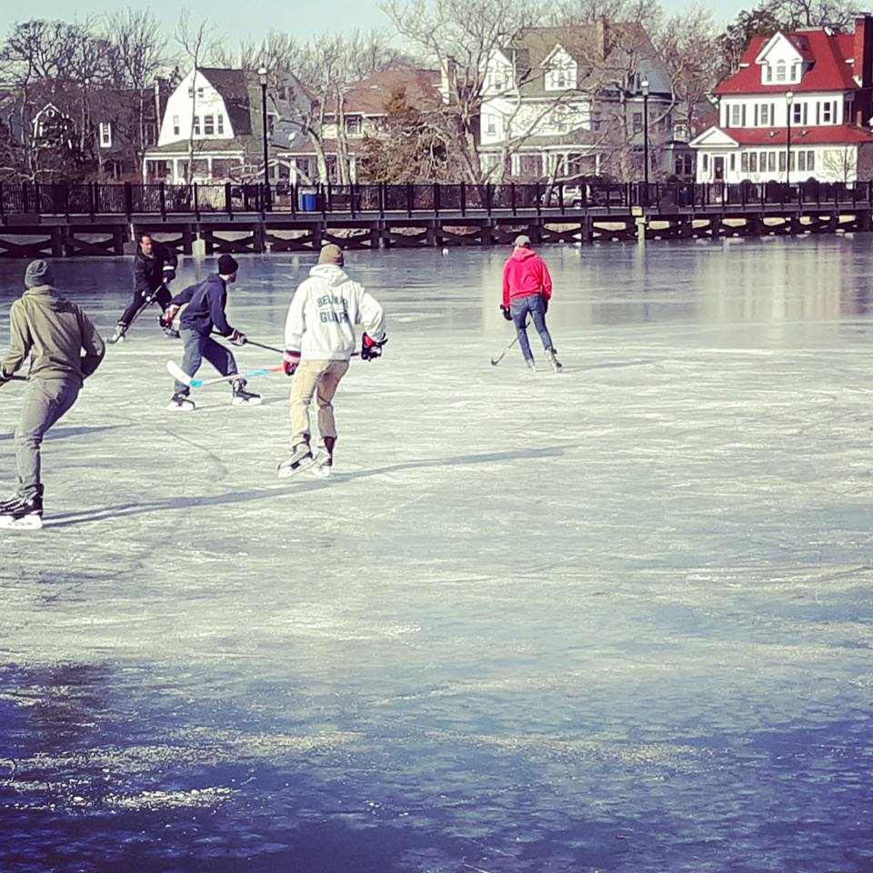
Sunset Lake Today 2018/2019

Slide 15
Master Plan Execution 2019/2020

