Slide 1
Overview of Monmouth County Lakes...Impacts and Issues
Stephen J. Souza, Ph.D.

Slide 2
Welcome

Slide 3
Attributes of The Coastal Lakes
Unique freshwater features...source of drinking water for early settlers
Some (e.g. Deal Lake & Wreck Pond) were once estuaries
Connect/discharge to ocean and some experience tidal exchange...resulting in euryhaline conditions
Important to tourist trade and early development of the Jersey Shore
History of anadromous fish spawning (blueback herring and shad)
Continue to be community focal point providing recreational opportunities within urban setting

Slide 4
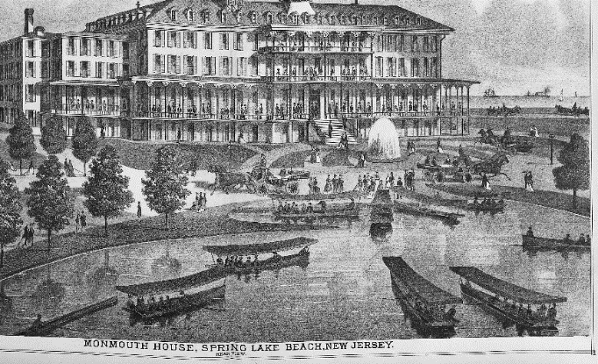
Spring Lake – Monmouth House 1878
From: New Jersey Coast First Atlas - https://library.princeton.edu/njmaps/coast.html

Slide 5
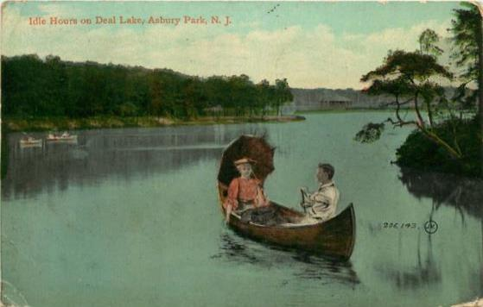
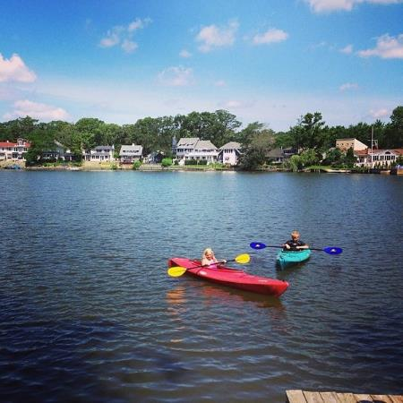
Although still beautiful important resources...
our Coastal Lakes are suffering from the effects of watershed development and urbanization
https://foursquare.com/v/deal-lake/4cee6bf37db3224b5eb4272e/photos

Slide 6
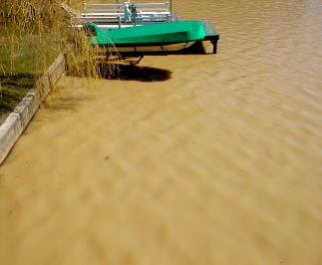
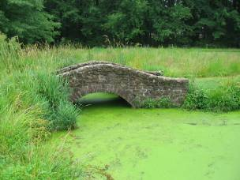
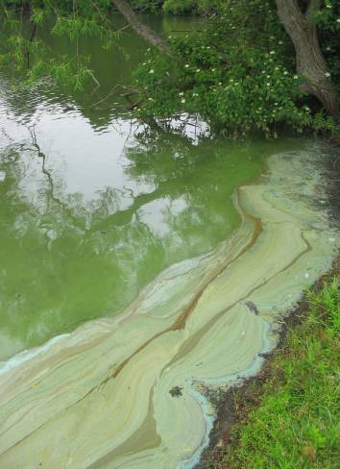
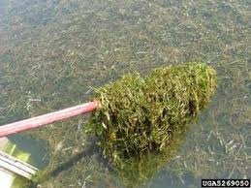
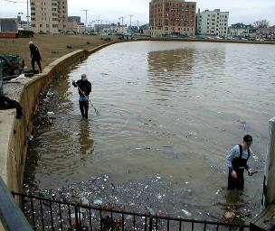
Problems Affecting NJ’s Coastal Lakes

Slide 7
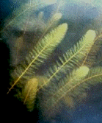
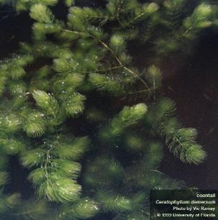
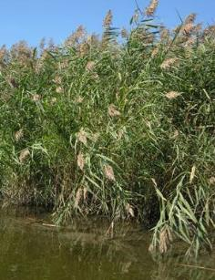
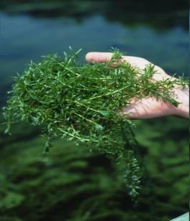
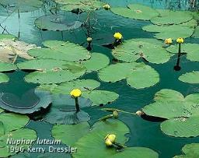
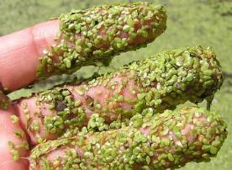
Invasive Aquatic Plants

Slide 8
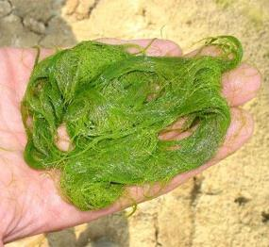
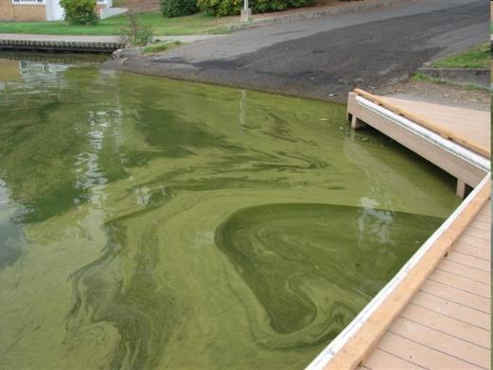
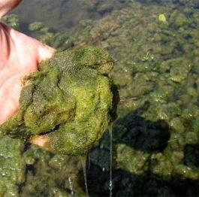
Algae Blooms

Slide 9
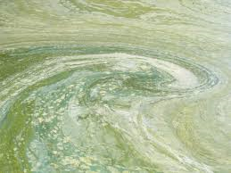
Harmful Algae Blooms (HABs)
Intense cyanobacteria (bluegreen algae) blooms
May generate very high concentrations of cyanotoxins that can impact health of humans, pets, and livestock.
Human Health Recreational Ambient Water Quality Criteria or Swimming Advisories for Microcystins and Cylindrospermopsin – Office of Water – EPA 822-P-16-002 December 2016
https://www.epa.gov/sites/production/files/2016-12/documents/draft-hh-rec-ambient-water-swimming-document.pdf

Slide 10
Unique Properties of Cyanobacteria
Many can fix and assimilate atmospheric nitrogen…providing them with an unlimited source.
Biologically adept at assimilating organic phosphorus – a common source of organic P is dead algae.
Can regulate positon in water column.
Many do well in low light conditions.
Selectively rejected as food source by filter feeders and zooplankton.
NOT best managed via algae treatments.

Slide 11
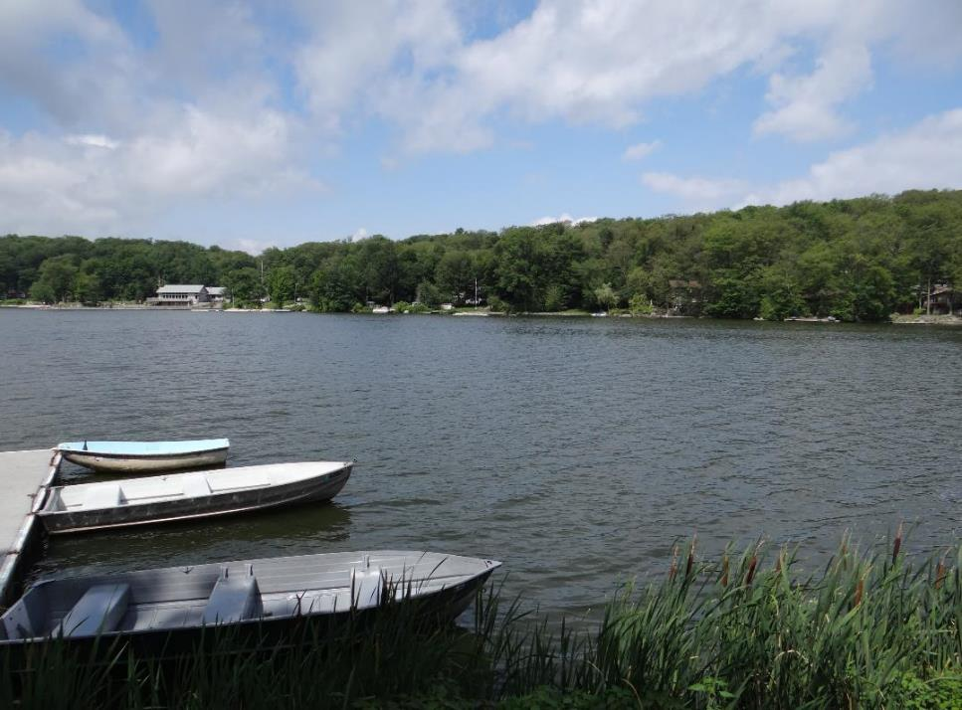
Successful Lake Management
Don’t Just Treat The Symptom….
Correct the Cause

Slide 12
Eutrophication
Natural process
Resulting from excessive nutrient loading
Phosphorus is typically the limiting nutrient – more phosphorus = more productivity = more algae and weeds
1lb of phosphorus = 1,000 lbs of algae
0.03 mg/L TP enough to stimulate an algae bloom – State WQ Std for phosphorus in lakes is 0.05 mg/L
A eutrophic lake IS NOT a dead lake!

Slide 13
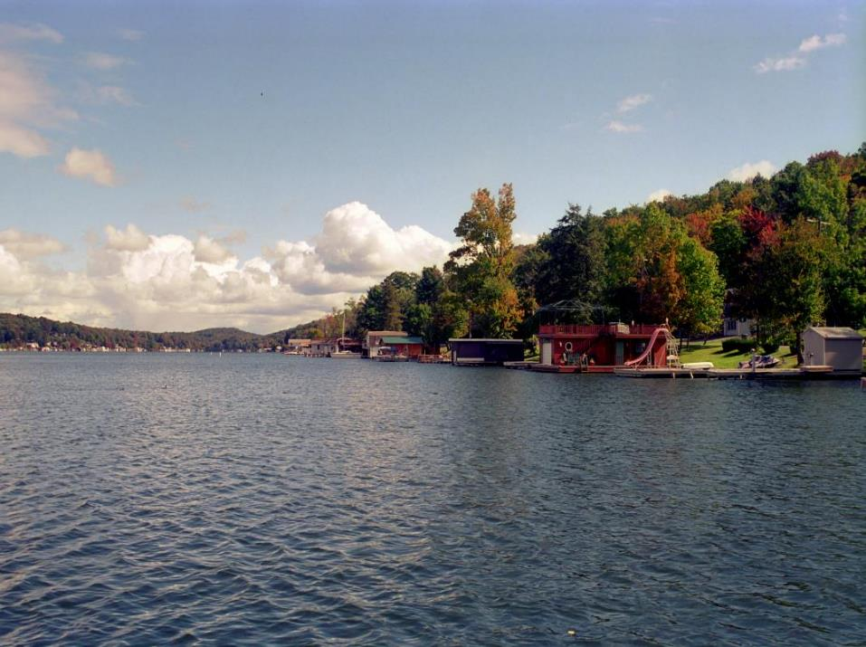
A Lake is a Reflection of Its Watershed
NALMS....2008

Slide 14
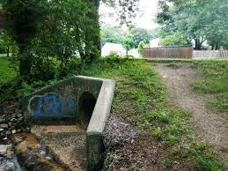
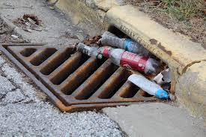
Lake/Watershed Connection
Most lake problems can be traced back to watershed
Especially true of lakes located within developed watersheds
Especially true of watersheds having long history of development

Slide 15
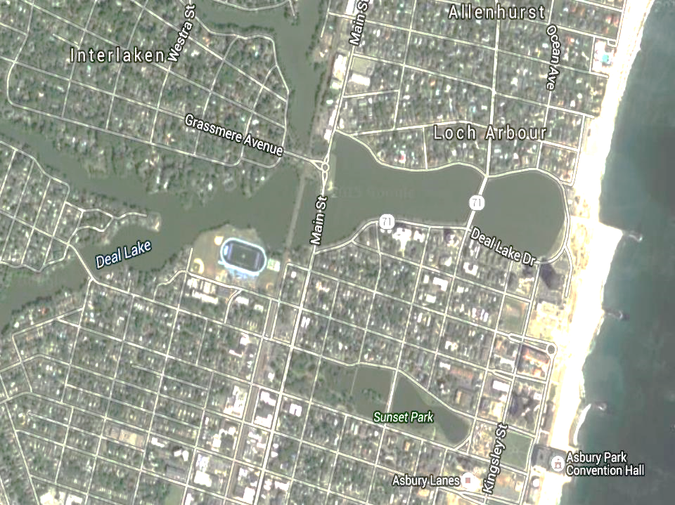
Long History of Watershed Development

Slide 16
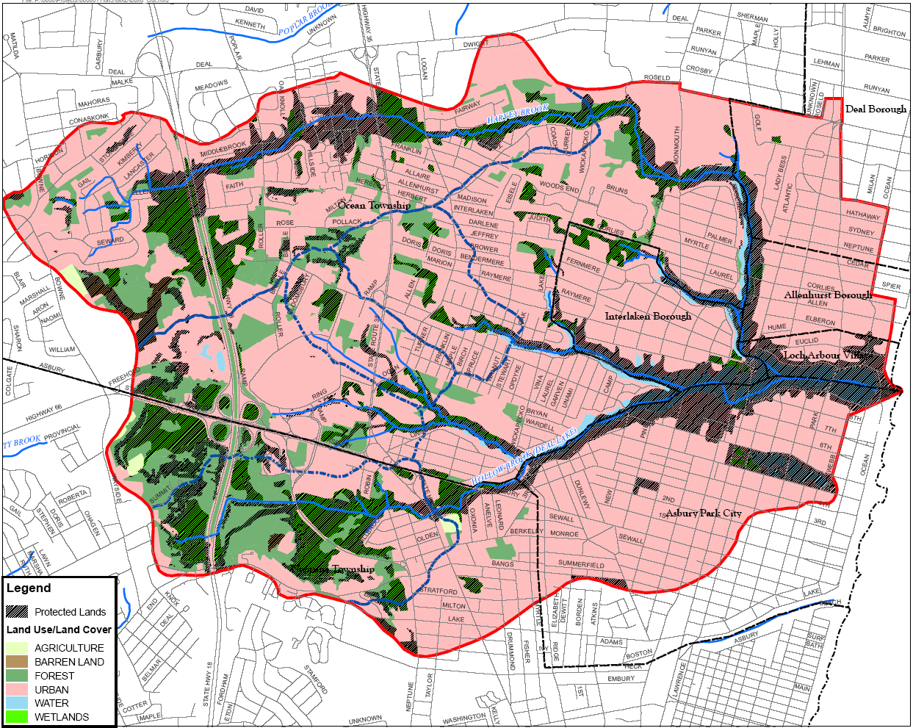

Slide 17
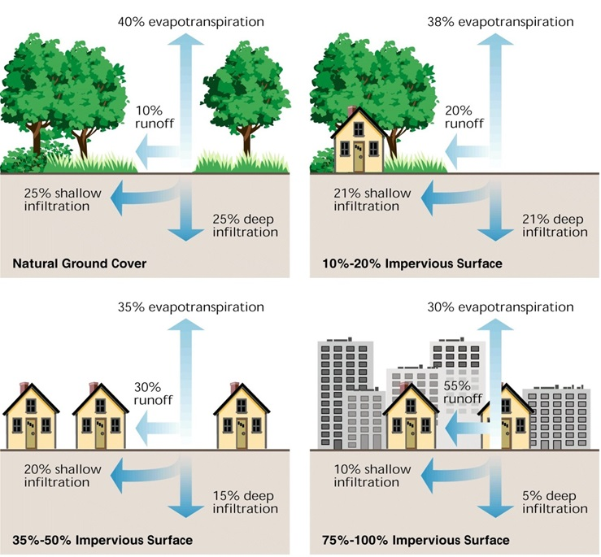
Source - http://prj.geosyntec.com/npsmanual/sectionintrourbanstormwaterrunoff.aspx

Slide 18
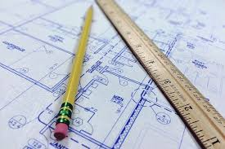
You Wouldn’t Build A House Without A Plan
What To Do?

Slide 19
Keys To A Successful Lake Restoration Plan
1. Collect and analyze lake and watershed data.
2. Set clearly defined, realistic restoration and management goals based on data.
3. Plan put into action with community understanding, support and backing.

Slide 20
Root Cause ID
Collect water quality data....snap shot of lake status
Delineate watershed/sub-watershed boundaries
Synthesize hydrologic data
Quantify annual amount of phosphorus, nitrogen and suspended solids loading originating both from external and internal sources
External – stormwater runoff, septic, agriculture, etc.
Internal – P recycled from sediments, decay of plants and algae, waterfowl, etc.

Slide 21
Root Cause ID
Data Analysis
Data Layers
Watershed Boundaries
Soil Properties
Land Use
Morphometry
Sedimentation
Pollutant Concentrations
DO/ Temperature
Biological Interactions
Recreational Needs
Hydrologic Data
Nutrient Loading Data
Trophic State Analysis

Slide 22
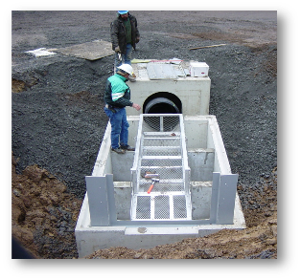
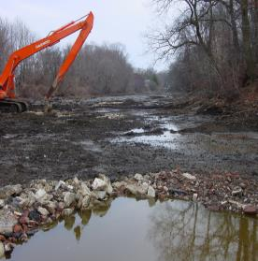
Correcting the Cause of Lake Problems
Data will help distinguish between the symptoms and causes of eutrophication
Data enables prioritization of management and restoration efforts....where to begin and what to address.
Prepare implementation schedule and restoration budget.
Identify required permits.

Slide 23
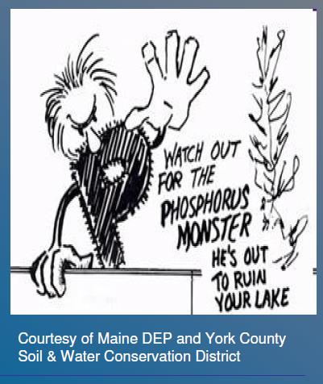
What Can We Do?
Coastal Lakes Need To Go On a Diet
Less phosphorus = less productivity = less weeds/algae
Less sediment loading = less in-filling and loss of water depth

Slide 24
Reduce Phosphorus Loading
Improved stormwater management
Volume based approach
Recharge when/where possible
Emphasize green infrastructure stormwater management techniques
Reduce sources
Pet waste
Wise use of fertilizer
Proper lawn waste management
Maintain/restore riparian vegetation
Control Canada geese

Slide 25
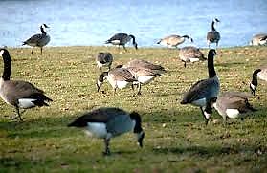
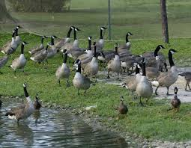
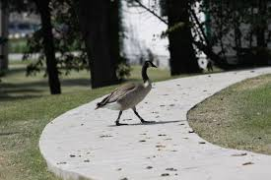
Canada Geese
We’ve created ideal goose habitat...wide open lawns adjacent to water
4 geese produce as much phosphorus in 1 day as a single septic system
On average 1 goose defecates 28 times per day and produces 2lbs of feces per day
Trample and destroy lake side vegetation

Slide 26
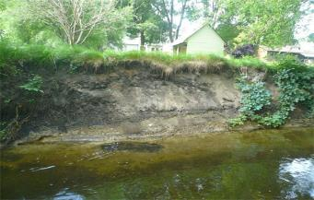
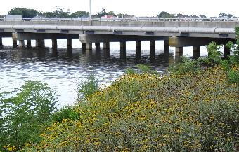
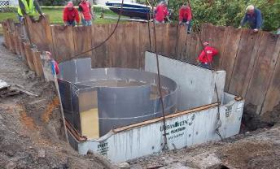
Reduce Sediment Loading
Reduce stormwater runoff – volume control not just rate reduction
Intercept and pre-treat runoff
Repair storm scoured and eroded stream banks
Prevent/reduce clearing of lake shore
Restore riparian and nearshore vegetation

Slide 27
In Summary
NJ’s Coastal Lakes are unique waterbodies
Their impacts and problems directly linked to watershed development and inadequate stormwater management
Reducing stormwater runoff related impacts requires reducing volume of stormwater runoff and decreasing the generation and transport of pollutants....phosphorus and sediment
This requires a well designed plan that is based on technically sound data
Plan success also requires community support

Slide 28
Stephen J. Souza, Ph.D. Founder Princeton Hydro, LLC SSouza@PrincetonHydro.com
Thank you....

