Slide 1
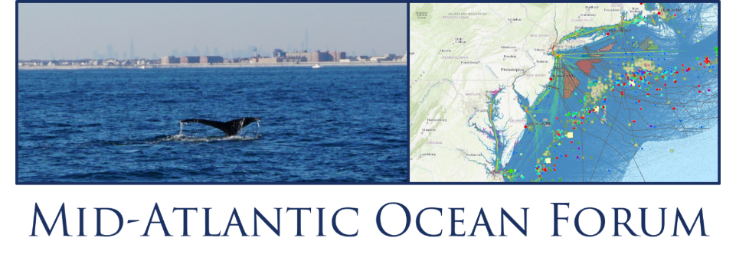
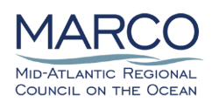
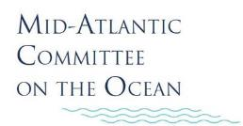
MID-ATLANTIC OCEAN DATA PORTAL
& REGIONAL DATA PRIORITIES
Nick Napoli, MARCO/Portal Team Lead
Karl Vilacoba, Monmouth U. Urban Coast Institute

Slide 2
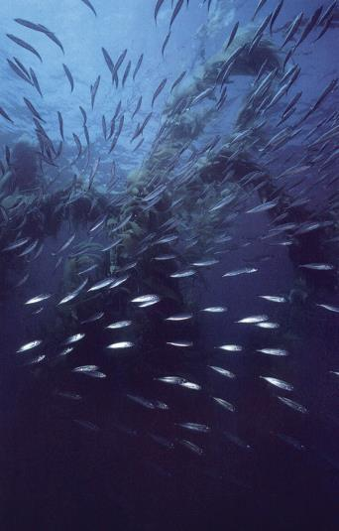
The Mid-Atlantic Ocean
Data Portal Team
The Portal is maintained by a team consisting of the Monmouth University Urban Coast Institute, Rutgers University’s Edward J. Bloustein School and Center for Remote Sensing and Spatial Analysis, The Nature Conservancy and Ecotrust, under the guidance of MARCO.

Slide 3
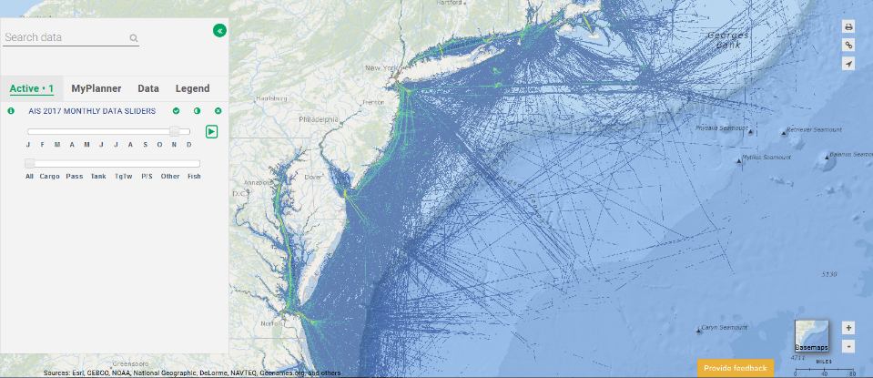
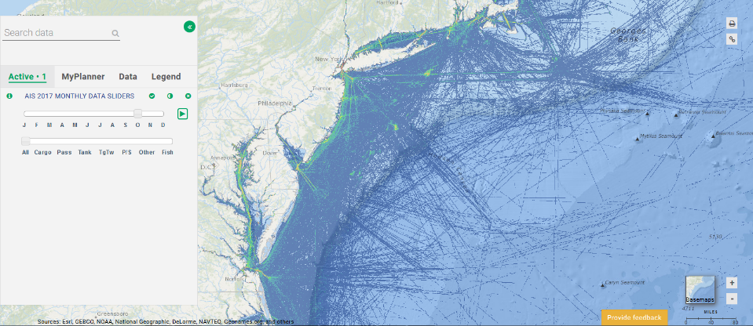
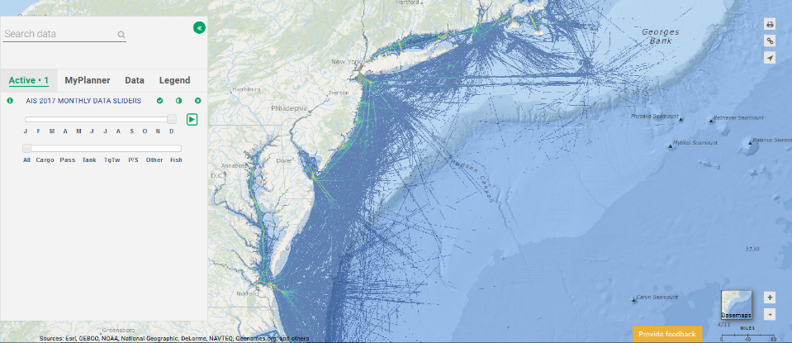
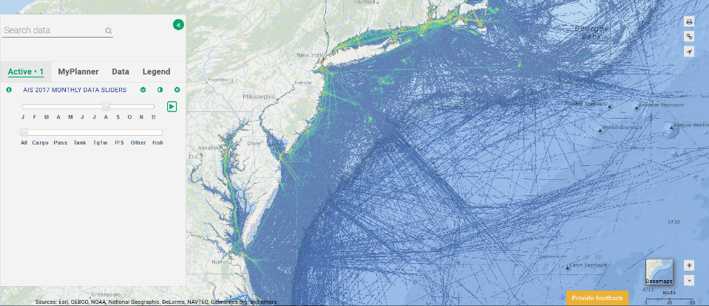
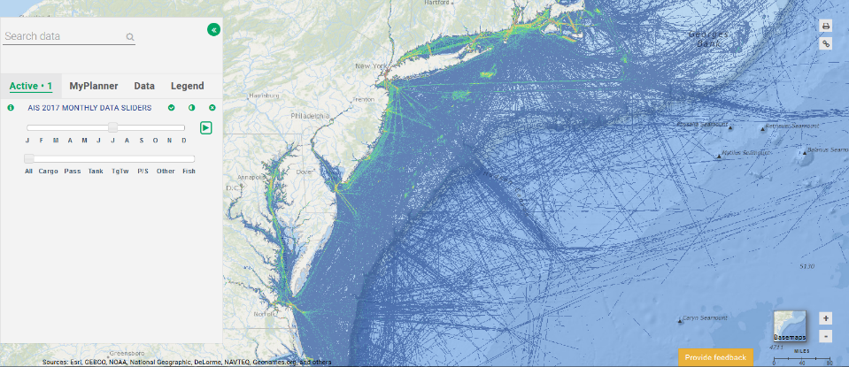
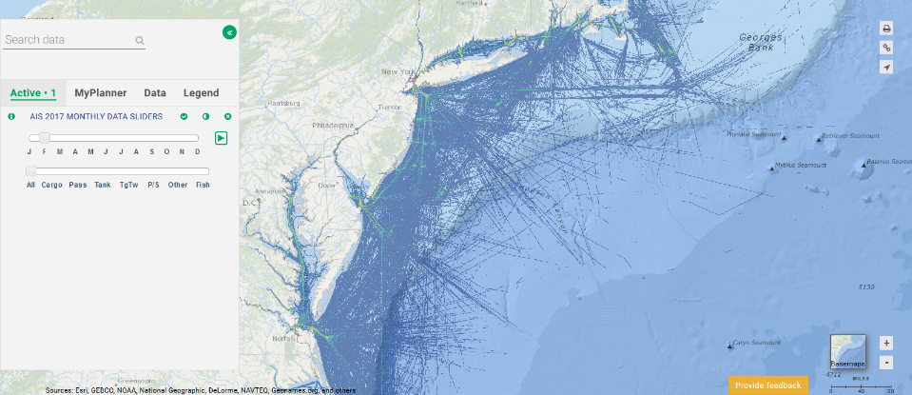
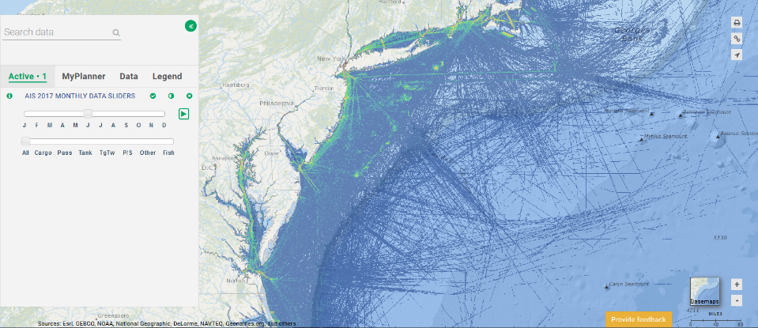
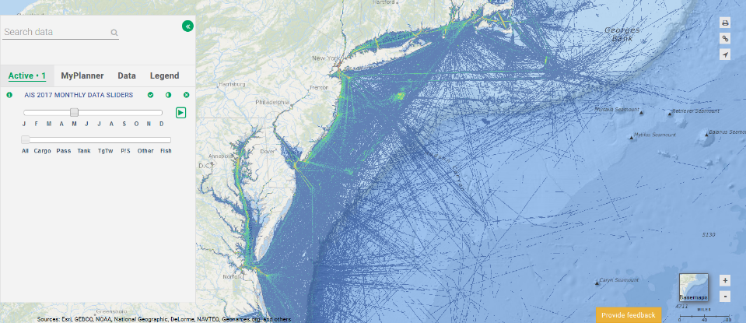
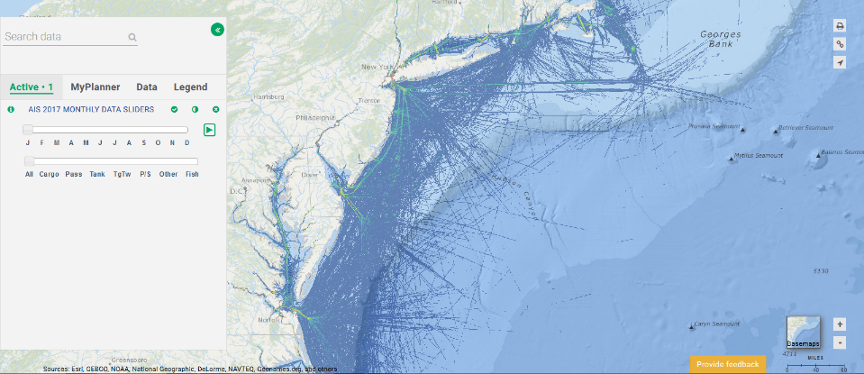
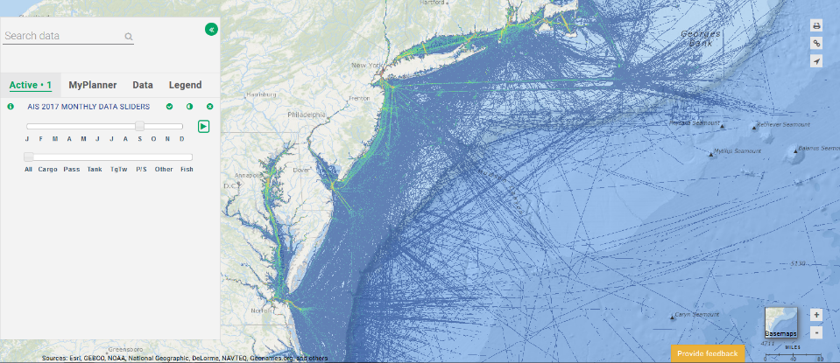
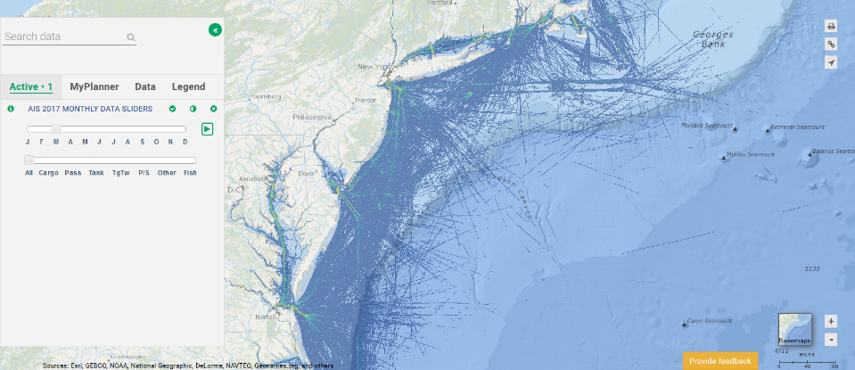
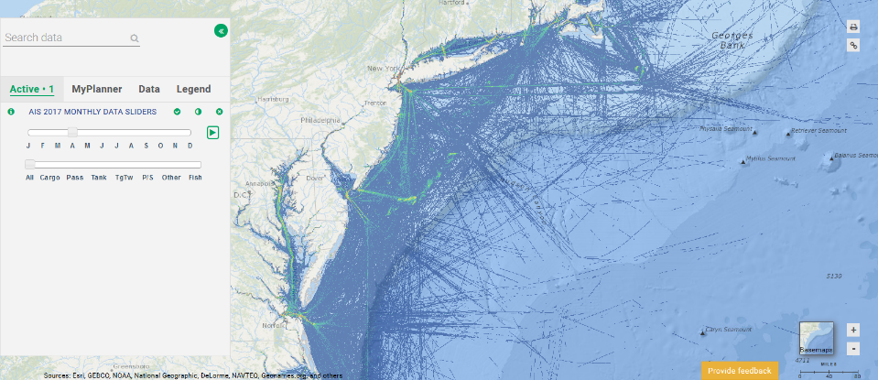
2019 Work Plan: Sliders & Animations
Months
Play button
Vessel types
UPCOMING APPLICATIONS: Commercial Fishing VTR/Communities at Sea, Monthly Marine Mammal Abundance, Seasonal Primary Productivity and Fronts Probability

Slide 4
2019 Data Priorities: Sample Products
FISHING: Party/charter VTR, VMS and artificial reef updates
MARITIME: 2018 AIS, BOEM sand data, cable updates
MARINE LIFE: MDAT fish data replacement and cetacean updates, shifting fish species
OCEANOGRAPHY: Bathymetry updates, USGS (bottom sheer stress, bed mobility), MARACOOS products
SOCIECONOMIC: MARCO resilience study maps (ocean employment % per county, seasonal housing)
WIND: Updates throughout year as data becomes available
TOOLS: New linear measurement tool, comprehensive bookmark upgrades
And much more … Visit our Portal booth for further info!

Slide 5
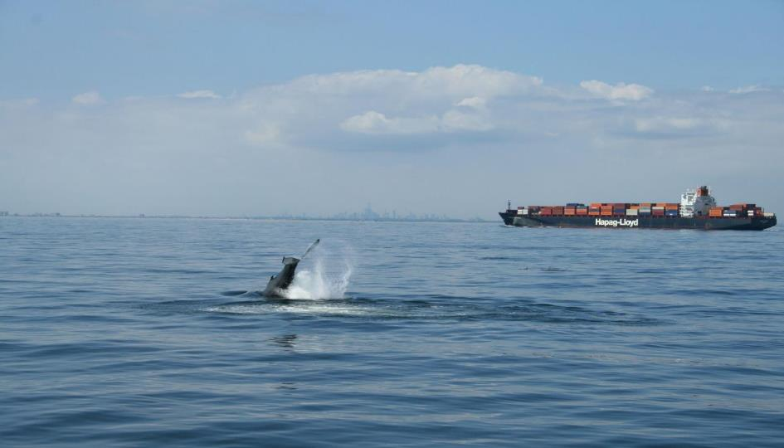
Potential Encounters Between Humpback Whales and Vessels in the Northwestern New York Bight
Danielle M. Brown

Slide 6
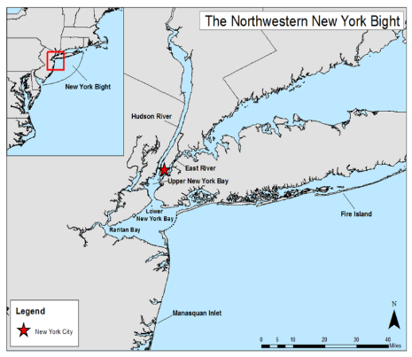
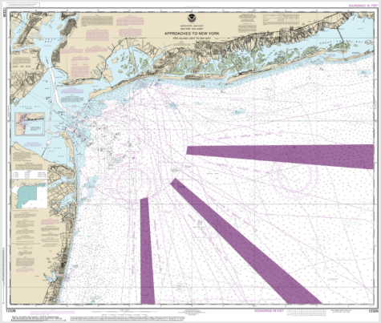
Vessel Approaches to the Port of NY and NJ
The Study Area

Slide 7
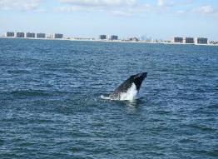

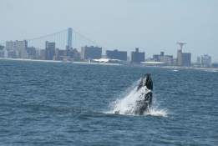
Humpback Whale Sightings, 2011-2016

Slide 9
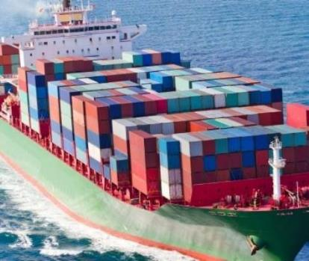

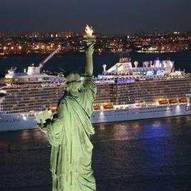
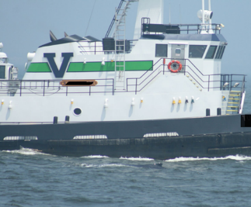
98% of humpback whales sightings overlapped with a vessel track
  27% cargo vessel overlap
  40% passenger vessel overlap
  40% tanker vessel overlap
  78% tow vessel overlap

Slide 10
Areas of Overlap

Slide 11
Whales feed in and around major shipping lanes and channels
Port location makes management difficult
No speed restrictions in place
Operators are unaware of/unprepared for whales
What if humpback whale sightings continue to increase?

Slide 12
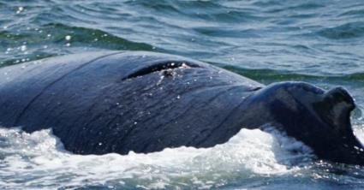
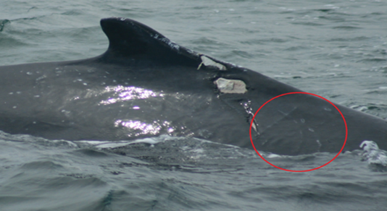
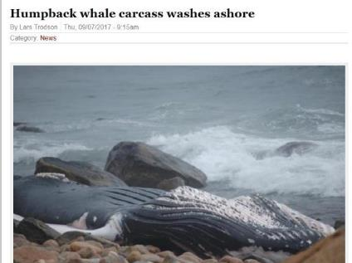
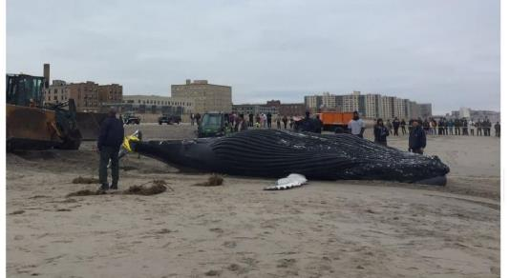

Slide 13
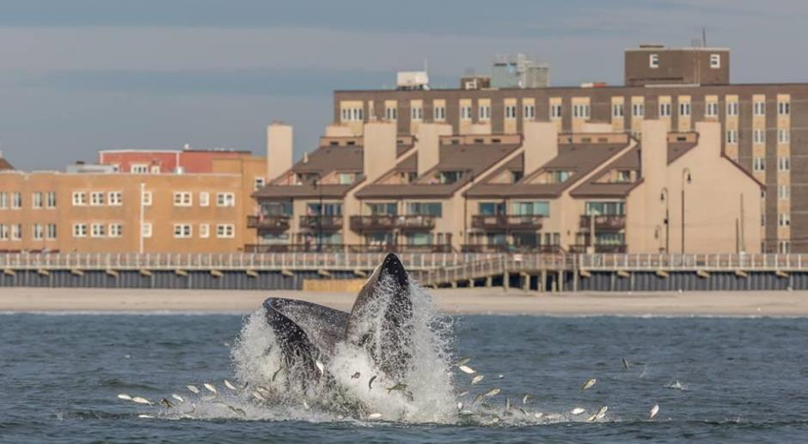
Future Directions
Are Atlantic menhaden the primary driver of humpback whale occurrence in the northwestern New York Bight?
If we can predict the inshore abundance of menhaden, can we predict the occurrence of humpback whales?
Can this be used to alert vessel operators?

Slide 14

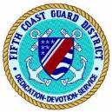
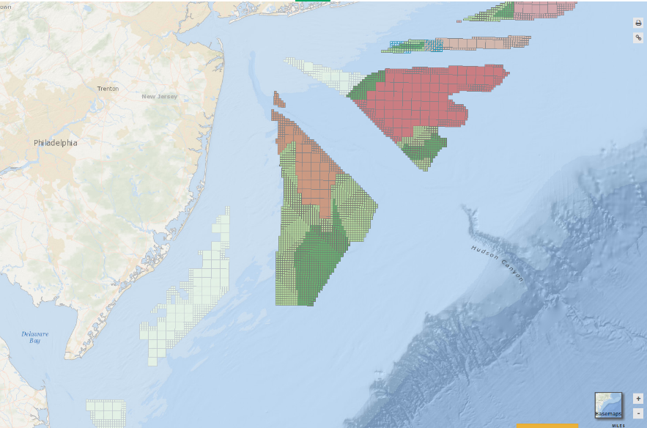
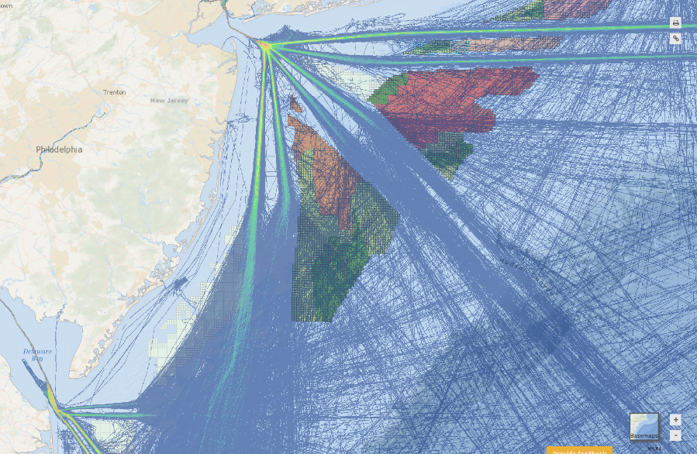
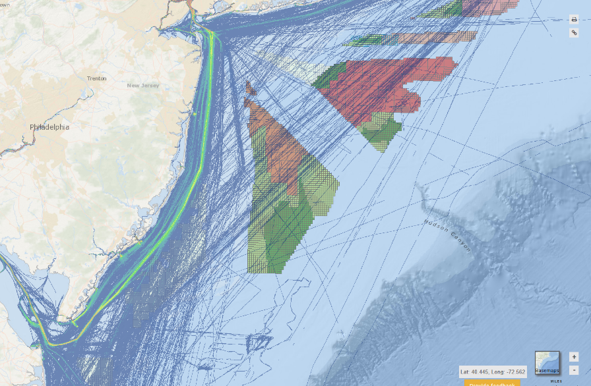
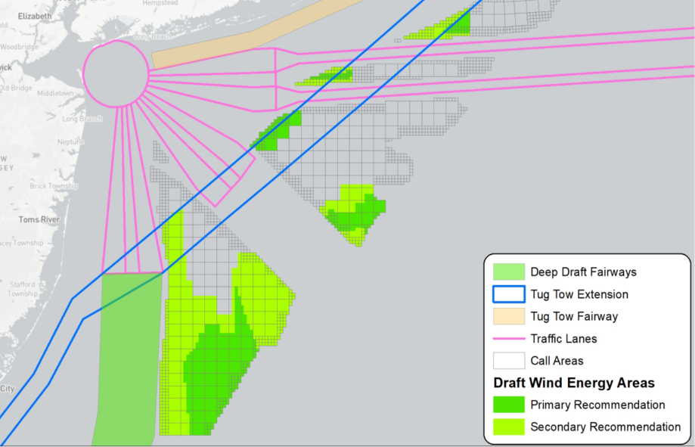
Matt Creelman
Marine Information Specialist

Slide 15

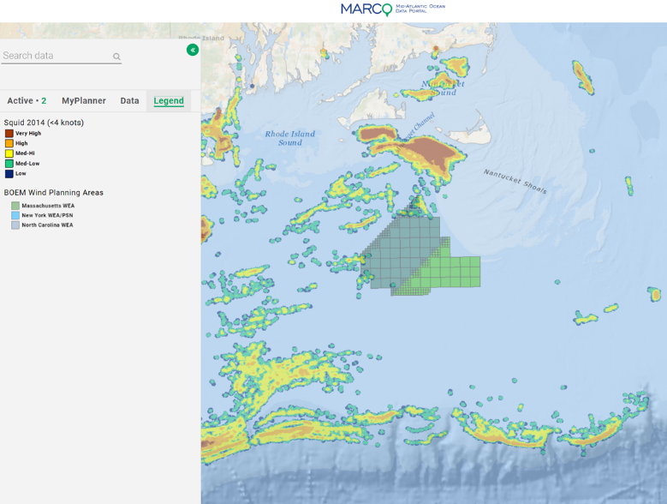
Stephen Drew, Equinor Wind
Fisheries Liaison Officer sdrew@searisksolutions.com
Portal data for offshore wind & fisheries
Decisions should be made with science & evidence
Multiple data sources should be consulted
Portal has valuable & trusted information
Example – 2014 squid trawl VMS data & new lease areas
Fishing is more intensive to the north and west; & slope edge

Slide 16

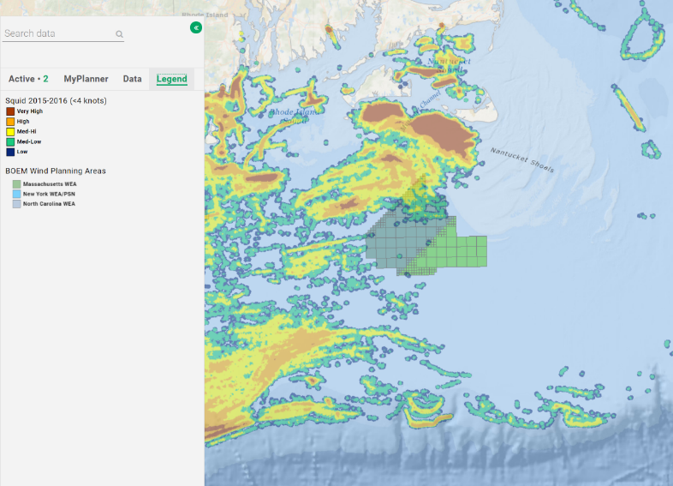
Example – squid trawl data
VMS data 2015-16 – new OSW leases areas
Squid concentrations and fishing move year to year
Some consistent patterns emerge
Maximum precision and time series are always helpful

Slide 17

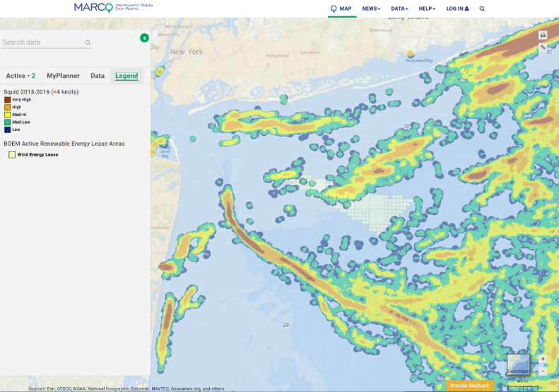
VMS squid trawl 2015-2016
Equinor Wind Lease in NY Bight
Squid trawls used mainly in northwestern part of lease
Data portal, scientists & fishermen agree that squid abundance varies by year and location

Slide 18
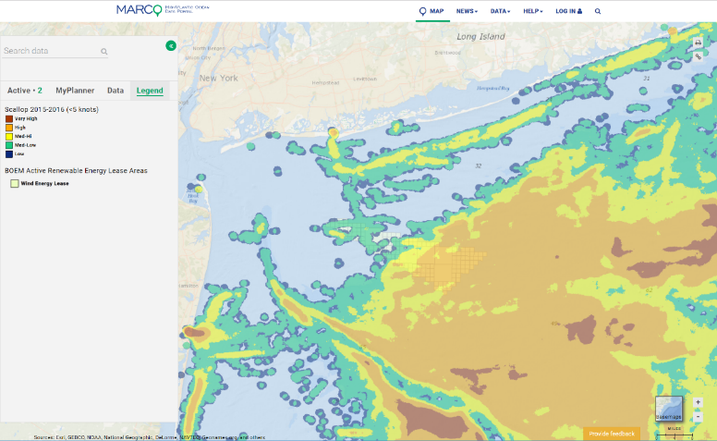
VMS scallop fishing 2015-2016
Equinor Wind Lease in NY Bight
Scallop dredges work more in SE part of lease and deeper waters outside
Different parts of a lease may see different types of fishing gear that could require different solutions for coexistence

Slide 19
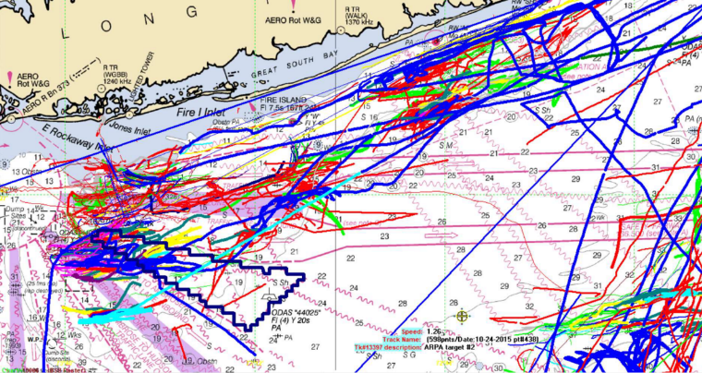
Other data sources should be consulted, i.e. fishermen interviews & plotter tracks
While MARCO provides a uniquely valuable range of trusted data, it is essential to consult other sources too
Plotter tracks provided by multiple trawlers corroborate occasional squid abundance in NW part of lease & show tow directions

Slide 20
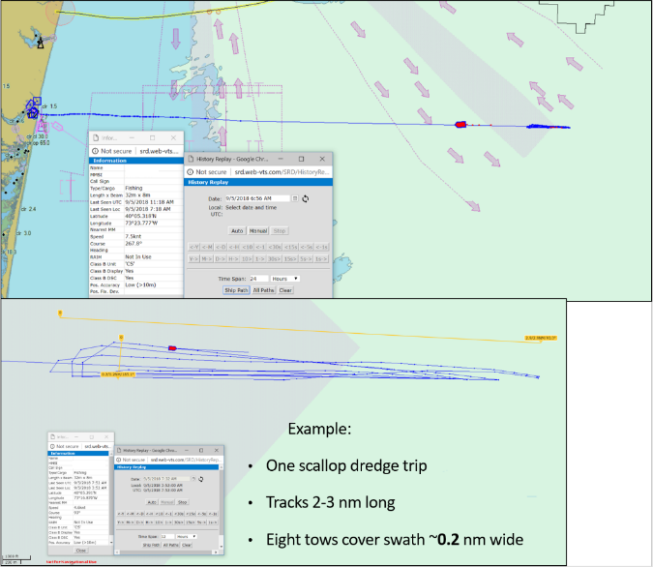
Other data sources should be consulted such as AIS detail
The Automatic Identification System (AIS) combined with other sources, can provide additional detail such as
confirmation of vessel type
fishing methods
dimensions and headings of typical fishing activities to inform issues such as turbine alignment & spacing

Slide 21
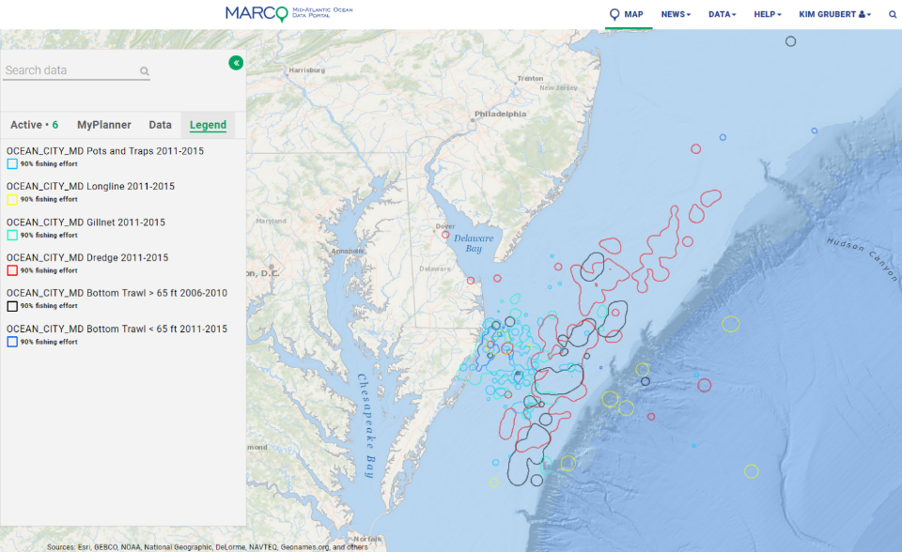
Kim Grubert, Maryland Dept. of Natural Resources:
Ocean City MD Communities at Sea

Slide 22
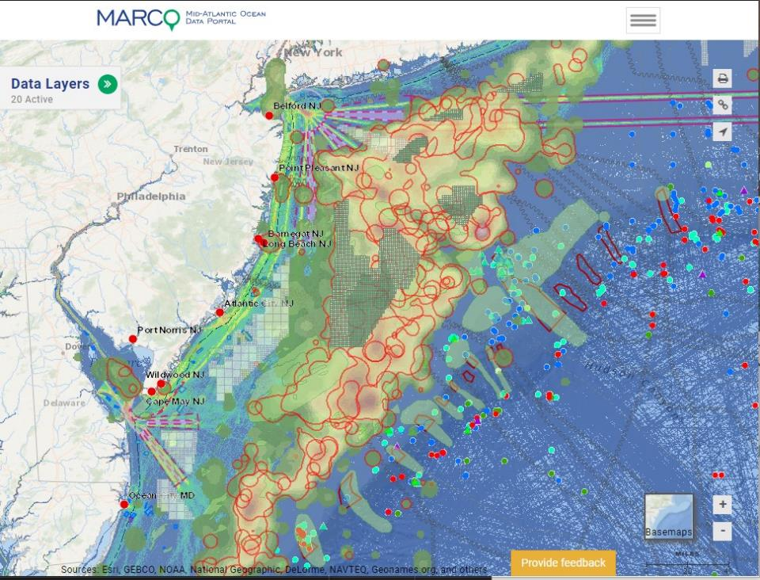
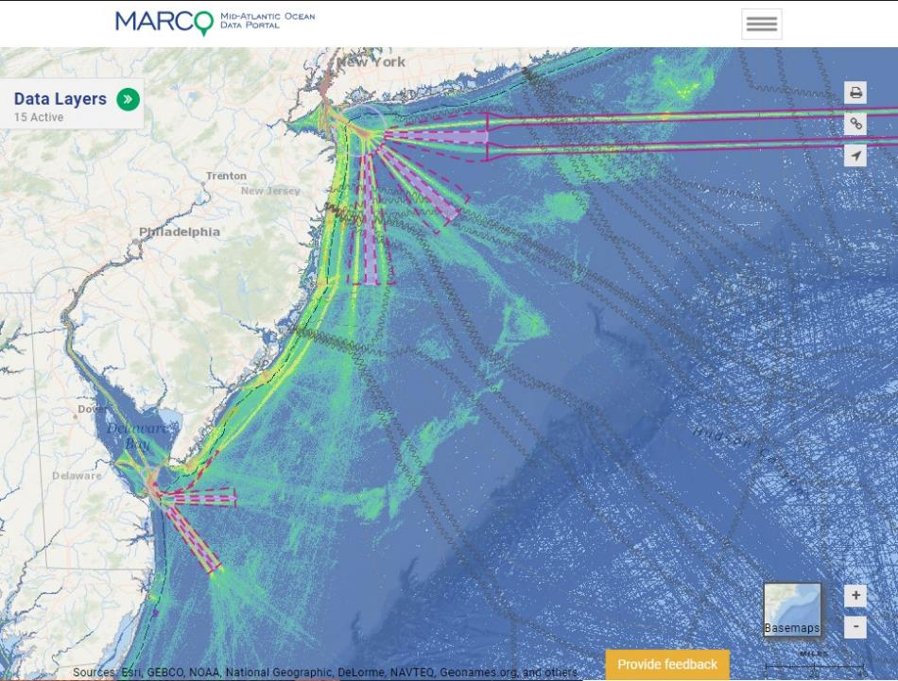
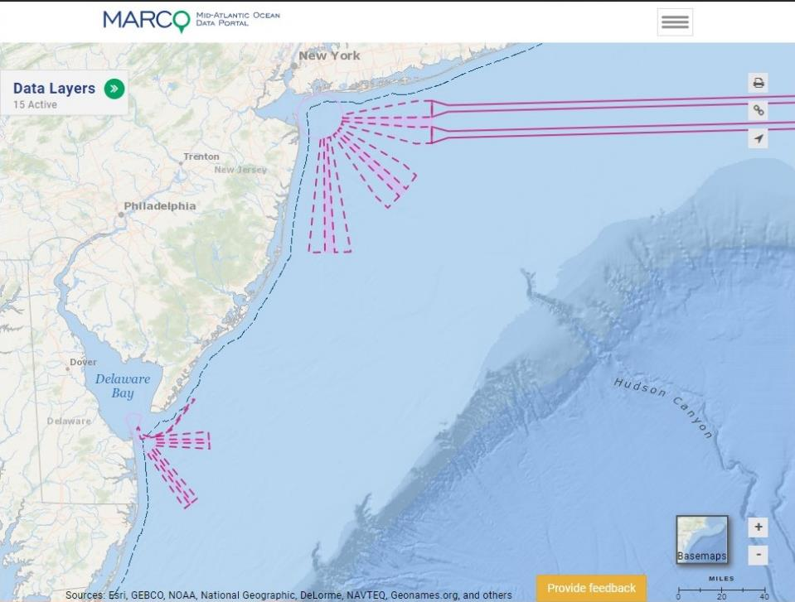
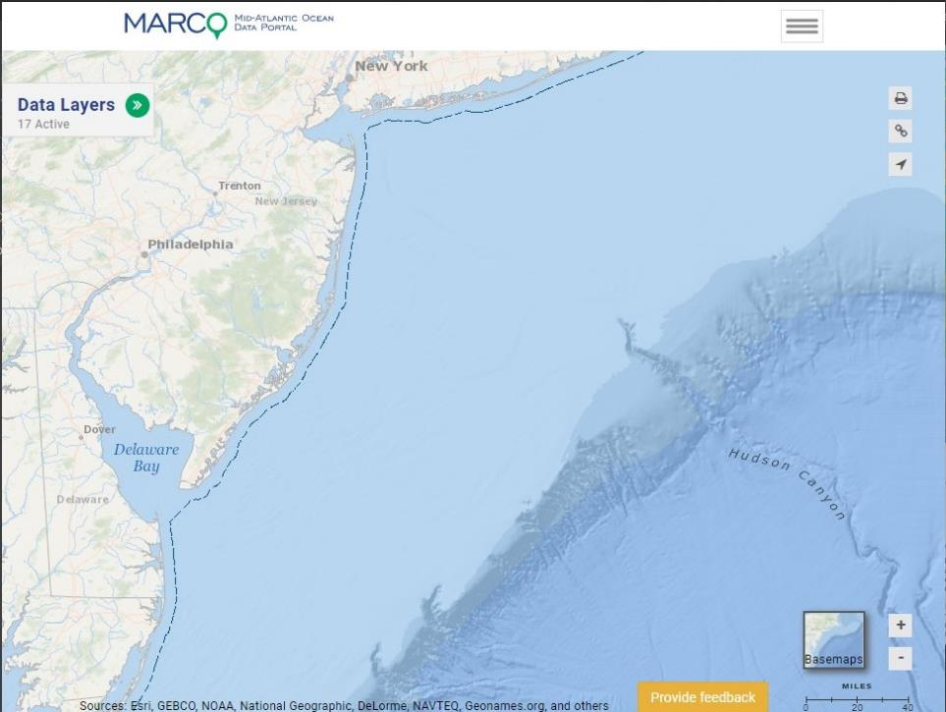
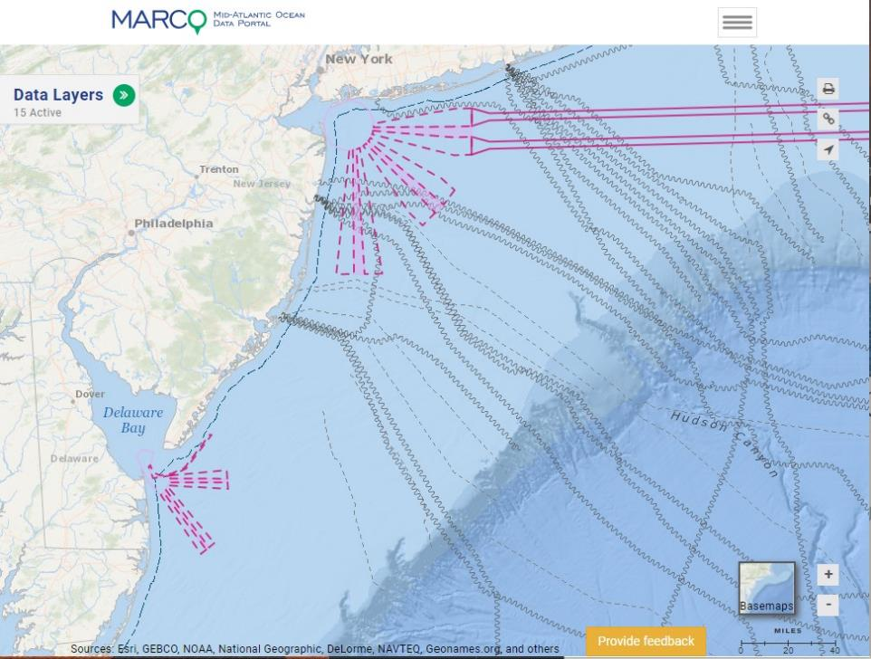
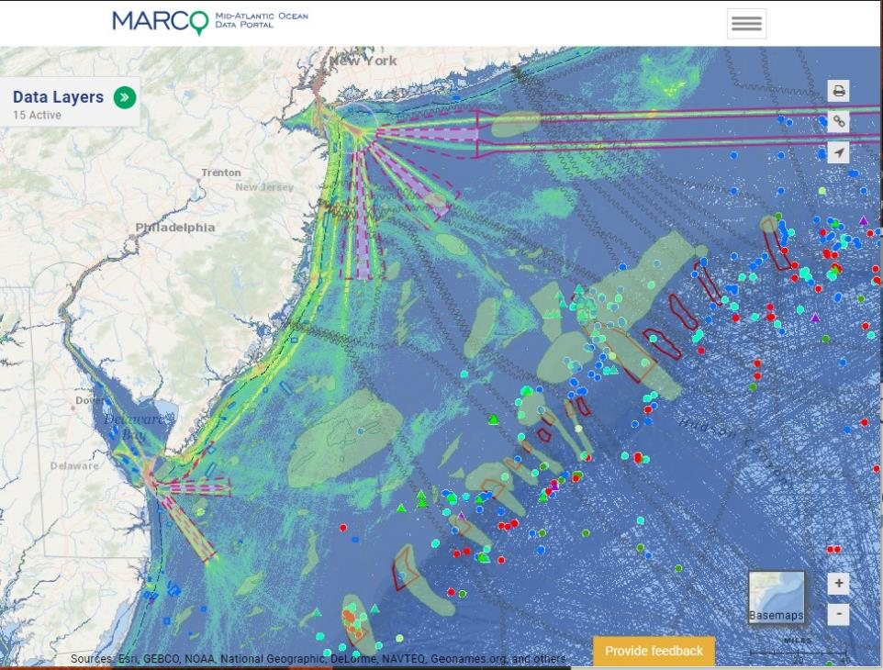
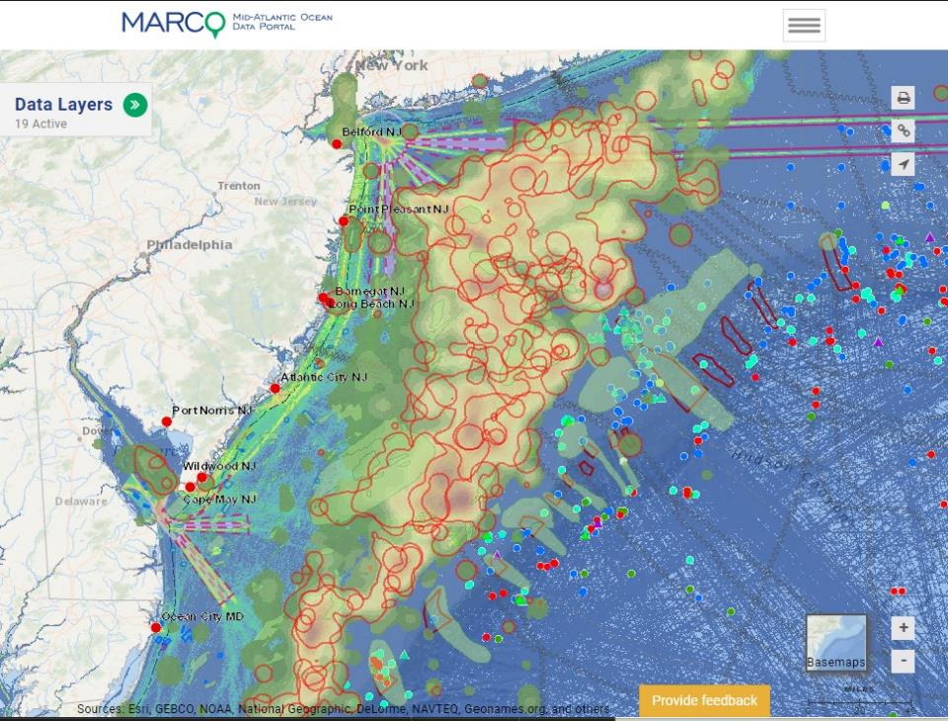

Kevin Hassell, NJDEP

Slide 23

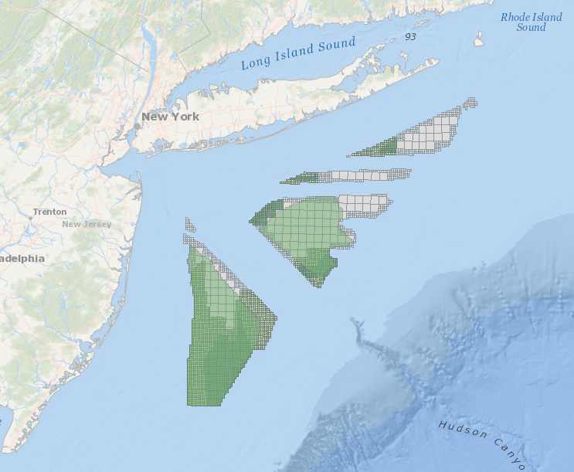
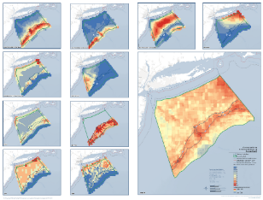








Lyndie Hice-Dunton: New York State Offshore Wind Master Plan

Slide 24





New York Bight Fishing Transit Routes
*Preliminary draft*

