Slide 1
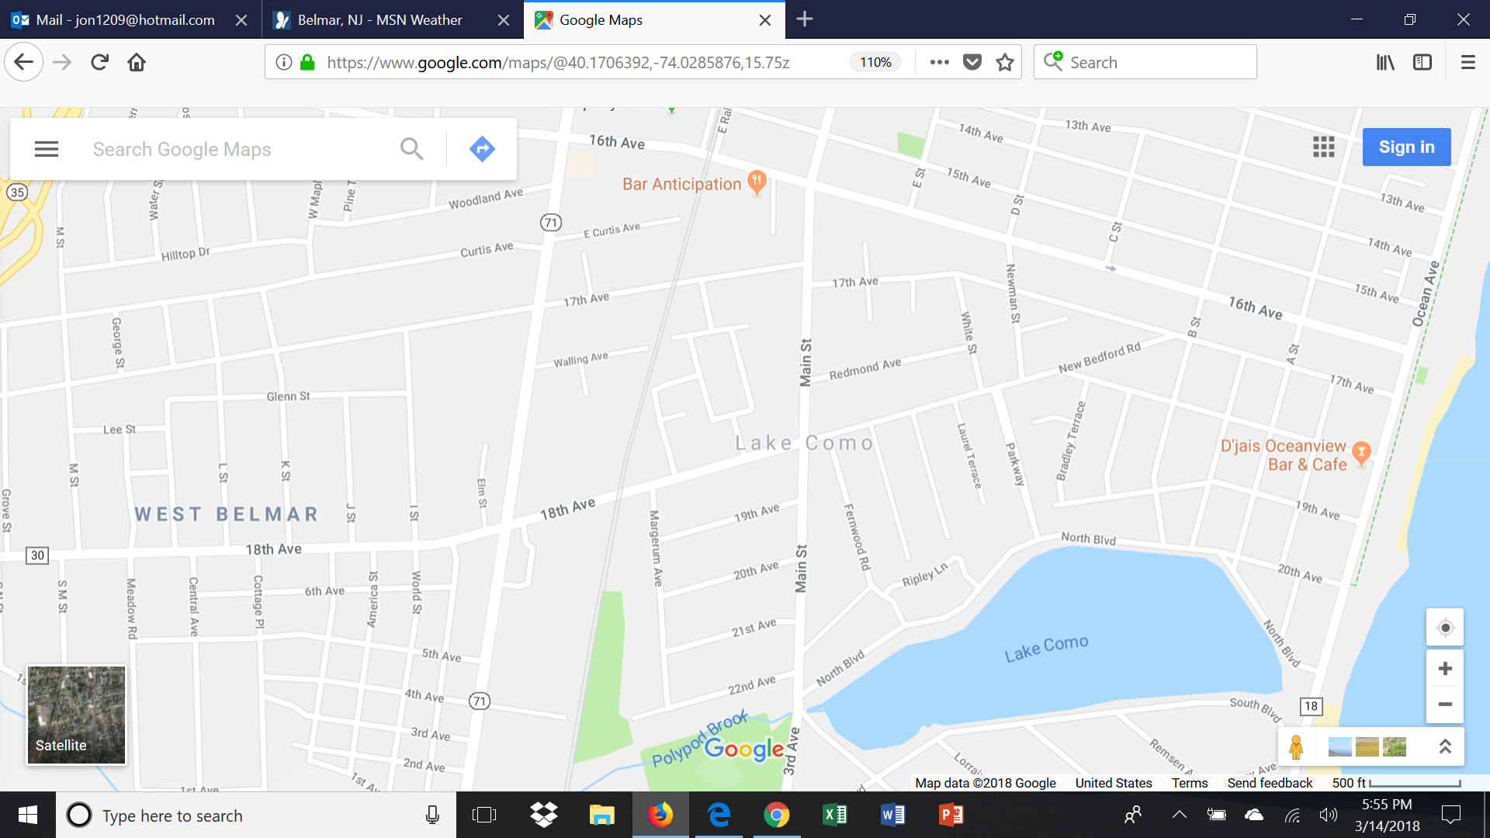
Monmouth University
COASTAL LAKES SUMMIT – March 15, 2019
Belmar
Wall
Township
BOROUGH of LAKE COMO
What We’re up to,
How Can We Help?
Jon Gibbons
Chair, Environmental Commission
Executive Director, Friends of Lake Como Environment, Inc.
Proprietor, Candide’s Garden
Spring Lake

Slide 2
“HERE COMES SUMMER…”
Our Social Environment
Party Zone
Raceway – GS Parkway to the Beach
“Drunken Promenade”
Raceway – GS Parkway to the Beach
Party Zone
“…Shore town with all the problems
and none of the advantages”
Ex-Mayor Brian Wilton
Where is the Sense of Place - Hometown? Village?
Partying MILLENNIALS – They could hold the key!
Move from a barely-noticed Pass-through
to a Distinctive Destination!

Slide 3

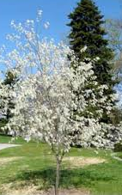
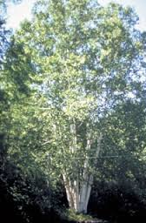
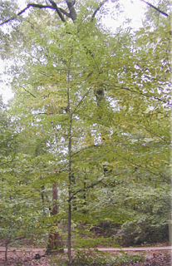
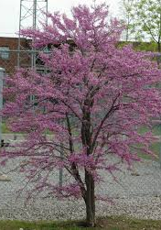
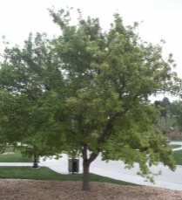
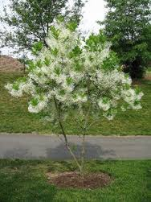
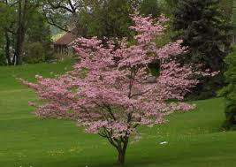
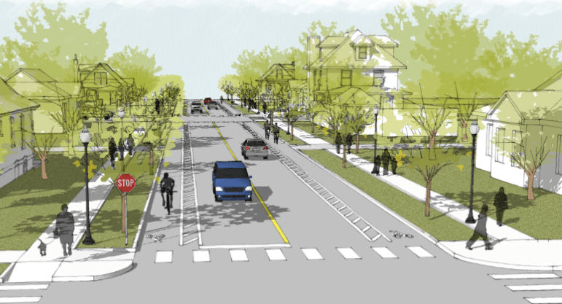
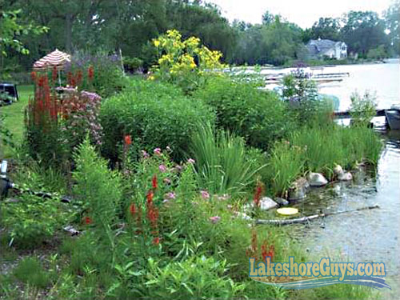
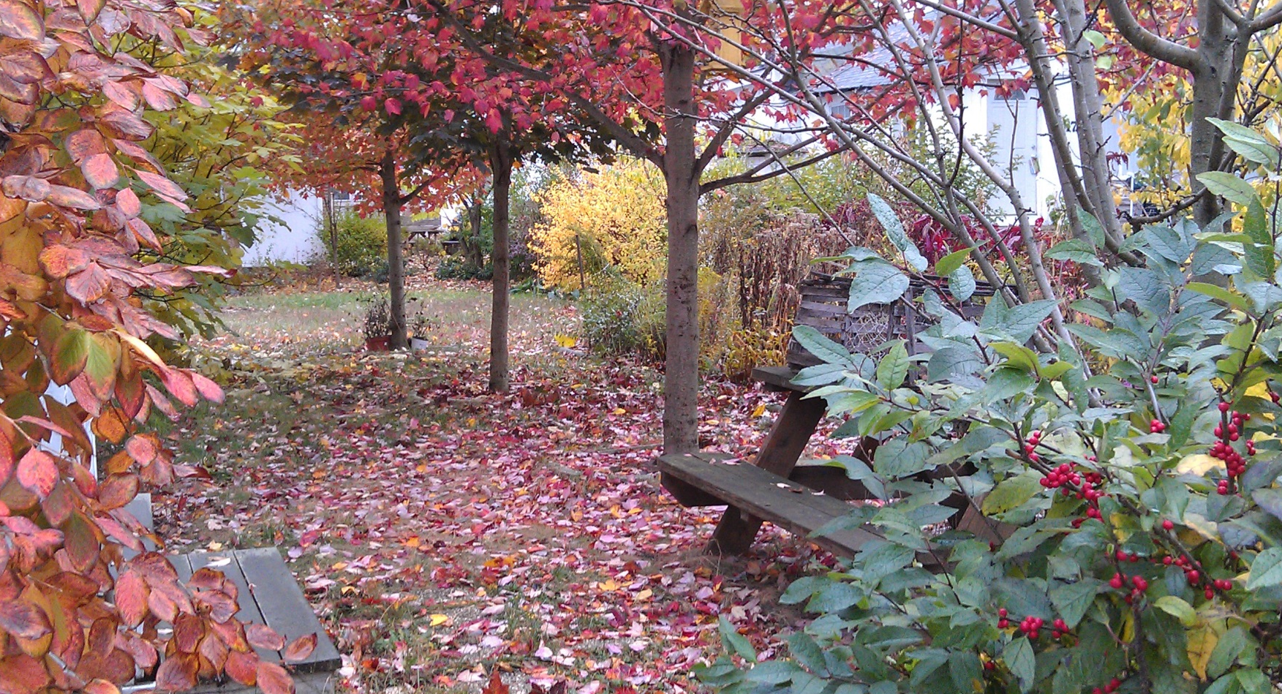

OUR VISION for LAKE COMO –
Move from a Barely-noticed Pass-through…..to a Distinctive Destination!
How – Create a Village-type atmosphere, with an Environmental Theme
PLAN:
Five more
environmental
destinations
in five years!
Main Street Arboretum
Dining,
& Street Fair
Patchwork for
Wildlife
Borough Hall Demo Gardens
“Pathway to the Lake”
Patchwork for Wildlife
Candide’s Garden
Lake Front Fun & Wildlife
Park
2018 - our first environmental destination!
Issue: Spring 2023

Slide 4
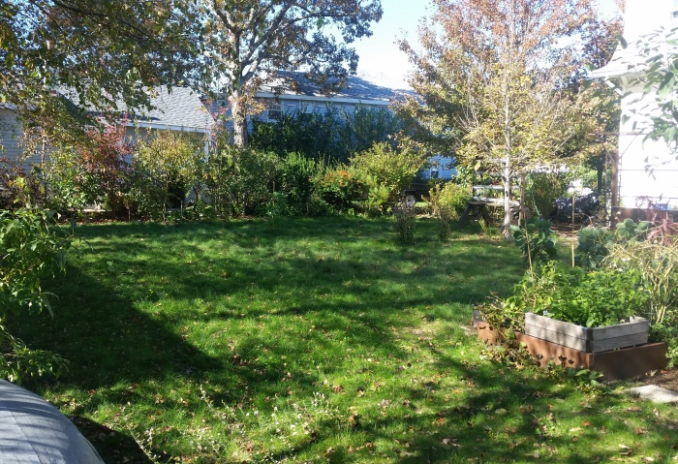
Candide’s Garden
Berry
Curiosity
Hedge
Herb
Lawn
Orchard
Pollinator
Shade
Shore
Veggie
Verge
Vertical
Weedy
Woodland
400 Species, 1500 Total.
40 Tree Species, 52 Total.
Natives, plus some “Garnish”
All Pervious Surfaces.
Stingy Water Management.
Street Trees Pilot Project.
Earth-friendly Maintenance.
Only diseased and seeded material leaves the site.
“No-Mow” Lawn &
Lawn Grid Driveway

Slide 5
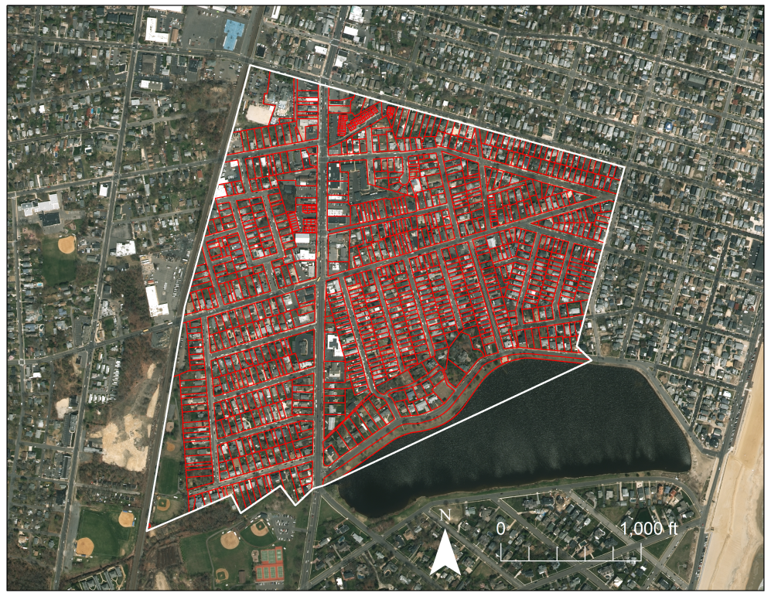
MANAGING THE PROGRAM – Online Map
Multi-Year Joint Venture :
Lake Como Environmental Commission – Plan Projects, People; Track Progress.
GIS Dept., Monmouth University – Interns Work on a Comprehensive Model of a Town.
We’ll keep track as the “patchwork” fills in!
Find it on Borough website - www.lakecomonj.org

Slide 6
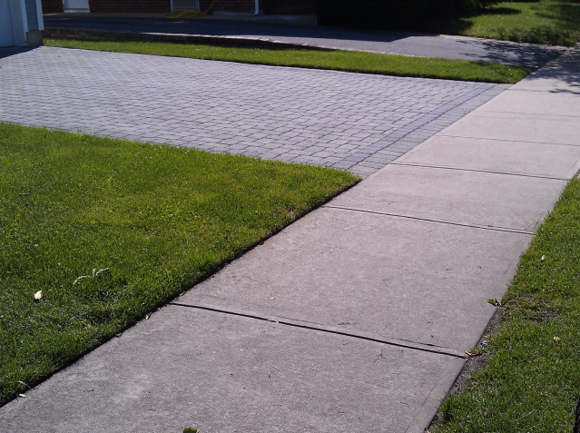
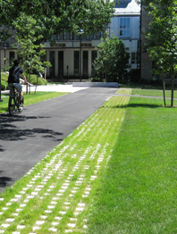
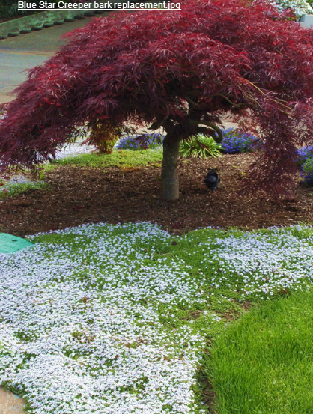
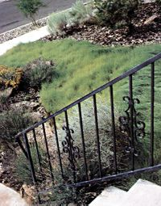
“COVERING GROUND”
Impervious Surfaces – Concrete, Macadam, Astro-turf
Non-Plant Based Surfaces, eg., Gravel, Rubber Mulch
Replace these environmentally useless or harmful surfaces with Native Plants/Ground Covers:
Pervious Pavers Reduced Lawn Area “No-Mow”Grass

Slide 7
CHOICES of SURFACES: EVALUATION
Coming Attraction:
RATING SYSTEM

Slide 8
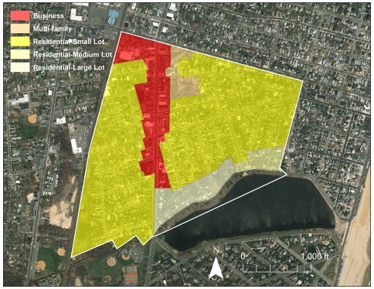
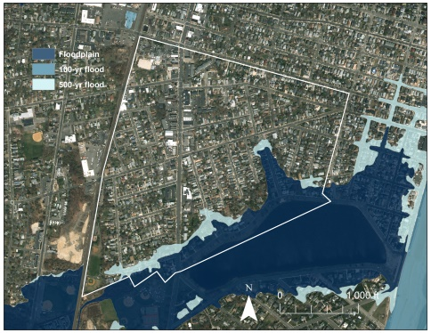
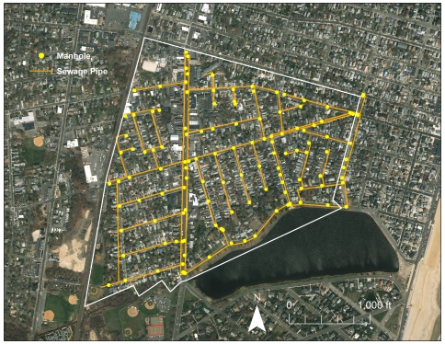
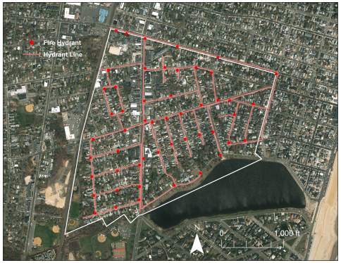
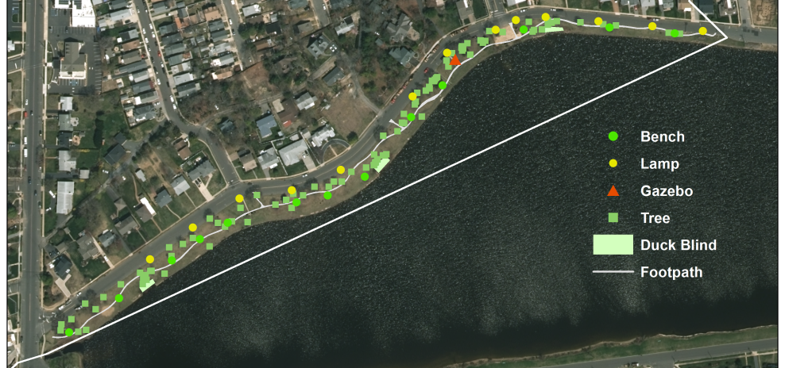
GEOGRAPHIC INFORMATION SYSTEM
Multi-Year Joint Venture :
Lake Como Environmental Commission – Plan Projects, People; Track Progress.
GIS Dept., Monmouth University – Interns Work on a Comprehensive Model of a Town.
Zoning Areas
Flood Zones
Sewage System
Water Supply
PROJECTS
Homeowner Support, Zoning
Tree Planting Program
Lake Front Planning
Urban Storm Water Model
Lake Front
Property Boundaries

Slide 9
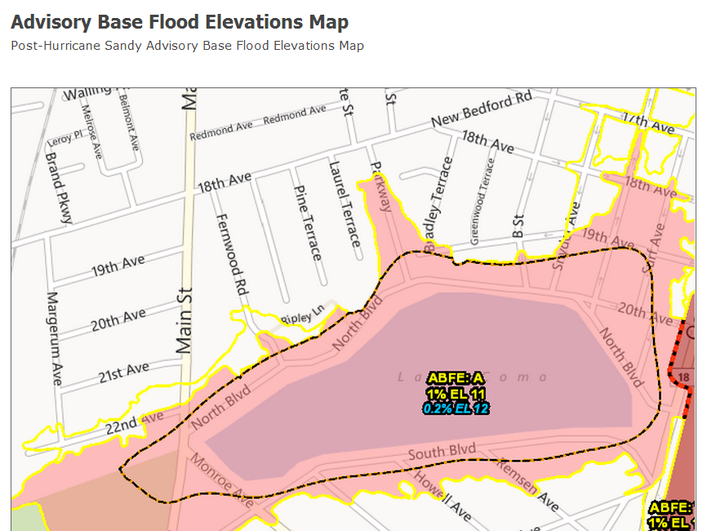
STORMS
Salt-Bearing Wind
Salt-Tolerance is KEY!
Salt Water Flooding

Slide 10
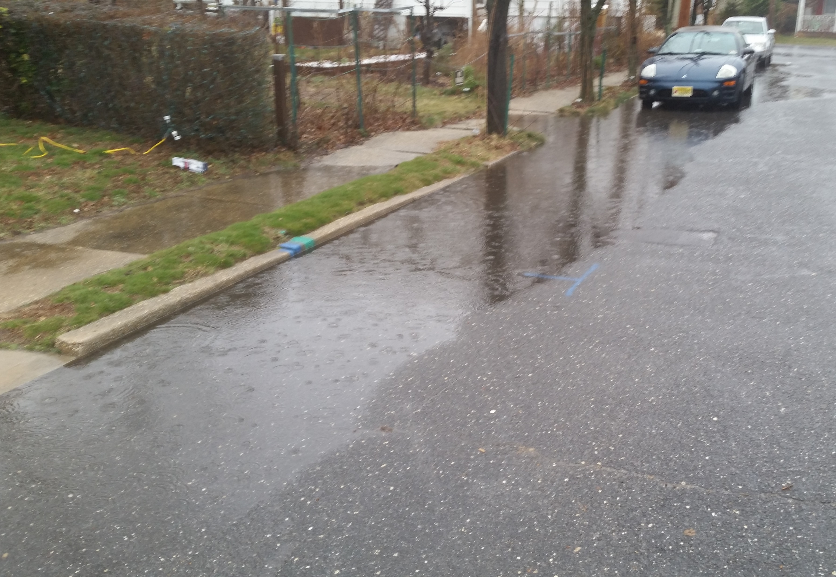
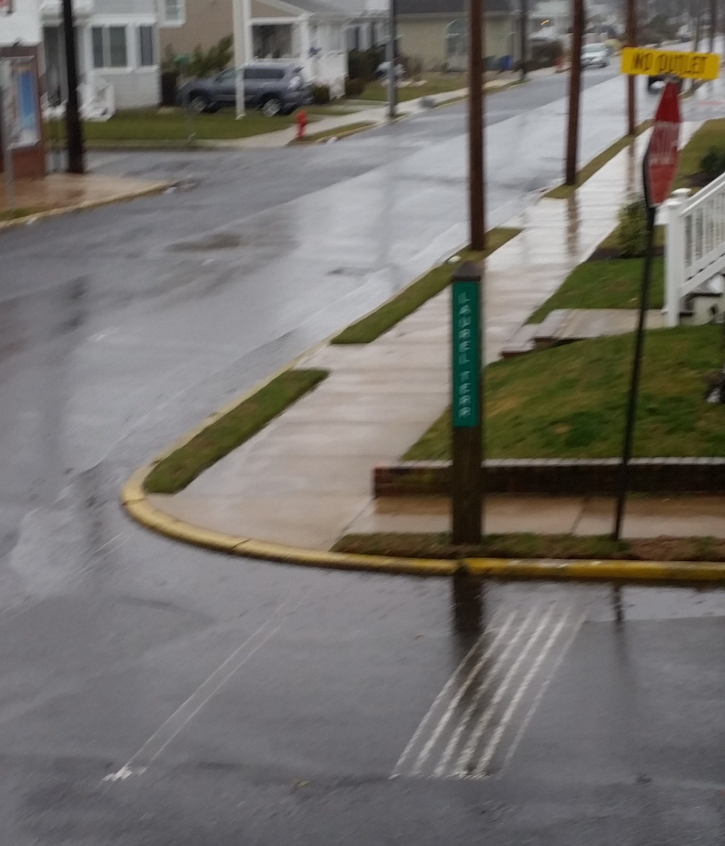
Borough Hall
Stormwater Management Demonstration Project
Observed increase in flooding all around town.
Candide’s Garden
Pervious concrete sidewalk – demonstration project.
Increase pipe capacity – remove blockages.
Reduce the load on the stormwater system – pervious surfaces
Reduce toxicity in the runoff – plant material.

Slide 11
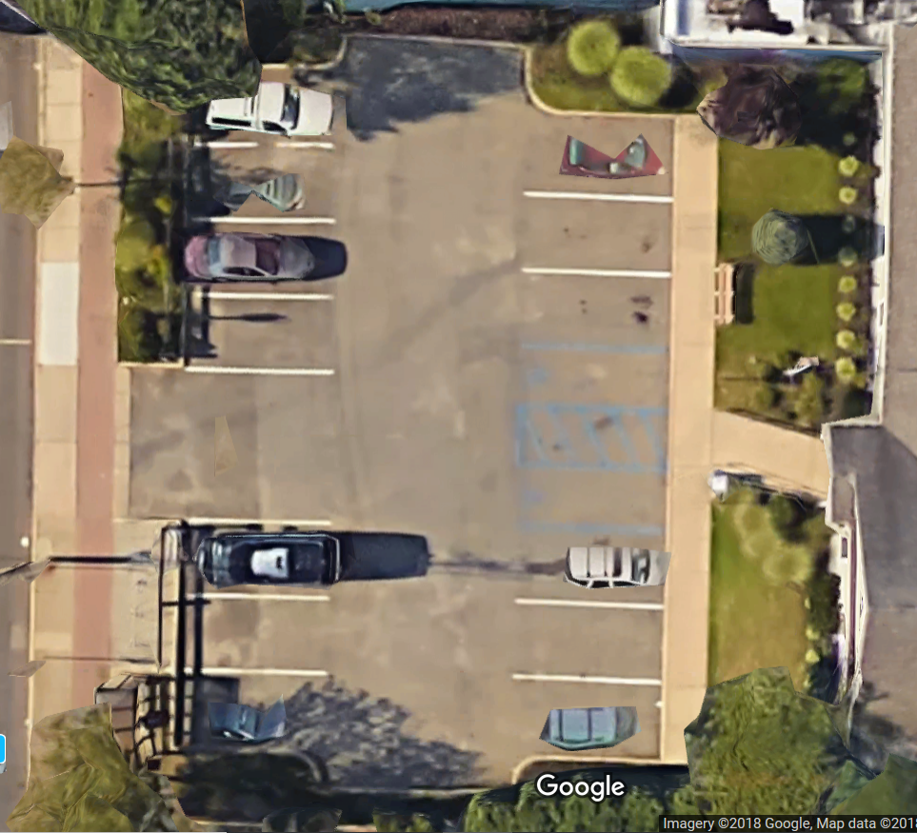
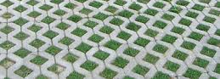
Borough Hall Stormwater Management
Demonstration
Project
BOROUGH HALL
Toxic stormwater runoff from
the parking lot in front of the
Borough Hall is channeled
into the entry driveway.
The Native Plant Garden and pervious bike rack area are isolated from the flow.
The runoff then funnels into
the Storm Sewers.
It finally finds its way into the
Lake, adding to its degradation.
Downward Slope
Curb Barrier
Curb Barrier
Bicycle Rack - Waffle Pavers
Native Plant Garden
Bicycle Rack
(Waffle Pavers)
Runoff into Storm Drain

Slide 12
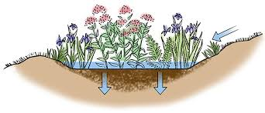
Borough Hall Stormwater Management
Demonstration
Project
BOROUGH HALL
Upgrade Native Plant Garden
to Rain Garden.
Cut slots to guide runoff
to pervious areas.
Install berm to direct runoff
to pervious areas.
Downward Slope
Rain Garden
Curb Barrier
Curb Barrier
Diverting
2” Berm
Waffle Pavers
Rain Garden
Bicycle Rack
(Waffle Pavers)
Storm Drain

Slide 13
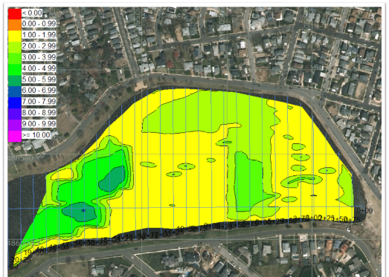
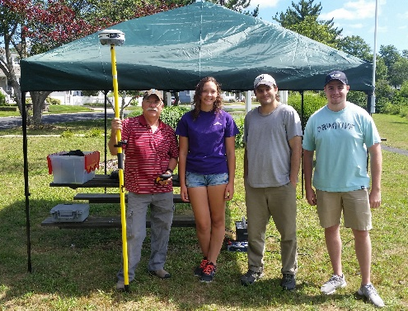
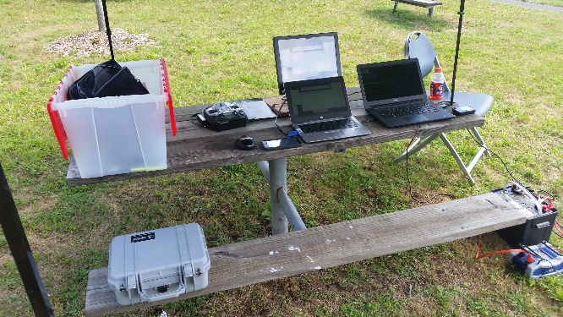
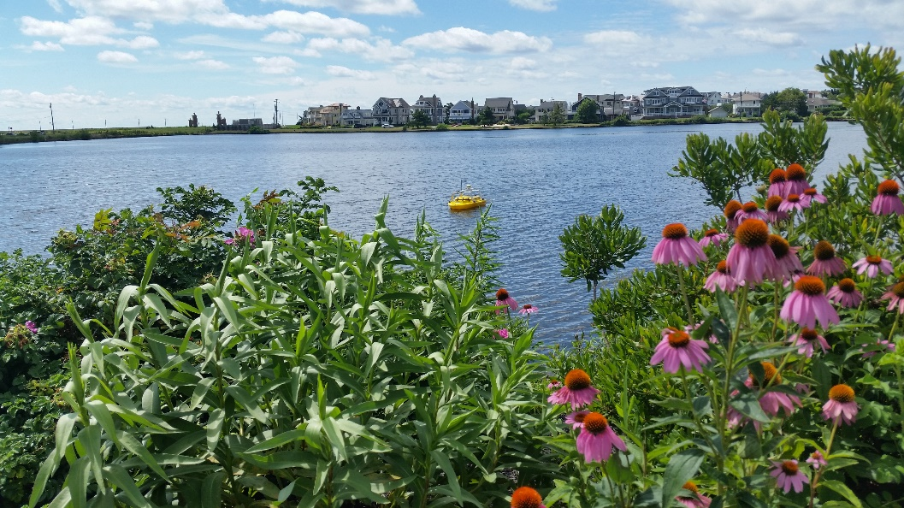
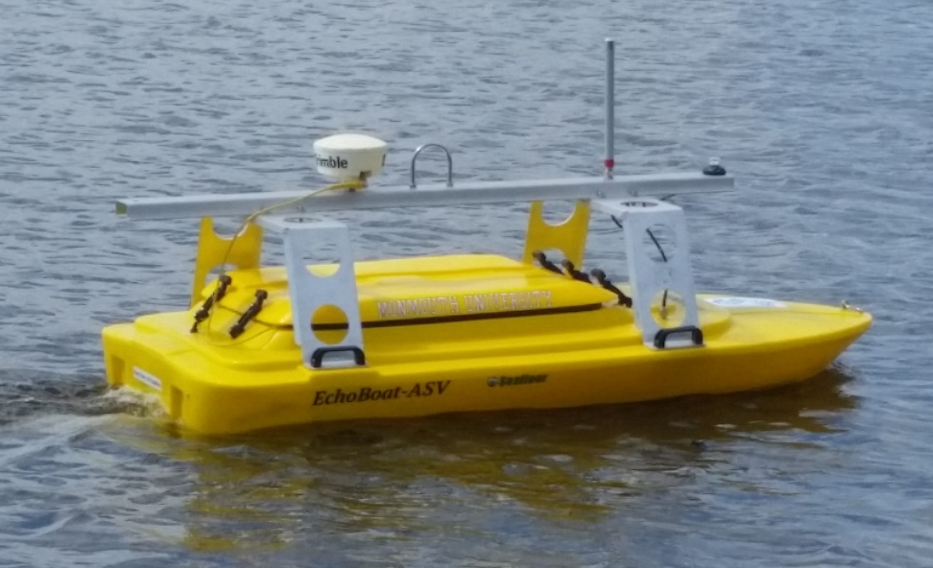
GIS: URBAN STORM WATER MODEL
STAGE 1 - ESTABLISHING THE PROFILE OF THE LAKE BOTTOM
Multi-Year Joint Venture :
Lake Como Environmental Commission & GIS Dept., Monmouth University – Interns
Profile - Lake Bottom
MU Survey Team
Automated Survey Path
A bit of Back-n-Forth – Over 6,000 Soundings!
Drone – Up Close & Personal
Profile of the bottom will be useful in planning environmental recovery of the Lake.
Lake Como, Spring Lake, and Belmar all stand to benefit!

Slide 14
Monmouth University
COASTAL LAKES SUMMIT – March 15, 2019
Belmar
Wall
Township
BOROUGH of LAKE COMO
What We’re up to,
How Can We Help?
Jon Gibbons
Chair, Environmental Commission
Executive Director, Friends of Lake Como Environment, Inc.
Proprietor, Candide’s Garden
Spring Lake

