Slide 1
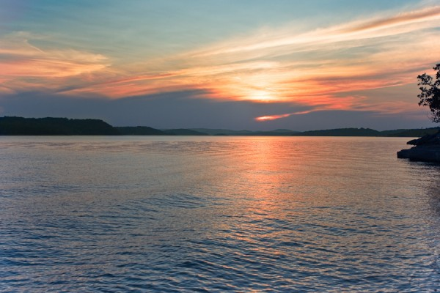
Moving Our Coastal Lakes
Into a Healthier and More Resilient Future
2019 Coastal Lakes Summit
Building Community-University Partnerships
John A. Tiedemann, Director
Monmouth University
Marine and Environmental Biology and Policy Program

Slide 2
Monmouth’s Coastal Lake Initiative
2005 - 2008
Purpose of the Coastal Lakes Initiative:
  Provide municipal officials, civic groups, community organizations, and local watershed management groups with information and tools necessary to develop cost-effective strategies to restore, protect, and maintain coastal lake ecosystems
  Watershed Bioassessments: Whale Pond Brook; Shippee’s Pond
  Microbial Source Tracking: Deal Lake, Wreck Pond

Slide 3
Monmouth’s Coastal Lakes Summit
2008
At the summit we reviewed the status of Monmouth County’s coastal lakes, our assessment of lake impairments and problems, and discussed issues impacting lake management efforts
Participants agreed that the lakes suffer from a central core of common problems
It was also acknowledged that attempts to manage or restore the lakes have tended to follow a disjointed path and the success and sustainability of these efforts has been hampered by the fact that, with few exceptions, no agency, organization, or governing body has taken lead responsibility for stewardship of these waterbodies

Slide 4
Coastal Lakes Use Impairment Ratings
Use | Good | Impaired | Severely Impaired
Swimming | 0 % | 33 % | 67 %
Boating, Sailing, Waterskiing | 0 % | 67 % | 33 %
Fishing | 10 % | 80 % | 10 %
Fish Consumption | 10 % | 70 % | 20 %
Fish, Wildlife, Aquatic Life Support | 10 % | 50 % | 40 %
Good = fully supporting the use Impaired = partially supporting the use Severely Impaired = not supporting the use

Slide 5
Coastal Lake Problems Identified
Coastal Lake Problems | Percent of Lakes Affected
Excess sediment & Decreasing depth | 83%
Degraded shoreline conditions | 83%
Degraded fish habitat | 75%
Excessive algae | 67%
Aquatic plant overgrowth | 67%
Debris & Garbage | 67%
Stormwater runoff | 67%
Pathogen contamination | 25%

Slide 6
The Future of Coastal Lakes in Monmouth County
2010
Our report outlined restoration techniques and best management practices that would achieve cost-effective, sustainable improvements in water quality, habitat quality, and overall health of the coastal lakes
In addition, we recommended development and implementation of a regional coastal lakes management strategy that streamlined permit processing and allocated State, County, and municipal resources to address issues such as:
dredging and dredged material management
aquatic weed control
shoreline restoration
stormwater infrastructure improvements

Slide 7
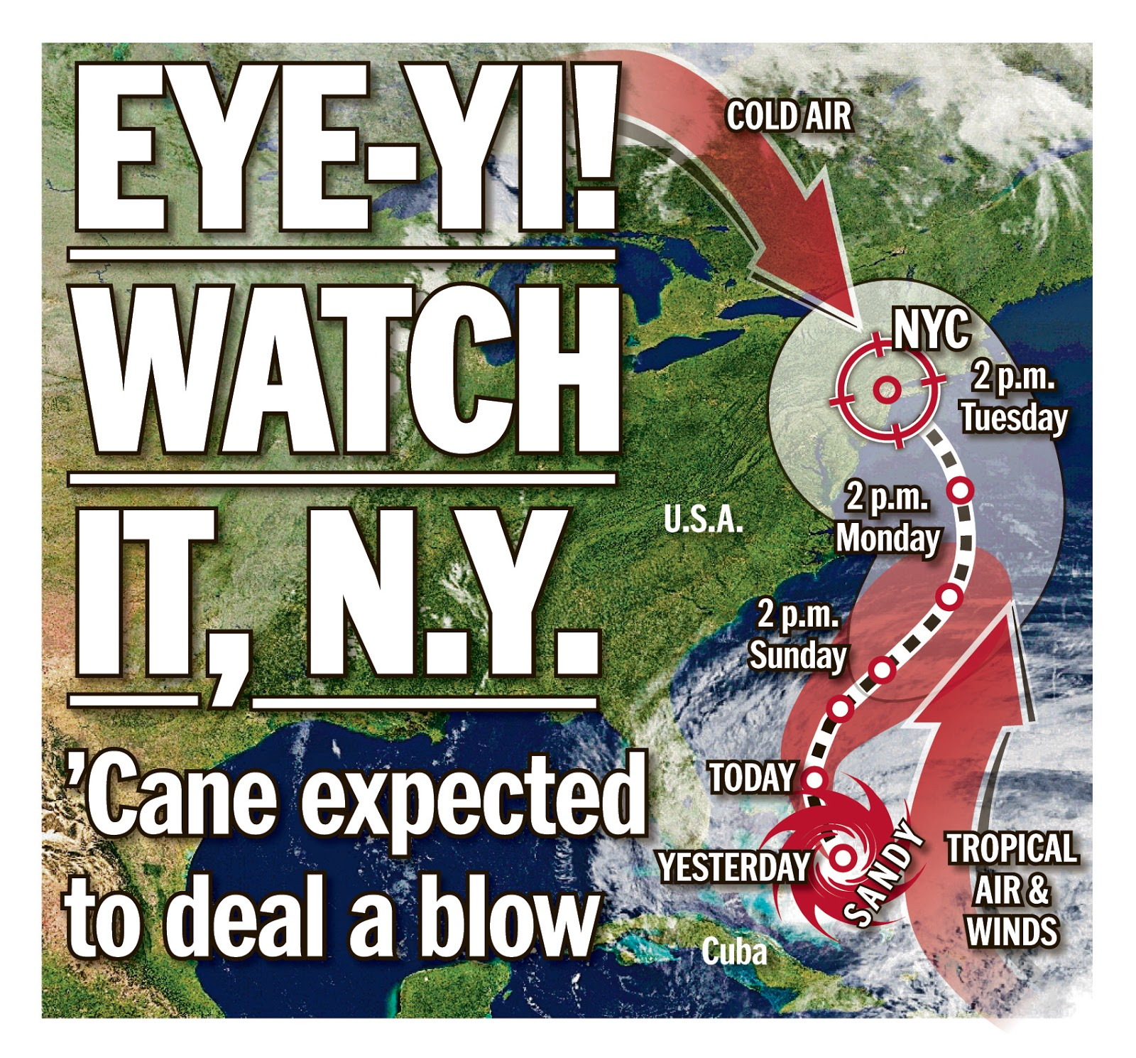
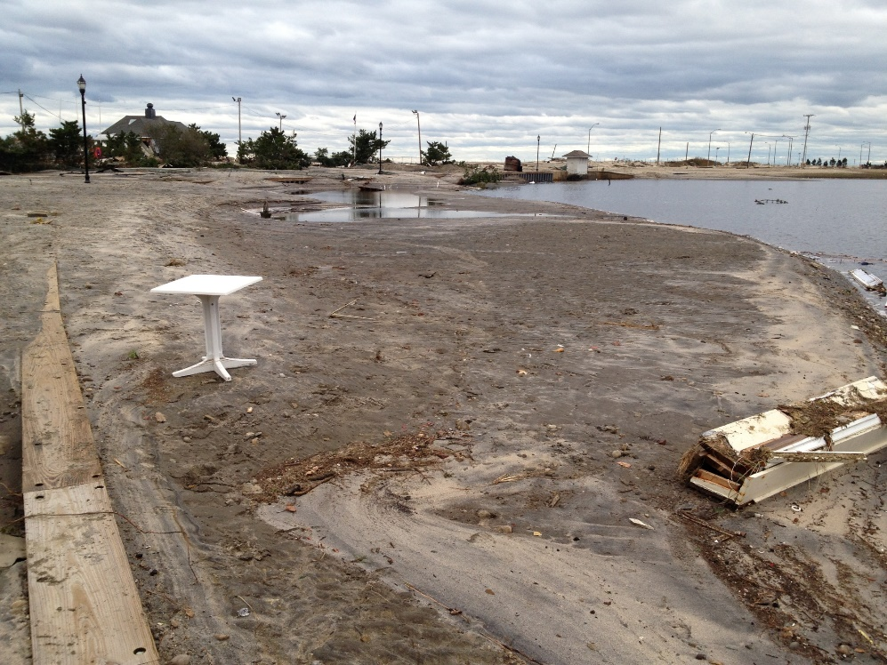
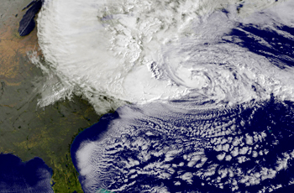
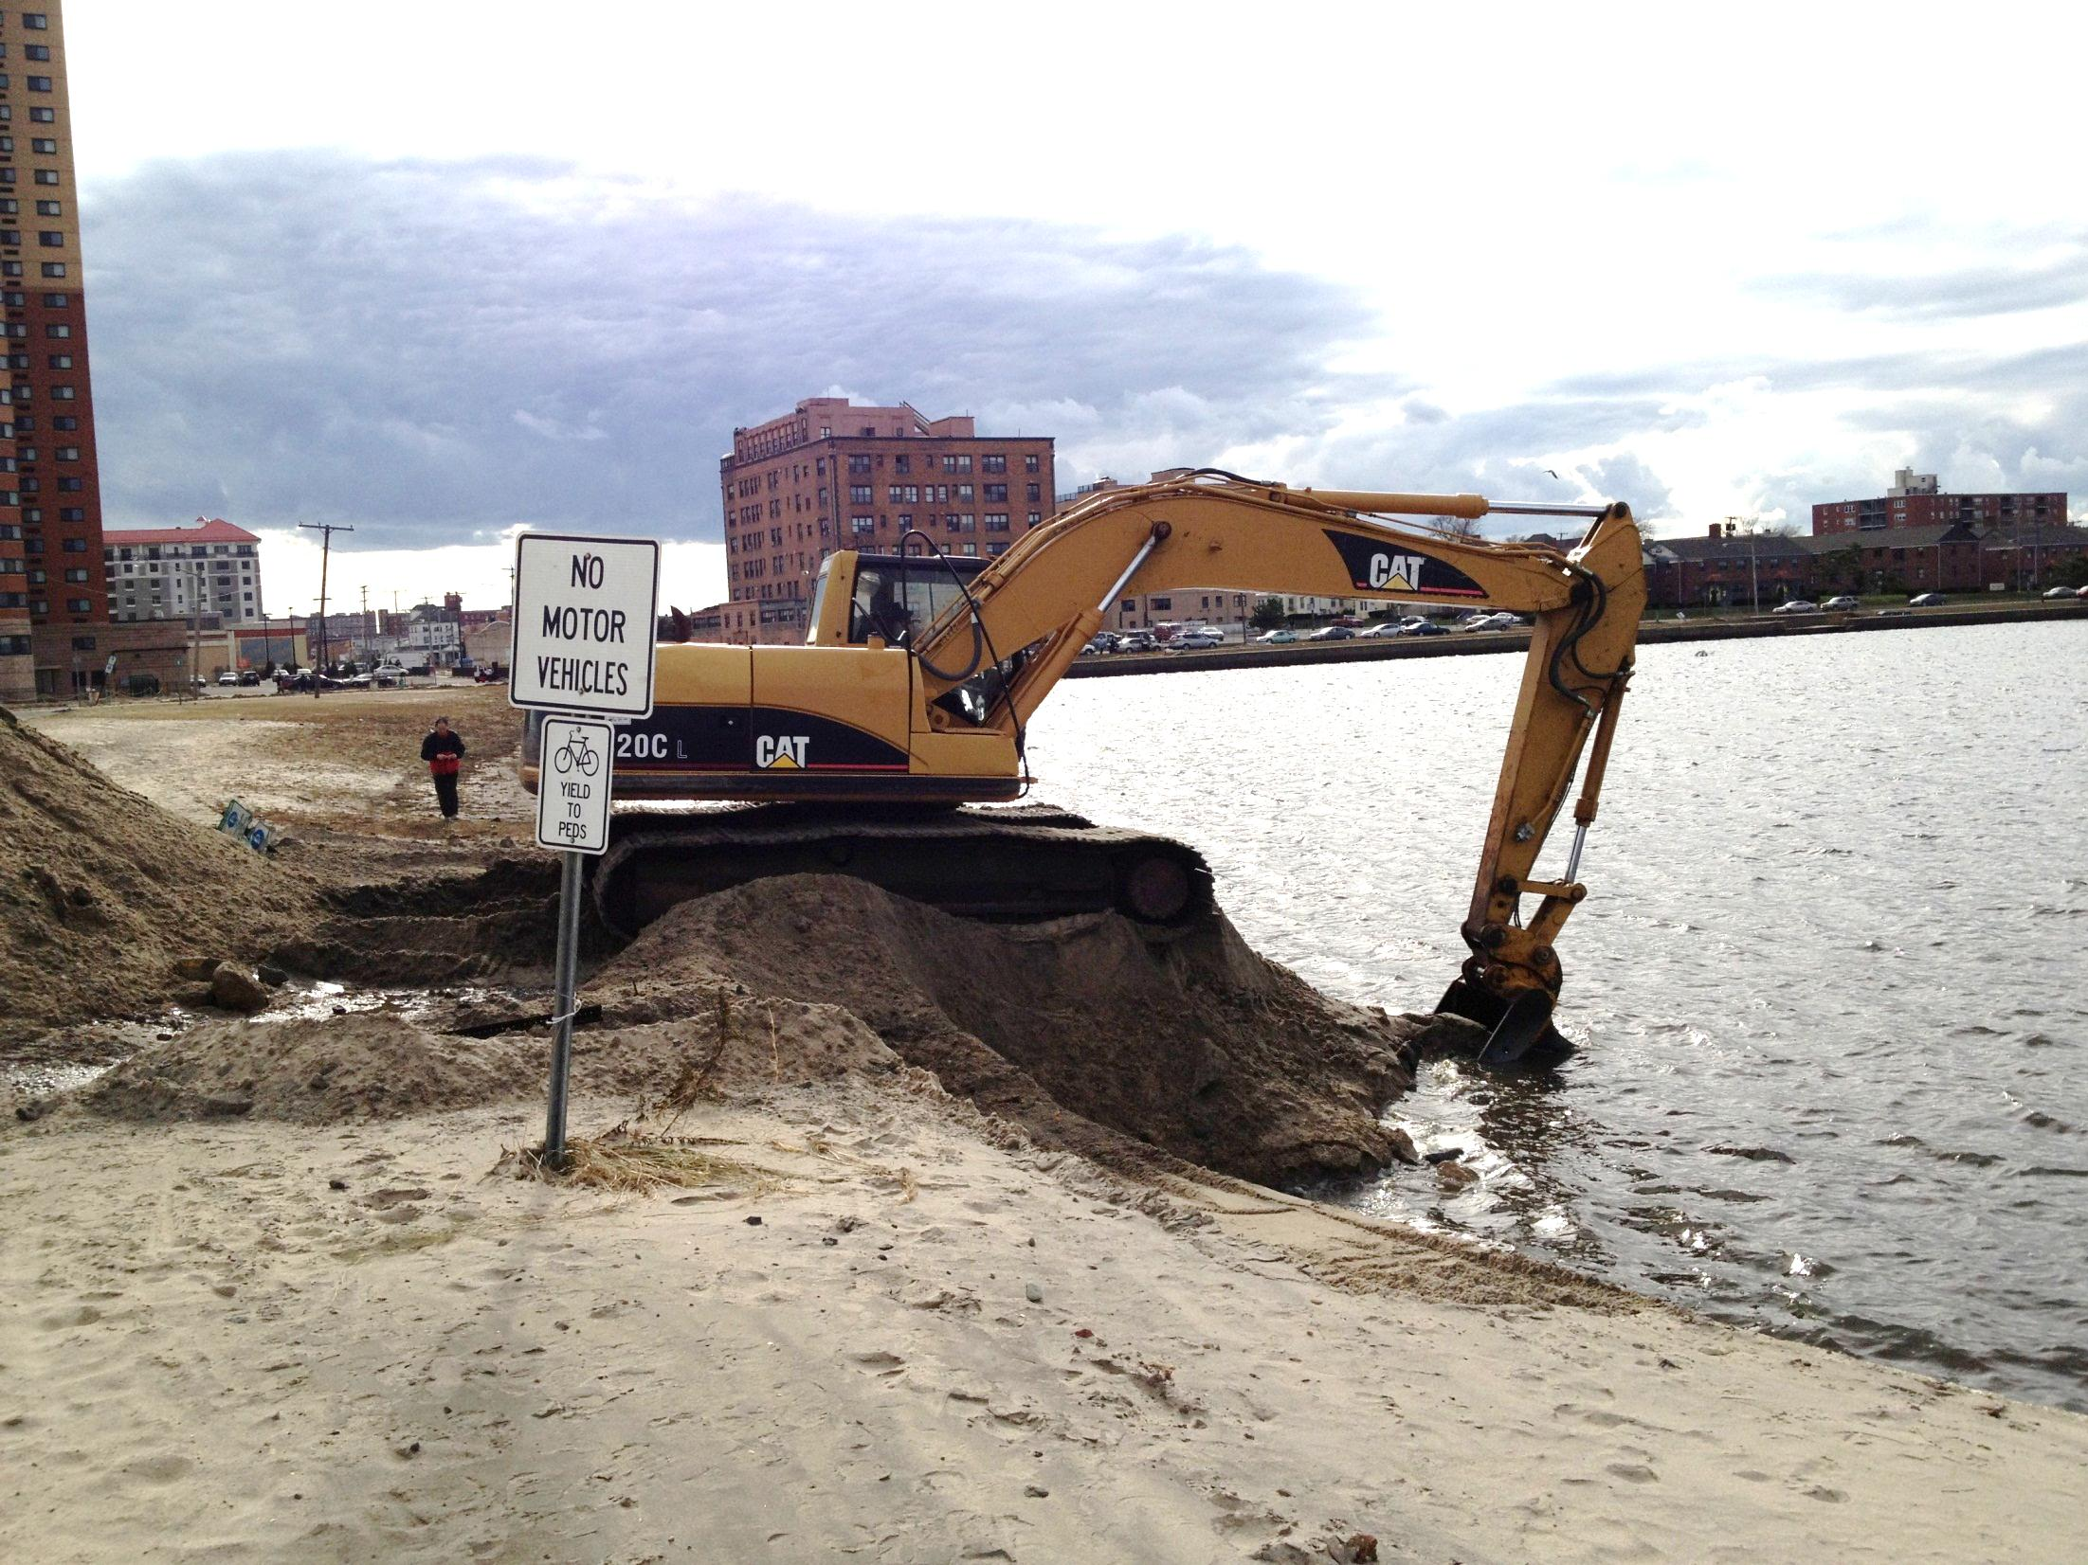

Slide 8
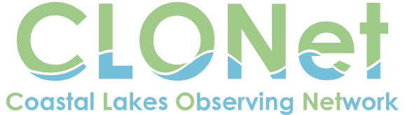
Creation of a comprehensive, regional coastal lakes management and restoration strategy remains a priority for guiding informed decisions to move our coastal lakes into a healthier and more resilient future
Coupled with a regional approach to management and restoration efforts, a sound water quality data base must be established for our coastal lakes

