Slide 1
Coastal Lakes Desirable Uses
Use | High | Med | Low
Contact Recreation | 17% | 25% | 58%
Boating, Sailing, Waterskiing | 50% | 29% | 21%
Fishing | 58% | 33% | 8%
Fish Consumption | 25% | 50% | 25%
Fish, Wildlife, Aquatic Life Support | 100% | --- | ---

Slide 2
Coastal Lake Problems Identified
Coastal Lake Problems | Percent of Lakes Affected
Excess sediment & Decreasing depth | 83% | 83%
Degraded shoreline conditions | 83% | 83%
Degraded fish habitat | 75% | 100%
Excessive algae | 67% | 100%
Aquatic plant overgrowth | 67% | 83%
Debris & Garbage | 67% | 100%
Stormwater runoff | 67% | 100%
Pathogen contamination | 25% | 83%

Slide 3
Desirable Uses of Coastal Lakes 3 = High 2 = Medium 1 = Low
Uses | Whale Pond | Deal Lake | Sunset Lake | Wesley Lake | Lake Como | Sylvan Lake
CONTACT RECREATION | 1 | 1.3 | 1.3 | 2.5 | 3 | 1
BOATING | 1 | 3 | 1.7 | 2.7 | 1 | 2.5
RECREATIONAL FISHING | 3 | 3 | 1.7 | 2.5 | 2 | 3
FISH CONSUMPTION | 3 | 1.5 | 1.7 | 2.5 | 2.5 | 1.5
FISH & WILDLIFE HABITAT | 3 | 3 | 3 | 3 | 3 | 3

Slide 4
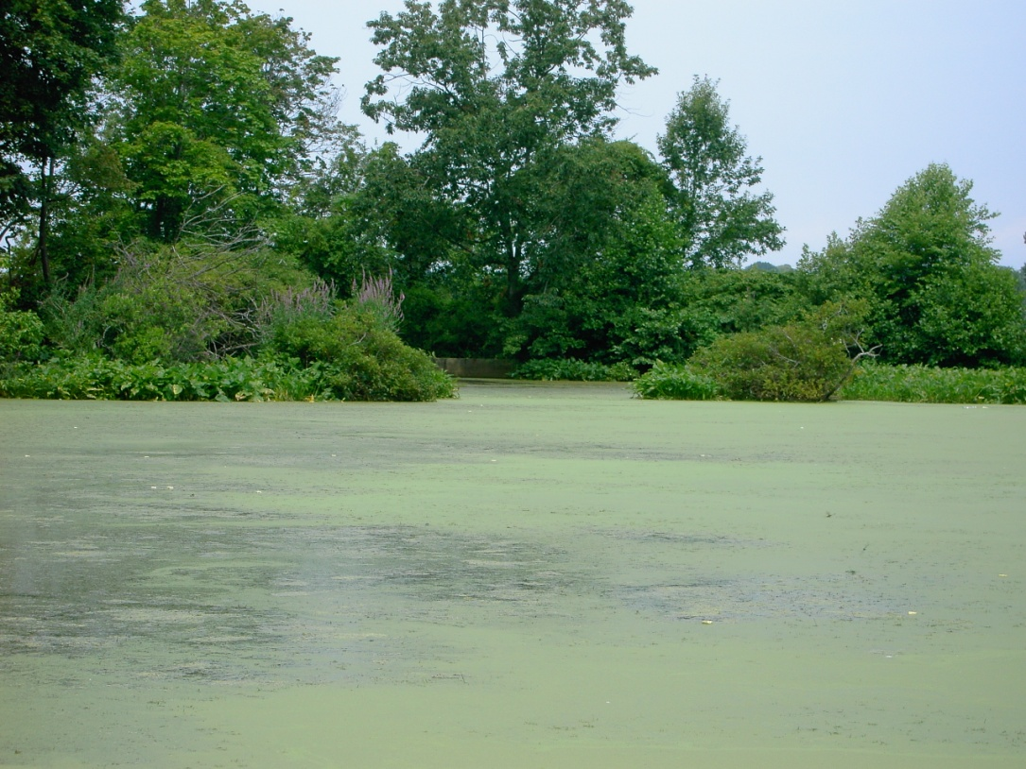
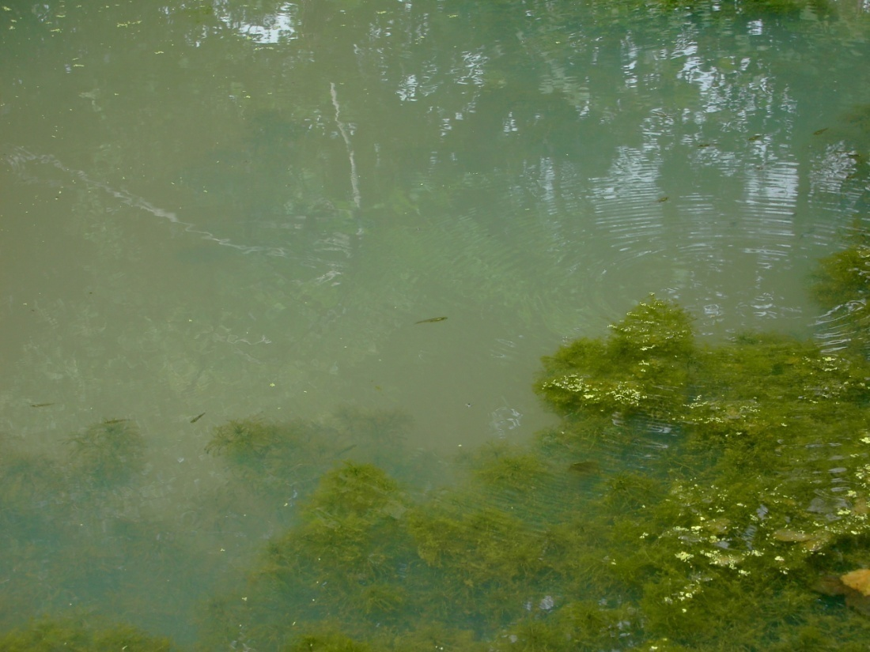
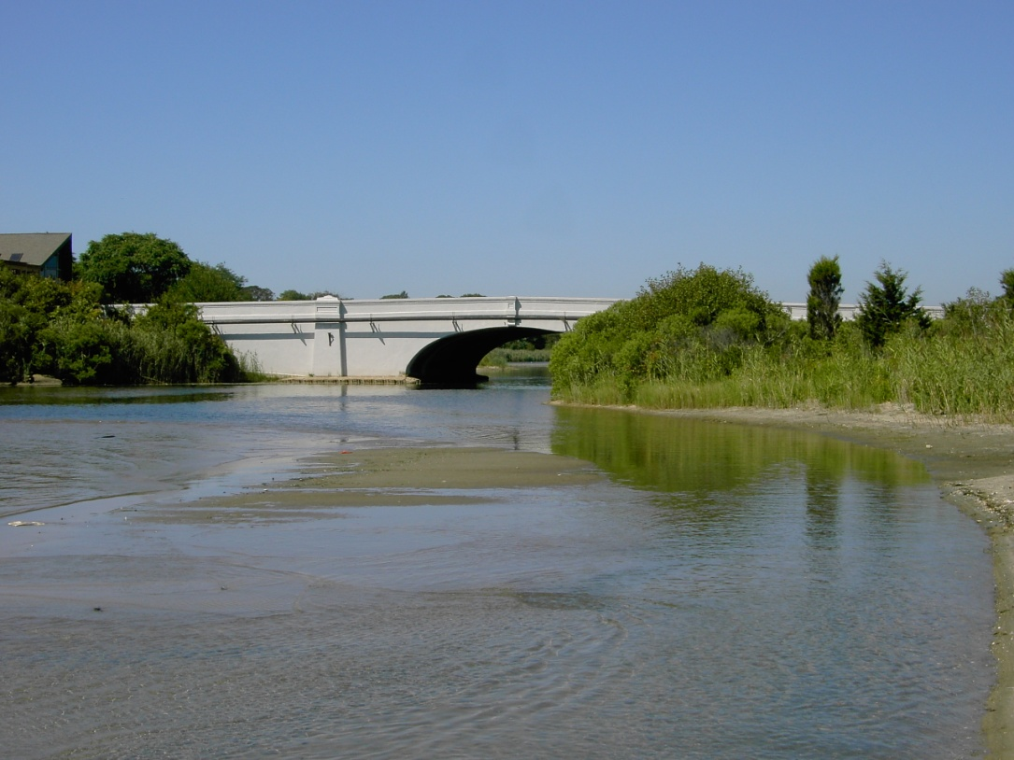
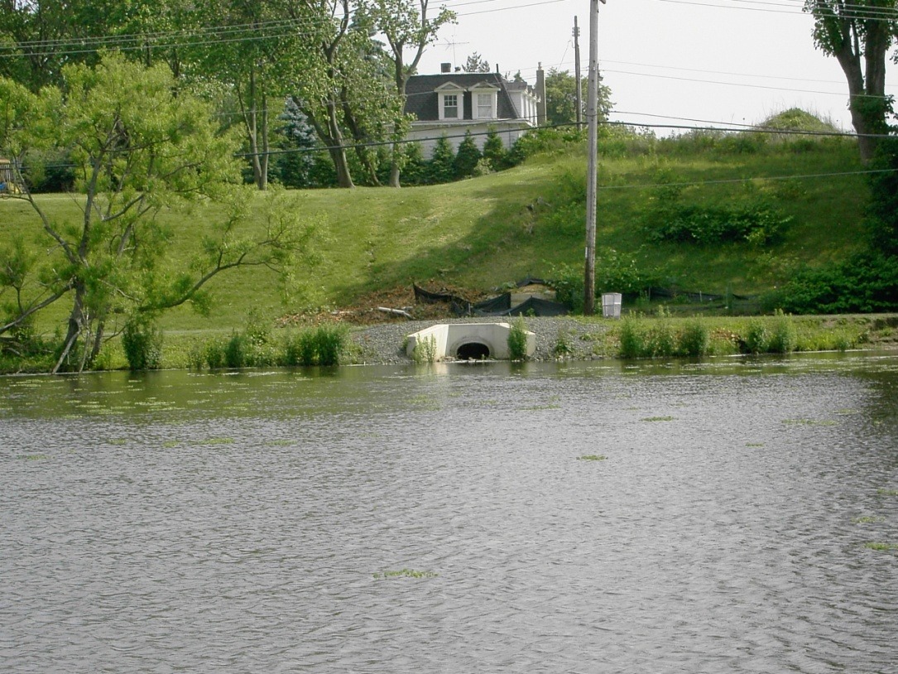
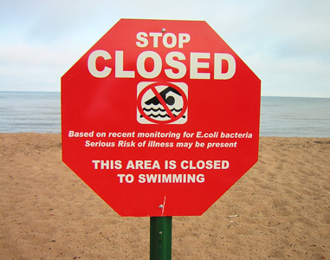
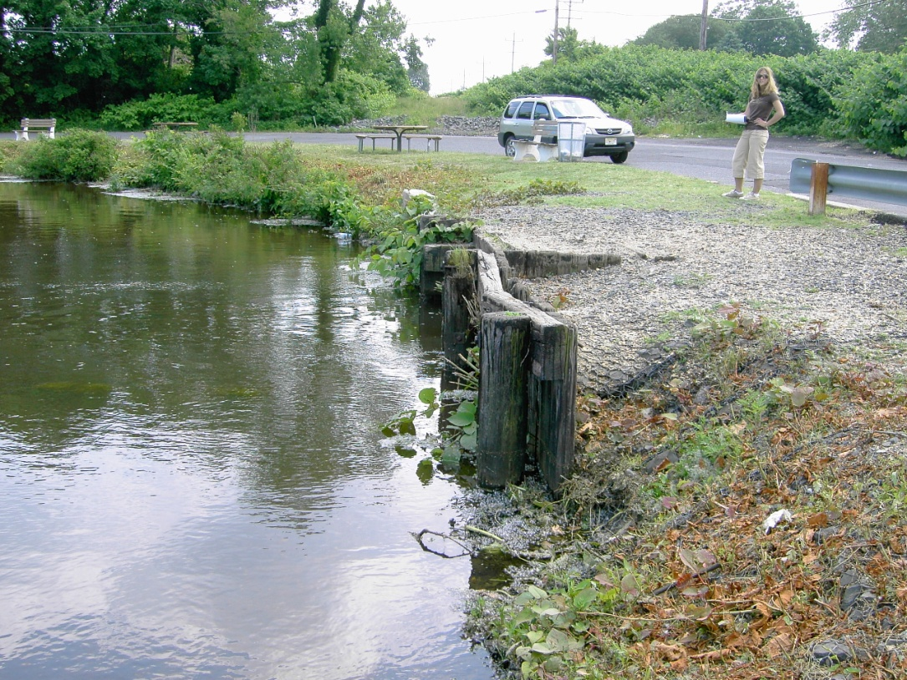
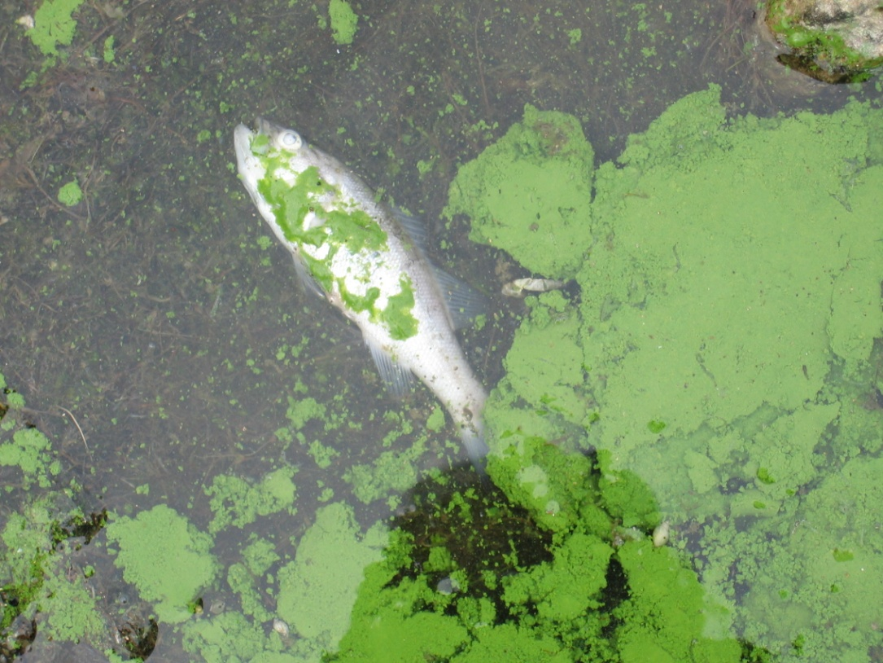
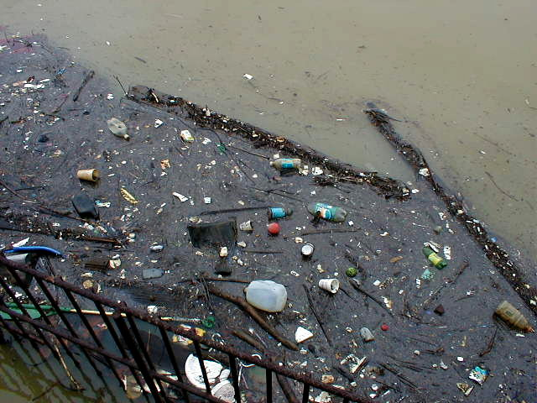
Priority Problems Facing Coastal Lakes 3= High 2= Medium 1 = Low
Issues | Whale Pond | Deal Lake | Sunset Lake | Wesley Lake | Lake Como | Sylvan Lake
 | 1 | 3 | 3 | 1 | 2 | 3
 | 2 | 3 | 3 | 2 | - | 3
 | - | 3 | 3 | 3 | 3 | 3
 | 1 | 3 | 3 | 3 | 3 | 2
- | - | 3 | 2 | 3 | 2 | 2
 | - | 3 | 3 | 3 | 3 | 3
 | 1 | 3 | 3 | 2 | 2.3 | 3
 | 1 | 3 | 2.7 | 3 | 2 | 2
EXCESSIVE ALGAE
AQUATIC PLANT OVERGROWTH
SEDIMENTATION
DECREASING DEPTH
STORMWATER DISCHARGES
PATHOGEN CONTAMINATION
DEGRADED SHORELINE CONDITIONS
DEGRADED FISH HABITAT
FLOATABLES AND DEBRIS

