Slide 1
Conserving and sustainably using the ocean, seas, and marine resources through a New Blue Economy
12 October 2017
Mark J. Spalding
President, The Ocean Foundation
Notes:
Date and location of presentation?

Slide 2
The Ocean Economy has always existed for:
Transport and trade
Resource extraction, and sadly
Waste disposal (intentional and unintentional)

Slide 3
How to include Non-Market Values in Accounting?
The ocean generates economic values that are not usually quantified
Limited consensus exists on how to quantify these non-market values
And, economic losses resulting from unsustainable use (and abuse) of coastal & marine resources are not usually captured

Slide 4
What is the unquantified value the ocean provides?
Provisioning: oxygen and water (we only quantify food)
Regulating: climate/temperature regulation, coastal stabilization
Supporting: pollution filtration and waste processing (we quantify shipping)
Cultural services: aesthetics, recreation, fun and inspiration

Slide 5
Ocean generated value is threatened by cumulating human activities
CO2 emissions (acidification)
Over-fishing/by-catch
Decimation of top predators
Open pen fish farming
Noise pollution from shipping, etc.
Minerals and petroleum extraction
Coastal wetlands, mangroves and seagrass destruction
Tropical reef and deep, cold water coral destruction
Deliberate and accidental toxic dumping
Toxic run-off from roads, farms and other human settlements (algal blooms – hypoxia)
Plastic loading

Slide 6
The New Blue Economy Subsector
How can we define a new Blue Economy that moves us away from destructive extraction-focused business sectors that deplete our ocean resources, damage our economy, & cost people jobs?

Slide 7
How do we get to the New Blue Economy
We recognize:
That we must stop taking ocean & coastal ecosystems (and services) for granted
That all nations blue economies are connected
More is not necessarily better – GDP with lots of externalities is not sustainable

Slide 8
European definition of Blue Growth
“Blue Growth is the long term strategy to support sustainable growth in the marine and maritime sectors as a whole”
Notes:
Delete?

Slide 9
We aren’t interested in the whole. We want the subset of the entire ocean economy that is sustainable:

Slide 10
Previously our activities were short-sighted, & unsustainable (we assumed we could dump as much in, and take out as much as we wanted to)
We need less risk to our water, food, and energy security
The new blue economy is about sustainability
Some parts of old ocean economy are evolving
Emerging sectors – some still extractive (seabed mining) / some focused on change (new ideas about ships and shipping)

Slide 11
Examples of the “Old” Ocean Economy
Offshore oil and gas
Recreational and commercial fishing
Open pen aquaculture
Shipping
Coastal development
Telecommunications

Slide 12
New Industry Sectors Reflecting Changes in the Ocean Economy
Renewable Energy
Seabed mining (still potential)
Remediation/restoration
Blue biotechnology
Blue carbon
Blue technology
Nutrition
Nutraceuticals
Cosmetics
Fisheries byproduct transformation
Innovative marine molecules sector

Slide 13
2016 SDGs Driving the New Blue Economy
UN adopted Sustainable Development Goals include SDG14, to “Conserve and Sustainably Use the Oceans, Seas and Marine Resources for Sustainable Development,” which outlines seven targets & three means of implementation relating to the sustainable use of the ocean
For example Target 14.7, declares, “By 2030 increase the economic benefits to small island developing states (SIDS) & least developed countries (LDCs) from the sustainable use of marine resources, including through sustainable management of fisheries, aquaculture and tourism”

Slide 14
SDG14 supports 9 of the other 17 SDGs
SDG1 – end poverty
SDG2 – end hunger
SDG3 – ensure healthy lives and well-being
SDG5 -- achieve gender equality
SDG8 -- promote sustained, inclusive and sustainable economic growth
SDG9 -- build resilient infrastructure
SDG10 -- reduce inequality within, and among countries
SDG11 -- make cities and human settlements safe, resilient and sustainable
SDG13 -- combat climate change

Slide 15
The Ocean Foundation’s Efforts to Foster & Formalize the New Blue Economy
TOF is dedicated to identifying and investing in those activities that comprise a sustainable blue economy
We co-sponsored and co-chaired a Blue Economy roundtable discussion at the House of Sweden
TOF and the Center for Blue Economy are working on a joint proposal for a series of workshops designed to facilitate multinational (Asia, EU and USA) agreement on the identification of the new Blue Economy via mutually agreed criteria, industry classification codes etc.
“The Oceans in National Income Accounts: Seeking Consensus on Definitions and Standards,” workshop was held in Monterey in October 2015.
Included 30 representatives from 10 nations

Slide 16
Blue Economy Business Council
We are working with the American Sustainable Business Institute and European Sustainable Business Council to create the Blue Economy Business Council
Building a Business Voice and Power for a Healthy Ocean Economy
To counter status quo defense and the too narrow agenda of the International Chamber of Commerce, World Ocean Council, U.S. Chamber of Commerce etc.

Slide 17
Seagrass Grow
Seagrass meadows provide unquantified ecosystem services: carbon storage, storm surge protection and critical habitat for commercial and recreational species
To quantify part their value and generate financial support for restoration we choose to focus on blue carbon
First-ever blue carbon offset calculator www.seagrassgrow.org
Notes:
Volvo Ocean Race

Slide 18
Protecting Food Resources
International Ocean Acidification Initiative
Early warning of OA events
Protecting food supplies
International Sustainable Aquaculture Initiative
Defining
SeaWeb Sustainable Seafood Initiative
SeaWeb Seafood Summit
Seafood Champions
Speaking of Seafood

Slide 19
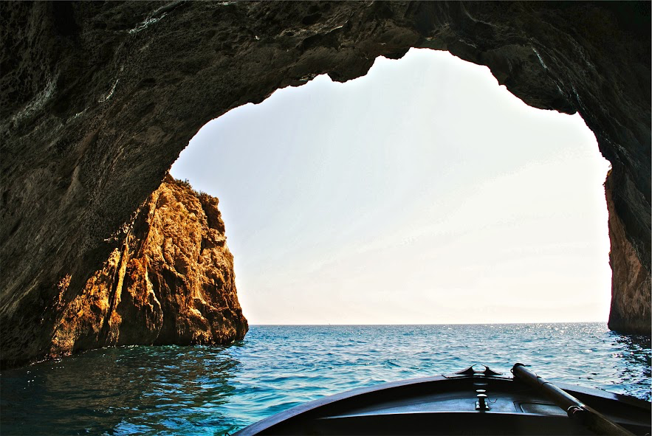
How does TOF see ocean-related investing?

Slide 20
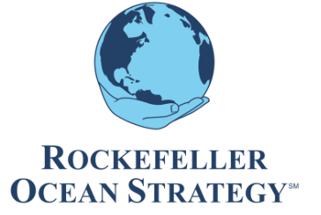
“An unprecedented ocean-centric investment fund”

Slide 21
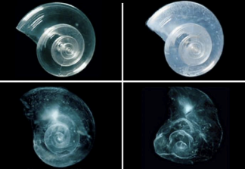
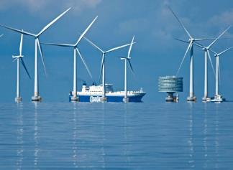
Threats
Solutions
Industries
Investment
Threats to the ocean are known
We have good ideas of what viable solutions are
We can guess what industries are supplying solutions
We can identify best-in-class
products and services
Credit: Courtesy of David Littschwager/National Geographic Society
Notes:
Please add two slides just after slide 18 that address:
Rockefeller Ocean Strategy portfolio:
-- We know what the threats are to the ocean
-- We have very good ideas on what are the solutions to those threats
-- We can thus guess which industries might be looking at producing solutions
-- We can then look for companies in those industries and seek to identify the best-in-class products or services being created.
Threats to the ocean are known
As are viable solutions
We can pinpoint which industries offer solutions
We can seek the best-in-class products and services

Slide 22
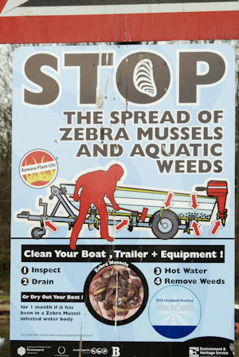
1
2
Known Threats
Good
Solutions
Ballast water introduces alien, potentially invasive species
Clean ballast water before dumping in bays and harbors
3
4
Probable Actors
Best
Services
Chemical treatment and filtration companies provide solutions
Identify best in class products and services: filtration combined with UV treatment
Notes:
SAME HERE
Picture of a zebra mussel
Picture of (maybe even an Alfa Laval) filtration system?
AN EXAMPLE
-- Threat: introduction of alien, invasive species into bays and harbors via ballast water
-- Solution: clean the ballast water before dumping
-- Industries: chemical treatment or filtration
-- Best-in-class: filtration combined with UV treatment [Alfa Laval's Pure Ballast <http://www.alfalaval.com/solution-finder/products/pureballast/Documents/PureBallast%202%20ballast%20water%20treatment%20system_1008.pdf>]

Slide 23
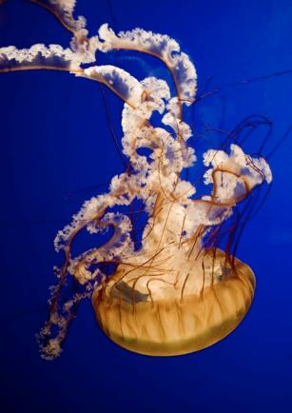
Ocean Strategy Process
Fundamental bottom up, industry driven research
Active, long-only publicly traded securities
Dedicated sustainability research team
The Ocean Foundation expertise
All market capitalizations
Global diversification
50-80 Holdings
Aaron Parecki/ Flickr Creative Commons
To protect and restore a healthy ocean around the world

Slide 24
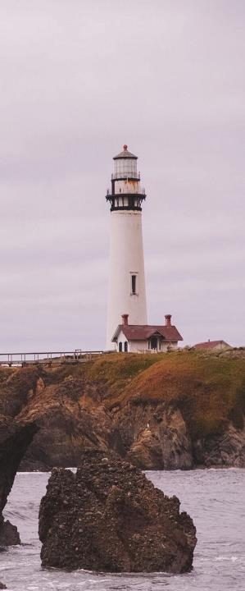
The Ocean Foundation’s
Rockefeller Ocean Strategy
Over 5 years we reviewed thousands of companies looking for products and services that are “actively good for the ocean”
In 2012 we co-launched the Rockefeller Ocean Strategy, as an international, all cap, private placement in active, long-only publicly traded securities
A Triple-Screened Fund
TOF is now paid to screen each company with ocean health in mind, and to provide Rockefeller & Co. specialized insight and research on coastal and ocean trends, risks and opportunities
Rock&Co screens each company for investment quality and standard CSR criteria

Slide 25
Rockefeller Ocean Strategy
We hold positions in over 50 companies, and have over $20m under management
Our investment hypothesis for the ROS has been confirmed by its consistently performing well
We are offering an alternative for those divesting of fossil fuel company stock
In 2015, marked 36 months track record and the ability to seek institutional investors

Slide 26
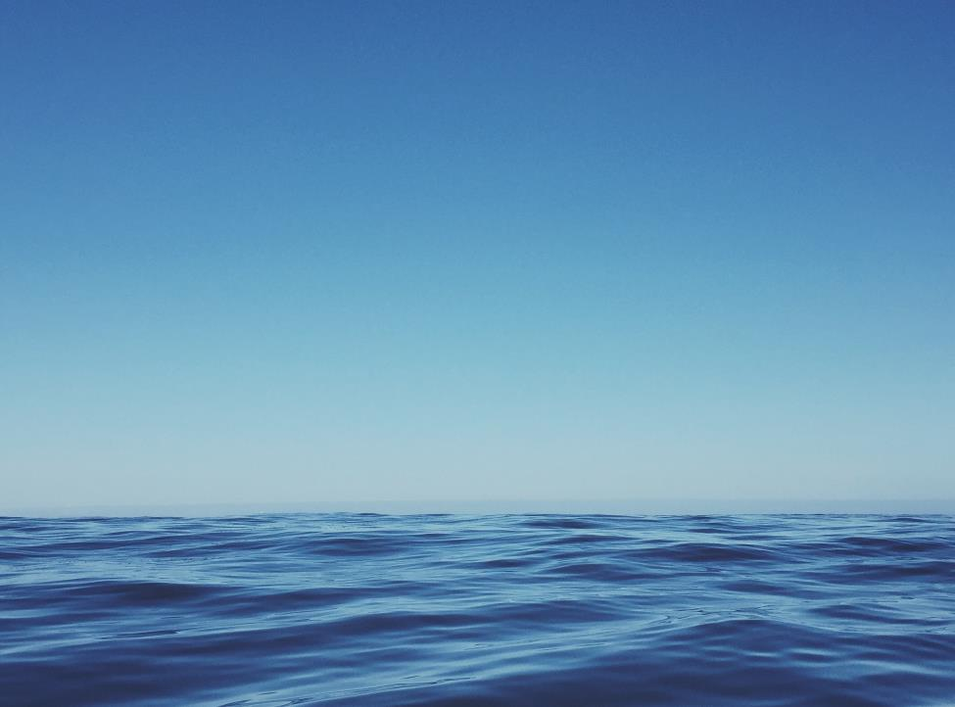
Companies that have a product or service that is actively good for the ocean will make profits, help investors earn income, and contribute to a new bottom line... a healthier ocean.
And, that is how we get to a New Blue Economy!
Notes:
And, we are helping make the ocean healthier in the process!

Slide 27
Thank you!
www.oceanfdn.org

