Slide 1
The Mid-Atlantic Bight in 2030
Some Observations
Jerry R. Schubel, PhD
Aquarium of the Pacific
Mid-Atlantic BLUE
Ocean Economy 2030
Exploring the prospects and challenges for emerging
ocean industries to 2030
October 12-13, 2017
Monmouth University

Slide 2
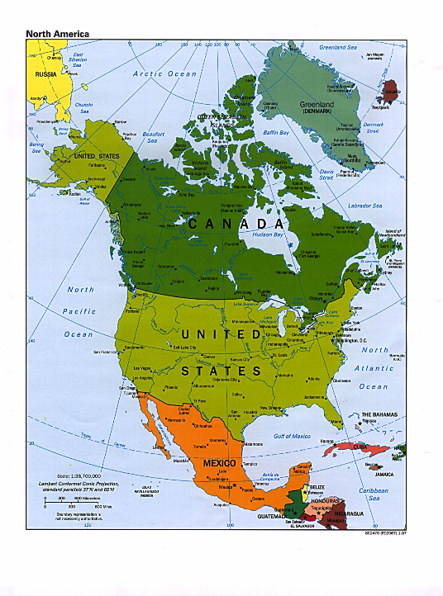

Slide 3
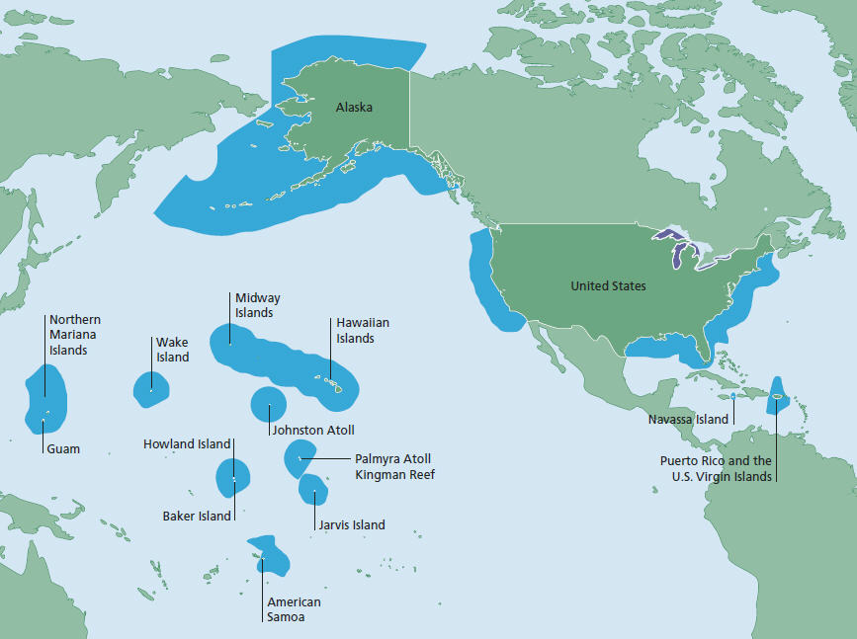

Slide 4
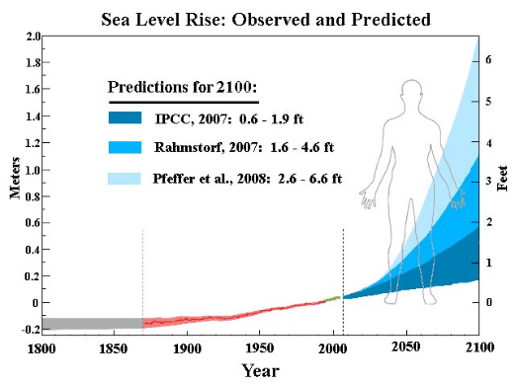
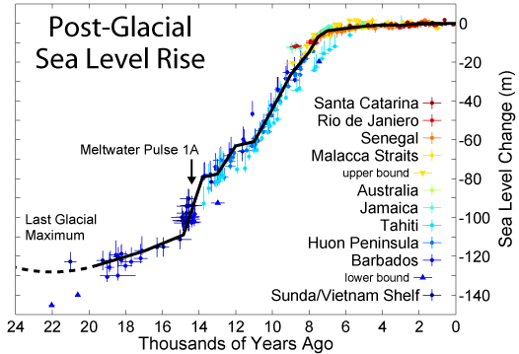
The Dutch settled in
New Amsterdam in 1624

Slide 5
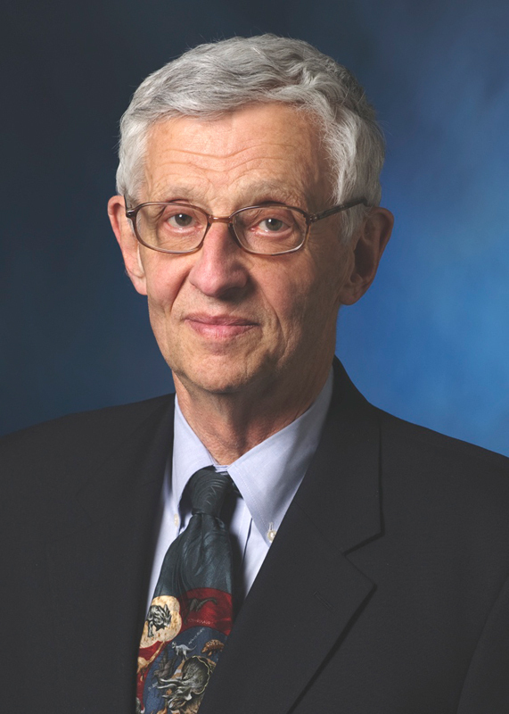
Richard M. Cyert
President Carnegie Mellon University
1972-1990

Slide 6
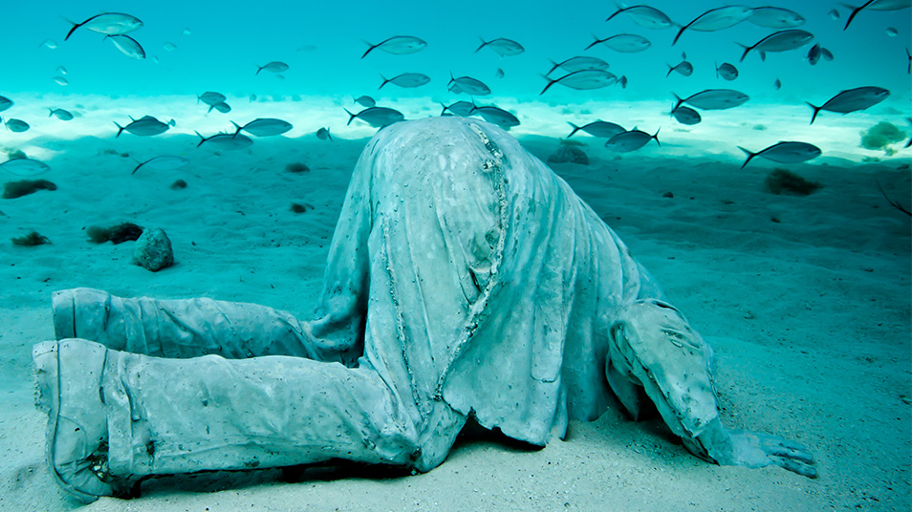
Welcome to the Anthropocene

Slide 7
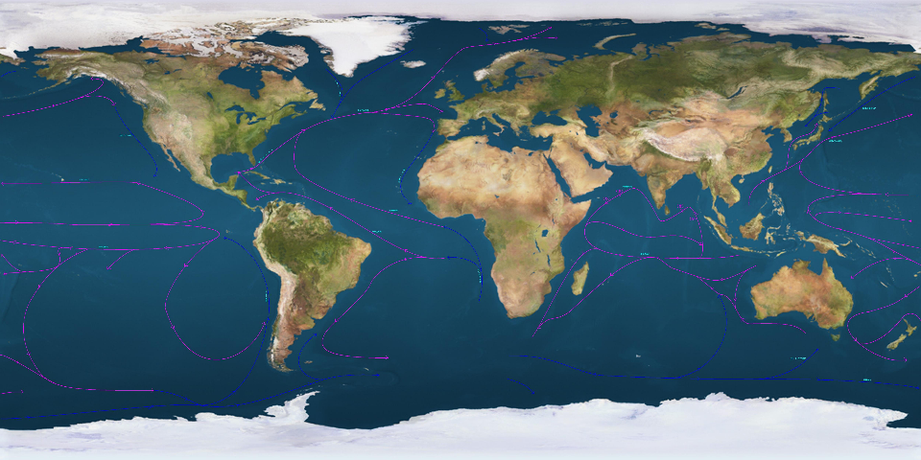
The World Ocean Covers 70% of Earth’s Surface
It Provides only 2% of Global Food Supply & 16% of Animal Protein

Slide 9
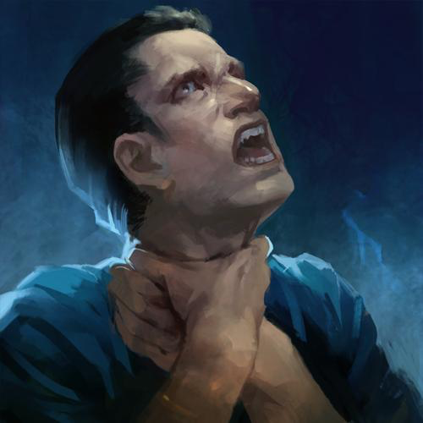
We have a permitting process that strangles innovation

Slide 10
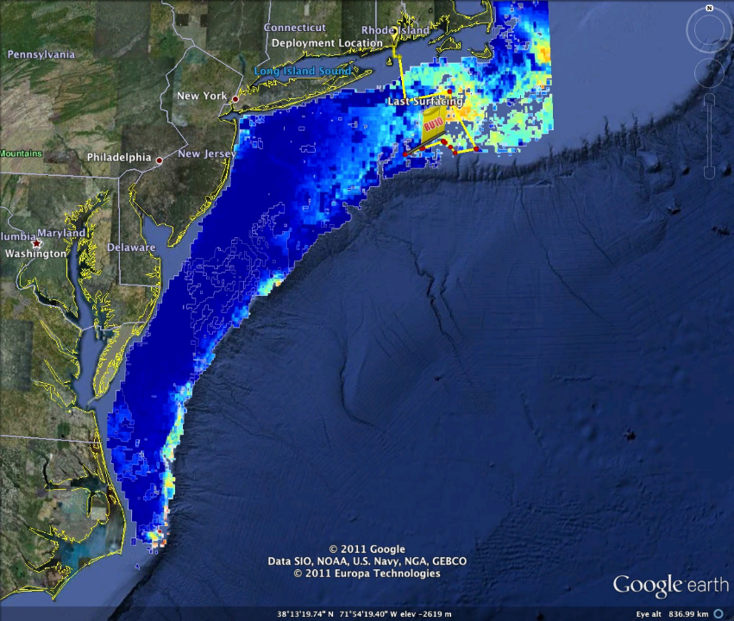

Slide 11
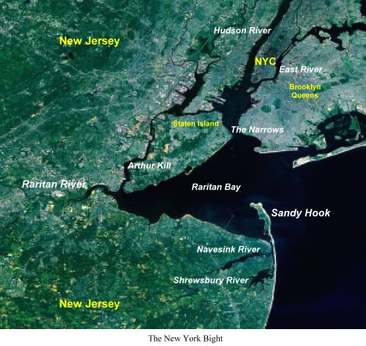

Slide 12
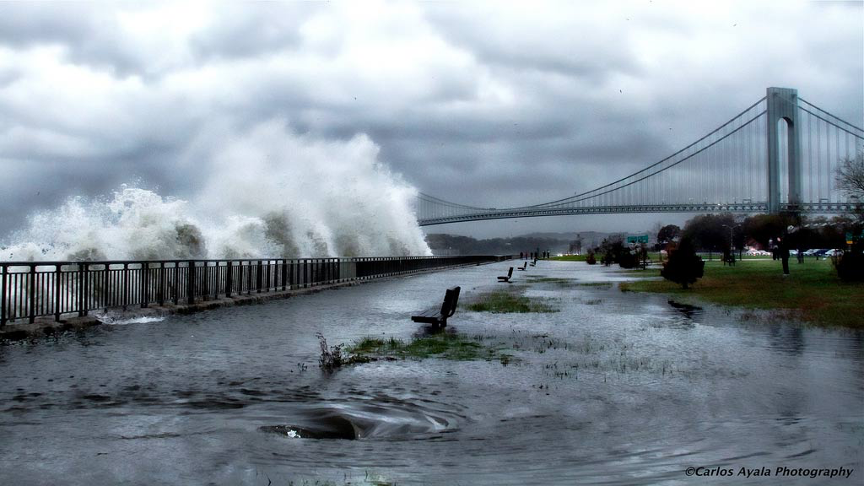

Slide 13
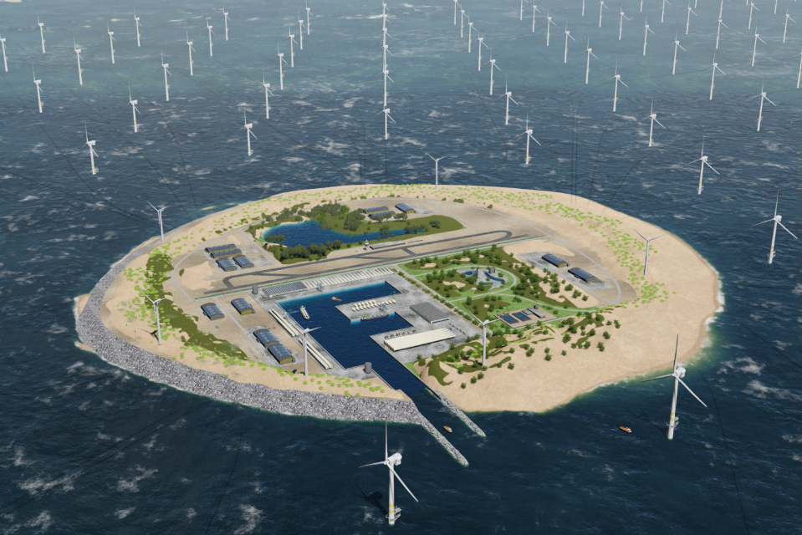

Slide 14
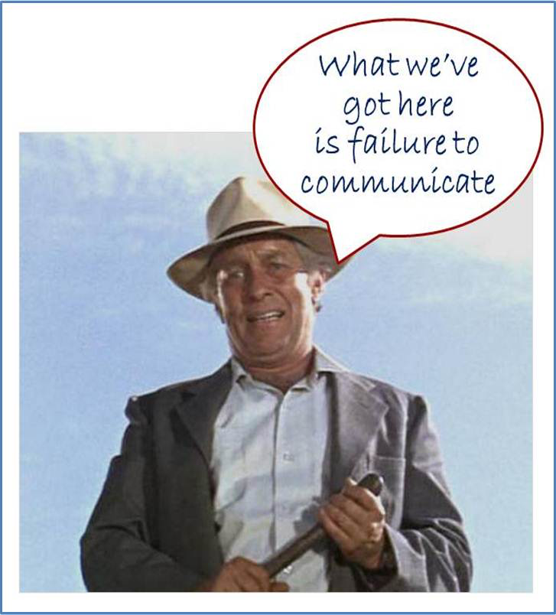
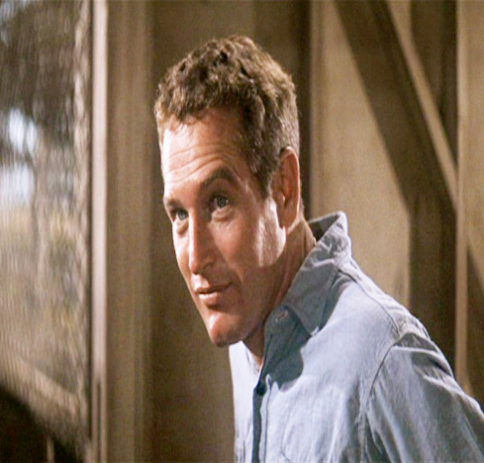
Cool Hand Luke

Slide 15
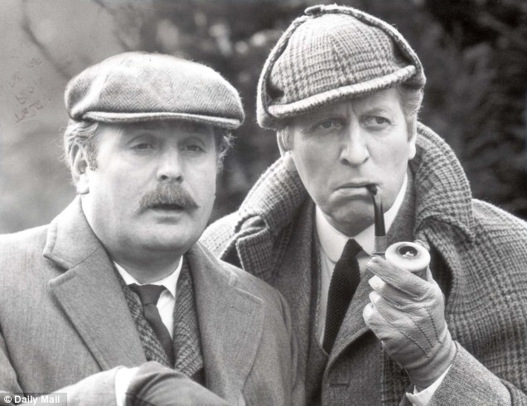

Slide 16
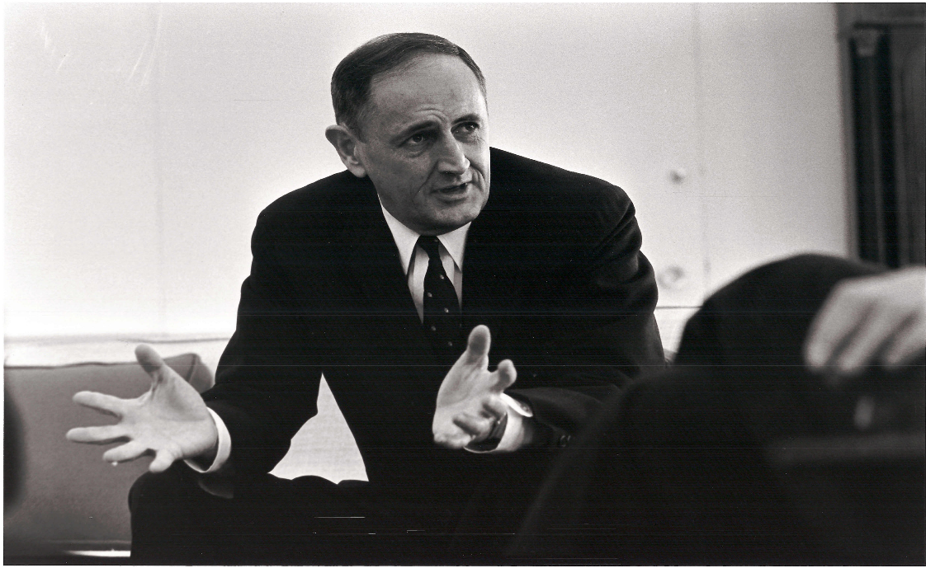
We care continually faced with a series of great opportunities brilliantly disguised as insoluble problems.
John W. Gardner

Slide 17
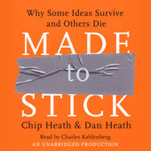
Getting The Messages Right
MADE TO STICK by Chip and Dan Heath
Simple
Unexpected
Concrete
Credible
Emotional…all wrapped –up in
Stories

Slide 18
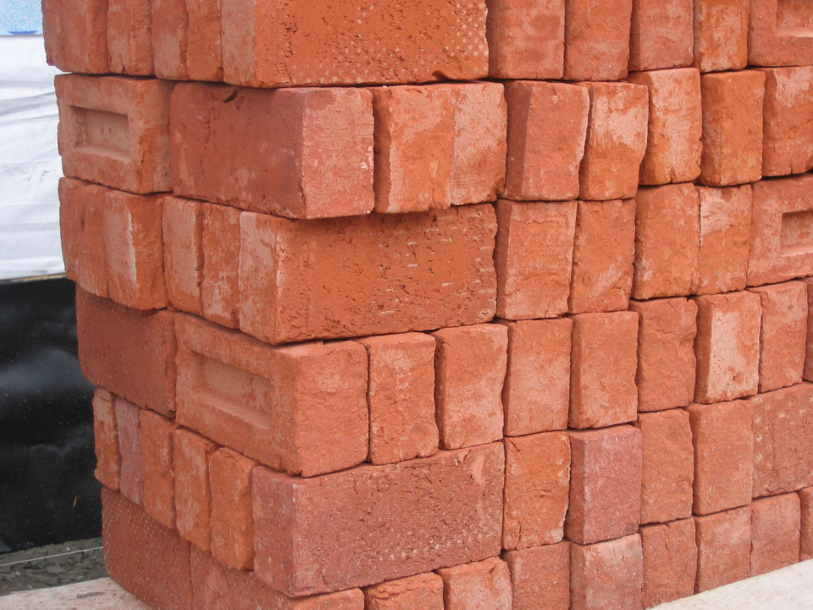

Slide 19
“Specialization, not generalization, is the signal of academic rigor.”
Andrew Hoffman

Slide 20
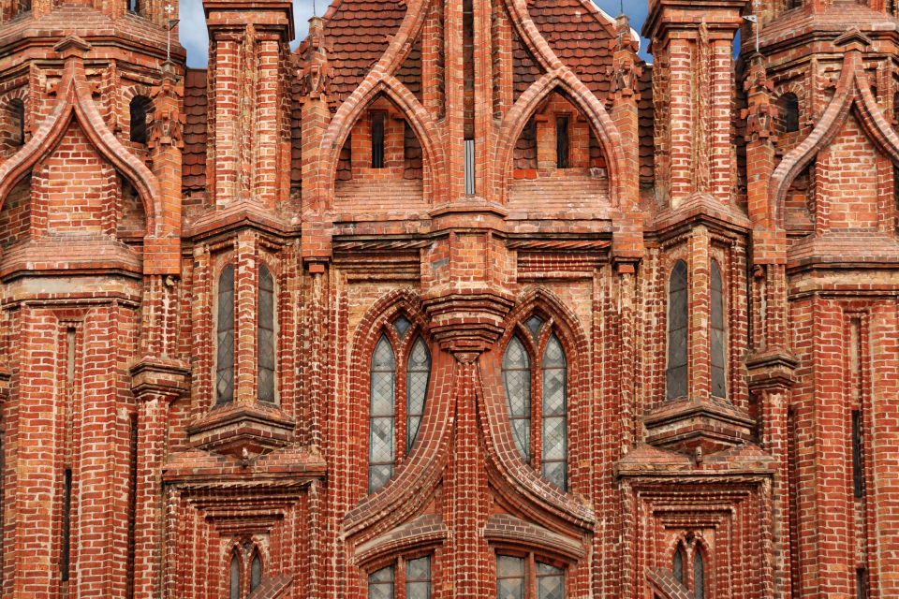

Slide 22
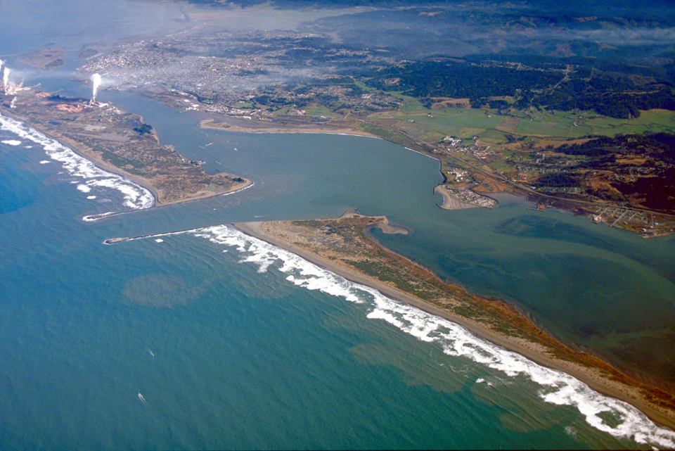
Notes:
Humboldt Bay, California

Slide 23
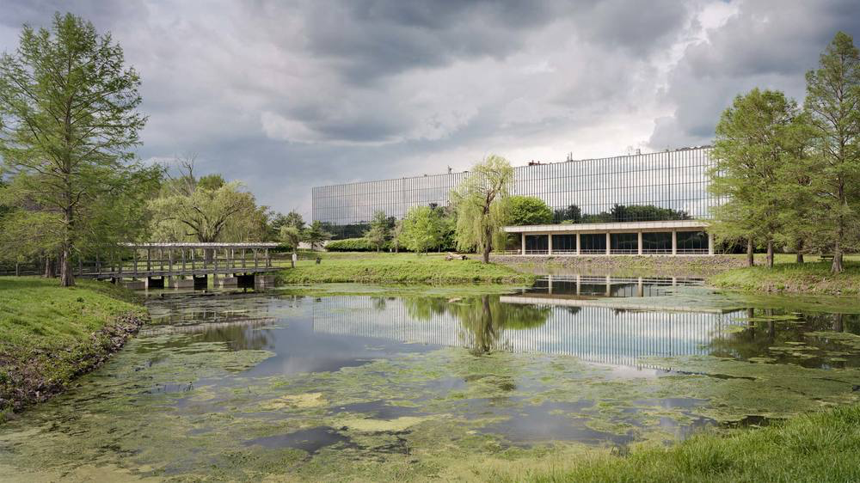
Bell Labs, Murray Hill, NJ

Slide 24
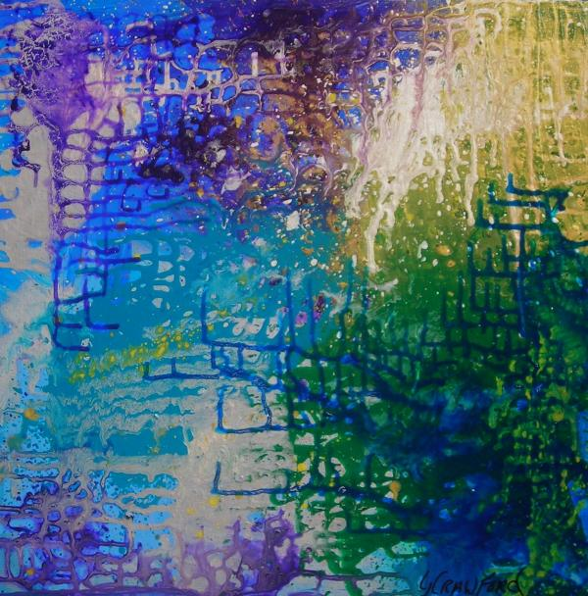
Thank You!

Slide 25
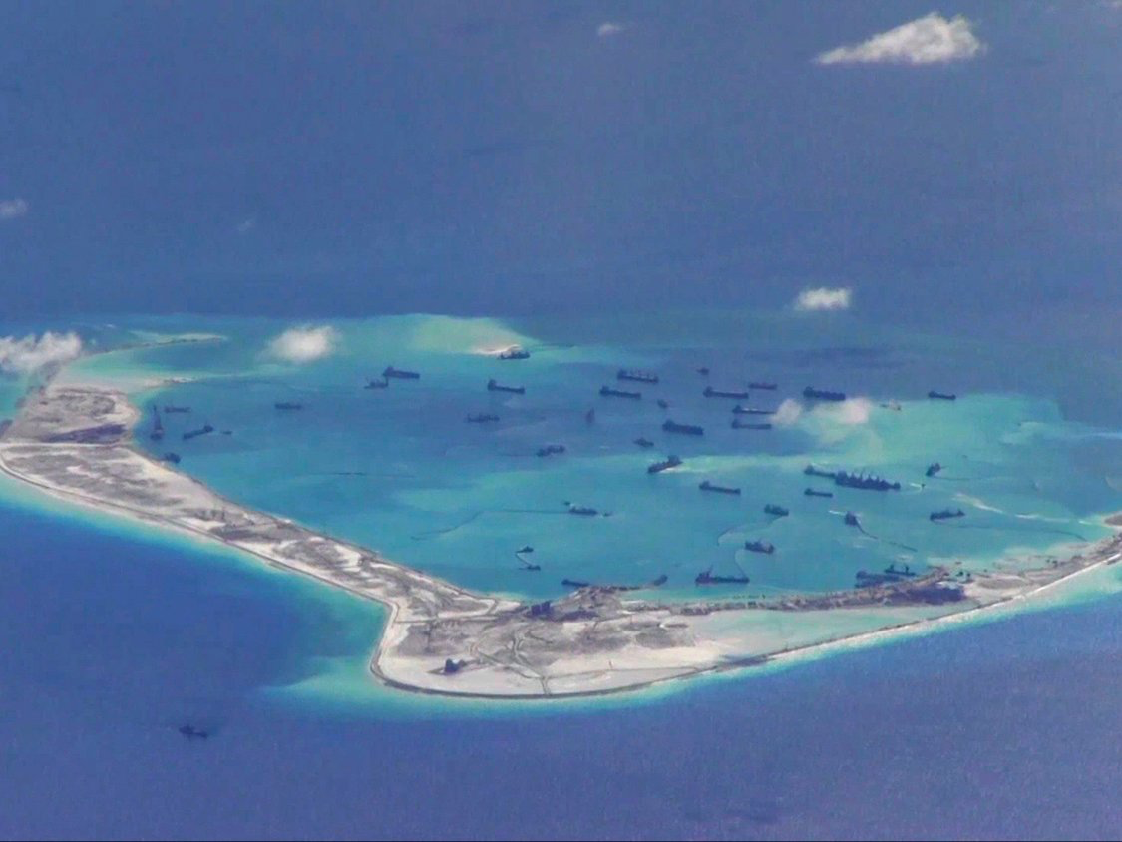
Notes:
S. China Sea

Slide 26
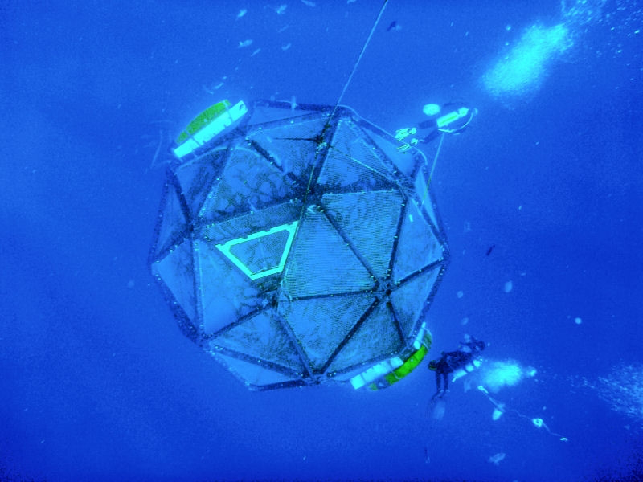

Slide 27
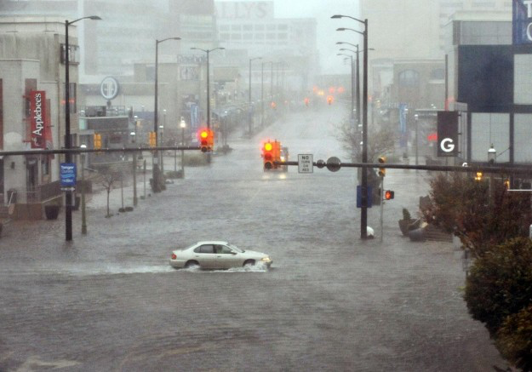

Slide 28
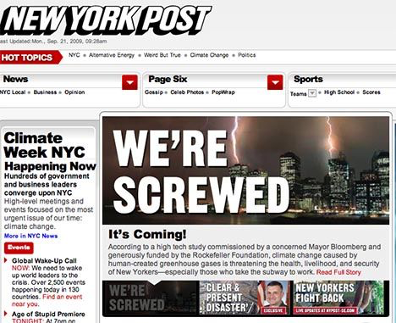

Slide 29
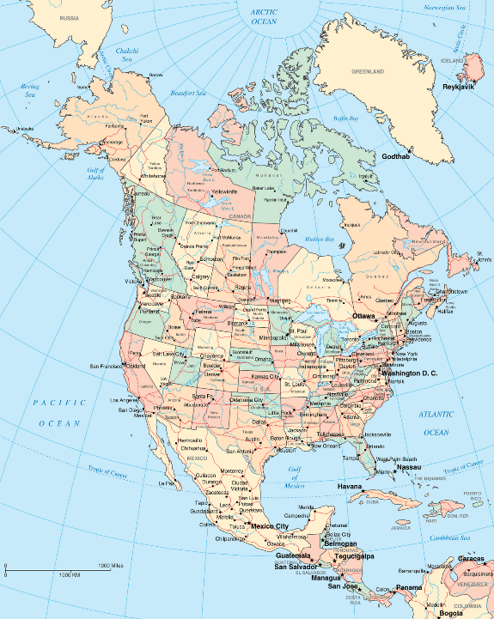

Slide 30
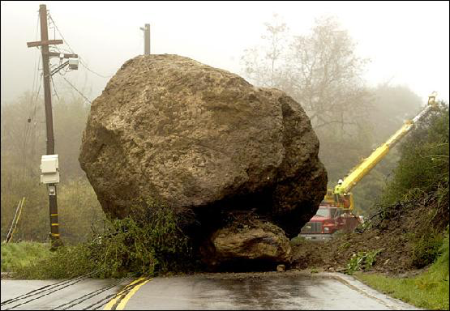

Slide 31
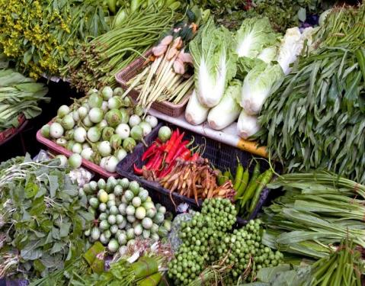
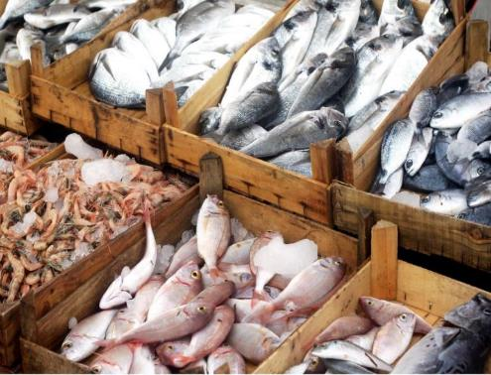
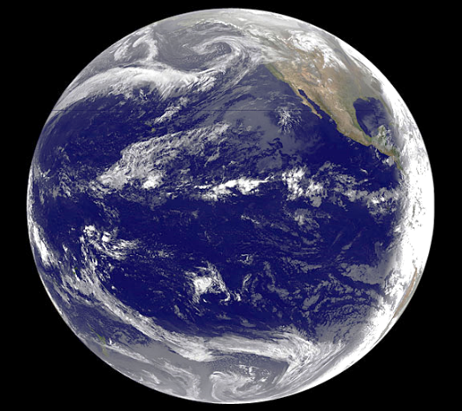
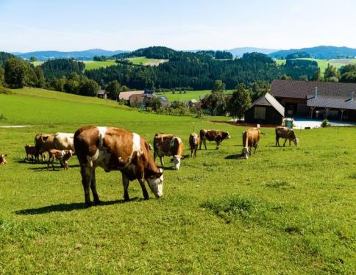
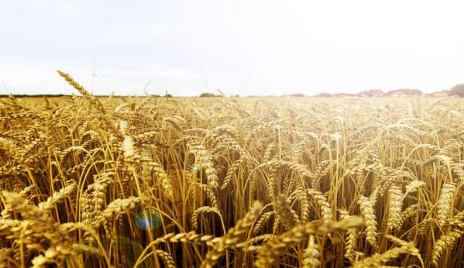
71 % of Earth’s Surface is Ocean
2% of food supply

