Slide 1
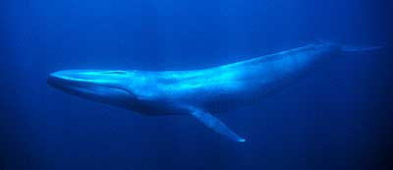
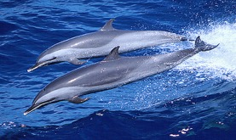
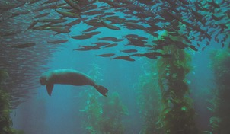
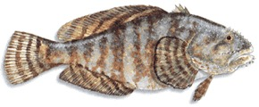
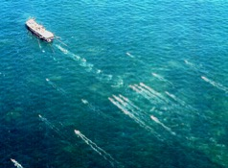
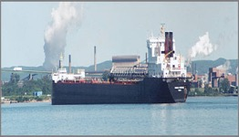
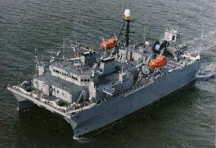
Marine Animal Acoustics and Anthropogenic Noise
Marine animals produce sound and listen for environmental acoustic cues. Underwater sound is critical in life history
For many of the same physical reasons, humans produce underwater sound either intentionally or incidentally
Miksis-Olds and Martin – 2016 NOEF white paper/MURU Forum
see: www.dosits.org

Slide 2
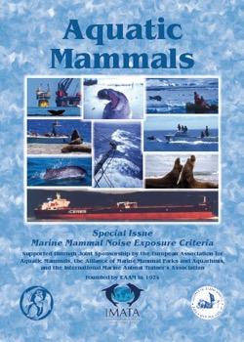
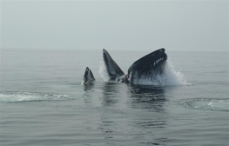
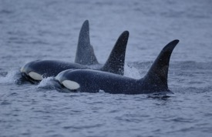
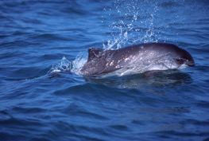
Effects of Noise on Marine Life
None observable
Interference with Communication
Auditory masking (loss of acoustic “habitat”)
Temporary or permanent hearing damage
Behavioral Responses
Orientation, increased alertness, vocal changes
Effects on feeding, social activity, risk of predation
Habitat abandonment: temporary or permanent
Physiological Effects (stress, DCS)
Stranding causing injury or death
Generally
Increasing Severity
but
Generally Decreasing Occurrence

Slide 3
Animals and anthropogenic sounds have widely variable characteristics
Whales
Fish
Turtles
Seals & Sea Lions
Dolphins
Porpoises
200 k
1 Hz
10 Hz
100 Hz
1 kHz
10 kHz
100 kHz
LFA Sonar
MFA Sonar
Echosounders/
Mapping Sonars
Shipping , Seismic Surveys, Pile Driving, Oil and Gas Drilling

Slide 4
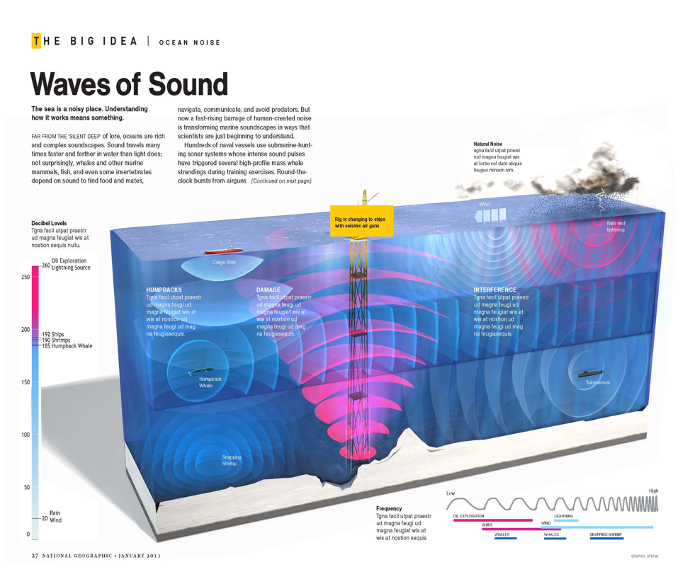

Slide 5
Selected International and National Measures to Address Ocean Noise
UN/IMO Vessel Quieting Guidelines
UN Ocean Noise Voluntary Commitment
Intl. Quiet Ocean Experiment (IQOE)
Acoustic monitoring integration in -OOS’
Industry-supported Joint Partnerships for Passive Acoustic Monitoring (North Slope AK, GoMex)
U.S. NOAA’s Ocean Noise Strategy
Port of Vancouver (BC) ECHO program

Slide 6
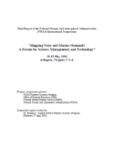
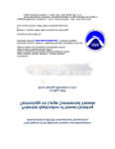
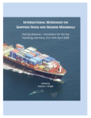
Vessel-Quieting Guidelines (2004-14)
2004 NOAA Symposium: brought stakeholders together for the first time to discuss impacts and potential solutions
2007 NOAA Symposium: focused on technical details and basic costs and benefits of various noise reduction options
2008 Okeanos Workshop: defined goals for noise reduction
IMO GUIDELINES ISSUED - 2014
IMO (U.S. proposal, 2008)
IMO CG reports
Model basin technical response
AMSA report
ANSI standards
- Okeanos Workshop
IMO Corresp.
Group forms
IWC Session on masking noise
IMO CG recs.
EU MSFD
2nd NOAA Symposium
- IMO info paper
1st NOAA
Symposium
NOAA
Steering Group
2004
2005
2006
2007
2008
2009
2010

Slide 7
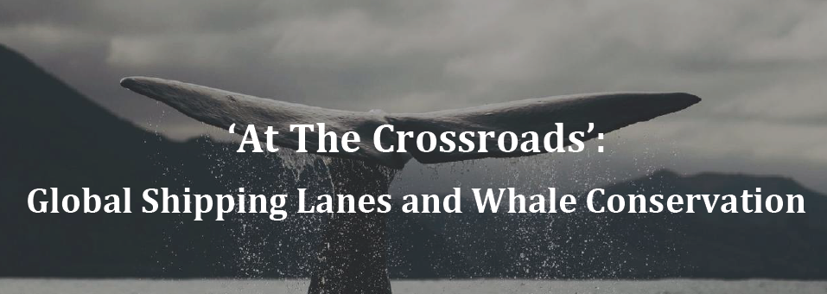
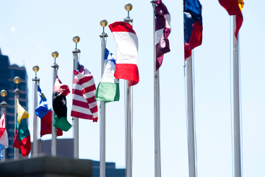
Tim Collins WCS
https://sdg14.wcs.org/Events/Global-Shipping-and-Whale-Conservation
un.org
Notes:
This work is especially relevant because of the recent increase in marine protected areas off the coast of Gabon. We will be helping inform policy and management of these new areas in an effort to protect this population of humpback whales.

Slide 8
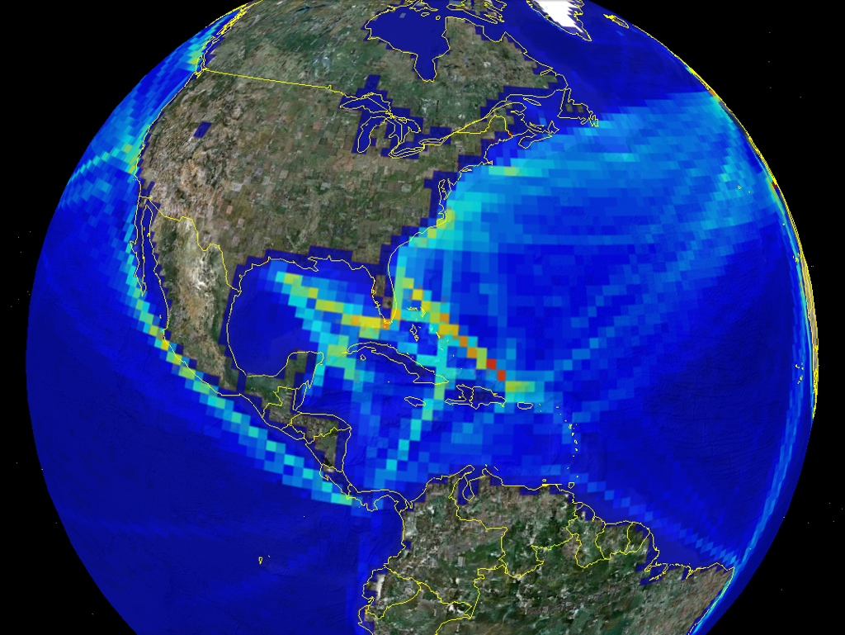
The NOAA Underwater Sound Field Mapping Working Group:
Developing Geospatial Tools to Inform Management of Cumulative Impacts
<cetsound.noaa.gov>
Courtesy: NOAA (L. Hatch)
http://cetsound.noaa.gov
Notes:
I’m now going to give you an overview presentation of the work of the Underwater Sound Field Mapping Working Group, with some notes on its specific objectives and how those objectives translated into the work that was conducted.

Slide 9
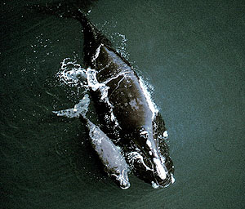
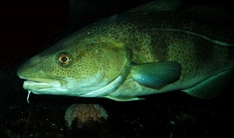
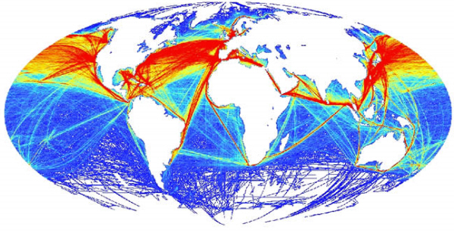
Human-induced underwater noise
Current Noise Management:
Mainly activity by activity
Relatively short term, relatively small scale
Thresholds for high intensity, transient sources
Difficulty incorporating ambient noise variability (natural and anthropogenic)
Heavy emphasis on impacts to marine mammals
Goals for Future Noise Management:
Cumulative footprints from multiple source types
Ecologically-relevant scales (space and time)
Addressing chronic lower intensity sources
Incorporating ambient noise variability (natural and anthropogenic)
Emphasizing impacts to a variety of marine animals and their habitats
Courtesy: NOAA (L. Hatch)
Notes:
You’ll hear more in upcoming talks about the status of current noise management in US waters, but traditional focus has been on relatively short term and relatively small scale human activities, emphasizing thresholds of noise exposure from high intensity and short duration sources, with limited abilities to incorporate knowledge of background noise and with heavy emphasis on marine mammals.
The Sound Field Mapping Working Group focused on developing a first pass at quantitative tools that could support the additional management of cumulative footprints from multiple source types at large scales in both space and time, that could therefore incorporate chronic, lower intensity sources and make in-roads into supporting better representations of ambient noise and impacts to species beyond marine mammals.

Slide 10
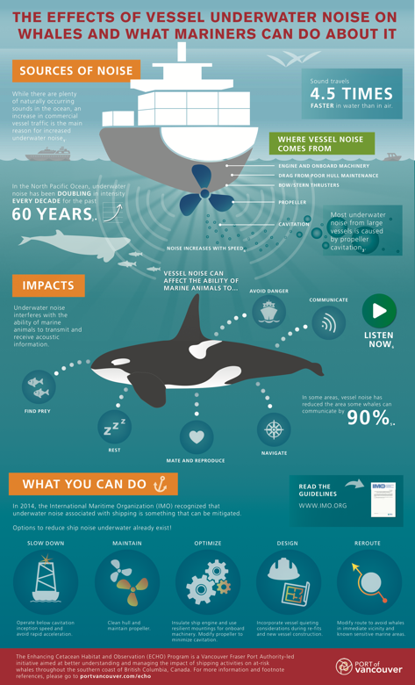
New Initiatives to Reduce Shipping Noise: Port of Vancouver
ECHO* is a Vancouver Port Authority-led collaborative regional initiative to better understand and manage cumulative impacts of shipping activities in southern BC
Jan 2017: Vancouver Fraser Port Authority adds new incentive criteria to its existing EcoAction program to include harbor due rate discounts for quieter ship - 3 quiet-vessel ship classifications; 3 propeller technologies
Summer 2017: ECHO program planning a voluntary vessel slow down trial through important killer whale critical habitat - Measuring relationship between vessel speed and u/w noise
ECHO infographic to synthesize IMO quieting guidelines shared on IMO educational website
Collaborative Mariner’s Guide to Whales, Dolphins and Porpoises of Western Canada developed to raise mariner awareness on the issue of vessel-whale interactions
* http://www.portvancouver.com/environment/water-land-wildlife/marine-mammals/echo-program/

Slide 11
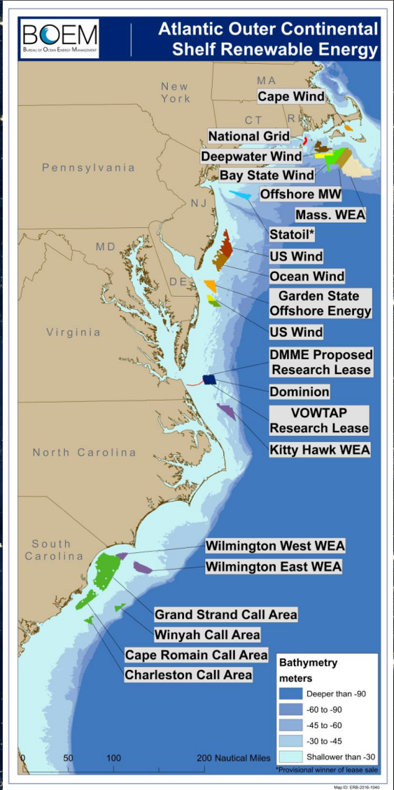
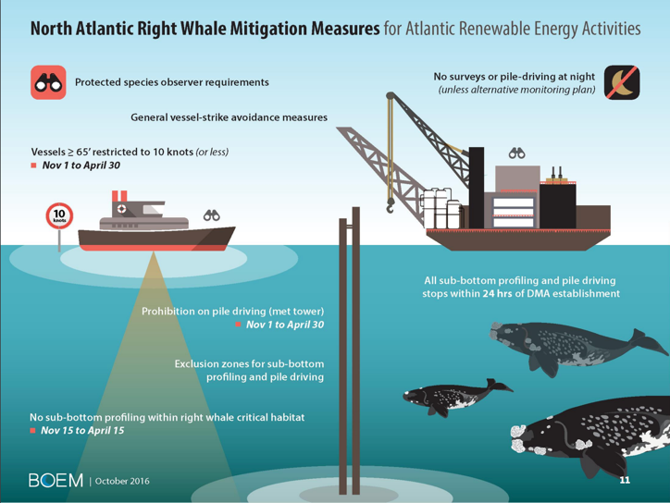
Energy development and ocean noise in the Mid-Atlantic
March 2017 BOEM: best practices and protected species
National OCS Program 2019-2024

Slide 12
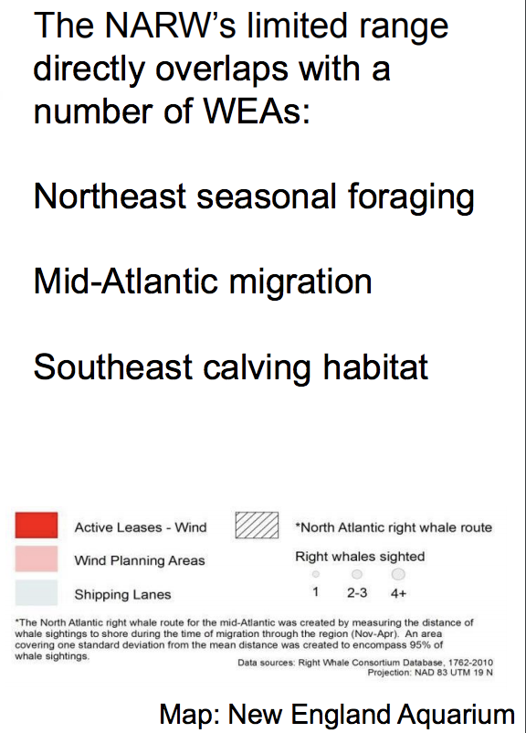
Endangered Species and Wind Energy Development

Slide 13
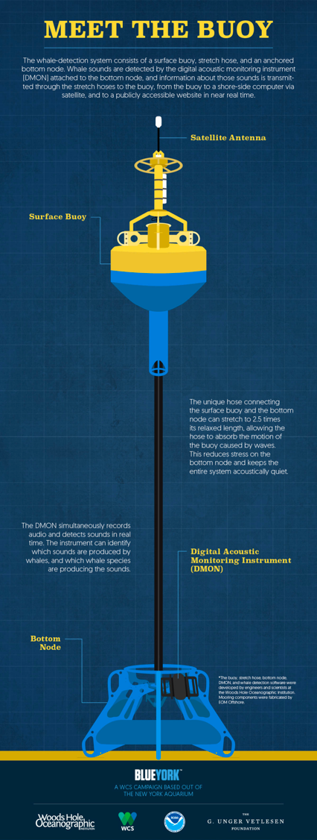
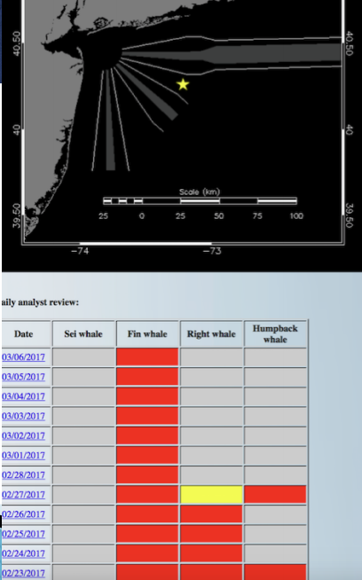
Technology
Passive acoustic monitoring units
WCS/WHOI near-real time acoustic-monitoring buoy just outside New York City Harbor off the coast of Long Island
Detected humpback, fin, sei, and endangered North Atlantic right whales
Efficiency and less noise in next class of bulk carrier ships by 2023
But Noise overall in the Oceans...

Slide 14
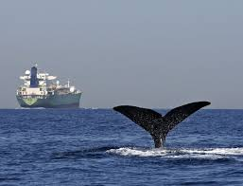
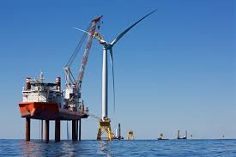
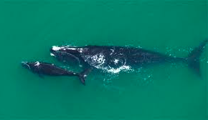
Conclusions and Recommendations
Local, regional, and national collaboration is necessary and effective
Shipping industry and governments need to work together worldwide
Quiet zones and quieting technology
IMO guidelines resulted from partnerships

Slide 15
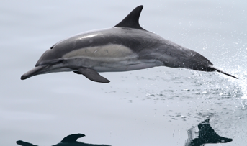
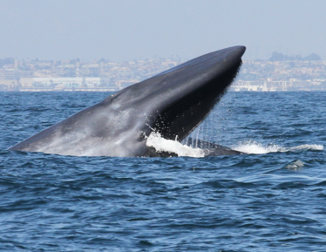
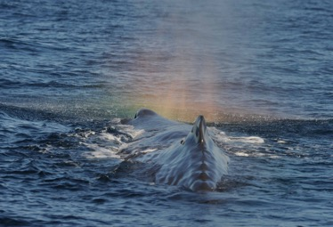
Conclusions and Recommendations
Targeted research and technological advancements in acoustic monitoring
Strength of synoptic oceanographic data
Biological distribution and noise metrics
Proactive monitoring measures work
Reducing information gaps ahead of proposed work reduces unnecessarily stringent regulations: Proactive Investment
Can inform operational efficiency/maintenance
Win-Win for Blue Ocean Economy

