Slide 1
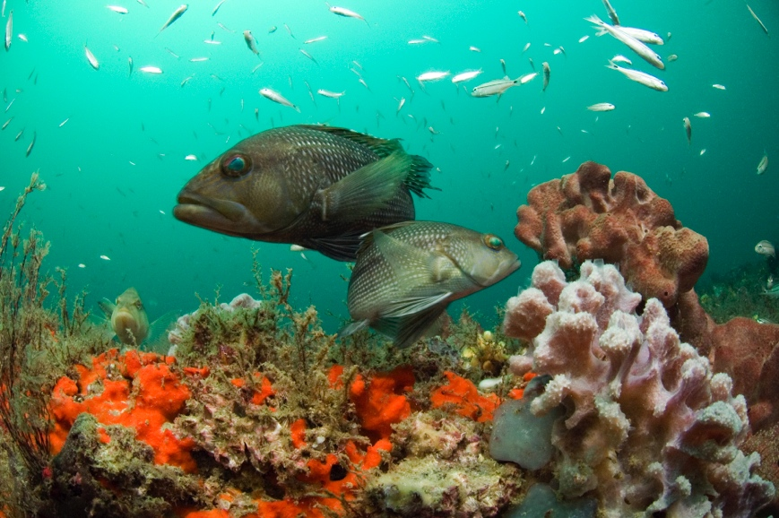
OceanAdapt Data to guide a productive marine economy in a changing climate
Malin Pinsky
Rutgers University

Slide 2
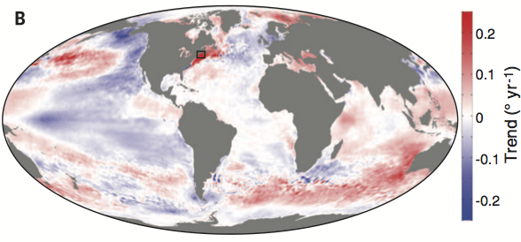
Rapidly warming ocean
2010
Pershing et al. 2015

Slide 3
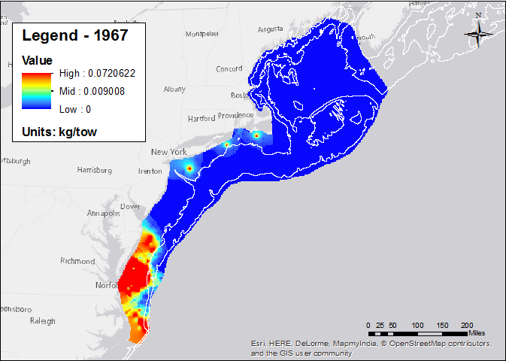
Boston
New York
Washington

Slide 4
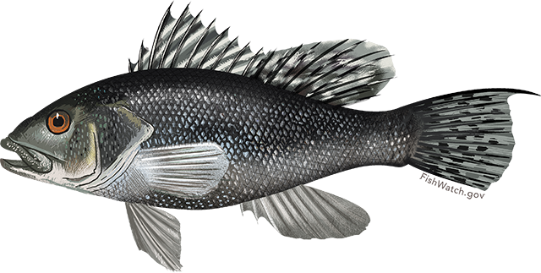
1967
Black sea bass

Slide 5
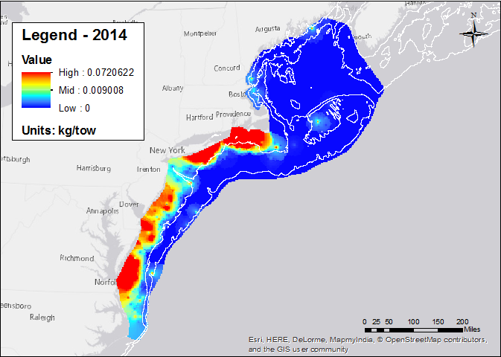
2014
Black sea bass

Slide 6
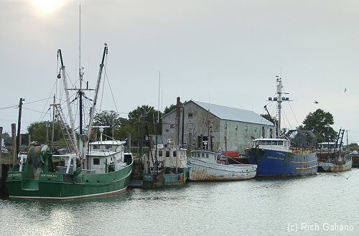
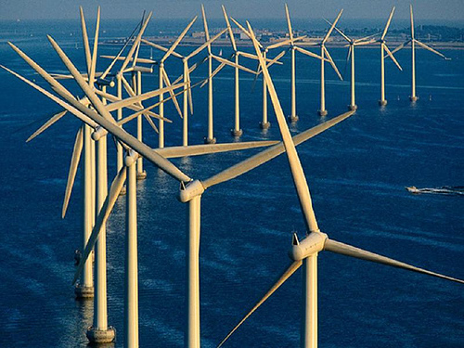
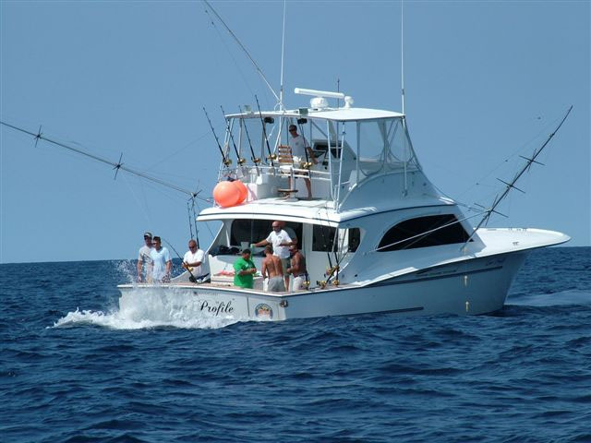
Notes:
These changes affect how people use the ocean and the impacts cascade throughout our coastal economy. Changing species distributions affect where, when, and which species commercial fisheries catch, as well as the fish recreational anglers catch and how many anglers go out and from which ports. In addition, though, they affect the port infrastructure and dockside industries that are needed, plus interactions with other ocean uses like energy development.
When we go from thinking the ocean is relatively static map to one that is moving, there are potentials for both upsides and downsides for the economy and ocean economic sectors. New species moving into a region, for example, may be new fishing opportunities.
Our belief, however, is that the potential for upsides are greater if we go into the future with our eyes open and our headlights on, fully informed about how the ocean is changing and how it’s likely to change in the future.

Slide 7
OceanAdapt: Data to aid climate adaptation
Notes:
To that end, Rutgers University and the National Marine Fisheries Service have put together a website to document and provide information on shifting species, both in the Mid-Atlantic and around the US.

Slide 8
http://oceanadapt.rutgers.edu
Track shifts in distribution of 665 U.S. marine fish and invertebrates
Notes:
We’ve worked with the science centers to streamline the pipeline of data from field surveys to QA/QCed data and posting on the website. NOT ATTRIBUTION or tying these changes to temperature. While, as I’ve shown you, temperature has a strong influence on the distribution of marine animals, other factors like fishing and species interactions can be important in certain cases as well.

Slide 9
http://oceanadapt.rutgers.edu
Track shifts in distribution of 665 U.S. marine fish and invertebrates
Operational
Notes:
We’ve worked with the science centers to streamline the pipeline of data from field surveys to QA/QCed data and posting on the website

Slide 10
http://oceanadapt.rutgers.edu
Track shifts in distribution of 665 U.S. marine fish and invertebrates
Operational
Open science
Notes:
We’ve worked with the science centers to streamline the pipeline of data from field surveys to QA/QCed data and posting on the website

Slide 11
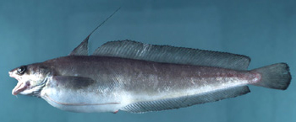
Maps to communicate
Red hake

Slide 12
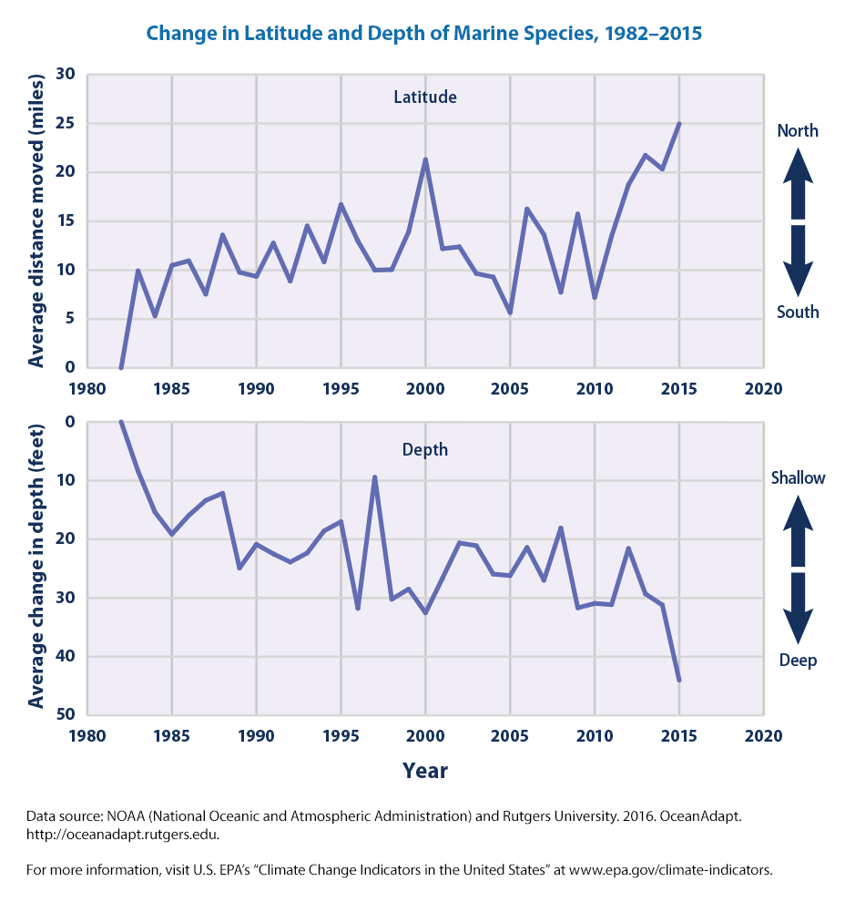
National indicator

Slide 13
Projections 2020-2100
2080-2100
Spanish mackerel

Slide 14
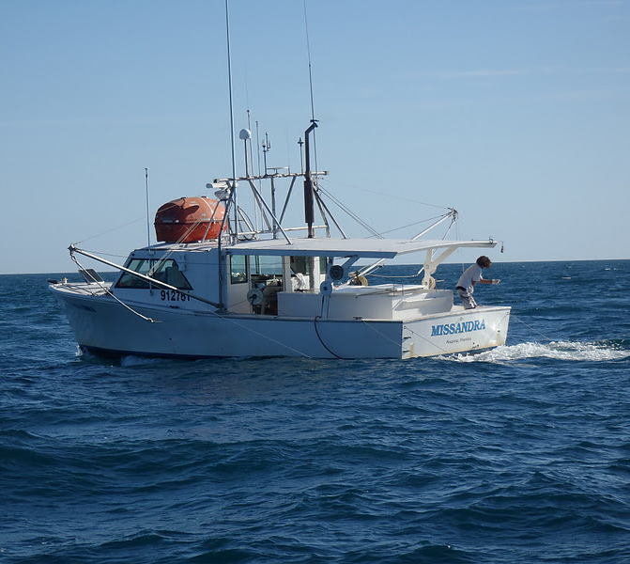
Finding compatible ocean uses

Slide 15
oceanadapt.rutgers.edu
Data for the marine economy in a changing climate
Historical and future ocean animal distributions
Win-win solutions for compatibility among ocean economic sectors

Slide 16
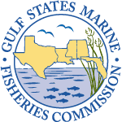
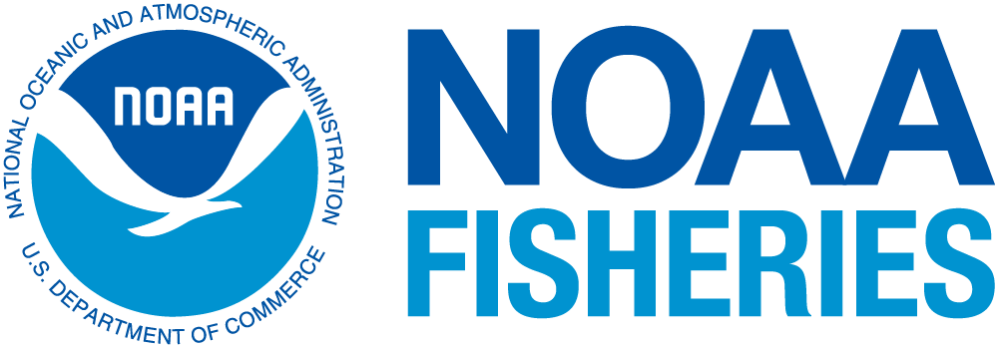
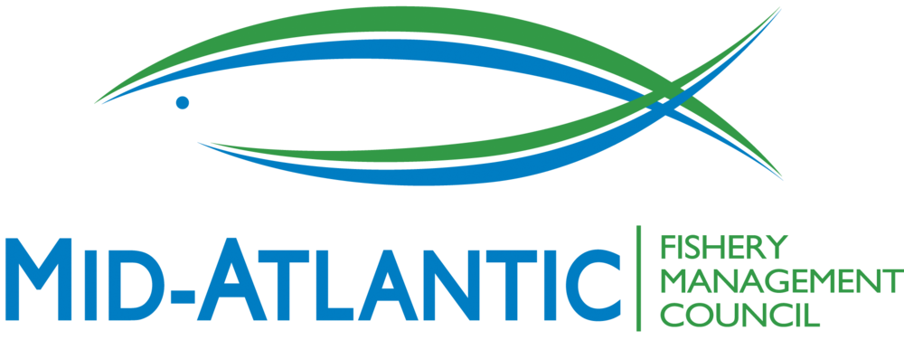
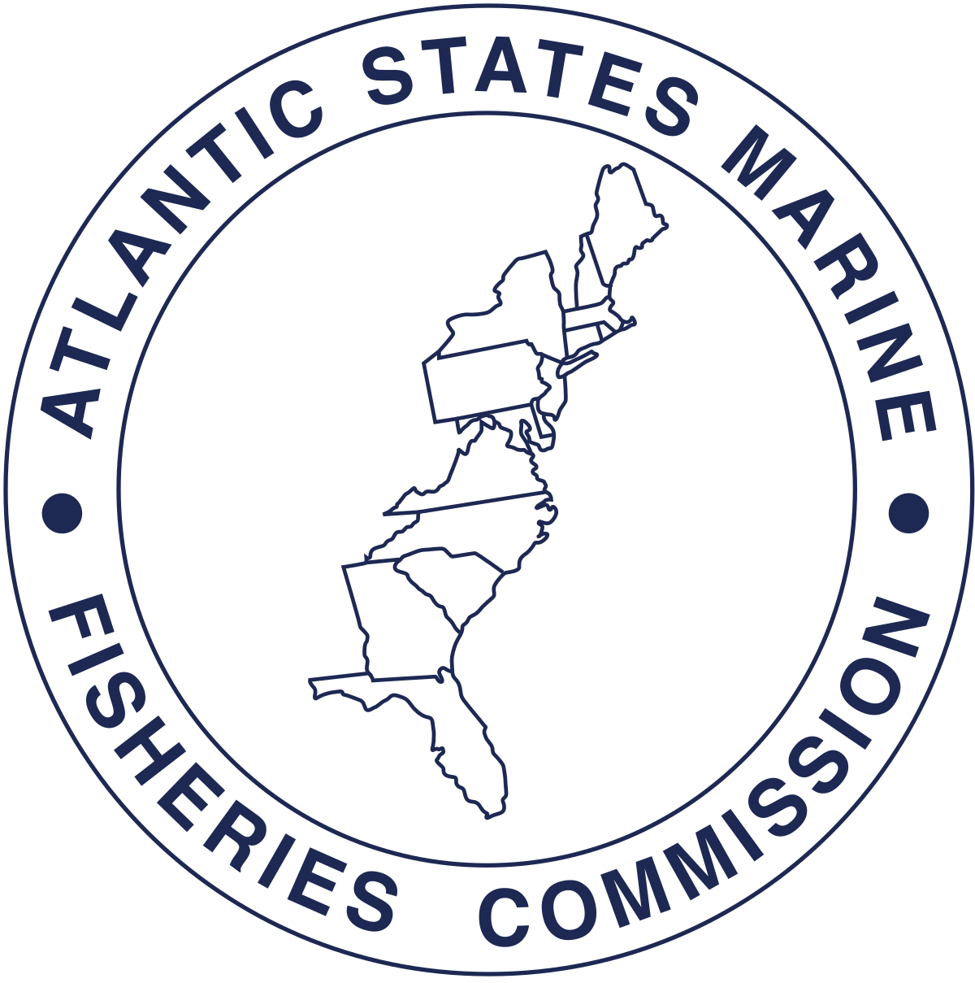
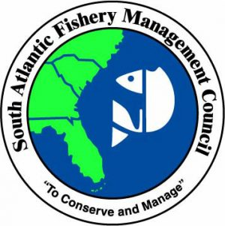
Audience
14,000 visitors

