Slide 1
Mid-Atlantic
Sea Level Rise &
Coastal Development
Philip Orton, Research Assistant Professor
Stevens Institute of Technology
porton@stevens.edu; Davidson Laboratory; Stevens Institute of Technology, Hoboken, NJ

Slide 2
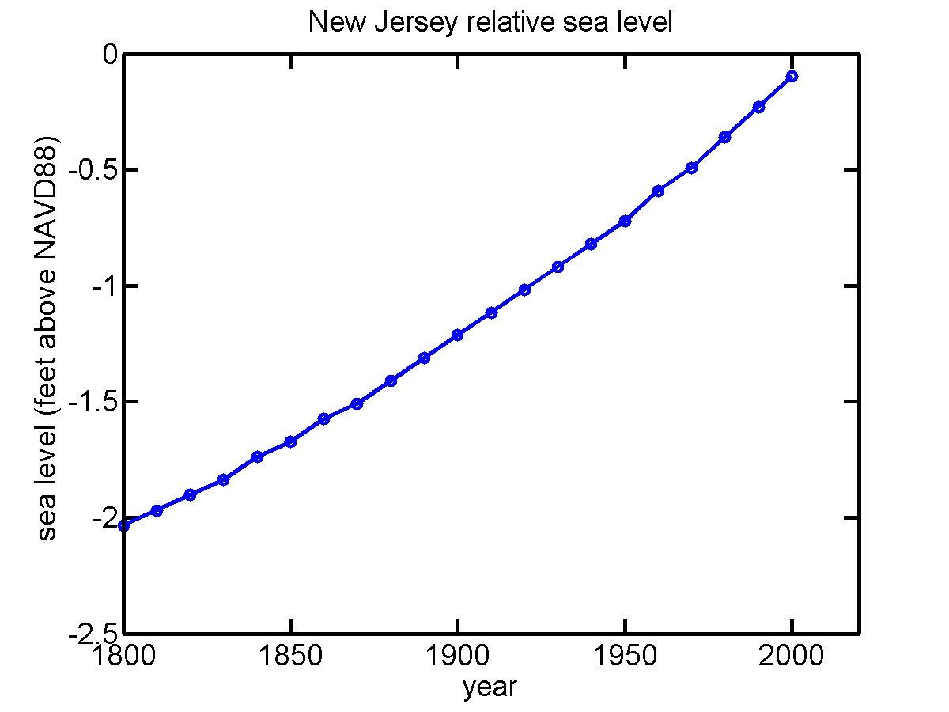

Slide 3
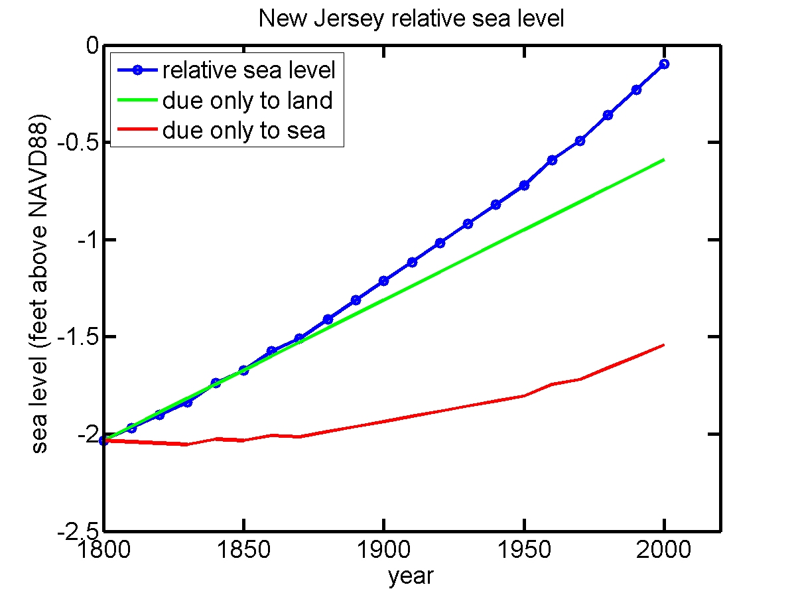

Slide 4
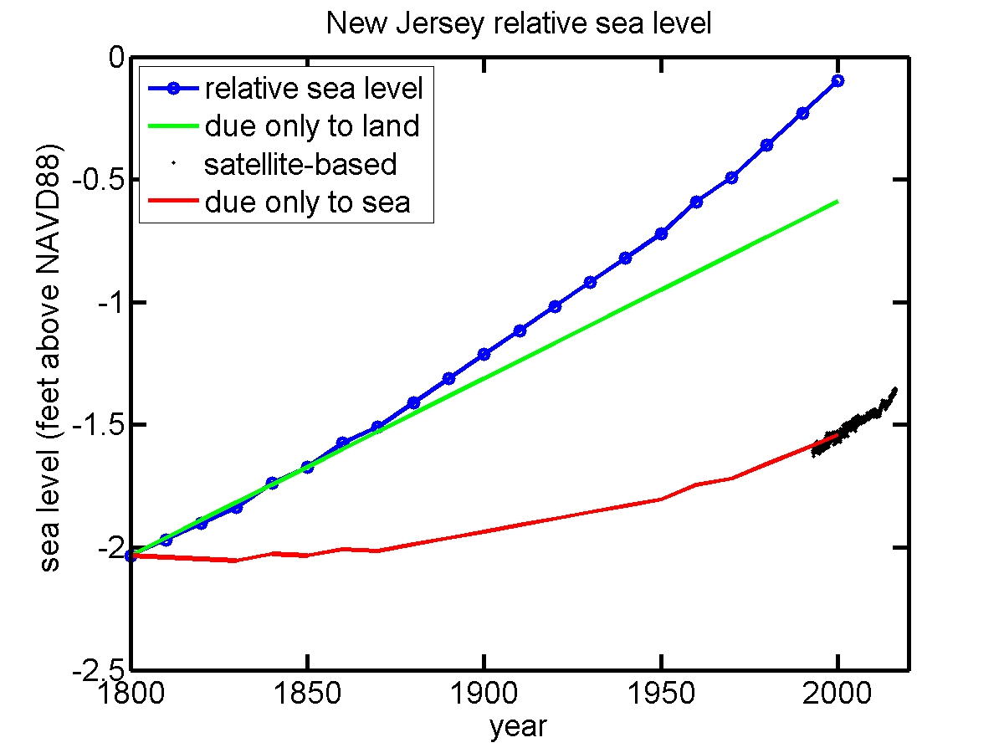
v

Slide 5
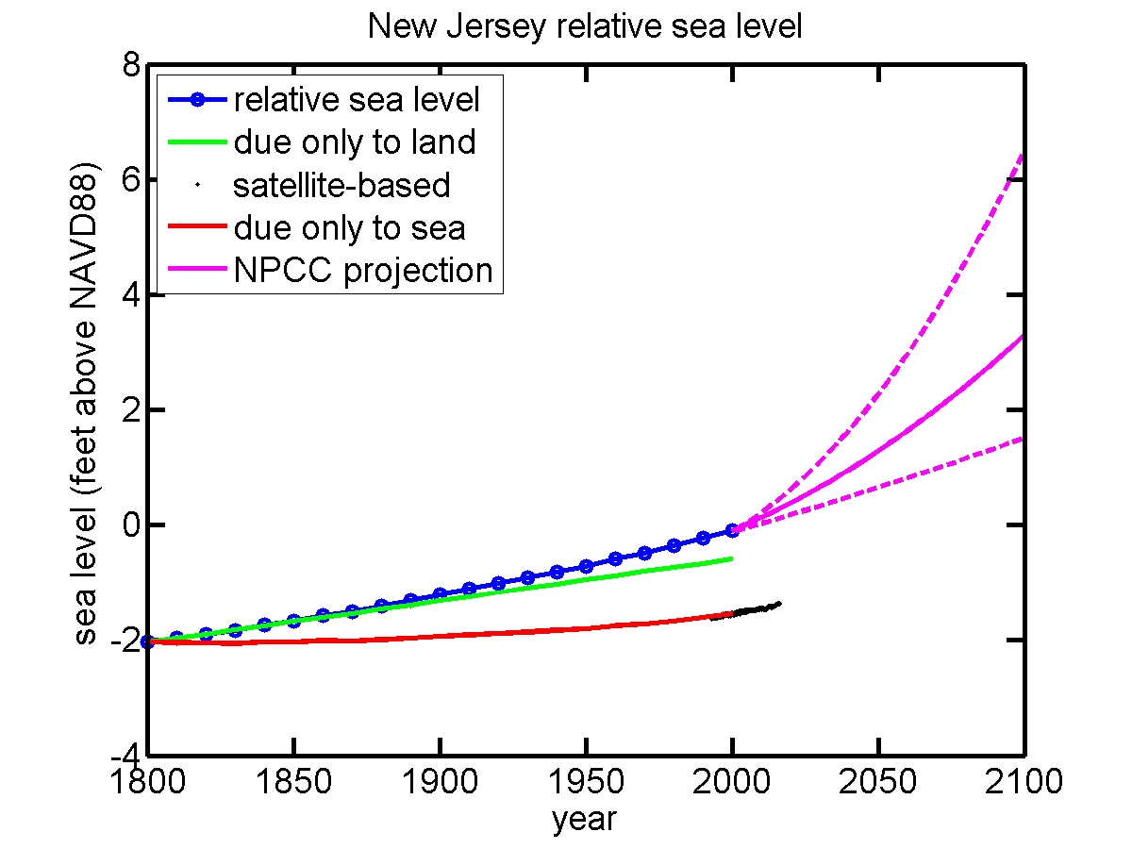

Slide 6
Conclusions, Recommendations
A short-term perspective on the impact of SLR between 2017 and 2030 is that it will not yet be an economic game changer
There is a clear risk that human-caused sea level rise will accelerate and devastate coastal areas of the Mid-Atlantic, leaving it completely different from the present
Coastal municipalities or states should prepare adaptation plans for 1 and 3 feet of sea level rise
To reduce these impacts I recommend everyone work to reduce greenhouse gas emissions
In the near-term this will not have a noticeable impact
However, in the long-term, and with respect to the “existential threat” of SLR, this can help avoid the worst impacts
Raises the odds of passing along a Mid-Atlantic Shore similar to the one we know, for future generations

