Slide 1
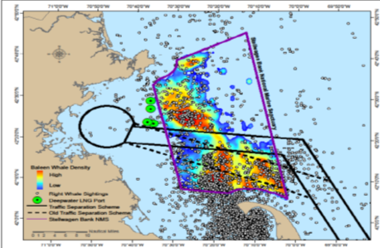
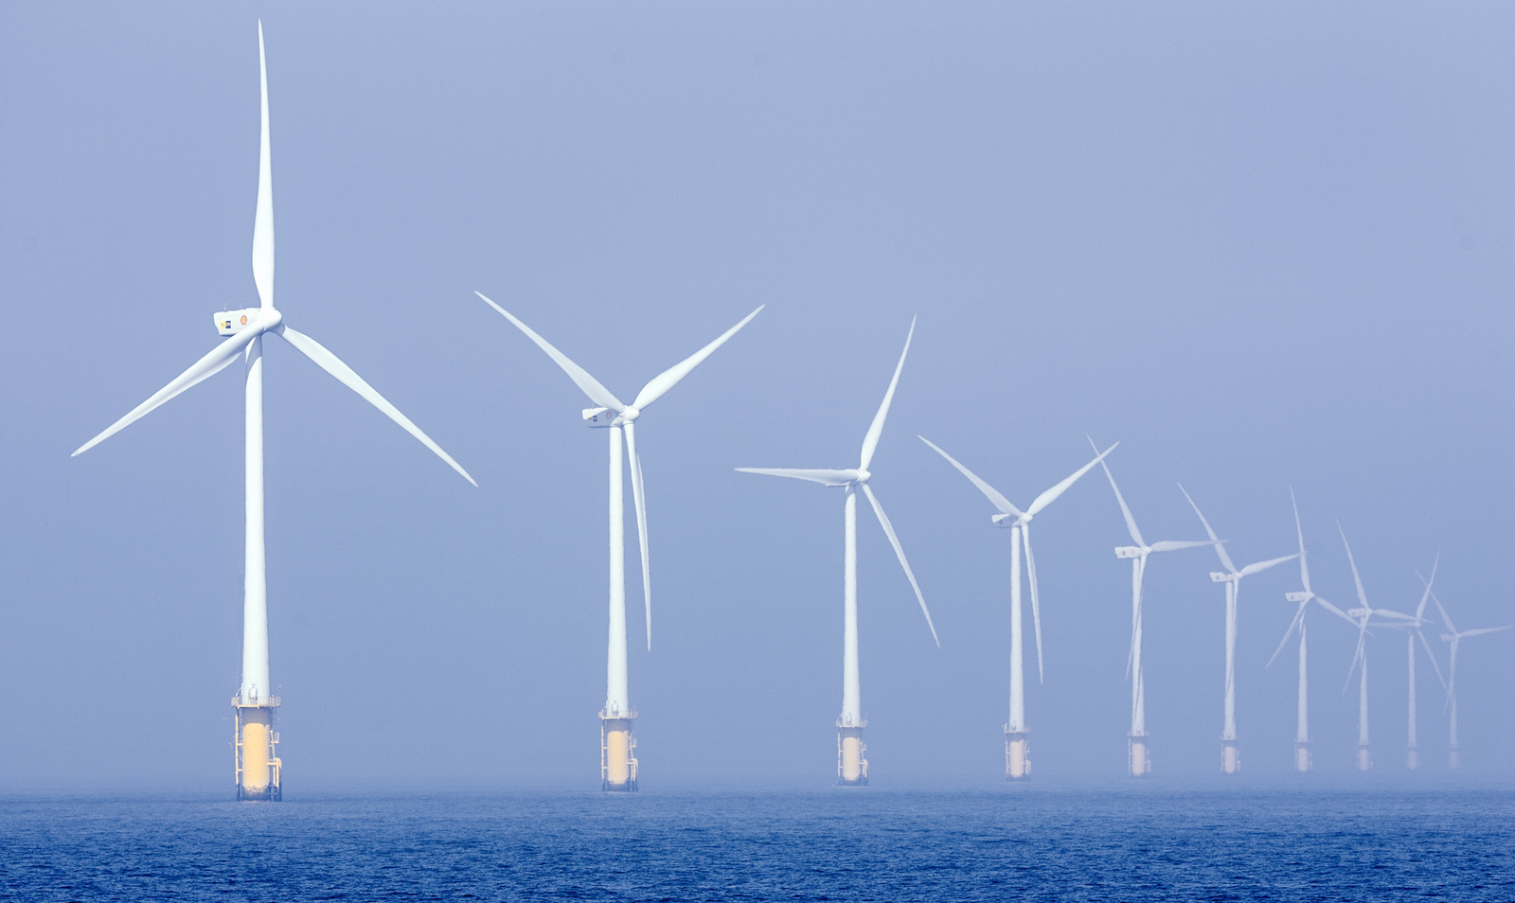
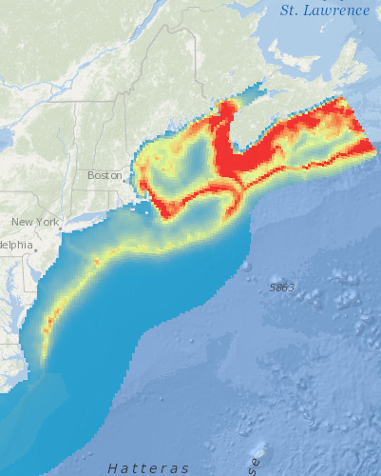
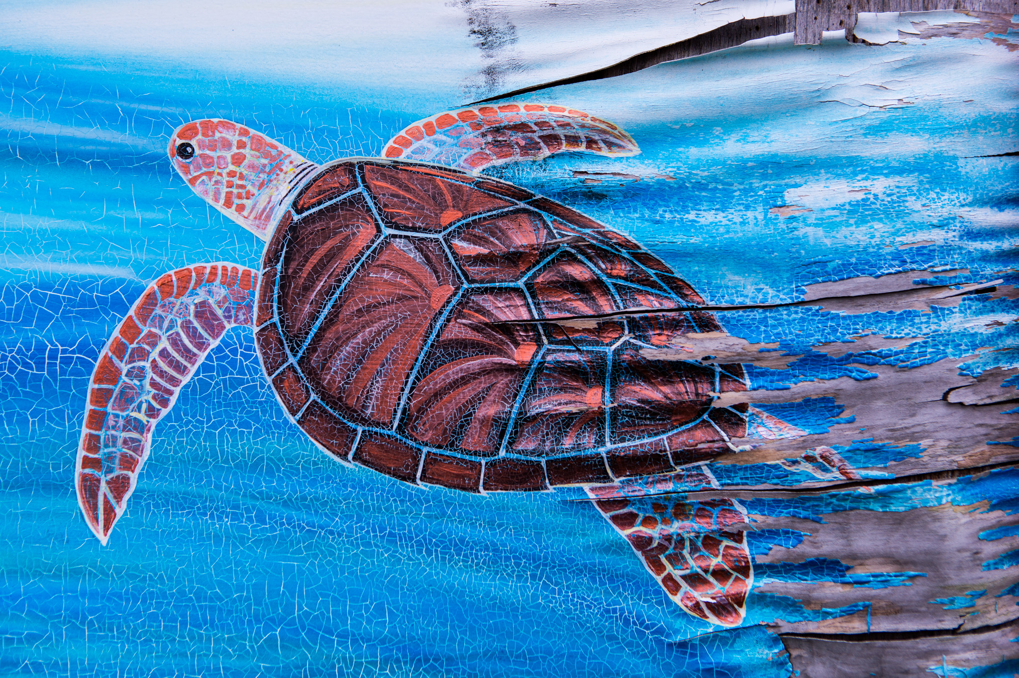
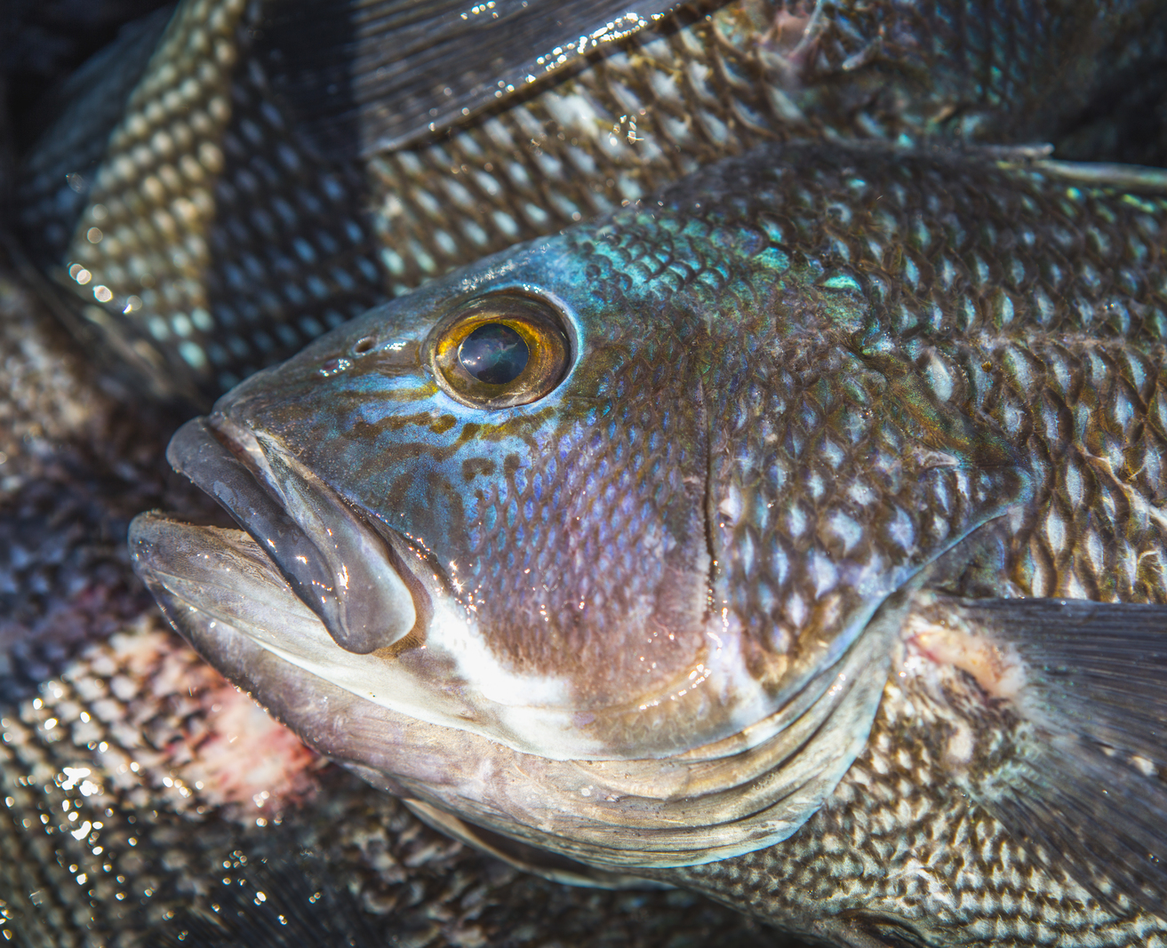
Introduction to: Mapping & Visualization to Improve Understanding & Build Public Support for the Blue Ocean Economy
Jay Odell
October 14, 2017

Slide 2
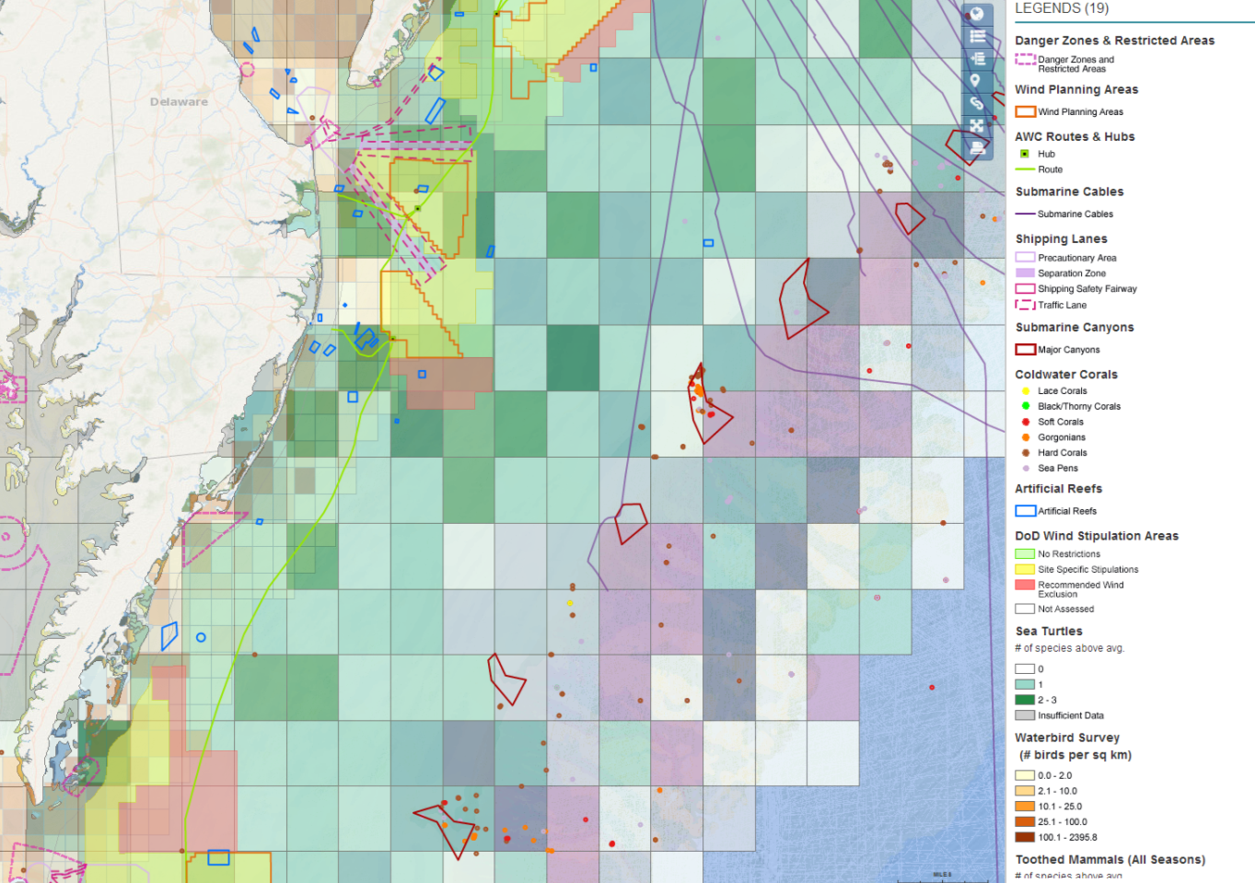
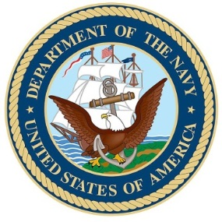
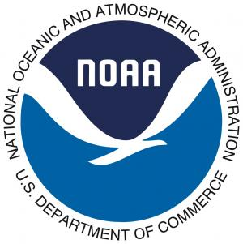
Mid-Atlantic Ocean Data Portal Project
Notes:
We have spent several years discovering, compiling, analyzing – and in some cases using participatory mapping and online survey tools – integrating map data and making it readily available to support any sort of management or planning process through the easy to use Portal interface.
We have found that integrating data that formerly sat in separate silos helps people to better understand the ocean and how we use and depend upon it, but also that the very process of compiling the data has fostered increased coordination and communication within and between the agencies and several new collaborations.

Slide 3
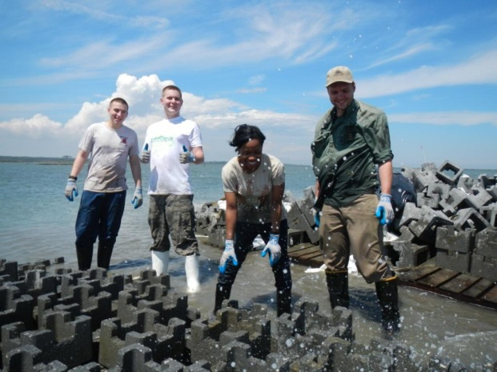
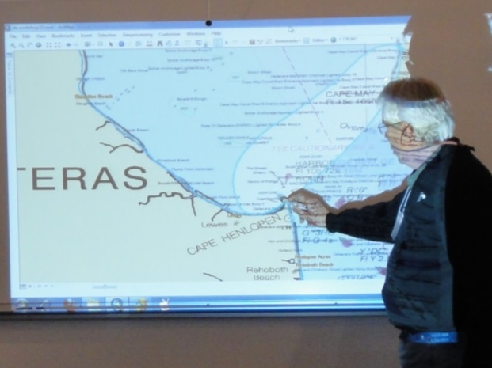
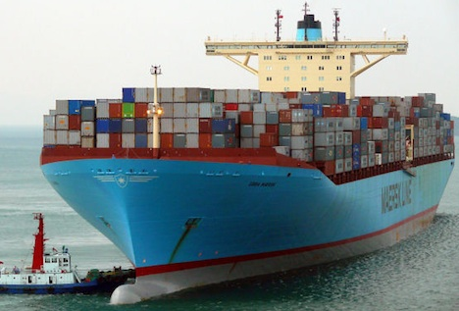
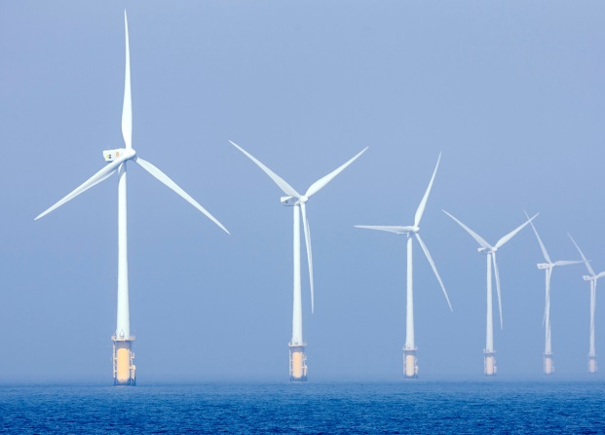
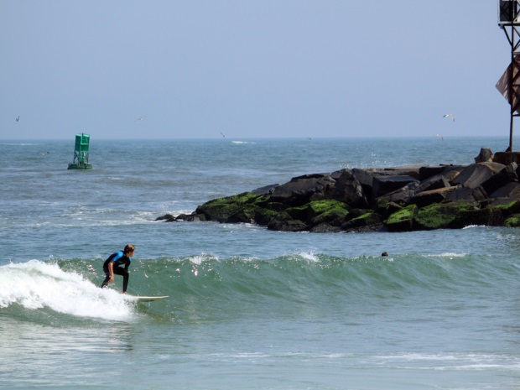
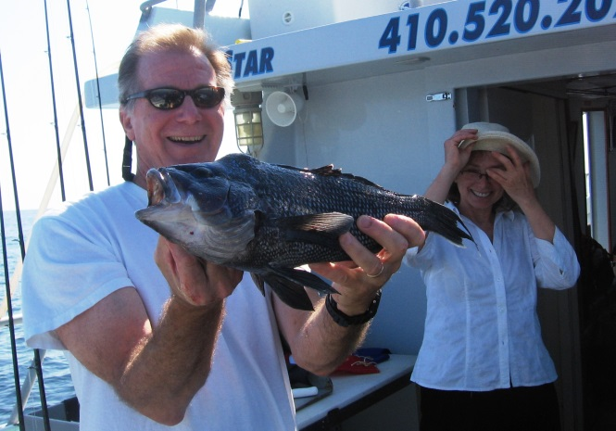
Notes:
Our goal is that all MidA stakeholders have a chance to help us get it right, and when they use the Portal, they see themselves on the maps… Can riff on this more…it’s their ocean, their map, their opportunity to shape their ocean future…

Slide 4
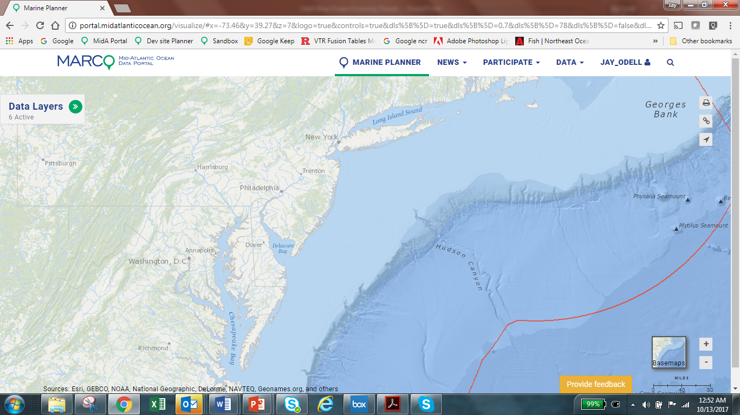

Slide 10
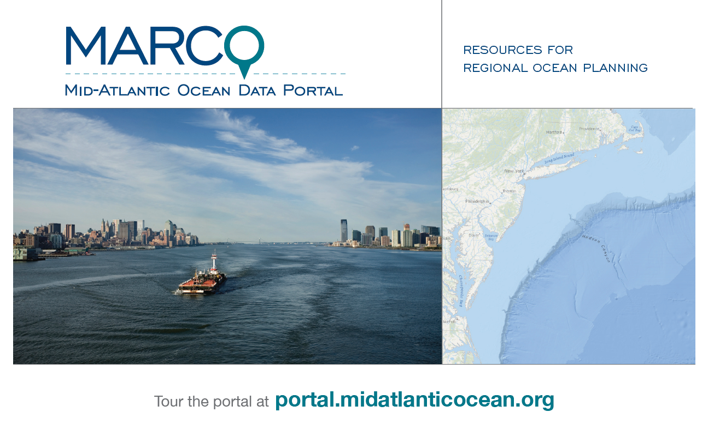
@PortalMarco

