Slide 1
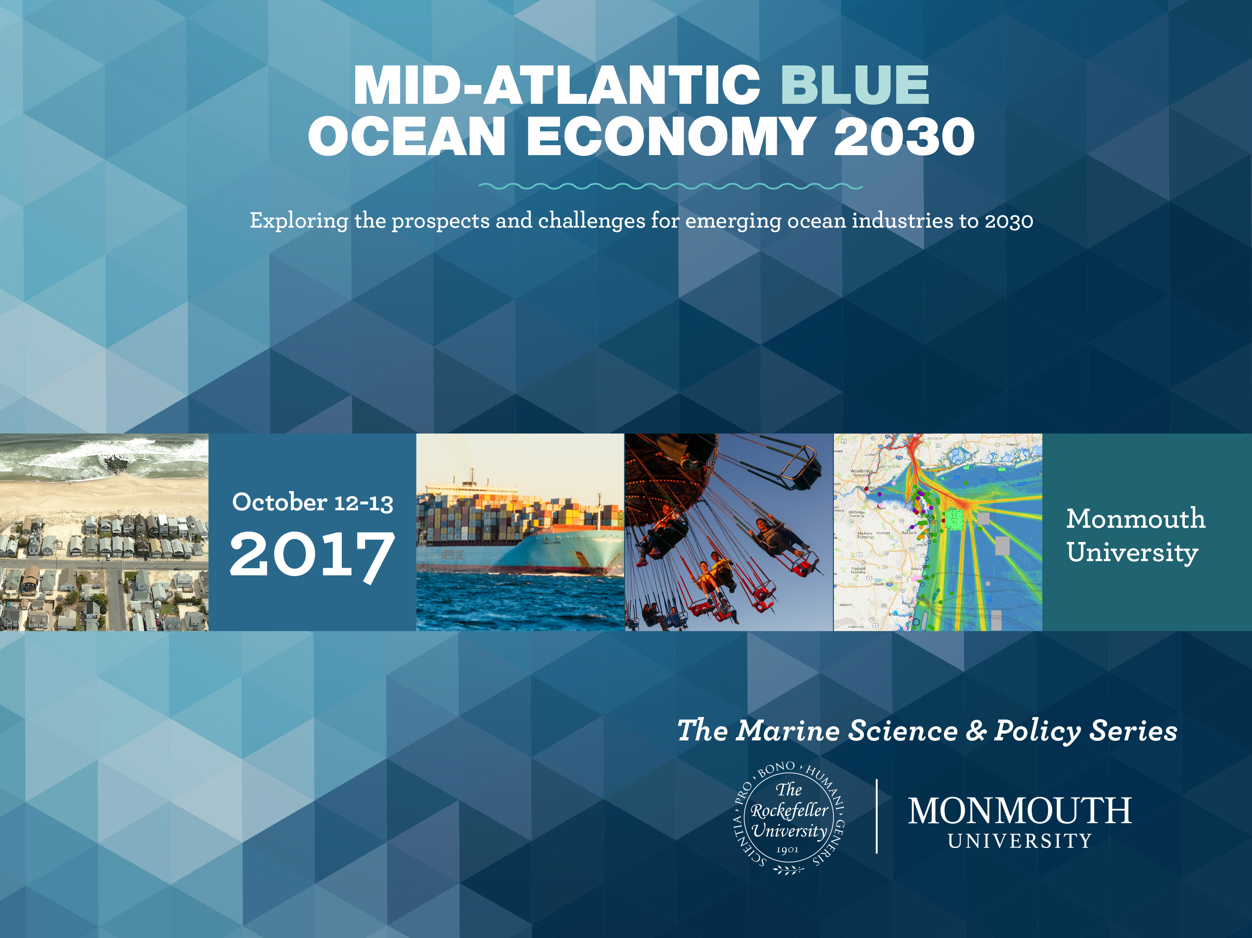

Slide 2


Slide 3
Forecasted growth of tourism

Slide 4
Tourism will continue to outpace the overall economy

Slide 5
The BEA provides a further breakdown

Slide 6
What's driving this growth?
An aging population
Increased connectivity and ease of travel
Increasing demand for “luxury goods”
Continued rise of international tourism

Slide 7
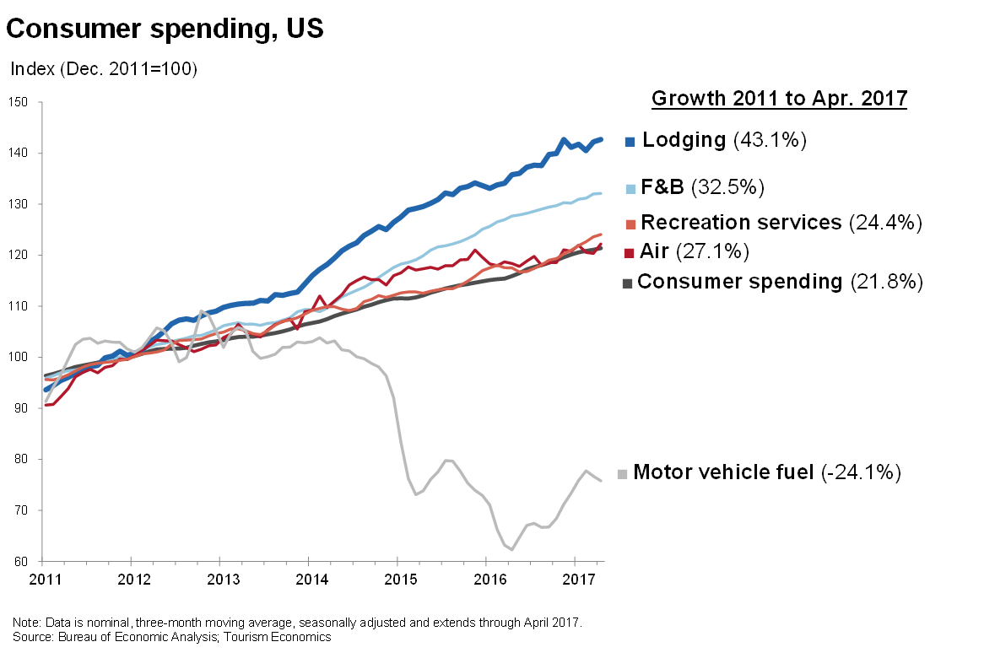
What's driving this growth – luxury goods

Slide 8
What's driving this growth – international tourism

Slide 9
How will the tourism industry actually change
More customized and authentic experiences
More reliant on the “gig” economy
More senior
More international
More competition

Slide 10
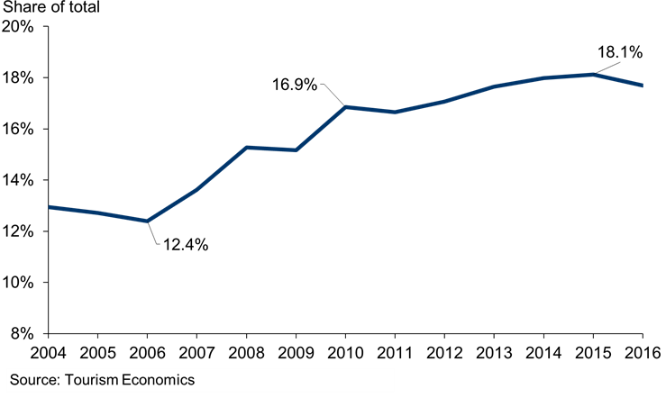
Changes – more international
International share of tourism spending

Slide 11
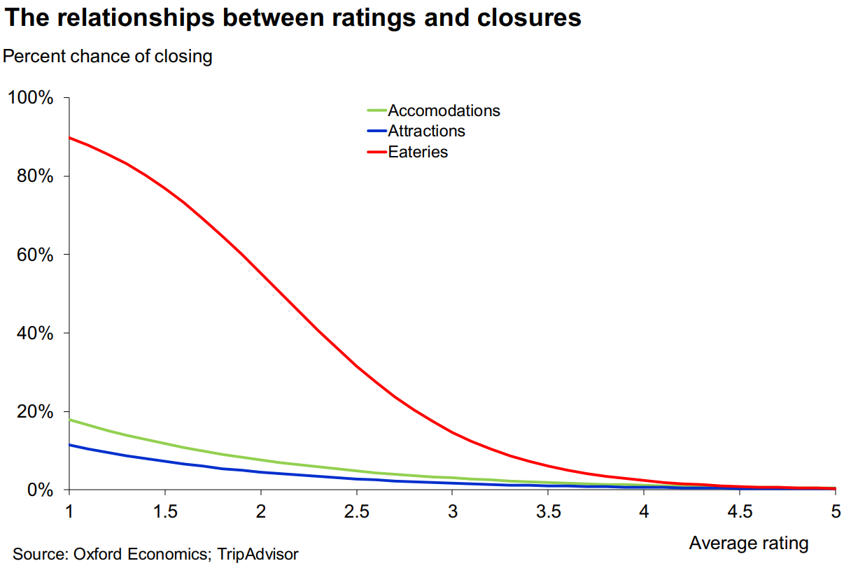
Changes - more competition
The relationship between ratings and closures

Slide 12
Possible downsides
Competition for coastal real estate
Political climate and visa restrictions
Drop in funding for tourism promotion
A hurricane or superstorm

Slide 13
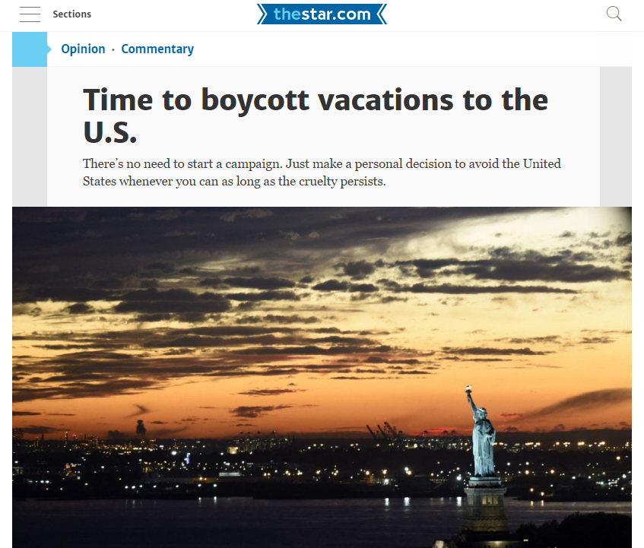
Downsides - political climate

Slide 14
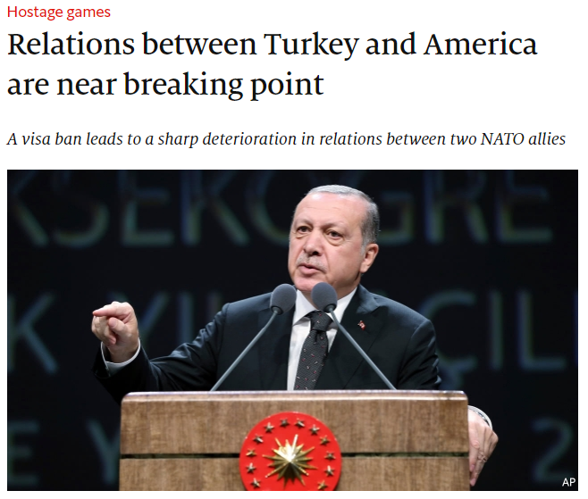
Downsides – visa restrictions
Economist.com

Slide 15
Downsides – DMO funding
Tourism promotion spending growth, ‘06-‘16

Slide 16
Downsides – hurricanes and severe storms
Key tourism metrics in New Jersey

