Slide 1
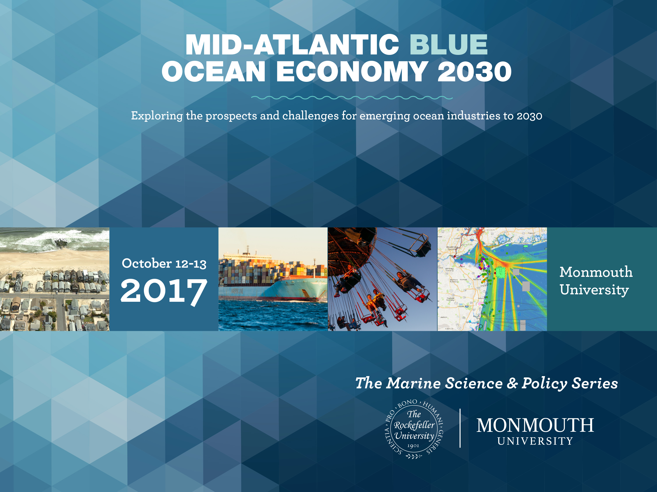

Slide 3
Economics of Mid-Atlantic Fisheries - in the year 2030
by Dennis King University of Maryland Center for Environmental Science

Slide 4
Overview
Expect increasing volatility until 2030, driven mostly by climate-driven changes in ocean conditions affecting:
Fishery Resources
Fishery Management
Fishery Science
But also because of changes in
Institutions: Councils and state fishery agencies
Approaches: Shift From species-based to ecosystem-based Technology: ocean data, side scanning sonar, refrigeration,
electronic monitoring, better enforcement
Economics: consolidation, aquaculture, gentrification, labelling, buying local, boat to table, etc.

Slide 5
Ten Reasons to expect volatility from now until 2030 (1 to 5)
Climate-driven changes in ocean conditions
Regulators responding to changing ocean conditions
Less reliable results from fishery models
Shift from species-based to ecosystem-based management
Changes in the law giving federal fishery managers more flexibility and more mandates to consider socio-economics

Slide 6
Ten Reasons to expect volatility from now until 2030 (6 to 10)
Changes in state allocations of catch quotas
Technological change favoring consolidation
of fishing and seafood businesses
Increased monitoring of fishing and more enforcement using modern electronics
9. Likely restructuring of state and federal fishery institutions
10. More influence of environmental NGOs in fishery management

Slide 7
Overview of Key Mid-Atlantic Fisheries
Key Commercial Species
Key Recreational Species
American lobster
American surf clam
Blue crab
Eastern Oyster
Menhaden
Quahog clam
Sea scallop
Squid
Other
0.1%
3.1%
10.6%
0.9%
67.3%
0.8%
1.9%
1.2%
12.7%
Black seabass
Bluefish
Atlantic croaker
Spot
Scup
Weakfish drum
Winter flounder
Tautog
14.1%
9.4%
17.7%
5.0%
9.5%
1.2%
0.1%
4.7%
0.8%
0.6%
Summer flounder
Striped bass
14.1%
24.2%
Value of 2015 Landings ($000):
$512,081
Value of 2015 Trip Expenses ($000): $686,527
Source: NOAA, Fishery Economics of the U.S., 2015

Slide 8
Trends in Mid-Atlantic Commercial Fisheries (2002-2015)

Slide 9
Trends in Mid-Atlantic Recreational Fisheries (2002-2015)

Slide 10
Possible Causes of Declining Harvests in Mid-Atlantic Fisheries
Decline in abundance
Decline in availability
Decline in catchability
Decline in Fishing Effort
Retargeting of Fishing Effort
Increases in unreported catch
Increases in sampling error

Slide 11
Some trends worse than we see ?

Slide 12
Economic Impacts of Mid-Atlantic Fisheries
Commercial fisheries ($000)
Landed Revenues | New York | New Jersey | Delaware | Maryland | Virginia | Mid-Atlantic
Sales | $181,429 | $26,170 | $33,505 | $435,685 | $946,687 | $1,623,476
Income | $63,039 | $8,697 | $7,096 | $160,640 | $362,035 | $601,507
Value Added | $88,176 | $12,488 | $11,380 | $218,656 | $489,812 | $820,512
Jobs (#) | 3,514 | 292 | 263 | 7,465 | 15,439 | 26,973
Recreational fisheries ($000)
Economic Impacts | New York | New Jersey | Delaware | Maryland | Virginia | Mid-Atlantic
Sales | $873,940 | $1,838,756 | $100,498 | $723,669 | $520,947 | $4,057,810
Income | $376,697 | $785,623 | $40,261 | $300,832 | $212,751 | $1,716,164
Value Added | $586,816 | $1,225,361 | $65,387 | $470,291 | $336,869 | $2,684,724
Jobs (#) | 7,844 | 16,096 | 968 | 6,999 | 5,263 | 37,170

Slide 13
Ten Milestones to watch for
Incorporation of changing ocean conditions into fishery models/science
Shift from species-based to ecosystem-based fishery management
Fishing restrictions based on indicators of risk, not conventional fishery science
Adjustments in state fishery management to account for shifts in fisheries among Mid-Atlantic states…and into and out of the region
Modifications in the structure of federal and state fishery management institutions in the Mid-Atlantic region to reflect new fishery/ocean realities
Increasing joint government/fishing industry fish stock assessments
Increased availability and use of real time ocean conditions by fishermen.
Strategies adopted to prevent legal and political challenges based on scientific uncertainty from derailing necessary fishing restrictions
More balanced responses to already financially stressed commercial fishermen, growing numbers of recreational anglers, and increasingly influential environmental NGOs.
Consolidation of commercial fishing as a result of increased steaming and searching time, gentrification of ports, need to use modern technology, shifts in location of buyers, etc.

Slide 14
Conclusions
Expect increasing volatility in Mid-Atlantic fisheries driven mostly by impacts of changing ocean conditions on:
Abundance, Distribution, and Catchability of Fish
Reliability of Fishery Science and Fishery Models
Scientific justifications for Fishery Management Decisions
But also because of changes in fishery management
Institutions: both federal and state
Approaches: Shift from species-based to ecosystem-based
And, changes in:
Technology: More industry consolidation, more monitoring
Economics: more aquaculture, gentrification, buying local, boat to table, etc.

Slide 15
One Very General Recommendation
When shifting to an ecosystem-based approach consider a simple three step approach to
Integrated Risk Management
Step 1: Control manageable risks (e.g., fishing mortality)
Step 2: Monitor leading indicators of unmanageable risks (e.g., natural mortality, recruitment failure)
Step 3: Establish and follow agreed upon rules for responding when leading indicators of unmanageable risks indicate they are becoming unacceptable.
Note:
Step 2 focuses on risk to, not measures of, stock abundance.
Step 3 will be difficult because the only possible response in
most cases will be tighter fishing restrictions or prohibitions.

