Slide 1
Global trade outlook
12 October, 2017
Dr. Walter Kemmsies
Managing Director, Economist and Chief Strategist
JLL Ports Airports and Global Infrastructure

Slide 2


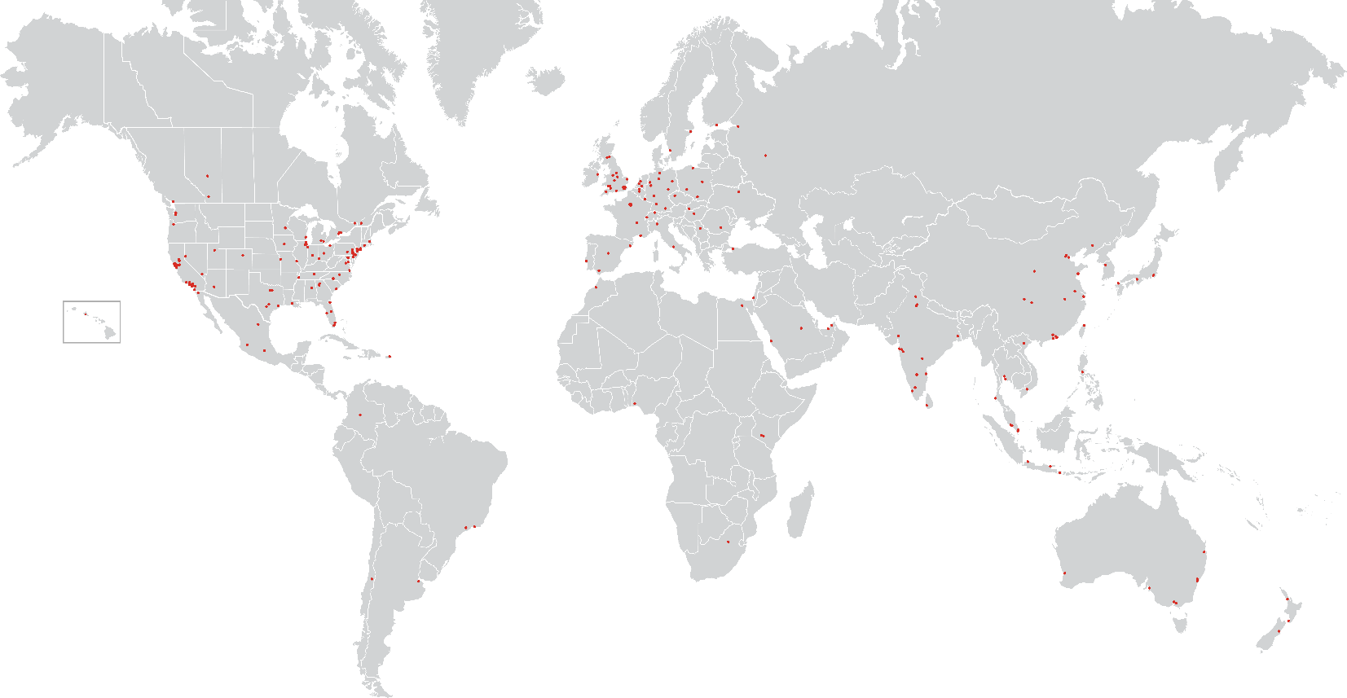



Global firm and capabilities overview
2015 fee revenue
$5.2B
S.F. under management
4B
Employees
70,000+
Corporate offices
300
LEED APs
1,600
Six Sigma Green or Black Belts
450
Only real estate firm listed
nine years running
Recognition for the fifth
consecutive year
Fortune World’s Most Admired Companies list - 2015
Americas
9 countries
137 offices
EMEA
30 countries
71 offices
Asia Pacific
16 countries
92 offices
JLL offices
2009-2016 Global outsourcing 100 list
Supporting the Global Real Estate Life Cycle
Diverse services and locations deliver investment grade ratings:
Moody’s: Baa2 (positive outlook)
S&P: BBB+ (stable outlook)
Committed to environmental sustainability for clients:
$47,000,000 year-end energy savings
278k metric tons reduced greenhouse gas emissions
890 Strategic Consultants: balancing long-term strategy with practical execution
4,560 Transaction Specialists: best portfolio results through local market expertise and action
640 Lease Administrators: portfolio transparency eliminates business risk
4,400 Project Managers: fast, flexible and on-time delivery
25,120 Facility Management staff: safe, reliable, expert and productive work environments
disclaimer
The views and opinions expressed by the speaker may not coincide with those held by Jones Lang Lasalle or its employees. Although information has been obtained from sources deemed reliable, Owner, Jones Lang LaSalle, and/or their representatives, brokers or agents make no guarantees as to the accuracy of the information contained herein, and offer the presentation without express or implied warranties of any kind. ©2016. Jones Lang LaSalle. All rights reserved.
Notes:
The thoughts and data shown in this paper reflect a privileged global view of the world economy.
Please note the disclaimer. Opinions expressed by the author do not necessarily represent views of his employer’s management or colleagues.

Slide 3
Preview
World trade is expected to continue to increase
  The global middle class is approximately 2.5 billion people today
  Free trade agreements are expected to be expanded rather than rescinded
Exports of goods where the US has comparative and even competitive advantages could increase
  These goods are agricultural, high end capital goods/machinery and energy/petrochemical in nature
  Free trade agreements need to be adjusted to accommodate this trade
Significant investment in infrastructure is needed
  Growth in trade combined with insufficient and unbalanced investment in freight movement infrastructure has dramatically increased congestion
  Without infrastructure investment growth will stagnate and emissions will increase

Slide 4
Largest populations and economies: 1980 - 2021
MILLIONS OF PEOPLE
US$ TRILLIONS
Notes:
The demographic and economic composition of the world economy has changed significantly in the last four decades. In 1980 there was one European country ranked among the 10 most populous, today and going forward there are no European countries in the top 10. Africa is now represented in the top 10 with Nigeria ranked 7th largest and poised to become the 6th largest within 5 years.
In terms of GDP, Mexico and Spain have fallen off the top 10 largest economies, replaced by India and Brazil. It is worth noting that in 1980 the US economy was nearly 10 times larger than the Chines economy but within a few years its GDP will be close to 90% of US GDP.

Slide 5
Distribution of population ages is widening
PEOPLE TURNING 65 IN THE US AND THEIR SHARE OF THE POPULATION PROPORTION OF POPULATION OVER 55 YEARS OF AGE
Fastest growing demographic segment
Typical maturing developed economies
Fastest aging
Highest growth potential economies
The world has never had such a large proportion of its population past middle age much less seen country populations decline due to natural causes.
Younger countries are gaining share of the world population and economy
Source: Census Bureau , Kemmsies
Notes:
Demographic trends underlie the change in the composition of the world economy. Developed economies have seen declining fertility and mortality rates. As their populations have aged so has population growth and therefore economic growth. Japan has the distinction of having been the only country to experience population decline not due to war or natural causes. The faster growing countries are those with younger populations, measured here by the proportion of the population over the age of 55, which is when many people begin retiring if they can afford it.

Slide 6
International labor cost comparisons – then and now
LOCAL MANUFACTURING WAGES CONVERTED INTO US$ AT PREVAILING EXCHANGE RATES IN 2001 AND 2015
Source: Government statistics agencies, Trading Economics. JLL
Notes:
Younger populations tend to earn lower wages, especially if they are employed in low skill jobs such as farming and mining. However, younger populations also spend most of their income on goods as opposed to services. The share of US household spending on goods was 80% of total expenditures, in the 1970s this share declined to 50% and today over 80% of household expenditures is on goods. Factories that manufacture goods for consumers, with or without trade agreements, are therefore prone to relocating to emerging market economies where consumer spending is likely to grow fast. This has indeed been the case. In the early stages of the relocation of consumer goods manufacturing, the relocated factories mostly produce for export. However, as wages rise more of the production is consumed locally. In China in the 2012 5 Year Plan there was a deliberate effort to engage in Fordism. A Fordist policy is named after Henry Ford who in 1914 paid his workers an unheard of $5 per day, which he defended by saying that if his workers could not buy the cars he was manufacturing, then who could?

Slide 7
Strong global trade growth supported by at least four factors
WORLD REAL GDP AND TRADE INDEXES 1950-2015E
China
Korea, Taiwan
Japan
Source: WTO, JLL
Notes:
This chart shows an index of the volume of world trade, by type of good traded and world GDP adjusted for inflation (real GDP). Manufactured goods trade rose 80-fold from 1950 to 2016. This was due to at least four factors: free trade agreements, investment in infrastructure (such as more and larger vessels as shown below), demographic trends and technological advances (computing and Internet) which allow a company to make global production and distribution decisions using real time data.
Trade in raw materials did not grow as much because they are not covered free trade agreements due to the fact that many countries are concerned about national security and prefer not to be dependent on foreign sources. Some countries, such as the US, flat out forbid the export of raw materials such as oil, which it deemed to be vital to national security.

Slide 8
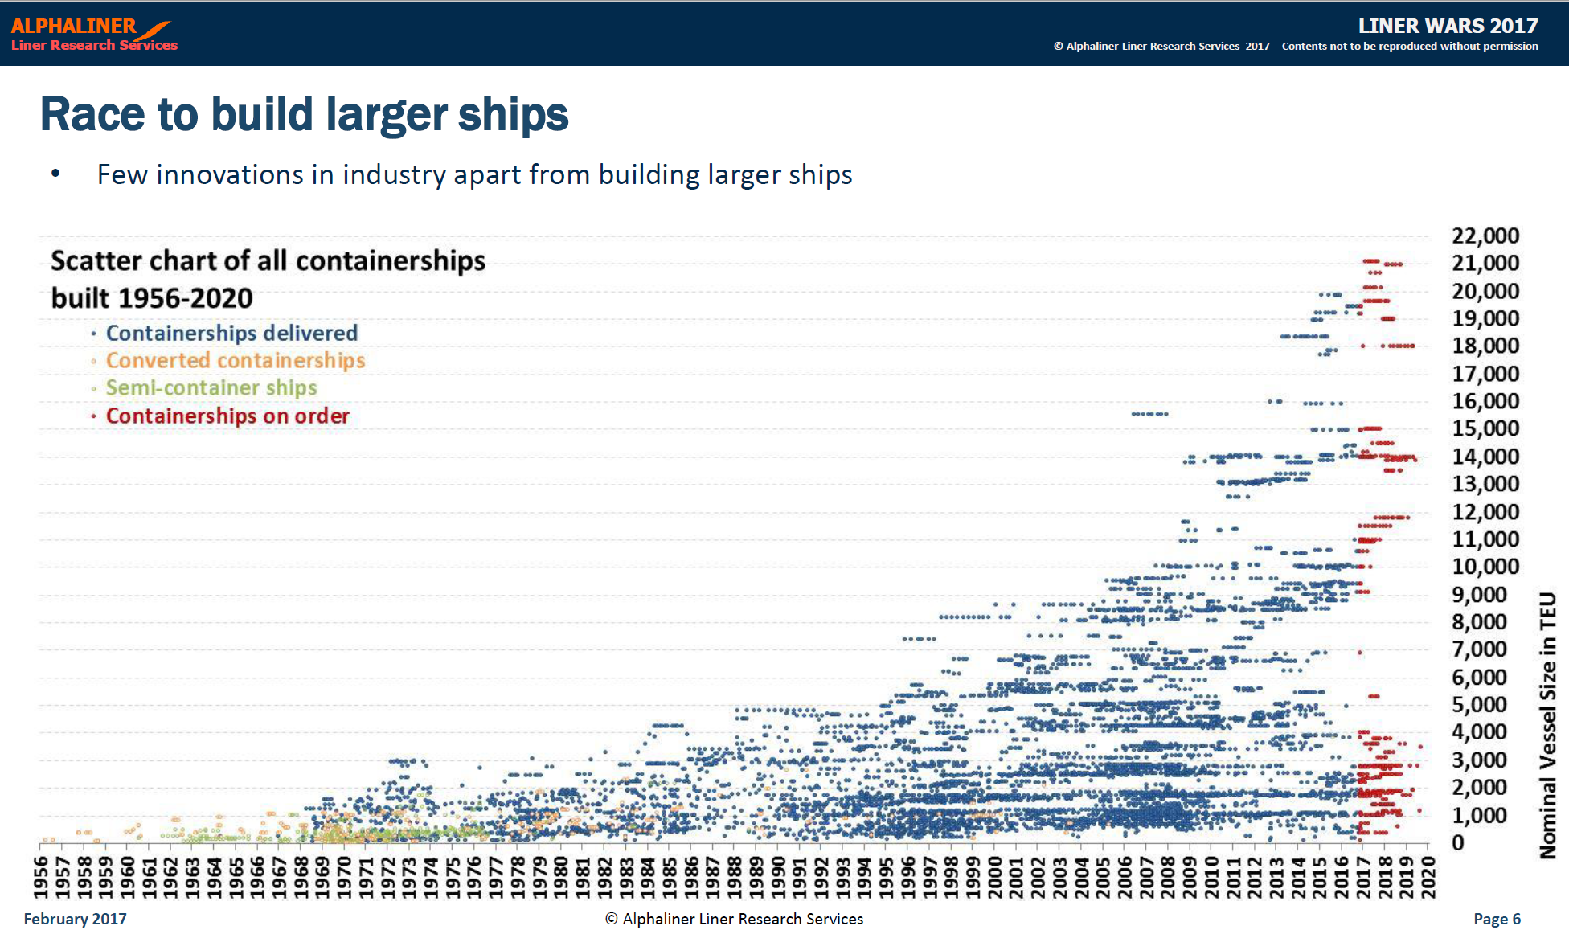
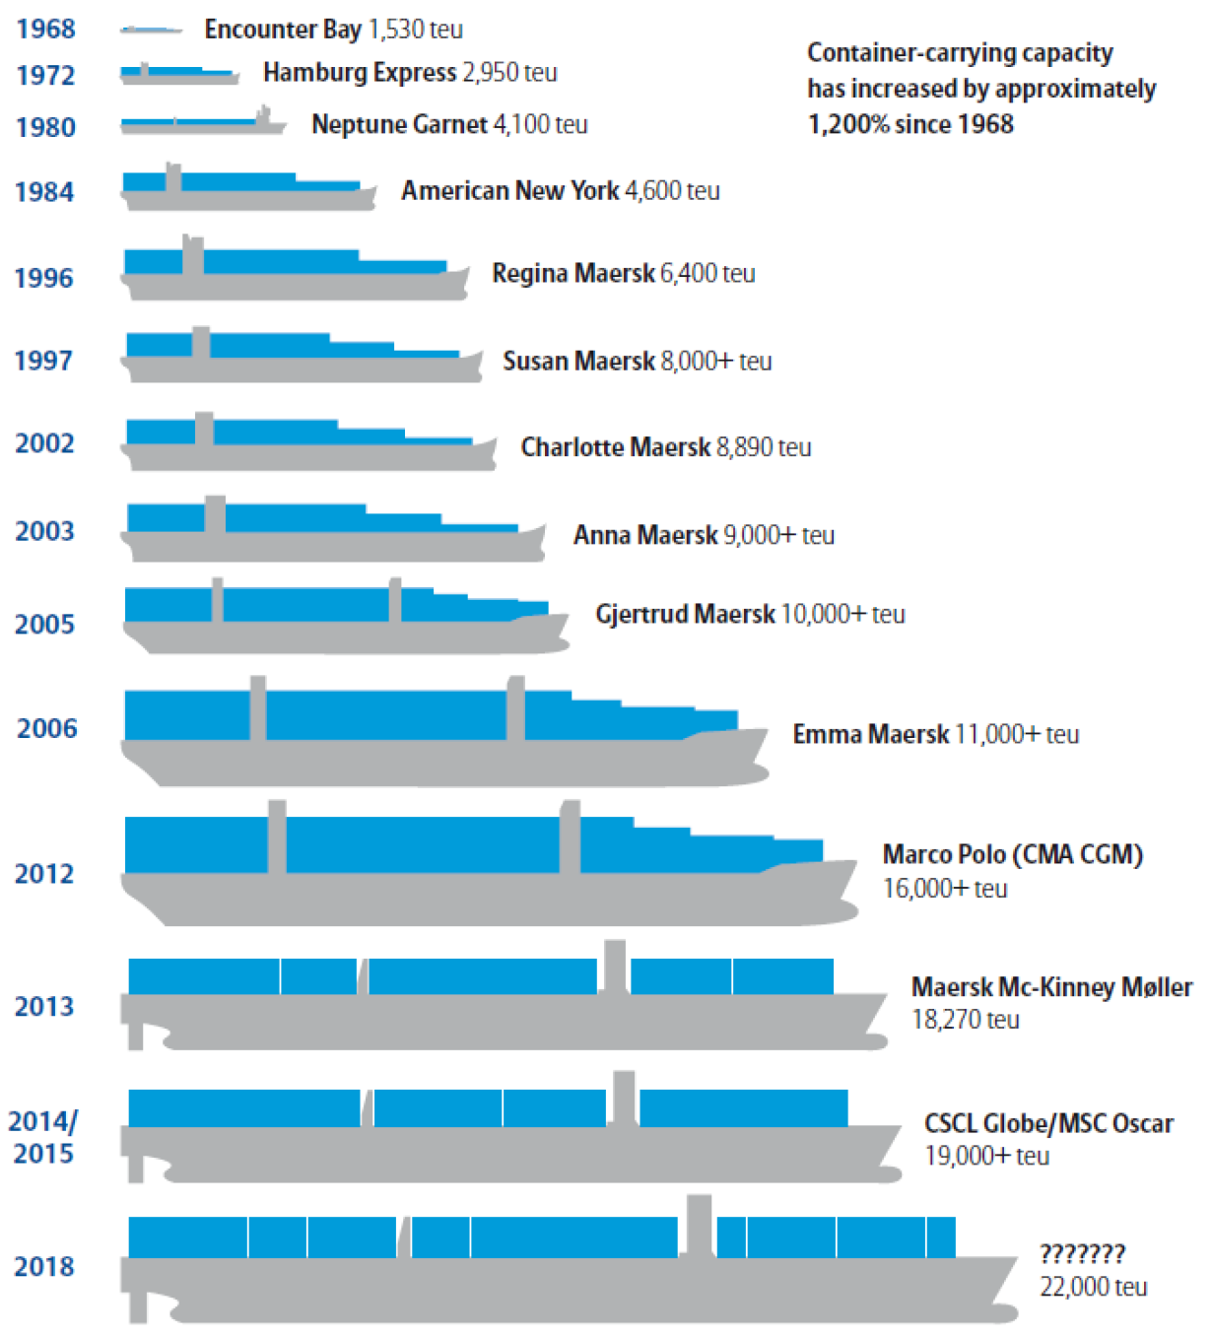
Ship sizes increased to accommodate global trade growth
EVOLUTION OF CONTAINERSHIP SIZE
Source: Alphaliner, World Shipping Council
Notes:
Across all types of vessels serving the global economy, there has been a dramatic increase in the fleet and the size of the vessels used to service global trade. The charts shown here illustrate development of vessels sizes as well as that of the global fleet.

Slide 9
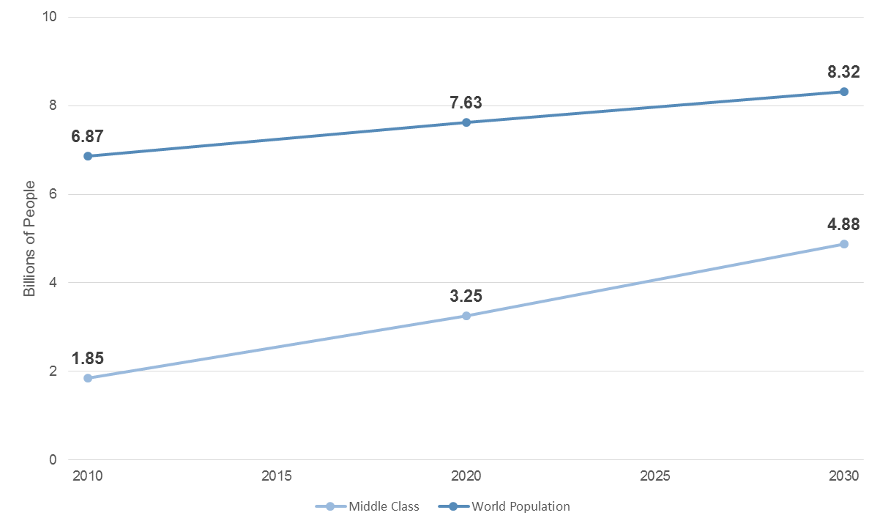
The largest global middle class ever
WORLD POPULATION AND OECD GLOBAL MIDDLE CLASS PROJECTIONS
Source: OECD, US Census Bureau
Notes:
As world trade grew, workers in emerging market economies were able to leave low paying jobs to become employed in higher value added, and therefore higher wage, activities such as manufacturing and services. The OECD estimates that the global middle class reached 1.85 billion and forecast that to grow to 3.25 billion by 2020. Linear interpolation of these estimates indicates the global middle class is about 2.5 billion today. The 2030 projections by the OECD are for the global middle class to reach nearly 5 billion, or almost double today’s level. It is not clear what assumptions were made about infrastructure investment needed to support the style of living of a global middle class of that size. Clearly this will require more energy production, access to better housing, food and medical care, and therefore increase the demand for trade.

Slide 10
Increasingly urbanized, increasingly congested
Percentage of urban population and agglomerations by size class: 1980 and 2011
1980
2011
Source: UN Department of Economic and Social Affairs
The world is urbanizing
Substitution of capital for labor in rural areas and higher income offered by manufacturing and services in urban areas drive migration to urban areas.
Better services supply in urban areas also attracts retirees.
In major port cities it is likely that congestion could worsen.
Notes:
The increase in the size of global middle class was accompanied by a dramatic increase in the urbanization of the world population as shown in the two maps published by UNESCO.

Slide 11
Transportation infrastructure spending lagged GDP growth
Public Spending on Transportation and Water Infrastructure Share of GDP from: 1956 to 2014
Notes:
Public spending on transportation and water infrastructure in the US accounted for 2.4 percent of GDP in 2014, down from 3.0 percent in 1959 (its largest share since construction of the Interstate Highway System began in 1956). Measured as a share of GDP, public spending over the past three decades has been fairly stable at 2.4 percent, although a combination of relatively slow growth in the economy and the higher federal outlays under the American Recovery and Reinvestment Act temporarily boosted spending to 2.7 percent from 2009 to 2010.

Slide 12
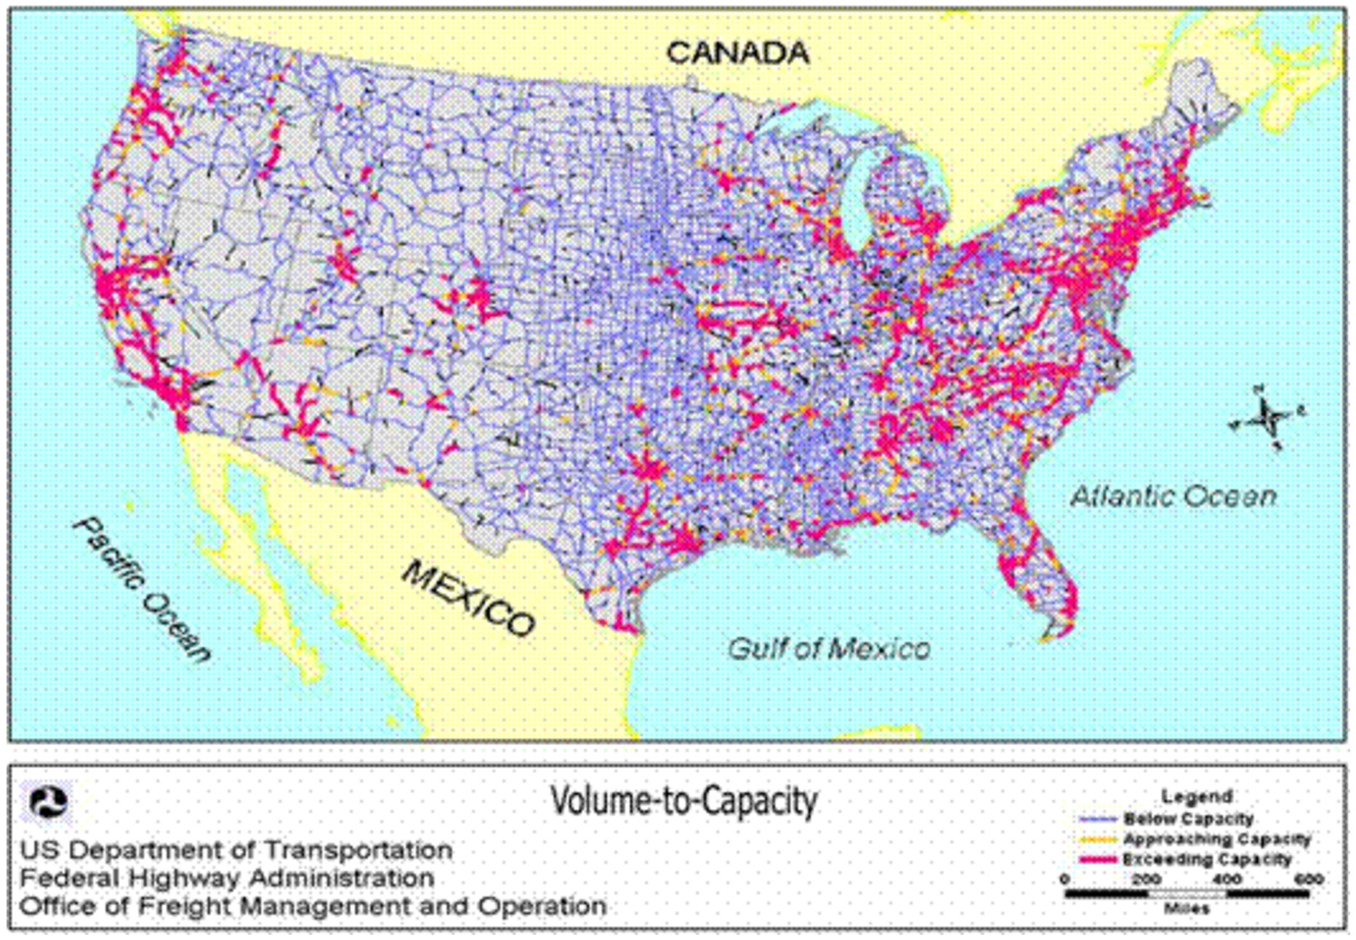
Roadway congestion is getting worse and ecommerce is growing
2020 Congestion Forecasts, With Trucks Ecommerce vs Total Retail Sales
Notes:
Between larger vessels being served at a high frequency at US ports and growing urbanization, combined with insufficient investment in roadways, freight movement has been shifting to railroads nationally and from stores to ecommerce locally. Much of the increase in ecommerce is likely due to congested traffic discouraging consumers from going to stores.

Slide 13
US trade deficit due to value gap
GOODS TRADE DEFICIT MEASURED IN US DOLLARS: 2003 – 2016E GOODS TRADE DEFICIT MEASURED IN METRIC TONS: 2003 – 2016E
Notes:
The US supported economic development in emerging market middle classes. In the process it increased its trade deficit measured both in terms of value as well as volume (tonnage). The trade deficit measured in terms of volume is smaller than that measured in dollars, which indicates that the US tends to import goods with a high value per ton and export those with a low value per ton.

Slide 14
What does the US export?
SHARES OF US EXPORTS BY VOLUME AND BY VALUE
Agriculture, Capital Goods and Energy
Notes:
A close examination of US exports shipped in containers or in bulk vessels shows that indeed US exports tend to be raw materials with a low value per ton. These goods can be categorized in three groups: agricultural; high end capital goods like tractors, bulldozers and airplanes that use GPS and big data capabilities to reduce the cost of building infrastructure and producing food; and energy products, which are increasingly refined in the US.

Slide 15
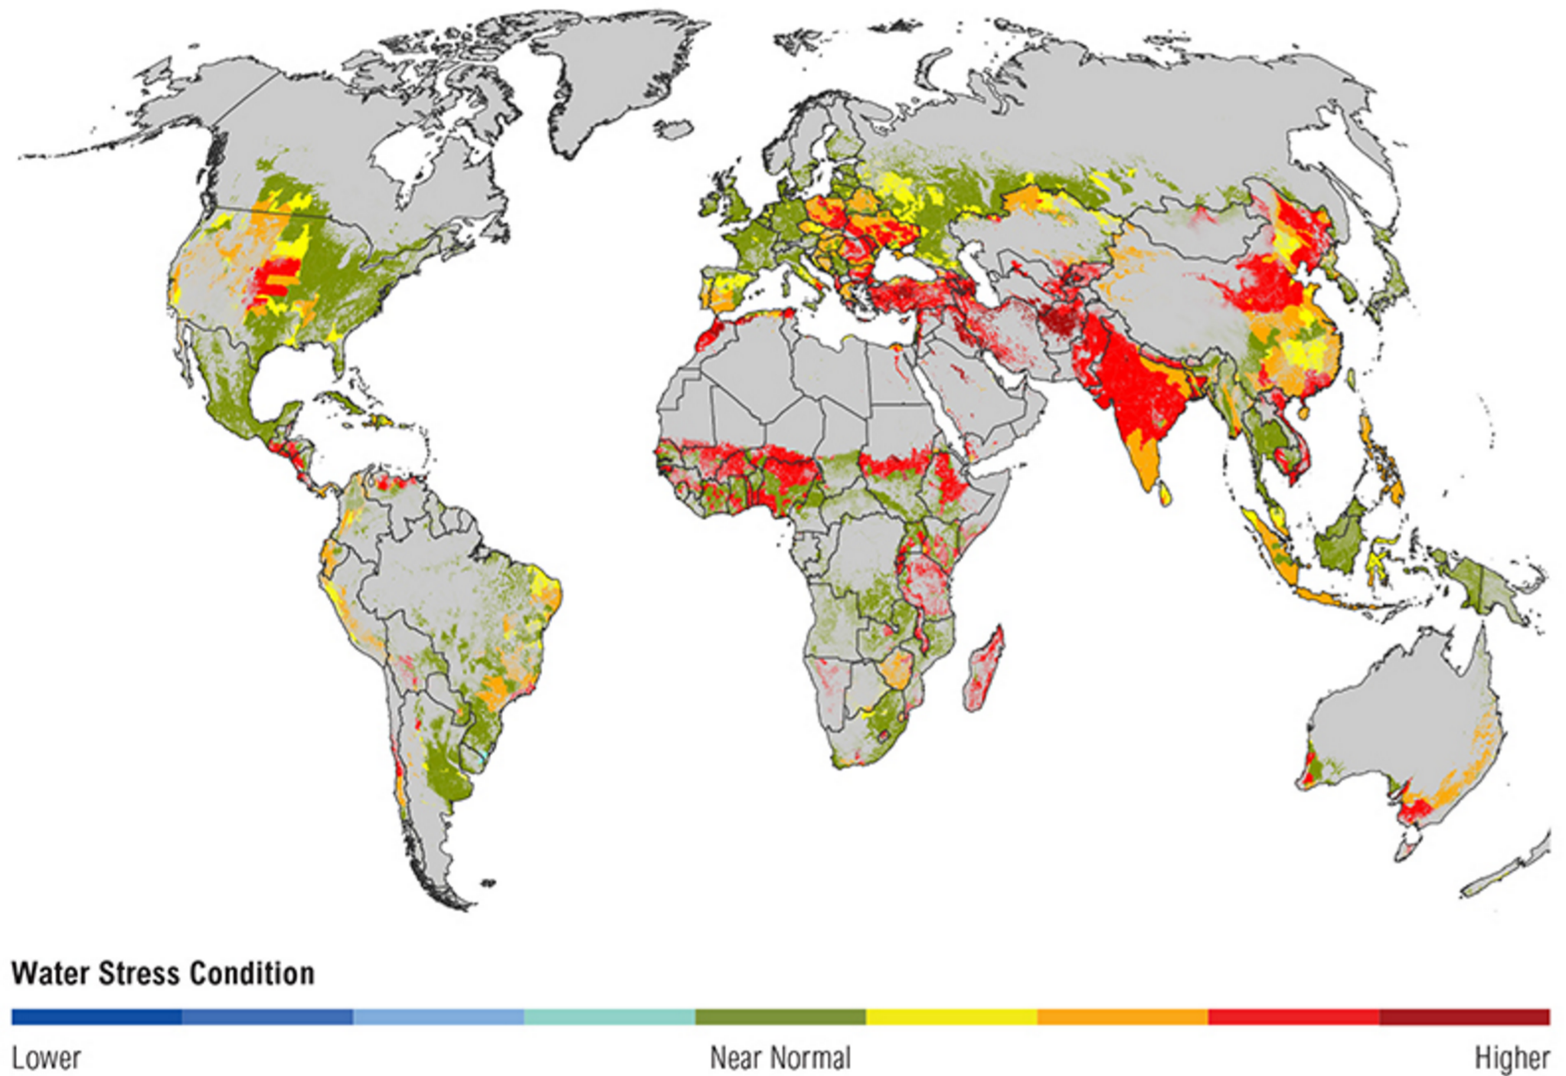
Water is the overlooked looming resource crisis
PROJECTED WATER STRESS IN 2025 PROJECTED BY WORLD RESOURCES INSTITUTE - AQUEDUCT
Water is becoming increasingly scarce in heavily populated and industrializing nations. Agricultural productivity is a significant challenge in these areas.
Source: http://www.wri.org//our-work/project/aqueduct
Notes:
It is not surprising that the US is among the largest exporters of agricultural goods and that Asia and the Middle East are the largest importers. Water is critical to agricultural production and it is increasingly short supply in food importing regions. It is also not surprising that China is very interested in Tibet since the Himalayan Plateau is the source of the three rivers that flow through most of Asia.

Slide 16
Increasingly automated manufacturing
ROBOTS ORDERED AND SHIPPED BY US MANUFACTURERS INDUSTRIAL PRODUCTION AND MANUFACTURING EMPLOYMENT
Manufactured goods production continued to increase even as US production was being offshored
Industrial production recovered from the 2007-2009 recession, however, goods producing employment hasn’t
Industrial robotics production and sales have tripled since 2009
Source: Robot Industry Association, JLL
Notes:
It is a myth that US manufacturing declined because of China. If anything US manufacturing activity has continued to increase. However, it has shifted away from consumer goods and towards industrial goods such as tractors and bulldozers that use GPS and big data technology to build roads and grow food more cheaply. There is little evidence of factories repatriating to the US (labeled as reshoring in the media), however, this could happen if raw materials costs remain low in the US and automation continues to increase. Growth in automation is indicated by the growth in robotics orders in the US since 2009 when the data was first collected.
It is a myth that US manufacturing emoployment declined because of China, it is far more likely that this was due to automation, the substitution of capital for labor.

Slide 17
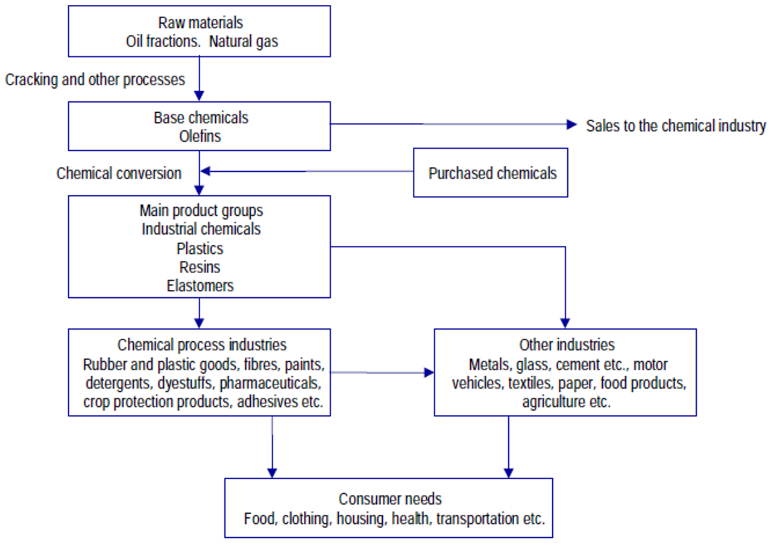
US natural gas and oil production at an all time high
US OIL AND NATURAL GAS PRODUCTION: 1965 - 2015
Petrochemical Supply Chain
Source: British Petroleum, JLL
Notes:
Thanks to hydraulic fracturing technology improvements, US production of oil and natural gas are historically high levels. Oil and natural gas exports are also growing. However, it is worth noting that a significant amount of the natural gas and oil are used to produce a range of petrochemicals as shown in the value chain shown on the right. US exports of petrochemicals such as resins, nylons and plastics. The US has recently overtaken Asia as the largest exporter to South America.

Slide 18
Summary
World trade is expected to continue to increase
  The global middle class is approximately 2.5 billion people today
  Free trade agreements are expected to be expanded rather than rescinded
Exports of goods where the US has comparative and even competitive advantages could increase
  These goods are agricultural, high end capital goods/machinery and energy/petrochemical in nature
  Free trade agreements need to be adjusted to accommodate this trade
Significant investment in infrastructure is needed
  Growth in trade combined with insufficient and unbalanced investment in freight movement infrastructure has dramatically increased congestion
  Without infrastructure investment growth will stagnate and emissions will increase
Notes:
It is likely that the US will renegotiate free trade agreements such as NAFTA and its position in the WTO. Whether or not a national infrastructure policy will also be developed remains to be seen. However, the private sector and agencies in many states, such as port authorities, are investing infrastructure, followed by significant infrastructure investment by US railroads – to the tune of about $25 billion per year.
These trends as well as those shown in this paper indicate that world trade is likely to continue to increase. The need to change the way oceans are used to support the global economy will become more important than ever before.

