Slide 1
Ecosystem Services & Natural Resources
Porter Hoagland, Hauke Kite-Powell, Di Jin, and Charles Colgan
Mid-Atlantic BLUE Ocean Economy 2030 Forum
12 October 2017

Slide 2
Outline
DPSIR
MAR Drivers and Pressures
ES typology
MAR salt marsh example
MAR ES “Endpoints”
MAR States and Impacts: 3 ES examples (provisioning, regulating, and cultural services)
MAR Responses
Notes:
DPSIR: Drivers-Pressures-Stressors-Impacts-Responses
MAR: Mid-Atlantic Region
ES: Ecosystem Services

Slide 3
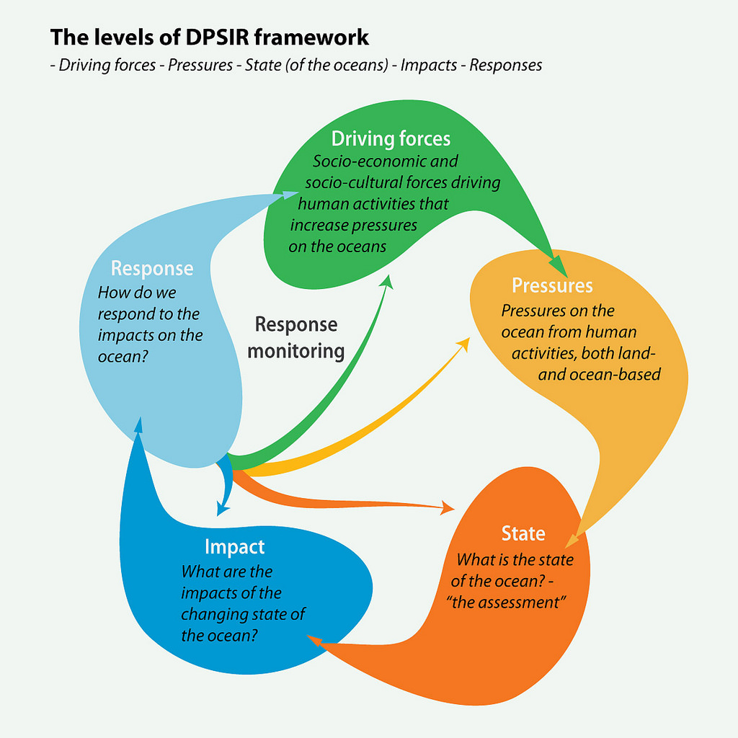
GRID Arendal (2016) “World Ocean Assessment Overview”
Notes:
No special insights here; it’s just a useful conceptual frame

Slide 4
Mid-Atlantic Drivers and Pressures
CO₂ emissions
sea levels ↑
coastal water temperatures ↑
storm severities ↑
pH, carbonate levels ↓, ↓
N releases (runoff, atmospheric deposition)
coastal primary production ↑
frequency of hypoxia ↑
seagrass habitats ↓
Human population (re)distribution
coastal residential development ↑
habitat encroachment ↑
flooding and erosion (extreme tides, surges) ↑
Living shorelines (wetlands) ↓
Notes:
High-grading a fuller list, which could be quite extensive

Slide 5
Notes:
Typology derived from the Millennium Ecosystem Assessment (MEA 2005)

Slide 6
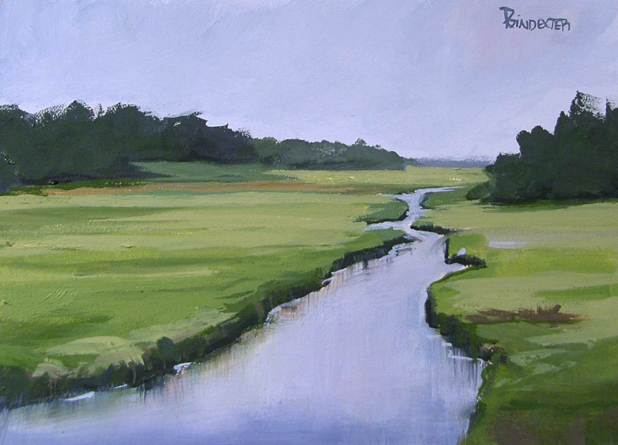
Salt Marsh:
WTP ~$80,000-159,000/ac/yr**
Provisioning:
Fish Harvesting
Hunting/Trapping
Surge/Flood/Erosion Protection
Carbon Sequestration
Nitrogen Assimilation
Primary Production
Nutrient Cycling
Soil Formation
Habitat
Regulating:
Supporting:
Recreational Fishing and Hunting
Walking/Hiking
Swimming
Photography
Cycling
Birdwatching
Motorized Boating
Non-motorized Boating
Camping
Other Wildlife Viewing
Other
Painting
Dianna Poindexter “Lewes Trail Salt Marsh” (2013)
Cultural:
*Estimated WTP mainly pertaining to Cultural Ecosystem Services.
DNREC (2017) “Delaware Tidal Wetland Ecosystem Services Valuation”
Notes:
Cultural services and estimates of WTP (consumer surplus) are from DNREC (2017) survey of activities either in or within view of salt marshes in Delaware
Annual C-sequestration of a Delaware salt marsh (not shown) is on the order of only $100/ac/yr (Carr et al. in prep.)
Painting: http://diannapoindexter.com/delaware-salt-marshhttpdiannapoindexter-comwp-contentuploads201212study-of-marsh-rehoboth-a-0031-jpg/

Slide 7
Mid-Atlantic Ecosystem Service “Endpoints”
Shipping and navigation
Coastal tourism (beach visits, boating)
Recreational fishing
Commercial fishing
Carbon sequestration
Waste disposal
Pipelines and cables
Sand and gravel production (beach nourishment)
Marine wildlife viewing (bird- and whale-watching)
Aquaculture
Renewable (wind) energy
Underwater cultural resources
Ocean science
Notes:
We are working to develop order-of-magnitude estimates of these ES endpoints
Ideally these values could be used to help make decisions over conflicting uses of the coasts and oceans

Slide 8
Status and Impacts: Three Mid-Atlantic Examples
Provisioning ES: Commercial Fishing
Regulating ES: Natural Flood Control
Cultural ES: Recreational Fishing

Slide 9
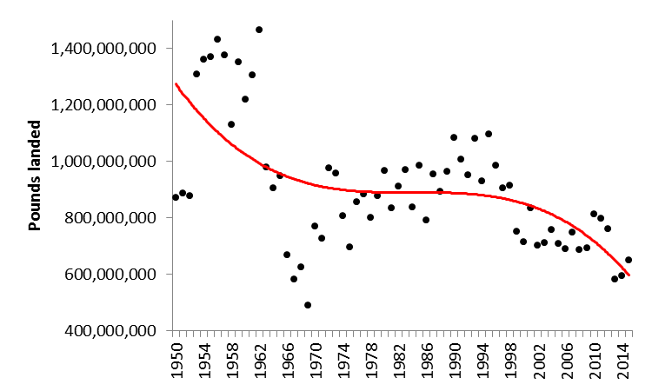
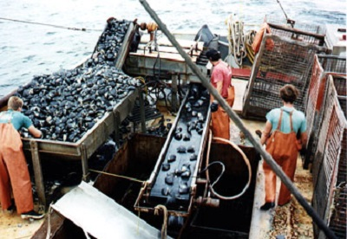
Commercial Fisheries
Historically expect ~ $0.5 ± $0.07 billion in revenues annually
Landings are downward trending
Rents ~ $0.2-0.3 billion annually
Implies an asset value of ~ $7-10 billion
Surfclams/ocean quahogs rationally managed with ITQs
Sea scallops, weakfish, black sea bass, squids, scup, filter feeders (menhaden) also important
MAFMC is implementing an ecosystem “approach” to fisheries management
Important nearshore fisheries: striped bass, summer flounder, blue crab, (lobster)
Temperature change is an imminent concern
SEAFOODNEWS.COM (December 16, 2016)
Notes:
Estimate of ex-vessel landings (lbs) of all Mid-Atlantic commercial fish, based upon NMFS historical landings data for NY, NJ, DE, MD, VA during 1950-2015 (should include landings from state-managed fisheries and shellfish, including clam and oyster lease production, as well)
Distribution of the value of landings in the mid-Atlantic commercial fisheries; mean is ~$520 million, showing ± 1 s.d. of $63 million
Assume that fixed and variable fishing costs comprise 50-62% of gross revenues (a crude “rule-of-thumb” for this region)
Thus, rents (net profits) might comprise ~$200-260m annually (= 0.38 to 0.50 times $520)
Capitalized at 3% to get an asset value

Slide 10
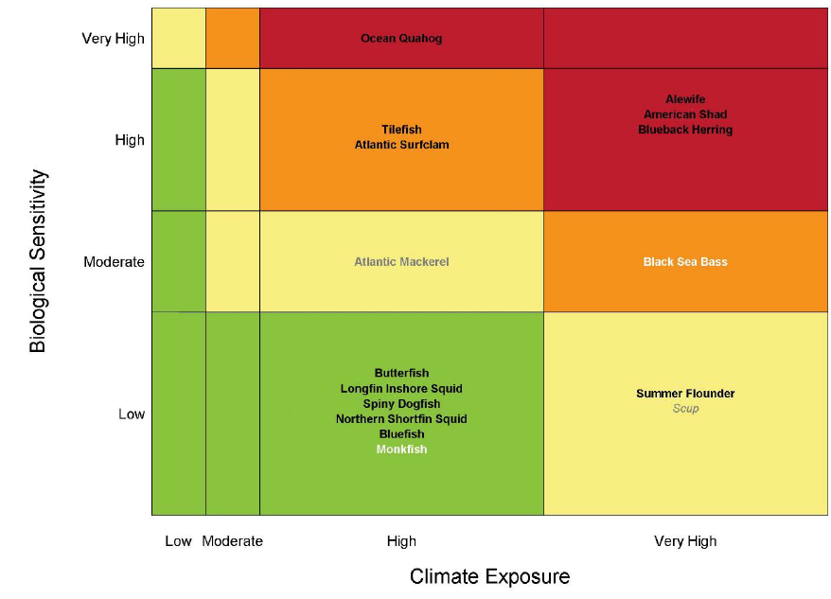
Northeast Fisheries Climate Vulnerability Assessment (NEVA)
Notes:
Risk assessment of exposure of fisheries to climate change: First implementation of NMFS’ national methodology for MAFMC managed species. Overall climate vulnerability is denoted by color: low (green), moderate (yellow), high (orange), and very high (red). Certainty in score is denoted by text font and text color: very high certainty (>95%, black, bold font), high certainty (90-95%, black, italic font), moderate certainty (66-90%, white or gray, bold font), low certainty (<66%, white or gray, italic font). Source: MAFMC (2016): Ecosystem Approach to Fisheries Management Guidance Document.

Slide 11
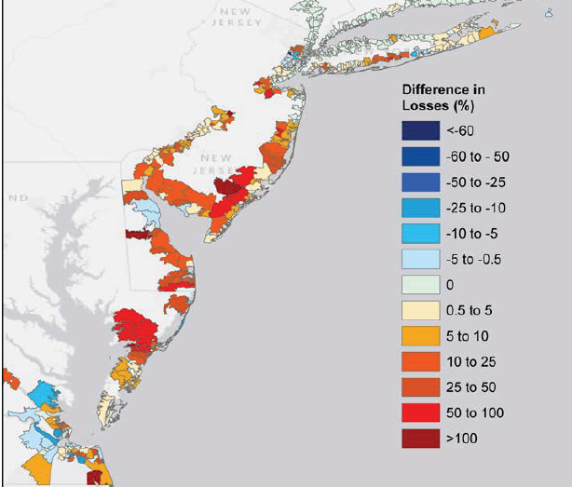
Coastal Wetland Flood Control
Narayan et al. (2016)
Reduced coastal property damages due to wetlands as “living shorelines” during Hurricane Sandy: ~0.6 billion
Average of 10% reduction in losses across the region
Average of 20% reduction in losses in Ocean County, NJ for flooding from 2,000 historical storms, dating back a century
Annual flood control values would depend upon return intervals for storms (e.g., risks of Sandy-type flood recurrence)
Return intervals for Sandy-type floods are significantly shortened by sea-level rise (Sweet et al. 2012)
State | Avoided Damages ($m)
NY | 138
NJ | 429
DE | 24
MD | 5
VA | 10
TOTAL | 606
Notes:
Narayan, S., Beck, M.W., Wilson, P., Thomas, C., Guerrero, A., Shepard, C., Reguero, B.G., Franco, G., Ingram, C.J., Trespalacios, D. 2016. Coastal Wetlands and Flood Damage Reduction: Using Risk Industry-based Models to Assess Natural Defenses in the Northeastern USA. Lloyd’s Tercentenary Research Foundation, London.
Sweet W, Zervas C, Gill S, Park J. 2013. Hurricane Sandy inundation probabilities today and tomorrow. Bulletin of the American Meteorological Society (September): S17-S21.

Slide 12
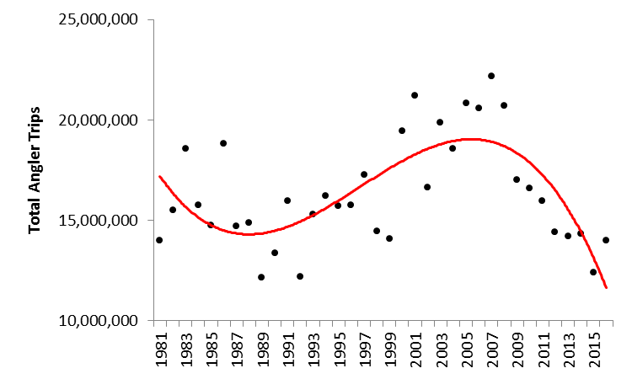
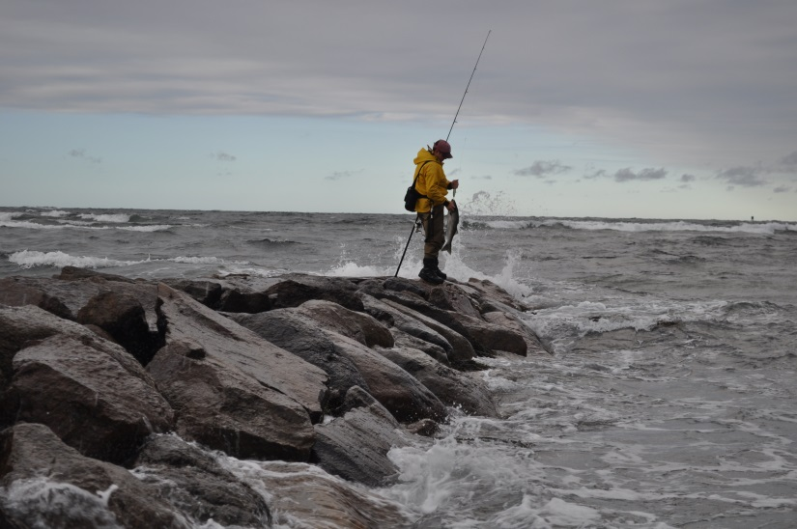
Recreational Fisheries
Historically expect ~ $1.2 ± 0.5 billion in WTP (consumer surplus) annually
Activity appears cyclical; currently in a trough
Annual WTP is ~ 3-4x commercial fishery rents
NJ, NY have most activity days
Charter/party business is important
Anglers target striped bass, bluefish, summer flounder, weakfish, tautog
High end includes bluefin tuna, billfish, sharks
Temperature change is an imminent concern
http://www.onthewater.com/
Notes:
Simulation of the value of activity days (participation) in the mid-Atlantic recreational fisheries, based upon historical angler trip data from 1981-2016
10,000 draws from combined normal distribution of participation (days) and with uniform distribution of the value of activity days ($/day in 2016 $; from Pendleton [2008])
Mean is $1.15 billion, showing ±1 s.d. of $0.54 billion

Slide 13
Some Sensible Mid-Atlantic Responses
Continue to refine assessments of risks from climate change, pollution, human developments
Must fix NFIP (e.g., add SLR to mapping)
Should further explore the benefits of “living shorelines”
Increase membership in Regional Greenhouse Gas Initiative (RGGI); carbon price
Expand macronutrient (N, P) credit exchanges and offsets
Rationalize more fisheries (e.g., surf clams)
Communicate above to policy-makers

