Slide 1
Mid-Atlantic Blue Ocean Economy 2030
Climate and Ecosystem Change
Jon Hare, NOAA Fisheries
October 2017

Slide 2
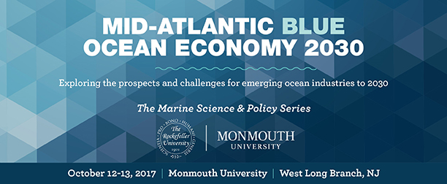
Marine Fisheries in the Mid-Atlantic Region
Mid-Atlantic Region
3.4 billion in value added to economy
60,000 jobs
2 million marine anglers

Slide 3
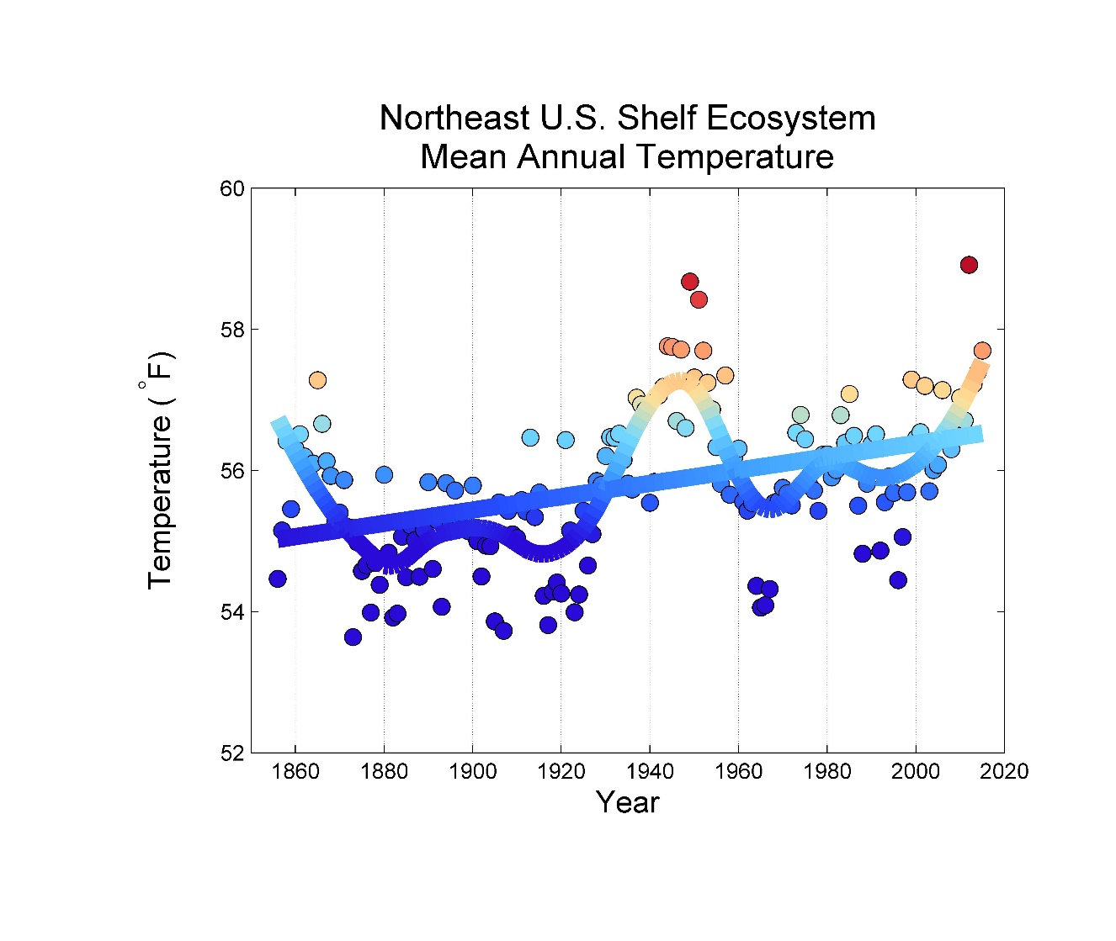
Northeast U.S. Climate Change and Variability
Climate change
Long-term difference in the earth, atmosphere, and ocean conditions
Climate variability
Natural variability within the climate system (for example year-to-year)

Slide 4
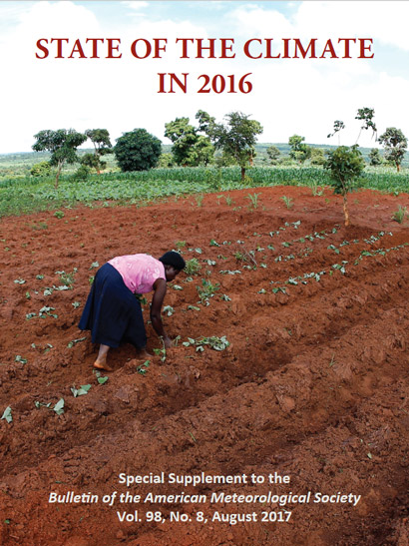
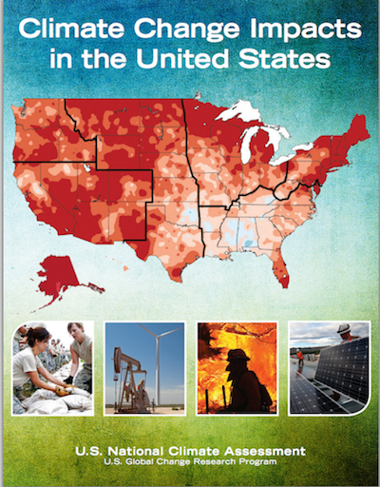
Northeast U.S. Climate Change and Variability
Temperatures increasing
Precipitation and streamflow changing
Large-scale circulation changing
pH decreasing (ocean acidification)
Wind patterns changing
Sea-level rising
And more ….
https://www.nefsc.noaa.gov/ecosys/current-conditions/frontal.html

Slide 5
Northeast U.S. Fisheries
Species productivity changing (not shown)
Species distribution changing (black line)
Fishing landings changing (gray line)
Fishing effort distribution changing (not shown)
American lobster
Summer flounder

Slide 6
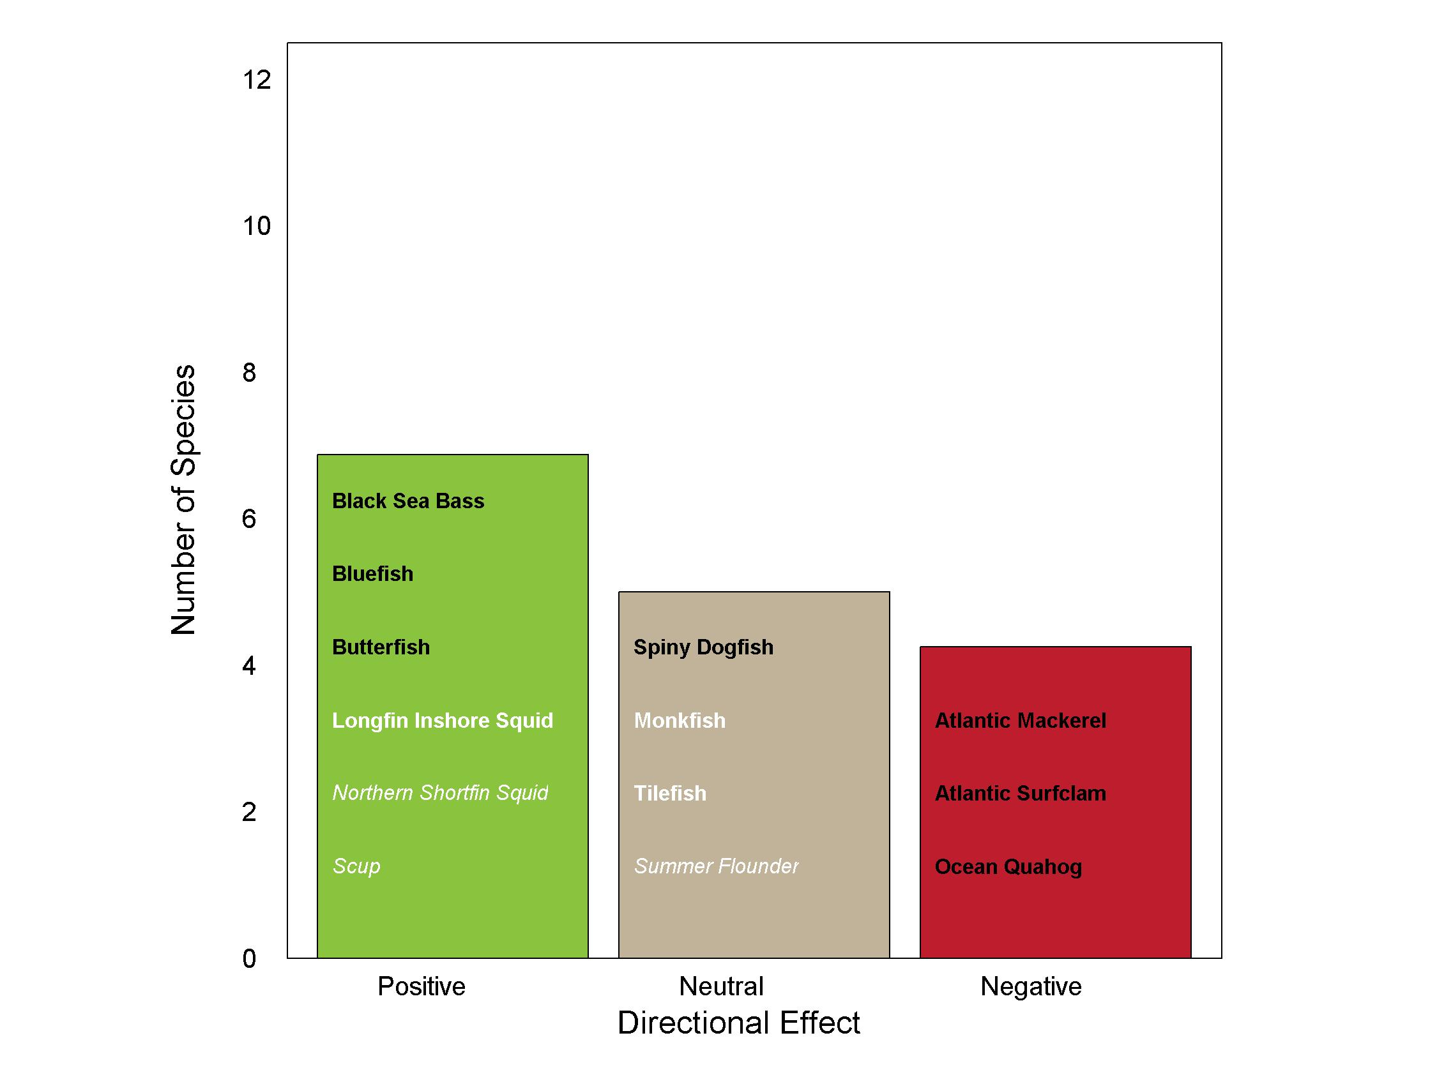
Directional Effect of Climate Change
Opportunities and challenges
How to take advantage of opportunities?
How to mitigate challenges?
http://journals.plos.org/plosone/article?id=10.1371/journal.pone.0146756

Slide 7
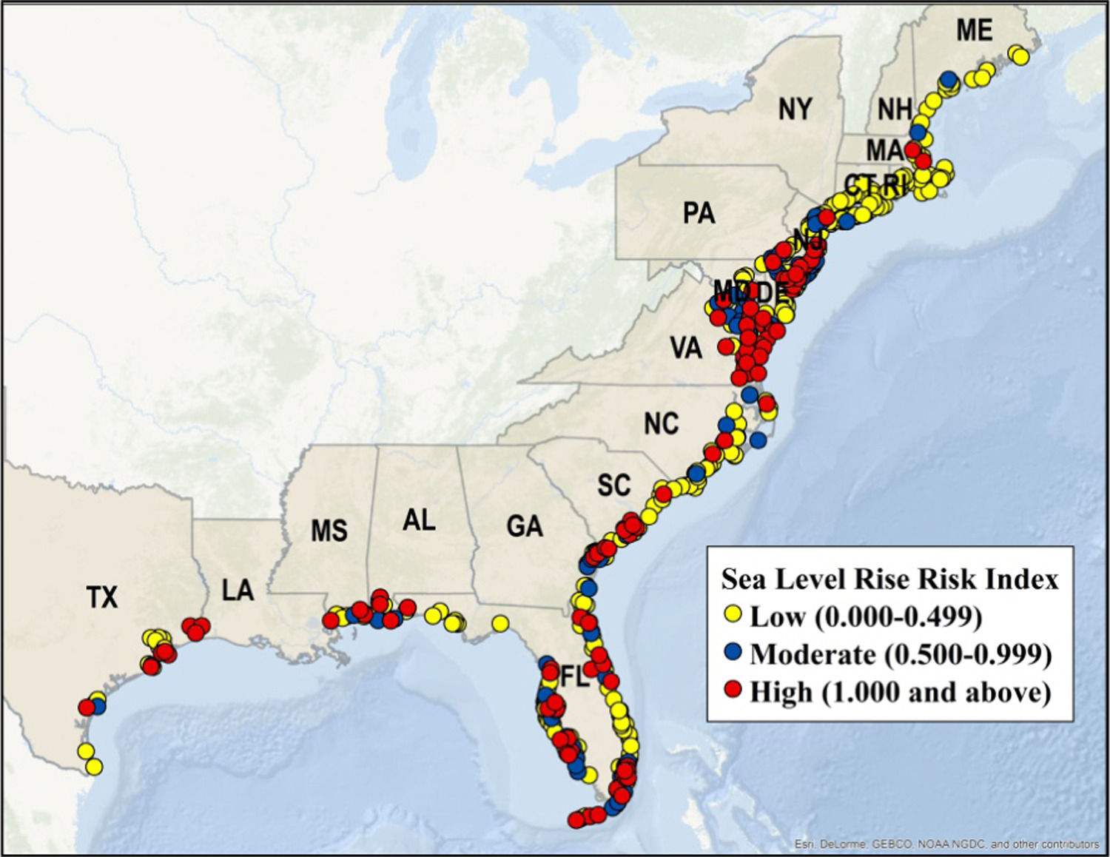
Community Risk to Climate Change
Seal-level Rise Vulnerability
http://www.sciencedirect.com/science/article/pii/S0308597X16302123#f0030

Slide 8
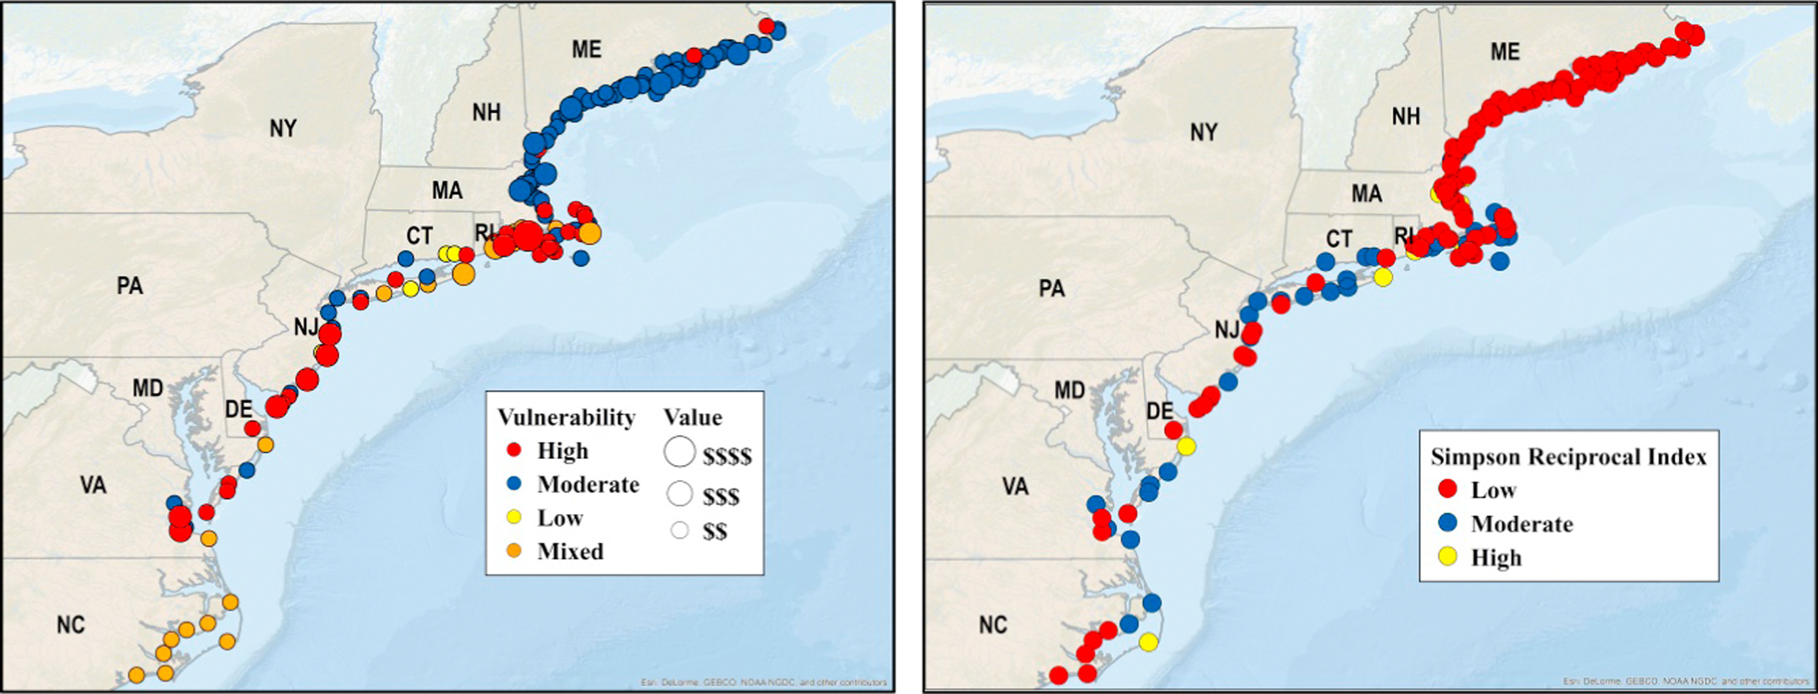
Community Risk to Climate Change
Value of Landings x Climate Vulnerability
Diversity
http://www.sciencedirect.com/science/article/pii/S0308597X16302123#f0030

Slide 9
Aquaculture
Potential for growth
State waters and federal waters

Slide 10
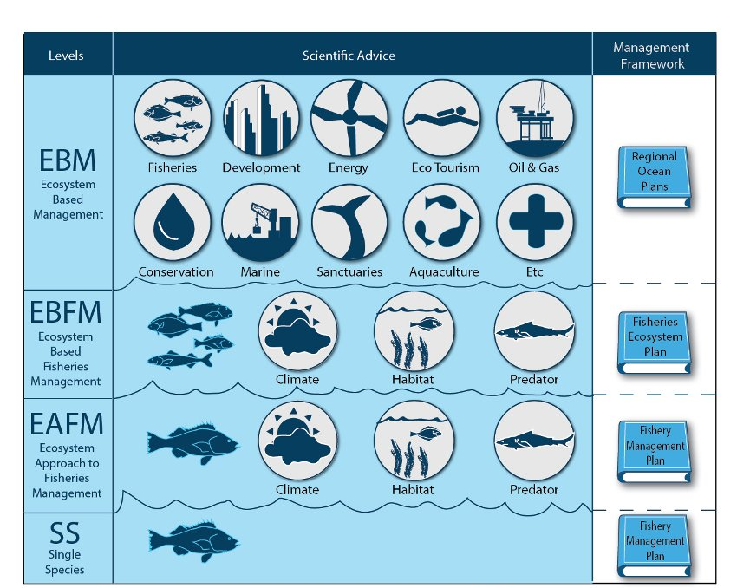
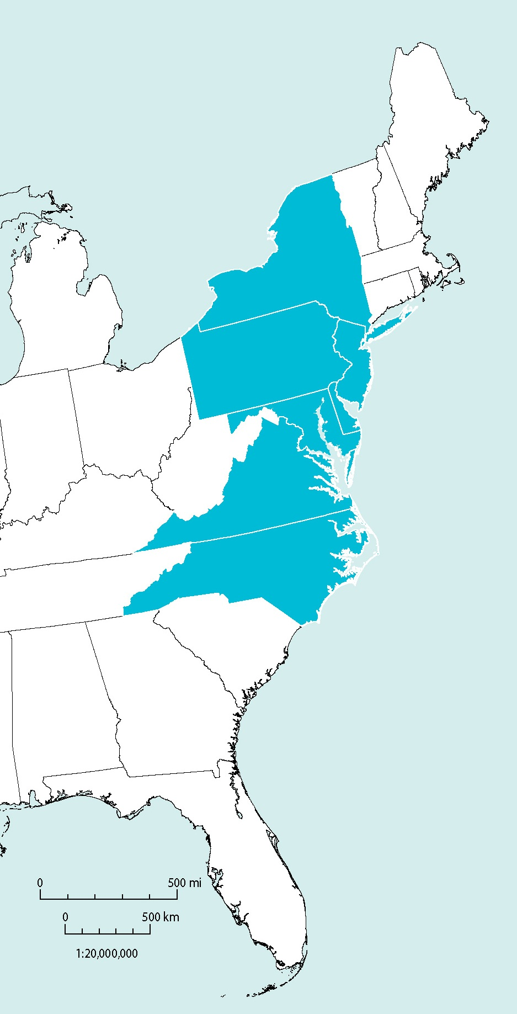
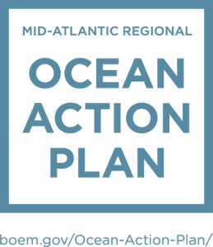
Next Steps
Ecosystem Based Management
Ecosystem Based Fisheries Management

