Slide 1
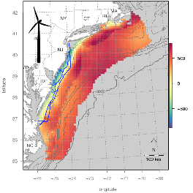
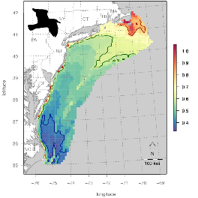
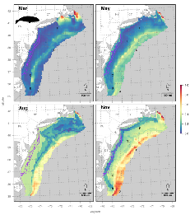


Marine life data analysis & ocean planning tools to support the Mid-Atlantic Blue Economy
Mid-Atlantic Blue Ocean Economy
Plenary: Mapping and Visualization to Improve Understanding and Build Public Support for the Mid-Atlantic Blue Ocean Economy
October 13, 2017
Pat Halpin
Jesse Cleary, Jason Roberts, Corrie Curtice & Ben, Best
Marine Geospatial Ecology Lab
Nicholas School of the Environment
Duke University

Slide 2
“Given the growing and seemingly limitless capacity to industrialize the oceans, there is a need to reimagine how to effectively measure, monitor and sustainably manage this seventy-one per cent of the Earth’s surface.”
Golden, J., J. Virdin, D. Nowacek, P.N. Halpin, L. Bennear, and P.G. Patil. (2017) A Watershed Moment for the Industrialization of Oceans: Making sure the Blue Economy is “Green”. Nature Ecology & Evolution 1:0017

Slide 3

Developing a sustainable Blue Economy will require detailed, objective and accessible information to inform planning and decision making
A core question: How can we provide information and tools to help balance when and where we develop ocean resources while maintaining marine species and habitats?

Slide 4
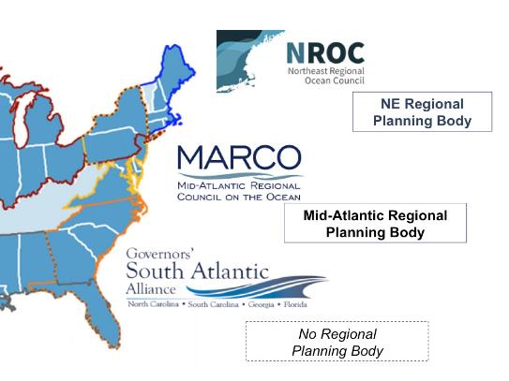



Ocean Planning to support a Blue Economy
MDAT
Marinelife Data & Analysis Team
We are working on preparing data for the region but there is no official planning process underway.

Slide 5
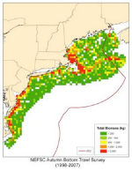
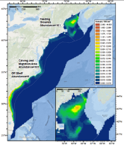
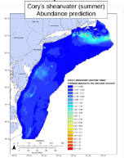
Marinelife Data – Species Data
>5,000 spatial data layers
Fish
  82 species
  Biomass
  1979-2014; 2005-2014
Mammals
  29 species / guilds
  Predicted density
  Monthly, Annual
Avian
  40 Species
  Predicted relative density and occurrence
  Seasonal, Annual

Slide 6
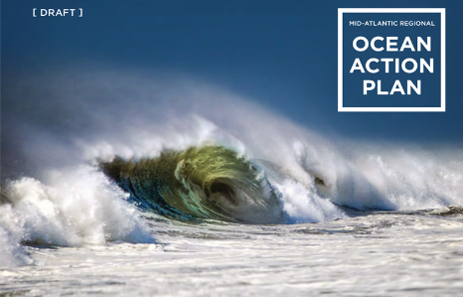
Ocean Planning involves two core activities:
1. Development of strategic ocean plans
2. Development of implementation tools & processes
Centralized
Dispersed
Both of these activities are essential and important

Slide 7
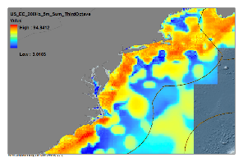
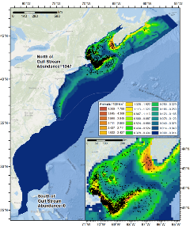
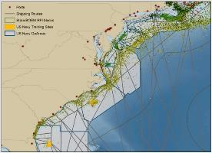
energy potential
chronic noise
Integrating species distributions and underwater sound into regional coastal and marine spatial planning (CMSP)
species densities
event noise
multisector CMSP
biologically
important areas

Slide 8
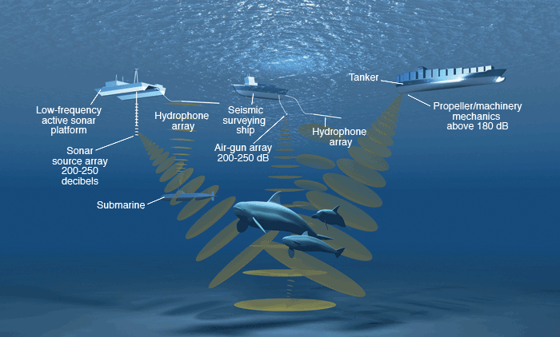
Forecasting how many marine mammals may be impacted by human activities
Our role is primarily to model where and how many cetaceans will be found at different times of the year…
http://www.marineinsight.com/marine/environment/effects-of-noise-pollution-from-ships-on-marine-life/

Slide 9
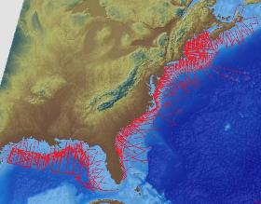
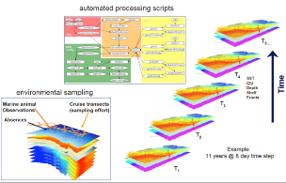
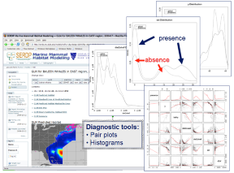
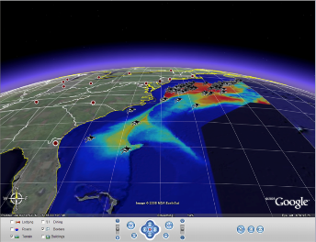
Marine mammal abundance modeling process
1: observation data aggregation
2: fusion with oceanographic data
Data
4: model product development
Information
3: statistical modeling

Slide 10
dynamic oceanographic predictor variables
currents, eddys & kinetic energy
The challenge is modeling species distributions at relevant time scales that capture seasonal migratory behaviors
sea surface temperature
chlorophyll a

Slide 11
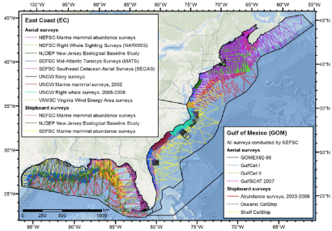
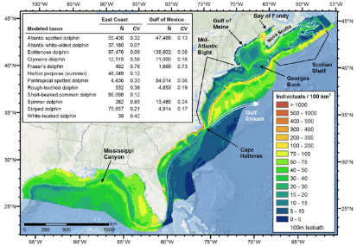
www.nature.com/scientificreports/

Slide 12
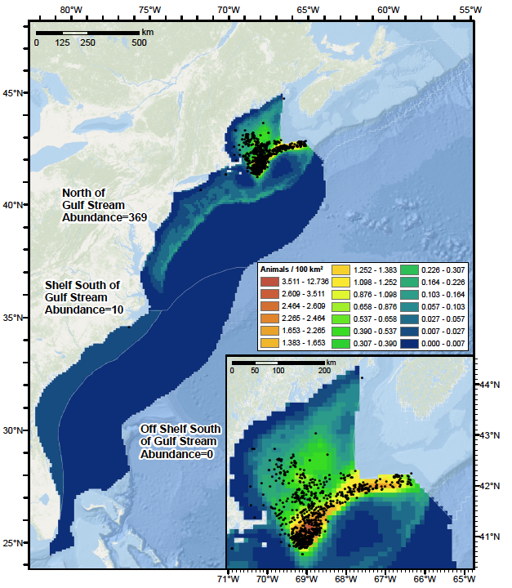
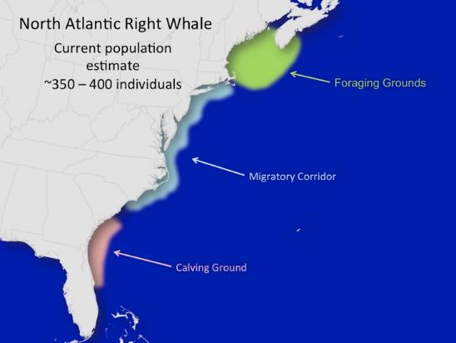
North Atlantic Right Whale
Summer Season

Slide 13
energy potential
chronic noise
We need to be able to assess potential interactions between marine life and environmental inputs…
species densities
event noise
multisector CMSP
biologically
important areas

Slide 14
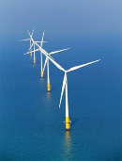
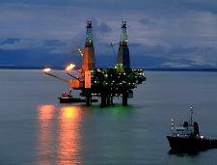

Offshore energy development
Chronic
Event
  The development of noise budgets for CMSP
      Ambient noise (state 0)
      Chronic noise (state 1)
      Event noise (state 2)
Natural sounds – fish, snapping shrimp…
Shipping, fishing vessels…
Seismic surveys, pile driving…
Notes:
Comprehensive marine spatial planning requires mapping chronic background noise levels arising from offshore human activities over scales relevant to long-term, regional-scale decision-making. For example, predicted average annual noise contributions from merchant shipping to low-frequency noise levels can be integrated with other human-induced marine environmental stressors to evaluate potential cumulative impacts associated with proposed use scenarios (e.g., siting new offshore energy installations, creating new marine protected areas, shifting commercial vessel traffic patterns). Predicted average annual noise contributions from merchant shipping to low-frequency noise levels also provide a background for understanding the acoustic influence of localized proposed activities, such as off the coast of the Northeastern U.S. Frequency: 50 Hz; Duration: average annual Leq; Depth: 5 m; Grid size: 1oNx1oW (Figure 1A), ~10km x 10km (Figure 1B); Source Data: U.S. Voluntary Observing Ship (VOS) reporting data 2004-5. Based on source level of “Merchant Vessel” ship-type at 6 m depth (Renner, W. W. (1986). Ambient Noise Directionality Estimation System (ANDES) Technical Description, Science Applications Int. Corp, SAIC-86/1645).
Propagation Modeling Parameters: Kraken Normal Modes (Porter and Reiss, 1984, 1985; Porter, 1991).
Environmental Variables: Bathymetry from SRTM30 (David T. Sandwell, Walter H. F. Smith, and Joseph J. Becker, 2008) and ETOPO2 (U.S. Geological Survey, 2004); Sea surface roughness based on 10-knot wind speed; Seabed from NCEAS conversion of dbSEABED into “hard” and “soft” bottom types (Halpern et al. 2008); Sound-speed profiles from WOA “Annual Average” (World Ocean Database 2005. S. Levitus, Ed., NOAA Atlas NESDIS 60, U.S. Government Printing Office, Washington, D.C.).
Cumulative impact assessment of short-term but relatively high-intensity acoustic events often fall short of including the full suite of sources that were active during operations. Here, predicted noise levels due to three concurrent geophysical seismic exploration surveys in the Beaufort Sea allow managers to better approximate the result- ing sound field experienced by seasonally resident species.
In a January 19, 2010 letter to the President’s Council on Environmental Quality, NOAA Administrator Dr. Jane Lubchenco committed to improving the tools used by the agency to evaluate the impacts of underwater noise on cetacean species. As a result, two product-driven working groups were convened in January 2011: the Underwater Sound-field Mapping Working Group and the Cetacean Density and Distribution Mapping Group.
Frequency: broadband 10Hz-1kHz; Total sound exposure level (SEL) over full pulse duration (summed for all sources); Max Level over Depth (2 m to local ocean depth); Grid size: ~2.5 km x 2.5 km; Source Data: Public comprehensive reports on 2008 season activities.
For more information see:
Harrison et al. (2011) “The NOAA Cetacean Density and Distribution Mapping Working Group: Developing Comprehensive Geospatial Tools to Assist Management in Impact Analyses of Cetaceans in US EEZ Waters.” Poster Presentation, Biennial Meeting Society for Marine Mammalogy; and http://www.st.nmfs.noaa.gov/cetsound
Propagation Modeling Parameters: RAM Parabolic Equation (Collins, 1993) with complex density seafloor interface approximation (Zhang and Tindle (1995)). Environmental Variables: Bathymetry from GINA database; Sound Speed Profile from GDEM database (Teague et al., 1990); Seabed properties from JASVO technical references.
Tier 1: Habitat-based Density Models - Abundance predicted heterogeneously across a surface of cells based on environmental covariates. Probability of detection is accounted for as a function of distance from the line transect to the observed species. Abundance is derived from the predicted encounter rate along the effective strip width and school size, one or both of which may vary based on the environment.
Tier 2: Stratified Density Models - Abundance predicted homogeneously across a large area. Probability of detection is accounted for as a function of distance from the line transect to the observed species. Abundance is derived from the encounter rate, effective strip width, average school size, and an assumed or estimated value for the trackline detection probability.
Tier 3: Probability of Occurrence - probability of encountering the species predicted heterogeneously across a surface of cells based on environmental covariates.
Tier 4: Observations - Presence-only observations. Principally these observations were collated at OBIS-SEAMAP based on visual observations aboard ships or aircraft on scientific surveys. Acoustic observations and other opportunistic visual observations have also been included. The observations have not been corrected for heterogeneity in survey effort or detection probabilities across the study area.
Tier 5: Records Exist - Observation records are known to exist in published literature but are not yet included the CetMap data system.
** We also include a qualifier that can pertain to Tiers 1-5, "valid time period extended based on expert recommendation"
Tier 6: Expert Knowledge Present/Absent/Rare/Unknown - Species status [present/absent] is known in a given region. This is how we include information from the regional species lists generated by CetMap experts and others.
Tier 7: No Data - No models, data, or expert knowledge about a given species in a given region.
Additional Contextual Information / Important Areas - Areas identified by experts as biologically important for certain species for feeding, breeding, calving, small resident population, etc.

Slide 15
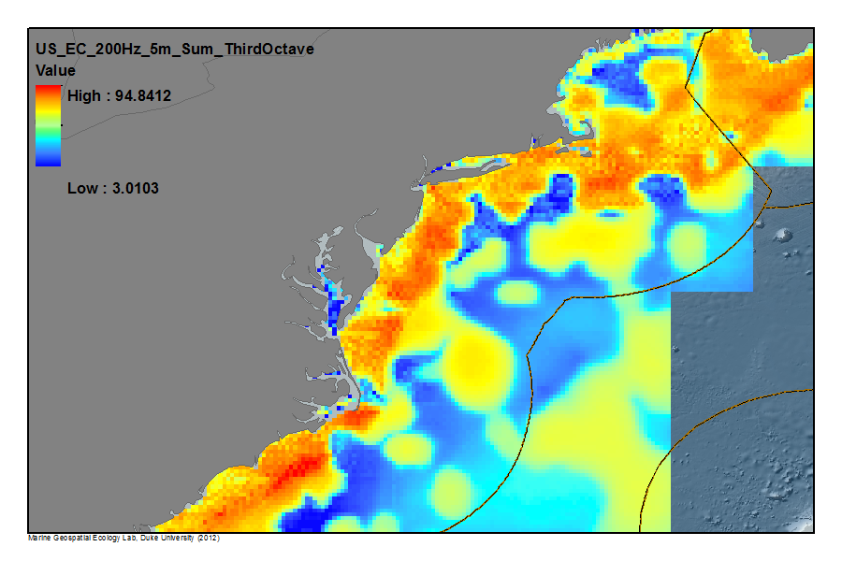
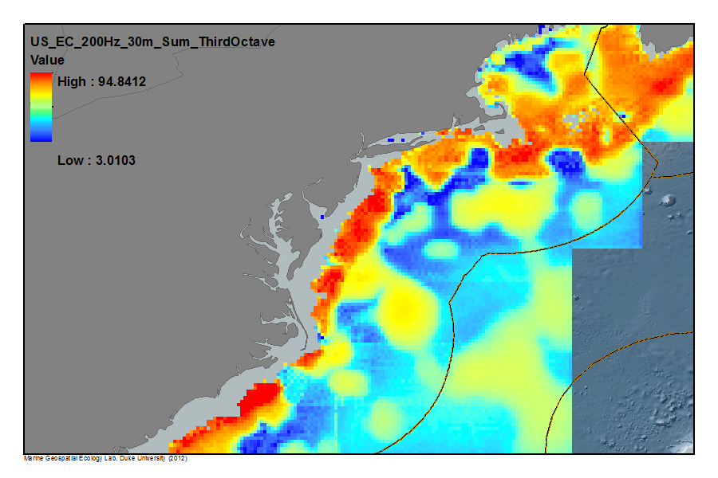
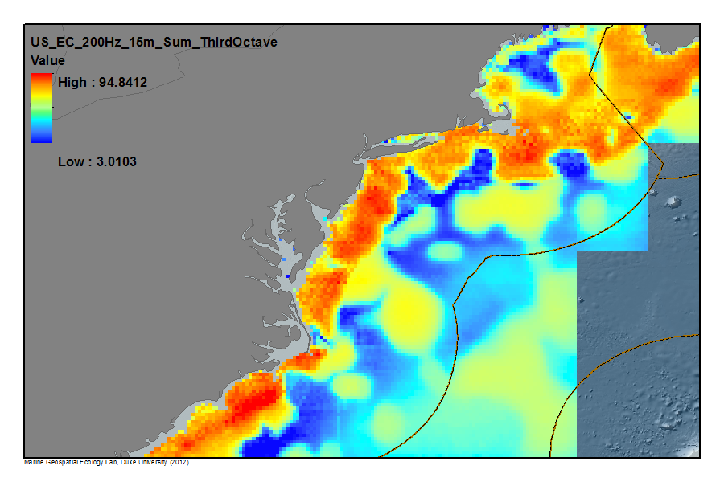
LEQ 200Hz 30m, 15, and 5m
Regional scale of chronic sound
Trend: Higher to lower (average) sound with distance from shore.
Models develop by Heat, Light & Sound Research, Inc.
For NOAA-CetSound
Maps by Duke MGEL

Slide 16
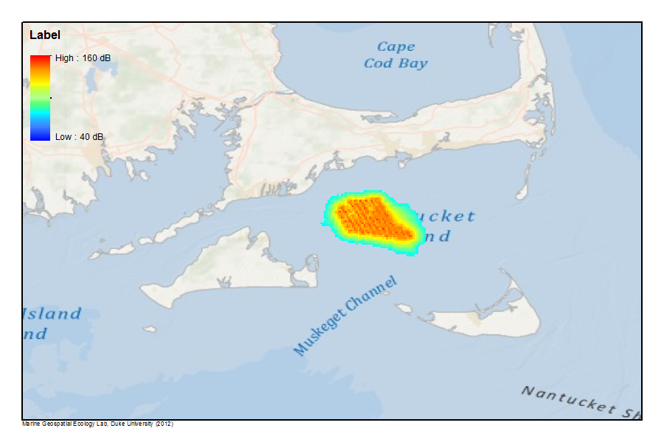
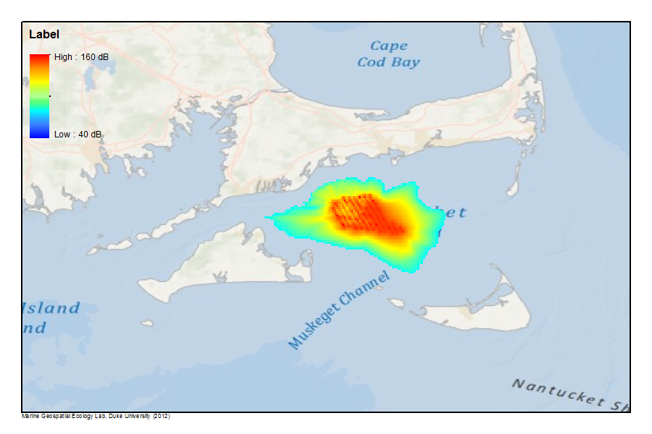
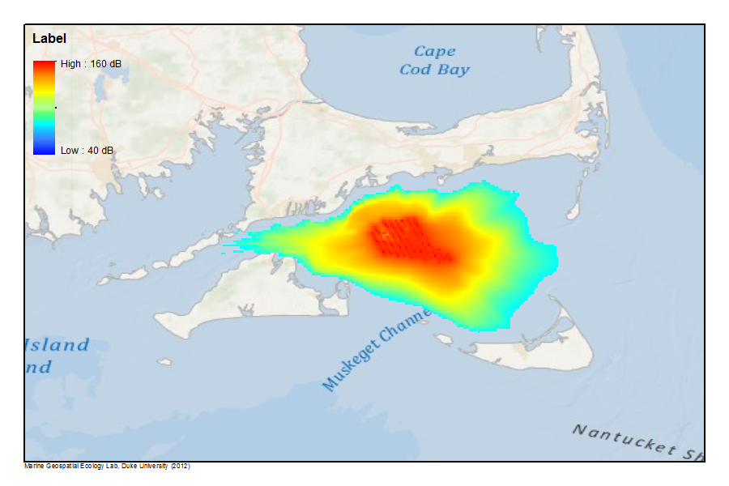
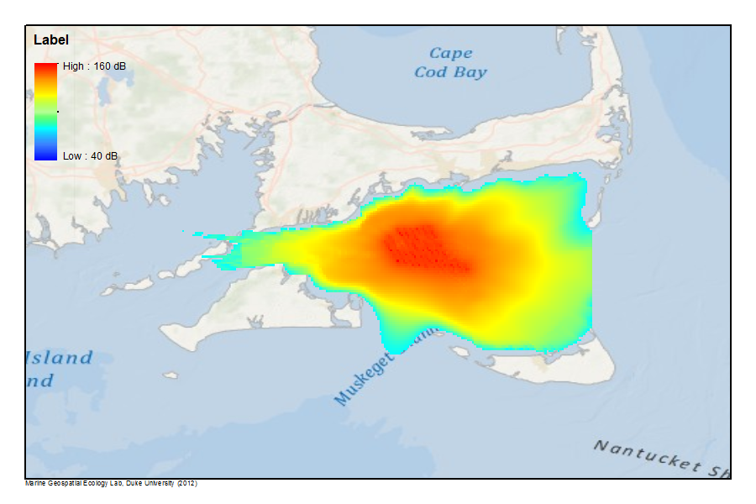
Event noise simulation:
Pile driving - Cape Wind
Models develop by Heat, Light & Sound Research, Inc.
For NOAA-CetSound
Maps by Duke MGEL

Slide 17
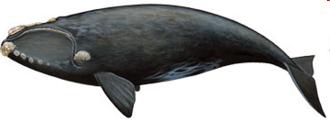
Integrating cetacean & sound analysis into CMSP
What about seasonally migratory species?

Slide 18

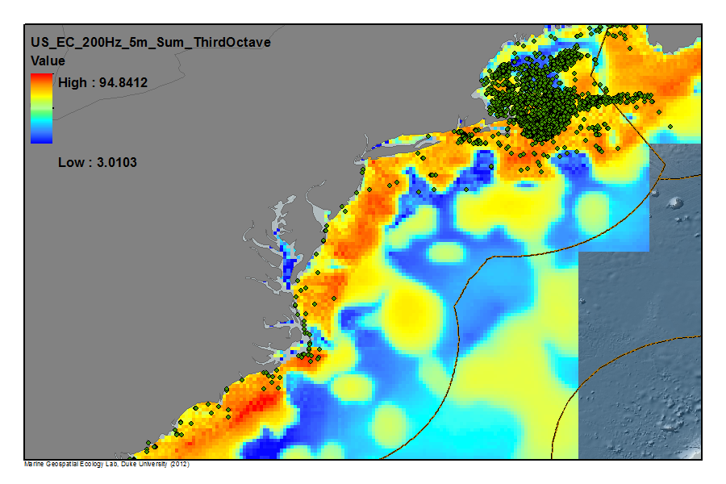
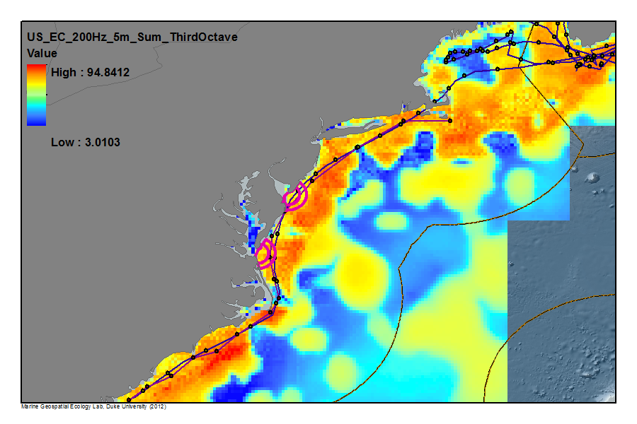
North Atlantic Right Whale

Slide 19
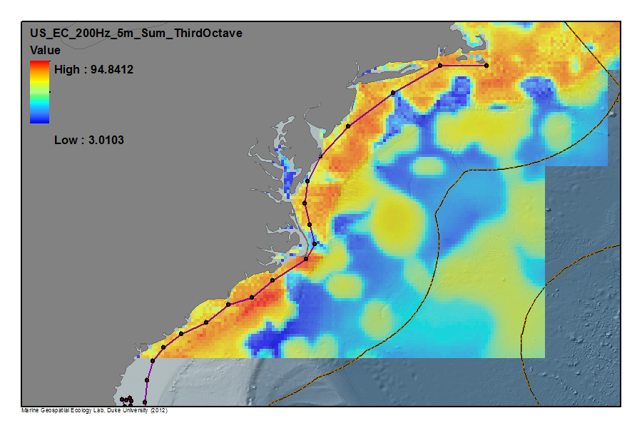
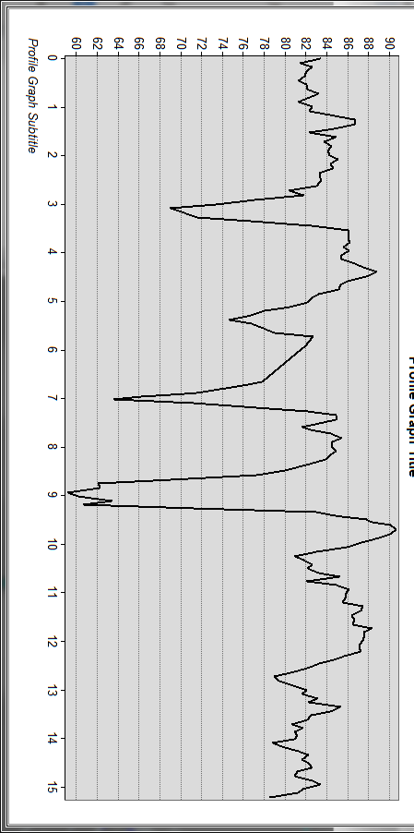

Northbound North Atlantic Right Whale: telemetry track through “average” (LEQ) sound field
(From: Schick et al. 2010)
Track data: Scott Kraus, Chris Slay, Mark Baumgartner, Bruce Mate

Slide 20
energy potential
chronic noise
Integrating underwater sound into regional coastal and marine spatial planning (CMSP)
Regional CMSP
species densities
event noise
multisector CMSP
biologically
important areas

Slide 21
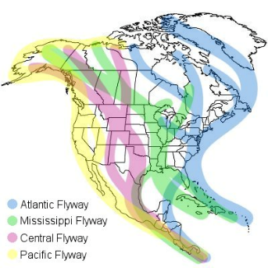
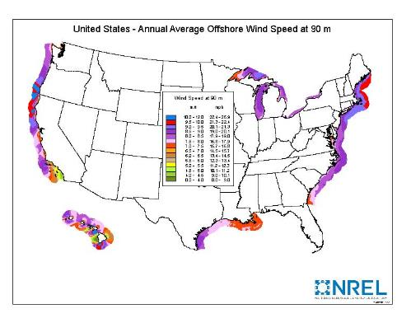

Wind energy
Areas of high wind energy potential
seabird flyways
marine mammal corridors

Slide 22
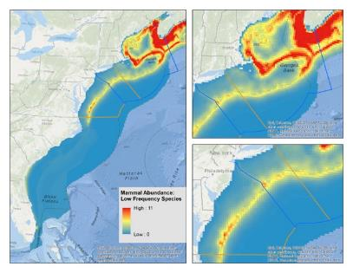
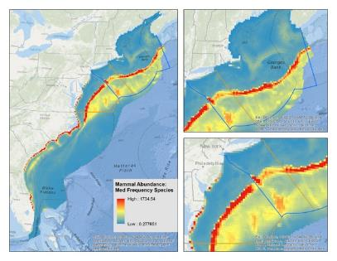
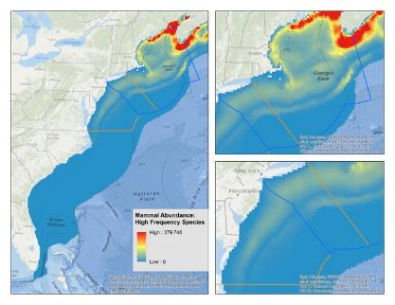
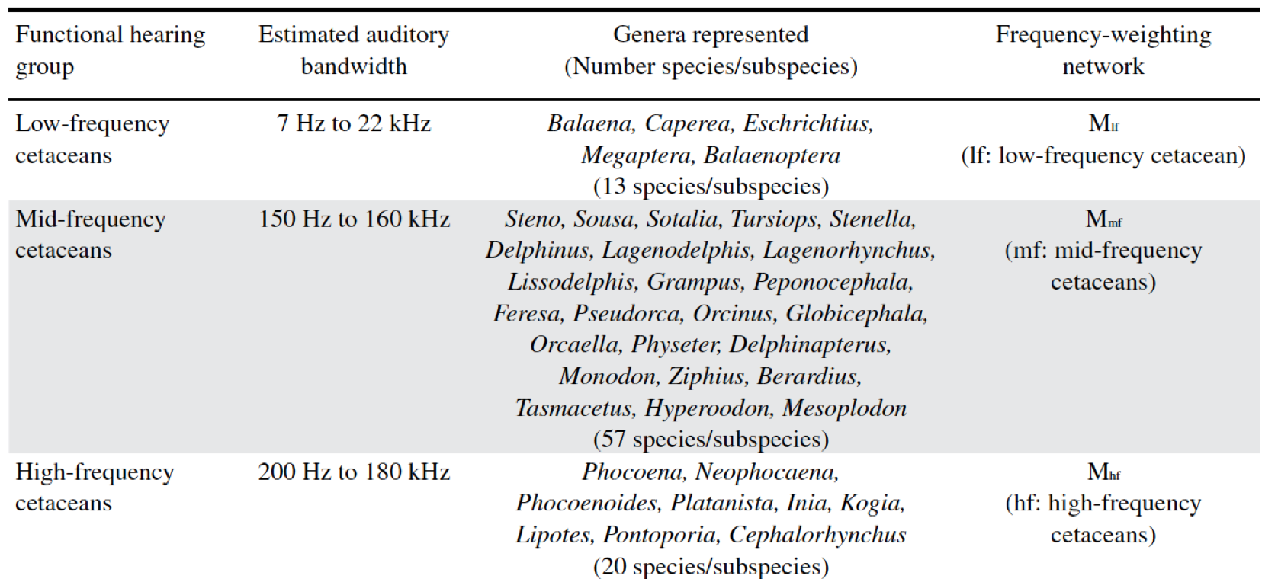
Cetacean sound use & potential sensitivity to masking
Low-frequency cetaceans
Mid-frequency cetaceans
High frequency cetaceans
Southhall, B. et al. 2007. Marine Mammal Noise Exposure Criteria: Initial Scientific Recommendations. Aquatic Mammals.

Slide 23
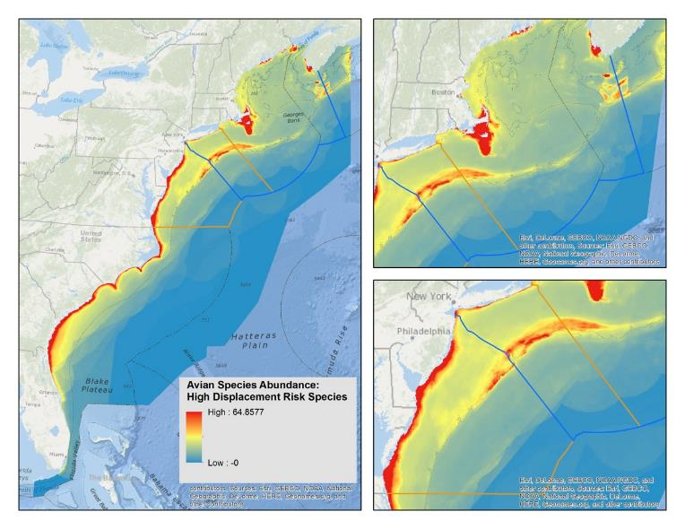
Avian Abundance
High Displacement Risk Species

Slide 24

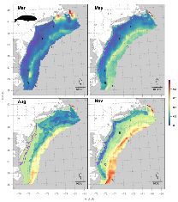
Balancing competing uses: trade-off analyses
high value wind energy
“optimal”
solution
Wind energy valuation (net present value in $US millions) with access to the Atlantic Wind Connection (purple lines).
low seabird & cetacean risk
Source: Best et al. (in prep.)
Notes:
White, Crow, Benjamin S Halpern, and Carrie V Kappel. 2012. “Ecosystem Service Tradeoff Analysis Reveals the Value of Marine Spatial Planning for Multiple Ocean Uses.” Proceedings of the National Academy of Sciences, March. doi:10.1073/pnas.1114215109.

Slide 25
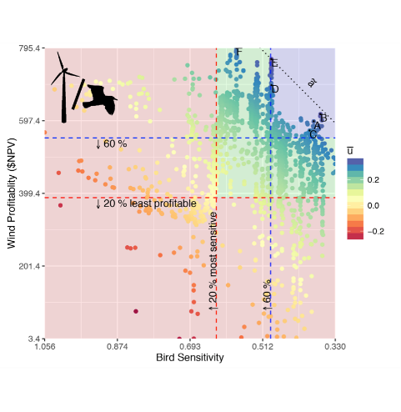
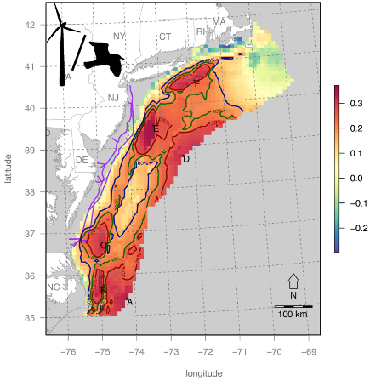
Balancing competing uses: trade-off analyses
Creating decision support tools to simultaneously evaluate the economic and conservation values of selected sites
+ / + frontier
Increasing wind value
lower bird interaction risk
Source: Best et al. (in prep.)
http://shiny.env.duke.edu/bbest/siting/
Notes:
White, Crow, Benjamin S Halpern, and Carrie V Kappel. 2012. “Ecosystem Service Tradeoff Analysis Reveals the Value of Marine Spatial Planning for Multiple Ocean Uses.” Proceedings of the National Academy of Sciences, March. doi:10.1073/pnas.1114215109.

Slide 26

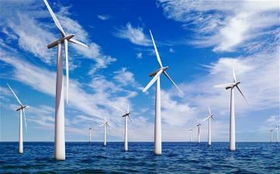

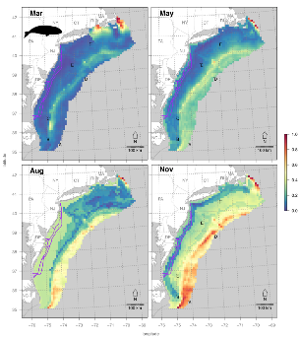
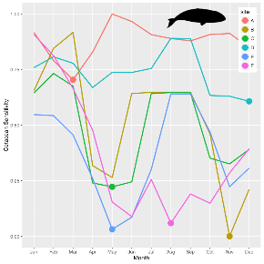
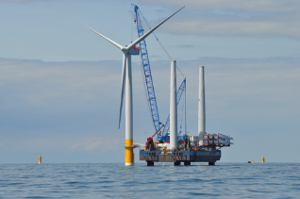
Timing
seabirds: year-round interactions
cetaceans: construction interactions
Notes:
White, Crow, Benjamin S Halpern, and Carrie V Kappel. 2012. “Ecosystem Service Tradeoff Analysis Reveals the Value of Marine Spatial Planning for Multiple Ocean Uses.” Proceedings of the National Academy of Sciences, March. doi:10.1073/pnas.1114215109.

Slide 27
Balancing competing uses: trade-off analyses
Source: Best et al. (in prep.)
Notes:
White, Crow, Benjamin S Halpern, and Carrie V Kappel. 2012. “Ecosystem Service Tradeoff Analysis Reveals the Value of Marine Spatial Planning for Multiple Ocean Uses.” Proceedings of the National Academy of Sciences, March. doi:10.1073/pnas.1114215109.

Slide 28
Balancing competing uses: trade-off analyses
Tools to link economic value and environmental suitability
Source: Best et al. (in prep.)
Notes:
White, Crow, Benjamin S Halpern, and Carrie V Kappel. 2012. “Ecosystem Service Tradeoff Analysis Reveals the Value of Marine Spatial Planning for Multiple Ocean Uses.” Proceedings of the National Academy of Sciences, March. doi:10.1073/pnas.1114215109.

Slide 29
Balancing competing uses: trade-off analyses
A possible high value / low impact site
Best time of year to do construction
Source: Best et al. (in prep.)
Notes:
White, Crow, Benjamin S Halpern, and Carrie V Kappel. 2012. “Ecosystem Service Tradeoff Analysis Reveals the Value of Marine Spatial Planning for Multiple Ocean Uses.” Proceedings of the National Academy of Sciences, March. doi:10.1073/pnas.1114215109.

Slide 30
Balancing competing uses: trade-off analyses
high value wind energy
optimal
solution
Wind energy valuation (net present value in $US millions) with access to the Atlantic Wind Connection (purple lines).
low seabird & cetacean risk
Need to add commercial & recreational fishing and other important sectors
Source: Best et al. (in prep.)
Notes:
White, Crow, Benjamin S Halpern, and Carrie V Kappel. 2012. “Ecosystem Service Tradeoff Analysis Reveals the Value of Marine Spatial Planning for Multiple Ocean Uses.” Proceedings of the National Academy of Sciences, March. doi:10.1073/pnas.1114215109.

Slide 31
Keeping the Blue Economy green
1. Development of strategic ocean plans
2. Development of implementation tools & processes
In order to keep our blue economy green, we need to we need to “reimagine how to effectively measure, monitor and sustainably manage” our ocean resources. invest in the development of both ocean plans and multi-sector implementation tools.

Slide 32
Thank you

