Slide 1
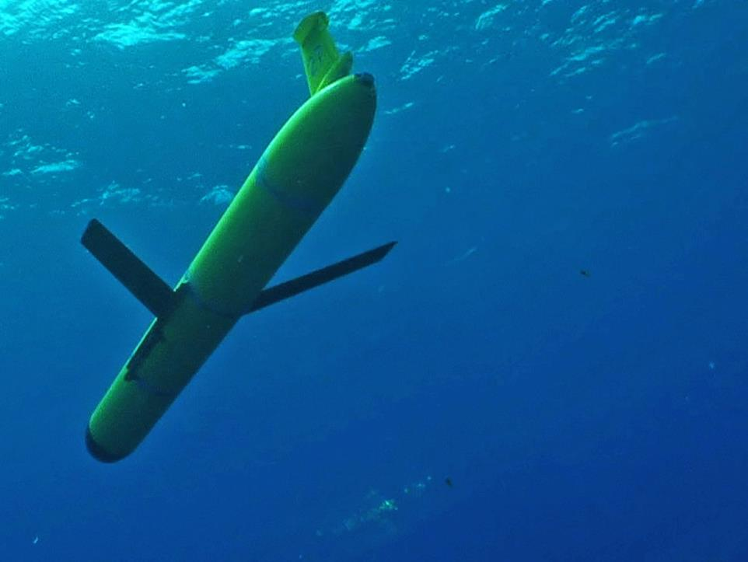
Mid-Atlantic Blue Ocean Economy 2030
Ocean Observations
Scott Glenn
Rutgers University
NJ-BPU, MARACOOS, IOOS, OOI, GOOS,
IOC
Conclusions Up Front:
Mid-Atlantic is home to the most advanced observing systems in the world
Much can be leveraged to support the Blue Ocean Economy
Well defined process to fill gaps
Greatest need is not for new technologies – it is nurturing the will to use what already exists

Slide 2
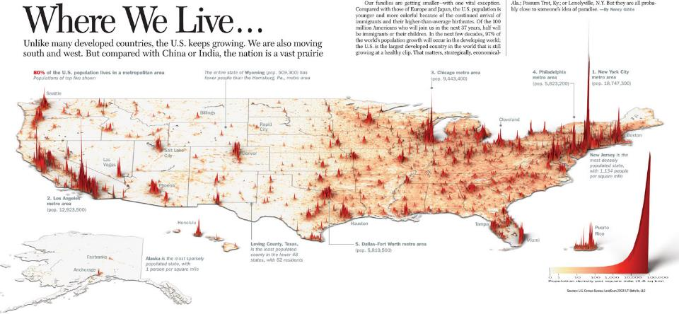
Mid-Atlantic Drivers
1/4 of U.S. Population
1/4 of U.S. GDP
World’s Largest Navy Port
Commercial Ports
Fishing Fleets
Energy - Offshore Wind
…..
Mid-Atlantic Stressors
Water quality
Hurricanes & Winter Storms
Flooding – Extreme and Nuisance
Hypoxia
Intense multi-use waterways
Urbanized coasts
….

Slide 3
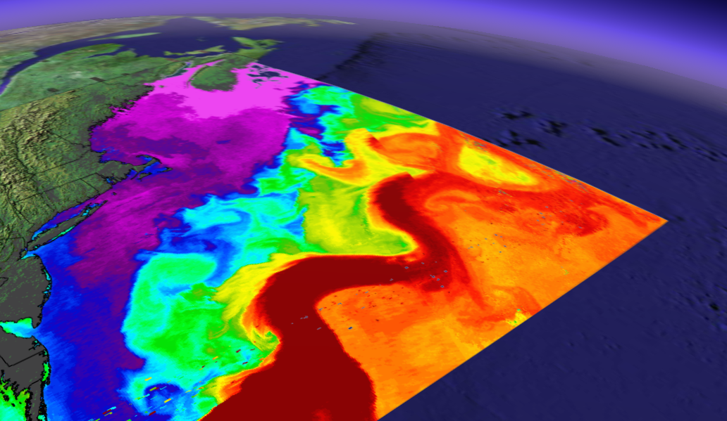
Mid-Atlantic Bight is Physically Complex

Slide 4
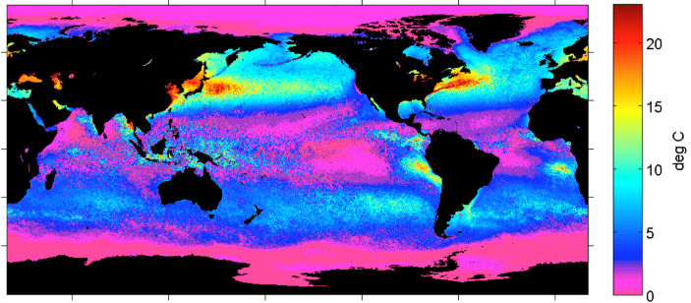
Summer – Winter Sea Surface Temperature Difference
Summer heating produces a highly stratified Mid Atlantic -
A warm surface layer + An unseen cold bottom layer
Mid Atlantic
Winter (1-layer)
Cold Pool
Mid Atlantic
Summer (2-layers)
Mid-Atlantic’s Cold Pool

Slide 5
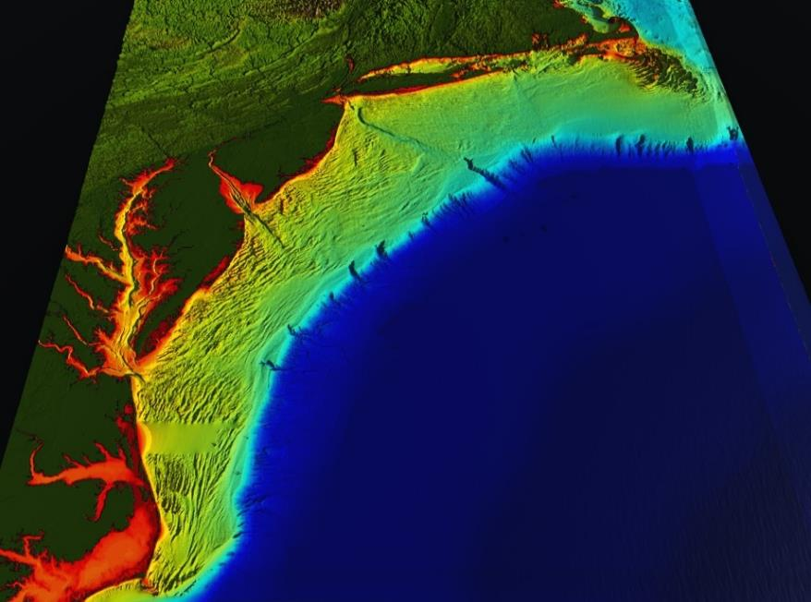
RI
U..
Middle Atlantic
Regional Association
Coastal
Ocean Observing System
10 States - 78 Million People
1000 km Cape to Cape
CT
Cape
Cod
MA
NY
PA
NJ
MARACOOS:
An Integrated, Sustained & Certified Real-time Observation and Forecast System
DE
MD
VA
NC
Cape
Hatteras
Notes:
5

Slide 6
MARACOOS Integration Matrix
Integration Matrix: Capabilities Support Multiple Themes
Regional Priority Themes | Regional Observation & Modeling Capabilities
 | Weather Mesonet | HF Radar Network | Statistical STPS | Satellite Imagery | Glider Surveys | Dynamical Ocean Forecasts
Theme 1. Maritime Commerce & Safety | Operational Input to USCG SAROPS | Operational input to USCG SAROPS | Operational input to USCG SAROPS | SST for survivability planning | Assimilation dataset for forecast models | Surface currents for SAROPS
Theme 2. Fisheries | Weather forecast ensemble validation | Circulation and divergence maps for habitat |  | SST & Color for habitat | Subsurface T & S for habitat | 3-D fields of T, S, circulation for habitat
Theme 3. Public Health & Water Quality | Winds for transport, river plumes, & upwelling | Surface currents for floatables, bacteria, spill response | Surface currents for floatables, bacteria, spill response | Ocean color for river plumes | Nearshore dissolved oxygen surveys | Surface currents for floatables, bacteria, spill response
Theme 4. Coastal Flooding | Weather forecast ensemble validation | Assimilation dataset for forecast models |  | SSTs assimilation into forecast models | Assimilation dataset for forecast models | Nested forecast ensembles
Theme 5. Offshore Energy | Historical analysis & wind model validation | Historical current analysis & wind model validation |  | Historical analysis surface fronts & plumes for siting | Historical analysis of subsurface fronts & plumes | Coupled ocean-atmosphere models for resource estimates

Slide 7
MARACOOS Integration Matrix
Integration Matrix: Capabilities Support Multiple Themes
Regional Priority Themes | Regional Observation & Modeling Capabilities
 | Weather Mesonet | HF Radar Network | Statistical STPS | Satellite Imagery | Glider Surveys | Dynamical Ocean Forecasts
Theme 1. Maritime Commerce & Safety | Operational Input to USCG SAROPS | Operational input to USCG SAROPS | Operational input to USCG SAROPS | SST for survivability planning | Assimilation dataset for forecast models | Surface currents for SAROPS
Theme 2. Fisheries | Weather forecast ensemble validation | Circulation and divergence maps for habitat |  | SST & Color for habitat | Subsurface T & S for habitat | 3-D fields of T, S, circulation for habitat
Theme 3. Public Health & Water Quality | Winds for transport, river plumes, & upwelling | Surface currents for floatables, bacteria, spill response | Surface currents for floatables, bacteria, spill response | Ocean color for river plumes | Nearshore dissolved oxygen surveys | Surface currents for floatables, bacteria, spill response
Theme 4. Coastal Flooding | Weather forecast ensemble validation | Assimilation dataset for forecast models |  | SSTs assimilation into forecast models | Assimilation dataset for forecast models | Nested forecast ensembles
Theme 5. Offshore Energy | Historical analysis & wind model validation | Historical current analysis & wind model validation |  | Historical analysis surface fronts & plumes for siting | Historical analysis of subsurface fronts & plumes | Coupled ocean-atmosphere models for resource estimates

Slide 8
MARACOOS Integration Matrix
Integration Matrix: Capabilities Support Multiple Themes
Regional Priority Themes | Regional Observation & Modeling Capabilities
 | Weather Mesonet | HF Radar Network | Statistical STPS | Satellite Imagery | Glider Surveys | Dynamical Ocean Forecasts
Theme 1. Maritime Commerce & Safety | Operational Input to USCG SAROPS | Operational input to USCG SAROPS | Operational input to USCG SAROPS | SST for survivability planning | Assimilation dataset for forecast models | Surface currents for SAROPS
Theme 2. Fisheries | Weather forecast ensemble validation | Circulation and divergence maps for habitat |  | SST & Color for habitat | Subsurface T & S for habitat | 3-D fields of T, S, circulation for habitat
Theme 3. Public Health & Water Quality | Winds for transport, river plumes, & upwelling | Surface currents for floatables, bacteria, spill response | Surface currents for floatables, bacteria, spill response | Ocean color for river plumes | Nearshore dissolved oxygen surveys | Surface currents for floatables, bacteria, spill response
Theme 4. Coastal Flooding | Weather forecast ensemble validation | Assimilation dataset for forecast models |  | SSTs assimilation into forecast models | Assimilation dataset for forecast models | Nested forecast ensembles
Theme 5. Offshore Energy | Historical analysis & wind model validation | Historical current analysis & wind model validation |  | Historical analysis surface fronts & plumes for siting | Historical analysis of subsurface fronts & plumes | Coupled ocean-atmosphere models for resource estimates

Slide 9
MARACOOS Integration Matrix
Integration Matrix: Capabilities Support Multiple Themes
Regional Priority Themes | Regional Observation & Modeling Capabilities
 | Weather Mesonet | HF Radar Network | Statistical STPS | Satellite Imagery | Glider Surveys | Dynamical Ocean Forecasts
Theme 1. Maritime Commerce & Safety | Operational Input to USCG SAROPS | Operational input to USCG SAROPS | Operational input to USCG SAROPS | SST for survivability planning | Assimilation dataset for forecast models | Surface currents for SAROPS
Theme 2. Fisheries | Weather forecast ensemble validation | Circulation and divergence maps for habitat |  | SST & Color for habitat | Subsurface T & S for habitat | 3-D fields of T, S, circulation for habitat
Theme 3. Public Health & Water Quality | Winds for transport, river plumes, & upwelling | Surface currents for floatables, bacteria, spill response | Surface currents for floatables, bacteria, spill response | Ocean color for river plumes | Nearshore dissolved oxygen surveys | Surface currents for floatables, bacteria, spill response
Theme 4. Coastal Flooding | Weather forecast ensemble validation | Assimilation dataset for forecast models |  | SSTs assimilation into forecast models | Assimilation dataset for forecast models | Nested forecast ensembles
Theme 5. Offshore Energy | Historical analysis & wind model validation | Historical current analysis & wind model validation |  | Historical analysis surface fronts & plumes for siting | Historical analysis of subsurface fronts & plumes | Coupled ocean-atmosphere models for resource estimates

Slide 10
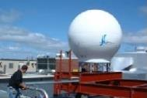
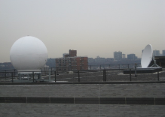
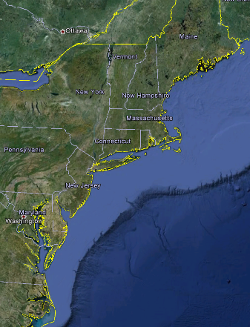
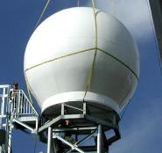
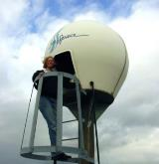
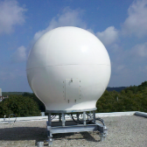
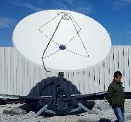
Real-Time Satellite Ground Stations in the Northeast U.S.
Satellites: NOAA Polar Orbiters, NPP, Terra, Aqua, Metop & GOES
U. Maine
City College of N.Y.
Rutgers
Industry
Partner
U. Delaware
Johns Hopkins

Slide 11
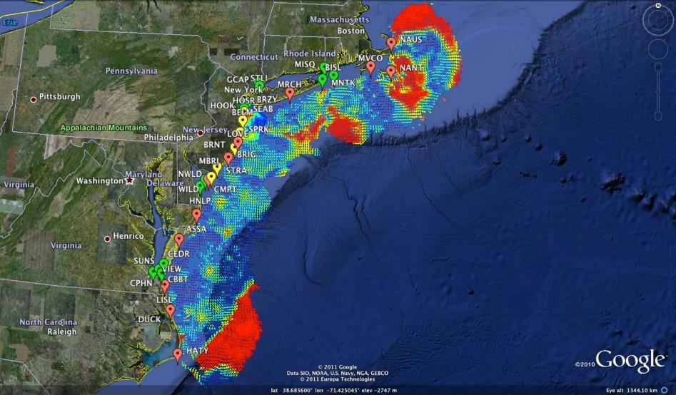
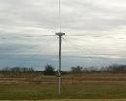
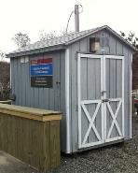
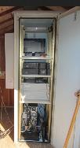
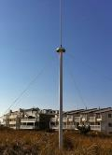
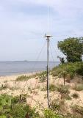
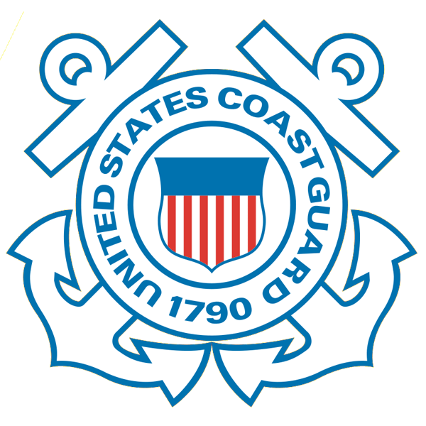
Mid-Atlantic Bight HF Radar Network
1000 km
Cape to Cape
Mid-Atlantic HF Radar Network
16 Long-Range CODARs
8 Medium-Range CODARs
17 Short-Range CODARs
41 Total
Triple Nested, Multi-static, Multi-use
Industry Partner: CODAR Ocean Sensors

Slide 12
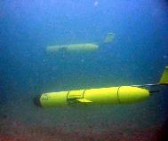
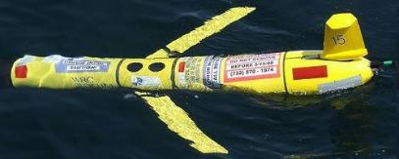
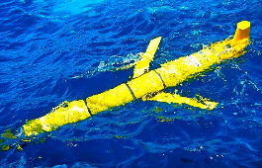
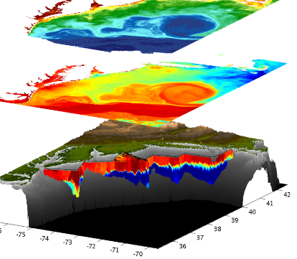
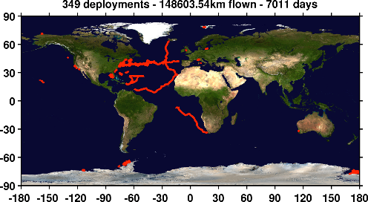
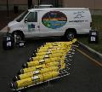
Mid-Atlantic Bight Glider Network
RU01
RU15
RU29
G1
G1-Ruggedized
G2
Satellite Ocean Color
Satellite SST
Subsurface
Glider
Data
Industry Partner: Teledyne Webb Research

Slide 13
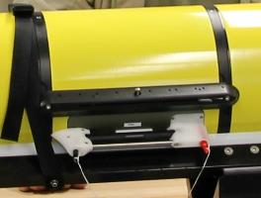
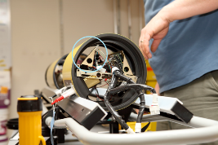
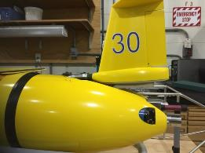
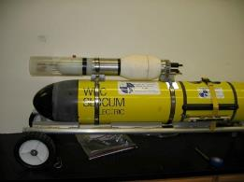
Gliders are configurable with a wide variety of sensors
Acoustic Modem
ADCP/DVL
Altimeter
Bathyphotometer (bioluminescence)
Beam Attenuation Meter
Echo Sounder
Optical Backscatter
Optical Attenuation
Oxygen
Conductivity, Temperature, Depth
Fish Tracking
Fluorometer
Hydrocarbon
Hydrophones
Nitrates
PAR sensor
Radiometer
Scattering Attenuation Meter
Spectrophotometer (red tide)
Turbulence
Wave Accelerometer
Internal Payload Bay
Internal
External Payload Area
External Mounted

Slide 14
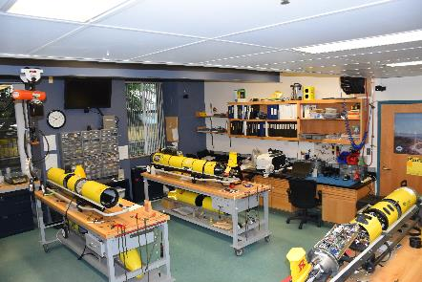
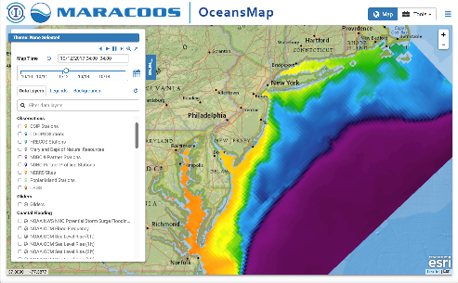
Rutgers University - Coastal Ocean Observation Lab
Observatory Operations, Data Fusion & Training Center
Notes:
14

Slide 15
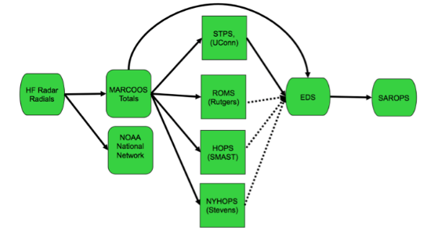
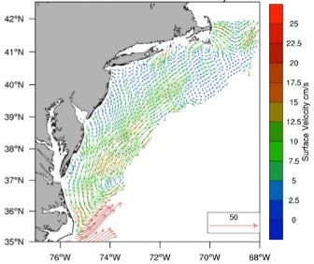
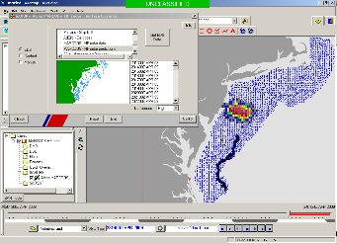
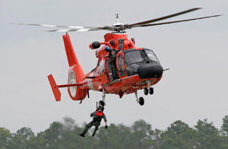
Operational Use of HF Radar Surface Currents for Search And Rescue
Surface Currents
Data Acquisition
Data Product Generation & Management
Search And Rescue Optimal Planning System (SAROPS)

Slide 16
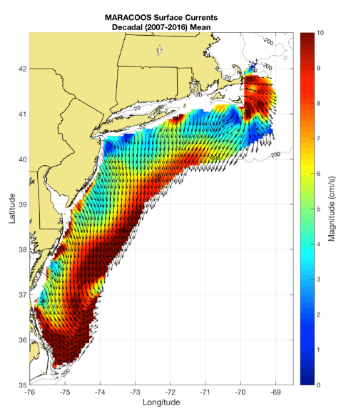
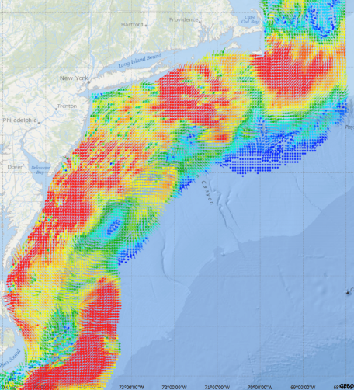
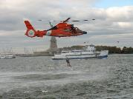
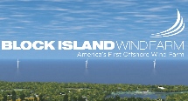
Generate Surface Current Maps Every Hour for a Decade
5 MHz- 17 Stations
13 MHz- 7 Stations
25 MHz- 16 Stations
Outside- 6 Stations
TOTAL – 46 Stations
Winter Storm Jonas
2016/01/23 20:00 UTC
Decadal Mean Currents
for Spatial Planning
Hourly Maps for
Search And Rescue

Slide 17
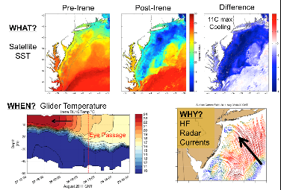
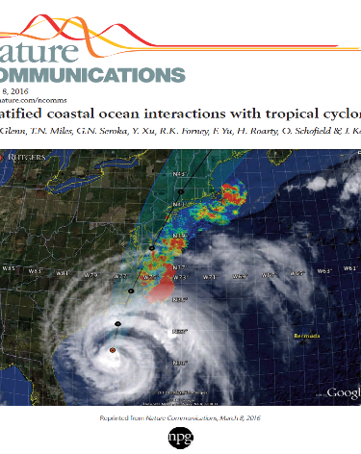
Operations to Research (O2R) Demonstrated
Integrated
Ocean Observatory
identifies processes responsible for rapid ahead-of-eye cooling.
Atmospheric
model sensitivities identify ahead-of-eye cooling as the missing process for rapid de-intensification
NOAA OAR

Slide 18
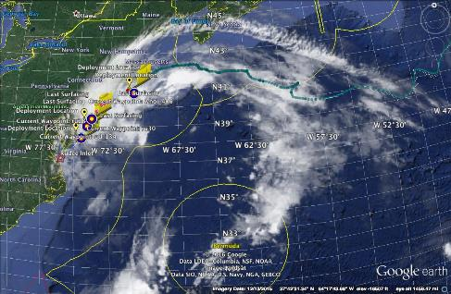
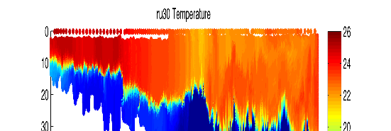
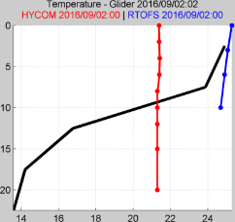
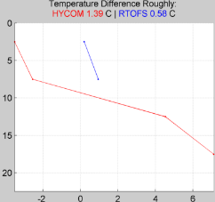
R2O - Hurricane Hermine Response - Glider Fleet Launched, 9/2016
Glider
HYCOM
RTOFS

Slide 19
R2O - Navy Global HYCOM: Temperature Below Summer Thermocline
Operational GOFS 3.0
OpTest of GOFS 3.1
No Cold Pool
Well Defined
Cold Pool
Isopycnal Layers on Shelf
Sigma/Z-levels on Shelf

Slide 20
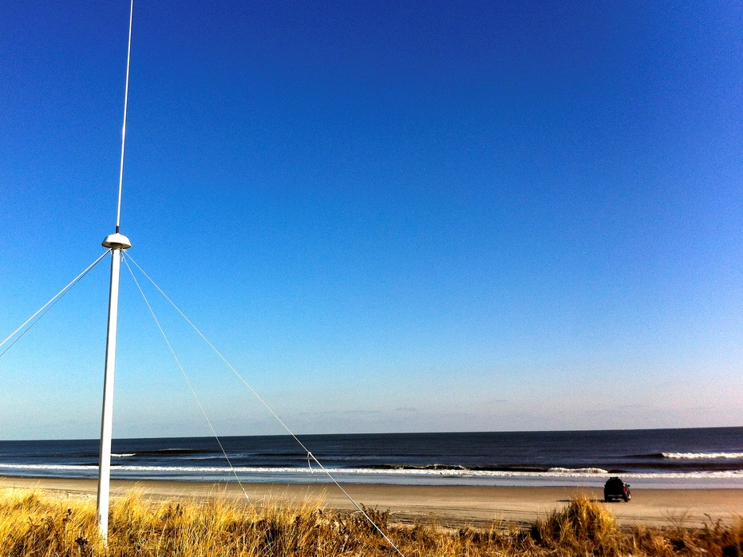
Conclusions:
Mid-Atlantic is home to the most advanced observing systems in the world - e.g. IOOS MARACOOS & NSF OOI
Much can already be leveraged to support the Mid-Atlantic Blue Ocean Economy
Well defined process to fill gaps, e.g.:
GOOS – Framework for Ocean Observing
MARACOOS – Integration Matrix
Greatest need is not for new technologies – it is nuturing the will to use what already exists

