Slide 1
Starting to Define The Mid-Atlantic Blue Economy:
Charles S. Colgan PhD
Director of Research
Center for the Blue Economy
Middlebury Institute of International Studies at Monterey
Monterey, California

Slide 2
Ocean Economy Employment
Mid Atlantic
United States

Slide 3
Ocean Economy GDP
Mid Atlantic
United States

Slide 4
Changes in Ocean Economy Employment 2005-2014

Slide 5
Changes in Ocean Economy GDP 2005-2014

Slide 6
Ocean Economy by State: Employment Total 2014: 755,000

Slide 7
Ocean Economy by State: GDP Total 2014: $50 Billion

Slide 8
Coastal Economy by State: Employment Total 2016: 16.5 million

Slide 9
Coastal Economy by State: GDP Total 2016: $2.5 trillion

Slide 10
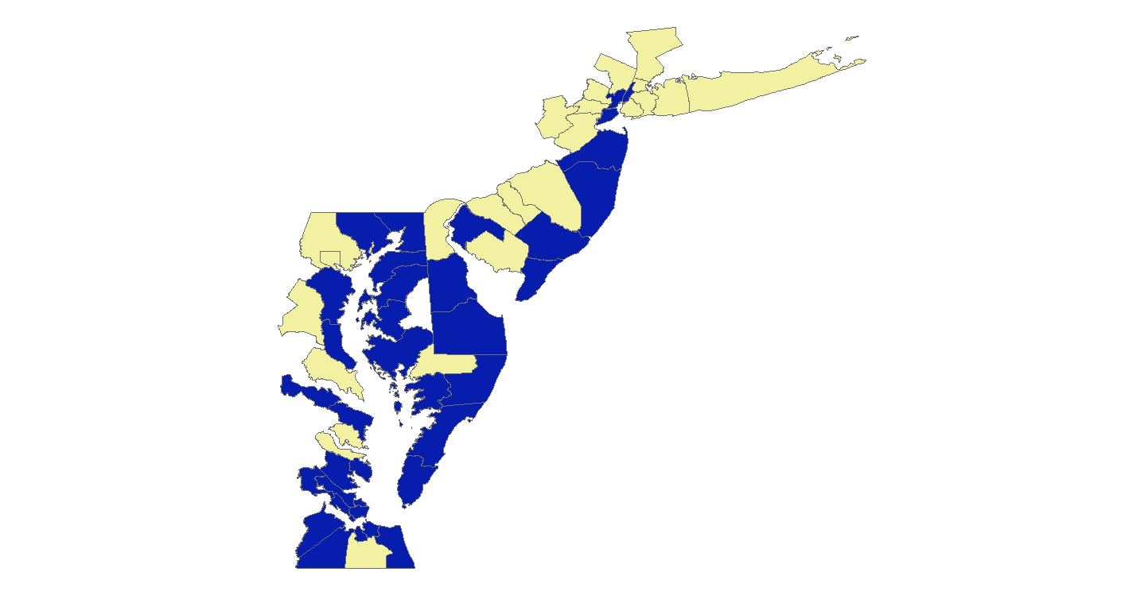
Ocean Economy as Percent of County Economy (2014)
Blue=Above Regional Median Percent Tan=Below Median

Slide 11
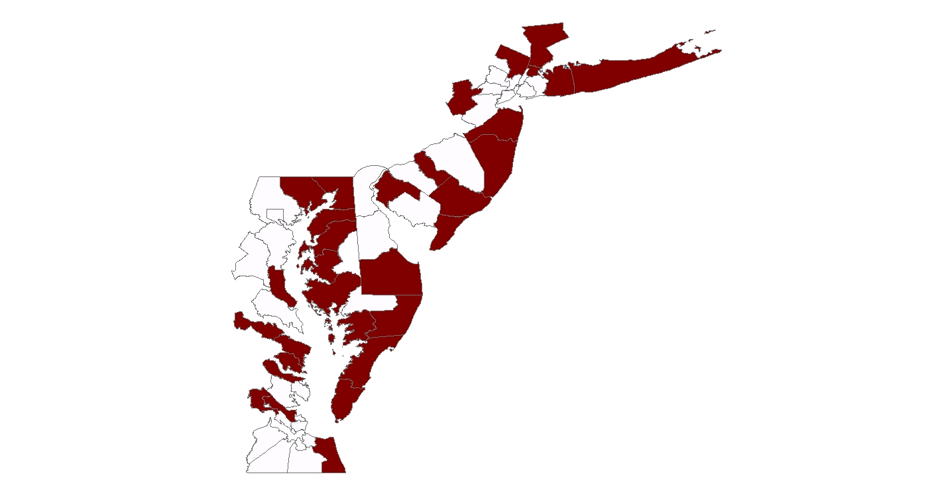
Summer Peaking Tourism & Recreation
Red=Summer Peak > Regional Median White= Below Median

Slide 12
Outlook for U.S. Water Transportation to 2030
History
Forecast

Slide 13
Outlook for U.S. Warehousing and Storage
History
Forecast

Slide 14
Outlook for U.S. Accommodations and Food Service to 2030
History
Forecast

Slide 15
Next Gen Blue Economy

Slide 16
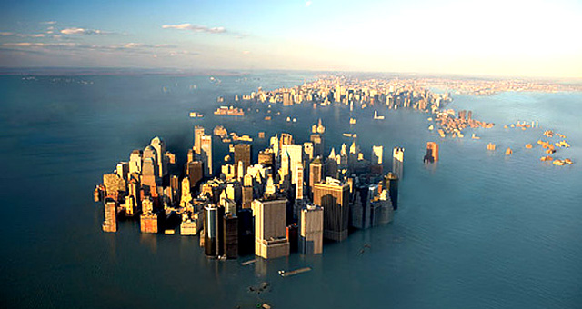
Climate Change and the Blue Economy

Slide 17
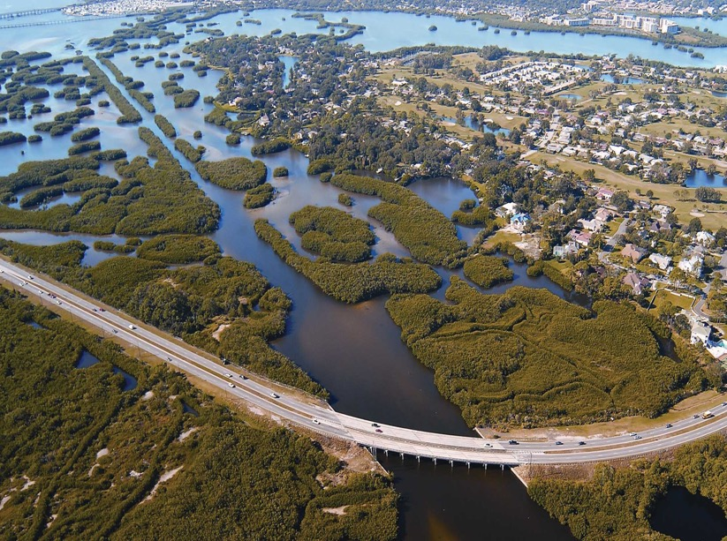

Slide 18
The Blue Economy: Connecting the Economy and the Environment
Ecosystem Service Accounts
Economic and Environment Accounts
National Income Accounts (GDP)
Ocean related industries
Natural Resource
Capital Accounts
Producing, Regulating, Cultural
Stocks and Flows of
Ecosystem Services
Environmental Expenditures

Slide 19
For More Information:
ccolgan@middlebury.edu
831-647-6615

