Slide 1
Offshore Energy and Minerals
in the Blue Ocean Economy
James Bennett
Chief, Office of Renewable Energy Programs
Mid-Atlantic Blue Ocean Economy 2030
West Long Branch, NJ | October 12, 2017

Slide 2
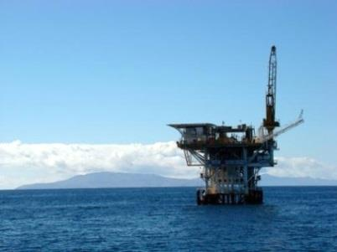
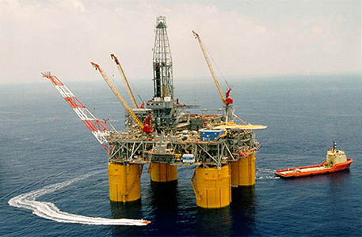
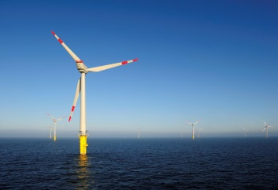
Outer continental shelf planning areas
National: 5-Year Leasing Plan, Natural Gas Demand, Alternative OCS Use
Alaska OCS
Pacific OCS
Gulf of Mexico OCS
Atlantic OCS

Slide 3
BOEM’s three program areas

Slide 4
Oil & Gas | Meeting National Energy Needs
3,000+ active oil and gas leases
18% of domestic oil, 4% of domestic natural gas production in FY2016
Significant economic benefits:
Employment (315,000 jobs)
U.S. Treasury revenue
Local tax revenue
~ $ 2.8 billion in leasing revenues in FY2016

Slide 5
Oil & Gas | Activities in the mid-Atlantic
Seven Geological and Geophysical (G&G) permits
~2.4 billion barrels of undiscovered technically recoverable oil resources and 24.63 trillion cubic feet of natural gas

Slide 6
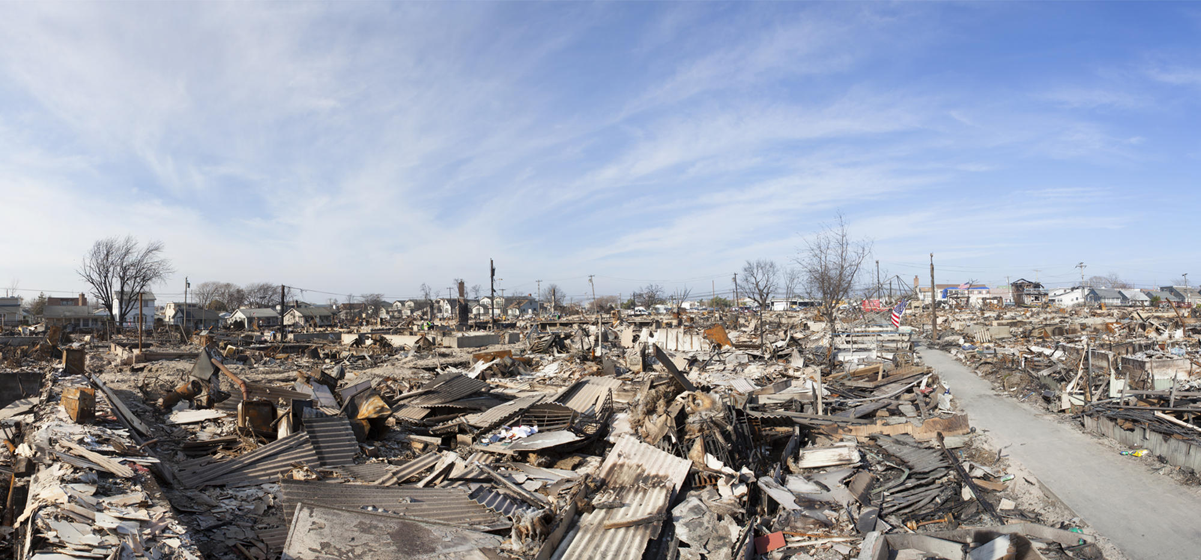
Marine minerals | RESTORATION
OCS sand used in New Jersey, Virginia, Maryland
Post-Hurricane Sandy, beach nourishment projects saved $ 1.3 billion in damages

Slide 7
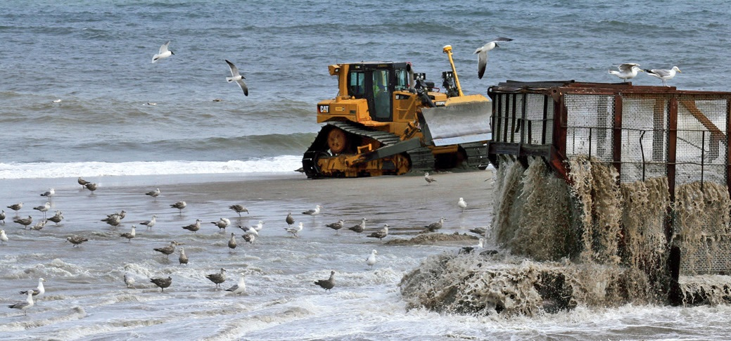
Marine minerals | current trends
Long-term planning
Evolving dredge technology: larger capacities, deeper water depths

Slide 8
Renewable energy | Atlantic ocs activities
Massachusetts
Rhode Island / Massachusetts
New York
New Jersey
Delaware
Maryland
Virginia
North Carolina

Slide 9
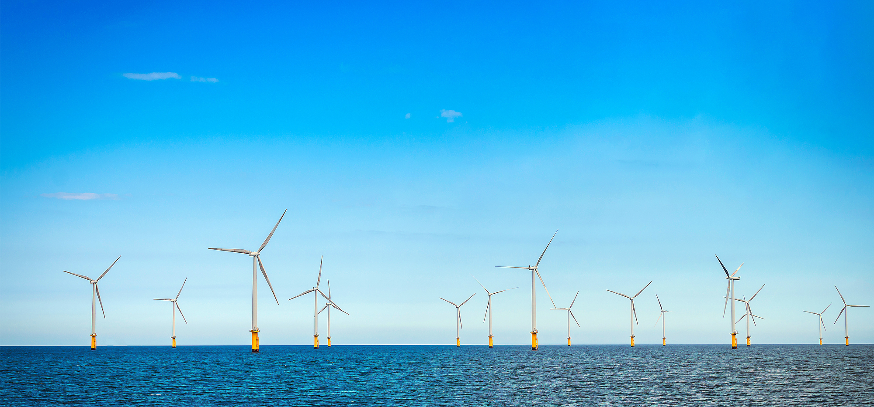
Renewable energy | offshore wind power
>8.45 GW potential generation capacity in Mid-Atlantic
$ 67.2 million from renewable energy lease auctions
Job creation

Slide 10
Renewable energy | current trends
Turbine size continues to grow
Lower cost
Floating turbine technology
Power purchase agreements

Slide 11
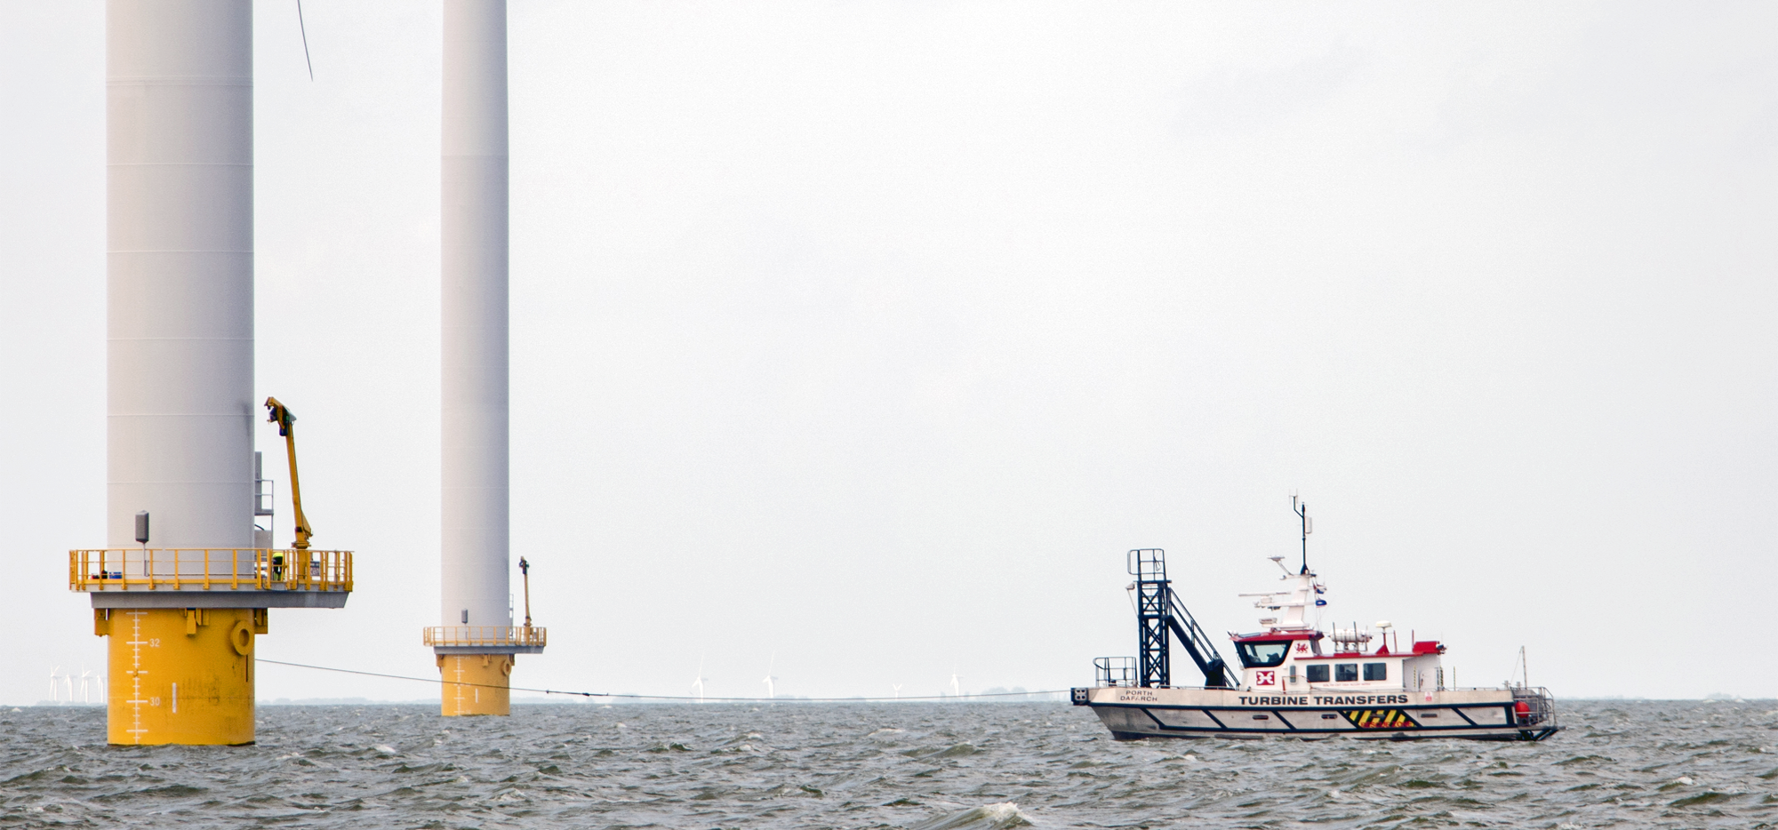
Renewable energy | Milestones
End of 2017, first Construction and Operations Plan
10 years could see 12 wind farms built

Slide 12
BOEM Challenges
Stakeholder engagement
Space-use conflicts
Safety
Best available science
Monitoring and mitigation

Slide 13
Questions?

