Slide 1
Monmouth University
School of Science
Proudly Presents
The
Class of 2020

Slide 2
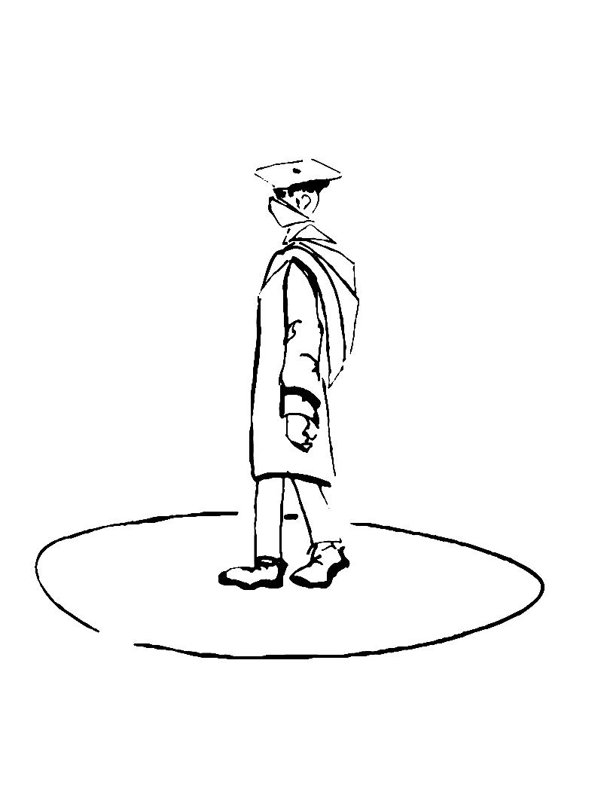

Slide 3
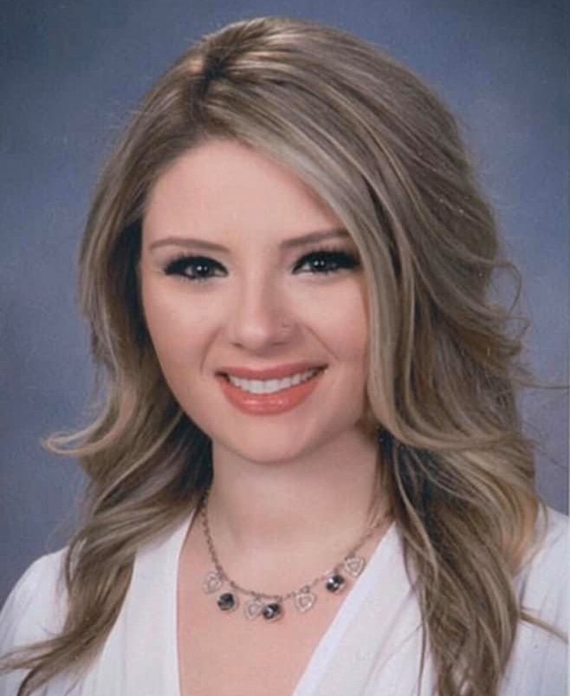
Brianna DeBlois
“But as for you, be strong and do not give up, for your work will be rewarded"
2 Chronicles 15:7

Slide 4
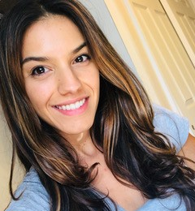
“To everyone who kept me going through this, thank you. I would not have made it without you.”
Amanda Fessina

Slide 5
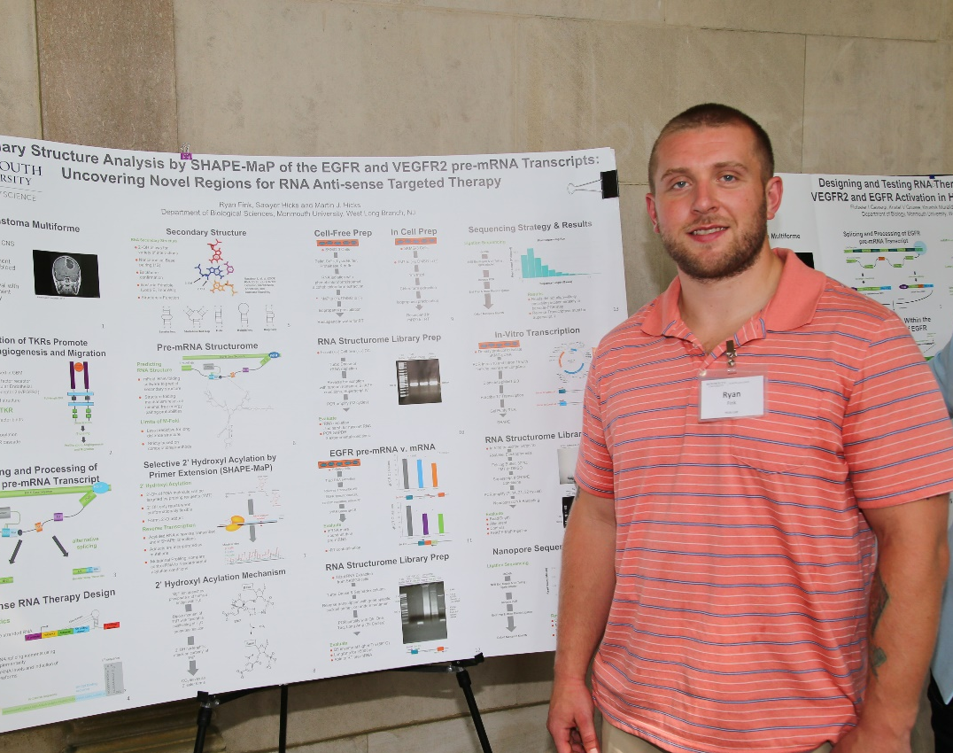
Ryan Fink
“Dedicated Father, cared about my classmate’s well-being, hard worker.”

Slide 6
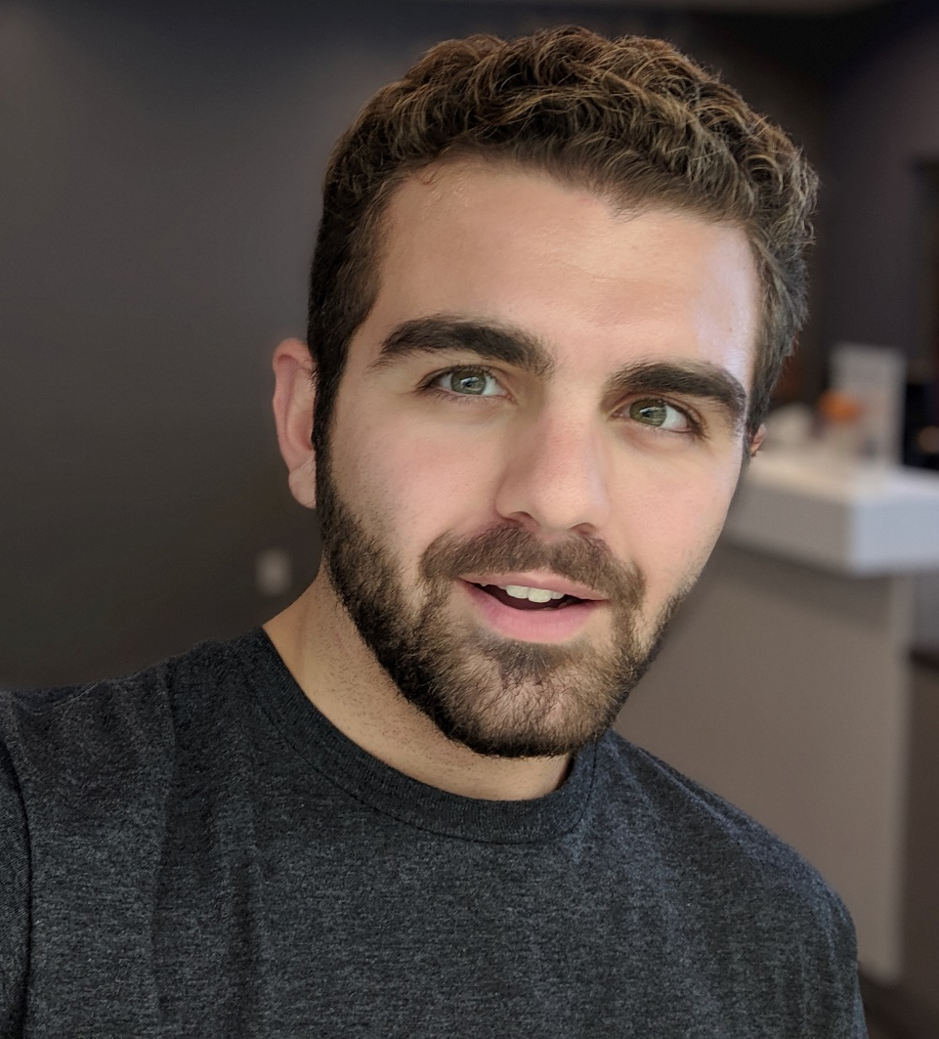
“Time spent at Monmouth was a priceless experience which gave you a toolkit to start building your future for yourself.”
David Grossi

Slide 7
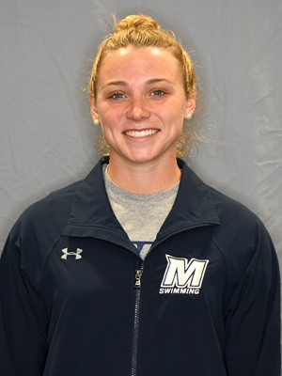
"One sentence is not enough to contain the gratitude I have for Monmouth since, without this school and the people I've encountered, I would not be the woman I am today. Thank you, and best of luck to the Class of 2020."
Bradie Keelen

Slide 8
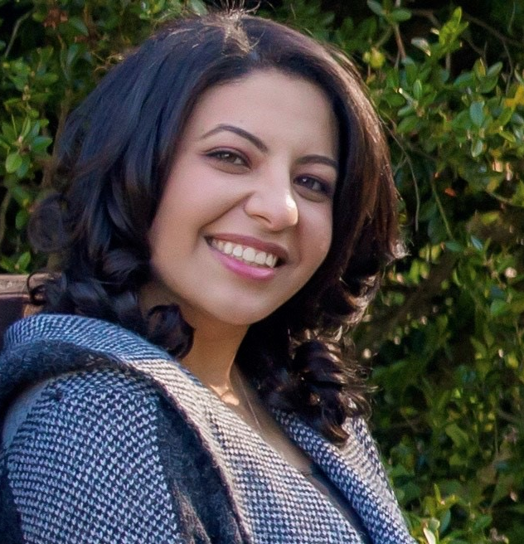
Nadine Khalil
“The God of heaven Himself will prosper us; therefore we his servants will arise and build” (Nehemiah 2:20)

Slide 9
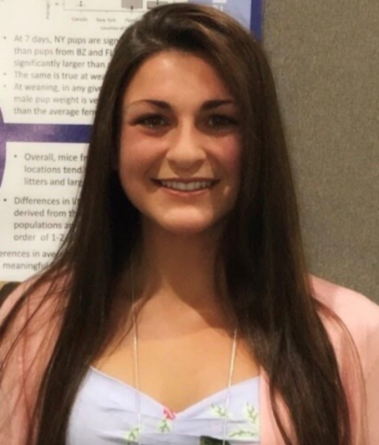
Tiffany Longo
“I am proud to be graduating from Monmouth because it has provided me with unforgettable experiences, long-lasting friendships, and the most meaningful four years of my life.”

Slide 10
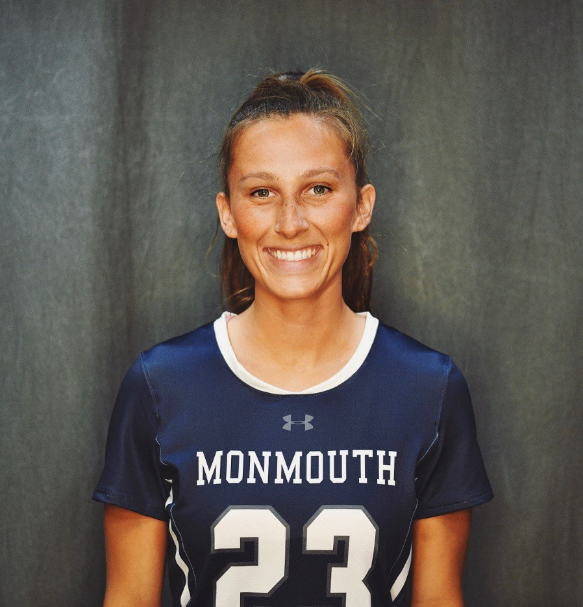
Chloe Novak
“I am proud and honored to be graduating with my degree in Biology with a Concentration in Cell Molecular Physiology and plan to specialize in ABA/Autism prior to attending PA school .”

Slide 11
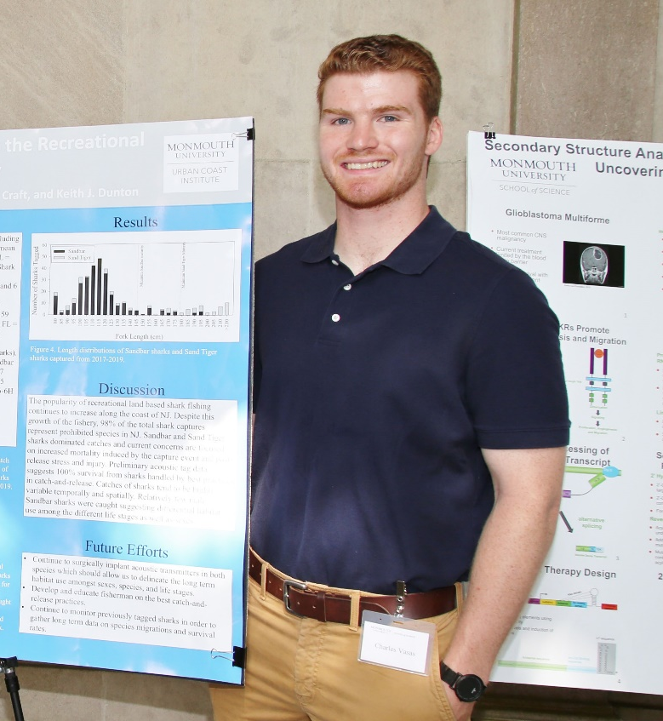
Charles Vasas
“My time at Monmouth was full of great experiences that made me a better scientist and person, and I would like to thank everyone especially the MEBP professors who helped me throughout my college career.”

Slide 12
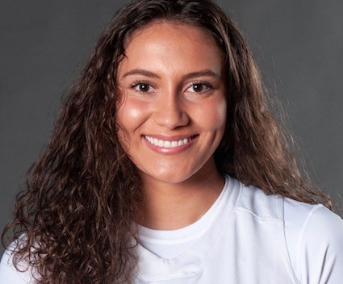
Adriana Zelaya
“At Monmouth I was surrounded by an extraordinary science program that gave me many opportunities and people who have become my lifelong friends. ”

Slide 13
Tugba Akilli
Beatris Almazova
Jasmine Barrow
Sylwia Bieszczad
Katrina Brooks
Jason Castillo
Eric Cervantes
Dominic Chiarello
Erin Conlon
Brianna DeBlois
Miriquel DeMoulin
Emily DiBona
Olivia DiPadova
Haydem Dominguez
Meagan Donohue
Caitlin Dowling
Mary Emich
Thomas Engel
Amanda Fessina
Ryan Fink
Dominick Gamba
Sarah Gillogy
Denisse Gracida
David Grossi
Adam Hansen
Shannon Harris
Hunter Hostage
Syed Mehdi Husaini
Asim Hussain
Andrew Ibrahim
Jive Jacob

Slide 14
Shantae James
Husnia Kakari
Michal Kalisz
Elmedina Karpuzi
Rachel Kasztan
Bradie Keelen
Lauren Kelly
Nadine Khalil
Arbaz Khan
Travis Kirk
Sean Kuback
Natalie Lavrov
Tiffany Longo
William Martin
Reina Montero
Laine Morris
Taylor Nason
Chloe Novak
Brianna Pinto
Kayla Rosado
Brandon Rosenblum
Anadi Saini
Geoffrey Schaefer
Shevaitha Shyamalan
Corrin Trerotola
Abigail Urbanak
Steven Valle Rodriguez
Charles Vasas
Danielle Wuss
Adriana Zelaya

Slide 15
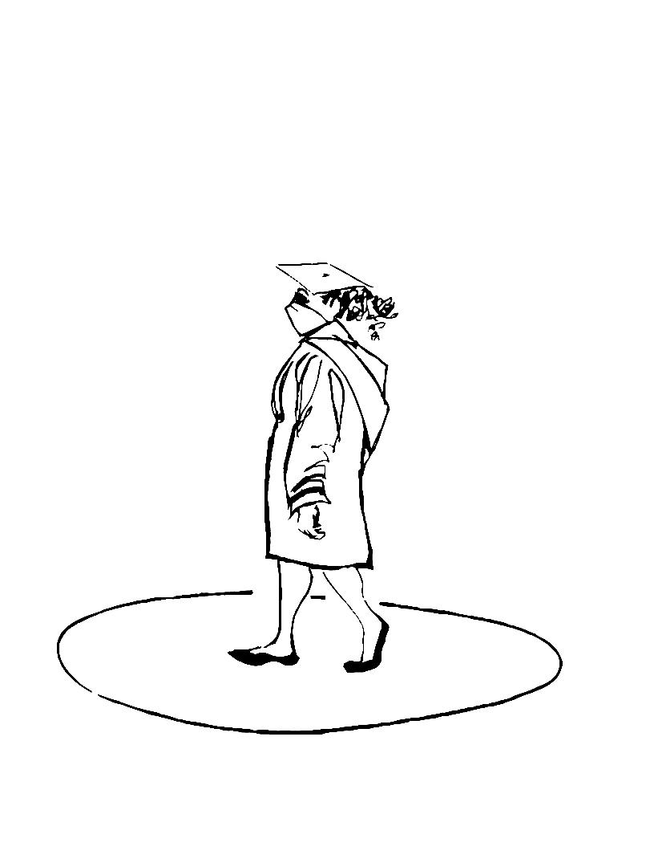

Slide 16
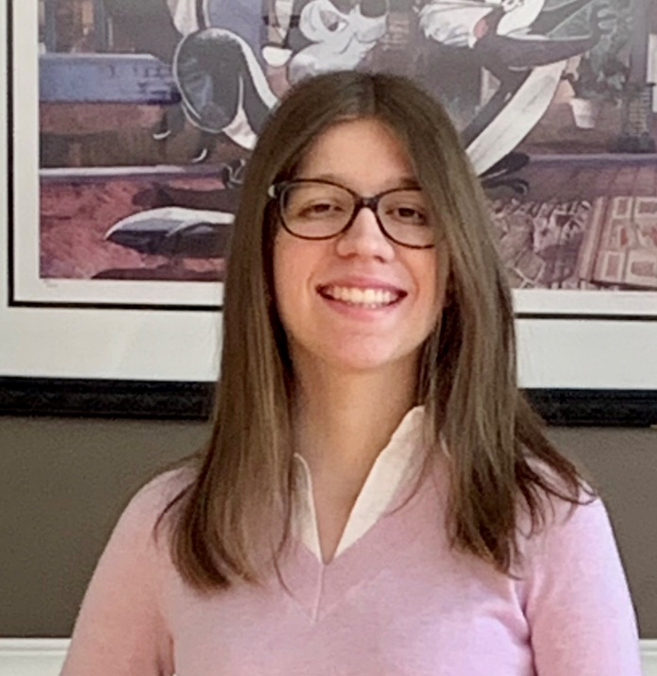
Naomi Altenburg
“Being at Monmouth University has allowed me to develop academically and socially which will benefit me in my personal and professional life.”

Slide 17
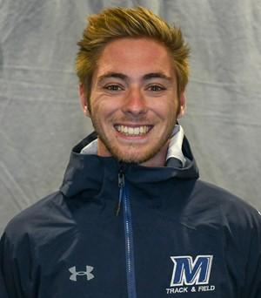
"I hope to be remembered as someone who always tried to do their best and was a good person"
Evan Jerolaman

Slide 18
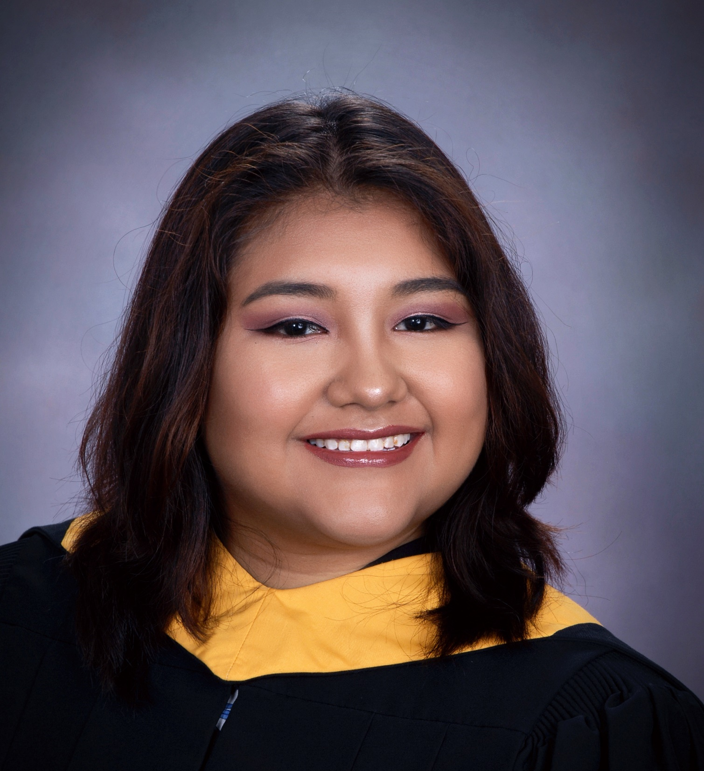
Olenka Mallqui
“First to Fly”
“I am proud to say I am the first woman in my family to finish an undergraduate education and obtain a B.S. in Chemistry.”

Slide 19
Naomi Altenburg
Jessica Baals
Christopher Bentsen
Ivana Diaz
Michele Dustman
Amalia Giraldo Llano
Danielle Guillen
Angelique Ithier
Priya Jassal
Evan Jerolaman
Olenka Mallqui
Kaitlyn Murtha
Roxy Nicoletti
Gabriela Padilla
Charmi Patel
Eric Philippou
Mika Schievelbein
Santino Timpani
James Tomasello

Slide 21
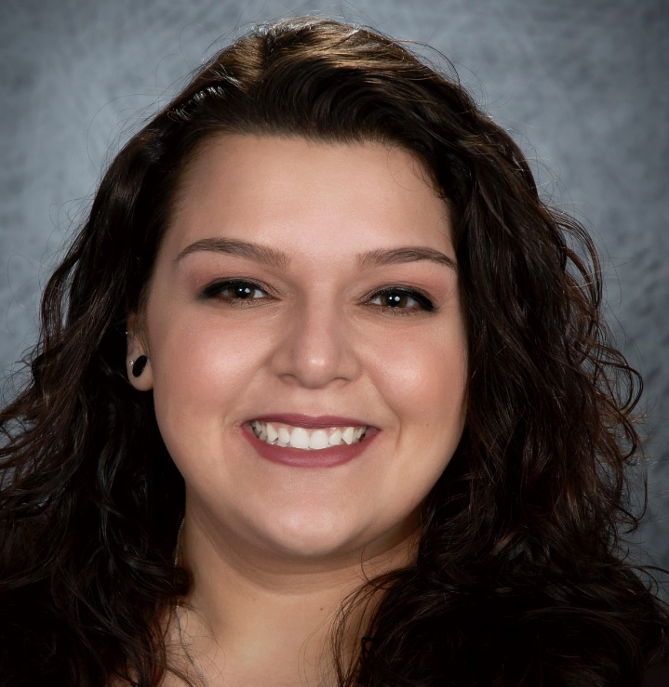
Hope Davis
“The CSSE department was very welcoming and helpful when I transferred to Monmouth.”

Slide 22
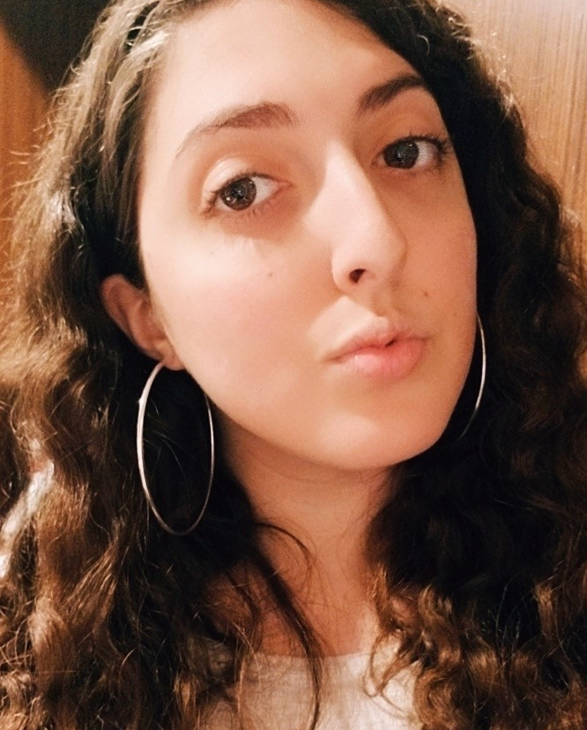
Sabina Graziano
“The past 4 years at Monmouth have been filled with amazing memories and experiences that I will never forget. Thank you, Monmouth University, for everything.”

Slide 23
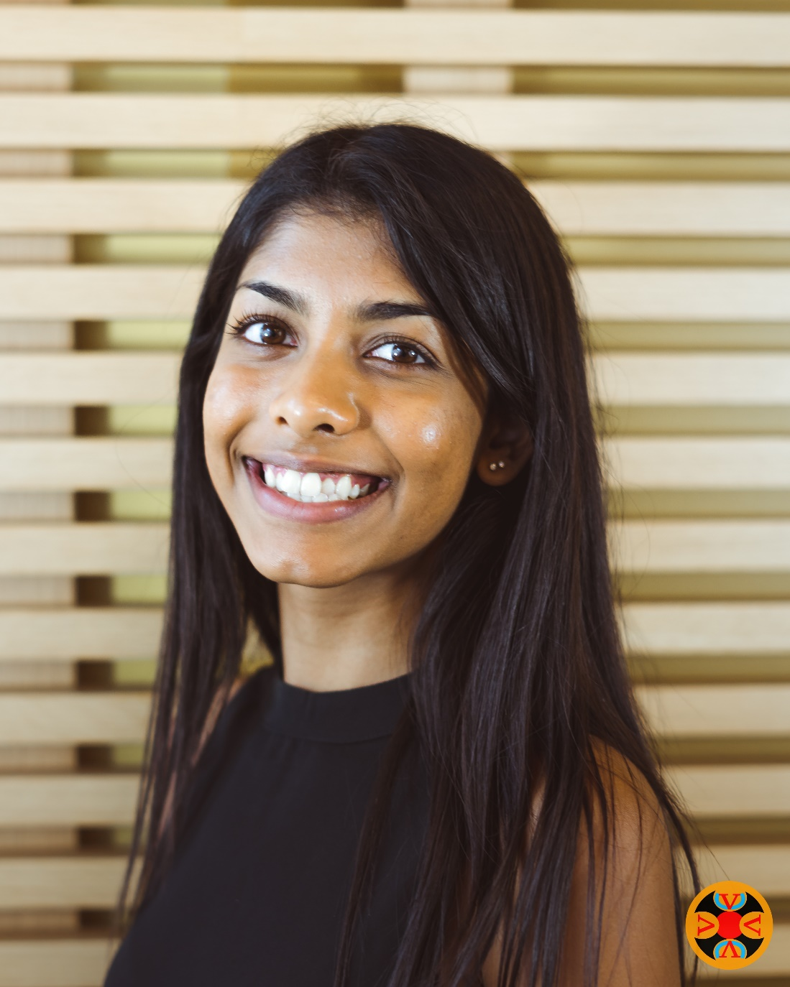
Davina Matadin
"The most transformative years of my life, filled with growth and learning. It is my goal to apply all that I have learned to make the world a better place."

Slide 24
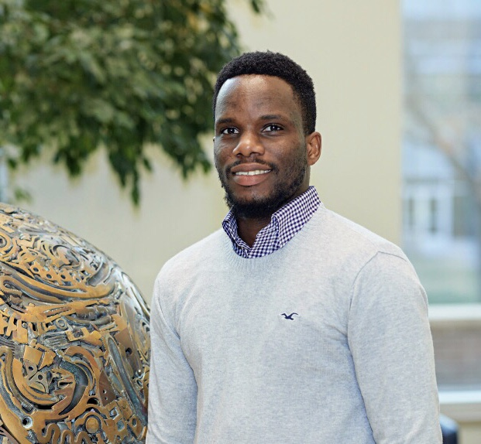
Paschal Uchubilo
“I’m grateful for all the people I met during the last 2 years. Looking forward to applying what I learned here in my next chapter and beyond.”

Slide 25
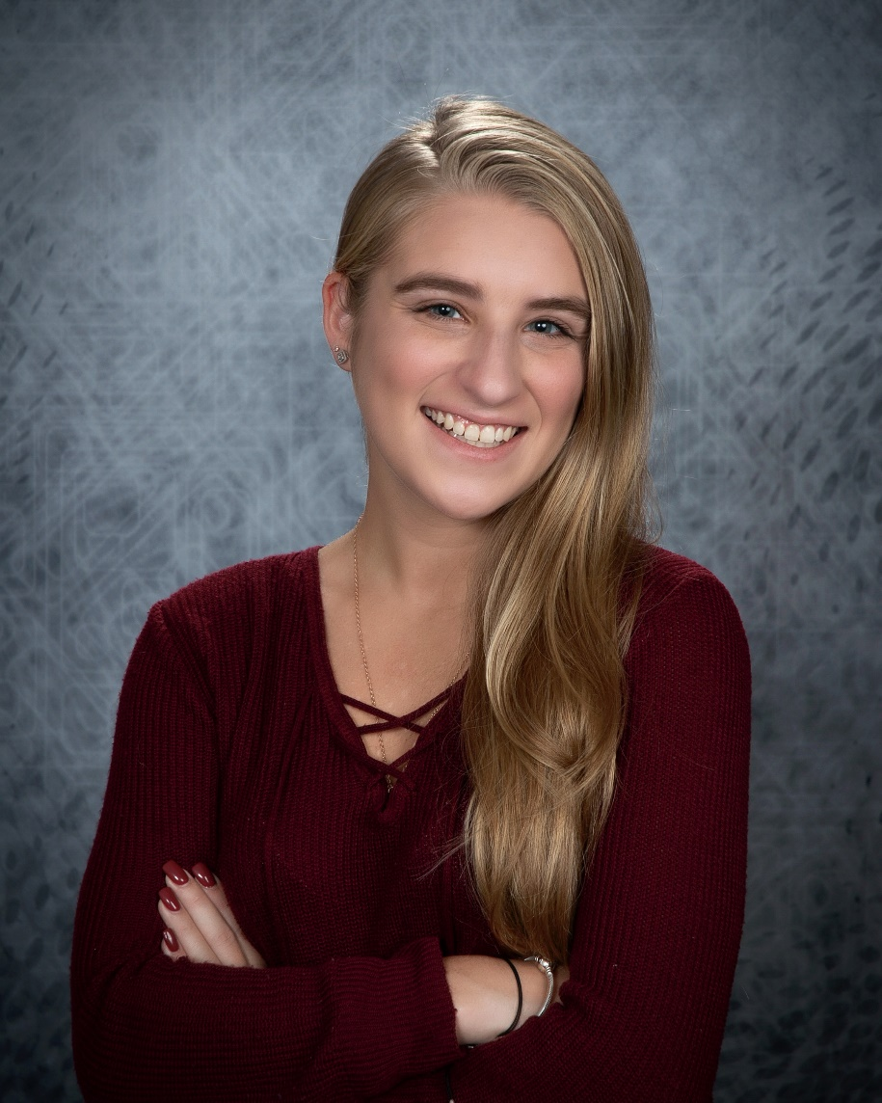
“The past four years at Monmouth University have been an interesting experience to say the least; but without a doubt, it was the best decision I have ever made and the greatest time of my life.”
Kaitlyn Vroman

Slide 26
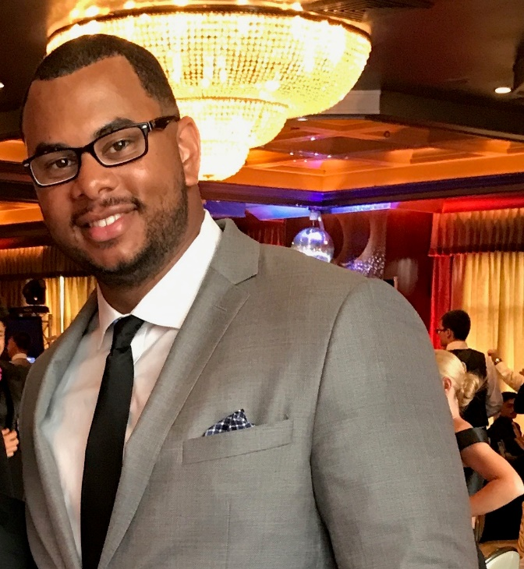
Christopher Watson
“I am thankful to have truly enjoyed my time at Monmouth University and I wish all my colleagues the best of luck in their upcoming careers!”

Slide 27
Evan Adams
Eric Alves
Derek Bagagem
Daniel Boniface
Christopher Burke
Christopher Calva
Sean Capper
Richard Chu
Ty Corneiro
Hope Davis
Jimmy Duong
Hamza Faiz
Josh Fuller
Sabina Graziano
Jaclyn Greening
Dylan Griswold
Jordan Herzog
Hoi Hon
Matthew Hosler
Donovin Innocent
Elias Jerman
Jiachen Ji
Victoria Johnson
Michael Karolewicz
Arthur Kotlyarsky
Michael Kulka
Raymond Lei

Slide 28
Minhao Liu
Matthew Mancino
Davina Matadin
Christopher McKay
Brad McNamee
Hooria Mian
Joseph Monaco
Kyle Mueller
Liam Onbashian
Hugo Parada
Connor Pescatore
Brandon Peters
Anthony Pitera
Jennifer Reid
Jordan Rice
Nicholas-Jason Roache
Mahmoud Shabana
Matthew Shober
Qi Si
Patricia Skora
Travis Spencer
Paschal Uchubilo
Nicholas Vail-Stein
Timothy Van Cauwenberge
Anthony Vives
Kaitlyn Vroman
Christopher Watson

Slide 29
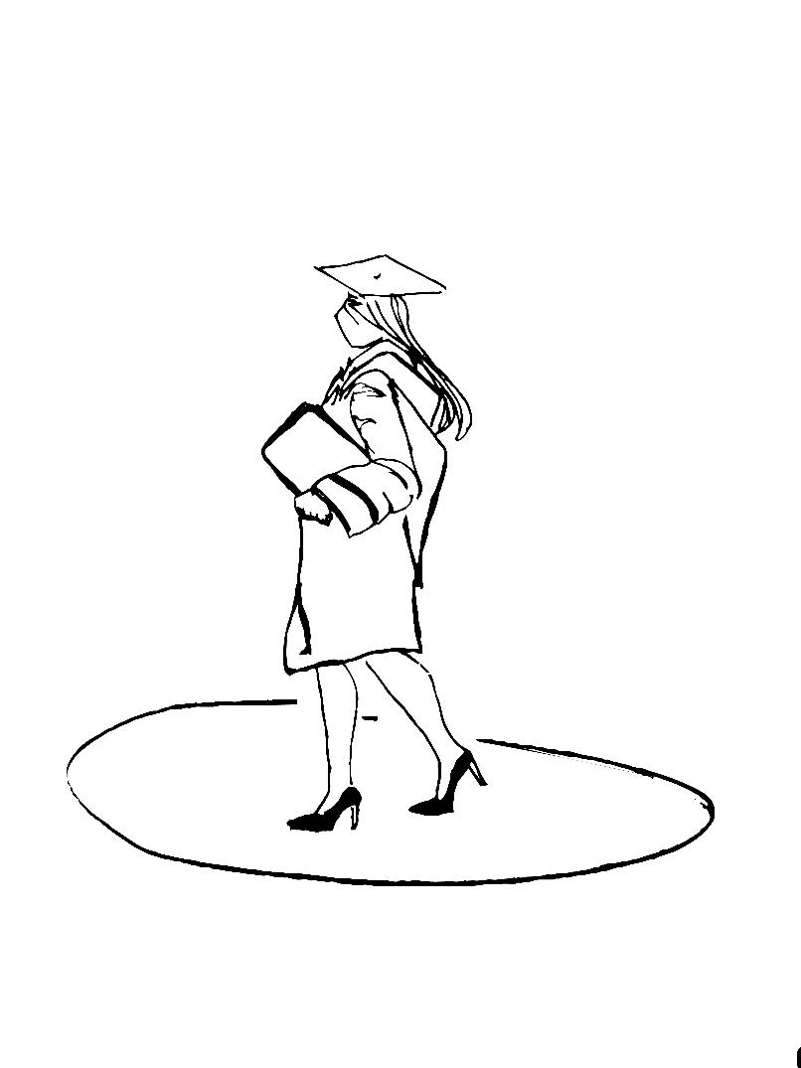

Slide 30
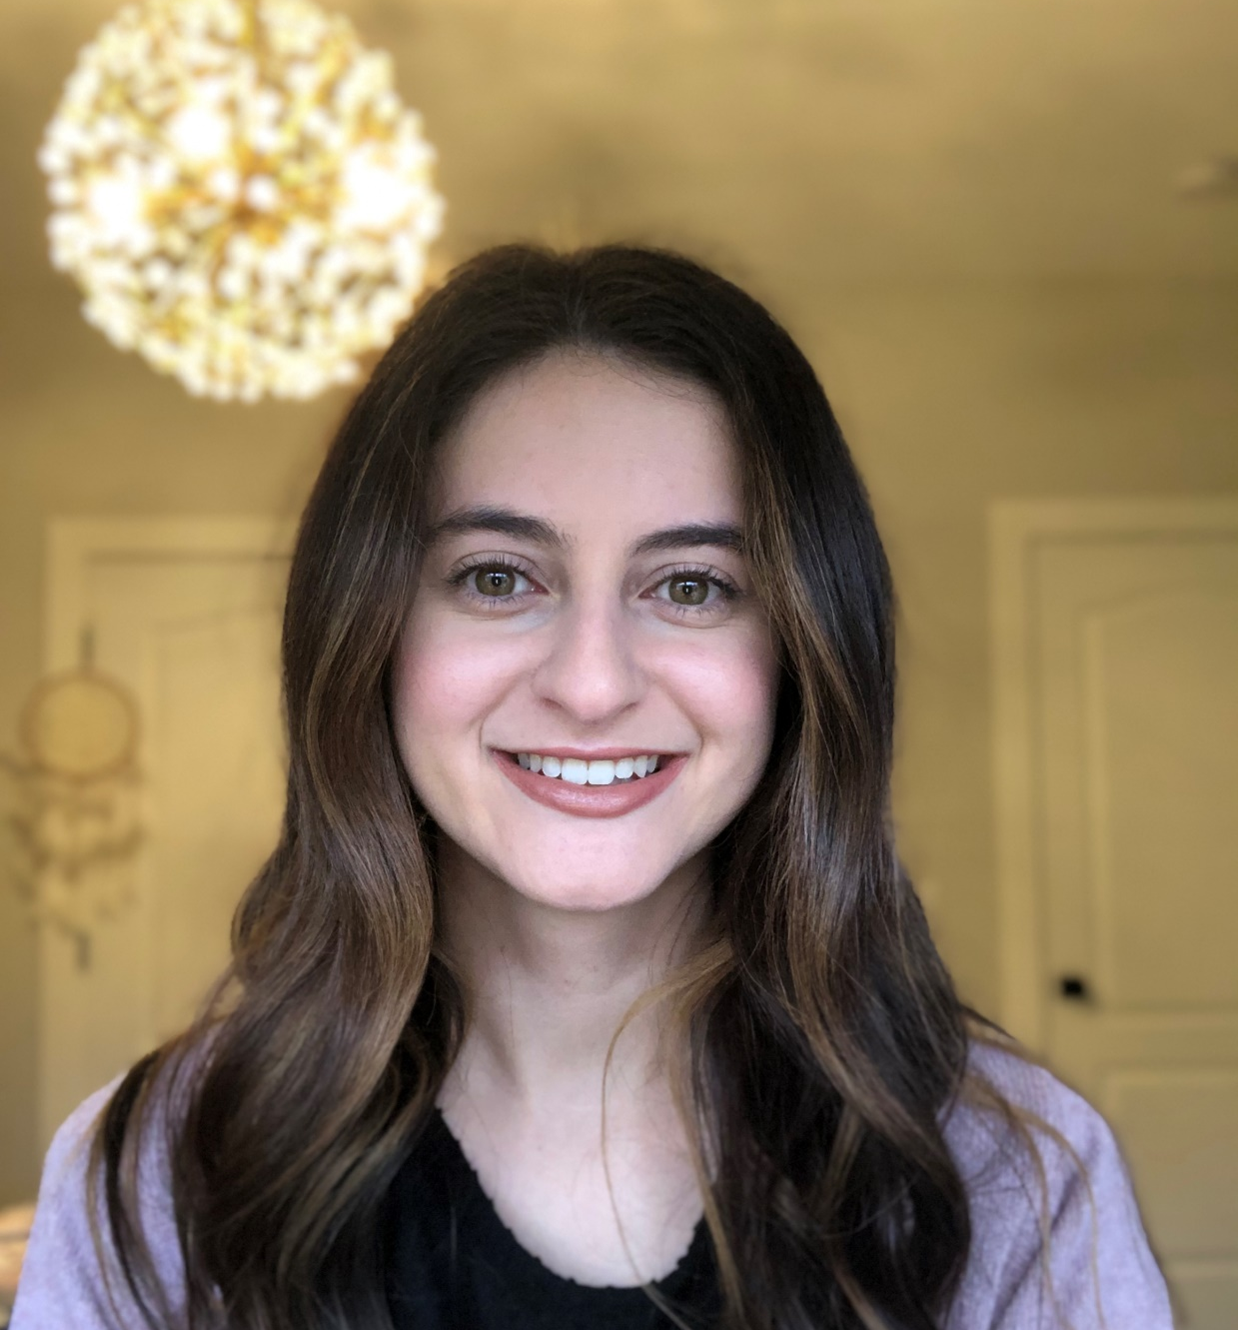
Gianna Attardi
“Thank you to the MU Mathematics Department and fellow math majors. The past four years have been challenging and I could not have done it without you!”

Slide 31
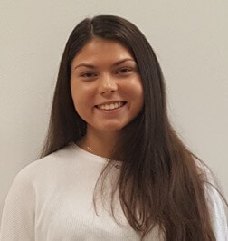
Samantha Cavalli
“My favorite aspect of my mathematical experience at Monmouth was interacting with my classmates and faculty. I felt very well take care of and enjoyed collaborating with everyone. I also think the sequence of courses benefited us, because every course laid a foundation and prepared us for the next. Lastly, the highlight of my time in the math department was taking consulting, because I learned a lot about working in the real world.”

Slide 32
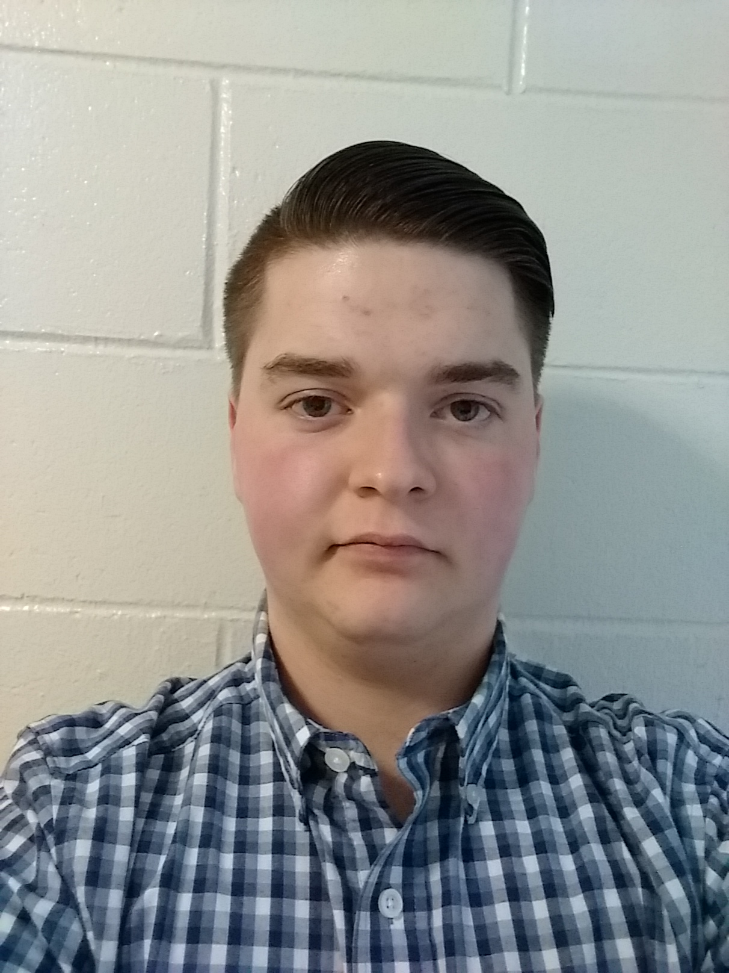
I am “someone who can relate to his peers while staying true to himself.”
Ryan Greenstone

Slide 33
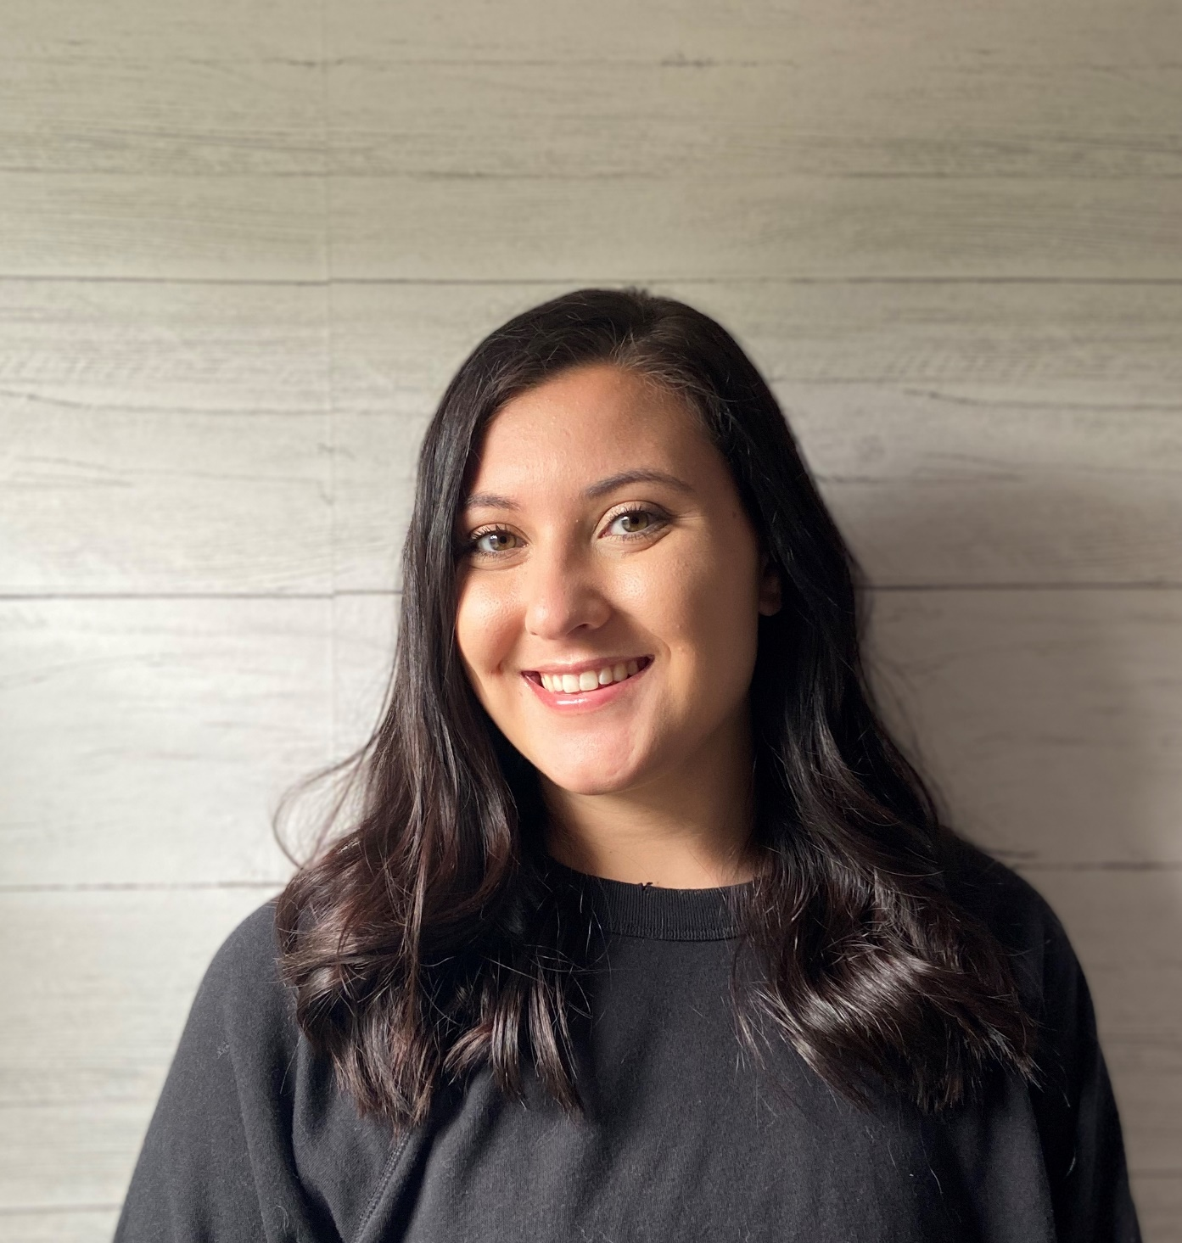
“I am grateful to have had the opportunity to work at the Math Learning Center and meet some of my best friends and create relationships with people in the Math department. Thank you everyone!”
Paulina Karach

Slide 34
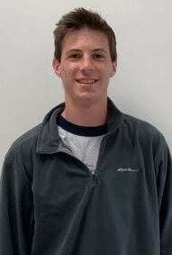
Matthew Lawson
“The best aspect, for me, was how much the professors cared. Not just about the students but also about what they were teaching. Almost all the professors I had were genuinely interested in what they were teaching and enjoyed teaching everyday. Also, these professors wanted the students to learn the material, like really learn it and not "learn" it for a test and then forget it, which was nice.”

Slide 35
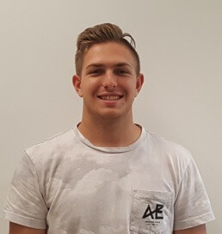
Jett Vernaci
“One of the best aspects of my mathematical experience at Monmouth was getting a job in the Math Learning Center. This allowed me to socialize with other math majors and make a lot of friends. I enjoyed helping people learn and understand concepts that they didn't get the first time around. This job also helped me get to know all the faculty and build relationships and connections with them. Being math club president was also a great experience, because it allowed me to provide opportunities to have people come together and have a good time.”

Slide 36
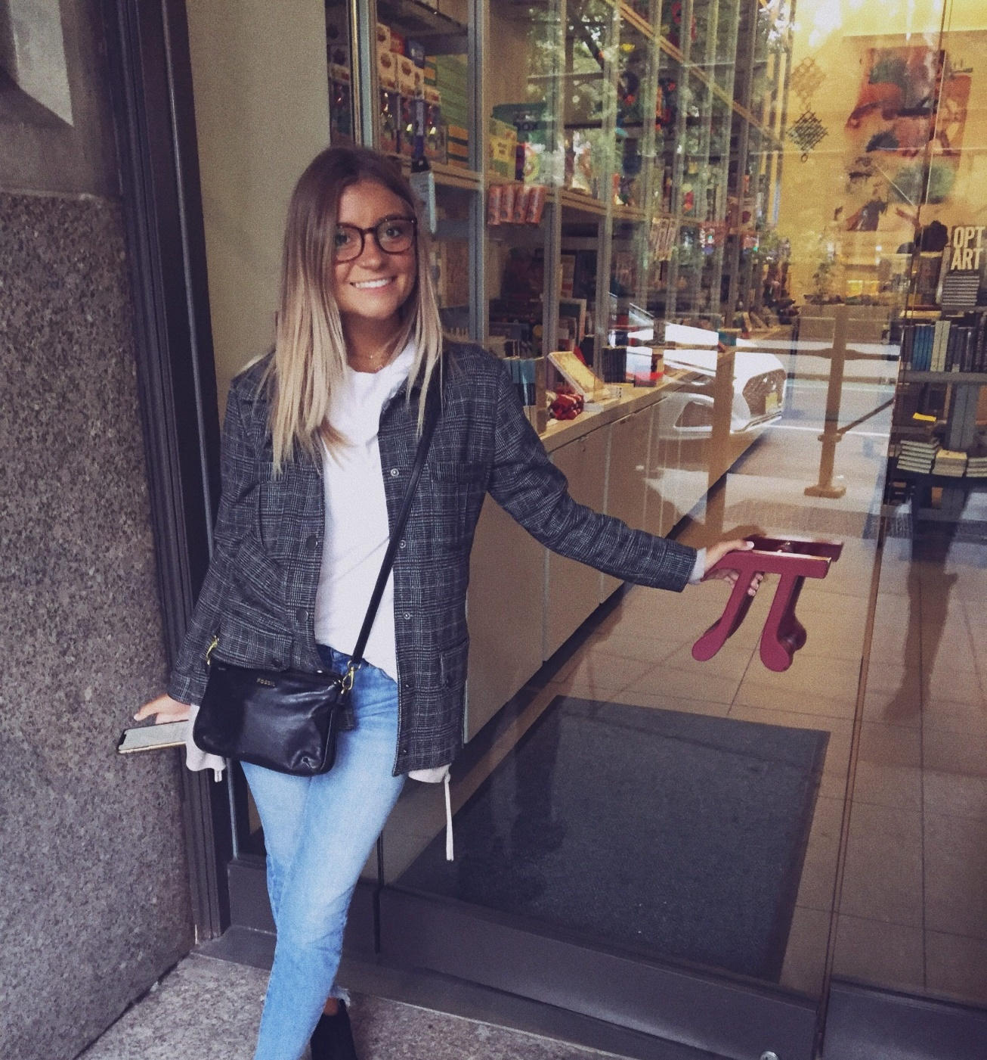
Kaitlyn Zuczek
“Monmouth has given me the skills to go into the world of math education with success for our future generations of students!”

Slide 37
Brooke Attardi
Gianna Attardi
Jonathan Carlin
Samantha Cavalli
Erin Dalm
Ryan Greenstone
Victoria Hancheck
Mahir Islam
Paulina Karach
Matthew Lawson
Christine McArdle
Jett Vernaci
Michael Welch
Jordan Wildermuth
Kaitlyn Zuczek

Slide 38
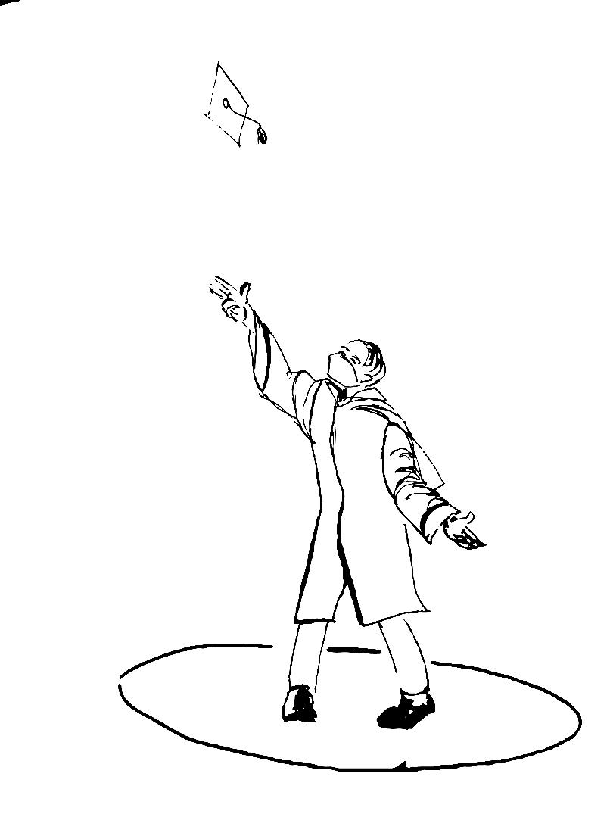
Congratulations Class of 2020!

Slide 39
Original Artwork by Kathleen Stark Carolan
Press [Esc] to end presentation

